Slide 1
Web Community of Practice
Web Governance & Writing for Web
For the KSU Website

Slide 2
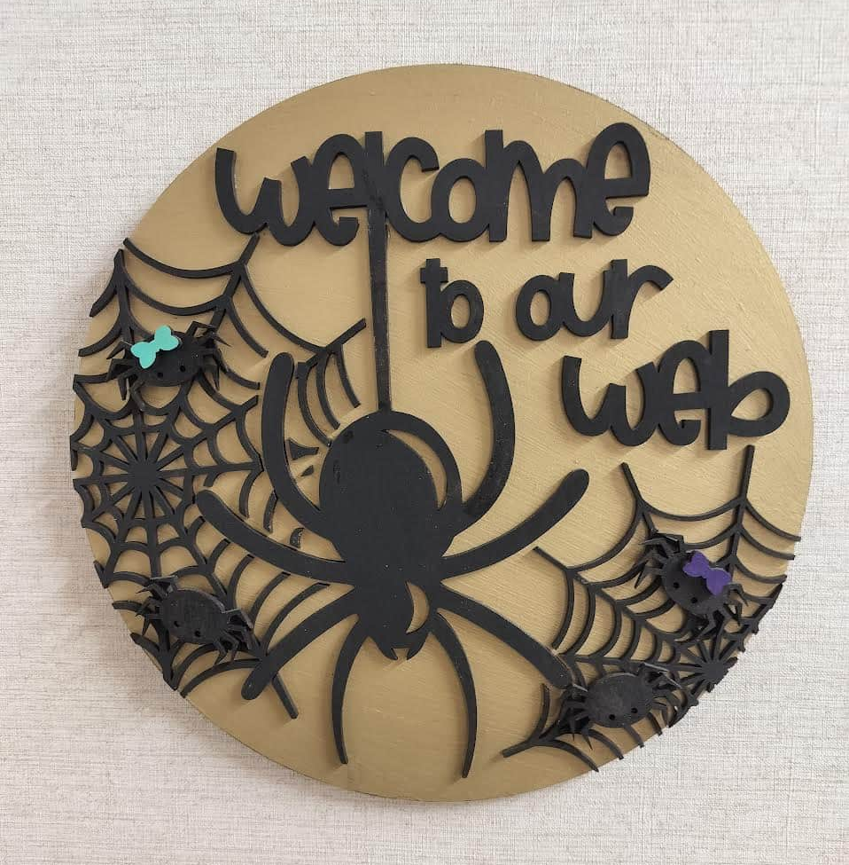
Meeting Schedule
Meeting cadence: Every 5 weeks
Upcoming dates: Nov 21, Jan 23, Feb 27, Apr 23
Topics: ADA/508 compliance, data analytics & SEO, writing for digital, and more
Led by: Strategic Communications Web Team
Meeting is Recorded (Please Mute)

Slide 3
Welcome
Web Governance
Writing for Web
Today's Agenda

Slide 4
Governance Goals
Consistency & Brand – Maintain consistency with page design through brand approved colors, proper logo usage and approved templates.
Risk, Privacy & Security – Microsites/tools require StratComm and UITS approval. All tags are managed centrally in GTM.
Accessibility & Quality – Meet WCAG 2.1 (Title II compliance) with a pre-publish checklist, including headings, ALT text, descriptive links and meta data.
Ownership & Cadence – Every page has an owner of record and a set review cycle (every semester/annual)
Speed & Efficiency – All requests go through ServiceNow ticketing system with clear SLAs for routine updates, new pages, redirects and emergencies.
Lifecycle Management – Date-bound content gets expiry dates – think evergreen. Low-traffic pages are queued to improve, consolidate or retire.
Notes:
Consistency & Brand
We want every page to feel like part of the same family.
That means approved logos, colors, and templates—so users have a seamless experience, whether they’re on the admissions page or a department page.
Think of it like our “digital curb appeal”—clean, consistent, and professional.
Risk, Privacy & Security
Any microsites, tools, or tags need approval to keep us safe.
Centralized tag management through GTM helps us monitor and protect data.
This prevents unauthorized tools or tracking from creating compliance or privacy risks.
Accessibility & Quality
All pages must meet WCAG 2.1 (Title II) standards.
That means proper headings, ALT text for images, descriptive link text, and metadata.
Accessibility isn’t just compliance—it’s about making sure everyone, including users with disabilities, can navigate our site.
Ownership & Cadence
Every page has an owner on record.
Owners are responsible for reviewing content regularly (semesterly or annually).
This keeps pages accurate and prevents outdated or orphaned content.
Speed & Efficiency
All updates flow through ServiceNow with SLAs for turnaround.
This keeps work structured—routine updates, redirects, and emergencies are prioritized appropriately.
The system makes sure requests don’t get lost in email chains.
Lifecycle Management
Not all content should live forever—pages have lifecycles.
Evergreen content stays, but low-traffic or outdated content is queued to improve, consolidate, or retire.
This ensures the site remains lean, relevant, and easy to navigate.
Together, these goals ensure the website stays professional, secure, accessible, and efficient while reducing risk and clutter.

Slide 5

Why Web Governance?
Our sites are a recruiting and reputation engine and need to be kept up-to-date and managed through clear guidelines and shared standards.
Governance = faster updates, fewer escalations, better search and lower risks. The goal isn't more rules, it's more about fewer surprises.
For Accessibility (ADA/WCAG 2.1) compliance.
For risk and brand protection. Regular reviews help stop non-compliant content, unapproved logos and other brand related issues.
Training before access along with the regular attendance to the Web Editors Community of Practice keeps editors aligned on accessibility, SEO and content quality.
Website Governance – Because "Click Here" is not a CTA it's
a cry for help.
Notes:
Websites as Recruiting & Reputation Engines
Our website is often the first impression for students, parents, and partners.
Outdated or inconsistent content directly impacts credibility.
Governance helps keep the site aligned with our reputation and brand.
Governance = Fewer Surprises
Governance doesn’t mean more rules — it means fewer problems down the road.
Faster updates, cleaner workflows, fewer escalations.
When standards are in place, we spend less time fixing mistakes and more time improving.
Accessibility (ADA/WCAG 2.1)
Accessibility is non-negotiable—it’s compliance and inclusivity.
Governance ensures every page meets standards like ALT text, headings, and descriptive links.
This protects the university legally and morally while serving all audiences.
Risk & Brand Protection
Regular reviews catch issues before they spread—like unapproved logos or outdated messaging.
Governance acts like quality control for our reputation online.
It prevents content that could undermine trust in the institution.
Training & Community of Practice
Access comes with training, because standards are only useful if people know how to apply them.
The Web Editors Community of Practice keeps everyone on the same page—SEO, accessibility, content quality.
This creates a shared culture of excellence across all departments.
Because “Click Here” is not a CTA
Governance elevates the user experience.
Calls to action (like “Apply Now” or “Request Info”) should be clear and compelling—not generic.
Strong governance ensures consistency in how we guide users to take the next step.
Governance isn’t about red tape—it’s about protecting the brand, improving the user experience, and making our digital presence work smarter, not harder.

Slide 6
KSU Sites & Modern Campus (CMS)
Strategic Communications governs and provides guidance for the KSU & Campus websites
Modern Campus (CMS)
  Strategic Communications
    Approves access
    Supports the university in creating and adding content
    Completes ticket and project requests
    Provides Governance
  UITS
    Provides onboarding training & set permissions
    Provides platform support, integrations, security
Notes:
Strategic Communications (StratComm)
Approves Access → We make sure only trained, authorized editors get access to the CMS.
Supports Content Creation → Our team partners with departments to build, edit, and publish content that follows brand and accessibility standards.
Handles Tickets & Projects → Requests for page updates, new sections, or larger web projects come through our ServiceNow process.
Provides Governance → We’re the guardrails: ensuring consistency, brand compliance, and accessibility across all sites.
UITS
Onboarding & Permissions → UITS provides initial CMS training and sets user permissions.
Platform & Security → They handle the technical backbone: integrations, system reliability, and data security.
Think of them as the “engineers under the hood” who keep the platform running smoothly.

Slide 7
Sites not Managed by Strategic Communications
Faculty Web Digital Commons Course Catalog Owl Life Owl Express ksuowls.com | D2L Owl Family Hub One USG Connect Give Pulse SharePoint EBSCO

Slide 8
CMS Roles/Responsibilities
CMS Editors & Owners
  Complete Modern Campus training
  Attend Web COP meetings
  Comply with Web Governance & USG standards
    Maintain accessible, compliant and up-to-date web content
    Conduct web content review prior to every semester
  Communicate web standards and governance within their unit
Content Owners
  SME for web content within their unit
  Communicate web needs to CMS editors and Strategic Communications
  Faculty are responsible for maintaining their personal faculty webpages
Notes:
CMS Editors & Owners
Training first. “If you can log in, you’ve completed Modern Campus training.” That’s our gate to quality.
Show up to Web COP. Our meetings keep standards, tips, and changes flowing; it’s where we swap ideas. Remember also that we have a chat available for discussion, as well.
Follow governance & USG standards.
Accessibility by default: correct headings, ALT text, descriptive links, contrast, captioned media.
Accuracy & freshness: each page reviewed every semester (or sooner) with an owner on record.
Be the standard-bearer in your unit. Translate guidelines into practice—templates, brand use, SEO basics, and when to send tickets vs. DIY.
Review: content edits and layout = you; new components, integrations, or tracking = submit a ServiceNow ticket.
Quick “what good looks like”
Pages have a named owner, pass an accessibility check, use approved templates, and were reviewed prior to the semester began..
Requests come through ServiceNow with clear goals, audience, and due dates.
No “Click Here,” no rogue logos, no orphan PDFs.

Slide 9
Keep It Fresh (Reviews & Sunsetting)
Content Owners should review all content annually. High impact pages must be reviewed before each semester.
  Best practice is to not add specific course information, instead link to the Graduate Catalog or the Undergraduate Catalog. This ensures one source of truth.
  Pages that have no owners or 12 months of inactivity are candidates for archive. Use Data – low-traffic / high bounce / zero-result queries = improve content or sunset.
  When pages are moved or archived, always apply a 301 redirect. This can be done through a ticket and should include the old URL and the new URL. This practice will help protect our SERP rankings and keep URLs out of the witness protection program.
  Be sure to add notes for all page updates for history/hand-offs.
Avoid ROT
  Redundant
  Outdated
  Trivial
Notes:
Who is the audience? Each piece of content on the site should have a clear primary audience
What do they need? Focus on their questions, goals and tasks
Where will they look for it? Use keywords and headings that align with how users may search
When will they need it? Is the content time sensitive, evergreen or frequently updated
Why does it matter? Ensure the content adds value for users while supporting the universities objectives
How should it be presented? Josie will get into this later in the presentation, but this is keeping content concise, scannable, and accessible
Content reviews – ROT analysis
Redundant – content that’s duplicated or overlaps unnecessarily.
Outdated – content that’s old, no longer accurate, or past its useful life.
Trivial – content that doesn’t add value to the user or the institution’s goals.
Use data to inform your decisions during content reviews
Annual & Semester Reviews
Every page should be reviewed at least once a year—but high-impact pages (like Admissions or Academics) should be checked before each semester.
This keeps our content accurate, relevant, and trustworthy.
One Source of Truth
Don’t duplicate course details—always link to the Graduate Catalog or Undergraduate Catalog.
This avoids conflicting information and ensures students see the most accurate version.
Archive Candidates
Pages with no owners or 12+ months of inactivity should be considered for archiving.
Use data to make the call: low traffic, high bounce rates, or zero-result searches signal content that should be updated or retired.
Redirects Protect SEO
Whenever a page is moved or removed, a 301 redirect must be applied.
This keeps search rankings strong and ensures users don’t hit broken links.
It also keeps URLs from disappearing into “witness protection.”
Documentation & Handoffs
Add notes for updates—this helps with continuity if ownership changes.
Think of it as leaving breadcrumbs for the next editor.
Avoid ROT (Redundant, Outdated, Trivial)
Redundant content = confusion.
Outdated content = loss of trust.
Trivial content = clutter.
If it doesn’t serve users or align with goals, consolidate or sunset it.

Slide 10
URL Management
Requests
  Subdomains – Reserved for specific uses and no longer for vanity purposes
  Short URLs - Submit a ticket through ServiceNow or email service@kennesaw.edu. The URL structure is go.kennesaw.edu/your-name/
URL Structure – Best practices
  Keep it short, simple and readable
  Use hyphens to separate words
  Include relevant keywords
  Avoid unnecessary words, numbers and special characters
  Follow governance rules for approvals
Notes:
Why URLs matter (30 sec)
Clean URLs = easier to read, easier to share, better SEO, and fewer support issues.
We design URLs to be predictable —so they don’t break print pieces or search rankings.
Requests
Subdomains — used only when there’s a real need for separation (security/compliance, external hosting, major app, or true microsite). Not for vanity or “cool names.” Fragmented subdomains dilute brand and SEO.
Short URLs (go.kennesaw.edu/___) — for print, slides, events, campaigns.
Submit via ServiceNow (or email listed) with destination URL, owner, start/end dates.
URL structure — Best practices
Short, simple, readable. Aim for 3–5 words that reflect the page’s purpose.
Use hyphens between words. No spaces or underscores.
Include relevant keywords that match what users search (e.g., /financial-aid/appeals/).
Avoid clutter: dates, versions, random numbers, special characters, stop-words when not needed.
Lowercase only; no file extensions in links (/apply/ not /apply.html).
Match the IA: mirror the site’s navigation path (e.g., /academics/programs/biology/).
Stability first: don’t rename URLs for minor content changes. If a change is necessary, request a 301 redirectvia ServiceNow.

Slide 11
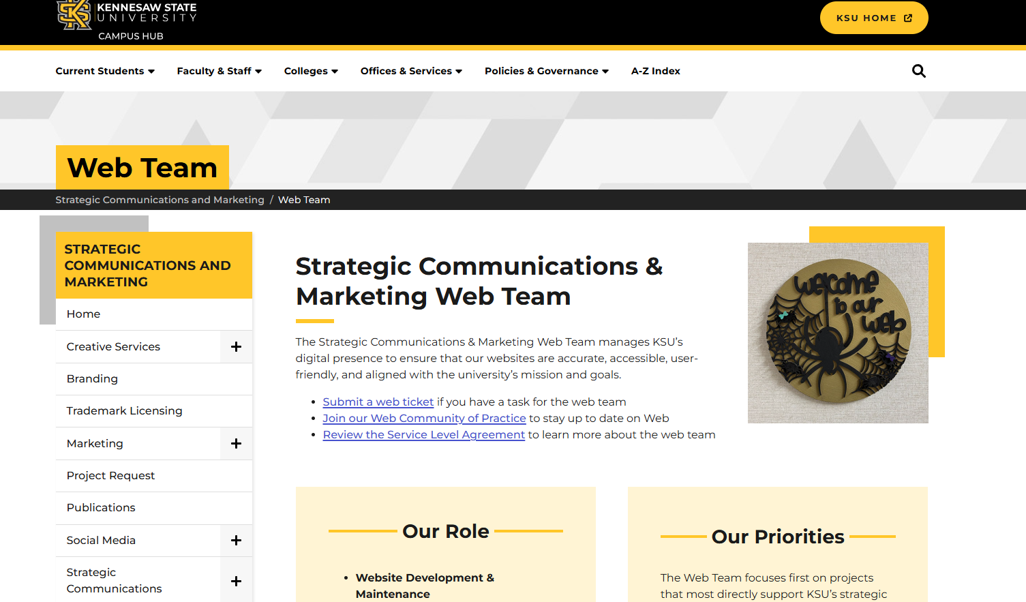
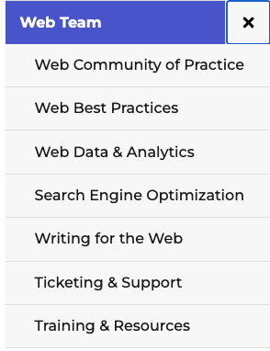
New Web Section
Strategic Communications & Marketing Web Team
  https://campus.kennesaw.edu/offices-services/stratcomm/web-team/index.php
One Web. Many hands. Shared governance.
Notes:
We have created a web team section under the Strategic Communications & Marketing site
WT COP meeting slides and recordings will be linked from this site along with a lot of other useful information and resources
Please check it out on a regular basis and stay up to date.

Slide 12
Search Tool - Cludo
Tool Management
Request Unit POCs
  Submit and approve ticket requests for your unit
  Authority to request search result boosting
  Suggest synonyms
  Suggest top 3 rankings for your unit/topic
  Attend meetings 4 times a year
  Reply to StratComm inquiries
  more….
Send POC contact information to Josie Carter jcart104@kennesaw.edu
Notes:
Strat Comm have recently started managing the new search tool Cludo
We are asking for a POCs within each unit that we can work with as we go forward and establish management for this tool.
Please email Josie Carter if you will be the POC for your unit
We will host a future meeting to discuss this in more detail once we have the POC names
Joe - This does not cover the work that we will do behind the scenes as the mangers of this tool, I don't think we need to yet, but whatever you think is best.

Slide 13
Audience & Purpose
Structure & Organization
Clarity & Readability
Accessibility
SEO& Findability
Content Formatting
Credibility & Trust
Calls to Action
Analytics & Continuous Improvement
Writing for Web
Notes:
Suggested structure, plus some activities:
1. Audience & Purpose
Who are you writing for? (personas, primary vs. secondary users)
What action do you want them to take? (task completion, engagement, awareness)
Tone and voice aligned with brand and audience expectations.
2. Structure & Organization
Clear hierarchy: headings (H1, H2, H3), short paragraphs, logical flow.
Inverted pyramid style: most important information first.
Scannability: bullets, numbered lists, bolding, pull quotes.
Why writing for web is different – users scan, not read…
3. Clarity & Readability
Plain language: simple, direct, and jargon-free.
Short sentences and active voice.
Reading level appropriate for your audience (often Grade 8–10 for general public).
https://www.plainlanguage.gov/media/FederalPLGuidelines.pdf
4. Accessibility (ADA/508)
Alt text for images, descriptive link text, and transcripts for media.
Avoid relying only on color, ensure contrast. Use the WebAIM Contrast Checker
Headings and lists used semantically, not just for styling.
5. SEO & Findability
Keyword alignment with what users search for.
Meta titles, descriptions, and structured data.
Internal linking and meaningful anchor text.
6. Content Formats
Use the right format for the message (web page, FAQ, blog, call-to-action, news, etc.).
Break complex content into chunks or interactive formats (accordions, tabs, video).
7. Credibility & Trust
Cite authoritative sources.
Keep content accurate, up to date, and transparent.
Include authorship or contact info where relevant.
8. Engagement & Calls to Action
CTAs that are clear, specific, and actionable.
Buttons or links placed where users naturally look.
Encourage the next step, not just passive reading.
9. Analytics & Continuous Improvement
Reach out to StartComm for more info on performance with GA4, heatmaps, or task success metrics.
Iterate based on data (e.g., engagement, search terms, clicks, events per session ).
Use A/B testing where possible to refine messaging.
Suggested activities:
Give a sample paragraph written in “institutional jargon” → have groups rewrite it in plain language for a student, parent, or employer persona.
Provide a “wall of text” paragraph → ask participants to break it into headings, bullets, and bold keywords. Share before/after.
Show two screenshots (good vs. bad). Ask participants to identify accessibility problems (e.g., vague links, missing alt text).
Share a topic (e.g., “nursing program”) → have participants brainstorm keywords a student might search. Then compare with what’s actually on the page.
Show a sample webpage → ask participants to highlight where the CTA should go and rewrite it to be clearer. – we could use the career site we just worked on.

Slide 14
Audience & Purpose
Identify Your Audience
  Create personas or consider your primary vs. secondary users
Define Your Action
  Clarify what the user should do—submit a form, engage with an event, etc.
Tone & Voice
  Match KSU brand and audience expectations; friendly but professional
Helpful Tip
    Ask yourself: "Would a new user immediately understand what to do on this page given the content I've created and the actions I've provided?"
Notes:
Personas were covered in our meeting last month

Slide 15
Structure & Organization
Follow Heading Hierarchy
  Use headings to group content together. H1—H2—H3...
  Headings Audit
Lead with Key Information
  Most important content first on the page ("above the fold")
    Add page summaries at the top of each page
Helpful Tips
    Page Summaries Rule of Thumb:
    Min 2 bullets, Max 5 bullets, 14-21 words, or
    35-50 words or less, no more than 2 sentences
Activity
Notes:
Page summaries at the top of every page so it is clear from the get-go - what the page is about.
I would like us to demo this on an actual KSU page.
Create a summary and then display the page with the new summary on it?
This is to highlight how you have immediately made it easier for a user.
- use short phrases and words user will understand
- if using bullets try to keep bullets a similar length
- use the same format for each - all starting w a verb, noun etc...
- summarize the info. on your page
- make your summary easy to scan by following the helpful tips on this slide
Activity:
Show a KSU page (https://www.kennesaw.edu/cetl/programs-services/index.php)
Give chat 2 minutes to craft a page summary under the H2.
Open "inspect" on page to edit the page summary currently on page to suggestions in the chat. (Or a builder could create a before and after page for us)

Slide 16
Structure & Organization (2)
Scannable Content
  Use bullets, numbered lists, bold key content
    keep bullets similar length
    use a consistent format (start all with a verb, noun etc...)
Paragraphs
  2-4 sentences max
  users scan pages
Helpful Tip
    Users typically come to a webpage to complete a task, good page structure and scannable content enhances the user experience and increases engagement

Slide 17
Clarity & Readability
Plain Language
  Keep content simple, direct, and easy to read
  Avoid jargon
Short Sentences
  Aim for sentences between 15-20 words max
Active Voice
  "Submit your application" vs. "Your application should be submitted"
Check Readability Score/Level
  Grade 8-10 reading level
  Tools: Hemingway Editor, Microsoft Word's Document Stats
Notes:
You could flash up examples of plain language vs language full or jargon etc..

Slide 18
Accessibility (ADA/508)
Alt Text
  Describe images and media clearly; avoid "image of"; use one or two keywords; under 125 characters.
    Example: "Cheering students standing in the crowded bleachers of a KSU football game."
Links
  Explain the destination of an action (ex: "Download Application Form"); do NOT use "Click Here"
Color Contrast
  Readable text over color backgrounds: https://webaim.org/resources/contrastchecker/
HTML Headings Tags
  H1—H6: Logical reading and navigation order (screen reader)
Activity
Notes:
Accessibility Activity:
"Click here" to access additional application information for a degree program. Ask chat to make it more accessible.
Provide image to Teams chat. Give a "poor" example of alt text for the image and ask chat to correct it.
See image in Notes. Post in Teams with this activity guidance. "This image is used for the 'KSU Night at the Braves'. If the alt text was 'KSU at the braves', how can this alt text be improved?" https://www.kennesaw.edu/alumni/events-programs/index.php

Slide 19
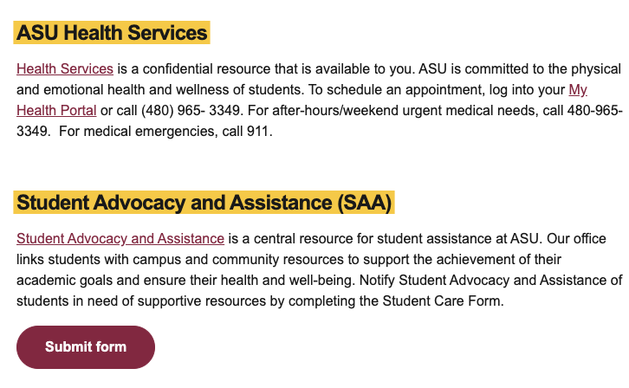
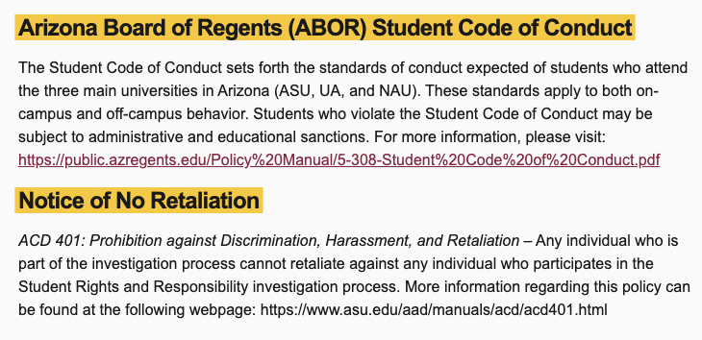
Hyperlinking Examples
Good Hyperlink Example
Poor Hyperlink Example

Slide 20
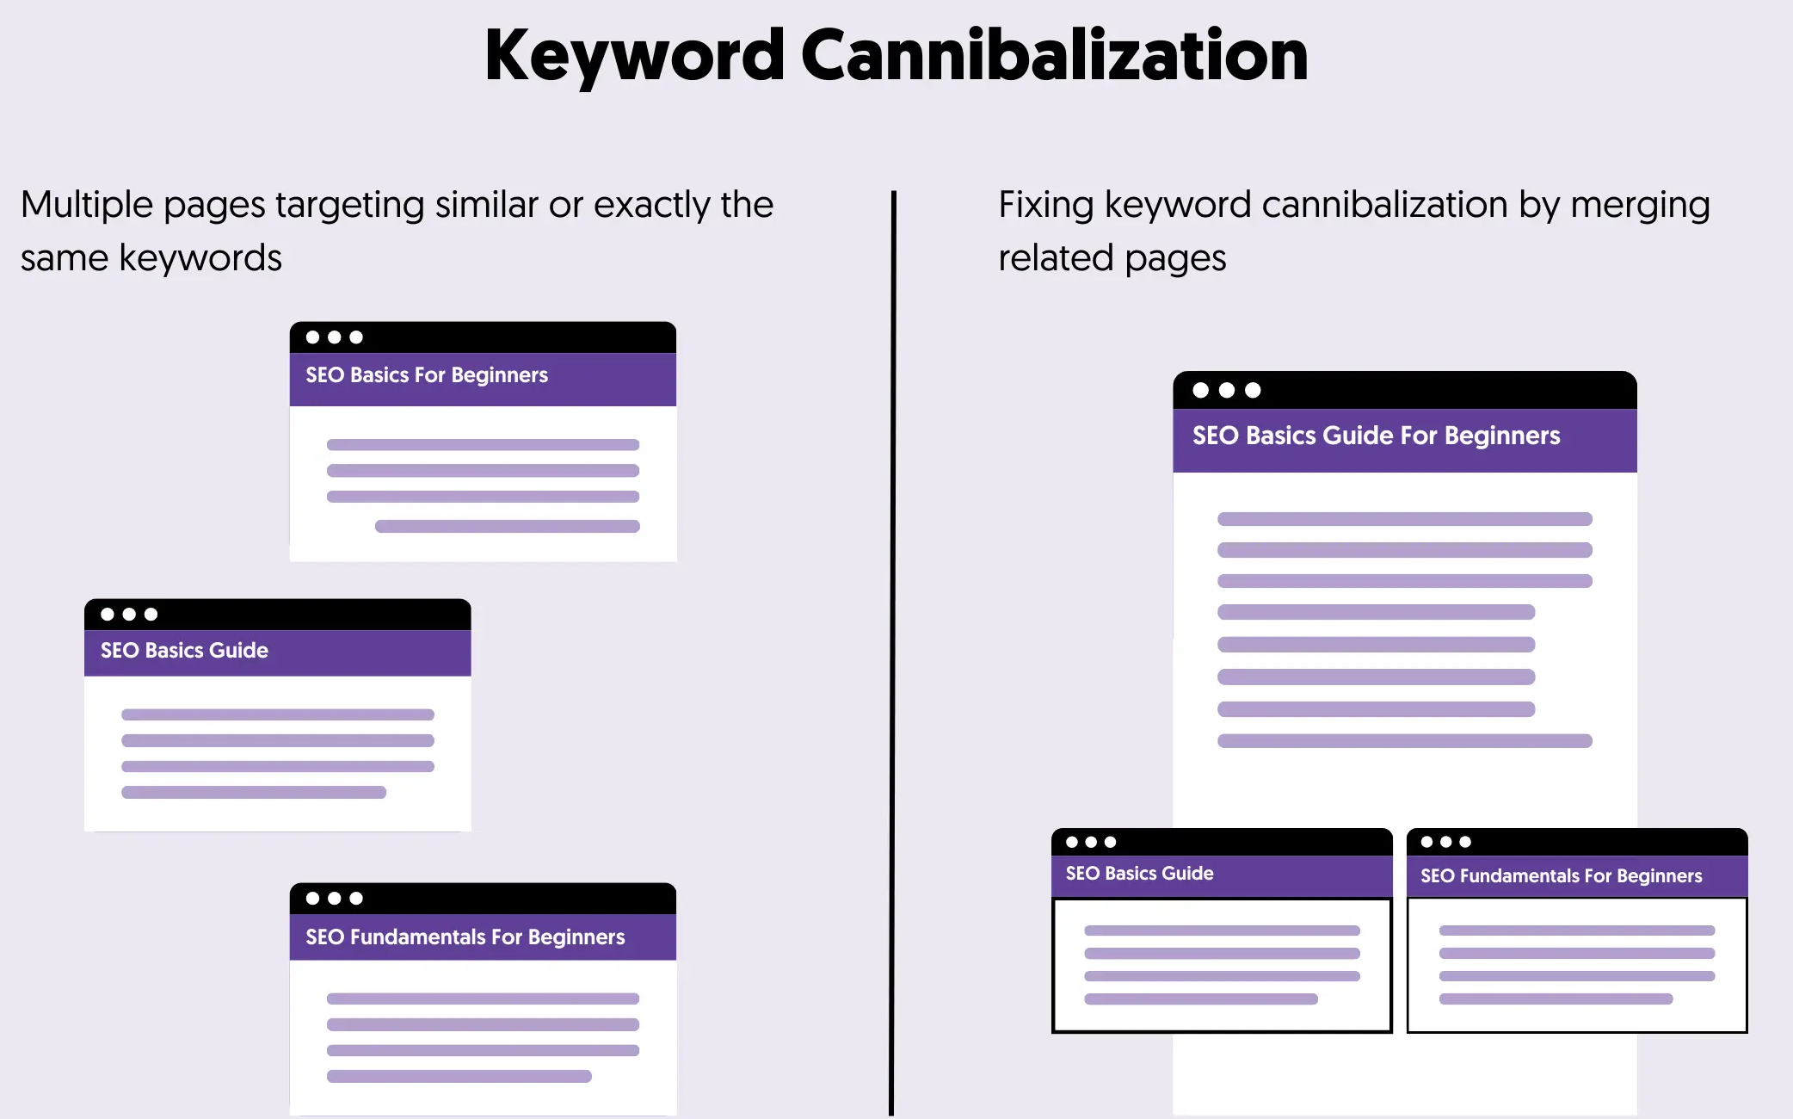
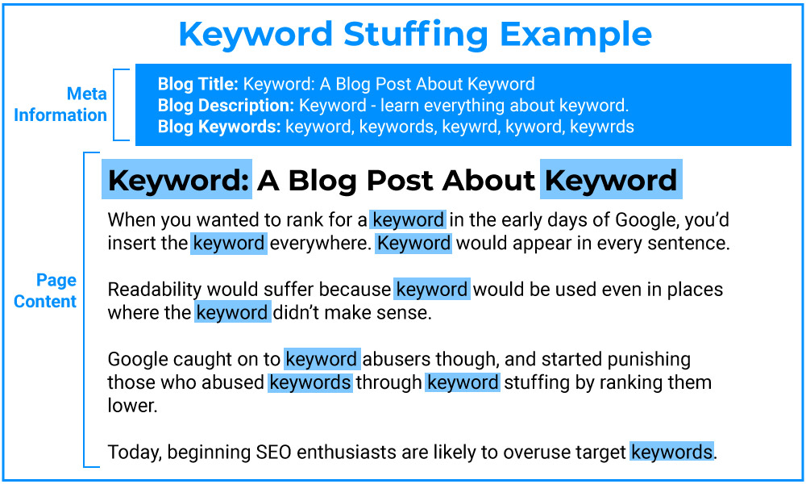
SEO & Findability
Use Relevant Keywords & Avoid
  Keyword stuffing;
  Content cannibalization;
Prioritize keyword placement
  Impact areas (H1—H6, body content, actions, technical, etc.)
  Regularly review page analytics

Slide 21
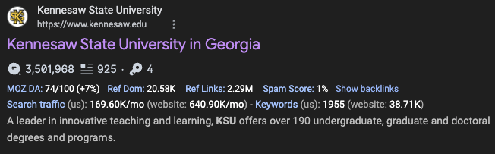
Meta Data
Create concise titles (<60 characters) and descriptions (<155 characters)

Slide 22
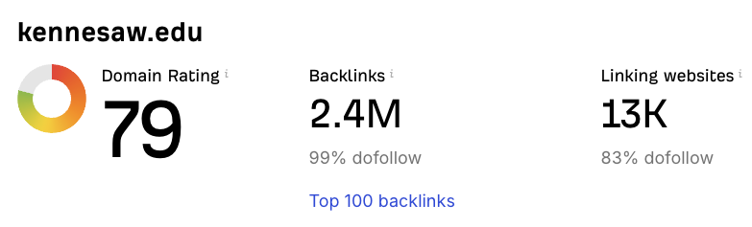
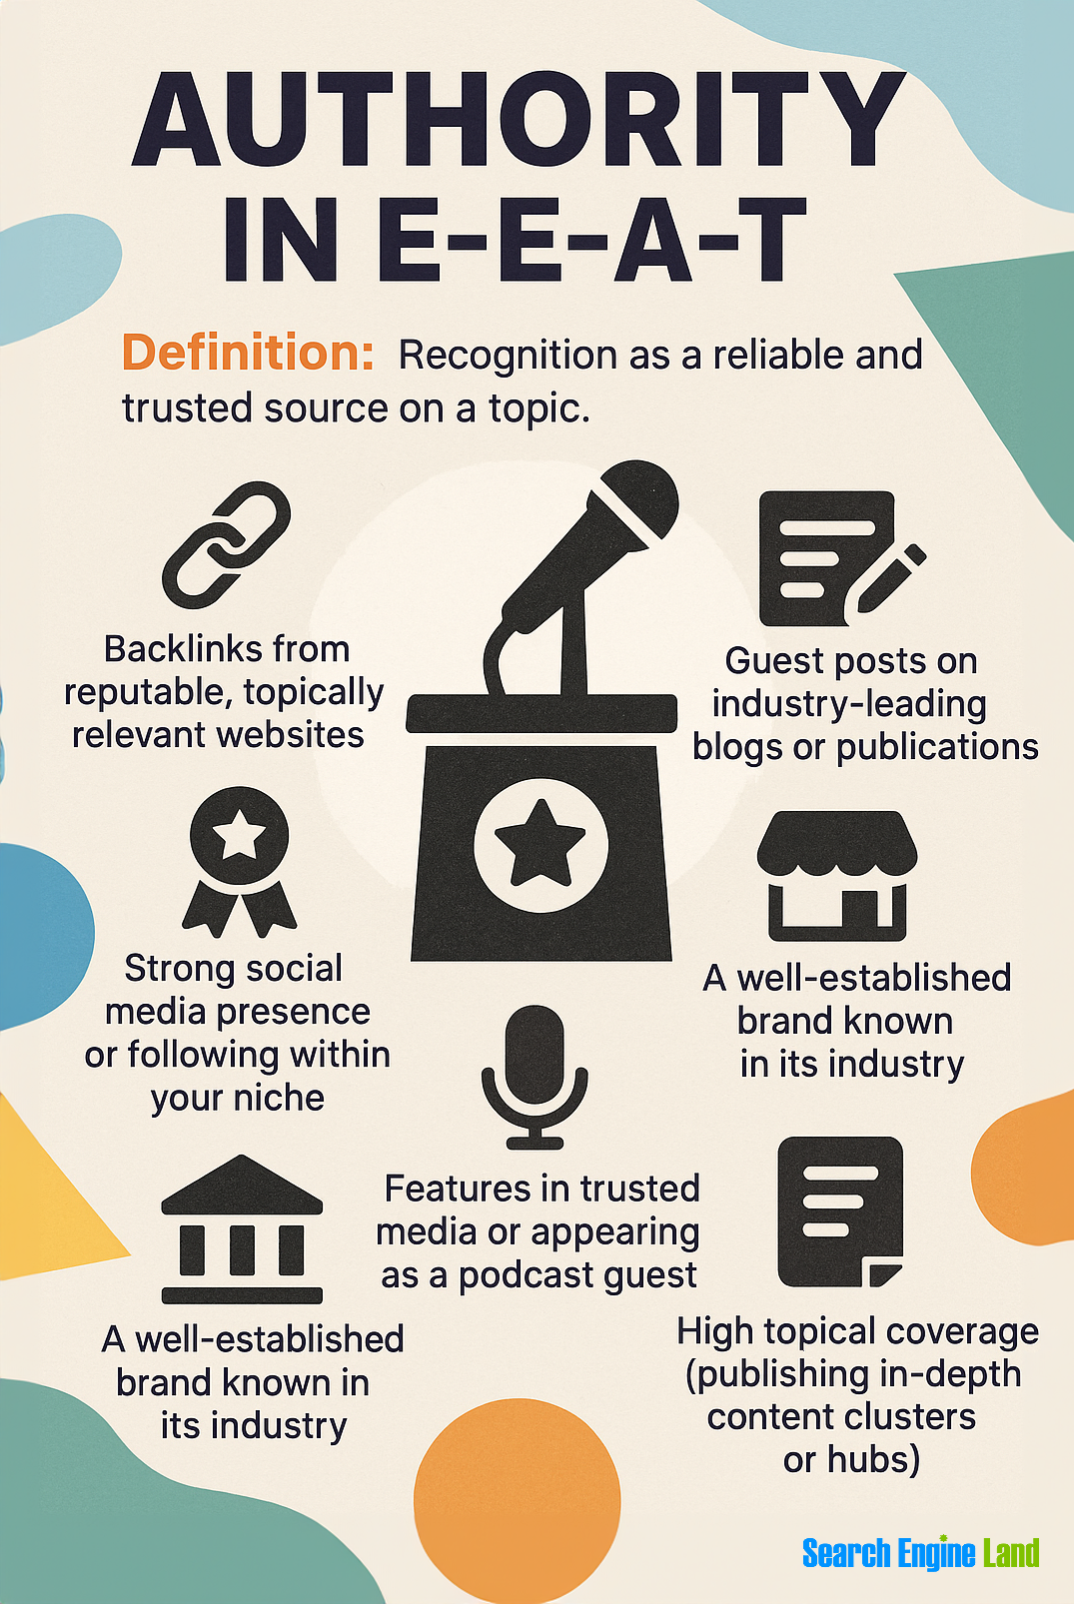
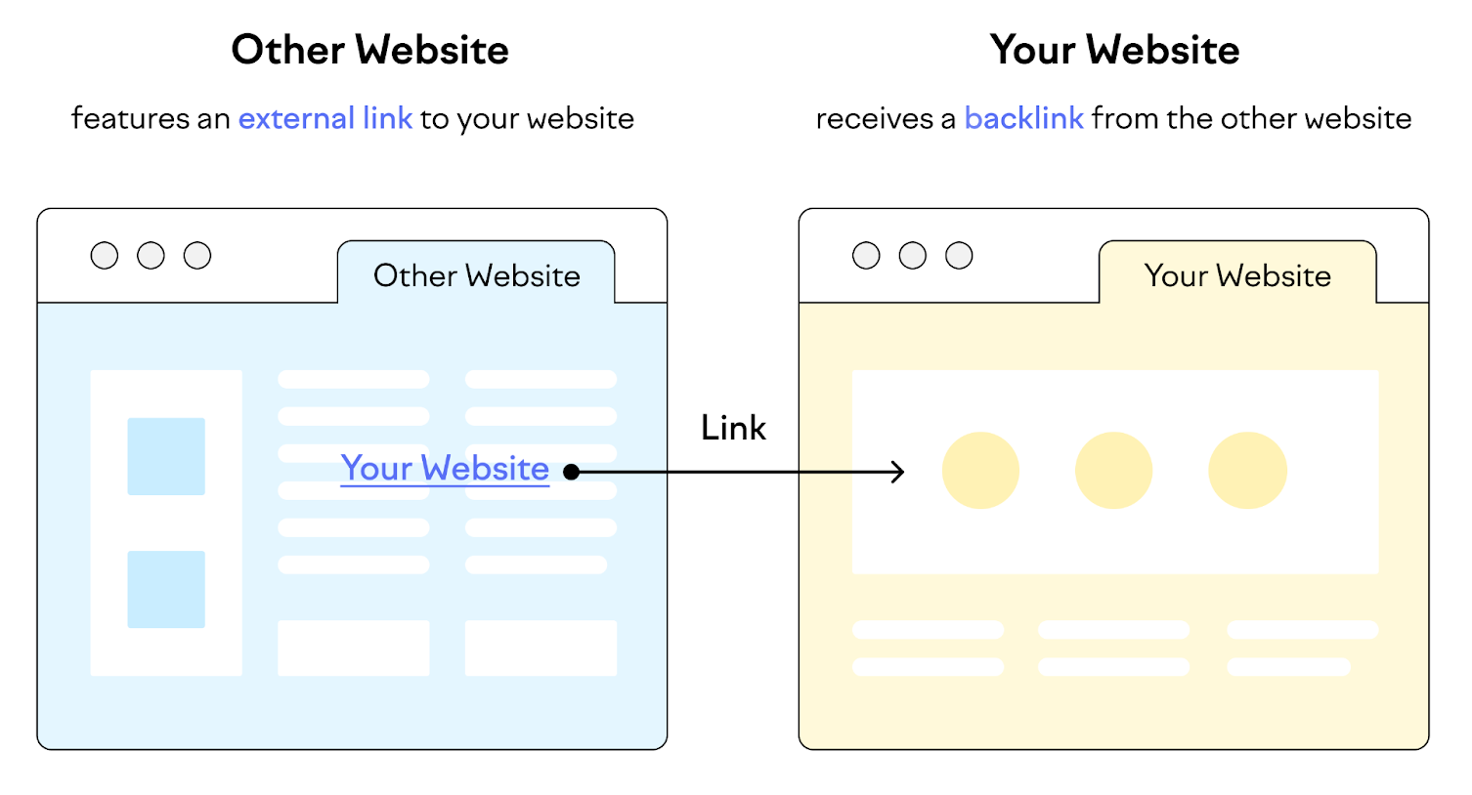
SEO Authority
Establish Credibility & Trust
Search engines assign trust and credibility
Influenced by backlinks, content quality, relevance to searches, and user engagement
Higher authority → better chances of ranking for competitive keywords
Building Authority with Content
Create high-quality, original content that fully addresses a user's search intent
Update content regularly to maintain accuracy and user trust
Encourage sharing and backlinks through valuable resources
  Use relevant internal and external links to trusted sources
  Place links at beginning or end of a sentence—not in the middle. This makes content easier to scan/read.

Slide 23
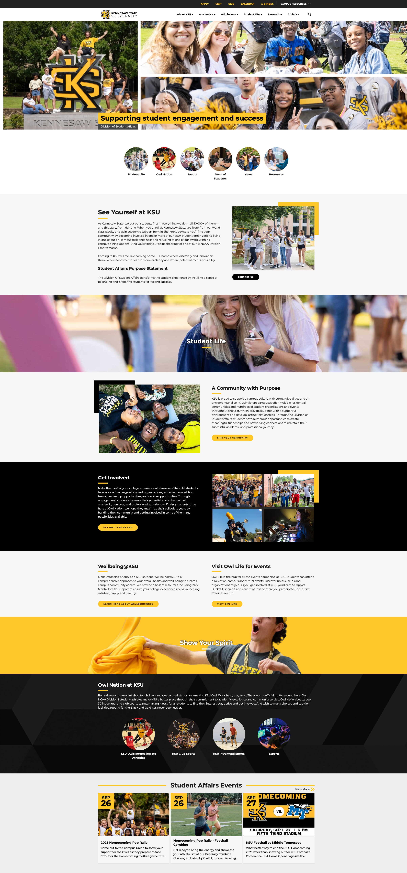
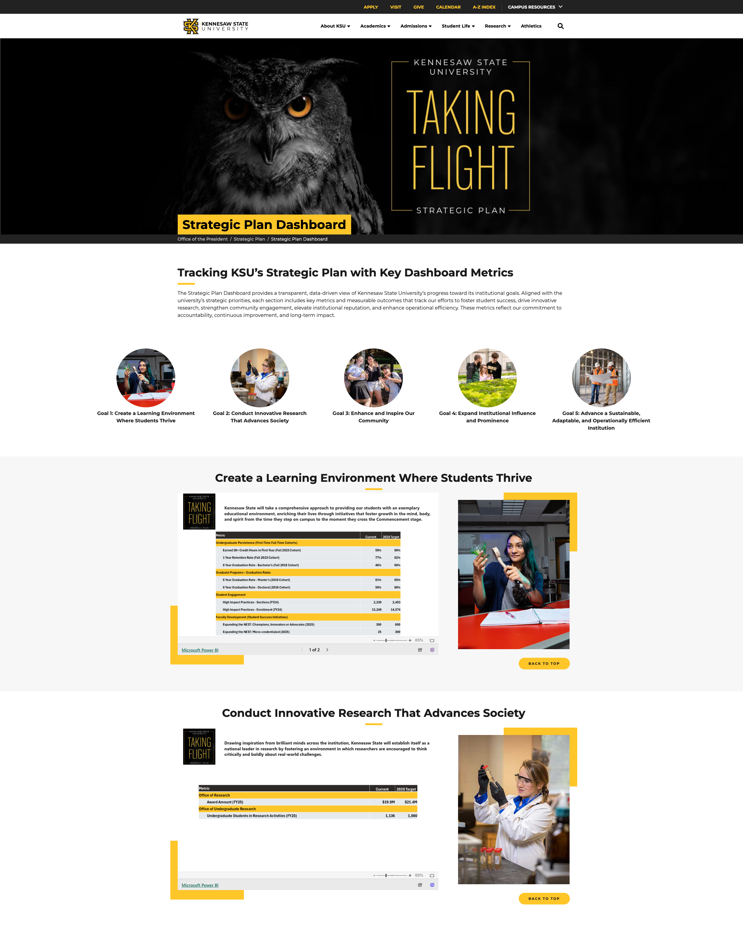

Content Formats
Select the Right Format
  FAQs for questions, blogs for stories, CTAs for actions, etc.
Create Content Chunks
  Use tabs, accordions, or videos for complex information
Visual Cues
Example of a Well-Designed Page
  Easy to scan; small content chunks
  Bolded text draws the eye to need-to-know details
  A video/photo gallery used to add visual interaction
  An online form is used on-page with clear CTAs
  Use evergreen content that's easy to update

Slide 24
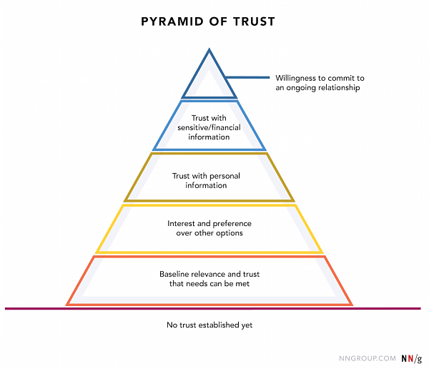
Credibility & Trust
Cite Your Sources
  Link to official KSU pages as the "source of truth" or other recognized authorities (ex: USG)
Accuracy
  Update data/statistics, deadlines, policies, class information, and relevant services/resources routinely
    Link to Course Catalog as source of truth
Transparency
  Include contact information and actionable options when relevant
Helpful Tip
  Double-check facts before publishing; broken links/outdated content will breakdown trust with the user and in search

Slide 25
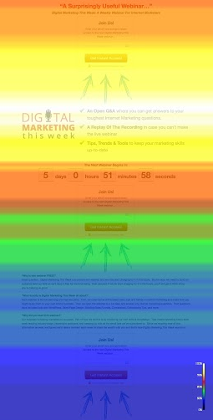
Engagement & Call to Actions
Be Specific
  "Register for Fall Orientation" instead of "Click Here" or "Learn More"
Placement
  Place actions near relevant content chunks or near the top and bottom of the page to maximize action
Design
  Use Omni options like buttons or hyperlinks to draw attention; keep styling consistent on-page; describe the action before the user takes it to help build trust
Set Up the Next Step
  Think beyond reading; make your information actionable; think through the entire required process for your user
    Ex: pose questions they might ask to create solutions
    Typically, web users have a specific scanning pattern when they skim content
Notes:
Most updated studies (more to come) on % of web users read a web page vs. scan:
https://www.nngroup.com/articles/how-people-read-online/
https://startwithrex.com/insights/the-science-behind-how-people-read-online-what-it-means-for-your-content/
https://www.nngroup.com/articles/f-shaped-pattern-reading-web-content/

Slide 26
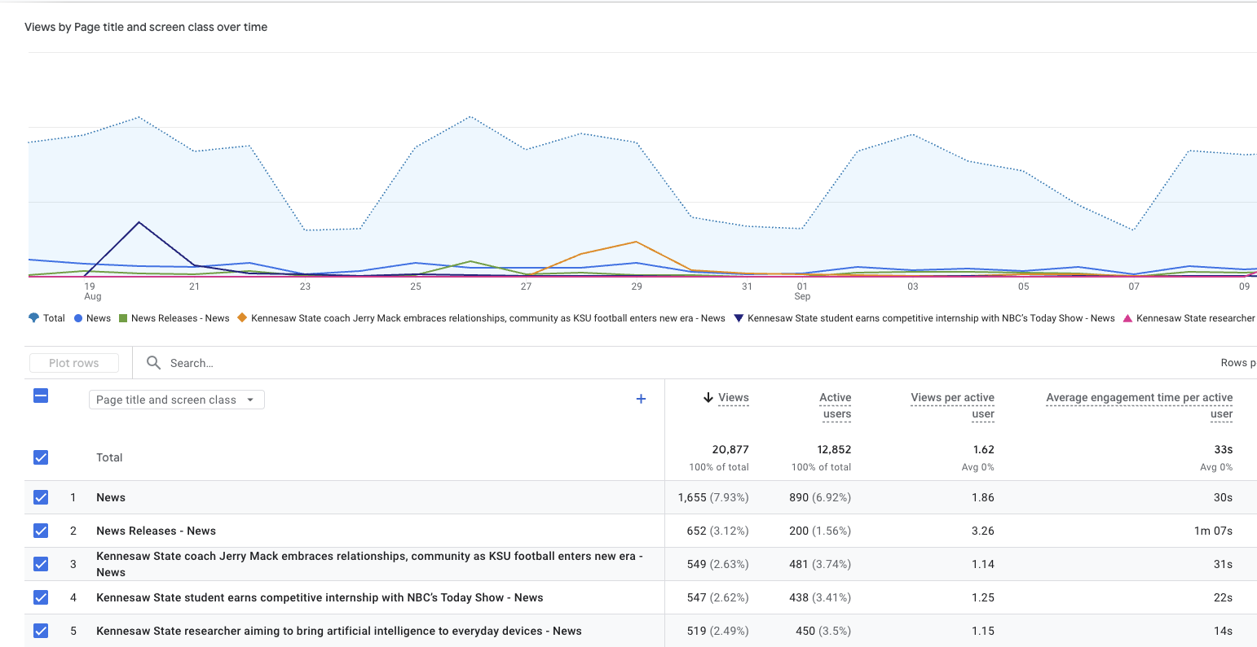
Analytics & Content Improvement
Monitor Performance
  Get view access to Run Google Analytics reports
    Submit a ticket to StratComm
  Run monthly reports and make content improvements based on data
Iterate Content
  Adjust headings, CTAs, or layout
Notes:
Send a ticket for GA4 view access

Slide 27

Questions
Please enter into the chat one challenge you have when working with your site....
Notes:
Can ask them for one challenge when working on your site?

Slide 28
Port Update
During the port process, all sites remain available — no downtime or offline pages
StratComm & UITS have successfully completed porting Groups 1, 1.2, 1.3, 2 and 2.1
We will be sending quick fix/improvement recommendations over the next week or two for ports already completed
Group 2.2 is scheduled to start on 10/6
Group 2.3 is scheduled to begin on 10/20
Group 2.4 is scheduled to begin on 11/3
Next college sites
Website Status Tracking

Slide 29
Governance
Web Site Governance
Service Level Agreement: Web Services
Purpose: This Service Level Agreement (SLA) outlines the services provided by the Strategic Communications and Marketing (StratComm) web team.
The SLA is designed to guide the development and maintenance of university websites and web content that align with KSU’s mission, vision and strategic goals, whether for university–wide initiatives or individual departments.

Slide 30

Future Meeting Topics
ADA / 508 compliance
Data Analytics & SEO
Writing for Digital
Please share any topics you would like us to cover!
Notes:
Do we want to mention the port process and where we are with that? Halfway through etc…
Can ask them for one challenge when working on your site?

Slide 31

Our Team
Leadership:
Joe Lacy - Director, SEO and Website Strategy
Sharon McAleer - Web Team Manager
Writers:
Josie Carter - Lead Marketing and SEO Copywriter
Malik Jones - Marketing and SEO Copywriter
Webmasters:
Jonathan Gilliam – Senior Webmaster and SEO Specialist
Anthony Matusko - Senior Webmaster and SEO Specialist
Elizabeth Ball - Webmaster and SEO Specialist
Sean Bresnan - Webmaster and SEO Specialist
Matthew Gordon - Webmaster and SEO Specialist
Tara Rose - Webmaster and SEO Specialist
Notes:
Add the slide Joe had here just so they know who we are again

