Slide 1
Web Community of Practice
Web Best Practices
For the KSU Website
8/29/2025

Slide 2
Welcome
Governance
Writing for Web
Today's Agenda

Slide 3

Goal of the Web Community of Practice
The Web Community of Practice brings together KSU web editors to collaborate, share knowledge, and strengthen the university’s online presence. In alignment with KSU’s strategic plan, the community aims to:
Advance student success
Elevate KSU’s brand and reputation
Foster collaboration and efficiency
Support professional development
Together, this community will help position KSU as a nationally recognized, student-focused university through a cohesive and engaging digital presence.
Meet every 6 weeks
Next Meetings are Oct. 3, Nov. 21,

Slide 4
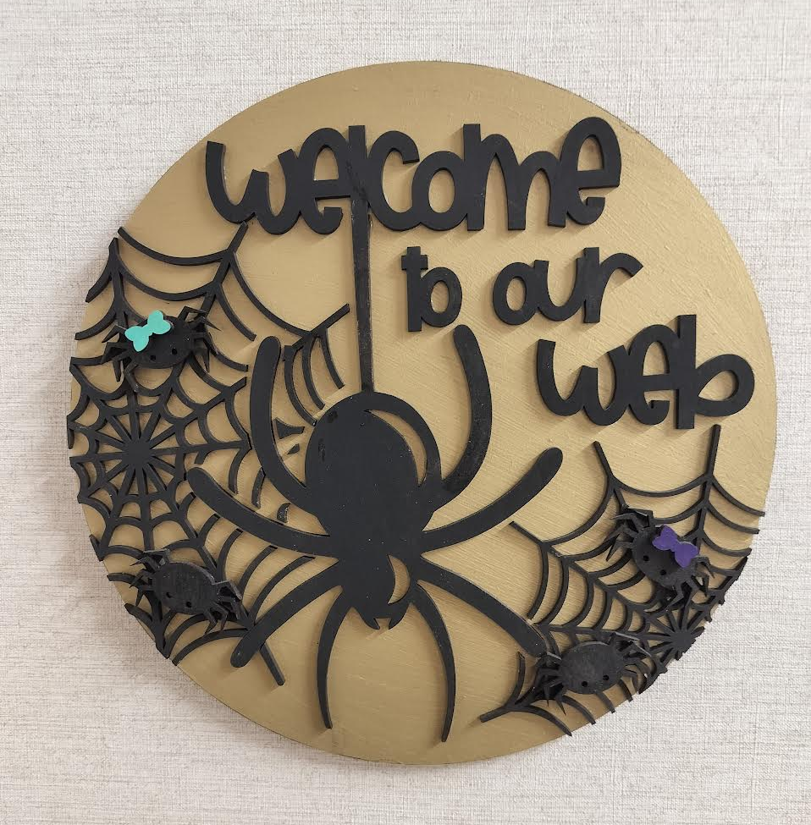
Meeting Schedule
Meeting cadence: Every 5 weeks
Upcoming dates: Nov 21, Jan 23, Feb 27, Apr 23
Topics: ADA/508 compliance, data analytics & SEO, writing for digital, and more
Led by: Strategic Communications Web Team
Meeting is Recorded (Please Mute)

Slide 5
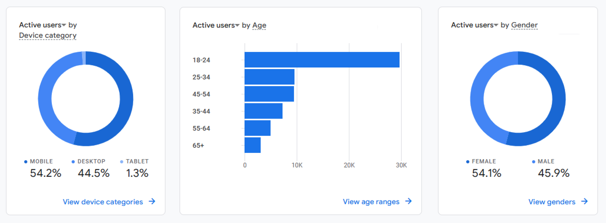
Analytics – July 2025
Mobile vs Desktop
Users Age
Users Gender
On average users visit 2.1 pages
They spend 1m and 3 secs per active user session
67% of our traffic comes through Organic Search (Google, Bing etc.)
Notes:
• We’ve been in a period of transition with the migrations.
• It will take another 6–12 months before we start to see reliable trends once migrations are fully complete.
• In July, you can already see at a high level that mobile traffic is higher than desktop—and we expect that to continue surpassing desktop moving forward.
• Best practice is to write for digital first and always preview pages on mobile.
• In July , 74% of our traffic comes through Google.
• This means users are less likely to start on a homepage and navigate through the site—instead, they jump in and out via search results, staying on average 48 seconds per session

Slide 6

Current Student Persona
Molly Harris — Current Student
Summary Molly is studying nursing as her major and commutes daily from Marietta. She primarily accesses the KSU website on her mobile device rather than her laptop.
Goals & Behaviors
Uses the site daily to check the academic calendar and registration dates
Logs into the student portal for classes, grades, and financial aid
Needs quick access to accurate, student-focused content while on the go
Age | 19
Gender | Female
Occupation | Undergraduate Student
Education | GED
Interests | Soccer, Reading

Slide 7
Why Create Personas
Data-Driven, Not Assumptions
Analytics reveal real audience demographics, devices, and behaviors
Sharper Content & Messaging
Tailor tone, CTAs, and topics to each audience
Better UX & Navigation
Design flows and menus around actual user journeys
Supports Personalization
Distinguish needs of students, alumni, faculty, prospects, etc.
Measurable Impact
Track KPIs by persona segment to refine strategy continuously

Slide 8
Interactive Exercise: Web Writing
Look at the following two web pages closely (Page A & B) and answer the following questions:
Who is the audience(s)?
What is the main objective of this page's content?
Which version accomplished their objective through the content best?
Page A
Page B

Slide 9
Writing for the Web – Top 5 Principles
Concise
Meta title: 50–60 chars | Meta desc: 140–155 chars | Sentences: ≤30 words
Scannable
H1s: 1 per page, unique, 20–60 chars; Use correct hierarchy (H1, H2, H3); subheads ≤60 chars
Target Audience
Important content above the fold (top 30%)
Place key actions early & after final scroll
Current
Review & Update content every semester; Outdated pages = +40% bounce rate
Accessible
Always use alt text; Descriptive hyperlinks (do not use “click here”)

Slide 10
Best Practices
New Pages
File Management
Headings
Images
Videos
Accessibility
Links
Publishing
Best Practices

Slide 11
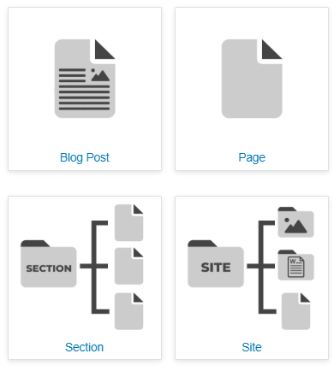
New Pages
New Section
Folder-name & breadcrumb path
Index page & page title
Set up /docs and /images
New Page
Page-name & page title
Note: Naming Files
All lowercase, with dashes, use words
Notes:
Here are 5 best practices to follow when requesting or creating a page URL:
Keep it short, simple, and readable
Use hyphens to separate words
Include relevant keywords
Avoid unnecessary words, numbers, and special characters
Follow governance rules for approval and future-proof

Slide 12
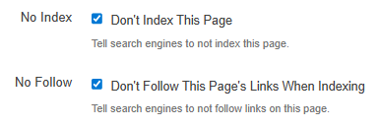
New Pages
No – Index / No – follow
New section or page
Turn off when live
Not guaranteed
Not for page updates
Call Us to Get Help!
We’re on teams-calling
Notes:
Pages not to index:
- Logins
- Search results
- Thank you/Confirmation pages
- Staging/test/dev
- Error pages 404
- Filtered/Navigation pages
- Private/restricted content

Slide 13

File Management
Images - /images folder
Re-sized images
Documents - /docs folder
Compressed / optimized files
Set Up Redirects
Deleting pages
Moving pages
Renaming pages
Notes:
Please note that checking broken links and pages that have moved is very important during this time and should be part of ongoing maintenance each week, especially as we continue to port sites to Campus Hub

Slide 14
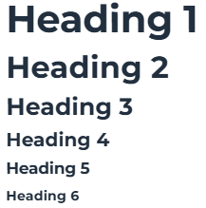
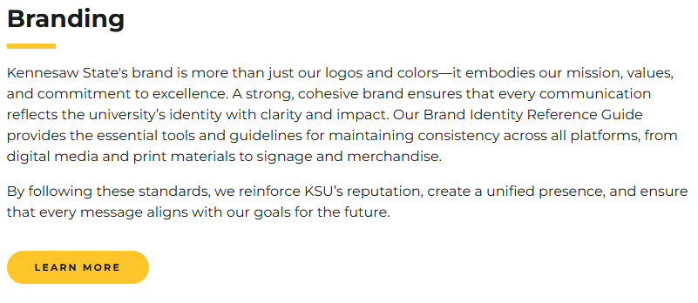
Headings
Setup with Hierarchy
Only one H1
Don’t skip levels
Avoid Links in Headings
Use a button
Heading Length
55 to 60 characters max, if longer Google cuts it off
Unique

Slide 15
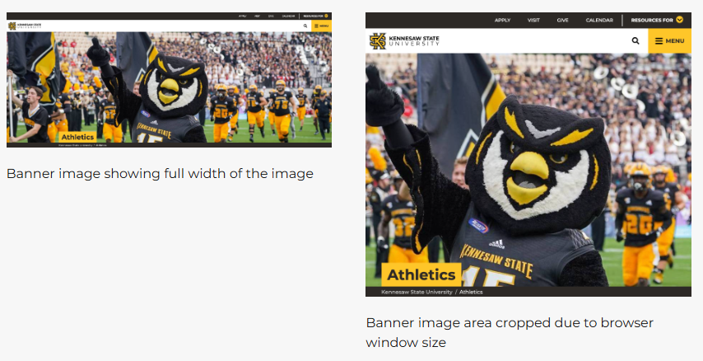
Images
Fit the Space
Resize, but don’t make too small
100 KB is ideal for most images
Test on desktop and mobile
Don’t Use Text on Images
Accessibility / readability issues
Select Images that Add Value
Use images only when they add value to the user experience or clearly support the message

Slide 16
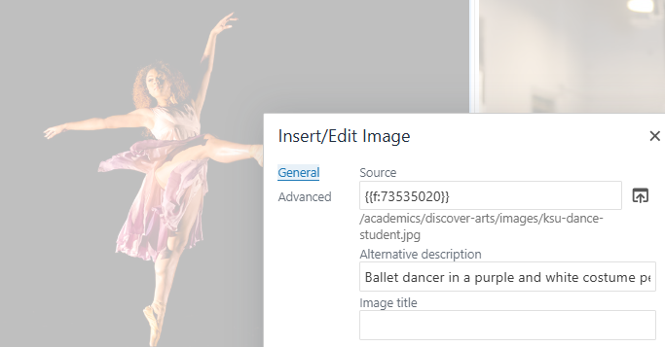
Images
Use a Meaningful Image Description
Determine the image’s purpose
Describe the image’s content and purpose
Avoid:
“Image of…” or “photo of…”
Demographic information unless relevant.
Overly long descriptions (for complex images - brief description in the alt-text, a longer description on the page or a link to it.)
Notes:
Image descriptions are important for
- Accessibility, screen readers
- Improve SEO (search engine rely on image descriptions)
- Better UX, select images that are relevant, and not to fill a space on the page. Add value for users
-Without descriptions, it may result in less trust and engagement

Slide 17
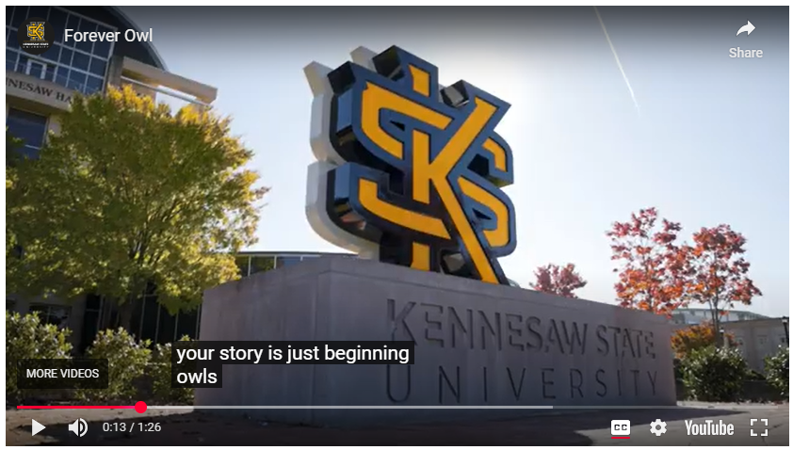
Video
Accessibility
Include closed captioning and/or audio description
Don’t auto-play
Keep Up-to-date
Use current branding
Make sure content is correct and relevant
Notes:
PDFs: https://www.kennesaw.edu/academic-affairs/curriculum-instruction-assessment/digital-learning-innovations/academic-web-accessibility/advanced-accessibility-solutions/pdf-accessibility-solutions/index.php
Or accessibility training: https://www.kennesaw.edu/academic-affairs/curriculum-instruction-assessment/digital-learning-innovations/academic-web-accessibility/advanced-accessibility-solutions/accessibility-training/index.php
https://m.youtube.com/watch?v=a2hqmqZzegg

Slide 18
Accessibility
In 1998 the US Congress amended the Rehabilitation Act to require Federal agencies to make their electronic and information technology accessible to people with disabilities.
It’s the Law
Americans with Disabilities Act of 1990
Section 508 of the Rehabilitation Act of 1973
Features of Compliance
Color and Contrast
Alt-Text for Images
Captions or Transcripts for Video
Keyboard Navigation
Screen Reader Accessibility
In 2021, 42.5 million people in the US civilian noninstitutionalized population had a disability, according to the Census.gov.
https://www.section508.gov/
https://www.ada.gov/
https://campus.kennesaw.edu/policies-governance/institutional-policies/docs/policies/web-accessibility-policy-statement.pdf

Slide 19
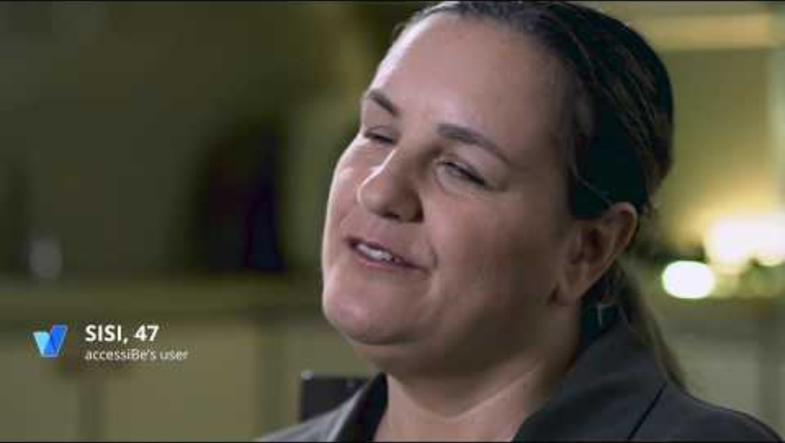
Accessibility
https://www.youtube.com/watch?app=desktop&v=a2hqmqZzegg

Slide 20

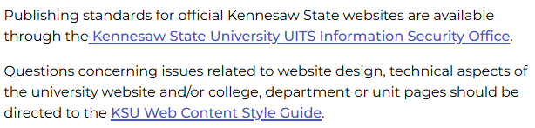
Links
Use A Dependency Tag
Use the file-browser to select internal links
When To Open In A New Tab
Anything off-site (outside of KSU)
Documents
Web Apps
Don’t Use “Here” Or “Click Here”
Use meaningful keywords as link text

Slide 21
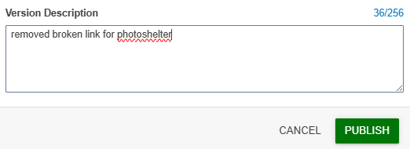
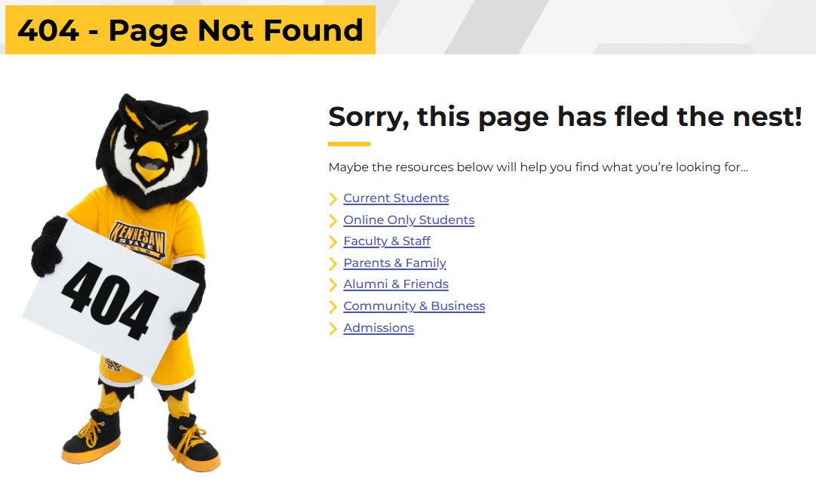
Publishing
Document the Changes in the Notes Box
Proofing
Spell check
Link check
Test forms

Slide 22

Questions
Please enter into the chat one challenge you have when working with your site....

Slide 23
Port Update
During the port process, all sites remain available — no downtime or offline pages.
StratComm & UITS have successfully completed porting Groups 1, 1.2, and 1.3.
Group 2 will begin on 9/4, including 15 sites as part of this port.
Group 2.2 is now scheduled to start on 10/6 (moved from 10/8).
Global Education will move out of Group 2.2 and into a new group 2.3, with its port scheduled to begin on 10/20.
Website Status Tracking

Slide 24
Service Level Agreement: Web Services
Service Level Agreement: Web Services
Purpose: This Service Level Agreement (SLA) outlines the services provided by the Strategic Communications and Marketing (StratComm) web team. It defines the roles and responsibilities of both the web team and the client, and sets clear expectations for service delivery, project support and communication.
The SLA is designed to guide the development and maintenance of university websites and web content that align with KSU’s mission, vision and strategic goals, whether for university–wide initiatives or individual departments.

Slide 25

Future Meeting Topics
Web Policy & Governance
ADA / 508 compliance
Data Analytics & SEO
Writing for Digital
Please share any topics you would like us to cover!

Slide 26

Our Team
Leadership:
Joe Lacy - Director, SEO and Website Strategy
Sharon McAleer - Web Team Manager
Writers:
Josie Carter - Lead Marketing and SEO Copywriter
Malik Jones - Marketing and SEO Copywriter
Webmasters:
Jonathan Gilliam – Senior Webmaster and SEO Specialist
Anthony Matusko - Senior Webmaster and SEO Specialist
Shontay Arrington - Webmaster and SEO Specialist
Elizabeth Ball - Webmaster and SEO Specialist
Sean Bresnan - Webmaster and SEO Specialist
Matthew Gordon - Webmaster and SEO Specialist
Tara Rose - Webmaster and SEO Specialist

