Slide 1

Web Community of Practice
Strategic Communication Updates & Web Tickets
April.3.2026

Slide 2


Agenda
Welcome
Strategic Communication Updates
Ports
Accessibility updates
Cludo – KSU online search tool
Modern Campus Form
Content review
How to submit web tickets to Strat Comm
Created by: Sharon McAleer, Jonathan Gilliam, Josie Carter, Joe Lacy, and Tara Rose

Slide 3
Goals of the Web Community of Practice
The Web Community of Practice brings together KSU web editors to collaborate, share knowledge, and strengthen the university’s online presence. In alignment with KSU’s strategic plan, the community aims to:
Advance student success
Elevate KSU’s brand and reputation
Foster collaboration and efficiency
Support professional development
Together, this community will help position KSU as a nationally recognized, student-focused university through a cohesive and engaging digital presence.

Slide 4
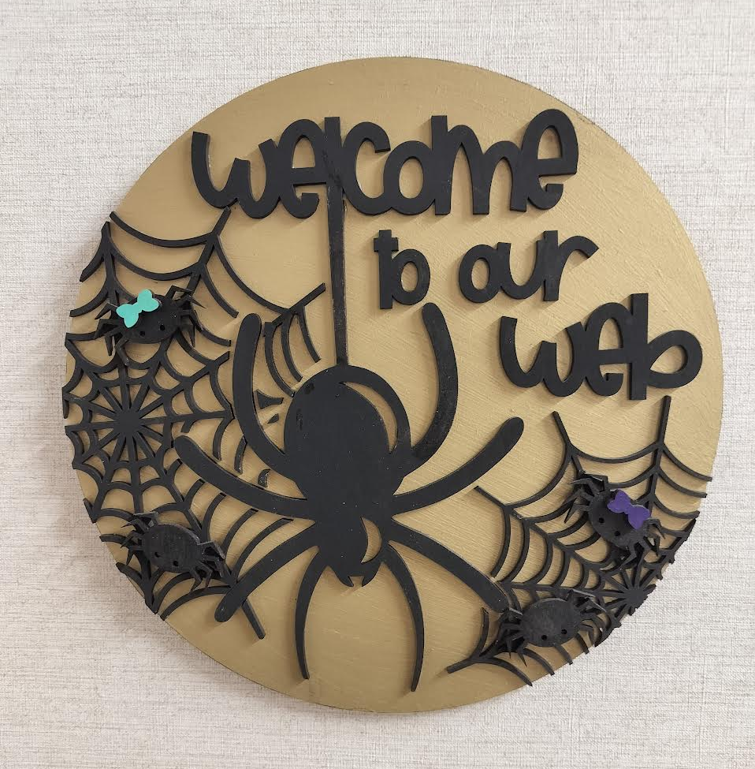
Meeting Schedule
Meeting cadence: Every 5 weeks
Upcoming dates: May 8 (Happy birthday Joe!)
Topics: UX, ADA/508 compliance, data analytics & SEO, writing for digital, content reviews and more
Led by: Strategic Communications Web Team
Meeting is Recorded (Please Mute)

Slide 5
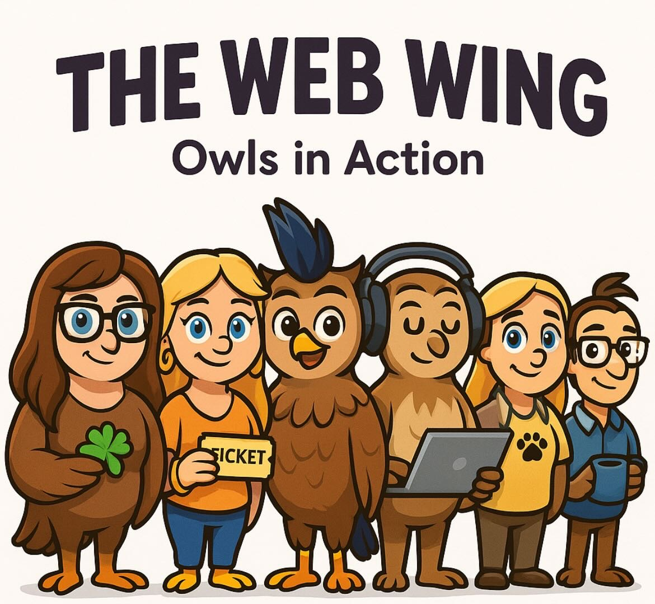
Port Update – Completed!
The Web Team have completed the ports!
Group 3.7 – Coles
Started 03/23, Completed 3/31
2 weeks early
3/31 vs 4/13
We will send QA/improvement recommendations for the last 4 ports soon.
Website Status Tracking
Redirects are in place for one year from the port completion dates. After that time, any links that have not been updated to the new campus location will result in broken links.
Please review and update these URLs.

Slide 6
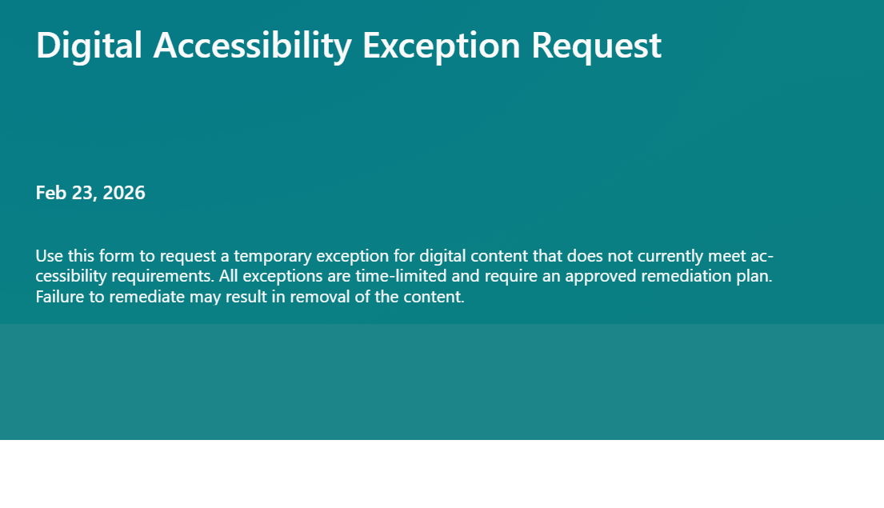
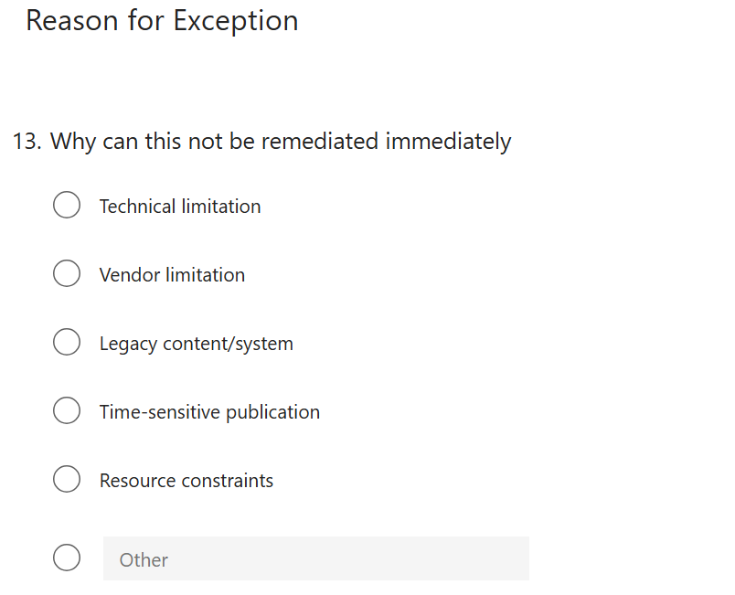
Digital Accessibility Waiver
Submit a ServiceNow ticket: Attention Strat Comm
Subject: Accessibility remediation
StratComm will review, set up a meeting and share the waiver form after we talk
Summary
Only for cases where accessibility requirements cannot be met immediately
Requires a documented remediation plan and timeline
Rare, temporary, and actively managed
Does not waive ADA Title II or WCAG requirements
Includes a firm remediation deadline
Non-remediated products will be removed from the site
Notes:
Link to show form: https://forms.office.com/Pages/DesignPageV2.aspx?subpage=design&id=5W7yRTTxnkO8k-bH4z1hwjUnI0W5HIxMofCI0pMB59BUMDBMRjlVTjRINU9JNk1PTEo1OVM2QVJNQi4u
I think folks should submit a ticket when they think they have a need for the waiver.
We schedule a meeting to discuss
If they have a need I give them access to complete the waiver form
I don’t think everyone should have access until we meet and discuss
Thoughts?
I can mention this process and create a note on our digital accessibility page for staff

Slide 7
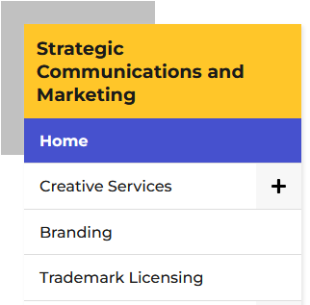
Accessibility Updates
CMS Improvements - StratComm in collaboration with UITS
Removed All Caps from Left Navigation
Improved Play/Pause function for Banner Videos
Additional Code Fixes (aria label attributes, etc.)
KSU’s Level Access Accessibility Score improved by 3 points
77.5 --> 80.5
Up Next: Improvements for Table Row Headers
Notes:
Slide 1: StratComm in collaboration with UITS have been making improvements to the CMS
Jonathan here they are we can select some to mention
Banner Header Tag - Adjusted role attribute for .banner from banner to region.
Republish needed.
List Elements - Moved related attributes and state changes to child paragraph node.
Chevrons - Added aria-hidden attribute to purely decorative icons .info_for_icon and .dropdown_arrow.
Left Navigation - Removed uppercase text-transform style from node.
Campus Home Page - Adjusted z-index style to a higher value to bring .helper-links above other nodes.
Video Banner Play/Pause - Added aria-label attribute to node to convey state change of video.
Video Banner Role - Removed role="presentation" from node and replaced with aria-hidden attribute.
Republish needed.
Utility Labels - Adjusted aria-label attribute for various utility nodes to have a unique identifier.
Removed all caps in the left nav, we improved the play pause button for hero videos, and adjust some accessibility code to improve our template. As a result, our LA score jumped by 3 points from 77.5 to 80.5. – include a graphic
Next on our roadmap with UITS are accessibility improvements for tables. This will ensure column headers and row headers read with each data point. For example: Example: Table without proper row headers (no rowspan)


Semester
Freshmen
Sophomores
Fall
250
320
Fall
310
310
Fall
310
460
What a screen reader announces:
“Row 1, 250, 320”
“Row 2, 310, 310”
“Row 3, 310, 460”
Why this is a problem
Users cannot tell what the numbers represent
Data relationships are not conveyed
What’s needed
· Row headers must be properly defined and linked to their data
· Support for rowspan and header associations ensures screen readers announce: “Fall, Freshmen 250, Sophomores 320”
We continue to collaborate with UITS on phase 2 of CMS accessibility improvements, future items include solutions for Math, table alignment, and audio descriptions in hero videos. Slide 2:
Level Access – the tool has been approved
We have started kick off meetings
2 primary features for this tools to take away are
Automated remediation
Accessibility dashboards
We are collaborating with UITS to set up the remediation widget and as we gather a timeline we will share it. We are eager to have the widget in place soon. What the widget does: widget that will automatically correct ADA issues on our site, while we work to fix in the web code. Express it’s a temp fix to give us time to correct long term.
HTML/Images only.
Slide 4:
What archived content means for Title II:
The Four Conditions: All Must Be Met
The content was created before the entity's compliance deadline. (April, 24 2024)
The content is retained solely for reference, research, or recordkeeping purposes.
The content has not been altered after the compliance deadline.
The content is not the subject of active use. Fail any one of those conditions, and the content does not qualify.
The age of the content doesn't matter. The main question is whether it is still relevant today.
Accommodation Requests: No Exemption When Someone Asks for it to be accessible
Slide 5: What is next : Check out the new digital accessibility web page here : <link> Communicate that a new accessibility web site is available
Show the frame work https://www.kennesaw.edu/accessibility/digital-accessibility-framework.php
Digital resources https://www.kennesaw.edu/accessibility/digital-accessibility.php
This summer Strat Comm will start work on creating an archived template solutions so we are all following that template and present archived content consistently across the site. This si a key req for ttle II.
LA dash board, but in the interim submit a request to Strat Comm if you would like a site improve accessibility report

Slide 8
Level Access
Approved!
Kick Off Meetings Started!
Primary Features:
Automated Remediation (corrects ADA issues on the live site) Timeline for implementation will be coming soon. This is meant to be a temporary fix to give more time to correct long term.
Accessibility Dashboards (quickly review issues and site performance)
Notes:
Slide 1: StratComm in collaboration with UITS have been making improvements to the CMS
Jonathan here they are we can select some to mention
Banner Header Tag - Adjusted role attribute for .banner from banner to region.
Republish needed.
List Elements - Moved related attributes and state changes to child paragraph node.
Chevrons - Added aria-hidden attribute to purely decorative icons .info_for_icon and .dropdown_arrow.
Left Navigation - Removed uppercase text-transform style from node.
Campus Home Page - Adjusted z-index style to a higher value to bring .helper-links above other nodes.
Video Banner Play/Pause - Added aria-label attribute to node to convey state change of video.
Video Banner Role - Removed role="presentation" from node and replaced with aria-hidden attribute.
Republish needed.
Utility Labels - Adjusted aria-label attribute for various utility nodes to have a unique identifier.
Removed all caps in the left nav, we improved the play pause button for hero videos, and adjust some accessibility code to improve our template. As a result, our LA score jumped by 3 points from 77.5 to 80.5. – include a graphic
Next on our roadmap with UITS are accessibility improvements for tables. This will ensure column headers and row headers read with each data point. For example: Example: Table without proper row headers (no rowspan)


Semester
Freshmen
Sophomores
Fall
250
320
Fall
310
310
Fall
310
460
What a screen reader announces:
“Row 1, 250, 320”
“Row 2, 310, 310”
“Row 3, 310, 460”
Why this is a problem
Users cannot tell what the numbers represent
Data relationships are not conveyed
What’s needed
· Row headers must be properly defined and linked to their data
· Support for rowspan and header associations ensures screen readers announce: “Fall, Freshmen 250, Sophomores 320”
We continue to collaborate with UITS on phase 2 of CMS accessibility improvements, future items include solutions for Math, table alignment, and audio descriptions in hero videos. Slide 2:
Level Access – the tool has been approved
We have started kick off meetings
2 primary features for this tools to take away are
Automated remediation
Accessibility dashboards
We are collaborating with UITS to set up the remediation widget and as we gather a timeline we will share it. We are eager to have the widget in place soon. What the widget does: widget that will automatically correct ADA issues on our site, while we work to fix in the web code. Express it’s a temp fix to give us time to correct long term.
HTML/Images only.
Slide 4:
What archived content means for Title II:
The Four Conditions: All Must Be Met
The content was created before the entity's compliance deadline. (April, 24 2024)
The content is retained solely for reference, research, or recordkeeping purposes.
The content has not been altered after the compliance deadline.
The content is not the subject of active use. Fail any one of those conditions, and the content does not qualify.
The age of the content doesn't matter. The main question is whether it is still relevant today.
Accommodation Requests: No Exemption When Someone Asks for it to be accessible
Slide 5: What is next : Check out the new digital accessibility web page here : <link> Communicate that a new accessibility web site is available
Show the frame work https://www.kennesaw.edu/accessibility/digital-accessibility-framework.php
Digital resources https://www.kennesaw.edu/accessibility/digital-accessibility.php
This summer Strat Comm will start work on creating an archived template solutions so we are all following that template and present archived content consistently across the site. This si a key req for ttle II.
LA dash board, but in the interim submit a request to Strat Comm if you would like a site improve accessibility report

Slide 9
Archived Content
Title II Requires 4 Conditions (All Must be Met)
The content was created before the entity's compliance deadline. (April 24, 2024)
The content is retained solely for reference, research, or recordkeeping purposes.
The content has not been altered after the compliance deadline.
The content is not the subject of active use.
Fail any one of those conditions, and the content does not qualify
Age of the content doesn't matter. -- Is it still relevant today?
No exemption when someone asks for it to be accessible
Notes:
Slide 1: StratComm in collaboration with UITS have been making improvements to the CMS
Jonathan here they are we can select some to mention
Banner Header Tag - Adjusted role attribute for .banner from banner to region.
Republish needed.
List Elements - Moved related attributes and state changes to child paragraph node.
Chevrons - Added aria-hidden attribute to purely decorative icons .info_for_icon and .dropdown_arrow.
Left Navigation - Removed uppercase text-transform style from node.
Campus Home Page - Adjusted z-index style to a higher value to bring .helper-links above other nodes.
Video Banner Play/Pause - Added aria-label attribute to node to convey state change of video.
Video Banner Role - Removed role="presentation" from node and replaced with aria-hidden attribute.
Republish needed.
Utility Labels - Adjusted aria-label attribute for various utility nodes to have a unique identifier.
Removed all caps in the left nav, we improved the play pause button for hero videos, and adjust some accessibility code to improve our template. As a result, our LA score jumped by 3 points from 77.5 to 80.5. – include a graphic
Next on our roadmap with UITS are accessibility improvements for tables. This will ensure column headers and row headers read with each data point. For example: Example: Table without proper row headers (no rowspan)


Semester
Freshmen
Sophomores
Fall
250
320
Fall
310
310
Fall
310
460
What a screen reader announces:
“Row 1, 250, 320”
“Row 2, 310, 310”
“Row 3, 310, 460”
Why this is a problem
Users cannot tell what the numbers represent
Data relationships are not conveyed
What’s needed
· Row headers must be properly defined and linked to their data
· Support for rowspan and header associations ensures screen readers announce: “Fall, Freshmen 250, Sophomores 320”
We continue to collaborate with UITS on phase 2 of CMS accessibility improvements, future items include solutions for Math, table alignment, and audio descriptions in hero videos. Slide 2:
Level Access – the tool has been approved
We have started kick off meetings
2 primary features for this tools to take away are
Automated remediation
Accessibility dashboards
We are collaborating with UITS to set up the remediation widget and as we gather a timeline we will share it. We are eager to have the widget in place soon. What the widget does: widget that will automatically correct ADA issues on our site, while we work to fix in the web code. Express it’s a temp fix to give us time to correct long term.
HTML/Images only.
Slide 4:
What archived content means for Title II:
The Four Conditions: All Must Be Met
The content was created before the entity's compliance deadline. (April, 24 2024)
The content is retained solely for reference, research, or recordkeeping purposes.
The content has not been altered after the compliance deadline.
The content is not the subject of active use. Fail any one of those conditions, and the content does not qualify.
The age of the content doesn't matter. The main question is whether it is still relevant today.
Accommodation Requests: No Exemption When Someone Asks for it to be accessible
Slide 5: What is next : Check out the new digital accessibility web page here : <link> Communicate that a new accessibility web site is available
Show the frame work https://www.kennesaw.edu/accessibility/digital-accessibility-framework.php
Digital resources https://www.kennesaw.edu/accessibility/digital-accessibility.php
This summer Strat Comm will start work on creating an archived template solutions so we are all following that template and present archived content consistently across the site. This si a key req for ttle II.
LA dash board, but in the interim submit a request to Strat Comm if you would like a site improve accessibility report

Slide 10
What's Next for ADA
New Digital Accessibility Webpage: https://www.kennesaw.edu/accessibility/digital-accessibility.php
New Digital Accessibility Framework: https://www.kennesaw.edu/accessibility/digital-accessibility-framework.php
Level Access: Adding User Dashboards soon (In the interim, contact StatComm to request a Siteimprove Report)
Summer: Start work on an Archive Template for Archived Content Pages
Notes:
Slide 1: StratComm in collaboration with UITS have been making improvements to the CMS
Jonathan here they are we can select some to mention
Banner Header Tag - Adjusted role attribute for .banner from banner to region.
Republish needed.
List Elements - Moved related attributes and state changes to child paragraph node.
Chevrons - Added aria-hidden attribute to purely decorative icons .info_for_icon and .dropdown_arrow.
Left Navigation - Removed uppercase text-transform style from node.
Campus Home Page - Adjusted z-index style to a higher value to bring .helper-links above other nodes.
Video Banner Play/Pause - Added aria-label attribute to node to convey state change of video.
Video Banner Role - Removed role="presentation" from node and replaced with aria-hidden attribute.
Republish needed.
Utility Labels - Adjusted aria-label attribute for various utility nodes to have a unique identifier.
Removed all caps in the left nav, we improved the play pause button for hero videos, and adjust some accessibility code to improve our template. As a result, our LA score jumped by 3 points from 77.5 to 80.5. – include a graphic
Next on our roadmap with UITS are accessibility improvements for tables. This will ensure column headers and row headers read with each data point. For example: Example: Table without proper row headers (no rowspan)


Semester
Freshmen
Sophomores
Fall
250
320
Fall
310
310
Fall
310
460
What a screen reader announces:
“Row 1, 250, 320”
“Row 2, 310, 310”
“Row 3, 310, 460”
Why this is a problem
Users cannot tell what the numbers represent
Data relationships are not conveyed
What’s needed
· Row headers must be properly defined and linked to their data
· Support for rowspan and header associations ensures screen readers announce: “Fall, Freshmen 250, Sophomores 320”
We continue to collaborate with UITS on phase 2 of CMS accessibility improvements, future items include solutions for Math, table alignment, and audio descriptions in hero videos. Slide 2:
Level Access – the tool has been approved
We have started kick off meetings
2 primary features for this tools to take away are
Automated remediation
Accessibility dashboards
We are collaborating with UITS to set up the remediation widget and as we gather a timeline we will share it. We are eager to have the widget in place soon. What the widget does: widget that will automatically correct ADA issues on our site, while we work to fix in the web code. Express it’s a temp fix to give us time to correct long term.
HTML/Images only.
Slide 4:
What archived content means for Title II:
The Four Conditions: All Must Be Met
The content was created before the entity's compliance deadline. (April, 24 2024)
The content is retained solely for reference, research, or recordkeeping purposes.
The content has not been altered after the compliance deadline.
The content is not the subject of active use. Fail any one of those conditions, and the content does not qualify.
The age of the content doesn't matter. The main question is whether it is still relevant today.
Accommodation Requests: No Exemption When Someone Asks for it to be accessible
Slide 5: What is next : Check out the new digital accessibility web page here : <link> Communicate that a new accessibility web site is available
Show the frame work https://www.kennesaw.edu/accessibility/digital-accessibility-framework.php
Digital resources https://www.kennesaw.edu/accessibility/digital-accessibility.php
This summer Strat Comm will start work on creating an archived template solutions so we are all following that template and present archived content consistently across the site. This si a key req for ttle II.
LA dash board, but in the interim submit a request to Strat Comm if you would like a site improve accessibility report

Slide 11

Accessibility Audit Steps
Request a SiteImprove Audit from StratComm
Page Title
URL
Page Report (SiteImprove Details)
CMS (Modern Campus Editor Link)
Click on the Page Report to View the Issues https://my2.siteimprove.com/Inspector/..~
Click on the CMS link to Edit the Page https://a.cms.omniupdate.com/..~
Run a PDFs Events Report in GA4
Consider deletion of PDFs with no traffic in 12 months

Slide 12

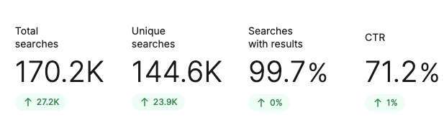
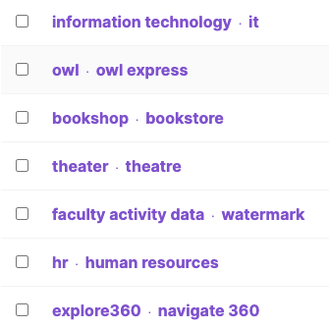
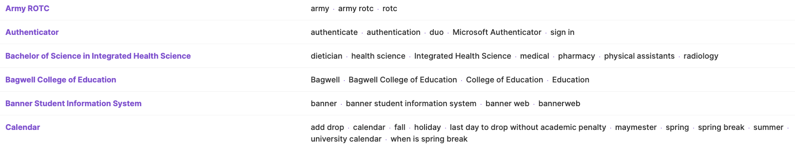
Cludo Updates
Live Demonstration:
Let's improve a user search term together!
POC Ticket Requests Only: Departments now submit search updates via service tickets
Supported Changes: misspellings/synonyms, page promotions/removals, order of result lists (rankings)
Post-CoP Follow-Up: Web editors did receive process details via email last CoP
Notes:
Josie:
updated pics of analytics/tools
Take screen share for 2 minutes to show a brief example of fixing a search term with a banner
"Owl Train" show in all page results the term search numbers from the last 7 days
Create a Banner for this since this is a non-Omni page
Banner H2: OwlTrain by Percipio
Copy for Banner: Access OwlTrain to complete assigned University training, compliance courses, and professional development modules. Log in to track your progress, view upcoming deadlines, and explore additional learning opportunities.
Button Copy: Begin Your Training
Show after results of Banner front end

Slide 13
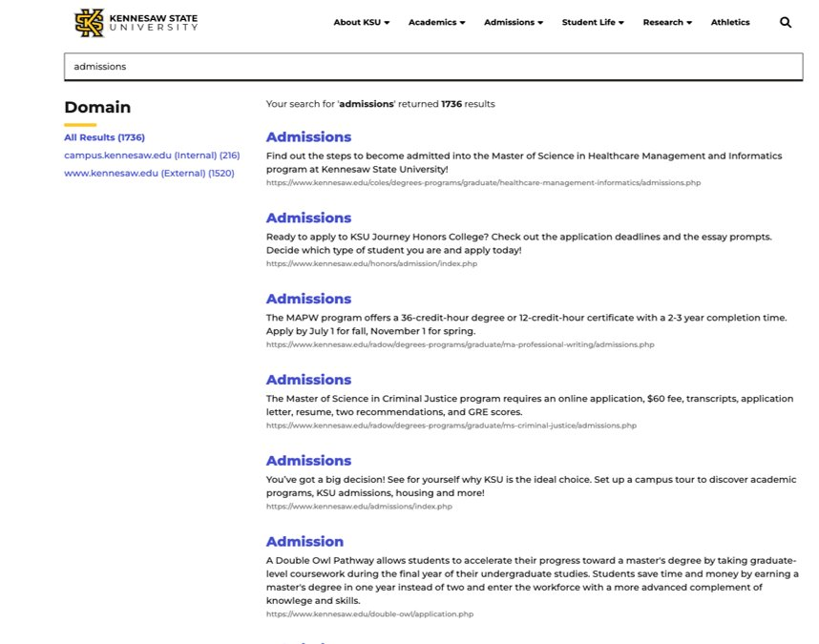
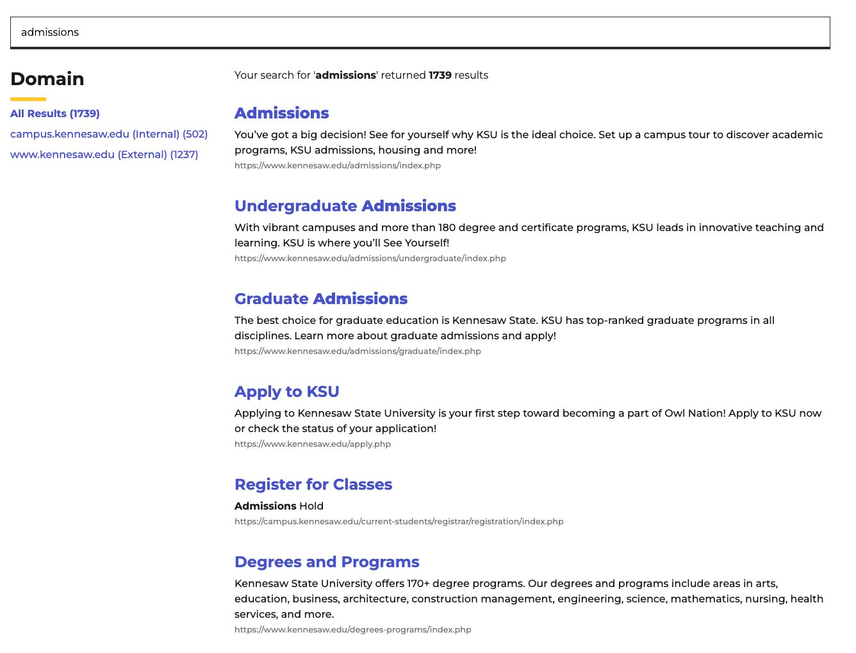

Cludo (Before & After Results)
Before (Admissions)
After (Admissions)
Notes:
Show Before and After front end improvements (like from Harrison presentation)

Slide 14

What's Changing?
Modern Campus – Forms
The Form Submission Process.
March 26, 2026
New forms built after March 26, 2026, will no longer send submissions by email.
After March 26, 2026
Form submissions must be viewed in Modern Campus.
July 2026
Legacy forms can no longer be edited.
November 2026
Legacy forms will be removed from the platform.
Start planning now for any form that still needs to be active after November 2026.
Notes:
Next steps: We need to know how many forms are on the MC
Divide by college and depart
Start recreating forms

Slide 15
Spring Content Review
Thank you to those who have completed a site content review! Please complete site content reviews by April 30, 2026:
Request your URL inventory
Submit a ServiceNow ticket to StratComm to receive a list of your site URLs (email: service@kennesaw.edu).
Review your pages
In the spreadsheet provided by StratComm, add a Status column and mark each URL as:
Keep (no change)
Update
Remove / Redirect Needed (if the page should come down/replaced)
Confirm completion
When finished submit the KSU Web Content Semester Review Completion Form
Make updates
Update content directly in Modern Campus, or
Submit a ServiceNow ticket if you need help from the StratComm Web Team.
Notes:
! (Add note the first time is more difficult)
During our last Web CoP we went over creating a content inventory – Preview meetings
You can read more on the StratComm website - Web Content Review Process

Slide 16
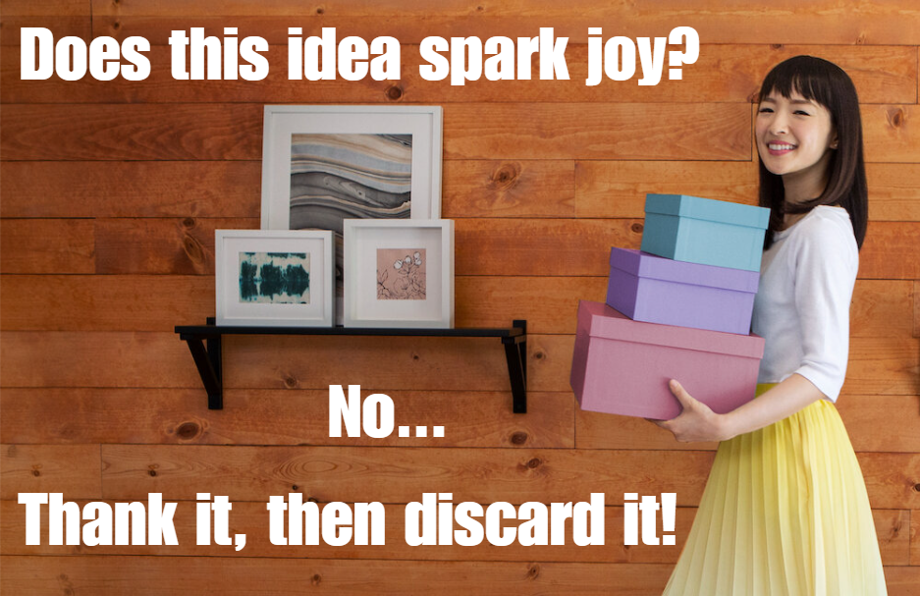
Content Inventory - Refresh
What is a content inventory? A content inventory is a structured review of all pages and files on your website to ensure content is:
Accurate
Current
Accessible
Aligned with university goals and policies
It helps us identify what should be
Kept
Updated
Removed (redirected)

Slide 17
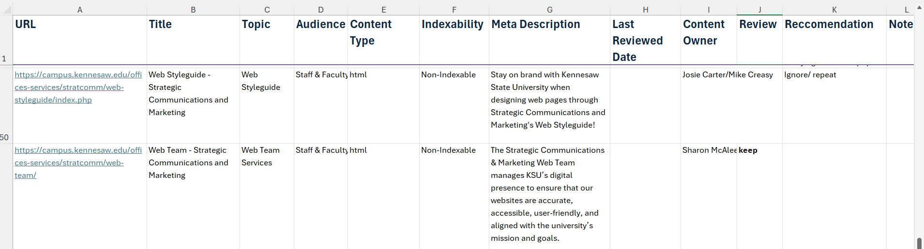
Content Inventory - Sample

Slide 18
Add Review Columns
Column | Purpose
Review Status | Required decision for each URL/File: Keep, Update, Remove/Redirect
Notes/Action Needed | What needs to change
Content Owner | Who is responsible
Last Reviewed Date | Accountability
Accessibility Issues | PDFs, tables, images, video etc.
Notes:
First time through will take a little more time, and it will get easier as you repeat in the future
Review Status (keep these consistent):
Keep – No Change
Updated
Remove / Redirect Needed
Consistency here makes reporting and follow-up much easier.

Slide 19
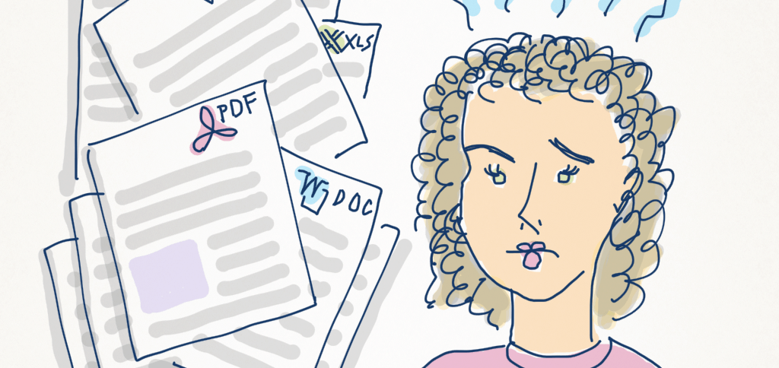
Review Each Page Using These Categories - 1
Accuracy & Relevance
Information is current and correct,
Contacts, titles, dates, and policies are up to date,
Duplicate or outdated content is removed
Audience & Purpose
Intended audience is clear,
Page supports a specific user need
Timeliness
Date-specific information is still valid
Notes:
HTML is the default e.g.: PDF summary page https://www.cdc.gov/tb/communication-resources/tuberculosis-fact-sheet.html

Slide 20
Review Each Page Using These Categories - 2
Accessibility & Usability
Headings follow a logical order,
Images include meaningful alt text,
Links use descriptive text,
PDFs are necessary (otherwise use a web page)
Links & Files
Links work and point to the correct destination
Style, SEO & Governance
Spelling, grammar, and punctuation are correct,
Clear headings, chunked content, short paragraphs, and actionable CTAs,
One H1, unique page title, clear meta description
Notes:
HTML is the default e.g.: PDF summary page https://www.cdc.gov/tb/communication-resources/tuberculosis-fact-sheet.html

Slide 21
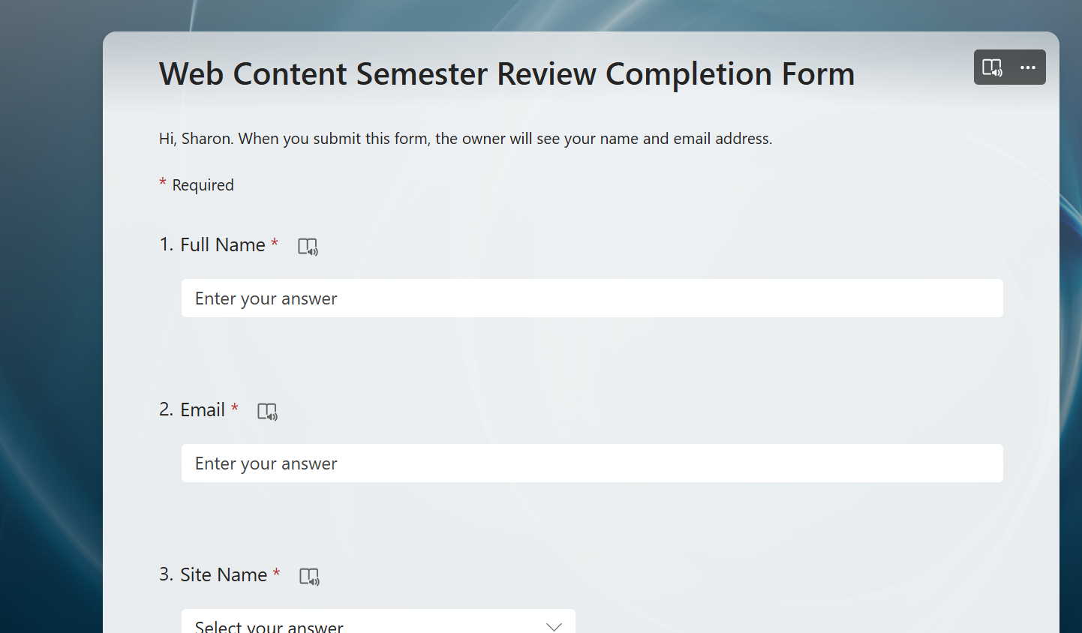
Confirm Completion
Your Finished
Ensure every URL has a Status
Submit the Content Review Completion Form
Keep the spreadsheet for your records
Note: Completion indicates each URL has been reviewed and tagged with a status, not that final actions are complete.
The Web Team will follow up only if a submission is missing or incomplete. We do not need to see your inventory.

Slide 22
Web Tickets – Service Now
Types of Requests
Tickets
Projects
How best to submit a ticket
Information to include
Best practices
Tickets vs Projects
Turn around times for tickets vs projects
(Examples – a good ticket includes…..)
Strat Comms ticket volume

Slide 23

Web Tickets Data
Web Tickets – Service Now
In the last 6 months (Sept. 2025 – February 2026)
We received 1103 Tickets:
1021 – Tickets – (Page updates, New page, Forms)
82 – Internal Projects (Site ports, Special department request, Website redesigns)
1065 completed, currently we have 38 tickets in progress/open
Internal Projects should be submitted as a regular ticket
StratComm will determine if it is an internal project and schedule a kickoff meeting

Slide 24
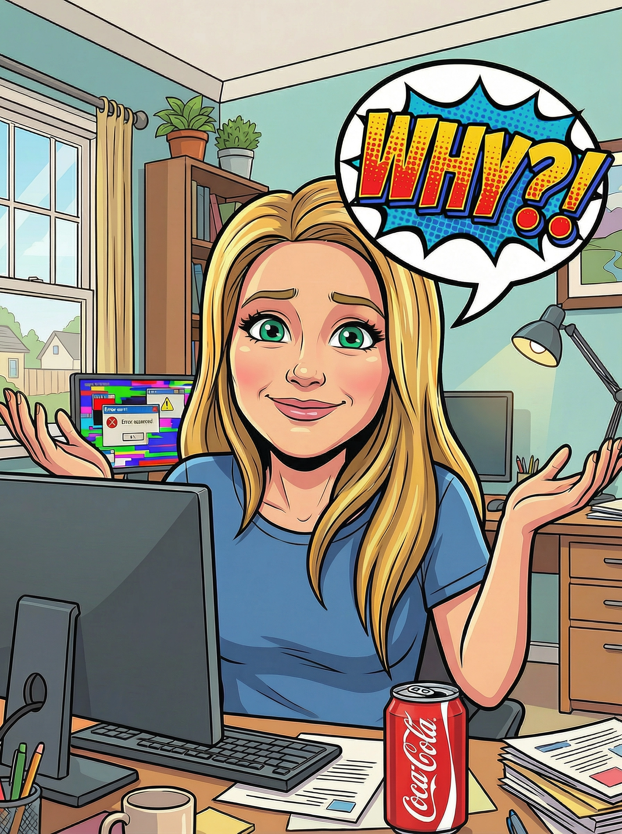
Why Submit a Ticket?
Types of Ticket Requests
Create or Update university pages correct broken links fix formatting errors update outdated information Create go.kennesaw.edu links (Vanity URLs) Add documents as links: pdf, docx, pptx, xlsx Build forms using Omni or Formstack Build image galleries. (Images must be under 1M) | Maintain accurate and up-to-date information across university web pages (academic programs, admissions, events, etc.) Add multimedia (photos, videos, graphics) and optimize them for web use Recommend improvements for site structure, navigation, content and usability Request GA4/Accessibility reports for your site

Slide 25
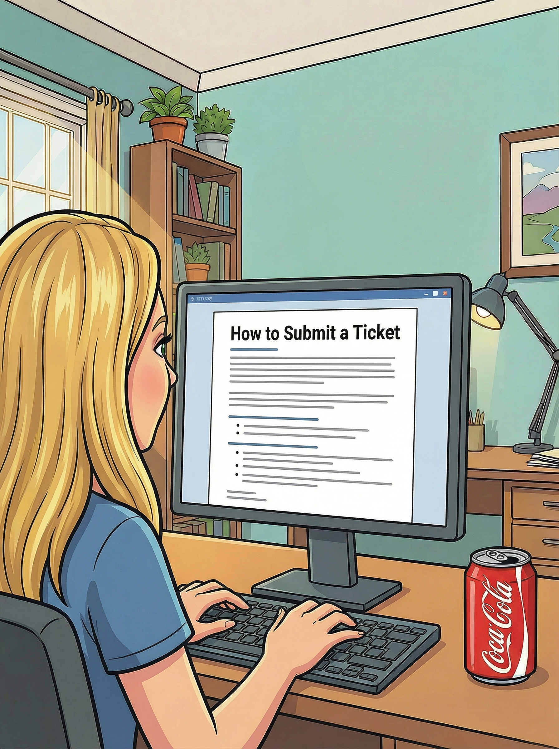
Form vs. Email
How to Submit a Ticket?
Fill out the Web Request form You do have to log in to fill out the form. Completing the form helps the web team as it has required fields to provide additional context.
OR
Email Service: service@kennesaw.edu There are no prompts. Please include url of the page you need edits to or if a new page, the url you want it linked from.
More information is best!

Slide 26
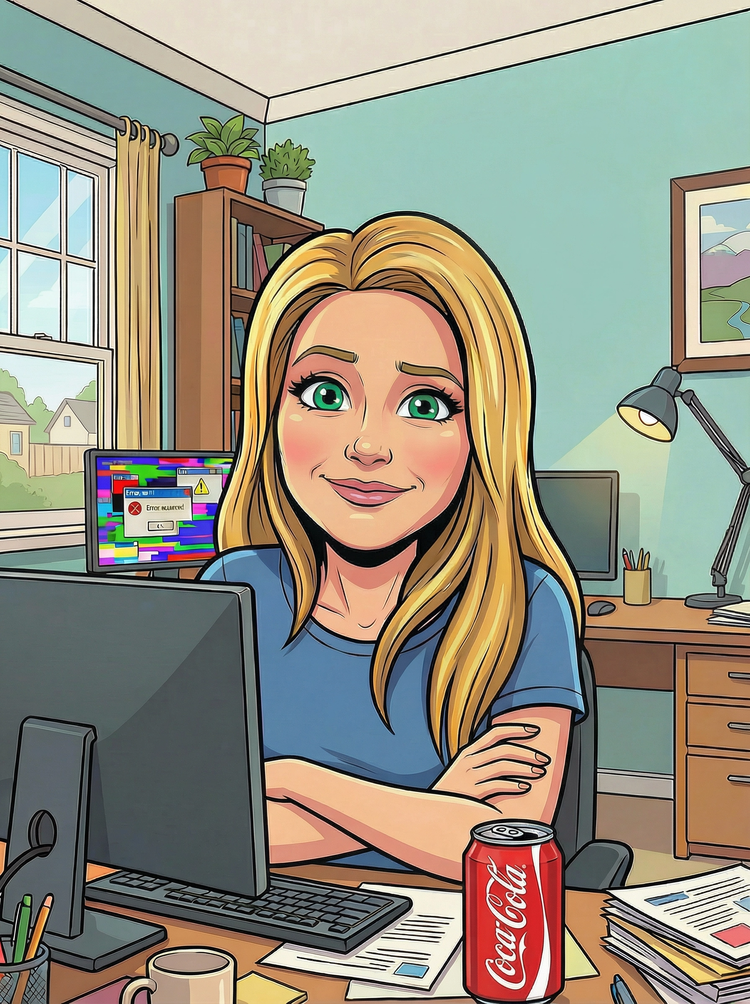
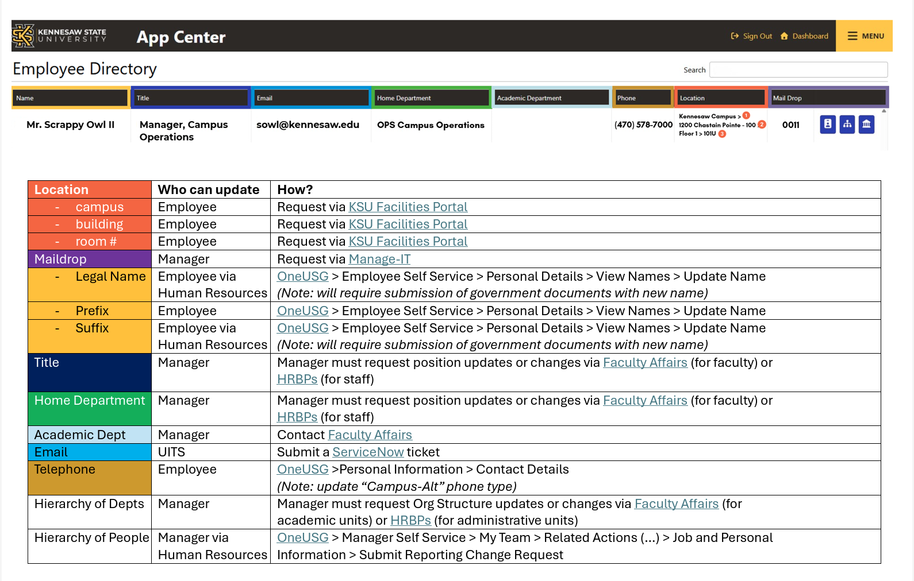
The StratComm Web Team Cannot:
Sorry!!!
Faculty Web: Create/edit any facultyweb.kennesaw.edu pages. Please submit a ticket and it is routed to EAS - Web Services and Mobile Development (UITS).
Directory Info: Location/Phone Number
Name Changes: Employee & HR
Email Address: Submit a ticket.
Update catalog or academic map information. Email: catalogs@kennesaw.edu
Faculty/Staff Directory Updates

Slide 27
Resources
Strategic Communications & Marketing Web Team
Governance
Content Review
Content Review Resources
Creating a content inventory – Previous Web CoP Meetings
Web Content Review Process
Content Inventory and Auditing 101 –NN/g
Conducting a Content Audit and Inventory as if you are Organizing a Pantry
Content Inventory, Audit, & Management – Washington State University *
How To: Content Inventory and Audit NN/g
Writing for the Web Quick Guides (coming soon)
How to make Faculty/Staff Directory Updates

Slide 28

Questions?

Slide 29
Meet the Team
Leadership:
Joe Lacy - Director, SEO and Website Strategy
Sharon McAleer - Web Team Manager
Writers:
Josie Carter - Lead Marketing and SEO Copywriter
Malik Jones - Marketing and SEO Copywriter
Webmasters:
Jonathan Gilliam – Senior Webmaster and SEO Specialist
Anthony Matusko - Senior Webmaster and SEO Specialist
Tara Rose - Webmaster and SEO Specialist
Elizabeth Ball - Webmaster and SEO Specialist
Sean Bresnan - Webmaster and SEO Specialist
Matthew Gordon - Webmaster and SEO Specialist

