Slide 1

Web Community of Practice
Strategic Communication Updates & Web Tickets
May.8.2026

Slide 2


Agenda
Welcome
Strategic Communication Updates
  Campus Port Project Summary & Impact (Joe)
  Accessibility Updates (Jonathan)
  Content Inventory Report (Matthew)
  Broken Links Best Practices (Elizabeth)
Created by: Joe Lacy, Jonathan Gilliam, Matthew Gordon, and Elizabeth Ball

Slide 3
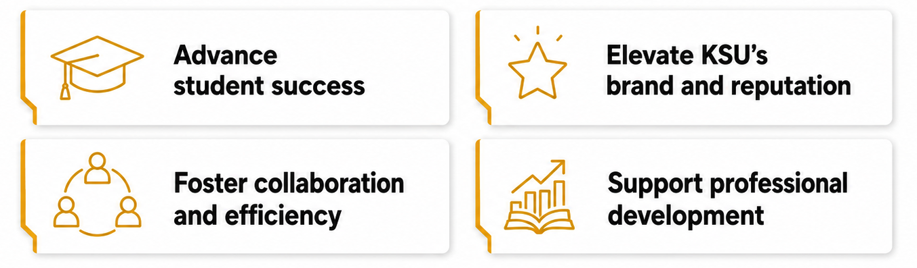
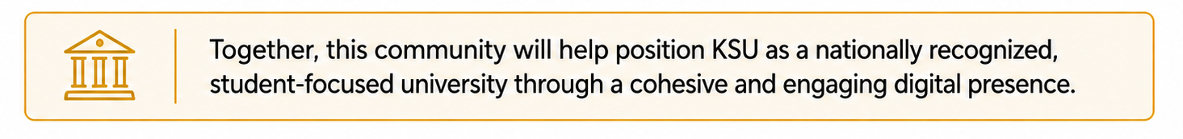
Goals of the Web Community of Practice
The Web Community of Practice brings together KSU web editors to collaborate, share knowledge, and strengthen the university’s online presence. In alignment with KSU’s strategic plan, the community aims to:

Slide 4
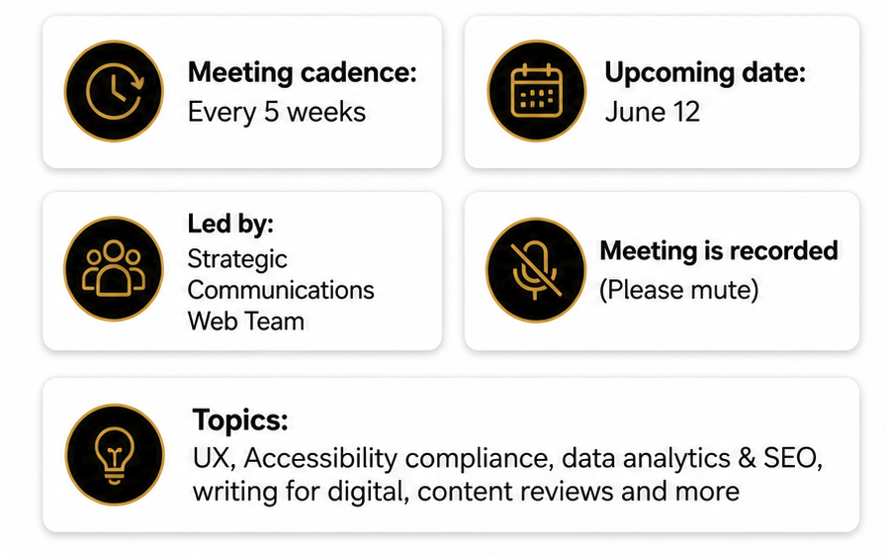


Meeting Schedule

Slide 5
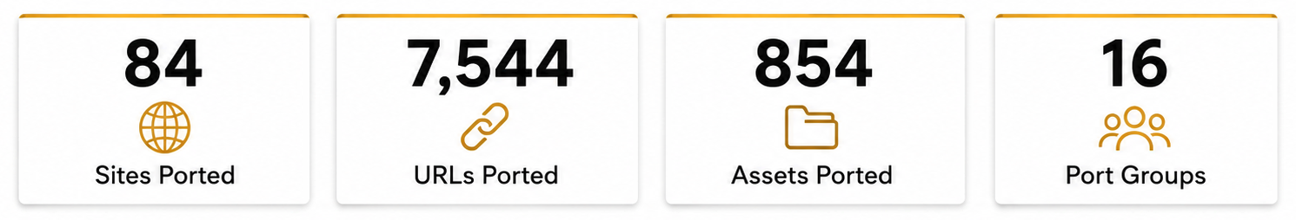
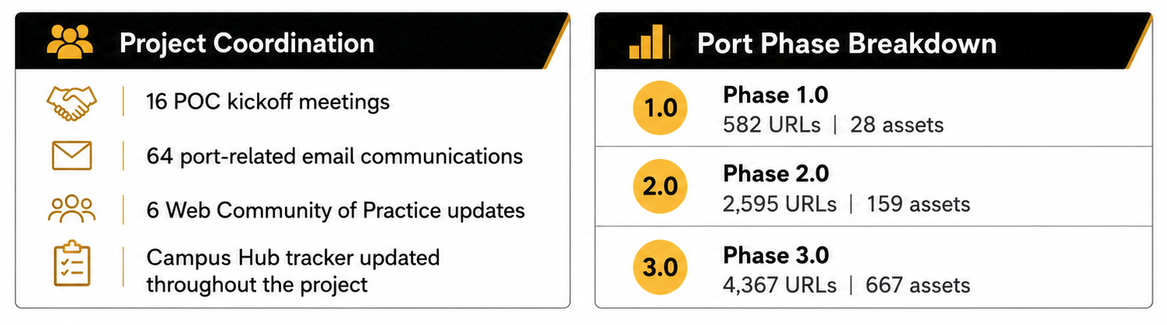
Port Project Update

Slide 6
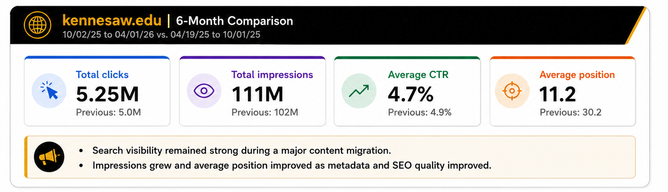
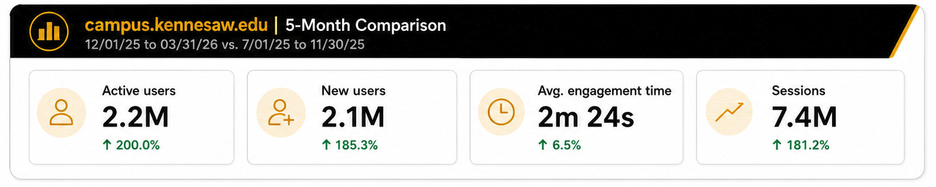
Port Project Impact

Slide 7

Accessibility – Title II
Title II
Deadline Extended to
April 26, 2027
Notes:
Slide 1:
StratComm in collaboration with UITS have been making improvements to the CMS
Jonathan here they are we can select some to mention
Banner Header Tag - Adjusted role attribute for .banner from banner to region.
Republish needed.
List Elements - Moved related attributes and state changes to child paragraph node.
Chevrons - Added aria-hidden attribute to purely decorative icons .info_for_icon and .dropdown_arrow.
Left Navigation - Removed uppercase text-transform style from node.
Campus Home Page - Adjusted z-index style to a higher value to bring .helper-links above other nodes.
Video Banner Play/Pause - Added aria-label attribute to node to convey state change of video.
Video Banner Role - Removed role="presentation" from node and replaced with aria-hidden attribute.
Republish needed.
Utility Labels - Adjusted aria-label attribute for various utility nodes to have a unique identifier.
Removed all caps in the left nav, we improved the play pause button for hero videos, and adjust some accessibility code to improve our template.
As a result, our LA score jumped by 3 points from 77.5 to 80.5. – include a graphic
Next on our roadmap with UITS are accessibility improvements for tables. This will ensure column headers and row headers read with each data point. For example:
Example: Table without proper row headers (no rowspan)


Semester
Freshmen
Sophomores
Fall
250
320
Fall
310
310
Fall
310
460
What a screen reader announces:
“Row 1, 250, 320”
“Row 2, 310, 310”
“Row 3, 310, 460”
Why this is a problem
Users cannot tell what the numbers represent
Data relationships are not conveyed
What’s needed
· Row headers must be properly defined and linked to their data
· Support for rowspan and header associations ensures screen readers announce: “Fall, Freshmen 250, Sophomores 320”
We continue to collaborate with UITS on phase 2 of CMS accessibility improvements, future items include solutions for Math, table alignment, and audio descriptions in hero videos.
Slide 2:
Level Access – the tool has been approved
We have started kick off meetings
2 primary features for this tools to take away are
Automated remediation
Accessibility dashboards
We are collaborating with UITS to set up the remediation widget and as we gather a timeline we will share it.
We are eager to have the widget in place soon.
What the widget does: widget that will automatically correct ADA issues on our site, while we work to fix in the web code. Express it’s a temp fix to give us time to correct long term.
HTML/Images only.
Slide 4:
What archived content means for Title II:
The Four Conditions: All Must Be Met
The content was created before the entity's compliance deadline. (April, 24 2024)
The content is retained solely for reference, research, or recordkeeping purposes.
The content has not been altered after the compliance deadline.
The content is not the subject of active use.
Fail any one of those conditions, and the content does not qualify.
The age of the content doesn't matter. The main question is whether it is still relevant today.
Accommodation Requests: No Exemption When Someone Asks for it to be accessible
Slide 5:
What is next :
Check out the new digital accessibility web page here : <link>
Communicate that a new accessibility web site is available
Show the frame work https://www.kennesaw.edu/accessibility/digital-accessibility-framework.php
Digital resources https://www.kennesaw.edu/accessibility/digital-accessibility.php
This summer Strat Comm will start work on creating an archived template solutions so we are all following that template and present archived content consistently across the site. This si a key req for ttle II.
LA dash board, but in the interim submit a request to Strat Comm if you would like a site improve accessibility report

Slide 8
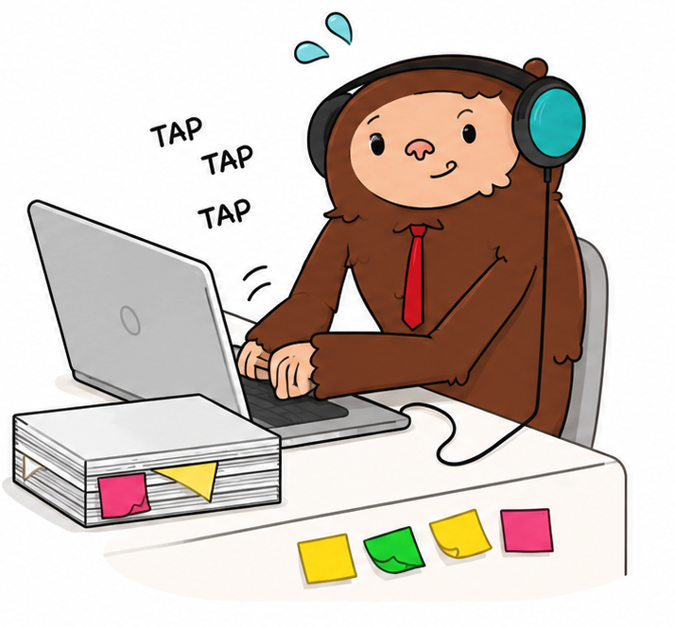
Accessibility – Title II
Title II
Deadline Extended to
April 26, 2027
Notes:
Slide 1:
StratComm in collaboration with UITS have been making improvements to the CMS
Jonathan here they are we can select some to mention
Banner Header Tag - Adjusted role attribute for .banner from banner to region.
Republish needed.
List Elements - Moved related attributes and state changes to child paragraph node.
Chevrons - Added aria-hidden attribute to purely decorative icons .info_for_icon and .dropdown_arrow.
Left Navigation - Removed uppercase text-transform style from node.
Campus Home Page - Adjusted z-index style to a higher value to bring .helper-links above other nodes.
Video Banner Play/Pause - Added aria-label attribute to node to convey state change of video.
Video Banner Role - Removed role="presentation" from node and replaced with aria-hidden attribute.
Republish needed.
Utility Labels - Adjusted aria-label attribute for various utility nodes to have a unique identifier.
Removed all caps in the left nav, we improved the play pause button for hero videos, and adjust some accessibility code to improve our template.
As a result, our LA score jumped by 3 points from 77.5 to 80.5. – include a graphic
Next on our roadmap with UITS are accessibility improvements for tables. This will ensure column headers and row headers read with each data point. For example:
Example: Table without proper row headers (no rowspan)


Semester
Freshmen
Sophomores
Fall
250
320
Fall
310
310
Fall
310
460
What a screen reader announces:
“Row 1, 250, 320”
“Row 2, 310, 310”
“Row 3, 310, 460”
Why this is a problem
Users cannot tell what the numbers represent
Data relationships are not conveyed
What’s needed
· Row headers must be properly defined and linked to their data
· Support for rowspan and header associations ensures screen readers announce: “Fall, Freshmen 250, Sophomores 320”
We continue to collaborate with UITS on phase 2 of CMS accessibility improvements, future items include solutions for Math, table alignment, and audio descriptions in hero videos.
Slide 2:
Level Access – the tool has been approved
We have started kick off meetings
2 primary features for this tools to take away are
Automated remediation
Accessibility dashboards
We are collaborating with UITS to set up the remediation widget and as we gather a timeline we will share it.
We are eager to have the widget in place soon.
What the widget does: widget that will automatically correct ADA issues on our site, while we work to fix in the web code. Express it’s a temp fix to give us time to correct long term.
HTML/Images only.
Slide 4:
What archived content means for Title II:
The Four Conditions: All Must Be Met
The content was created before the entity's compliance deadline. (April, 24 2024)
The content is retained solely for reference, research, or recordkeeping purposes.
The content has not been altered after the compliance deadline.
The content is not the subject of active use.
Fail any one of those conditions, and the content does not qualify.
The age of the content doesn't matter. The main question is whether it is still relevant today.
Accommodation Requests: No Exemption When Someone Asks for it to be accessible
Slide 5:
What is next :
Check out the new digital accessibility web page here : <link>
Communicate that a new accessibility web site is available
Show the frame work https://www.kennesaw.edu/accessibility/digital-accessibility-framework.php
Digital resources https://www.kennesaw.edu/accessibility/digital-accessibility.php
This summer Strat Comm will start work on creating an archived template solutions so we are all following that template and present archived content consistently across the site. This si a key req for ttle II.
LA dash board, but in the interim submit a request to Strat Comm if you would like a site improve accessibility report

Slide 9
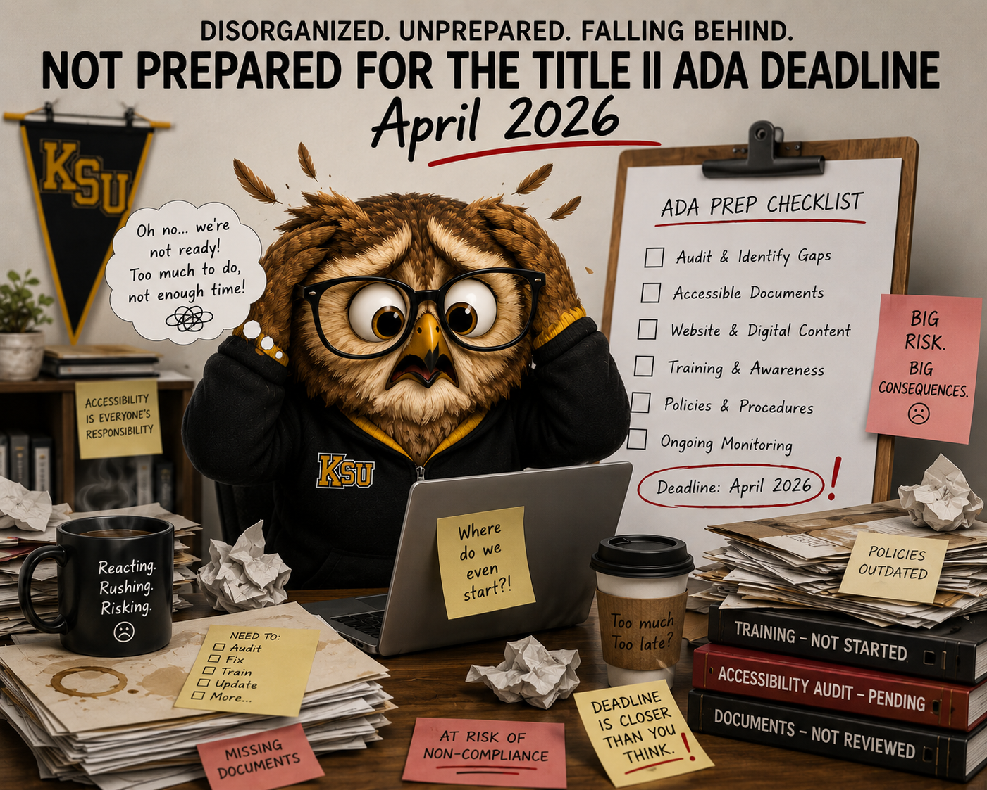
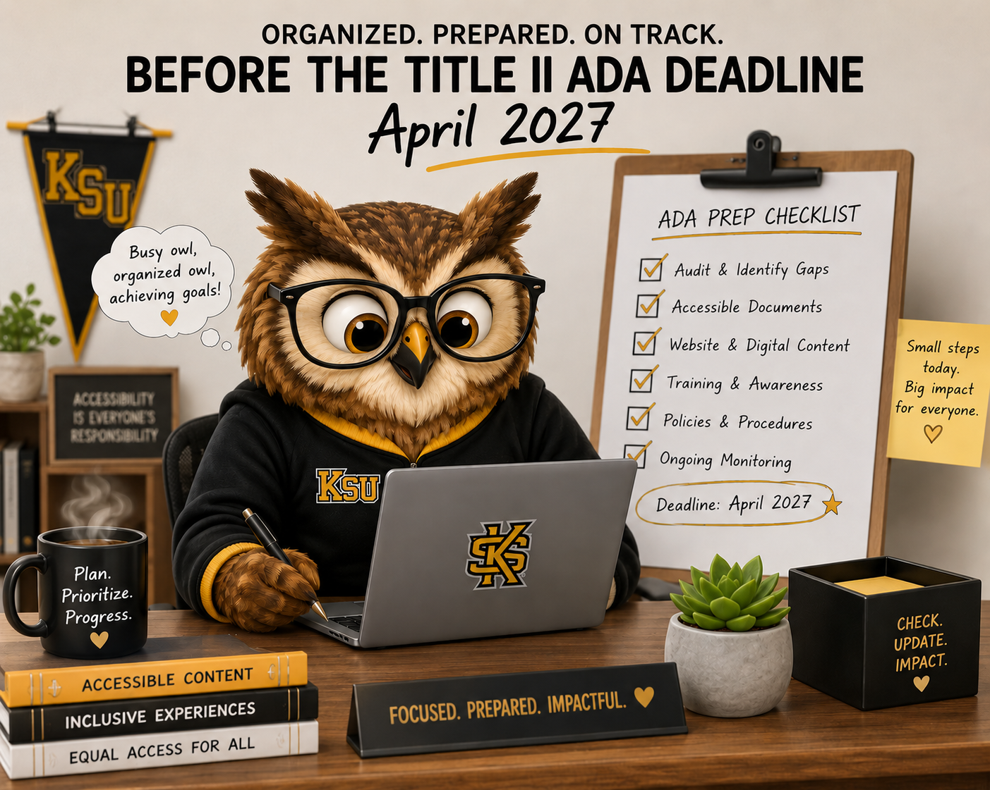
Title II Deadline Extended
April 2026
April 2027
Extended to April 26, 2027
Notes:
Slide 1:
StratComm in collaboration with UITS have been making improvements to the CMS
Jonathan here they are we can select some to mention
Banner Header Tag - Adjusted role attribute for .banner from banner to region.
Republish needed.
List Elements - Moved related attributes and state changes to child paragraph node.
Chevrons - Added aria-hidden attribute to purely decorative icons .info_for_icon and .dropdown_arrow.
Left Navigation - Removed uppercase text-transform style from node.
Campus Home Page - Adjusted z-index style to a higher value to bring .helper-links above other nodes.
Video Banner Play/Pause - Added aria-label attribute to node to convey state change of video.
Video Banner Role - Removed role="presentation" from node and replaced with aria-hidden attribute.
Republish needed.
Utility Labels - Adjusted aria-label attribute for various utility nodes to have a unique identifier.
Removed all caps in the left nav, we improved the play pause button for hero videos, and adjust some accessibility code to improve our template.
As a result, our LA score jumped by 3 points from 77.5 to 80.5. – include a graphic
Next on our roadmap with UITS are accessibility improvements for tables. This will ensure column headers and row headers read with each data point. For example:
Example: Table without proper row headers (no rowspan)


Semester
Freshmen
Sophomores
Fall
250
320
Fall
310
310
Fall
310
460
What a screen reader announces:
“Row 1, 250, 320”
“Row 2, 310, 310”
“Row 3, 310, 460”
Why this is a problem
Users cannot tell what the numbers represent
Data relationships are not conveyed
What’s needed
· Row headers must be properly defined and linked to their data
· Support for rowspan and header associations ensures screen readers announce: “Fall, Freshmen 250, Sophomores 320”
We continue to collaborate with UITS on phase 2 of CMS accessibility improvements, future items include solutions for Math, table alignment, and audio descriptions in hero videos.
Slide 2:
Level Access – the tool has been approved
We have started kick off meetings
2 primary features for this tools to take away are
Automated remediation
Accessibility dashboards
We are collaborating with UITS to set up the remediation widget and as we gather a timeline we will share it.
We are eager to have the widget in place soon.
What the widget does: widget that will automatically correct ADA issues on our site, while we work to fix in the web code. Express it’s a temp fix to give us time to correct long term.
HTML/Images only.
Slide 4:
What archived content means for Title II:
The Four Conditions: All Must Be Met
The content was created before the entity's compliance deadline. (April, 24 2024)
The content is retained solely for reference, research, or recordkeeping purposes.
The content has not been altered after the compliance deadline.
The content is not the subject of active use.
Fail any one of those conditions, and the content does not qualify.
The age of the content doesn't matter. The main question is whether it is still relevant today.
Accommodation Requests: No Exemption When Someone Asks for it to be accessible
Slide 5:
What is next :
Check out the new digital accessibility web page here : <link>
Communicate that a new accessibility web site is available
Show the frame work https://www.kennesaw.edu/accessibility/digital-accessibility-framework.php
Digital resources https://www.kennesaw.edu/accessibility/digital-accessibility.php
This summer Strat Comm will start work on creating an archived template solutions so we are all following that template and present archived content consistently across the site. This si a key req for ttle II.
LA dash board, but in the interim submit a request to Strat Comm if you would like a site improve accessibility report

Slide 10
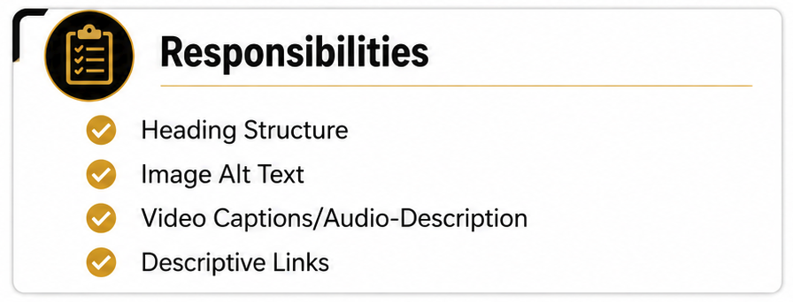
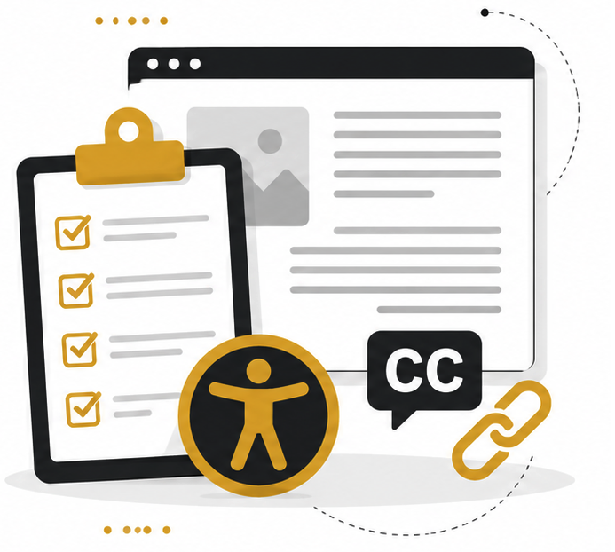
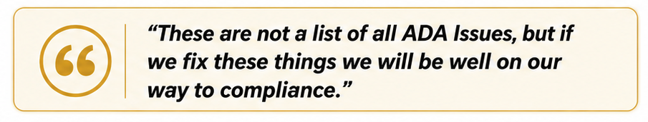
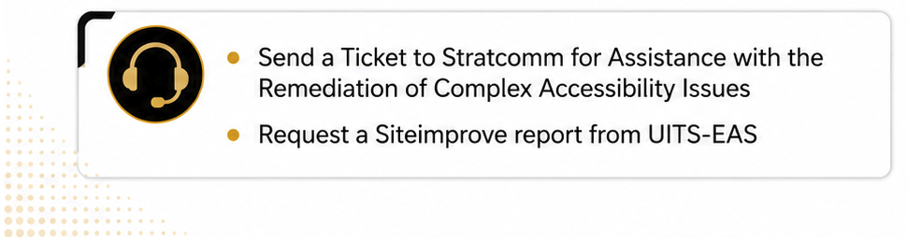
Web POCs - Accessibility Tasks
Notes:
Slide 1:
StratComm in collaboration with UITS have been making improvements to the CMS
Jonathan here they are we can select some to mention
Banner Header Tag - Adjusted role attribute for .banner from banner to region.
Republish needed.
List Elements - Moved related attributes and state changes to child paragraph node.
Chevrons - Added aria-hidden attribute to purely decorative icons .info_for_icon and .dropdown_arrow.
Left Navigation - Removed uppercase text-transform style from node.
Campus Home Page - Adjusted z-index style to a higher value to bring .helper-links above other nodes.
Video Banner Play/Pause - Added aria-label attribute to node to convey state change of video.
Video Banner Role - Removed role="presentation" from node and replaced with aria-hidden attribute.
Republish needed.
Utility Labels - Adjusted aria-label attribute for various utility nodes to have a unique identifier.
Removed all caps in the left nav, we improved the play pause button for hero videos, and adjust some accessibility code to improve our template.
As a result, our LA score jumped by 3 points from 77.5 to 80.5. – include a graphic
Next on our roadmap with UITS are accessibility improvements for tables. This will ensure column headers and row headers read with each data point. For example:
Example: Table without proper row headers (no rowspan)


Semester
Freshmen
Sophomores
Fall
250
320
Fall
310
310
Fall
310
460
What a screen reader announces:
“Row 1, 250, 320”
“Row 2, 310, 310”
“Row 3, 310, 460”
Why this is a problem
Users cannot tell what the numbers represent
Data relationships are not conveyed
What’s needed
· Row headers must be properly defined and linked to their data
· Support for rowspan and header associations ensures screen readers announce: “Fall, Freshmen 250, Sophomores 320”
We continue to collaborate with UITS on phase 2 of CMS accessibility improvements, future items include solutions for Math, table alignment, and audio descriptions in hero videos.
Slide 2:
Level Access – the tool has been approved
We have started kick off meetings
2 primary features for this tools to take away are
Automated remediation
Accessibility dashboards
We are collaborating with UITS to set up the remediation widget and as we gather a timeline we will share it.
We are eager to have the widget in place soon.
What the widget does: widget that will automatically correct ADA issues on our site, while we work to fix in the web code. Express it’s a temp fix to give us time to correct long term.
HTML/Images only.
Slide 4:
What archived content means for Title II:
The Four Conditions: All Must Be Met
The content was created before the entity's compliance deadline. (April, 24 2024)
The content is retained solely for reference, research, or recordkeeping purposes.
The content has not been altered after the compliance deadline.
The content is not the subject of active use.
Fail any one of those conditions, and the content does not qualify.
The age of the content doesn't matter. The main question is whether it is still relevant today.
Accommodation Requests: No Exemption When Someone Asks for it to be accessible
Slide 5:
What is next :
Check out the new digital accessibility web page here : <link>
Communicate that a new accessibility web site is available
Show the frame work https://www.kennesaw.edu/accessibility/digital-accessibility-framework.php
Digital resources https://www.kennesaw.edu/accessibility/digital-accessibility.php
This summer Strat Comm will start work on creating an archived template solutions so we are all following that template and present archived content consistently across the site. This si a key req for ttle II.
LA dash board, but in the interim submit a request to Strat Comm if you would like a site improve accessibility report

Slide 11


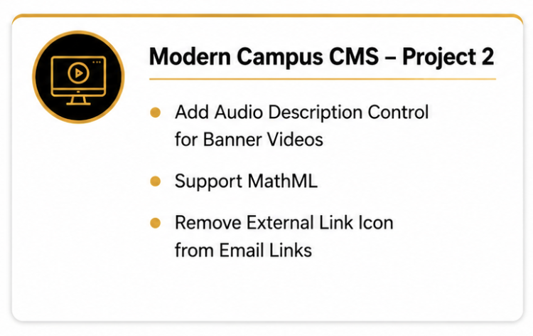
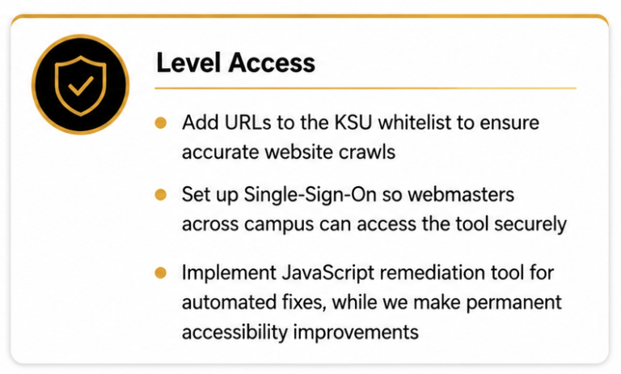
UITS & StratComm Collaboration
Notes:
Slide 1:
StratComm in collaboration with UITS have been making improvements to the CMS
Jonathan here they are we can select some to mention
Banner Header Tag - Adjusted role attribute for .banner from banner to region.
Republish needed.
List Elements - Moved related attributes and state changes to child paragraph node.
Chevrons - Added aria-hidden attribute to purely decorative icons .info_for_icon and .dropdown_arrow.
Left Navigation - Removed uppercase text-transform style from node.
Campus Home Page - Adjusted z-index style to a higher value to bring .helper-links above other nodes.
Video Banner Play/Pause - Added aria-label attribute to node to convey state change of video.
Video Banner Role - Removed role="presentation" from node and replaced with aria-hidden attribute.
Republish needed.
Utility Labels - Adjusted aria-label attribute for various utility nodes to have a unique identifier.
Removed all caps in the left nav, we improved the play pause button for hero videos, and adjust some accessibility code to improve our template.
As a result, our LA score jumped by 3 points from 77.5 to 80.5. – include a graphic
Next on our roadmap with UITS are accessibility improvements for tables. This will ensure column headers and row headers read with each data point. For example:
Example: Table without proper row headers (no rowspan)


Semester
Freshmen
Sophomores
Fall
250
320
Fall
310
310
Fall
310
460
What a screen reader announces:
“Row 1, 250, 320”
“Row 2, 310, 310”
“Row 3, 310, 460”
Why this is a problem
Users cannot tell what the numbers represent
Data relationships are not conveyed
What’s needed
· Row headers must be properly defined and linked to their data
· Support for rowspan and header associations ensures screen readers announce: “Fall, Freshmen 250, Sophomores 320”
We continue to collaborate with UITS on phase 2 of CMS accessibility improvements, future items include solutions for Math, table alignment, and audio descriptions in hero videos.
Slide 2:
Level Access – the tool has been approved
We have started kick off meetings
2 primary features for this tools to take away are
Automated remediation
Accessibility dashboards
We are collaborating with UITS to set up the remediation widget and as we gather a timeline we will share it.
We are eager to have the widget in place soon.
What the widget does: widget that will automatically correct ADA issues on our site, while we work to fix in the web code. Express it’s a temp fix to give us time to correct long term.
HTML/Images only.
Slide 4:
What archived content means for Title II:
The Four Conditions: All Must Be Met
The content was created before the entity's compliance deadline. (April, 24 2024)
The content is retained solely for reference, research, or recordkeeping purposes.
The content has not been altered after the compliance deadline.
The content is not the subject of active use.
Fail any one of those conditions, and the content does not qualify.
The age of the content doesn't matter. The main question is whether it is still relevant today.
Accommodation Requests: No Exemption When Someone Asks for it to be accessible
Slide 5:
What is next :
Check out the new digital accessibility web page here : <link>
Communicate that a new accessibility web site is available
Show the frame work https://www.kennesaw.edu/accessibility/digital-accessibility-framework.php
Digital resources https://www.kennesaw.edu/accessibility/digital-accessibility.php
This summer Strat Comm will start work on creating an archived template solutions so we are all following that template and present archived content consistently across the site. This si a key req for ttle II.
LA dash board, but in the interim submit a request to Strat Comm if you would like a site improve accessibility report

Slide 12
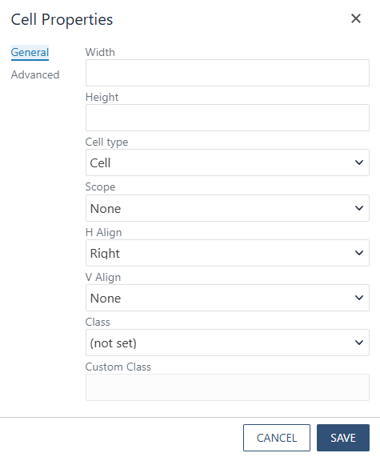
New Table Options
Users can adjust the following table cell properties:
Width
Height
Cell Type
  Cell
  Header Cell
Scope
  Row
  Column
  Row Group
  Column Group
Horizontal Align
  None
  Left
  Right
  Center
Vertical Align
  Top
  Middle
  Bottom
Notes:
Slide 1:
StratComm in collaboration with UITS have been making improvements to the CMS
Jonathan here they are we can select some to mention
Banner Header Tag - Adjusted role attribute for .banner from banner to region.
Republish needed.
List Elements - Moved related attributes and state changes to child paragraph node.
Chevrons - Added aria-hidden attribute to purely decorative icons .info_for_icon and .dropdown_arrow.
Left Navigation - Removed uppercase text-transform style from node.
Campus Home Page - Adjusted z-index style to a higher value to bring .helper-links above other nodes.
Video Banner Play/Pause - Added aria-label attribute to node to convey state change of video.
Video Banner Role - Removed role="presentation" from node and replaced with aria-hidden attribute.
Republish needed.
Utility Labels - Adjusted aria-label attribute for various utility nodes to have a unique identifier.
Removed all caps in the left nav, we improved the play pause button for hero videos, and adjust some accessibility code to improve our template.
As a result, our LA score jumped by 3 points from 77.5 to 80.5. – include a graphic
Next on our roadmap with UITS are accessibility improvements for tables. This will ensure column headers and row headers read with each data point. For example:
Example: Table without proper row headers (no rowspan)


Semester
Freshmen
Sophomores
Fall
250
320
Fall
310
310
Fall
310
460
What a screen reader announces:
“Row 1, 250, 320”
“Row 2, 310, 310”
“Row 3, 310, 460”
Why this is a problem
Users cannot tell what the numbers represent
Data relationships are not conveyed
What’s needed
· Row headers must be properly defined and linked to their data
· Support for rowspan and header associations ensures screen readers announce: “Fall, Freshmen 250, Sophomores 320”
We continue to collaborate with UITS on phase 2 of CMS accessibility improvements, future items include solutions for Math, table alignment, and audio descriptions in hero videos.
Slide 2:
Level Access – the tool has been approved
We have started kick off meetings
2 primary features for this tools to take away are
Automated remediation
Accessibility dashboards
We are collaborating with UITS to set up the remediation widget and as we gather a timeline we will share it.
We are eager to have the widget in place soon.
What the widget does: widget that will automatically correct ADA issues on our site, while we work to fix in the web code. Express it’s a temp fix to give us time to correct long term.
HTML/Images only.
Slide 4:
What archived content means for Title II:
The Four Conditions: All Must Be Met
The content was created before the entity's compliance deadline. (April, 24 2024)
The content is retained solely for reference, research, or recordkeeping purposes.
The content has not been altered after the compliance deadline.
The content is not the subject of active use.
Fail any one of those conditions, and the content does not qualify.
The age of the content doesn't matter. The main question is whether it is still relevant today.
Accommodation Requests: No Exemption When Someone Asks for it to be accessible
Slide 5:
What is next :
Check out the new digital accessibility web page here : <link>
Communicate that a new accessibility web site is available
Show the frame work https://www.kennesaw.edu/accessibility/digital-accessibility-framework.php
Digital resources https://www.kennesaw.edu/accessibility/digital-accessibility.php
This summer Strat Comm will start work on creating an archived template solutions so we are all following that template and present archived content consistently across the site. This si a key req for ttle II.
LA dash board, but in the interim submit a request to Strat Comm if you would like a site improve accessibility report

Slide 13
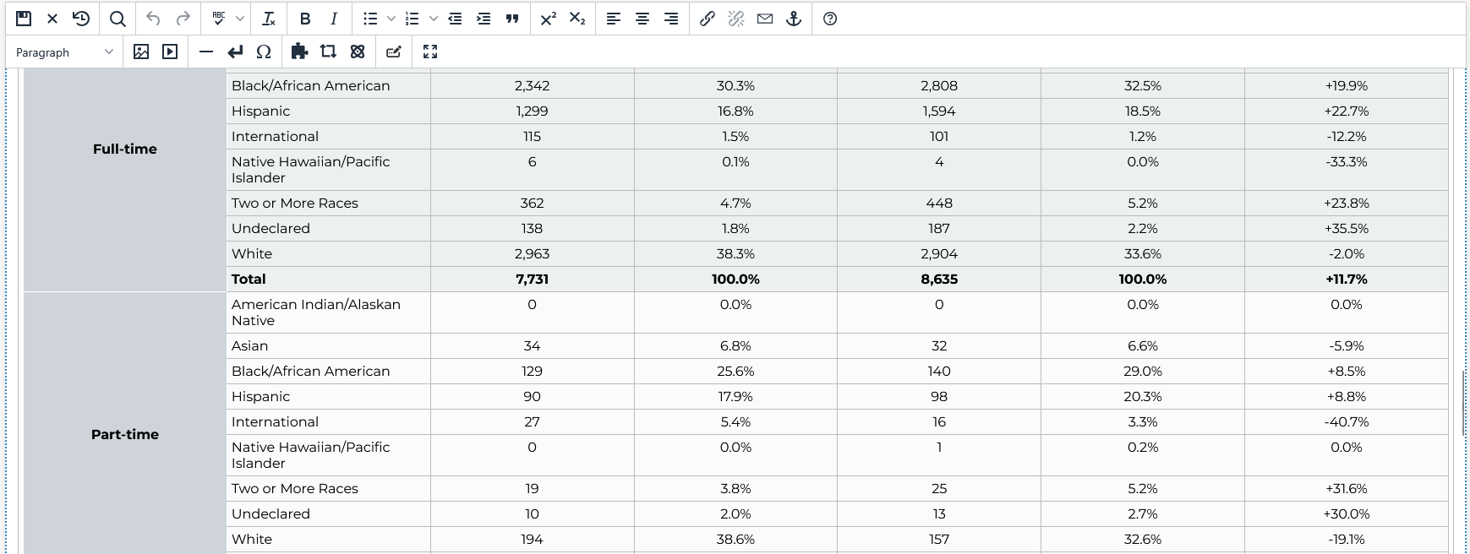
Table Updates – ADA Impacts
Sample Showing Row Span (Scope > Row)
Notes:
Slide 1:
StratComm in collaboration with UITS have been making improvements to the CMS
Jonathan here they are we can select some to mention
Banner Header Tag - Adjusted role attribute for .banner from banner to region.
Republish needed.
List Elements - Moved related attributes and state changes to child paragraph node.
Chevrons - Added aria-hidden attribute to purely decorative icons .info_for_icon and .dropdown_arrow.
Left Navigation - Removed uppercase text-transform style from node.
Campus Home Page - Adjusted z-index style to a higher value to bring .helper-links above other nodes.
Video Banner Play/Pause - Added aria-label attribute to node to convey state change of video.
Video Banner Role - Removed role="presentation" from node and replaced with aria-hidden attribute.
Republish needed.
Utility Labels - Adjusted aria-label attribute for various utility nodes to have a unique identifier.
Removed all caps in the left nav, we improved the play pause button for hero videos, and adjust some accessibility code to improve our template.
As a result, our LA score jumped by 3 points from 77.5 to 80.5. – include a graphic
Next on our roadmap with UITS are accessibility improvements for tables. This will ensure column headers and row headers read with each data point. For example:
Example: Table without proper row headers (no rowspan)


Semester
Freshmen
Sophomores
Fall
250
320
Fall
310
310
Fall
310
460
What a screen reader announces:
“Row 1, 250, 320”
“Row 2, 310, 310”
“Row 3, 310, 460”
Why this is a problem
Users cannot tell what the numbers represent
Data relationships are not conveyed
What’s needed
· Row headers must be properly defined and linked to their data
· Support for rowspan and header associations ensures screen readers announce: “Fall, Freshmen 250, Sophomores 320”
We continue to collaborate with UITS on phase 2 of CMS accessibility improvements, future items include solutions for Math, table alignment, and audio descriptions in hero videos.
Slide 2:
Level Access – the tool has been approved
We have started kick off meetings
2 primary features for this tools to take away are
Automated remediation
Accessibility dashboards
We are collaborating with UITS to set up the remediation widget and as we gather a timeline we will share it.
We are eager to have the widget in place soon.
What the widget does: widget that will automatically correct ADA issues on our site, while we work to fix in the web code. Express it’s a temp fix to give us time to correct long term.
HTML/Images only.
Slide 4:
What archived content means for Title II:
The Four Conditions: All Must Be Met
The content was created before the entity's compliance deadline. (April, 24 2024)
The content is retained solely for reference, research, or recordkeeping purposes.
The content has not been altered after the compliance deadline.
The content is not the subject of active use.
Fail any one of those conditions, and the content does not qualify.
The age of the content doesn't matter. The main question is whether it is still relevant today.
Accommodation Requests: No Exemption When Someone Asks for it to be accessible
Slide 5:
What is next :
Check out the new digital accessibility web page here : <link>
Communicate that a new accessibility web site is available
Show the frame work https://www.kennesaw.edu/accessibility/digital-accessibility-framework.php
Digital resources https://www.kennesaw.edu/accessibility/digital-accessibility.php
This summer Strat Comm will start work on creating an archived template solutions so we are all following that template and present archived content consistently across the site. This si a key req for ttle II.
LA dash board, but in the interim submit a request to Strat Comm if you would like a site improve accessibility report
Suggested note
WCAG Criteria impacted
WCAG 1.3.1 — Info and Relationships (Level A)
Structural and semantic relationships must be preserved so that assistive technologies can convey meaning.
Data tables must indicate headers and their scope so users can associate data cells with the correct header.
Previously Modern Campus data tables did not meet accessibility standards. Gaps in how row headers are structured prevent screen readers from correctly understanding the data.

Slide 14
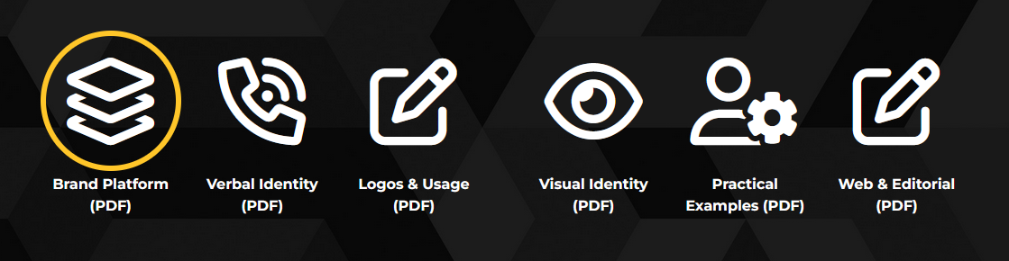
Icons and Channel Usage
  FontAwesome Icons
    Coded as "hidden"
    <i class="fa-regular fa-layer-group"
    aria-hidden="true"></i>
    Should only be decorative
  Channels Snippet
    Coded as "button"
    <a role="button" href="..link..">
    Do not use without links
    Not a substitute for Image Gallery
Notes:
Slide 1:
StratComm in collaboration with UITS have been making improvements to the CMS
Jonathan here they are we can select some to mention
Banner Header Tag - Adjusted role attribute for .banner from banner to region.
Republish needed.
List Elements - Moved related attributes and state changes to child paragraph node.
Chevrons - Added aria-hidden attribute to purely decorative icons .info_for_icon and .dropdown_arrow.
Left Navigation - Removed uppercase text-transform style from node.
Campus Home Page - Adjusted z-index style to a higher value to bring .helper-links above other nodes.
Video Banner Play/Pause - Added aria-label attribute to node to convey state change of video.
Video Banner Role - Removed role="presentation" from node and replaced with aria-hidden attribute.
Republish needed.
Utility Labels - Adjusted aria-label attribute for various utility nodes to have a unique identifier.
Removed all caps in the left nav, we improved the play pause button for hero videos, and adjust some accessibility code to improve our template.
As a result, our LA score jumped by 3 points from 77.5 to 80.5. – include a graphic
Next on our roadmap with UITS are accessibility improvements for tables. This will ensure column headers and row headers read with each data point. For example:
Example: Table without proper row headers (no rowspan)


Semester
Freshmen
Sophomores
Fall
250
320
Fall
310
310
Fall
310
460
What a screen reader announces:
“Row 1, 250, 320”
“Row 2, 310, 310”
“Row 3, 310, 460”
Why this is a problem
Users cannot tell what the numbers represent
Data relationships are not conveyed
What’s needed
· Row headers must be properly defined and linked to their data
· Support for rowspan and header associations ensures screen readers announce: “Fall, Freshmen 250, Sophomores 320”
We continue to collaborate with UITS on phase 2 of CMS accessibility improvements, future items include solutions for Math, table alignment, and audio descriptions in hero videos.
Slide 2:
Level Access – the tool has been approved
We have started kick off meetings
2 primary features for this tools to take away are
Automated remediation
Accessibility dashboards
We are collaborating with UITS to set up the remediation widget and as we gather a timeline we will share it.
We are eager to have the widget in place soon.
What the widget does: widget that will automatically correct ADA issues on our site, while we work to fix in the web code. Express it’s a temp fix to give us time to correct long term.
HTML/Images only.
Slide 4:
What archived content means for Title II:
The Four Conditions: All Must Be Met
The content was created before the entity's compliance deadline. (April, 24 2024)
The content is retained solely for reference, research, or recordkeeping purposes.
The content has not been altered after the compliance deadline.
The content is not the subject of active use.
Fail any one of those conditions, and the content does not qualify.
The age of the content doesn't matter. The main question is whether it is still relevant today.
Accommodation Requests: No Exemption When Someone Asks for it to be accessible
Slide 5:
What is next :
Check out the new digital accessibility web page here : <link>
Communicate that a new accessibility web site is available
Show the frame work https://www.kennesaw.edu/accessibility/digital-accessibility-framework.php
Digital resources https://www.kennesaw.edu/accessibility/digital-accessibility.php
This summer Strat Comm will start work on creating an archived template solutions so we are all following that template and present archived content consistently across the site. This si a key req for ttle II.
LA dash board, but in the interim submit a request to Strat Comm if you would like a site improve accessibility report

Slide 15

Get JAWS
Go to https://desktopsoftware.kennesaw.edu/
Click on "FUSION"
Click the "Get it Now" button
On the next page, enter your email address to sign in, and fill out the form
Note: Make sure you have time to configure JAWS
Notes:
Slide 1:
StratComm in collaboration with UITS have been making improvements to the CMS
Jonathan here they are we can select some to mention
Banner Header Tag - Adjusted role attribute for .banner from banner to region.
Republish needed.
List Elements - Moved related attributes and state changes to child paragraph node.
Chevrons - Added aria-hidden attribute to purely decorative icons .info_for_icon and .dropdown_arrow.
Left Navigation - Removed uppercase text-transform style from node.
Campus Home Page - Adjusted z-index style to a higher value to bring .helper-links above other nodes.
Video Banner Play/Pause - Added aria-label attribute to node to convey state change of video.
Video Banner Role - Removed role="presentation" from node and replaced with aria-hidden attribute.
Republish needed.
Utility Labels - Adjusted aria-label attribute for various utility nodes to have a unique identifier.
Removed all caps in the left nav, we improved the play pause button for hero videos, and adjust some accessibility code to improve our template.
As a result, our LA score jumped by 3 points from 77.5 to 80.5. – include a graphic
Next on our roadmap with UITS are accessibility improvements for tables. This will ensure column headers and row headers read with each data point. For example:
Example: Table without proper row headers (no rowspan)


Semester
Freshmen
Sophomores
Fall
250
320
Fall
310
310
Fall
310
460
What a screen reader announces:
“Row 1, 250, 320”
“Row 2, 310, 310”
“Row 3, 310, 460”
Why this is a problem
Users cannot tell what the numbers represent
Data relationships are not conveyed
What’s needed
· Row headers must be properly defined and linked to their data
· Support for rowspan and header associations ensures screen readers announce: “Fall, Freshmen 250, Sophomores 320”
We continue to collaborate with UITS on phase 2 of CMS accessibility improvements, future items include solutions for Math, table alignment, and audio descriptions in hero videos.
Slide 2:
Level Access – the tool has been approved
We have started kick off meetings
2 primary features for this tools to take away are
Automated remediation
Accessibility dashboards
We are collaborating with UITS to set up the remediation widget and as we gather a timeline we will share it.
We are eager to have the widget in place soon.
What the widget does: widget that will automatically correct ADA issues on our site, while we work to fix in the web code. Express it’s a temp fix to give us time to correct long term.
HTML/Images only.
Slide 4:
What archived content means for Title II:
The Four Conditions: All Must Be Met
The content was created before the entity's compliance deadline. (April, 24 2024)
The content is retained solely for reference, research, or recordkeeping purposes.
The content has not been altered after the compliance deadline.
The content is not the subject of active use.
Fail any one of those conditions, and the content does not qualify.
The age of the content doesn't matter. The main question is whether it is still relevant today.
Accommodation Requests: No Exemption When Someone Asks for it to be accessible
Slide 5:
What is next :
Check out the new digital accessibility web page here : <link>
Communicate that a new accessibility web site is available
Show the frame work https://www.kennesaw.edu/accessibility/digital-accessibility-framework.php
Digital resources https://www.kennesaw.edu/accessibility/digital-accessibility.php
This summer Strat Comm will start work on creating an archived template solutions so we are all following that template and present archived content consistently across the site. This si a key req for ttle II.
LA dash board, but in the interim submit a request to Strat Comm if you would like a site improve accessibility report

Slide 16
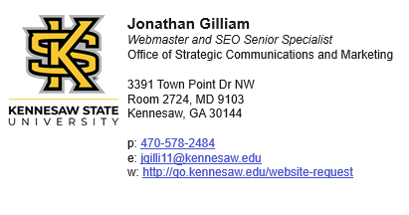
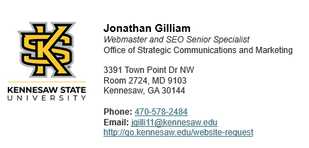
Email Signature Update
Update Your Email Signature
https://emailsignature.kennesaw.edu/
(old version)
(new version)
Notes:
Slide 1:
StratComm in collaboration with UITS have been making improvements to the CMS
Jonathan here they are we can select some to mention
Banner Header Tag - Adjusted role attribute for .banner from banner to region.
Republish needed.
List Elements - Moved related attributes and state changes to child paragraph node.
Chevrons - Added aria-hidden attribute to purely decorative icons .info_for_icon and .dropdown_arrow.
Left Navigation - Removed uppercase text-transform style from node.
Campus Home Page - Adjusted z-index style to a higher value to bring .helper-links above other nodes.
Video Banner Play/Pause - Added aria-label attribute to node to convey state change of video.
Video Banner Role - Removed role="presentation" from node and replaced with aria-hidden attribute.
Republish needed.
Utility Labels - Adjusted aria-label attribute for various utility nodes to have a unique identifier.
Removed all caps in the left nav, we improved the play pause button for hero videos, and adjust some accessibility code to improve our template.
As a result, our LA score jumped by 3 points from 77.5 to 80.5. – include a graphic
Next on our roadmap with UITS are accessibility improvements for tables. This will ensure column headers and row headers read with each data point. For example:
Example: Table without proper row headers (no rowspan)


Semester
Freshmen
Sophomores
Fall
250
320
Fall
310
310
Fall
310
460
What a screen reader announces:
“Row 1, 250, 320”
“Row 2, 310, 310”
“Row 3, 310, 460”
Why this is a problem
Users cannot tell what the numbers represent
Data relationships are not conveyed
What’s needed
· Row headers must be properly defined and linked to their data
· Support for rowspan and header associations ensures screen readers announce: “Fall, Freshmen 250, Sophomores 320”
We continue to collaborate with UITS on phase 2 of CMS accessibility improvements, future items include solutions for Math, table alignment, and audio descriptions in hero videos.
Slide 2:
Level Access – the tool has been approved
We have started kick off meetings
2 primary features for this tools to take away are
Automated remediation
Accessibility dashboards
We are collaborating with UITS to set up the remediation widget and as we gather a timeline we will share it.
We are eager to have the widget in place soon.
What the widget does: widget that will automatically correct ADA issues on our site, while we work to fix in the web code. Express it’s a temp fix to give us time to correct long term.
HTML/Images only.
Slide 4:
What archived content means for Title II:
The Four Conditions: All Must Be Met
The content was created before the entity's compliance deadline. (April, 24 2024)
The content is retained solely for reference, research, or recordkeeping purposes.
The content has not been altered after the compliance deadline.
The content is not the subject of active use.
Fail any one of those conditions, and the content does not qualify.
The age of the content doesn't matter. The main question is whether it is still relevant today.
Accommodation Requests: No Exemption When Someone Asks for it to be accessible
Slide 5:
What is next :
Check out the new digital accessibility web page here : <link>
Communicate that a new accessibility web site is available
Show the frame work https://www.kennesaw.edu/accessibility/digital-accessibility-framework.php
Digital resources https://www.kennesaw.edu/accessibility/digital-accessibility.php
This summer Strat Comm will start work on creating an archived template solutions so we are all following that template and present archived content consistently across the site. This si a key req for ttle II.
LA dash board, but in the interim submit a request to Strat Comm if you would like a site improve accessibility report

Slide 17
What's Next for ADA
Develop an Archive Template for Archived Content
Forms - reCAPTCHA
How to post Music on the website
Accessibility Resources
  New Digital Accessibility Webpage:
  https://www.kennesaw.edu/accessibility/digital-accessibility.php
  New PDF Accessibility Webpage:
  http://go.kennesaw.edu/pdf-accessibility
  New Digital Accessibility Framework:
  https://www.kennesaw.edu/accessibility/digital-accessibility-framework.php
Notes:
Slide 1:
StratComm in collaboration with UITS have been making improvements to the CMS
Jonathan here they are we can select some to mention
Banner Header Tag - Adjusted role attribute for .banner from banner to region.
Republish needed.
List Elements - Moved related attributes and state changes to child paragraph node.
Chevrons - Added aria-hidden attribute to purely decorative icons .info_for_icon and .dropdown_arrow.
Left Navigation - Removed uppercase text-transform style from node.
Campus Home Page - Adjusted z-index style to a higher value to bring .helper-links above other nodes.
Video Banner Play/Pause - Added aria-label attribute to node to convey state change of video.
Video Banner Role - Removed role="presentation" from node and replaced with aria-hidden attribute.
Republish needed.
Utility Labels - Adjusted aria-label attribute for various utility nodes to have a unique identifier.
Removed all caps in the left nav, we improved the play pause button for hero videos, and adjust some accessibility code to improve our template.
As a result, our LA score jumped by 3 points from 77.5 to 80.5. – include a graphic
Next on our roadmap with UITS are accessibility improvements for tables. This will ensure column headers and row headers read with each data point. For example:
Example: Table without proper row headers (no rowspan)


Semester
Freshmen
Sophomores
Fall
250
320
Fall
310
310
Fall
310
460
What a screen reader announces:
“Row 1, 250, 320”
“Row 2, 310, 310”
“Row 3, 310, 460”
Why this is a problem
Users cannot tell what the numbers represent
Data relationships are not conveyed
What’s needed
· Row headers must be properly defined and linked to their data
· Support for rowspan and header associations ensures screen readers announce: “Fall, Freshmen 250, Sophomores 320”
We continue to collaborate with UITS on phase 2 of CMS accessibility improvements, future items include solutions for Math, table alignment, and audio descriptions in hero videos.
Slide 2:
Level Access – the tool has been approved
We have started kick off meetings
2 primary features for this tools to take away are
Automated remediation
Accessibility dashboards
We are collaborating with UITS to set up the remediation widget and as we gather a timeline we will share it.
We are eager to have the widget in place soon.
What the widget does: widget that will automatically correct ADA issues on our site, while we work to fix in the web code. Express it’s a temp fix to give us time to correct long term.
HTML/Images only.
Slide 4:
What archived content means for Title II:
The Four Conditions: All Must Be Met
The content was created before the entity's compliance deadline. (April, 24 2024)
The content is retained solely for reference, research, or recordkeeping purposes.
The content has not been altered after the compliance deadline.
The content is not the subject of active use.
Fail any one of those conditions, and the content does not qualify.
The age of the content doesn't matter. The main question is whether it is still relevant today.
Accommodation Requests: No Exemption When Someone Asks for it to be accessible
Slide 5:
What is next :
Check out the new digital accessibility web page here : <link>
Communicate that a new accessibility web site is available
Show the frame work https://www.kennesaw.edu/accessibility/digital-accessibility-framework.php
Digital resources https://www.kennesaw.edu/accessibility/digital-accessibility.php
This summer Strat Comm will start work on creating an archived template solutions so we are all following that template and present archived content consistently across the site. This si a key req for ttle II.
LA dash board, but in the interim submit a request to Strat Comm if you would like a site improve accessibility report

Slide 18

Content Inventory Summary
Thank you to everyone who completed the content inventory!
32 total submissions received
Conducted 3 times per year, before each semester
  Spring
  Summer
  Fall
NEXT STEPS
Looking for 1 or 2
volunteers to present
Share your process, and lessons learned
Notes:
A content inventory is a structured review of website content to ensure it is accurate, current, accessible, and aligned with university goals while identifying what to keep, update, archive, or remove

Slide 19
Update to Content Inventory Process
Web content is reviewed three times per year to ensure accuracy, accessibility, and alignment with current university messaging
Review Periods
  December (prior to Spring semester), March (prior to Summer semester), July (prior to Fall semester)
Notifications – StratComm will send one month prior to each review cycle:
  November, February, June
College & Departmental Responsibilities
  Request a URL inventory for their site via service ticket (service@kennesaw.edu – provided by StratComm)
  Review all pages listed in the provided spreadsheet and for tracking indicate: Reviewed, Updated, or Deleted
  Update content directly in the Modern Campus CMS or submit ServiceNow tickets if assistance is needed
  Only the Spring Review in March Requires that you Submit the Web Content Semester Review Completion Form to formally confirm completion.
Web Content Review Process

Slide 20
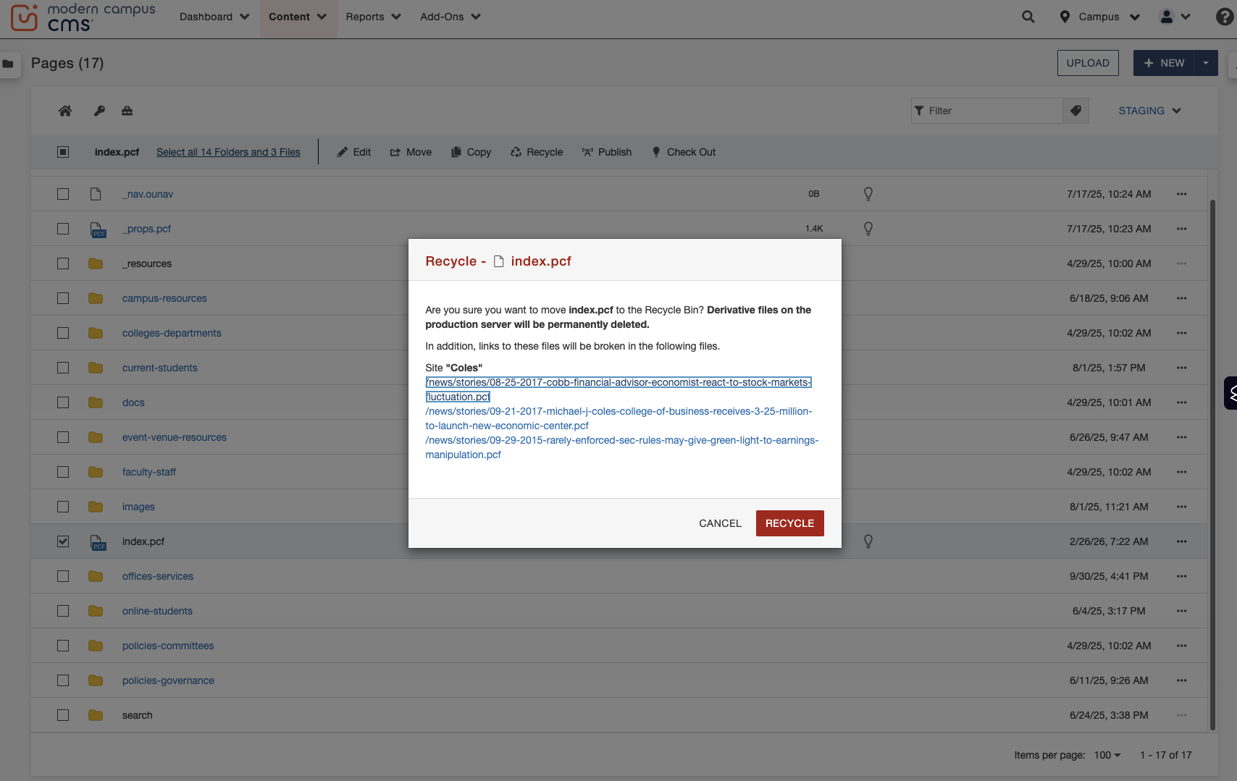
Best Practice when Deleting Pages
Deleting pages can create 404 errors across your website
When you delete a page, Modern Campus will display any page(s) that have dependency links pointing to it
Please make note of those pages and either:
  remove or update the links, or
  request redirects before the page has been deleted
    If redirects are needed, please submit a ticket to Website Update Request Form

Slide 21
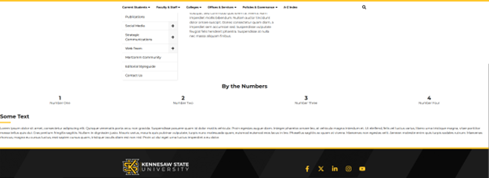
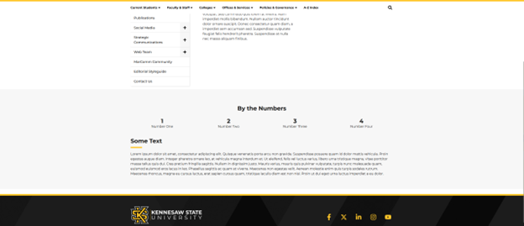
Page Layout – Sections Best Practices
In the Main Content region, you do not need to start with a "Section"
In the Additional Content region, you need to start with a "Section" for proper margins
Additional Content without Section
Additional Content with Section
Reminder:
When filling out a helpdesk ticket or sending a request to Service@kennesaw.edu, please be sure to include the URL(s) of the web pages you are asking us to work on.

Slide 22
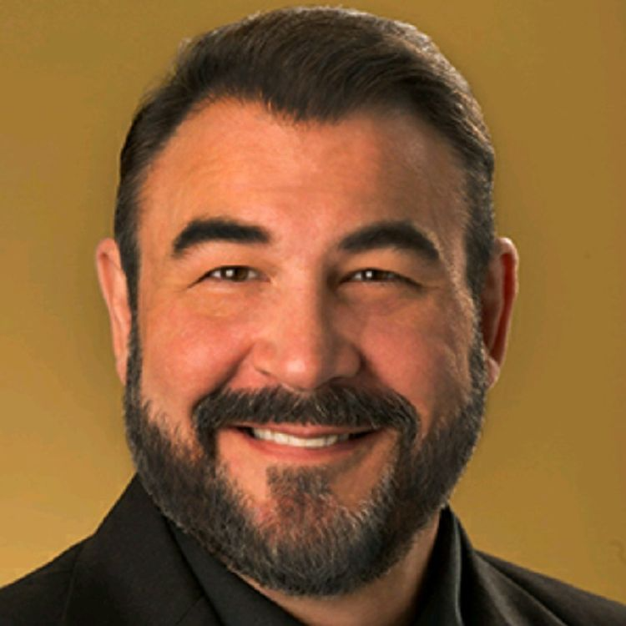
Farewell to Tony Matusko
Please take a minute to add a farewell note to Tony
  Kudoboard Farewell Messages From KSU Work Colleagues

Slide 23
Resources
Strategic Communications & Marketing Web Team
  Governance
  Content Review
Content Review Resources
  Creating a content inventory – Previous Web CoP Meetings
  Web Content Review Process
Accessibility Resources
  New Digital Accessibility Webpage:
  https://www.kennesaw.edu/accessibility/digital-accessibility.php
  New PDF Accessibility Webpage:
  http://go.kennesaw.edu/pdf-accessibility
  New Digital Accessibility Framework:
  https://www.kennesaw.edu/accessibility/digital-accessibility-framework.php
How to make Faculty/Staff Directory Updates

Slide 24

Questions?

Slide 25
Meet the Team
Leadership:
Joe Lacy - Director, SEO and Website Strategy
Sharon McAleer - Web Team Manager
Writers:
Josie Carter - Lead Marketing and SEO Copywriter
Malik Jones - Marketing and SEO Copywriter
Webmasters:
Jonathan Gilliam – Senior Webmaster and SEO Specialist
Anthony Matusko - Senior Webmaster and SEO Specialist
Tara Rose - Webmaster and SEO Specialist
Elizabeth Ball - Webmaster and SEO Specialist
Sean Bresnan - Webmaster and SEO Specialist
Matthew Gordon - Webmaster and SEO Specialist

