Slide 1
Web Community of Practice
Google Analytics GA4
November 2025
Created by: Sharon McAleer & Tony Matusko

Slide 2
Welcome
Google Analytics GA4
KSU Web Metrics Overview
Update Web POC list
Ports
H1 Audit
Content Review Checklist
Agenda

Slide 3

Goal of the Web Community of Practice
The Web Community of Practice brings together KSU web editors to collaborate, share knowledge, and strengthen the university’s online presence. In alignment with KSU’s strategic plan, the community aims to:
Advance student success
Elevate KSU’s brand and reputation
Foster collaboration and efficiency
Support professional development
Together, this community will help position KSU as a nationally recognized, student-focused university through a cohesive and engaging digital presence.
Meet every 6 weeks
Next Meetings are Oct. 3, Nov. 21,

Slide 4

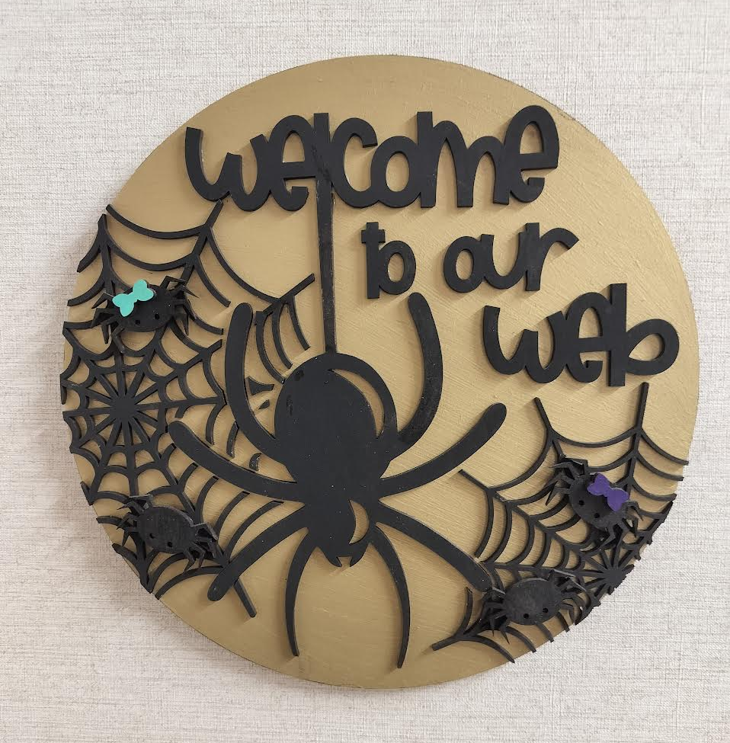
Meeting Schedule
Meeting cadence: Every 5 weeks
Upcoming dates: Jan 23, Feb 27, Apr 23
Topics: UX, ADA/508 compliance, data analytics & SEO, writing for digital, and more
Led by: Strategic Communications Web Team
Meeting is Recorded (Please Mute)

Slide 5
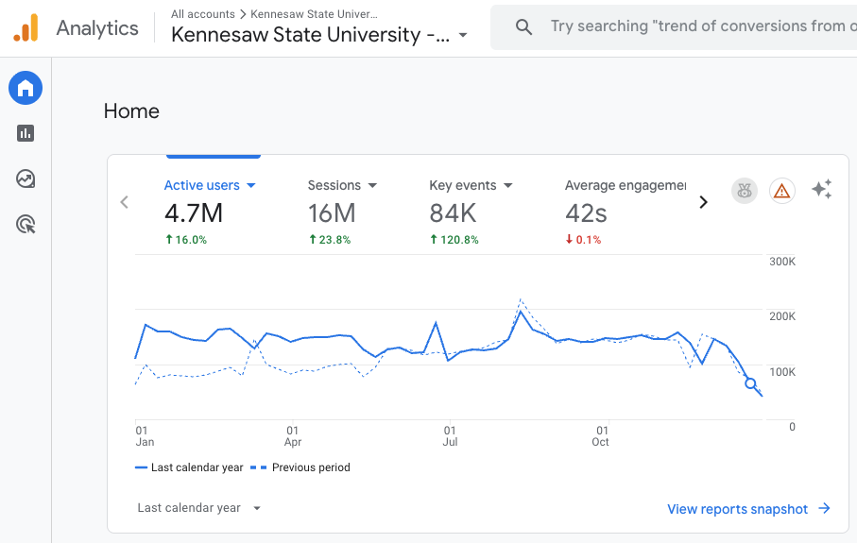
Google Analytics – GA4
GA4 helps you understand how people use your web site
what they do
where they go next
A picture of the entire user journey
Google Analytics (including GA4) does not track users in private/incognito mode.
GA4 is not about data it about the user's journey!

Slide 6
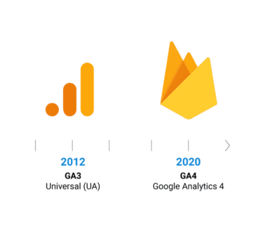
Google Analytics (GA4) History
GA4 released - October 2020
Sunset Universal Analytics – July 2023
Core difference:
GA4 tracks everything as events – page views, clicks, downloads etc…
Universal Analytics used sessions and hit types
GA4 supports KSU’s data-driven digital governance and accessibility compliance goals

Slide 7
GA4 Advancements
Unified tracking across web + app
Event-based model (no more hit categories)
Privacy-first, less reliance on cookies
Deeper, customizable reporting via Explorations
Better user journey and funnel visualization
And more…

Slide 8
GA4 Key Terminology
Events – any action, for example link click, pageview, scroll, file download…
Custom Event – you create to track something not captured automatically
Parameter – additional info attached to an events, such as link url or file name
Conversion – a key event that represents a meaningful action or goal such as form completion
User – a unique visitor
Dimension – label or description, such as page title, event name, page path
Metric – number or value, such as event count, users, views, sessions
Data Stream – data source, such as websites, iOS or android apps
Session – a period of continuous user activity
Engaged Session – A session lasting 10+ seconds, or with 2+ page views, or at least one conversion. Used instead of “bounce rate”
Engagement Rate – the percentage of sessions that qualify as engaged
View KSU GA4 Glossary of Terms

Slide 9
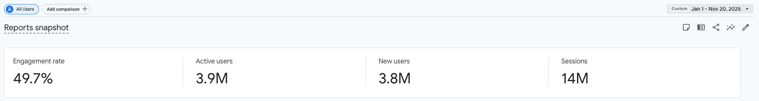
KSU Metrics Overview - Year to Date
Engagement rate is 49.7%, meaning nearly half of all sessions include meaningful interaction.
3.9 million active users visited the site between Jan 1 and Nov 20, 2025.
3.8 million new users discovered the site for the first time during this period.
14 million total sessions show strong recurring activity and high overall usage.
January 1, 2025 - Nov 20, 2025

Slide 10
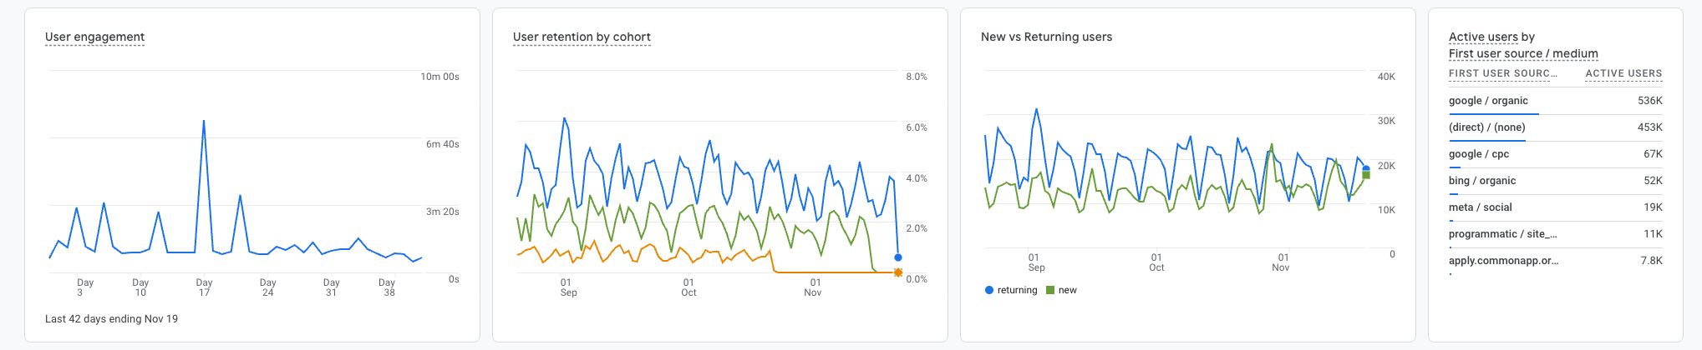
KSU Metrics Overview - Year to Date
User engagement remains steady, with regular peaks showing active interaction over time.
User retention is gradually declining, which is normal as time passes from a user’s first visit.
Returning users consistently outnumber new users, showing strong repeat engagement.
Google organic search is the top traffic source, followed by direct visits and Google ads (CPC).
January 1, 2025 - Nov 20, 2025

Slide 11
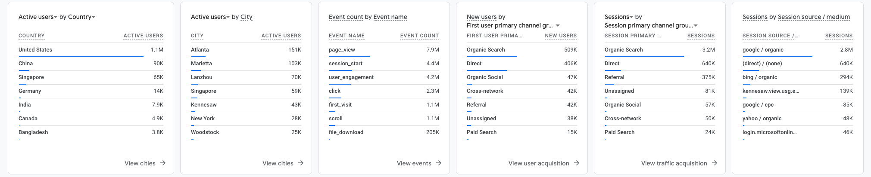
KSU Metrics Overview - Year to Date
The US leads with over 1.1M active users
Atlanta, Marietta are among the top cities sending active users to the site.
The most common interactions are page views, session starts, and clicks.
Organic Search brings in the highest number of new users
Most sessions overall come from Organic Search
Google organic continues to be the top driver of sessions, reinforcing the importance of SEO.
January 1, 2025 - Nov 20, 2025

Slide 12
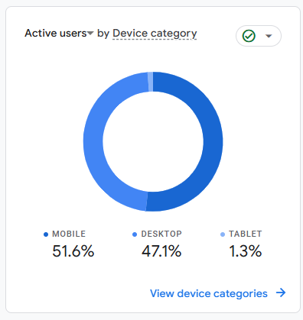
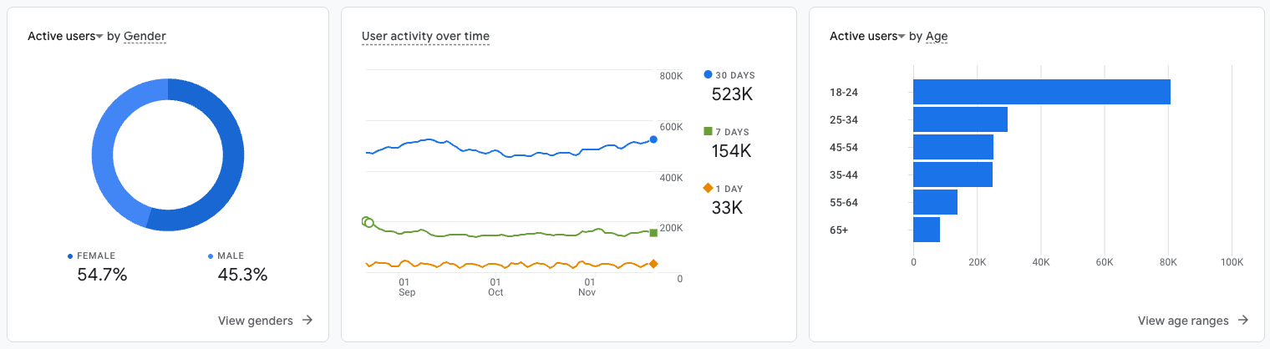
KSU Metrics Overview - Year to Date
Mobile leads slightly over with 51% of users on mobile and 47% on desktop.
Female users make up a slight majority, at about 55% of active users.
User activity is steady over time, with around 523K users active in the last 30 days.
18–24 is the largest age group, followed by 25–34 and 35–44.
January 1, 2025 - Nov 20, 2025

Slide 13
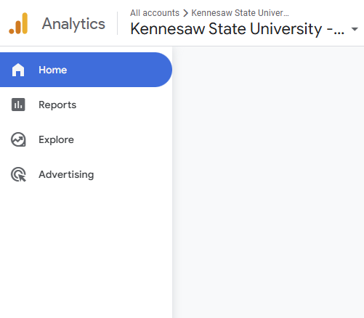
GA4 Tool Overview
Main Sections
Reports: Predefined dashboards & summaries, quick insights into user behavior and performance
Explore: Build custom reports
Advertising: Linked to Google Ads
Admin: Configuration and governance settings

Slide 14
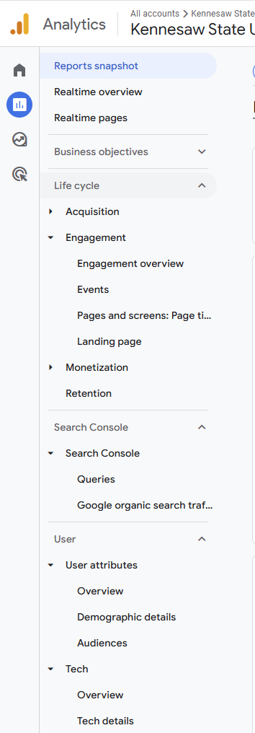
GA4 Reports Overview
Realtime: activity happening right now - pages viewed, locations, traffic sources
Business Objectives: Your goals, what matters most to KSU
Life Cycle: shows the journey of your visitors
Search Console: bridge between Google Search and your website
User: Learn about demographics, geography, and tech

Slide 15
10 Most Useful GA4 Reports
Realtime report - Shows who’s on your site right now.
Report Snapshots - A quick overview of users, engagement, conversions, and top pages.
Traffic Acquisition - Shows how visitors found your site.
Pages and Screens - Lists top pages, average engagement time, and key interactions.
Events - Displays all tracked actions like page views, clicks, downloads, etc.
Conversions - Shows key goal completions such as form submissions or downloads.
Landing Page - Identifies the first pages users land on.
Demographics - Provides visitor location, region, city, and language information.
Tech - Shows devices, browsers, and operating systems used by visitors.
Search Console - Displays search terms users typed in Google to reach your site.
GA4_Most_Useful_Reports_Guide.xlsx

Slide 16
GA4 Explorations
Explorations are GA4’s advanced, customizable analysis tools
They let you dig deeper than standard reports
Types | Best for
Free-form | Quickly analyze customized data tables for deeper insights
Funnel | Identify where users drop off during multi-step journeys
Path | Understand what users do before or after key actions
Segment | Compare user groups to reveal meaningful behavioral differences
Cohort | Measure retention and behavior of groups over time
User Lifetime | Evaluate long-term user engagement and value trends
User Explorer | View anonymized user journeys to diagnose interaction patterns

Slide 17
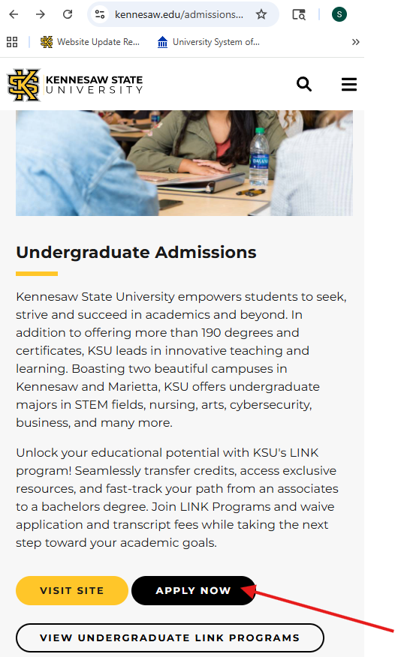
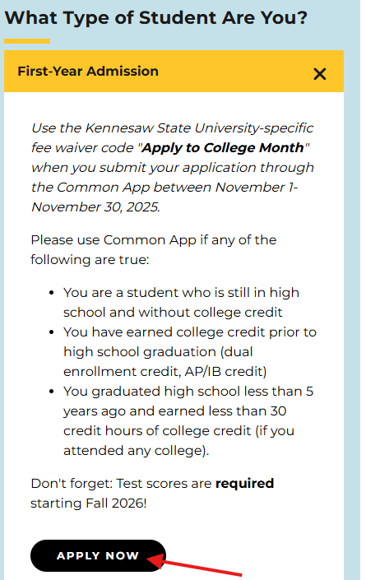
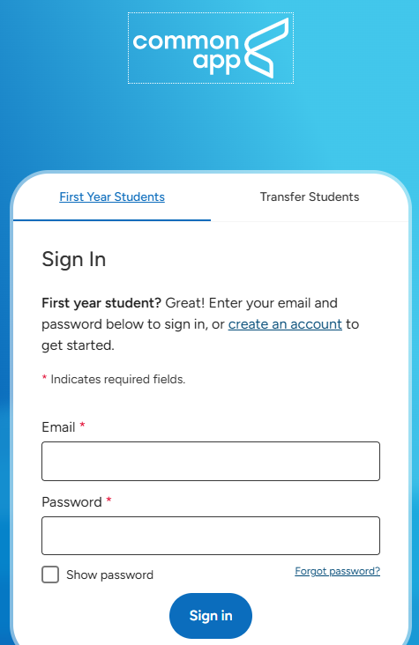
Explorations: Admissions Path – Last 90 days
Step 1 Admissions Page > 1.1 million active users
Step 2: Undergraduate Admissions 2.8% or 32,220K users
Step 3: Commons App Login 26k clicked the apply button to the Common App
Step 2 Roughly 3 out of every 100 people clicked how to apply. Decent click through rate
Step 3 80% - Excellent conversion behavior
Aug 15 – Nov 12, 2025

Slide 18
Interpreting Data
Distinct H1s
Focus on trends over time not just numbers
Compare engaged sessions vs total sessions.
Engagement replaces bounce rate
Spot which sources drive the best engagement
GA4 shows what happened, not why
Combine analytics with qualitative insights (UX testing, surveys etc…) before making conclusions

Slide 19
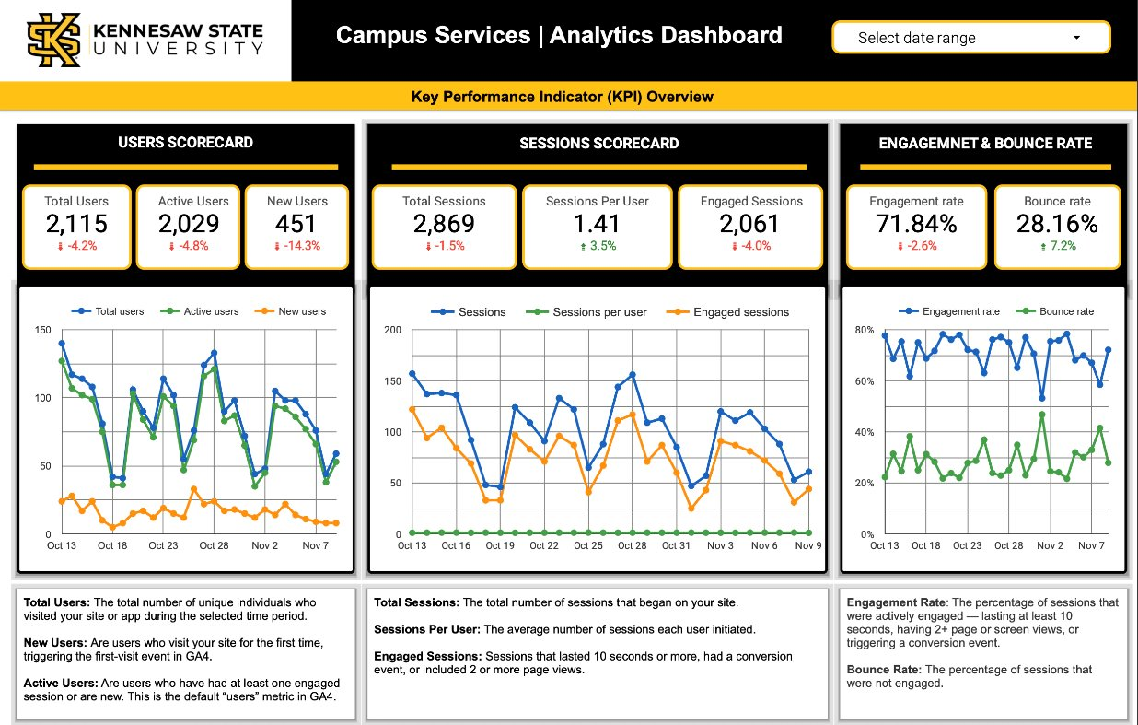
Dashboards – Key Performance Indicators Overview
In 2026, StratComm will provide analytics dashboards to colleges and units
Designed to give an overview into your website's performance
An at-a-glance summary to help guide decisions and identify opportunities for improvement
Page 1 highlights
Users
Sessions
Engagement
Trends
and more

Slide 20
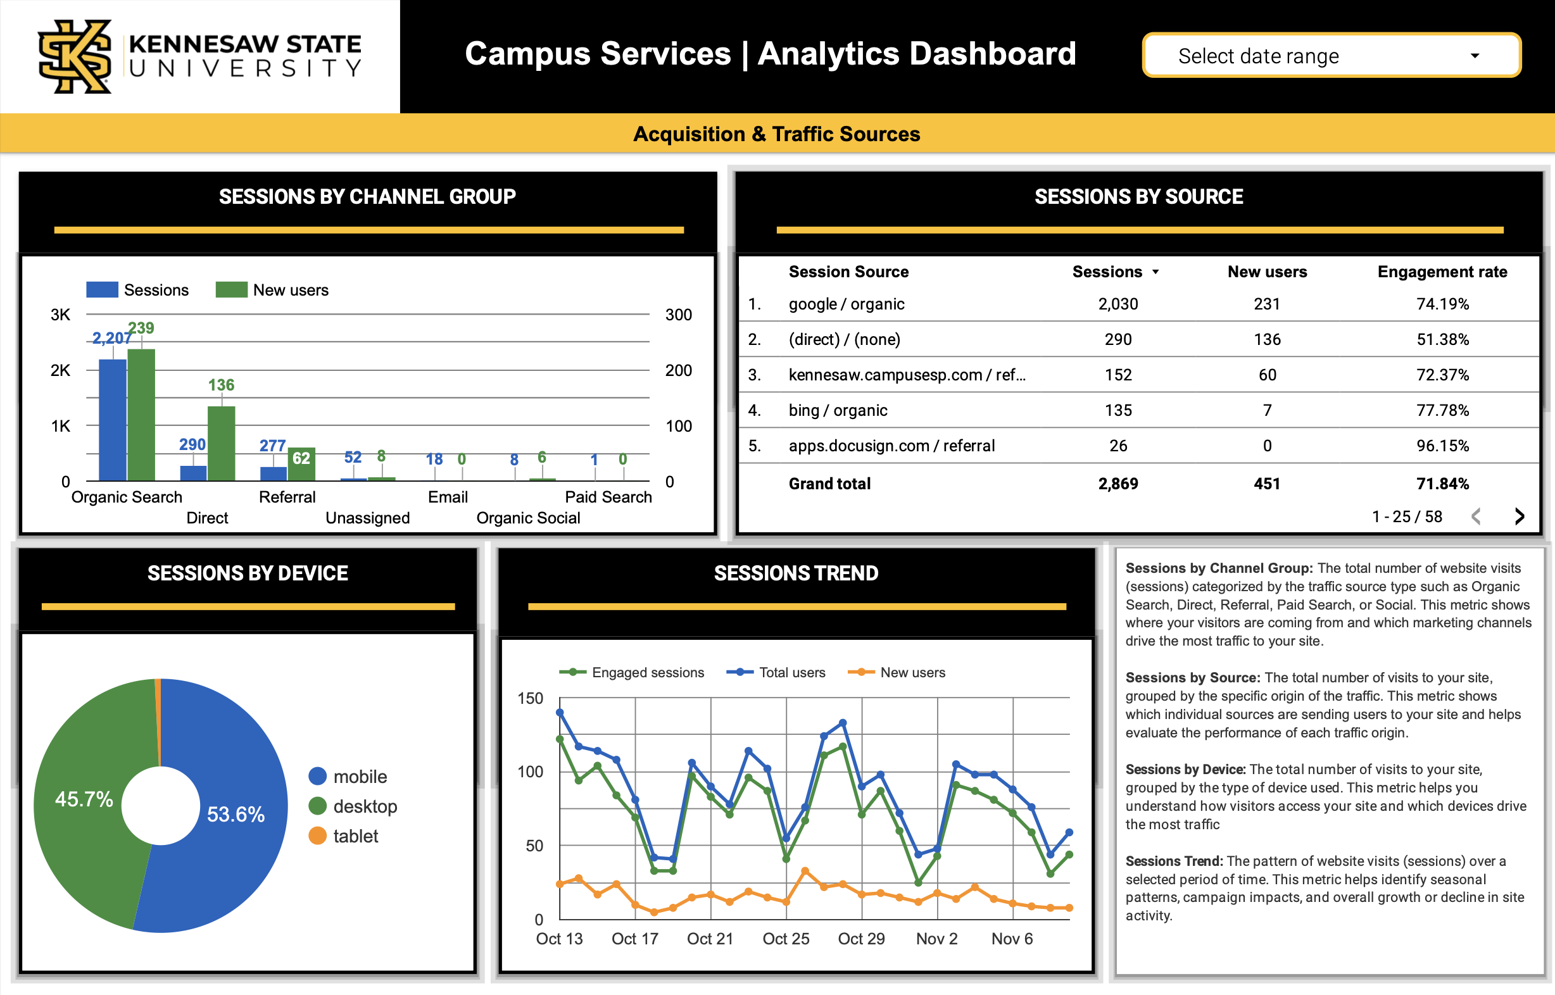
Dashboards – Acquisition & Traffic Sources
Page 2 - highlights how visitors are finding & accessing your website
Shows how sessions are generated and where users come from: search, direct, bookmarks….
Focuses on devices: mobile/desktop, and session trends to show how users engage with KSU sites

Slide 21
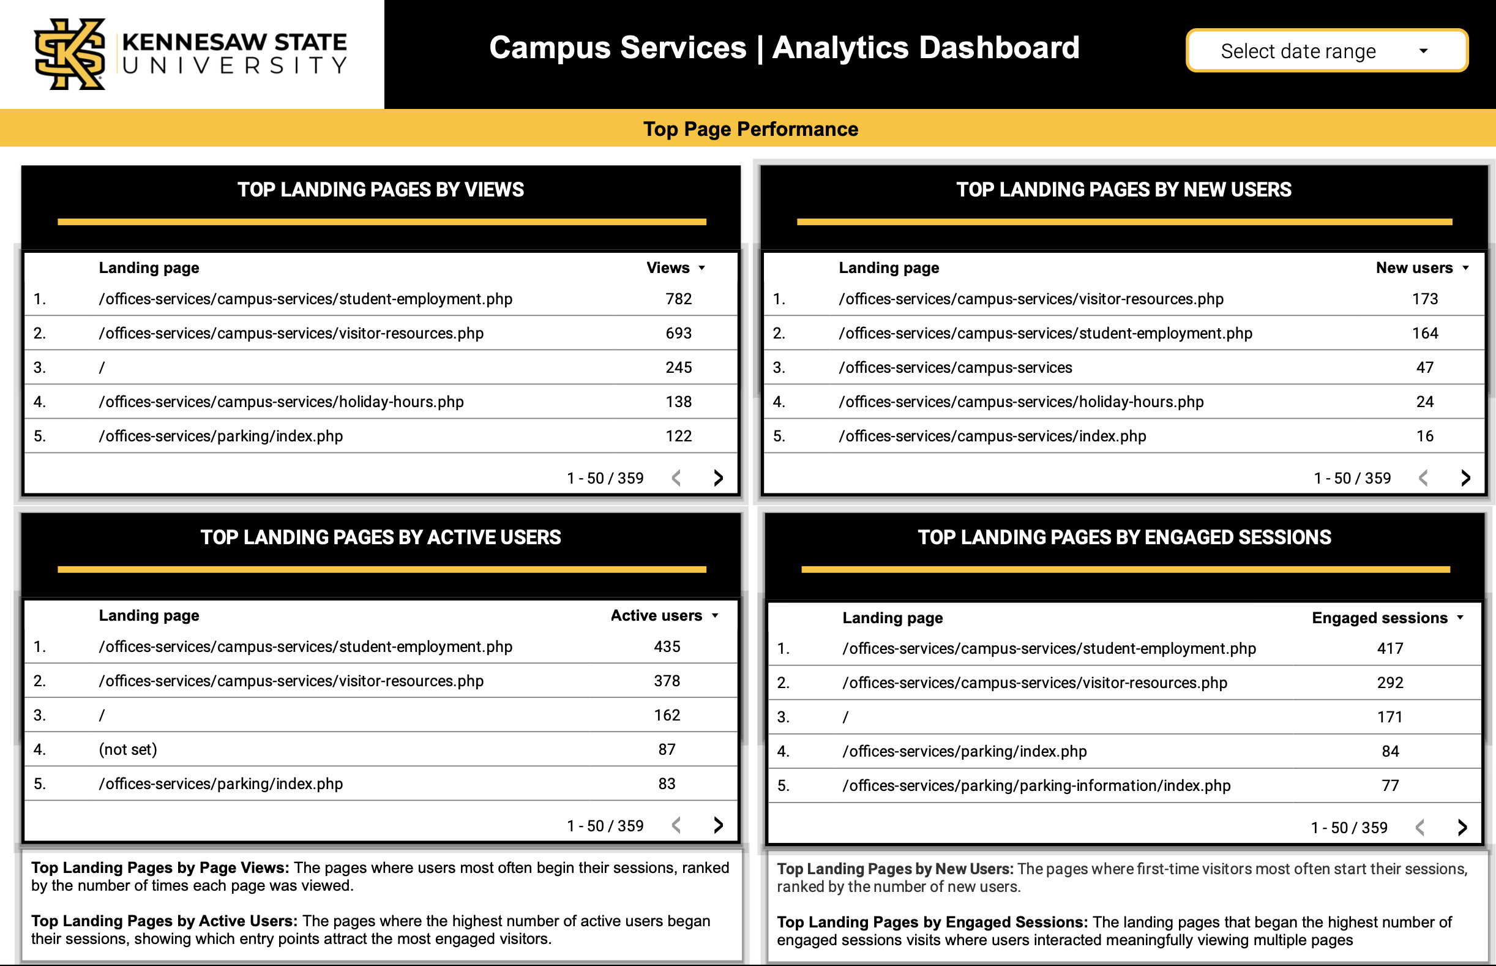
Dashboards – Top Page Performance
Page 3 - Highlights the most-visited and engaged pages on your site
Quick insight into how your web pages are performing
Shows which pages attract the most total views, active users, new visitors, and engaged sessions
These metrics help your team identify which content is working well and where there may be opportunities to improve or update pages

Slide 22
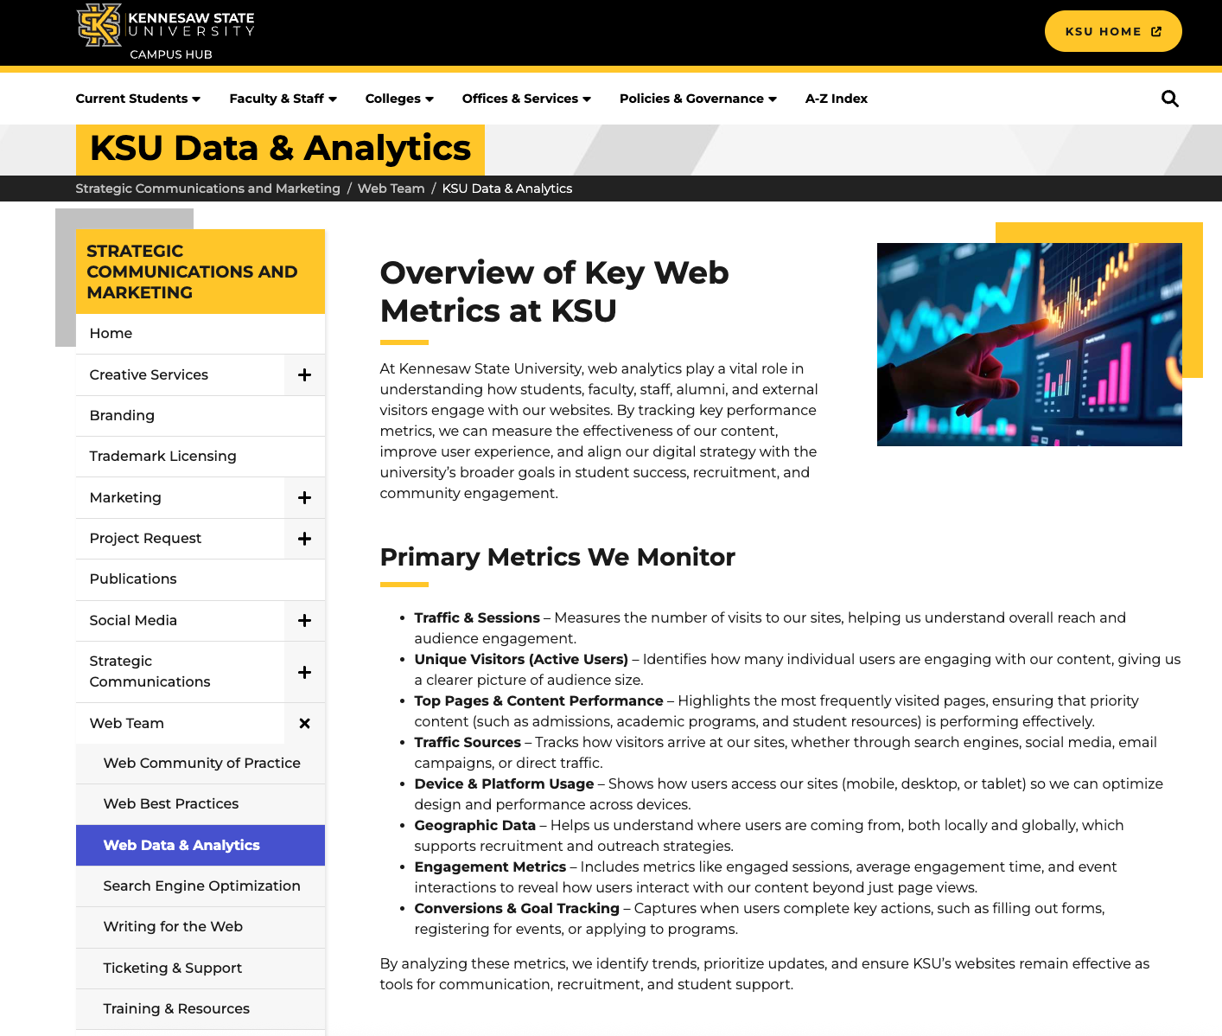
Google Analytics - Resources
We have several helpful Google Analytics resources available to support you as you learn GA4.
Overview of Key Web Metrics at KSU
Getting Started with Analytics: Introduction to Analytics
Guides and Videos
Analytics Help Resources

Slide 23

Questions
Please enter into the chat, raise your hand or come off mute to ask your question....

Slide 24
Website POCs

Slide 25
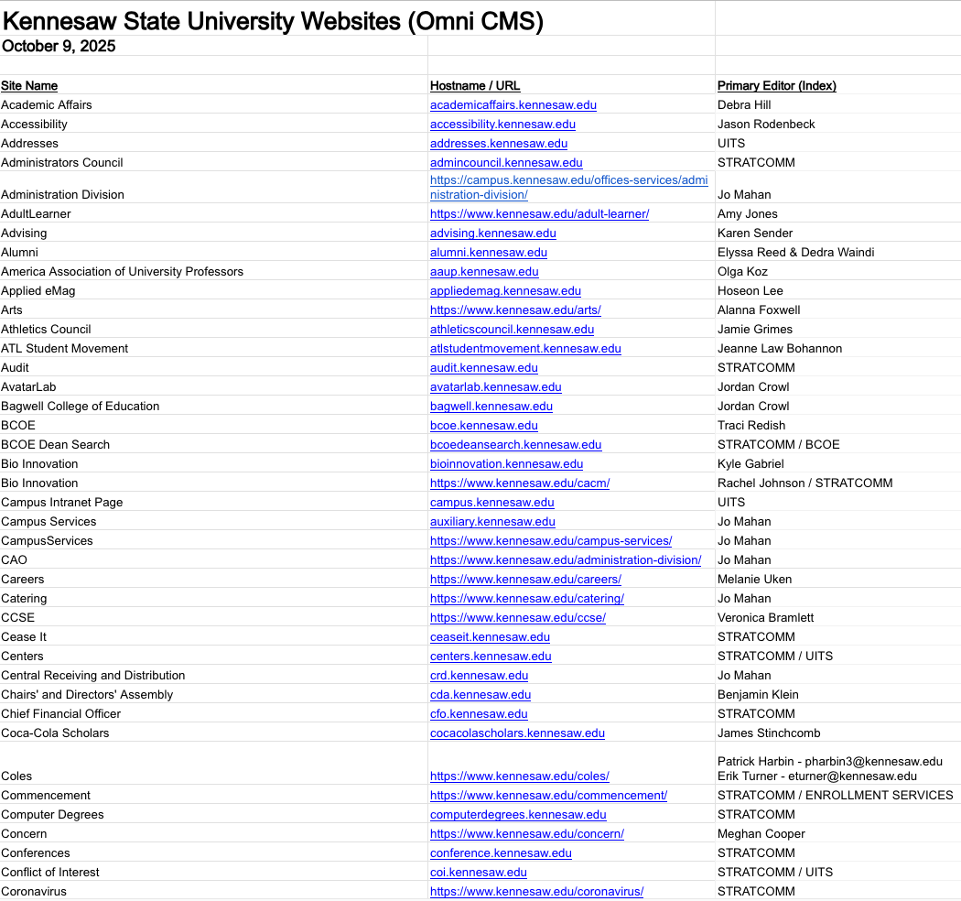
Review and Update Website POCs
Please review the Website POC list
Provide updates for anything that is no longer accurate
Please add a primary person for any group email box e.g.: enrollment services
Website Points of Contact List
Deadline 12/5

Slide 26
Ports

Slide 27
Port Update
During the port process, all sites remain available — no downtime or offline pages
StratComm & UITS have successfully completed porting Groups 1 and 2.
We will be sending quick fix/improvement recommendations over the next week or two for ports already completed
Group 3.1 started on 11/17
Website Status Tracking

Slide 28
Post Port QA

Slide 29
Post Port QA
During the Ports the Web Team conducts a quick QA
Headings, Fixing or removing broken links, Updating left-navigation links, and more
QA emails have been sent to port POCs
Please review and follow up by December 5
If you have questions reach out
Reminder: future ports MUST publish all content updates or revert to the last published version before your site port date
Current Port Schedule

Slide 30
H1 Audit

Slide 31
H1 Audit: Aug through Oct
The Web Team has conducted an H1 audit (9000+URLS)
Best practices:
Distinct H1s, GA4 analytics accuracy, ADA, SEO (no duplication)
Max 60 characters for SEO best practice
The Web team will send emails to POCs on December 1st
It will include a spreadsheet with the recommended changes
Once received, please complete the review by Jan 30 or sooner
If you have updated a H1 since the audit your welcome to consider the recommended alternative.

Slide 32
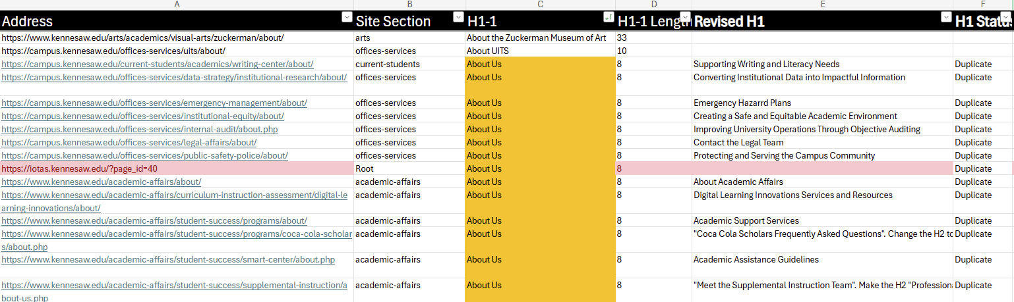
Sample H1 Audit Spreadsheet

Slide 33
Sites with H1s to Review

Slide 34
Checklist

Slide 35
Semester Web Content Review
Content:
Required 3x per year – every December, March, and July before each semester starts
Each college/department web POC reviews their pages and either updates directly in Omni CMS or submits a ServiceNow ticket to be completed
What to Check:
Accuracy & freshness (people, dates, announcements)
Links & files (no broken links, correct/accessible downloads)
Accessibility & style (headings, ALT text, clear CTAs, readable copy)
SEO basics (unique page title, good meta description, one H1)
Track Completion:
POCs mark pages as Reviewed / Needs Updates / Archived and submit conformation

Slide 36

Our Team
Leadership:
Joe Lacy - Director, SEO and Website Strategy
Sharon McAleer - Web Team Manager
Writers:
Josie Carter - Lead Marketing and SEO Copywriter
Malik Jones - Marketing and SEO Copywriter
Webmasters:
Jonathan Gilliam – Senior Webmaster and SEO Specialist
Anthony Matusko - Senior Webmaster and SEO Specialist
Elizabeth Ball - Webmaster and SEO Specialist
Sean Bresnan - Webmaster and SEO Specialist
Matthew Gordon - Webmaster and SEO Specialist
Tara Rose - Webmaster and SEO Specialist

