Slide 1

Web Community of Practice
How to Conduct a Web Content Inventory & Review
February.27.2026

Slide 2


Agenda
Welcome
StratComm Updates
Cludo Input
External Link Icon
Digital Accessibility Waiver
ADA Steps
How to Conduct a Web Content Inventory & Review
Created by: Sharon McAleer, Jonathan Gilliam, Josie Carter

Slide 3
Goals of the Web Community of Practice
The Web Community of Practice brings together KSU web editors to collaborate, share knowledge, and strengthen the university’s online presence. In alignment with KSU’s strategic plan, the community aims to:
Advance student success
Elevate KSU’s brand and reputation
Foster collaboration and efficiency
Support professional development
Together, this community will help position KSU as a nationally recognized, student-focused university through a cohesive and engaging digital presence.

Slide 4
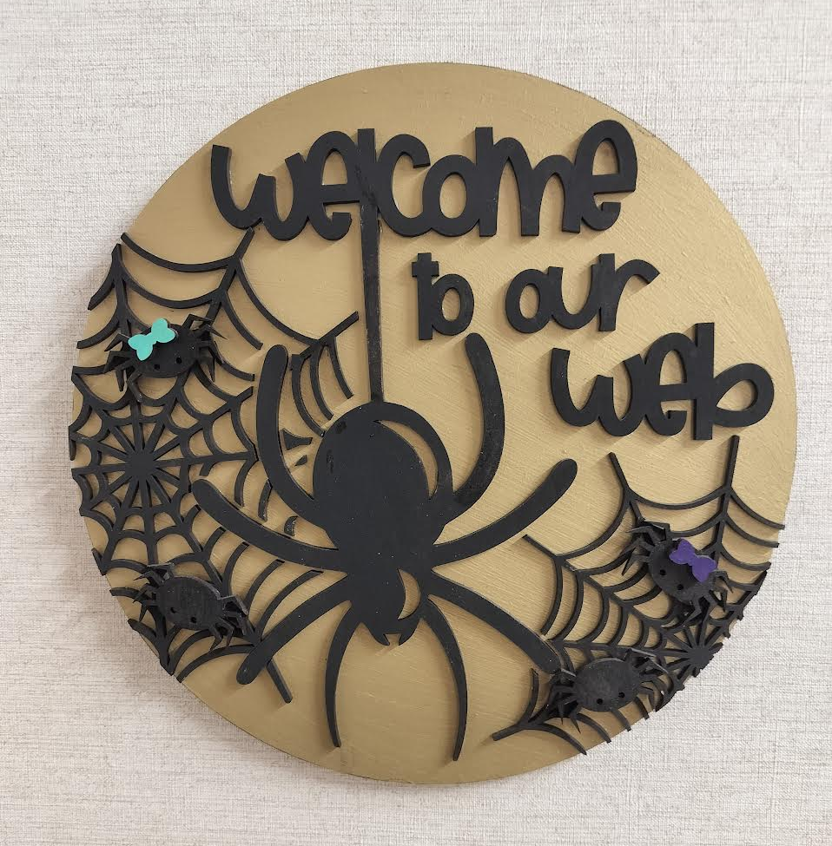
Meeting Schedule
Meeting cadence: Every 5 weeks
Upcoming dates: Mar 19 (All CoPs), Apr 3
Topics: UX, ADA/508 compliance, data analytics & SEO, writing for digital, content reviews and more
Led by: Strategic Communications Web Team
Meeting is Recorded (Please Mute)

Slide 5

Port Update
Group 3.5 started on 02/16: Arts
During the port process, all sites remain available — no downtime or offline pages
We will send quick fixes and improvement recommendations after your port is completed.
During 2/16 - 4/13 the web team are busy completing the last three ports
Reminder: please publish all content updates or revert to the last published version before your site port date to avoid drafts going live
Website Status Tracking

Slide 6
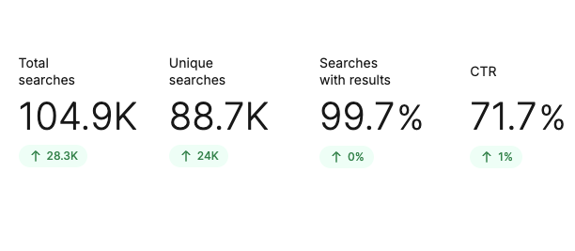
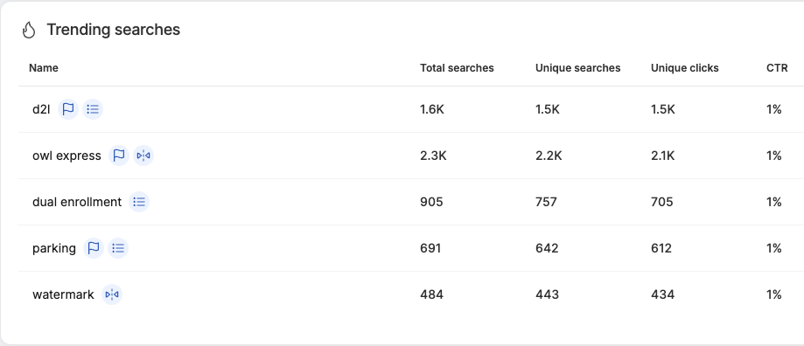
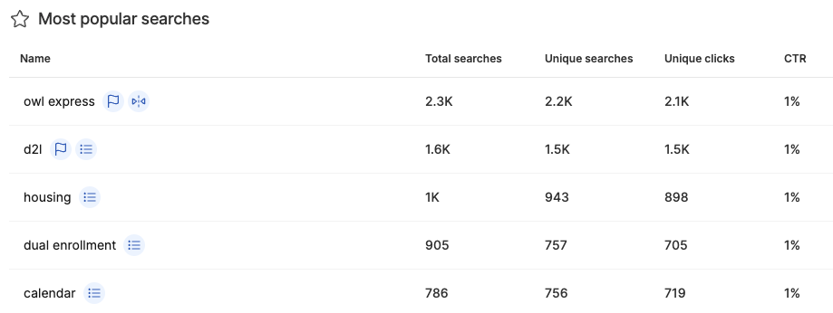
Cludo Search Governance
Search Governance Overview
Quarterly Email: Share search insights, curated results, and tool reminders
POC Requests Only: Departments submit search updates via service tickets
Supported Changes: Term boosts, page promotions/removals, banners
Tracking: All ticketed updates logged and reviewed annually
Post-CoP Follow-Up: Web editors receive process details via email

Slide 7
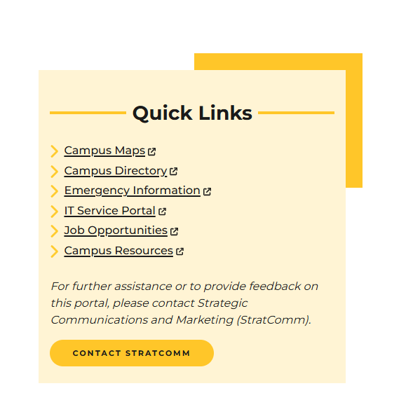
External Link Icon – Implemented 2.16
Applies to:
kennesaw.edu
campus.kennesaw.edu
Automatically displays on:
Any link that points outside the kennesaw.edu or campus.kennesaw.edu domains
Any link that opens in a new tab or window
Why this matters
Indicates when a link leads users away from KSU websites
Alerts users when a link opens in a new tab or window
Helps users understand what will happen before they click
Important guidance for Web POCs
Do not open KSU URLs or resources in new tabs or windows
This may create false positives
You can update the page in Modern Campus by removing the “open in a new window” setting and republishing
Please reserve new-tab/window behavior for cases where it is truly necessary.

Slide 8
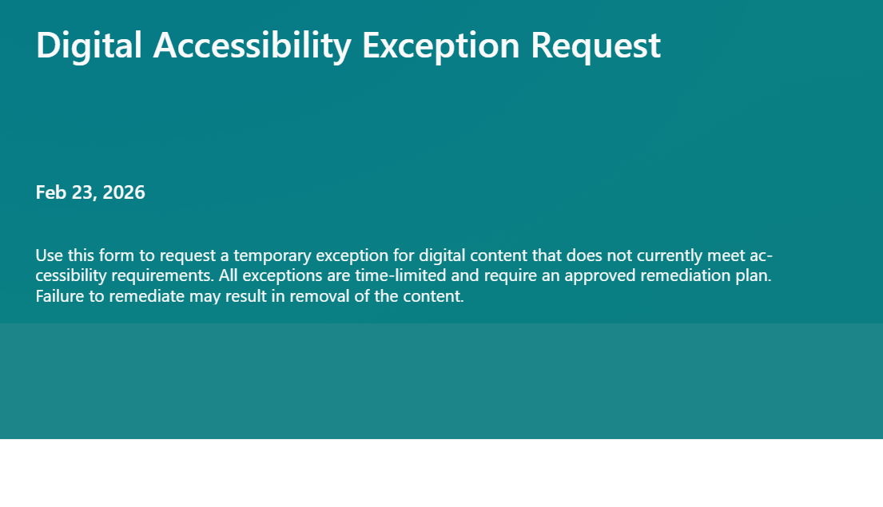
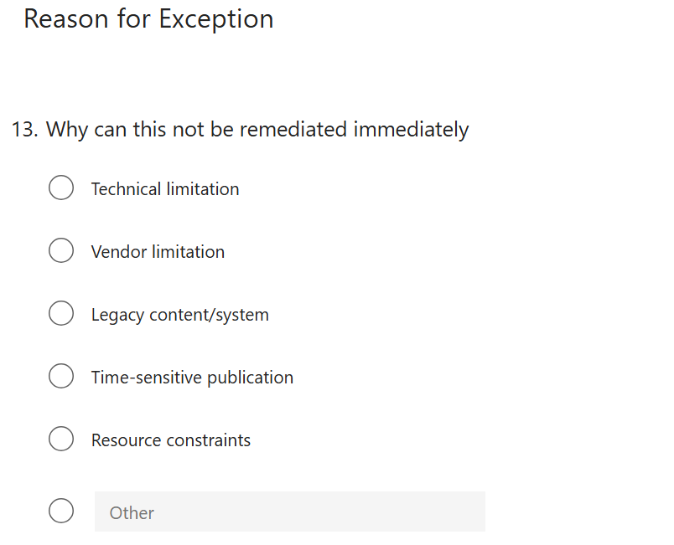
Digital Accessibility Waiver
Used only when accessibility requirements cannot be met immediately
Requires a documented remediation plan and timeline
Intended to be rare, temporary, and actively managed
Does not override ADA Title II or WCAG requirements
Approved waivers have a fixed remediation deadline
Products that do not remediate will be removed from the site
Notes:
Link to show form: https://forms.office.com/Pages/DesignPageV2.aspx?subpage=design&id=5W7yRTTxnkO8k-bH4z1hwjUnI0W5HIxMofCI0pMB59BUMDBMRjlVTjRINU9JNk1PTEo1OVM2QVJNQi4u

Slide 9
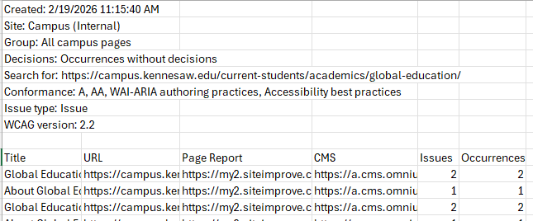
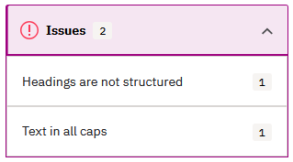
Accessibility Audit Steps
Request a SiteImprove Audit from StratComm
Page Title
URL
Page Report (SiteImprove Details)
CMS (Modern Campus Editor Link)
Click on the Page Report to View the Issues
Click on the CMS link to Edit the Page
Run a PDFs Events Report in GA4
Consider deletion of PDFs with no traffic in 12 months

Slide 10
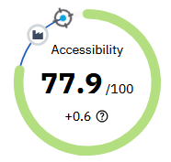
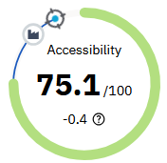
Accessibility Updates
Site Improve Accessibility Fixes on our Top 200 Pages are Complete
StratComm has been working with UITS
Upcoming Accessibility Enhancements
Banner Video
Audio descriptions for videos that require them
Aria hidden for decorative videos
Tables
Support for more complex tables
Addition of “rowspan”
Template Changes
Code enhancements
Kennesaw
Campus

Slide 11
How to Conduct a Web Content Inventory & Review
Web Content Governance
How to Conduct a Web Content Inventory & Review

Slide 12
Content Review Governance
All assigned web pages must be reviewed 3 times per year – before each semester begins (Spring / Summer / Fall) Web Content Review Process
What "Reviewed" Means:
Content is current, accurate, accessible, and functional at the time of the review.
Minimum Requirements:
Accuracy: dates, deadlines, fees, requirements, contact info
Accessibility (ADA): headings, link text, ALT text, contrast, captions/transcripts, documents
Searchable: clear titles / headings, scannable formatting, required metadata
Functionality: links, forms, media and downloads work properly
Compliance: do not duplicate authoritative sources (catalog, calendar, tuition) - link to source of truth
Outdated Content:
Content must be updated, consolidated, relocated or archived/removed - No "public archive" pages.
Review Expectations:
Document updates and complete the reviews by the posted deadlines. Request StratComm help when needed.

Slide 13
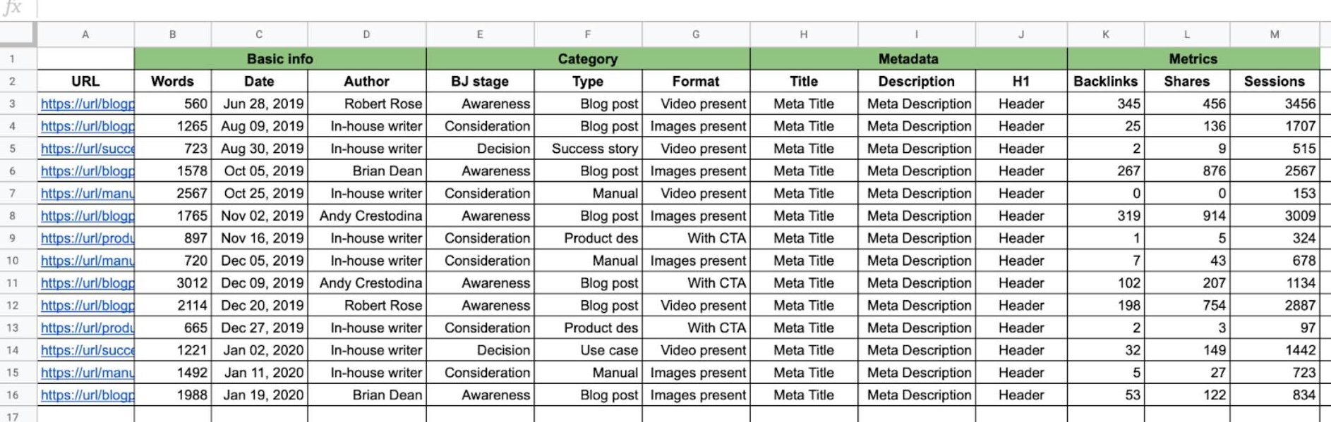
Content Inventory
What is a content inventory?
A content inventory is a structured review of all pages and files on your website to ensure content is:
Accurate
Current
Accessible
Aligned with university goals and policies
It helps us identify what should be
Kept
Updated
Archived
Removed (redirected)

Slide 14
IT Service Desk<service@kennesaw.edu>
Step 1: Get Your URL & File Inventory
Submit a service ticket to StratComm (service@kennesaw.edu) requesting a site section spreadsheet that includes:
Page & File URLs
Page titles
Content Type (PDFs, Word docs, images, etc.)
Metadata Description
Index Status – No index/no follow
Every URL in the list must be evaluated.
Tip: Files matter just as much as pages; PDFs are often the biggest accessibility risk. A Goggle Analytics events report can show PDF usage over a 6- or 12-month period, this will help you determine next steps.

Slide 15
Step 2: Add Review Columns
Column | Purpose
Status | Required decision for each URL/File
Notes/Action Needed | What needs to change
Owner | Who is responsible
Last Reviewed Date | Accountability
Accessibility Issues | PDFs, tables, images, video etc.
Status options (keep these consistent):
Reviewed – No Change
Updated
Remove / Redirect Needed
Consistency here makes reporting and follow-up much easier.
Notes:
First time through will take a little more time, and it will get easier as you repeat in the future

Slide 16
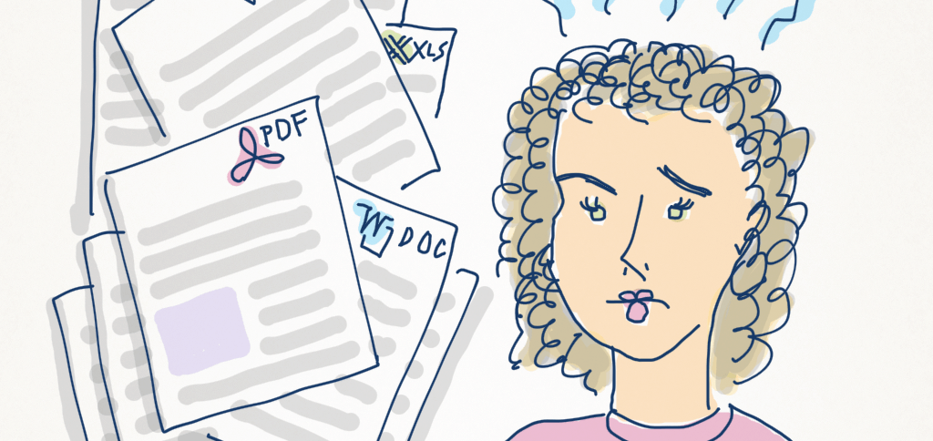
Step 3: Review Each Page Using These Questions
Accuracy & Relevance
Information is current and correct, Contacts, titles, dates, and policies are up to date, Duplicate or outdated content is removed
Audience & Purpose
Intended audience is clear, Page supports a specific user need
Timeliness
Date-specific information is still valid
Accessibility & Usability
Headings follow a logical order, Images include meaningful alt text, Links use descriptive text, PDFs are necessary (otherwise use a web page)
Links & Files
Links work and point to the correct destination
Style, SEO & Governance
Spelling, grammar, and punctuation are correct, Clear headings, chunked content, short paragraphs, and actionable CTAs, One H1, unique page title, clear meta description
Notes:
HTML is the default e.g.: PDF summary page https://www.cdc.gov/tb/communication-resources/tuberculosis-fact-sheet.html

Slide 17
Step 4: Apply Best Practice Decisions
Use these rules of thumb:
✅ Keep
Content is accurate, relevant, accessible, and actively used
✏️ Update
Content is valuable but needs:
New dates
Updated language
Accessibility fixes
Clearer structure
🗑️ Remove / Redirect
Outdated, duplicate, or no longer relevant
Pages tied to programs or events that no longer exist
Old PDFs replaced by updated web content
Best practice: Always recommend a redirect when removing a page to avoid broken links.

Slide 18
Step 5: Make Updates or Request Help
Small updates: Make directly in the CMS
Complex updates or removals: Submit a ServiceNow request to the StratComm Web Team (service@kennesaw.edu)
Files: Replace PDFs where possible; otherwise ensure they meet accessibility standards

Slide 19
Step 6: Confirm Completion
Once your review is finished:
Ensure every URL has a Status
Submit the required Content Review Completion Form
Keep the spreadsheet for your records
Note: Completion indicates each URL has been reviewed and tagged with a status, not that final actions are complete. Submit once statuses are assigned.
The Web Team will follow up only if a submission is missing or incomplete. We do not need to see your inventory.

Slide 20
Content Inventory Best Practices
Review content regularly (3x per year ahead of each semester)
Fewer pages = better UX and lower risk (Less is more)
When in doubt, simplify
Accessibility is not optional—it’s part of quality content and the law
Ownership matters: every page should have an accountable owner

Slide 21
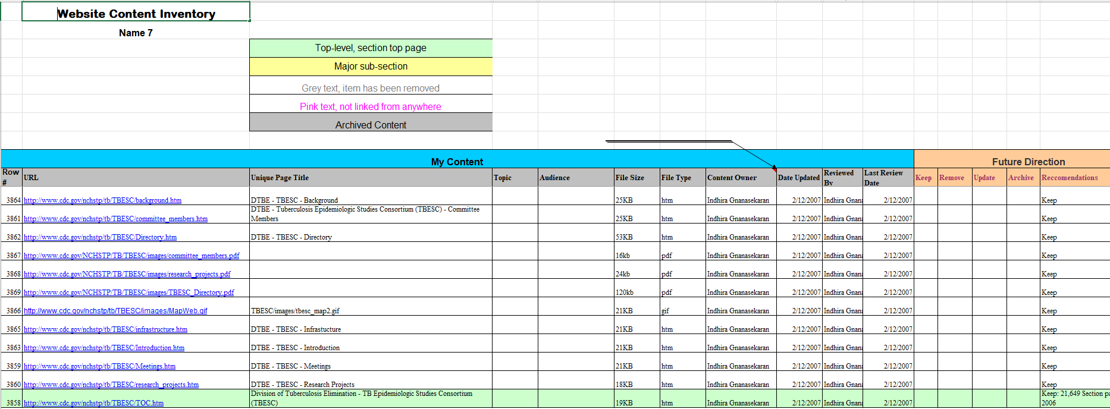
Sample Content Inventory
Notes:
Example inventory I completed for a site with over 5000+ URLs
We will share are inventory for StratComm site section once ready

Slide 22
Resources
Strategic Communications & Marketing Web Team
Website Updates:
Governance
Content Review
Content Inventory and Auditing 101 –NN/g
Conducting a Content Audit and Inventory as if you are Organizing a Pantry
Content Inventory, Audit, & Management – Washington State University *
How To: Content Inventory and Audit NN/g

Slide 23

Questions?

Slide 24
Meet the Team
Leadership:
Joe Lacy - Director, SEO and Website Strategy
Sharon McAleer - Web Team Manager
Writers:
Josie Carter - Lead Marketing and SEO Copywriter
Malik Jones - Marketing and SEO Copywriter
Webmasters:
Jonathan Gilliam – Senior Webmaster and SEO Specialist
Anthony Matusko - Senior Webmaster and SEO Specialist
Tara Rose - Webmaster and SEO Specialist
Elizabeth Ball - Webmaster and SEO Specialist
Sean Bresnan - Webmaster and SEO Specialist
Matthew Gordon - Webmaster and SEO Specialist

