Slide 1
Web Community of Practice
January 23, 2026
Created by: Jonathan Gilliam & Sharon McAleer

Slide 2
Welcome
StratComm Updates
  Ports
  KSU Search Tool Cludo
  H1 Audit
  Website updates
ADA Best Practices
Today's Agenda

Slide 3
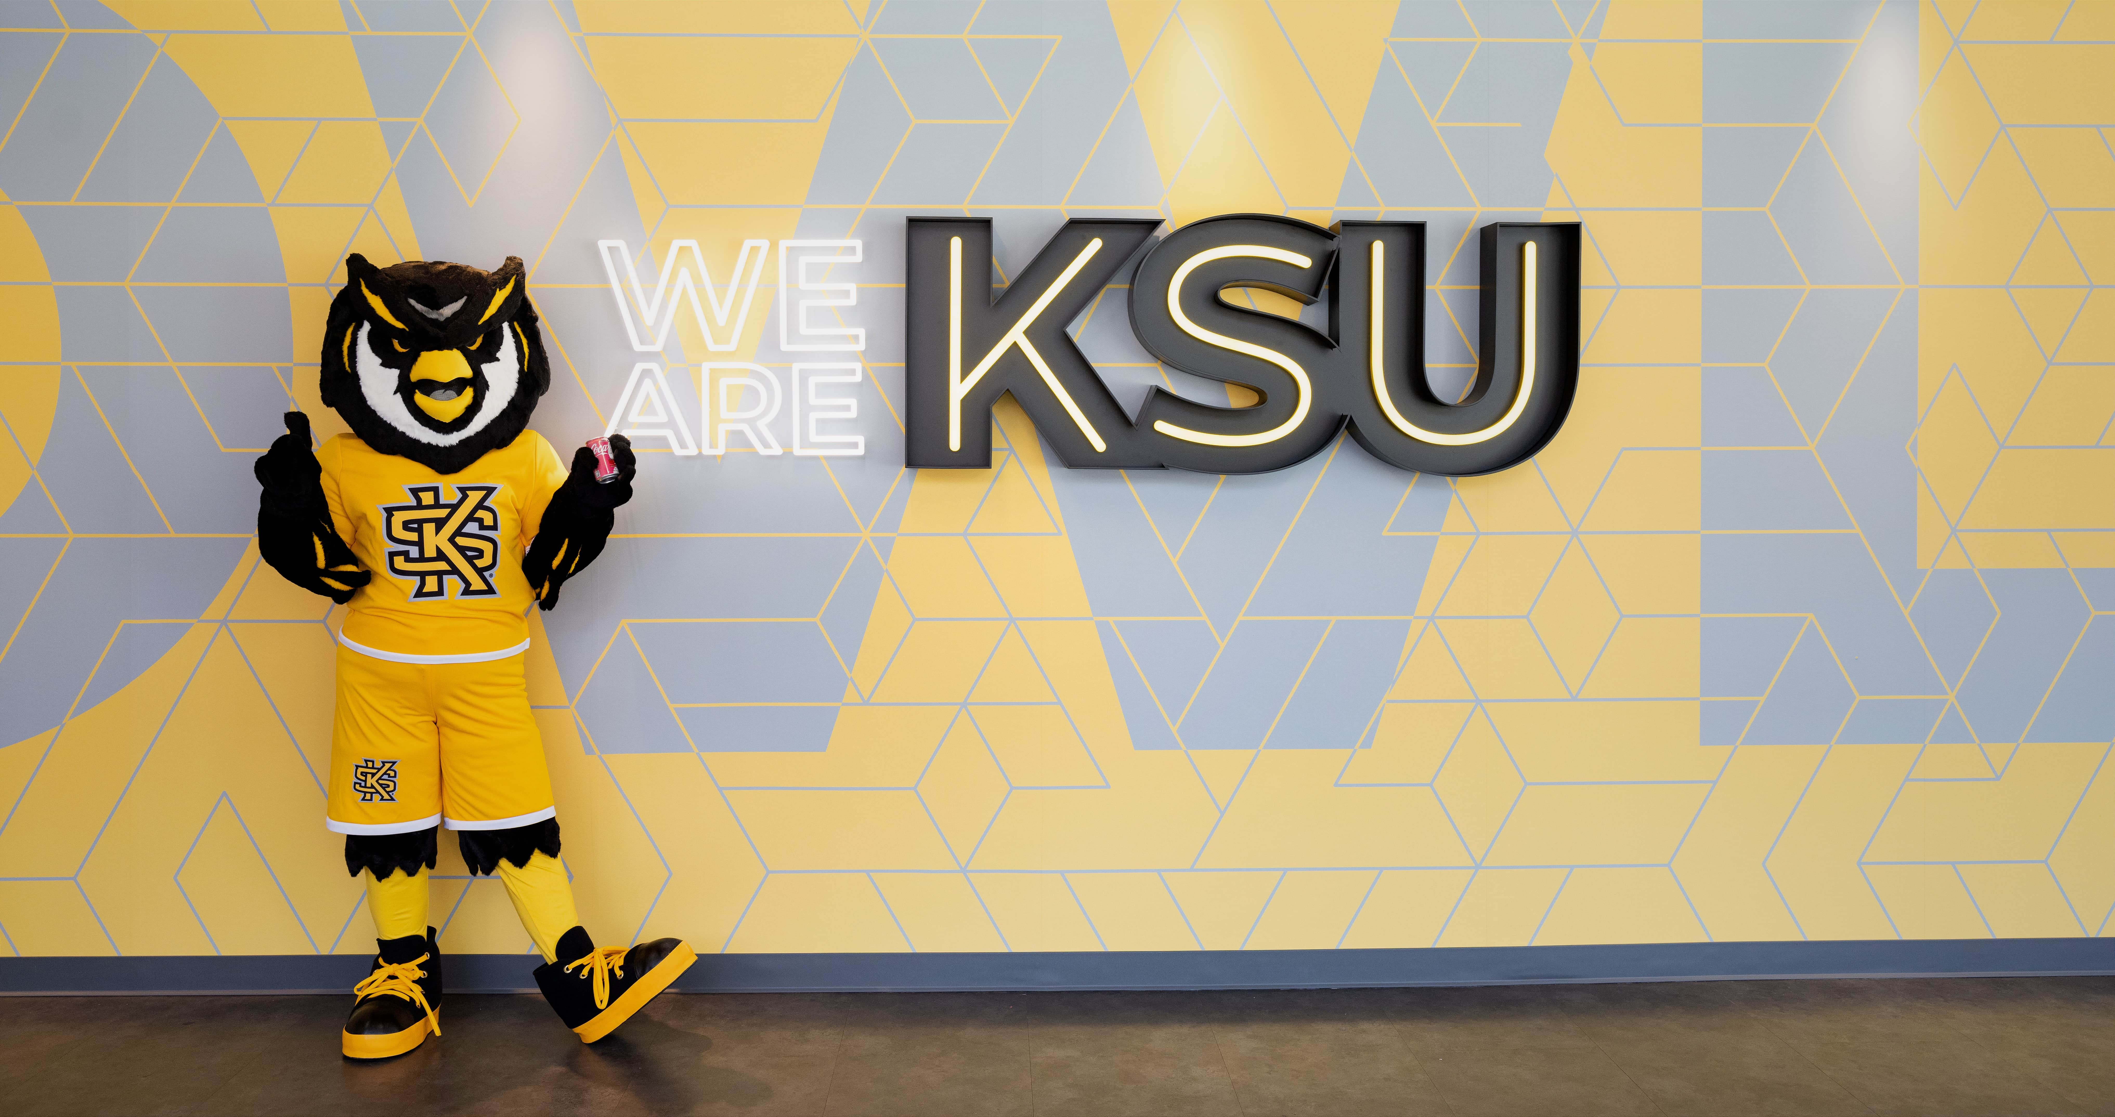
Goal of the Web Community of Practice
The Web Community of Practice brings together KSU web editors to collaborate, share knowledge, and strengthen the university’s online presence. In alignment with KSU’s strategic plan, the community aims to:
  Advance student success
  Elevate KSU’s brand and reputation
  Foster collaboration and efficiency
  Support professional development
Together, this community will help position KSU as a nationally recognized, student-focused university through a cohesive and engaging digital presence.
Meet every 6 weeks
Next Meetings are Oct. 3, Nov. 21,

Slide 4
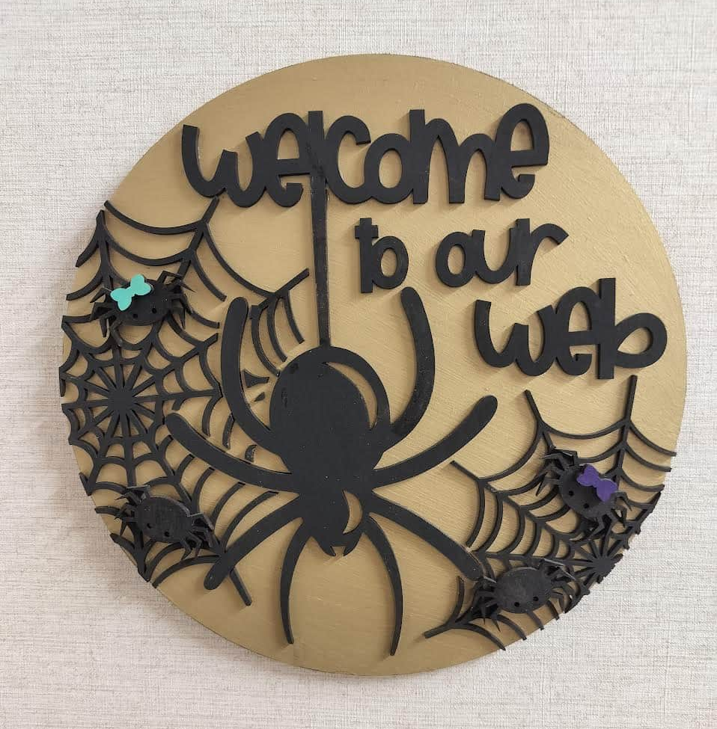
Meeting Schedule
Meeting cadence: Every 5 weeks
Upcoming dates: Feb 27, Mar 19 (All CoPs), Apr 3
Topics: UX, ADA/508 compliance, data analytics & SEO, writing for digital, content reviews and more
Led by: Strategic Communications Web Team
Meeting is Recorded (Please Mute)

Slide 5
Port Update
Group 3.4 starts on 02/02: CCSE & Graduate
During the port process, all sites remain available — no downtime or offline pages
We will be sending quick fix/improvement recommendations after your ports are completed
Reminder: future ports MUST publish all content updates or revert to the last published version before your site port date to avoid drafts going live
Website Status Tracking

Slide 6
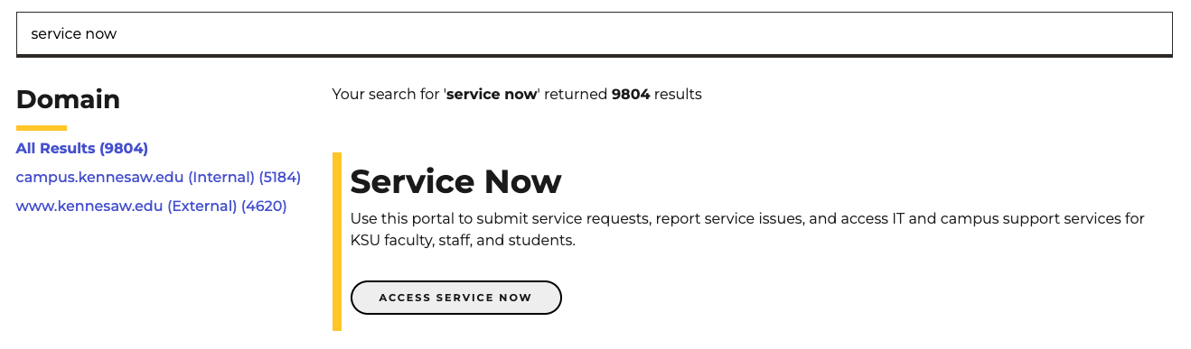
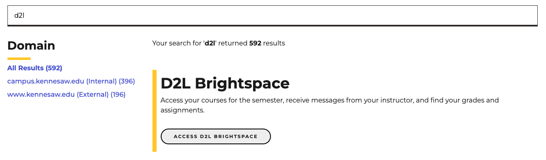
Search Tool - Cludo
Cludo Banners for Non-Modern Campus resources are added to our search results as of 1/22
Send POC contact information to Josie Carter - Deadline 2/6 jcart104@kennesaw.edu
Request Unit POCs
  Submit and approve ticket requests for your unit
  Authority to request search result boosting
  Suggest synonyms
  Suggest top 3 rankings for your unit/topic
  Attend meetings 4 times a year
  Reply to StratComm inquiries
Notes:
Strat Comm have recently started managing the new search tool Cludo
We are asking for a POCs within each unit that we can work with as we go forward and establish management for this tool.
Please email Josie Carter if you will be the POC for your unit
We will host a future meeting to discuss this in more detail once we have the POC names
Joe - This does not cover the work that we will do behind the scenes as the mangers of this tool.

Slide 7
H1 Audit
The Web Team conducted an H1 audit (9000+URLS) last quarter
Best practices:
  Distinct H1s, GA4 analytics accuracy, ADA, SEO (no duplication)
  Max 60 characters for SEO best practice or front load with the keywords
To stay on schedule, please reply to your H1 Audit email no later than January 30.
After January 30, the Web Team will start applying the recommended H1 updates.
Options to respond:
  We approve. We need SC Web Team to make the updates.
  We approve. Our department editor will make the updates.
  We have different suggestions for our H1s...
If you suggest a different H1, it will be reviewed and approved if it doesn’t duplicate another department page.
H1 Audit Questions? Contact Josie Carter at jcart104@kennesaw.edu
If you have updated a H1 since the audit your welcome to consider the recommended alternative.
Notes:
Sent after the post port QA first week of December
Timeline: is flexible as some college s have more URLs fixes than others but we would like to have it all completed by the start of Feb
Note things may have changed since Aug, it took 2+ month to complete as 9000 URLS
Next, I want to walk through the H1 audit we completed this fall. This audit covered more than nine thousand URLs across kennesaw.edu and campus.kennesaw.edu, making it one of the largest cleanup efforts we’ve completed.
One of the biggest issues we identified across multiple departments and colleges was duplicated H1 headings. When pages share the same H1, it creates several problems. It weakens clarity for users, it confuses search engines about which page is most relevant, and it ultimately lowers your visibility in search results. It also creates accessibility issues—screen readers use the H1 to understand the purpose of the page, so duplication becomes a barrier for users who rely on assistive technology.
All of this also impacts GA4 accuracy, since analytics rely on unique identifiers.
To support each unit, created a spreadsheet that outlines every duplicated H1 we found for your department and those that are longer than 60 Char.
You’ll see our recommended revisions, which follow best practices for SEO, accessibility, and consistent naming across the web.
Updating a page’s H1 requires Level 5 Omni access, so if no one in your area has that level, all you need to do is select ‘StratComm Web Team.’
Once your spreadsheet is returned to us, approved updates will be completed within one week—either by your team or by ours.
These changes will strengthen your pages, prevent search truncation, support accessibility, and help ensure your site aligns with best practices.
I’ll briefly show you what we evaluated in the audit.”

Slide 8
StratComm Web Section Updates
Strategic Communications & Marketing Web Team
  Website Updates:
    Governance
    Content Review
  February’s Web CoP meeting will cover the Content Review Process and How to Do This

Slide 9
ADA Best Practices
For Modern Campus (Omni CMS)
Web Team from The Office of Strategic Communications & Marketing
Created by: Jonathan Gilliam & Sharon McAleer

Slide 10
ADA Act & DOJ
Elements Outside of Your Control
What Can You Do in Modern Campus
Accessible Page Content
Snippet Usage
ADA Checklist
ADA Resources
In this session:
Notes:
Our session description:
Website Accessibility in Modern Campus CMS
Description:
Join the KSU Web Team from Strategic Communications & Marketing for a one-hour session focused on creating accessible, inclusive, and compliant web content within the Modern Campus CMS. This presentation will walk editors and site managers through best practices for meeting ADA and Section 508 requirements, using real examples from KSU sites.
Participants will learn:
How accessibility applies to content built in Modern Campus templates
Common accessibility pitfalls (e.g., color contrast, alt text, headings, and links) and how to avoid them
Best practices when using Snippets and other built-in Modern Campus tools to meet accessibility requirements
KSU’s expectations, resources, and upcoming accessibility initiatives
The session will include live demos, quick tips you can apply immediately, and time for Q&A. Whether you edit pages occasionally or manage a full site, this session will help ensure your content is usable by everyone and fully compliant with KSU standards.

Slide 11
Americans with Disabilities Act (ADA)
Title II of the ADA applies to all state and local government entities, including public colleges and universities
Public universities must ensure that all digital content is accessible
  This includes websites, web apps, learning systems, digital documents, mobile apps, student portals, and online services.
The legal standard:
  Web Content Accessibility Guidelines (WCAG) 2.1 AA
  Deadline April 24, 2026
  WCAG 2.2 AA became official October 2023
Notes:
WCAG 2.2 Adds 9 New Success Criteria
In 2.2
3.3.8 Accessible Authentication (Minimum) – login must not rely on memory tests (like CAPTCHAs or “enter the same pattern”)
Focus not obscured
24x24 touch targets or have enough spacing

Slide 12
It’s the Law
Section 508 of the Rehabilitation Act of 1973
Americans with Disabilities Act of 1990
Features of Compliance
Proper alternative (alt) text for images
Keyboard accessibility
Color contrast compliance
Clear headings and structure
Accessible documents (PDFs, PPT)
Captions and description for video/audio
In 1998, the US Congress amended the Rehabilitation Act to require Federal agencies to make their electronic and information technology accessible to people with disabilities.
In 2021, 42.5 million people in the US civilian noninstitutionalized population had a disability, according to the Census.gov.
Notes:
1998, 26 years after section 508 in 2024 title 2 of the ADA required state, local governments and universities….
No internet in 1990… late 90’s the internet hit.

Slide 13
Proactive Monitoring & Remediation
The Department of Justice (DOJ) expects universities to:
Conduct regular accessibility audits
Fix issues quickly (remediation)
Maintain an internal governance framework
Ensure vendors meet accessibility standards
Track issues across colleges, departments and units
Implement ongoing campus-wide training

Slide 14

Non-compliance
Results in:
  Mandatory corrective action plans
  Multi-year audits
  Public settlement agreements
  Reputational damage
  Significant staff time and cost
  Best to be proactive ahead of the April 24, 2026 deadline
Notes:
Examples:
In 2006, The National Federation of the Blind v. Target Corp. — The NFB sued Target over inaccessible website content for blind screen‐reader users.
monetary damages in the amount of six million

Slide 15
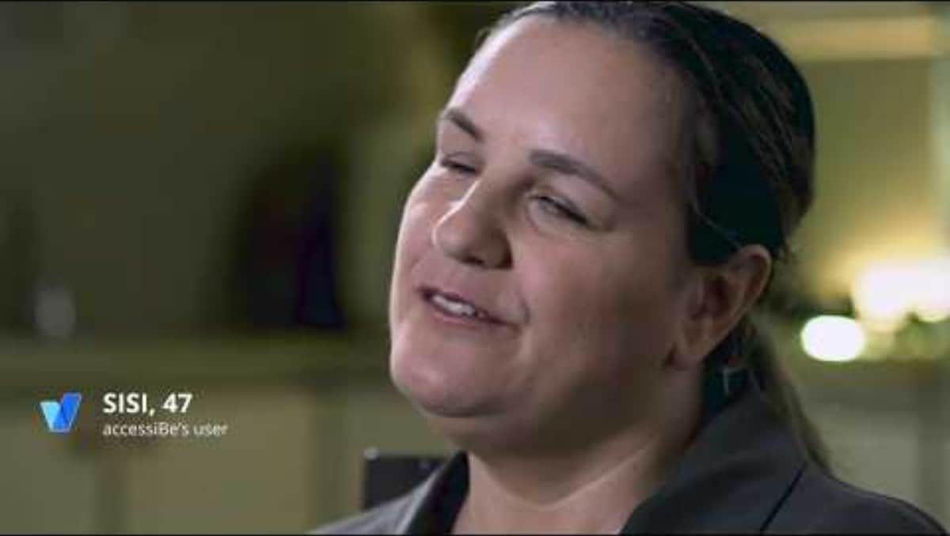
Why It’s Important
https://www.youtube.com/watch?app=desktop&v=a2hqmqZzegg

Slide 16

Accessibility is Not the Final Step – it’s a Starting Point
Accessibility at the end:
  Retrofits are expensive & time consuming
  Often require redesign or rework
  Deadlines slip and quality suffers
  Higher legal and compliance risk
  Creates stress for the team and users
  Fixing accessibility later usually means fixing everything
Accessibility at the start:
  Builds accessibility into design, content, and code
  Faster delivery with fewer surprises
  Lower cost and less rework
  Better experience for all users
  Stronger compliance and reduced risk
  When accessibility is built in, nothing has to be fixed later
Notes:
Plan for accessibility from day one — for web pages, apps, documents, video, and all digital products.
Accessibility works best when it’s planned at the beginning of a project — not added at the end.
When we treat accessibility as a final checklist item, we often discover that the design, structure, or technology doesn’t support it — which leads to rework, delays, and frustration.
When accessibility is built in from the start — in content structure, design choices, technology selection, and vendor requirements — it becomes part of normal quality, not an extra burden.
This applies to everything digital: websites, mobile apps, PDFs, videos, forms, dashboards, and third-party platforms.
Planning for accessibility early saves time, reduces risk, lowers cost, and most importantly ensures that everyone can use what we create.
If accessibility is optional at the start, it becomes expensive at the end.

Slide 17
Accessibility in Modern Campus (Omni)

Slide 18
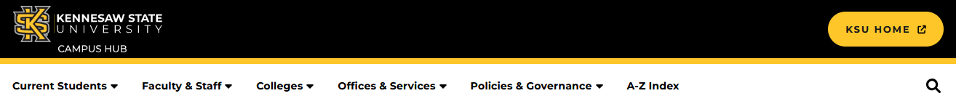
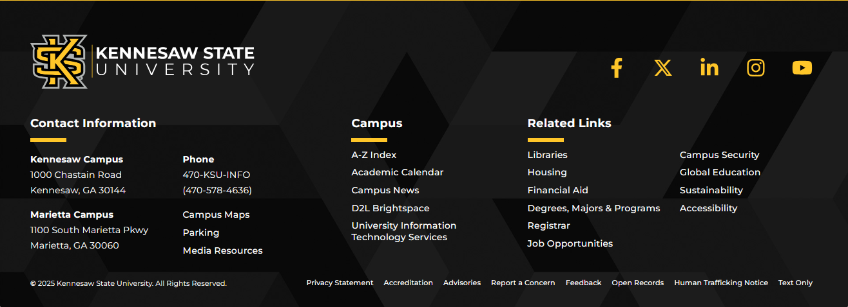
What is outside of your control?
Header Content
Footer Content
The header and footer are maintained by StratComm and UITS. If you see any issues or would like to request a change, please send us a service request.

Slide 19
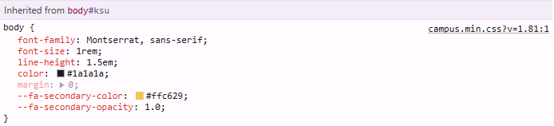
What is outside of your control?
CSS (Font, Color, Styles)
Toolbar Options
What’s Not on the Toolbar:
Underline Text
Strikethrough Text
Justify Alignment
Fonts
Font Sizes
Text Color
Background Color
Table*
(*snippet available)
Notes:
We are working to document ADA improvements at the template level –
We’ll share a ON page to place items they notice and think might not comply

Slide 20
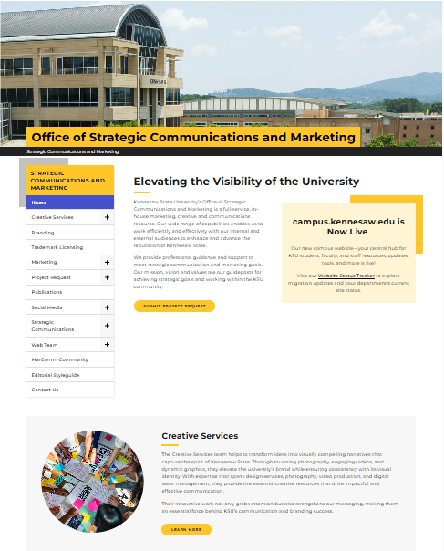
What can you control?
Page Content
Text
Headings
Links
Images
Video
Snippet Usage

Slide 21
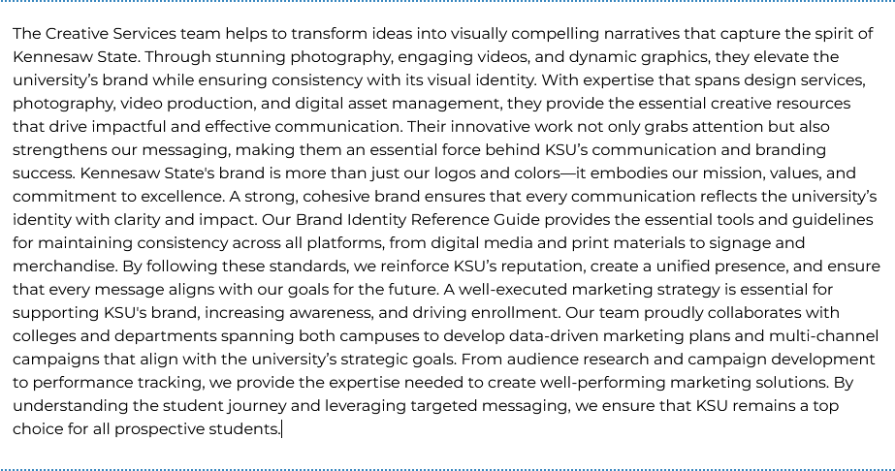
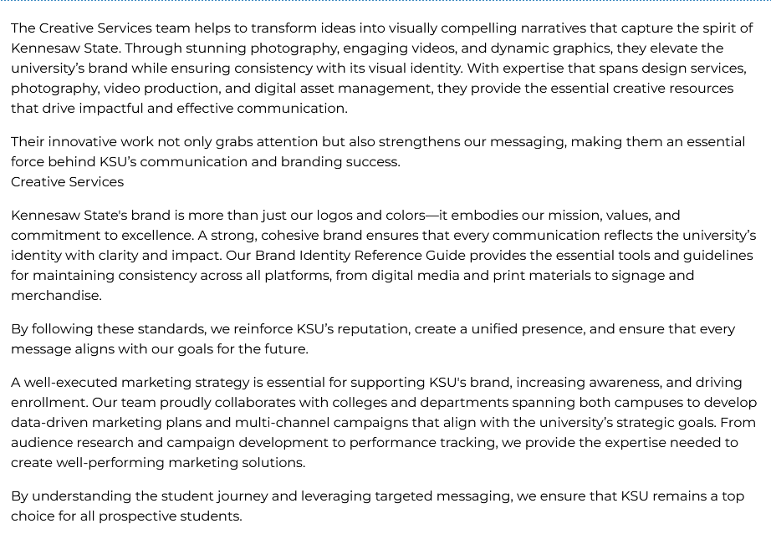
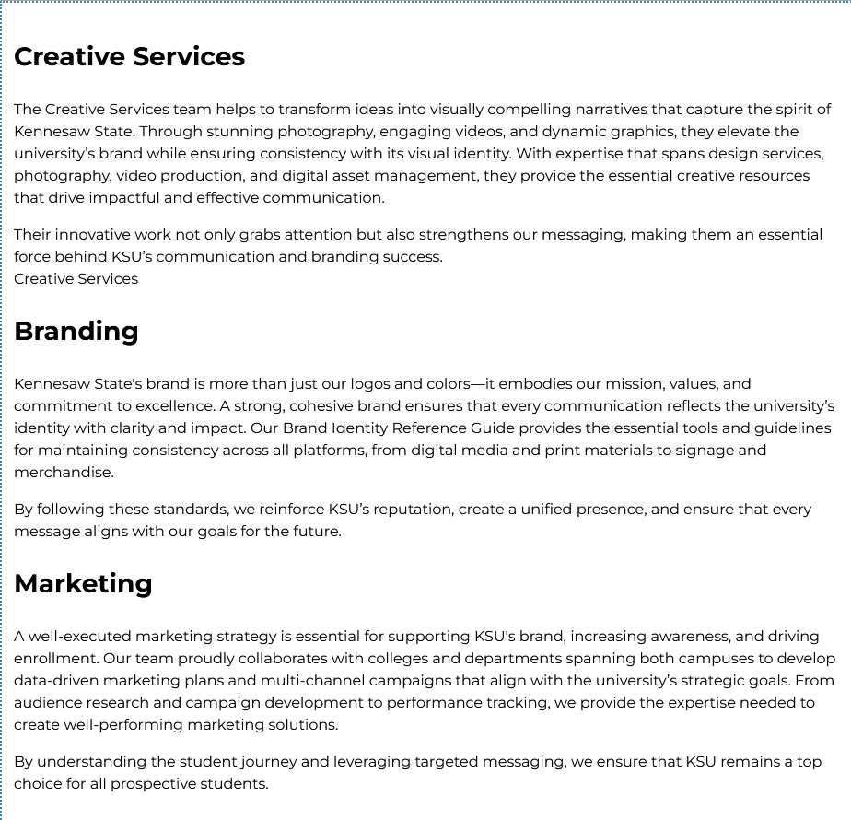
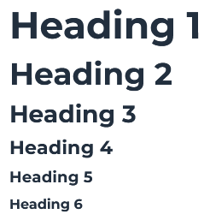
Text and Headings
Break Up Long Paragraphs
  Chunk content
Use Headings
  Only Use One H1;
  Should be Unique
  Follow a Hierarchy
  Don’t skip levels

Slide 22
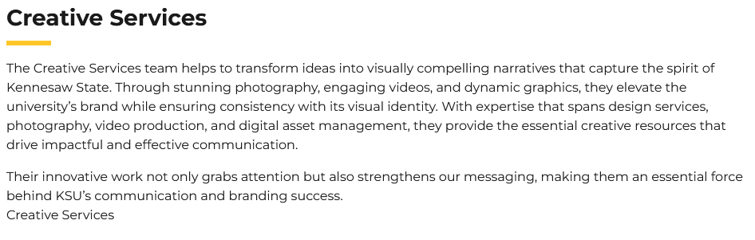
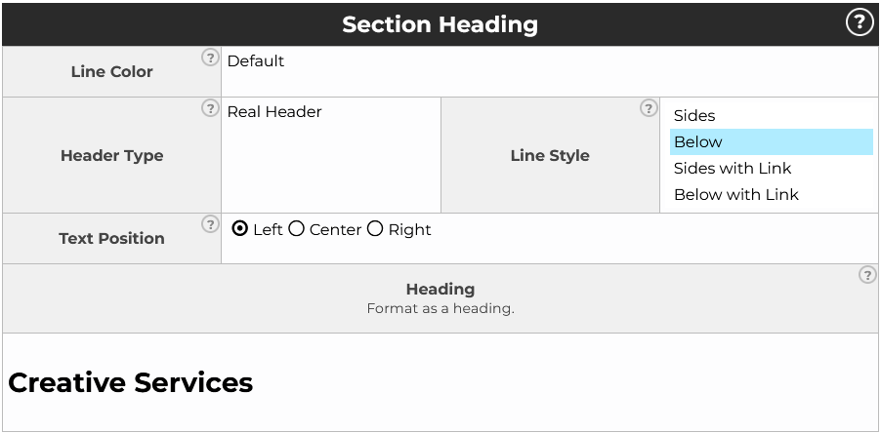
Section Headings
Use a Section Heading
Section Heading formatted as Heading (good example)
<h3 class="heading is_ is_bottom is_left">Creative Services</h3>
Section Heading defaut (bad example)
<p id="" class="is_text_3 heading is_ is_bottom is_left">Creative Services</p>
Note: Be sure to use the heading format for this text. It will default to something that looks like an H3 but will use a class tag.

Slide 23
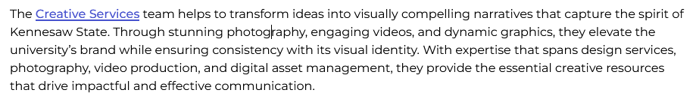

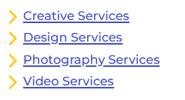
Links
Don’t Use
Here
Click Here
Read More
Learn More
Website
Link
More
Document
This Form
This Page
Download
PDF
Use a Descriptive Link
  In a sentence
  As a button
  With a link list

Slide 24
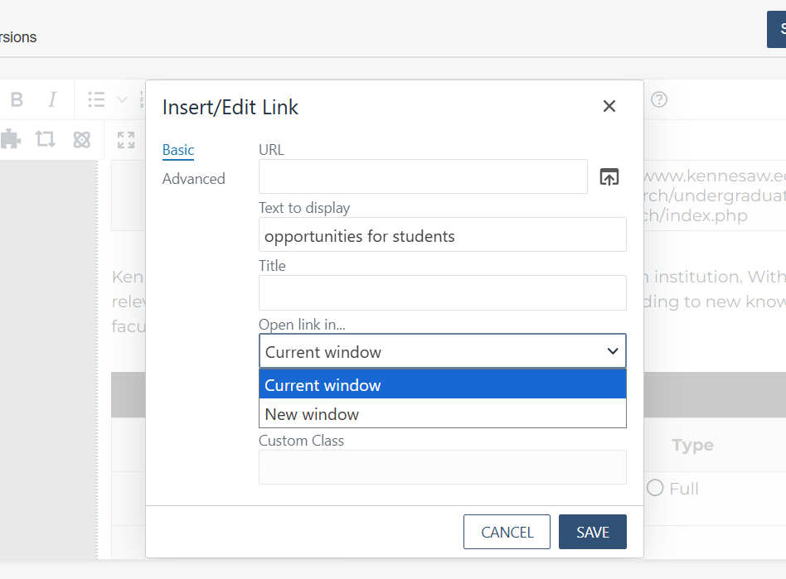
Outside Links
Open a Link in a New Tab
  Use for Outside Links
  Do not use new tab for KSU links
WCAG:
  A link that opens in a new window or tab SHOULD indicate that it opens in a new window or tab.
  Visual + auditory cues: Use text like “(opens in a new window)” or use ARIA attributes, hidden text for screen readers, or a consistent icon (with accessible label) so that both sighted and non-sighted users are informed.

Slide 25
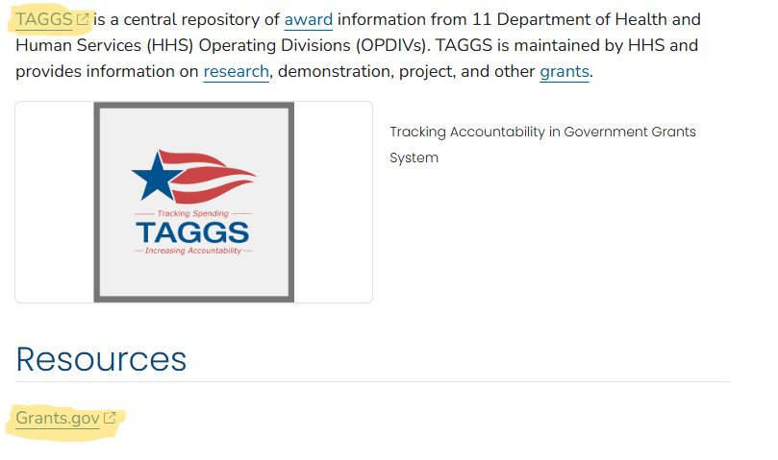
External Link Icon (Coming soon)
External Link Icon
  “The external link icon is a good way to communicate that a link is external.”
  https://designsystem.digital.gov/components/link/

Slide 26

Images
Use Images
  Relevant to the Page Content
  Avoid Text Images
Write an Image Description
  Briefly Describe the Image
  Demographic Information is Not Usually Needed (unless it is essential to understanding the image)
  Include Emotion, if Possible
  Do Not Say “image of…”
  Long Description (for Complex Images, Info-graphics)
A group of people collaborates around a table filled with colorful papers, sticky notes, and design drafts, conveying teamwork and creativity.
How to write good alt text - Making images accessible with alternative text

Slide 27
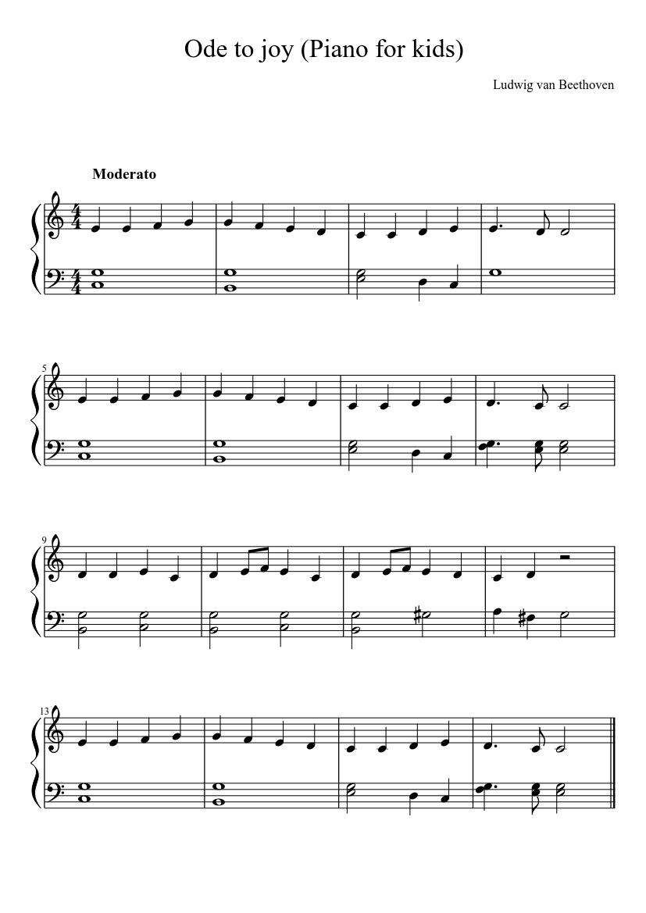

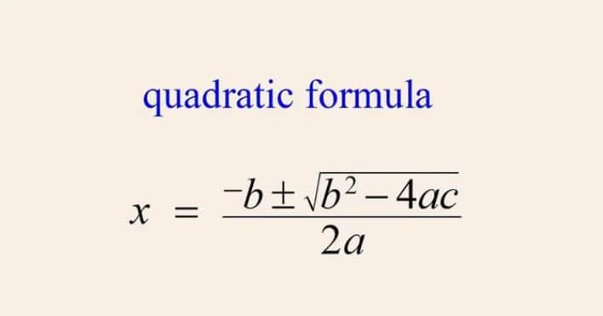
Music and Math Images
Close-up of a hand writing math equations on a transparent glass board with a white marker. The scene conveys focus and problem-solving.
text 'quadratic formula' in blue above the mathematical formula: x equals negative b plus or minus the square root of b squared minus 4ac, divided by 2a.
Sheet music for "Ode to Joy (Piano for kids)" by Beethoven, in the key of C major. The piece is in 4/4 time, marked "Moderato," contains 16 bars and has simple note patterns.
How to write good alt text - Making images accessible with alternative text

Slide 28
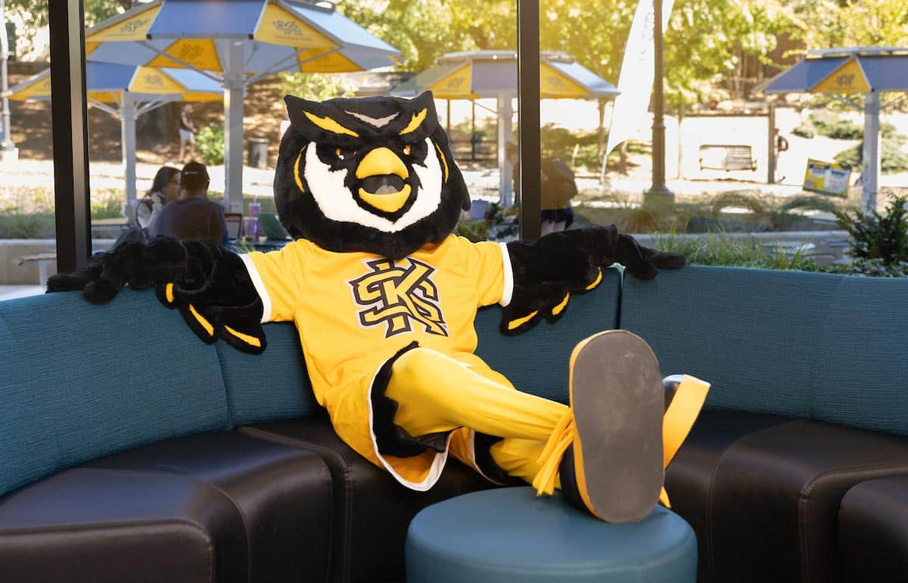
Practice!
Write an Image Description…

Slide 29
Practice!
Write an Image Description…
AI might give you…
A mascot, resembling an owl, relaxes on a blue couch wearing a bright yellow jersey. The scene is cheerful, with a sunlit courtyard visible outside.
Adjust it as needed…
A scrappy mascot, resembling an owl, relaxes on a blue couch wearing a bright yellow KSU jersey. The scene is cheerful, with a sunlit courtyard visible outside.

Slide 30
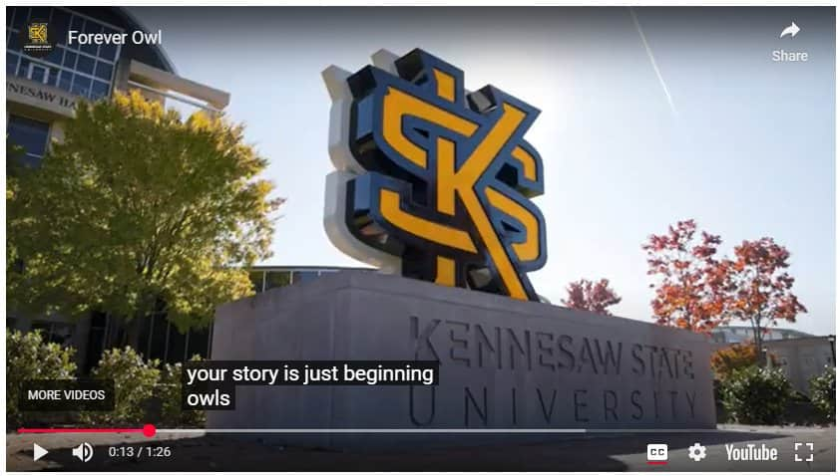
Video
Use Video
  Include closed captioning
  and/or audio description​
  Use current branding​
  Make sure content is
  correct and relevant​
Strategic Communications Video Services: http://go.kennesaw.edu/video
Notes:
We will be doing an audit of videos, please ensure your videos have CC and AD where applicable

Slide 31

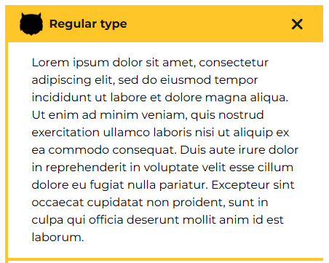
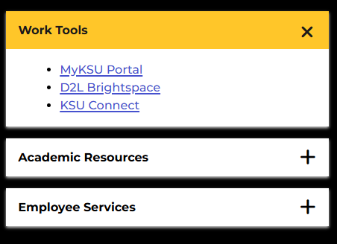

How Do I..?
Use the Accordion Snippet
  Keep lists to 5-7 items
  Use sparingly
  Don't nest within other accordions
  Don't use images in headings

Slide 32
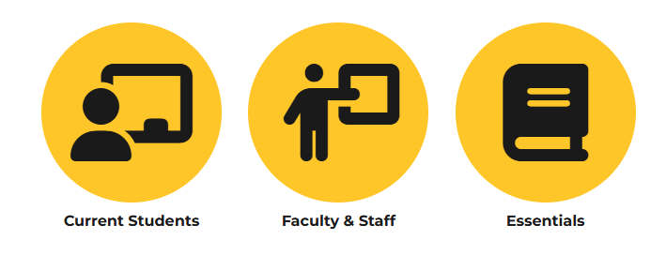
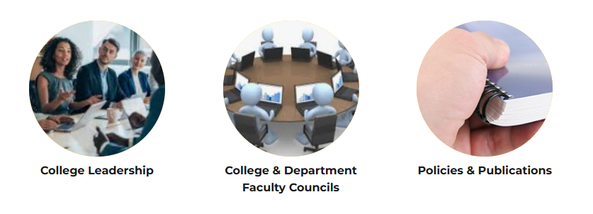
Channels
Use the Channels Snippet
  Use for Links
  May Have Icons or Images
  Use Font-awesome Icons
  Remember Image Descriptions
  Tip: "college leadership"
  does not describe this image...

Slide 33
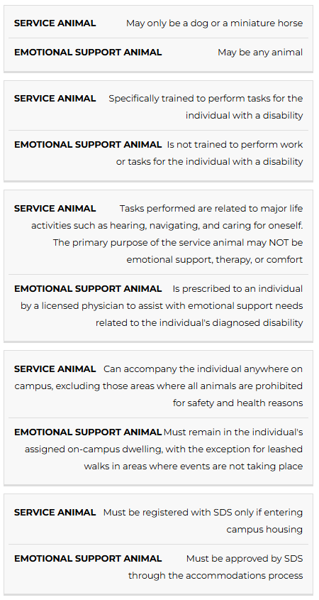
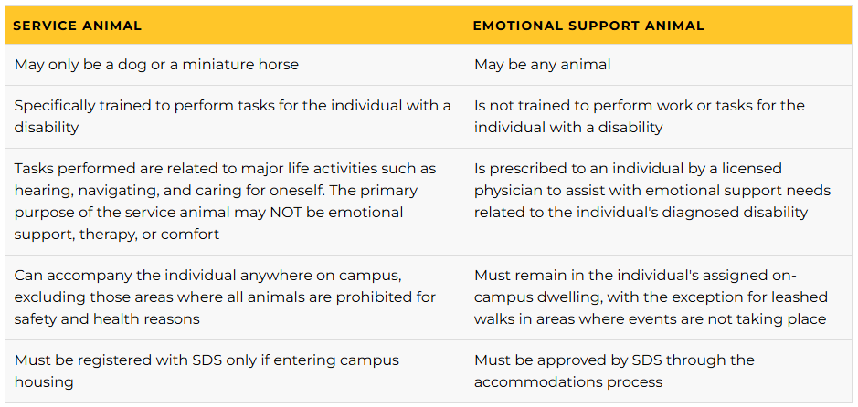
Tables
Use Tables
  Use the Columns tool for Page Layout
  Use the Table Snippet for Data
  Note: It Does Not Look Like a Table in Mobile

Slide 34
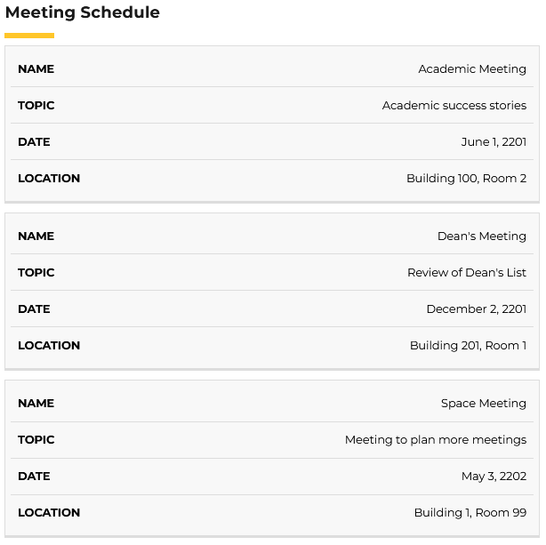
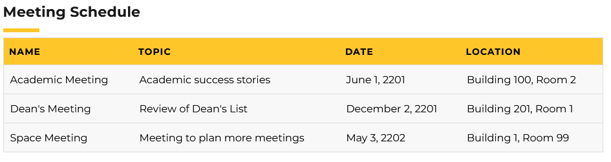
Tables for Data
All Columns have Headings
Rows have one set of information

Slide 35
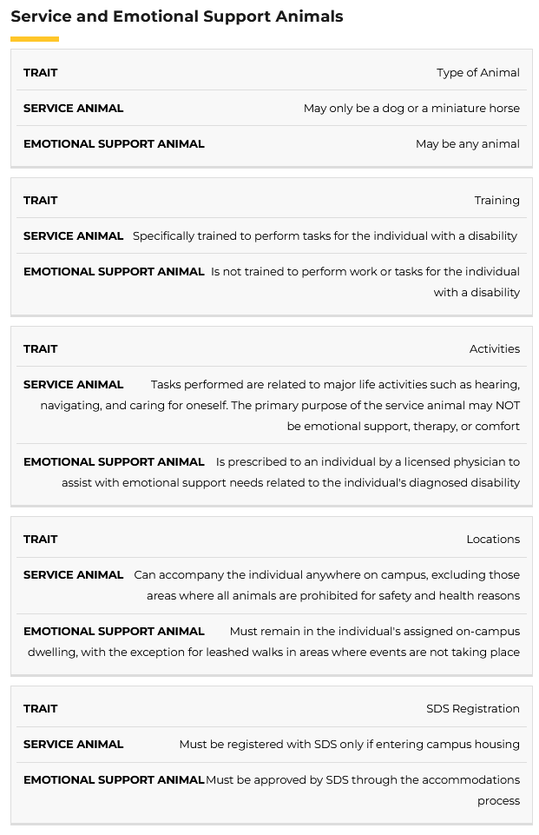
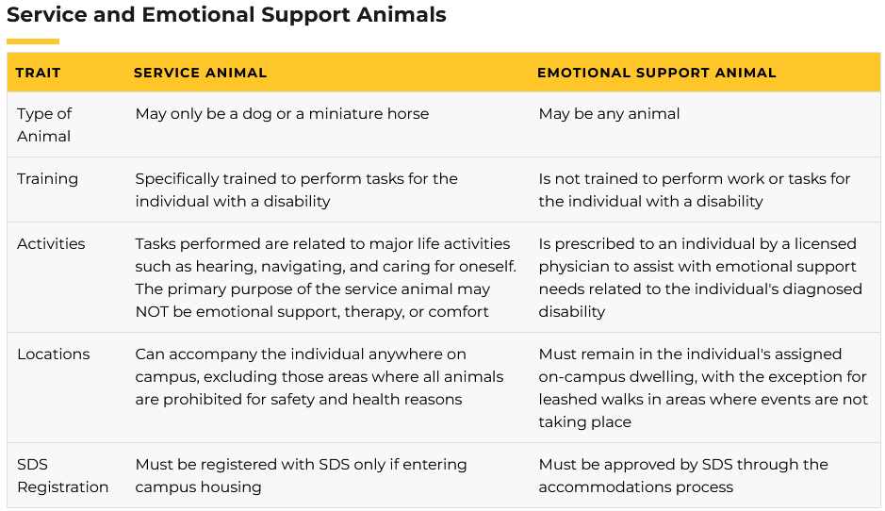
Example Data Table
Let's look at how to fix the Service Animal Table...
Notes:
Working w UITS & MC to ensure tables are ADA compliant w Row span and Col span attributes, this ensures every time that screen readers read the column header and row header before the cell data.

Slide 36
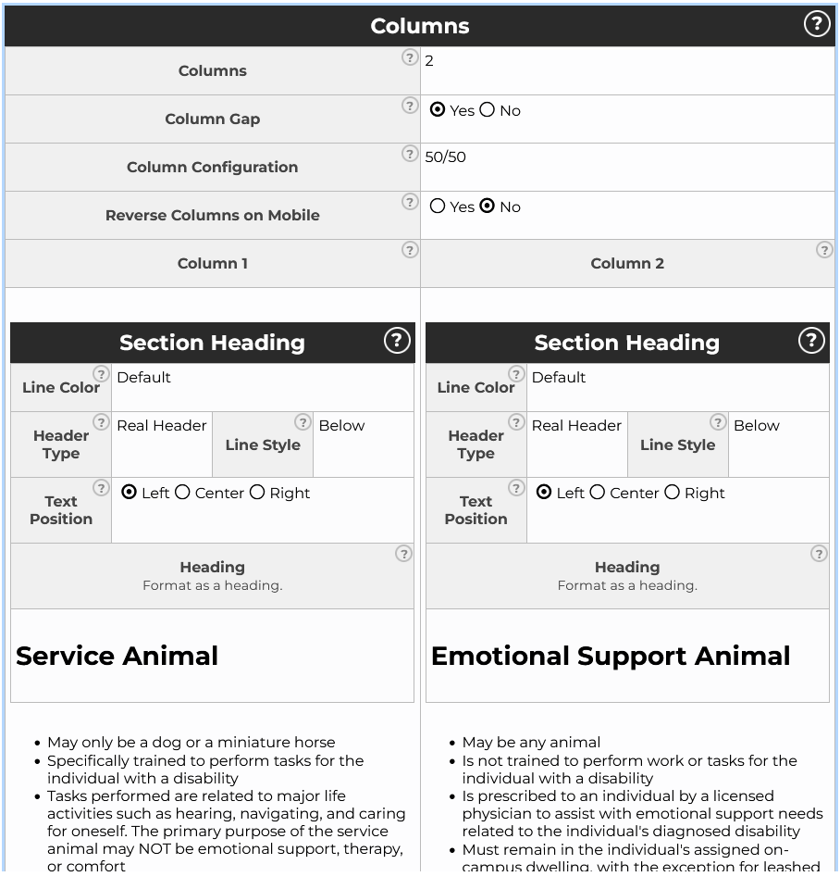
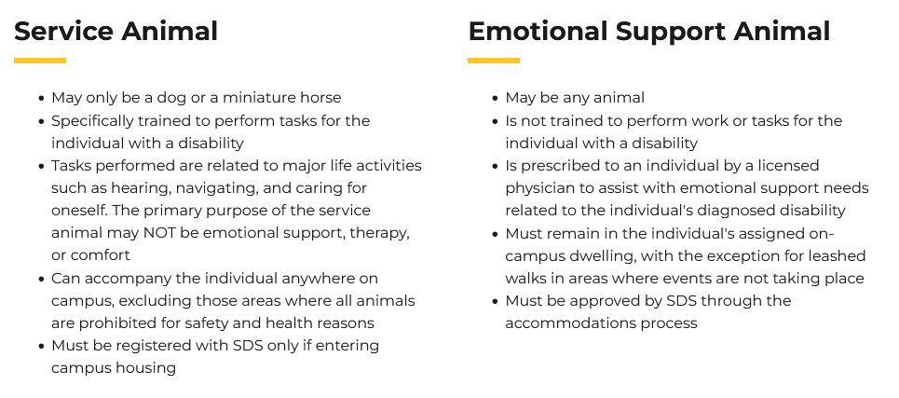
Columns
  Use the Columns Snippet for Page Layout

Slide 37
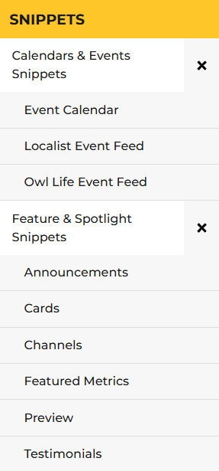
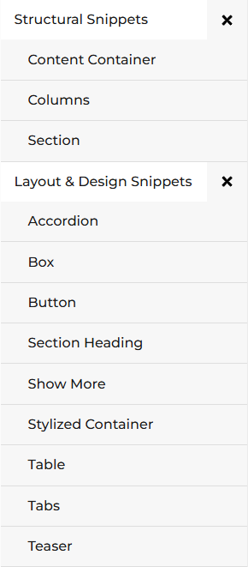
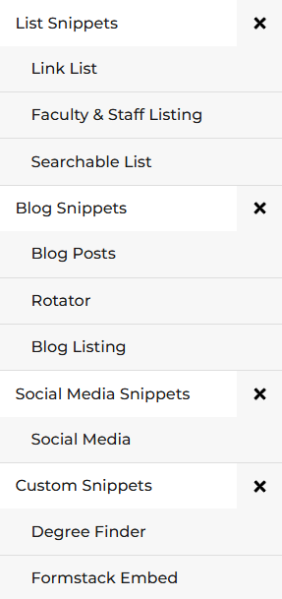
Snippet Library
See the Full Snippet Library
https://campus.kennesaw.edu/offices-services/omnicms/snippets/

Slide 38
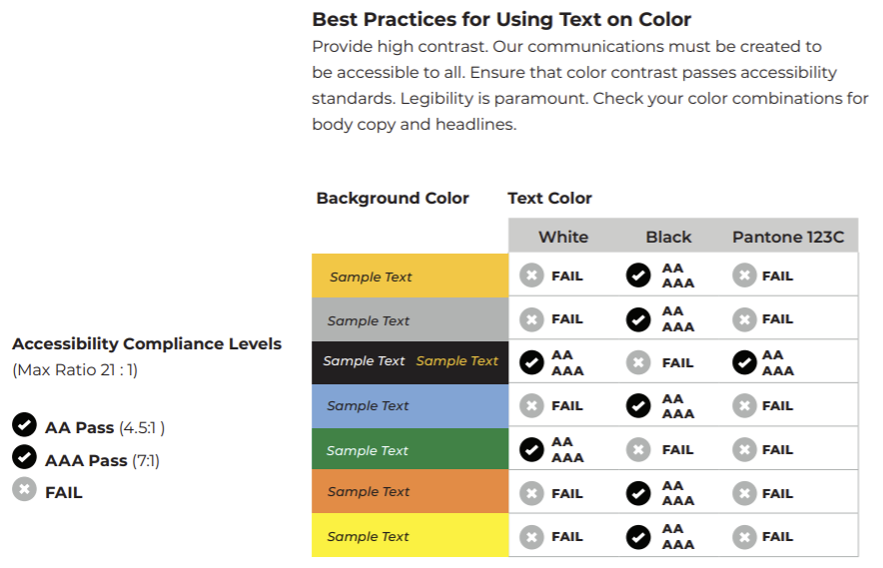
Background Colors
Apply Text on Color
KSU Brand Center - Color Guidelines

Slide 39
HTML vs PDF
HTML is always the default for web content
When PDFs Are Appropriate
  Use PDFs only when a true print or fixed layout is required, such as:
    Official forms
    Legal or policy documents
    Design-heavy brochures or flyers
    Archival or long-term downloadable reports
  In these cases:
    Treat the PDF as a downloadable complement, not the primary source
    Always provide an HTML version for on-screen reading when possible
    Create a PDF Summary section/Page
    Examples of PDF summary pages for inspiration:
        https://www.cdc.gov/tb/communication-resources/tuberculosis-fact-sheet.html
        https://www.cdc.gov/sti/php/communication-resources/syphilis-prenatal-screening-protect-your-baby.html

Slide 40

ADA Checklist
One Unique H1
Heading Hierarchy
Scannable Text
Descriptive Links
Image Descriptions
Closed Captions Videos
Audio Descriptions (If needed)
Table Column Headings
Also Test for:
Spelling Errors
Broken Links
Notes:
https://accessibility.huit.harvard.edu/audio-description
https://www.jmu.edu/accessibility/digital-accessibility/fundamentals/guides/audio-descriptions.shtml

Slide 41
ADA Resources
GSA Section508.gov
ADA.gov
Web Content Accessibility Guidelines (WCAG) 2.1
KSU - Student Disability Services
KSU - Academic Web Accessibility
Tools
Use the WebAIM Contrast Checker
Accessibility Testing Tool - ANDI
What is Ally?
Blackboard - Ally Accessibility Checklist
Policy
KSU - Web Accessibility Policy

Slide 42


Making Progress!
Site Improve
StratComm now has access
Working on ADA quick fixes for KSU’s most visited pages, e.g.:
/about, /academics, /admissions...
Some issues include:
  Headings are not structured
  Text in all caps
  Content missing after heading
  Inline frame missing a text alternative
  Interactive element does not meet minimum size nor spacing
Level Access
Approved and Coming Soon!

Slide 43
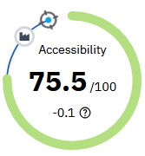

ADA top 200-page audit
Common Issues:
  Headings that are missing or not properly structured (H1–H5)
  Text written in ALL CAPS (for example: KENNESAW STATE UNIVERSITY)
  Headings with no content following them (no text between headings)
  Interactive elements (links) that are too small or too close together
  Embedded content (such as iframes) missing text alternatives
Site Improve Audit (Accessibility Report)
Top 200 Pages from GA4
(most visited) on "www" and "campus"
Stratcomm Web Team will be making updates

Slide 44
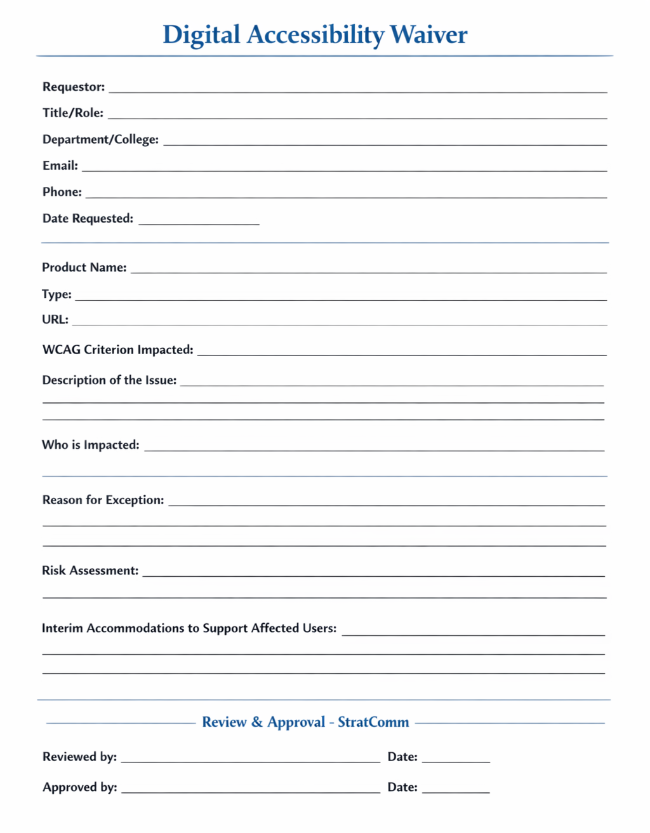
Request for a Web Accessibility Waiver
Request a temporary exception when accessibility requirements cannot be met immediately.
All exceptions require a remediation plan and timeline.
Accessibility exceptions are intended to be rare, temporary, and actively managed.
They do not remove the obligation to provide accessible experiences, and they do not override ADA Title II or WCAG compliance requirements.
Each request if approved will have a fixed timeline to remediate.
Products that do not remediate will be removed from the site.

Slide 45

Questions..?

Slide 46
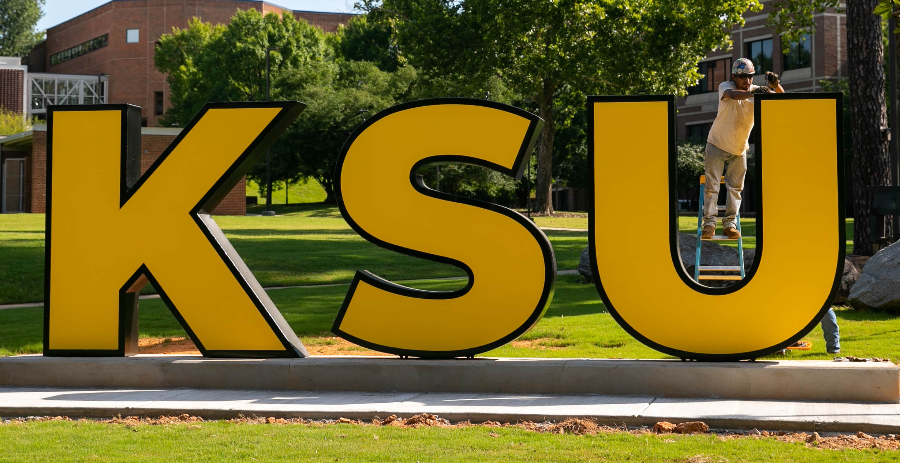
Our Team
Leadership:
Joe Lacy - Director, SEO and Website Strategy
Sharon McAleer - Web Team Manager
Writers:
Josie Carter - Lead Marketing and SEO Copywriter
Malik Jones - Marketing and SEO Copywriter
Webmasters:
Jonathan Gilliam – Senior Webmaster and SEO Specialist
Anthony Matusko - Senior Webmaster and SEO Specialist
Elizabeth Ball - Webmaster and SEO Specialist
Sean Bresnan - Webmaster and SEO Specialist
Matthew Gordon - Webmaster and SEO Specialist
Tara Rose - Webmaster and SEO Specialist
Notes:
Something to consider

