Slide 1
Welcome!
We will begin promptly at 2pm.

Slide 2
Managing Your Bleachers
How To Submit Changes for Multi-Incumbent Positions

Slide 3
What is a multi-incumbent position?
  Explanation
  Notes and Reminders
How do I submit changes?
  Add/Change Position Transaction
  My Team Transaction
What resources are available?
  SSC Knowledge Base
  HR Newsletter
  HR Training
  HR Teams
AGENDA

Slide 4
What is a multi-incumbent position?

Slide 5
A multi-incumbent position is a position that holds more than one employee at a time.
The type of employment and funding determines whether or not a position can be multi-incumbent.

Slide 6
To be multi-incumbent, positions MUST be:
Non-benefitted
  Temporary
  Regular with fewer than 20 standard hours per week
Lump-sum funded
  Positions that hold one budgeted amount for the role, not one budgeted amount per position/role
Positions That Can Be Multi-Incumbent

Slide 7


These people represent employees. Each employee has their own Employee ID.
Employees are hired into position 12345678. The data from the position is added to each employee for as long as each employee remains in the position.
Employees earn compensation based on the classification and their experience level.
This set of bleachers represents position number 12345678.
Position 12345678 is a Student Assistant position in Human Resources. It is a temporary, 19 hours per week position and reports to the Office Manager, position 87654321.
It is funded 100% from Human Resources.

Slide 8
When making changes to a multi-incumbent set up, you must first decide:
Are all employees changing?
Are they all changing in the same way?

Slide 9
Are all employees changing?
yes
Are they all changing in the same way?
no
yes
no
Of the ones who are changing, are they all changing in the same way?
1. Choose one change that will be made on the current position.
2. Transfer all employees not changing in that way into one or multiple new or existing multi-incumbent position(s) with matching position details.
3. Change the current position number to change all remaining incumbents.
Change the current position number to change all incumbents
no
yes
Transfer employees who are changing into multiple new or existing multi-incumbent positions with matching position details
Transfer employees who are changing into one new or existing multi-incumbent position with matching position details

Slide 10
How do I submit changes?

Slide 11
Actions that affect a POSITION are
routed through MANAGE POSITIONS
Manage Positions
Use for vacant positions
-OR-
Use when employee is changing while
staying in current position number
Classification (Job Code / Title)
Department
Reports To
Standard Hours / FTE
Pay Frequency
Position Funding

Slide 12
Employees who share a position number must all be changed in the same way if making changes via Manage Positions.
If only one or a group of employees within a position is changing, the employee(s) changing will need to be moved to a new position number via Transfer action.

Slide 13
Manage Position transactions can be edited once they are submitted by the HRBP or by HRMS.
However, ensuring that all data is complete and accurate prior to submission, including effective date, will prevent unnecessary delays and possible denial of submissions.

Slide 14
Please reach out to your HR Team if you have questions about a particular data element.
Submitting a transaction with incorrect information in order to submit it can cause unnecessary delays or possible denial.

Slide 15
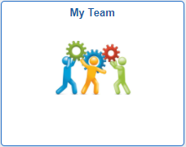
Actions that affect an EMPLOYEE are
routed through supervisor’s MY TEAM
My Team
Use when employee is moving to a new position number
Use when employee information is changing
Transfer
Promote
Demote
Change Time/Absence Approver
Reports To
Retire
Terminate
Salary Change
Supplemental Pay

Slide 16
My Team transactions can NOT
be edited by anyone once
they are submitted.
Ensuring that all data is complete and accurate prior to submission, especially effective date, will prevent HR from having to deny the transaction and you from having to start all over.

Slide 17
Please reach out to your HR Team if you have questions about a particular data element.
Submitting a transaction with incorrect information in order to submit it can cause unnecessary delays or possible denial.

Slide 18
What resources are available?

Slide 19

Shared Services Center
Knowledge Base
https://usg.service-now.com/usgsp
Resource developed by the University System of Georgia Shared Services Center to assist employees of the university system in navigating OneUSG products using knowledge articles and job aids.

Slide 20
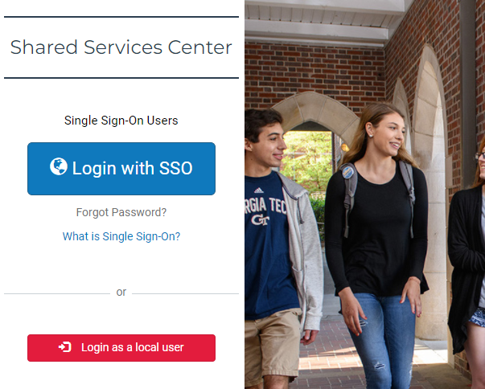
Click the blue log in button and then use your KSU NetID and password to log in, using DUO to authenticate.

Slide 21
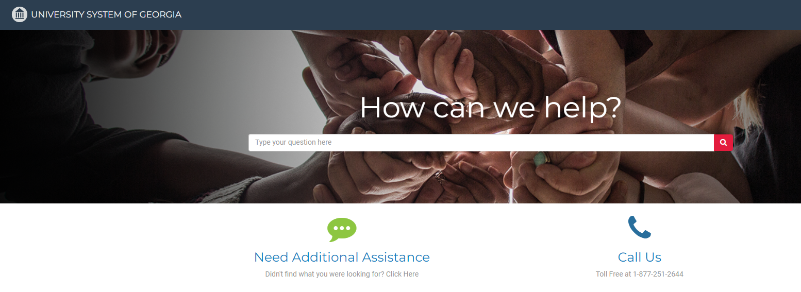
Search the landing page for topics related to
OneUSG transactions and/or products.

Slide 22
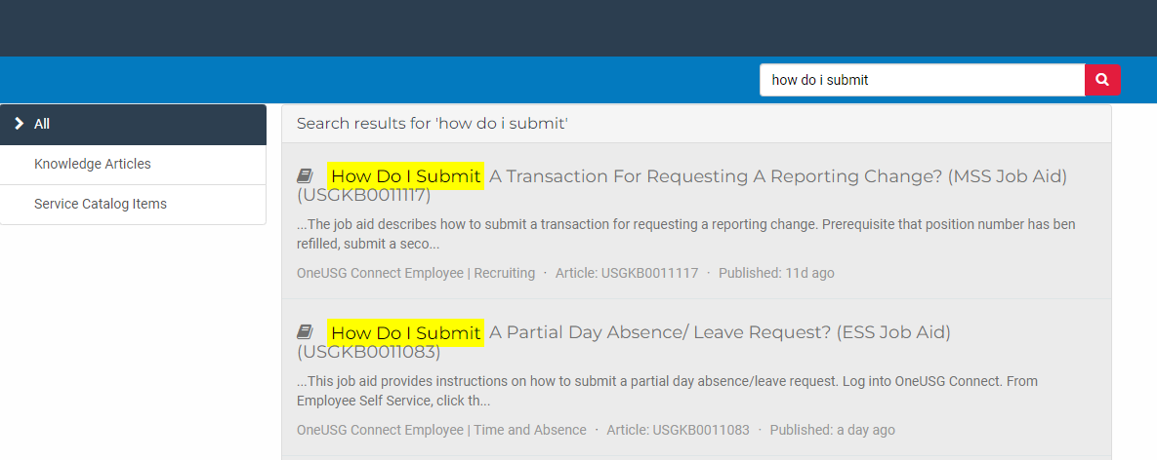
Search the search page for specific text within the searched articles.

Slide 23


https://hr.kennesaw.edu/
communication/newsletter.php
Resource developed by the KSU Human Resources team to inform employees of HR happenings and important topics.
MSS Tips and Tricks articles cover MSS materials and known tips and tricks for transaction success.
HR Newsletter Articles
MSS Tips and Tricks

Slide 24

HR team members provide a monthly webinar and lunch and learn that covers one MSS topic each month.
*See the next slide for a list of topics by month.
https://ksu.percipio.com/channels/df2be379-6673-4008-bd93-2db8587e2217?tab=ATTEND&localeCode=en-US
*Must log in with KSU NetID to view courses
*Dates and times of training sessions are decided at the beginning of the calendar year and all sessions are loaded into the HR Training website.
HR Training
Monthly MSS Sessions

Slide 25
January:
Where do I click? (Manage Positions and My Team Tiles)
February:
Managing Your Seats (Add/Change Position Transaction)
March:
They’re Not Mine! (Reporting and Time&Absence)
April:
Extra! Extra! (Supplemental Pay Transaction)
May:
Moving To a New Seat (Transfers, Promotions, Demotions)
June:
Sorry To See You Go! (Terminations)
July:
Show Me the Money! (Salary Changes)
August:
Let’s Change It All! (Multiple Simultaneous Changes)
September:
Where’s It At? (Viewing and Approving Transactions)
October:
Where’s It Go? (In-Depth Transaction Workflow)
November:
Managing Your Bleachers (Multi-Incumbent Positions)
December:
Can you cover me? (Delegations)
HR Training
Monthly MSS Sessions
(continued)

Slide 26
Have an MSS or HR related issue?
Don’t know who to call?
Check out this website for more info!
https://hr.kennesaw.edu/hrteams.php
Who’s Who in HR?

Slide 27
Questions?

Slide 28
Have a Great Day!

