Slide 1
Welcome!
We will begin promptly at 2pm.

Slide 2
Where’s It At?
How to view transactions to check status or to approve

Slide 3
How do I view transactions I’ve submitted?
Manage Positions > View Request History
Review Transactions
Notifications Bell
How do I approve transactions?
Manage Positions > Approve Requests
Approvals
Notifications Bell
What resources are available?
SSC Knowledge Base
HR Newsletter
HR Training
HR Teams
AGENDA

Slide 4
How do I view transactions I’ve submitted to check status?

Slide 5
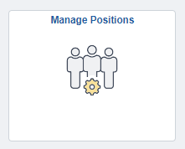
Actions that affect a POSITION are
routed through MANAGE POSITIONS
Manage Positions
Use for vacant positions -OR- Use when employee is changing while staying in current position number
Classification (Job Code / Title)
Department
Reports To
Standard Hours / FTE
Pay Frequency
Position Funding

Slide 6
Click the Manage Positions tile and then “View Request History” to begin

Slide 7
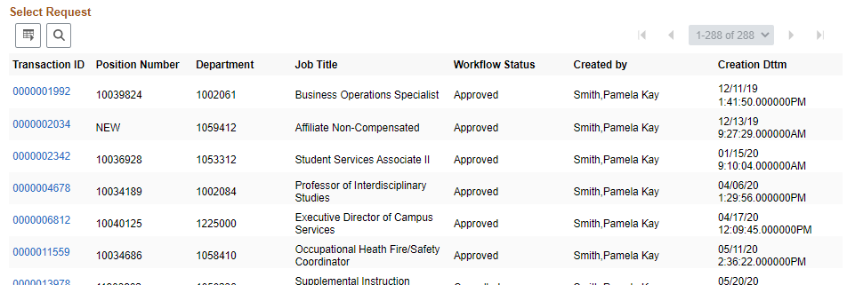
Request history table will appear that includes all transactions submitted by the user – click on the blue link next to the transaction to open it

Slide 8
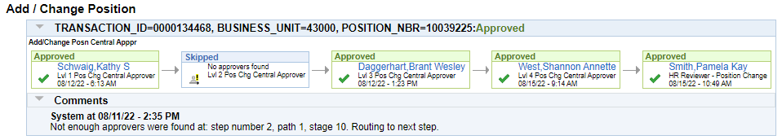
The workflow is on the bottom of page 3. Click Next Page at the bottom of the screen twice to get there. Each box in the sequence has four key elements that will explain the status of the transaction:
Status – at the top of the box is the status of that approval (Approved, Skipped, Denied, Pending)
Approver – the first line in the box is the name of the approver or the words “Multiple Approvers” (click to see the list) or “No approvers found”
Level – the second line in the box is the workflow level (all transactions have four levels of approval plus an “HR Reviewer”; any additional approvers manually inserted will say “Inserted Approver”)
Timestamp – the final line in the box is the timestamp for the approval/denial action

Slide 9
Actions that affect an EMPLOYEE are
routed through supervisor’s MY TEAM
My Team
Use when an employee is moving to a new position number
Use when an employee’s information is changing
Transfer
Promote
Demote
Change Time/Absence Approver
Reports To
Retire
Terminate
Salary Change
Supplemental Pay

Slide 10
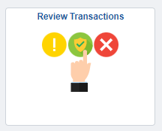
Click the Review Transactions tile to begin

Slide 11
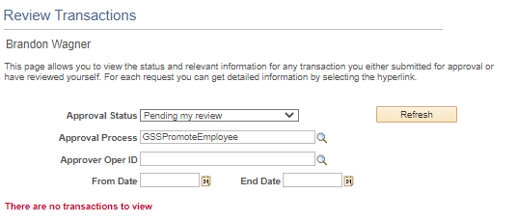
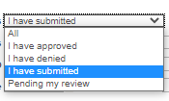
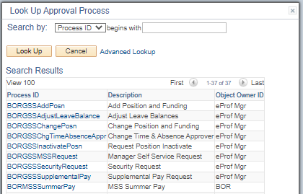
Click the arrow to choose the approval status you wish to see.
Select the transaction type – make sure to choose ones with “BORGSS” or “GSS” at the beginning!
Enter the date range you wish to see or click the calendar icon to choose the date from a calendar

Slide 12

Once you have selected your search criteria, click Refresh.
A blue spinning dial will appear in the top right corner. The search may take several minutes, depending on how many results there are.
Search results will appear (next slide) or you will receive this message.

Slide 13
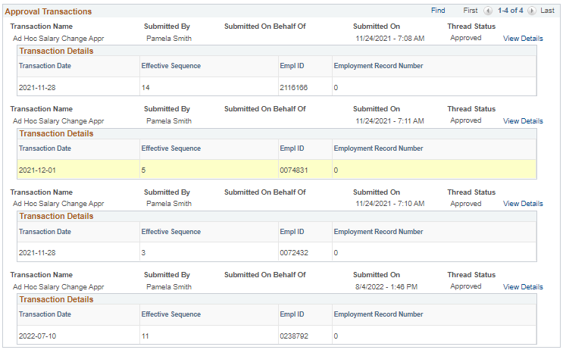
Click View Details to view transaction.

Slide 14
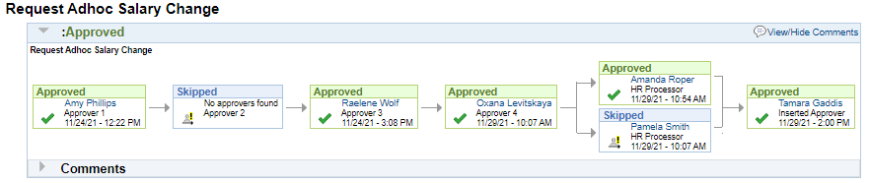
The workflow is on the bottom of the transaction page. Each box in the sequence has four key elements that will explain the status of the transaction:
Status – at the top of the box is the status of that approval (Approved, Skipped, Denied, Pending)
Approver – the first line in the box is the name of the approver or the words “Multiple Approvers” (click to see the list) or “No approvers found”
Level – the second line in the box is the workflow level (all transactions have four levels of approval plus an “HR Processor”; any additional approvers manually inserted will say “Inserted Approver”)
Timestamp – the final line in the box is the timestamp for the approval/denial action

Slide 15
How do I view a transaction to approve it?

Slide 16
Click the Manage Positions tile and then “Approve Requests” to view/approve Add/Change Position transactions

Slide 17
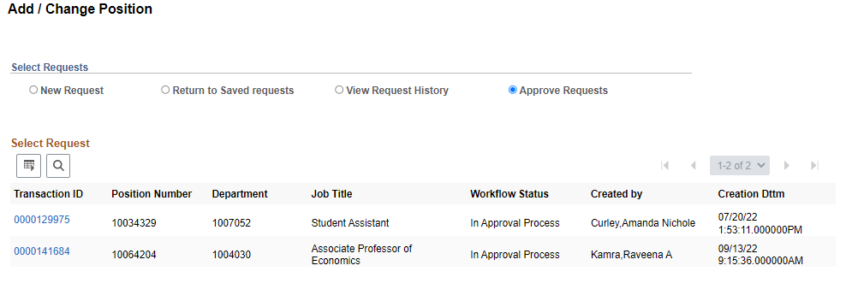
Any transactions pending your approval will be listed under “Approve Requests” - click on the blue link next to the transaction to open it, review it, and provide approval (these transactions are three pages, so make sure to click all the way through to the final approval)

Slide 18
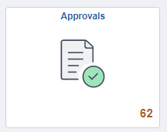
Click the Approvals tile to view/approve My Team transactions

Slide 19
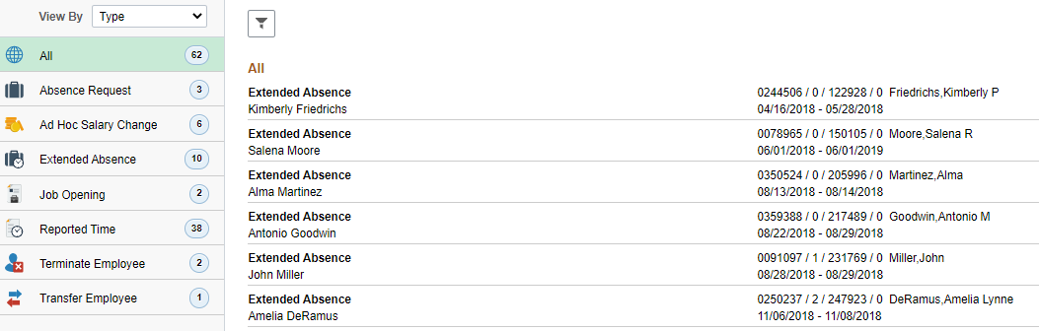

Any transactions pending your approval will be listed on the screen.
Use the “View By” box to filter transactions to certain types, requestors, or dates.
Click on a certain filter to see just those transactions.
Click on a transaction to view and then approve or deny it by clicking the appropriate button.

Slide 20
Click the Notifications Bell to view/approve all transactions

Slide 21
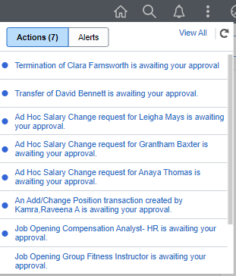
A summary window will appear under the notification bell when you click on it.
Click “View All” to see a list of all transactions

Slide 22
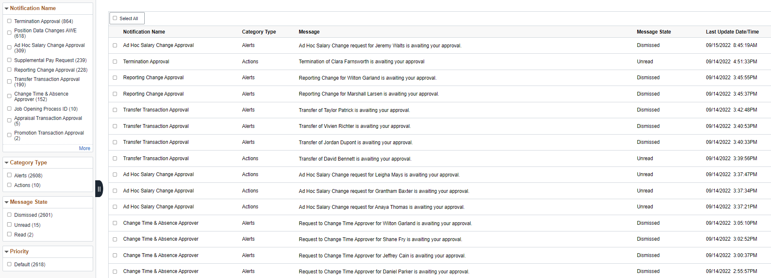
Top 100 transactions are displayed.
Filter options are on the left-hand side to narrow down results.
Click on a transaction to open it and then approve or deny it by clicking the appropriate button.

Slide 23
What resources are available?

Slide 24

Shared Services Center Knowledge Base
https://usg.service-now.com/usgsp
Resource developed by the University System of Georgia Shared Services Center to assist employees of the university system in navigating OneUSG products using knowledge articles and job aids.

Slide 25
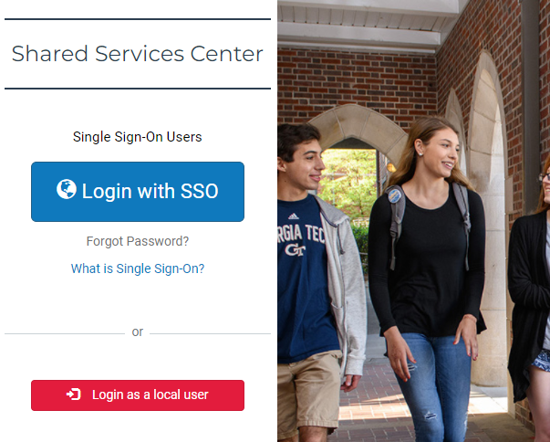
Click the blue log in button and then use your KSU NetID and password to log in, using DUO to authenticate.

Slide 26
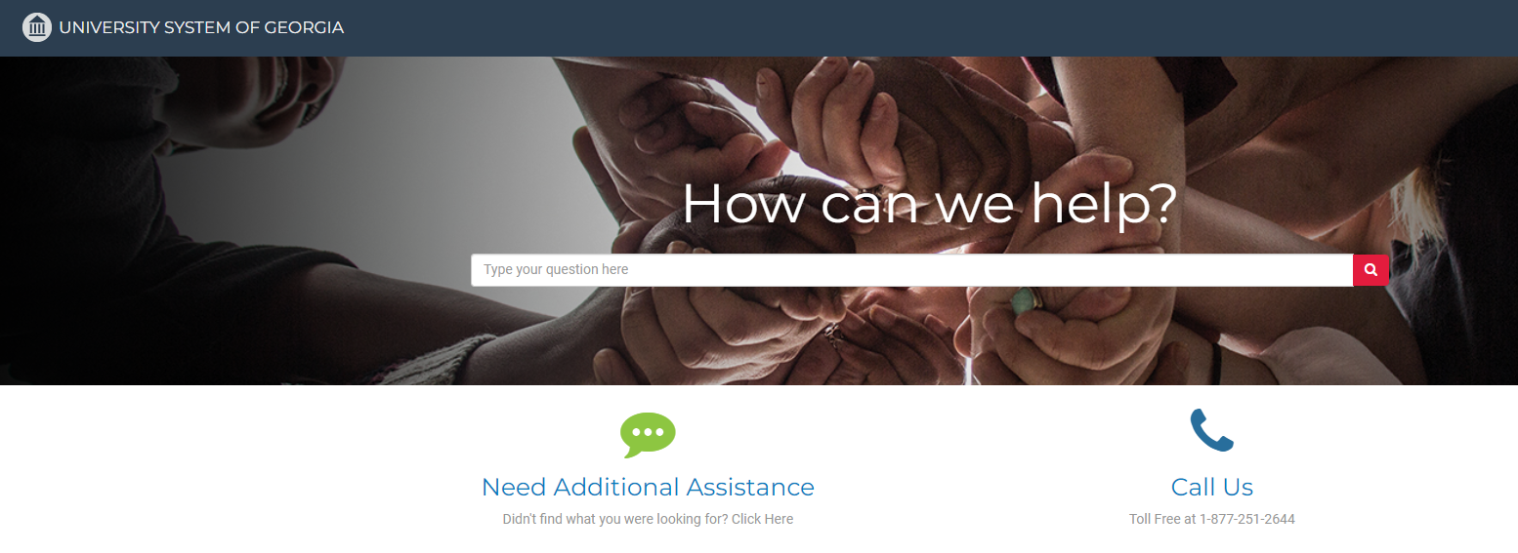
Search the landing page for topics related to
OneUSG transactions and/or products.

Slide 27
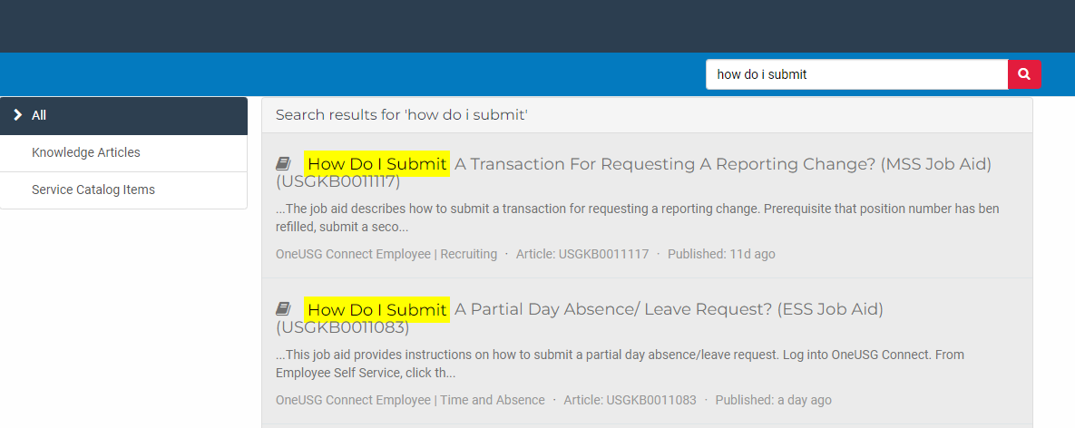
Search the search page for specific text within the searched articles.

Slide 28


https://hr.kennesaw.edu/ communication/newsletter.php
Resource developed by the KSU Human Resources team to inform employees of HR happenings and important topics.
MSS Tips and Tricks articles cover MSS materials and known tips and tricks for transaction success.
HR Newsletter Articles MSS Tips and Tricks

Slide 29

HR team members provide a monthly webinar and lunch and learn that covers one MSS topic each month.
*See the next slide for a list of topics by month.
https://ksu.percipio.com/channels/df2be379-6673-4008-bd93-2db8587e2217?tab=ATTEND&localeCode=en-US
*Must log in with KSU NetID to view courses
*Dates and times of training sessions are decided at the beginning of the calendar year and all sessions are loaded into the HR Training website.
HR Training Monthly MSS Sessions

Slide 30
January: Where do I click? (Manage Positions and My Team Tiles)
February: Managing Your Seats (Add/Change Position Transaction)
March: They’re Not Mine! (Reporting and Time&Absence)
April: Extra! Extra! (Supplemental Pay Transaction)
May: Moving To a New Seat (Transfers, Promotions, Demotions)
June: Sorry To See You Go! (Terminations)
July: Show Me the Money! (Salary Changes)
August: Let’s Change It All! (Multiple Simultaneous Changes)
September: Where’s It At? (Viewing and Approving Transactions)
October: Where’s It Go? (In-Depth Transaction Workflow)
November: Managing Your Bleachers (Multi-Incumbent Positions)
December: Can you cover me? (Delegations)
HR Training Monthly MSS Sessions (continued)

Slide 31
Have an MSS or HR related issue?
Don’t know who to call?
Check out this website for more info!
https://hr.kennesaw.edu/hrteams.php
Who’s Who in HR?

Slide 32
Questions?

Slide 33
Have a Great Day!

