Slide 1
Welcome!
We will begin promptly at 2pm.

Slide 2
Let’s Change It All!
Submitting Multiple, Simultaneous Changes through MSS

Slide 3
Manager Self Service Recap
Definition
Manage Positions and My Team Areas
Types of Transactions (in each area)
How do I submit transactions when multiple changes are happening simultaneously?
Allowable Simultaneous Changes
Notes and Reminders
What resources are available?
SSC Knowledge Base
HR Newsletter
HR Training
HR Teams
AGENDA

Slide 4
Manager Self Service Recap

Slide 5
Manager Self Service allows managers to perform tasks online that previously required the assistance of HR personnel.
This includes accessing information about your team members and utilizing paperless transaction and workflow processes.

Slide 6
Actions that affect a POSITION are
routed through MANAGE POSITIONS
Manage Positions
Use for vacant positions -OR- Use when employee is changing while staying in current position number
Classification (Job Code / Title)
Department
Reports To
Standard Hours / FTE
Pay Frequency
Position Funding

Slide 7
Manage Position transactions can be edited once they are submitted by the HRBP or by HRMS.
However, ensuring that all data is complete and accurate prior to submission, including effective date, will prevent unnecessary delays and possible denial of submissions.

Slide 8
Employees who share a position number must all be changed in the same way if making changes via Manage Positions.
If only one or a group of employees within a position is changing, the employee(s) changing will need to be moved to a new position number via Transfer action.

Slide 9
Actions that affect an EMPLOYEE are
routed through supervisor’s MY TEAM
My Team
Use when an employee is moving to a new position number
Use when an employee’s information is changing
Transfer
Promote
Demote
Change Time/Absence Approver
Reports To
Retire
Terminate
Salary Change
Supplemental Pay

Slide 10
My Team transactions can not be edited once they are submitted by the submitter, approvers, or Human Resources.
Making sure that all details, including effective date, are correct prior to submitting is key to a successful transaction.

Slide 11
How do I submit transactions when multiple changes are happening simultaneously?

Slide 12
Add/Change Position Transaction
Changes one or more elements associated with the position, including: classification (job code and title), reports to, pay group, regular/temporary status, full-time/part-time status, FLSA status, department, and standard hours/full-time equivalent. If multiple of these are changing, you can indicate all in one transaction to make all changes at once.
REMINDER: the system will not allow multiple Add/Change Position transactions to be submitted with the same effective date, so make sure all changes happening as of a specific date are submitted all in one transaction, as you will be unable to go back and submit another one with the same date.
Transfer, Demotion, and Promotion Transactions
Also allow a related pay rate change by sliding the pay rate change slider to YES when the transaction is initiated
Some transactions allow multiple changes

Slide 13
Add/Change Position Transaction
If classification is changing and pay rate is changing to be in line with a new pay grade, the new compensation rate should be indicated in the Summary of Request section
If reports to is changing and time and absence approver is changing to match the new reports to, the new time approver’s name can be indicated in the Summary of Request section
Reports To Change Transactions
If reports to is changing and time and absence approver is changing to match the new reports to, the new time approver’s name can be indicated in the Comments section
Transfer, Demotion, and Promotion Transactions
If an employee is moving to a new position via transfer, demotion, or promotion transaction, the system will allow the submitter to indicate if a new pay rate is associated with the change. If so, change the slider to “YES” to indicate the new pay rate as part of the transfer, demotion, or promotion transaction
Some transactions allow comments to change other related elements

Slide 14
All other simultaneous changes will require multiple transactions to request all appropriate changes
Example 1: an employee is changing to a new manager and is receiving a pay rate increase. Two transactions would be needed – one to change the reports to and one to change the pay rate.
Example 2: a position is moving to a new department and to a new funding source
Other simultaneous changes will require multiple transactions

Slide 15
When submitting multiple transactions, make sure to wait until one is fully approved (by all approvers, including HR) prior to submitting the next request
This does not apply to Change Position Funding requests. Change Position Funding requests may be submitted at the same time as other transactions, as they do not affect the same data tables.

Slide 16
What resources are available?

Slide 17

Shared Services Center Knowledge Base
https://usg.service-now.com/usgsp
Resource developed by the University System of Georgia Shared Services Center to assist employees of the university system in navigating OneUSG products using knowledge articles and job aids.

Slide 18
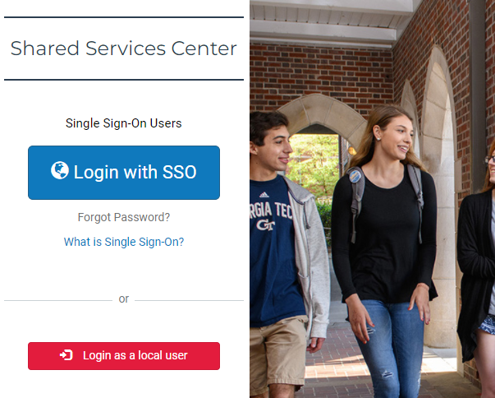
Click the blue log in button and then use your KSU NetID and password to log in, using DUO to authenticate.

Slide 19
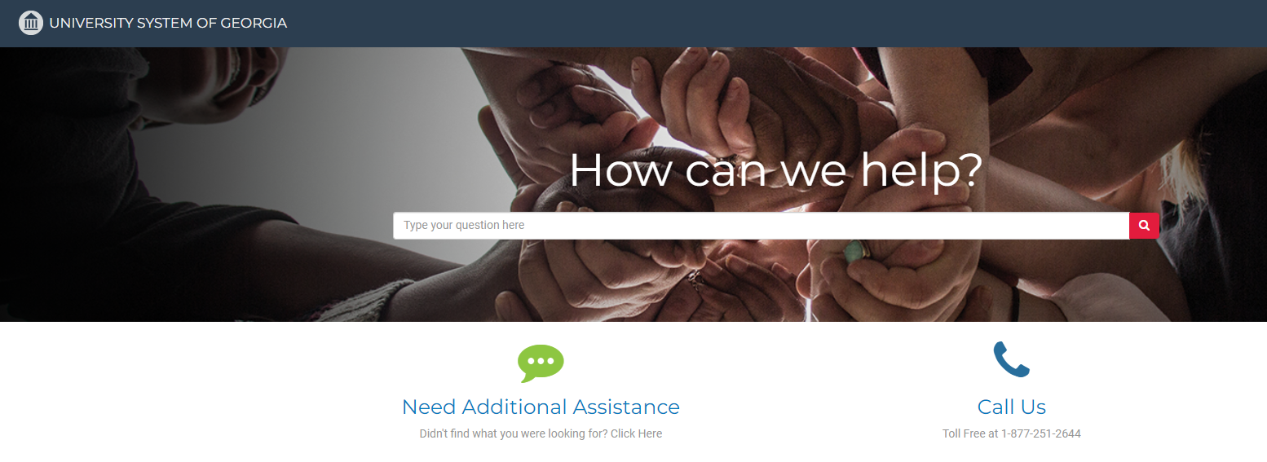
Search the landing page for topics related to
OneUSG transactions and/or products.

Slide 20
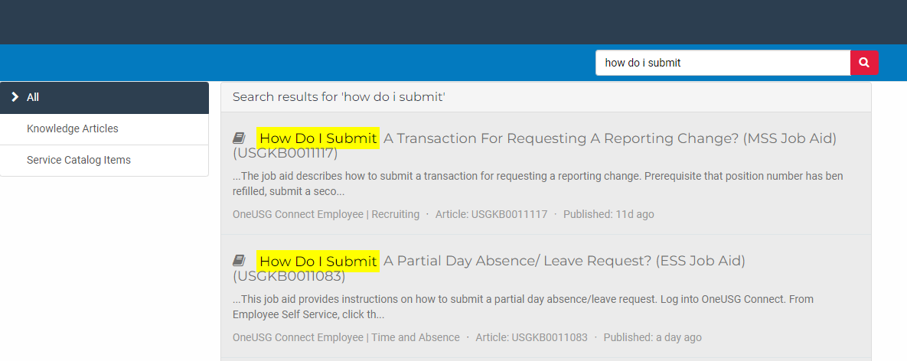
Search the search page for specific text within the searched articles.

Slide 21


https://hr.kennesaw.edu/ communication/newsletter.php
Resource developed by the KSU Human Resources team to inform employees of HR happenings and important topics.
MSS Tips and Tricks articles cover MSS materials and known tips and tricks for transaction success.
HR Newsletter Articles MSS Tips and Tricks

Slide 22

HR team members provide a monthly webinar and lunch and learn that covers one MSS topic each month.
*See the next slide for a list of topics by month.
https://ksu.percipio.com/channels/df2be379-6673-4008-bd93-2db8587e2217?tab=ATTEND&localeCode=en-US
*Must log in with KSU NetID to view courses
*Dates and times of training sessions are decided at the beginning of the calendar year and all sessions are loaded into the HR Training website.
HR Training Monthly MSS Sessions

Slide 23
January: Where do I click? (Manage Positions and My Team Tiles)
February: Managing Your Seats (Add/Change Position Transaction)
March: They’re Not Mine! (Reporting and Time&Absence)
April: Extra! Extra! (Supplemental Pay Transaction)
May: Moving To a New Seat (Transfers, Promotions, Demotions)
June: Sorry To See You Go! (Terminations)
July: Show Me the Money! (Salary Changes)
August: Let’s Change It All! (Multiple Simultaneous Changes)
September: Where’s It At? (Viewing and Approving Transactions)
October: Where’s It Go? (In-Depth Transaction Workflow)
November: Managing Your Bleachers (Multi-Incumbent Positions)
December: Can you cover me? (Delegations)
HR Training Monthly MSS Sessions (continued)

Slide 24
Have an MSS or HR related issue?
Don’t know who to call?
Check out this website for more info!
https://hr.kennesaw.edu/hrteams.php
Who’s Who in HR?

Slide 25
Questions?

Slide 26
Have a Great Day!

