Slide 1
Welcome!
We will begin promptly at 2pm.

Slide 2
Sorry to See You Go!
An In-Depth Look at the Termination Transaction

Slide 3
What is a Termination?
  Explanation
How Do I Submit a Termination?
  Transaction Walk Through
What resources are available?
  SSC Knowledge Base
  HR Newsletter
  HR Training
  HR Teams
AGENDA

Slide 4
What is a Termination?

Slide 5
A termination is the action that separates an employee from employment with KSU.
Terminations can have many different reasons, such as resignation, end of temporary employment, reduction in force, or misconduct.

Slide 6
How Do I Submit a Termination?

Slide 7
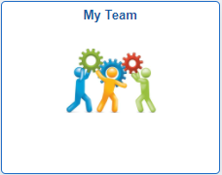
Actions that affect an EMPLOYEE are
routed through supervisor’s MY TEAM
My Team
Use when employee is moving to a new position number
Use when employee information is changing
Transfer
Promote
Demote
Change Time/Absence Approver
Reports To
Retire
Terminate
Salary Change
Supplemental Pay

Slide 8
Terminating a manager or time approver will cause vacant reporting or time approval issues
If the terminating employee is a manager or time approver, the employee’s reports should be carefully reviewed and updated

Slide 9
My Team transactions can NOT
be edited by anyone once
they are submitted.
Ensuring that all data is complete and accurate prior to submission, especially effective date, will prevent HR from having to deny the transaction and you from having to start all over.

Slide 10
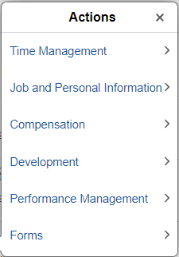
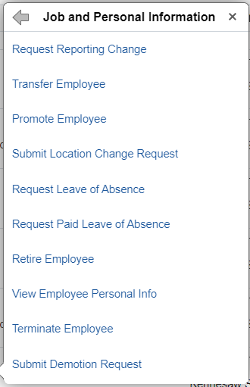
In My Team, you will see a list of employees who report to you. Find the person you wish to change and click the blue arrow next to their name.
Choose Job and Personal Information from the actions menu and then choose Terminate Employee.

Slide 11
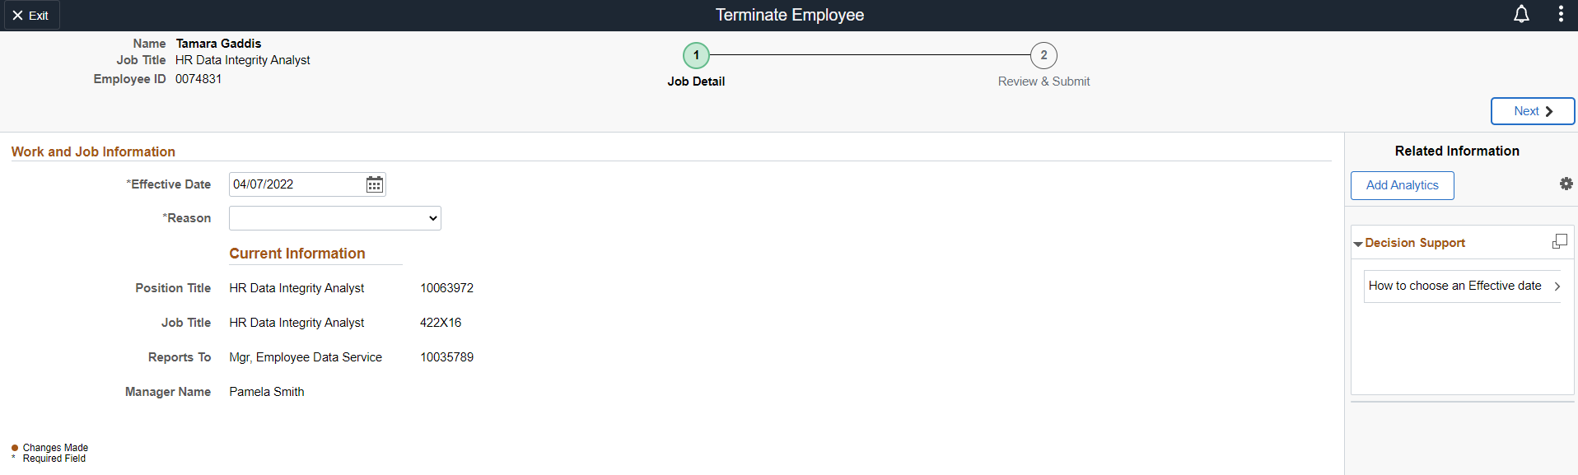
1. Type of transaction
3. Employee information – redacted here for privacy
6. Navigate to next step
2. Steps to complete transaction – current step is indicated with a green circle.
4. Effective date – must be changed to one day after the employee’s last day of work
5. Reason – must select the reason for the termination

Slide 12
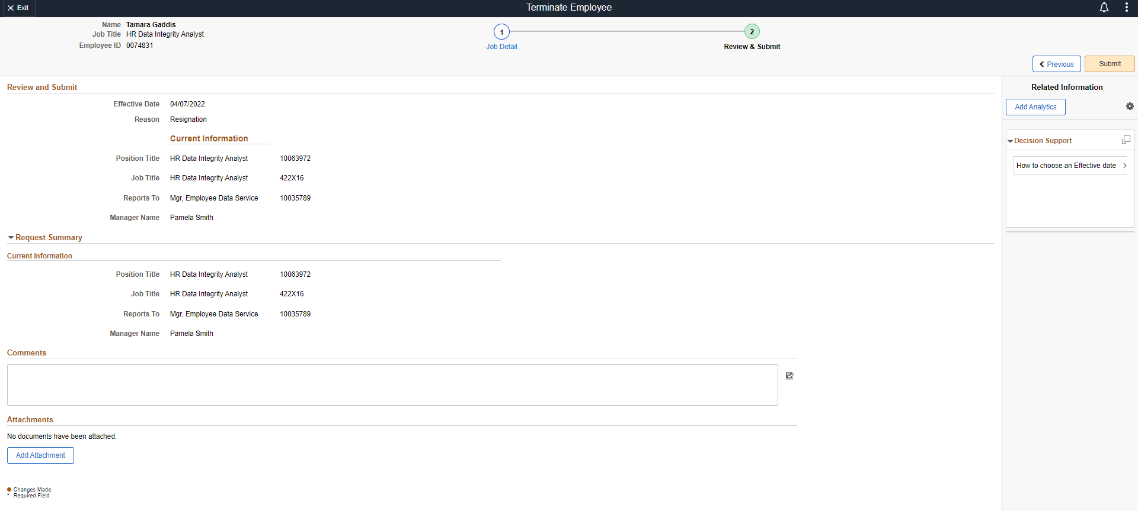
8. Click Submit
7. Review the transaction one more time for accuracy and add any appropriate comments and attachments (such as a resignation letter, if applicable).

Slide 13
What resources are available?

Slide 14

Shared Services Center
Knowledge Base
https://usg.service-now.com/usgsp
Resource developed by the University System of Georgia Shared Services Center to assist employees of the university system in navigating OneUSG products using knowledge articles and job aids.

Slide 15
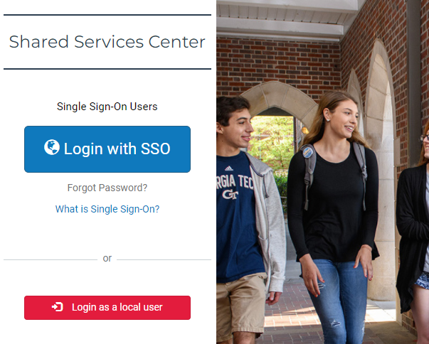
Click the blue log in button and then use your KSU NetID and password to log in, using DUO to authenticate.

Slide 16
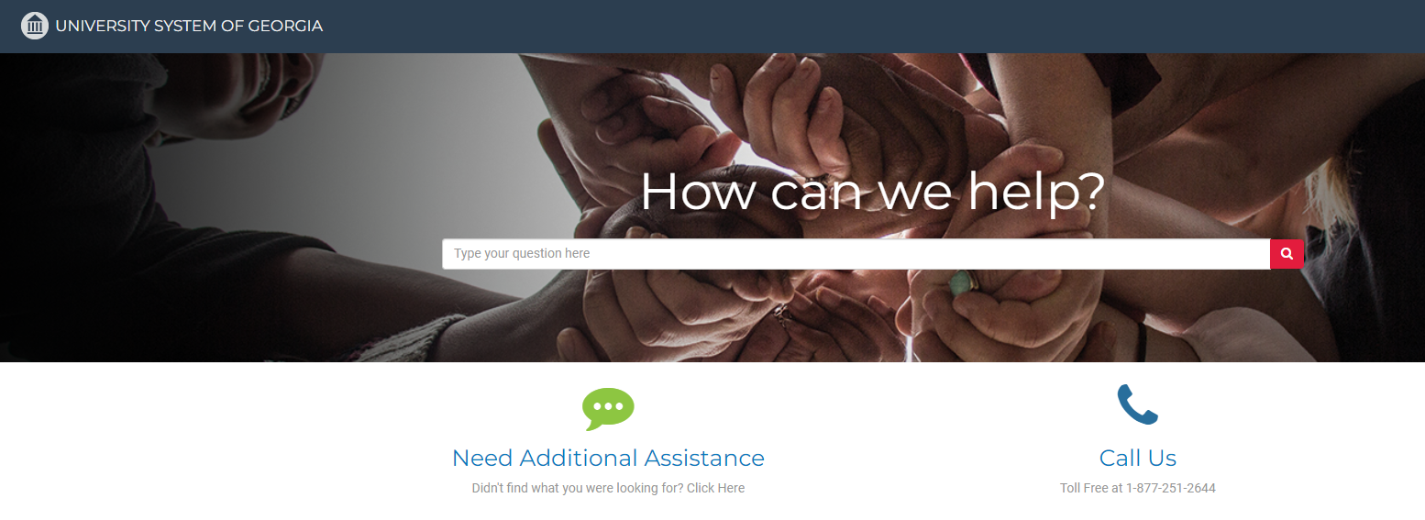
Search the landing page for topics related to
OneUSG transactions and/or products.

Slide 17
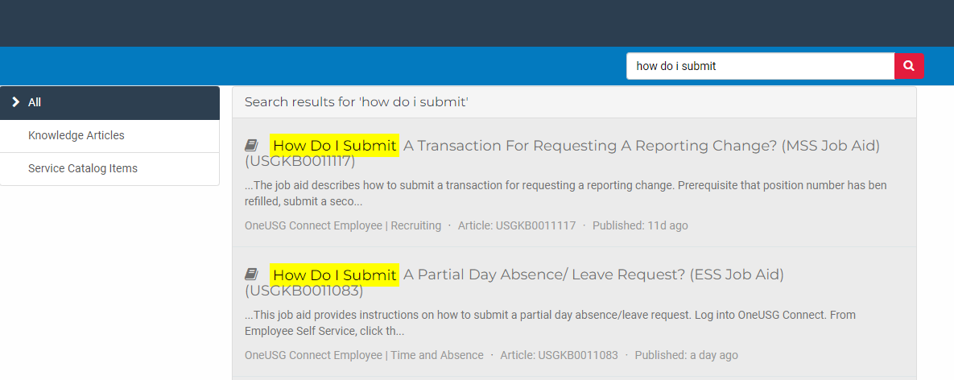
Search the search page for specific text within the searched articles.

Slide 18


https://hr.kennesaw.edu/
communication/newsletter.php
Resource developed by the KSU Human Resources team to inform employees of HR happenings and important topics.
MSS Tips and Tricks articles cover MSS materials and known tips and tricks for transaction success.
HR Newsletter Articles
MSS Tips and Tricks

Slide 19

HR team members provide a monthly webinar and lunch and learn that covers one MSS topic each month.
*See the next slide for a list of topics by month.
https://ksu.percipio.com/channels/df2be379-6673-4008-bd93-2db8587e2217?tab=ATTEND&localeCode=en-US
*Must log in with KSU NetID to view courses
*Dates and times of training sessions are decided at the beginning of the calendar year and all sessions are loaded into the HR Training website.
HR Training
Monthly MSS Sessions

Slide 20
January:
Where do I click? (Manage Positions and My Team Tiles)
February:
Managing Your Seats (Add/Change Position Transaction)
March:
They’re Not Mine! (Reporting and Time&Absence)
April:
Extra! Extra! (Supplemental Pay Transaction)
May:
Moving To a New Seat (Transfers, Promotions, Demotions)
June:
Sorry To See You Go! (Terminations)
July:
Show Me the Money! (Salary Changes)
August:
Let’s Change It All! (Multiple Simultaneous Changes)
September:
Where’s It At? (Viewing and Approving Transactions)
October:
Where’s It Go? (In-Depth Transaction Workflow)
November:
Managing Your Bleachers (Multi-Incumbent Positions)
December:
Can you cover me? (Delegations)
HR Training
Monthly MSS Sessions
(continued)

Slide 21
Have an MSS or HR related issue?
Don’t know who to call?
Check out this website for more info!
https://hr.kennesaw.edu/hrteams.php
Who’s Who in HR?

Slide 22
Questions?

Slide 23
Have a Great Day!

