Slide 1
Welcome!
We will begin promptly at 2pm.

Slide 2
Moving To a New Seat
An In-Depth Look at the Transfer, Promotion, and Demotion Transactions

Slide 3
What are the transfer, promotion, and demotion transactions?
Explanation
When To Use
How do I submit one of these transactions?
Transaction Walk Through
What resources are available?
SSC Knowledge Base
HR Newsletter
HR Training
HR Teams
AGENDA

Slide 4
What are the transfer, promotion, and demotion transactions?

Slide 5
Transfer, promotion, and demotion transactions allow you to move an employee from one position number into a different position number.
These transactions allow you to simultaneously change the rate of pay if needed.

Slide 6

This seat represents position number 12345678.
Position 12345678 is an Administrative Assistant in Human Resources. It is a regular, 40 hours per week position and reports to the Office Manager, position 87654321.
It is funded 100% from Human Resources.
This person represents employee 1122334.
Employee 1122334 is hired into position 12345678. The data from the position is added to the employee for as long as the employee remains in the position.
Employee 1122334 earns compensation based on the classification and their experience level.
These transactions allow you to move the employee to a new seat AND adjust that employee’s data (i.e. compensation) at the same time.

Slide 7
A transfer transaction allows you to move an employee from one position number into a different position number while simultaneously changing the rate of pay. These actions are usually performed for one of two reasons:
To move an employee from one position into another position within the same pay grade/classification
To manage position-related data for employees in multi-incumbent positions (students, part-time faculty, etc.)
Employees whose data is changing are moved into new positions in order to make requested changes without affecting other employees in the position when not all incumbents are changing in the same way
When To Use
Transfer

Slide 8
A promotion transaction allows you to move an employee from one position number into a different position number while simultaneously changing the rate of pay. These actions are usually only performed when an employee is moving into a position at a higher pay grade/classification.
When To Use
Promotion

Slide 9
A demotion transaction allows you to move an employee from one position number into a different position number while simultaneously changing the rate of pay. These actions are usually only performed when an employee is moving into a position at a lower pay grade/classification.
When To Use
Demotion

Slide 10
How do I submit a transfer, promotion, or demotion transaction?

Slide 11

Actions that affect an EMPLOYEE are
routed through supervisor’s MY TEAM
My Team
Use when employee is moving to a new position number
Use when employee information is changing
Transfer
Promote
Demote
Change Time/Absence Approver
Reports To
Retire
Terminate
Salary Change
Supplemental Pay

Slide 12
My Team transactions can NOT be edited by anyone once they are submitted.
Ensuring that all data is complete and accurate prior to submission, especially effective date, will prevent HR from having to deny the transaction and you from having to start all over.

Slide 13
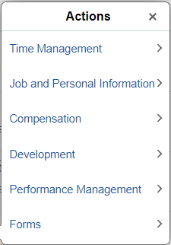
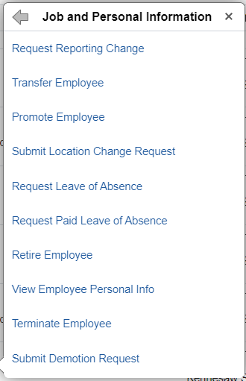
In My Team, you will see a list of employees who report to you. Find the person you wish to change and click the blue arrow next to their name.
Choose Job and Personal Information from the actions menu and then choose the appropriate transaction – Transfer Employee, Promote Employee, or Submit Demotion Request.

Slide 14
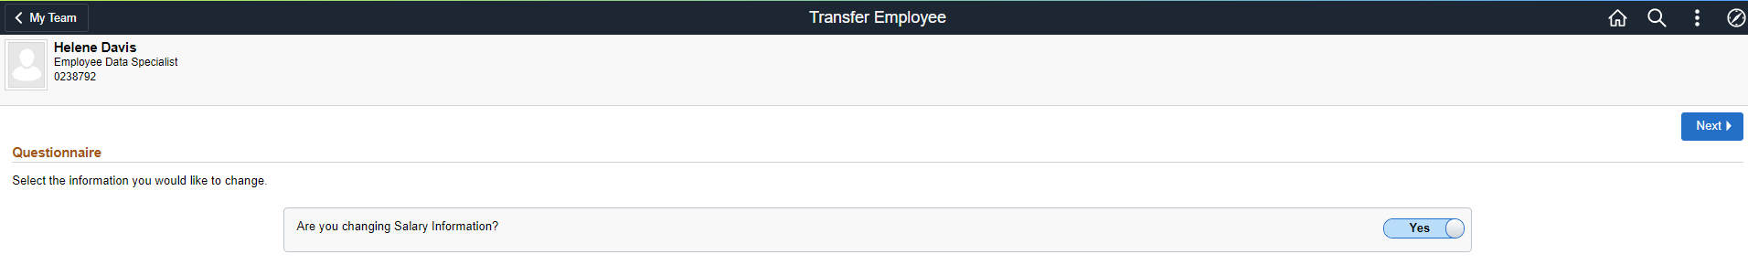
1. Type of transaction
2. Employee information – redacted here for privacy
4. Navigate to next step
3. Are you changing salary information? If yes, leave slider button as is on YES. If no, move slider button to the left to change to NO.

Slide 15
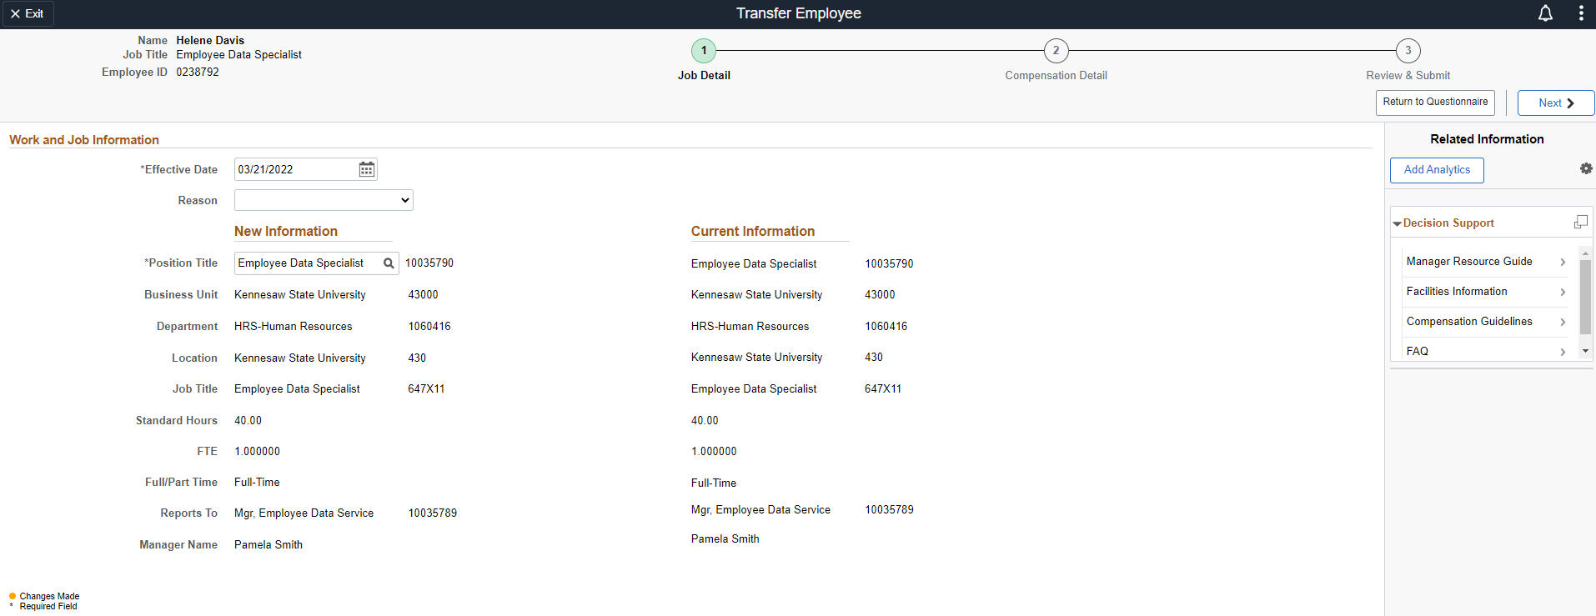
1. Type of transaction
3. Employee information – redacted here for privacy
2. Steps to complete transaction – current step is indicated with a green circle.
4. Effective date – must be changed to date that coincides with the beginning of a payroll period
5. Reason – select the most appropriate reason from the list of available options
6. The current position will be displayed under new information.
Click the magnifying glass to change the position number to the new position number the employee is moving into and wait for the lookup window to open.

Slide 16
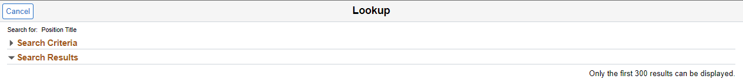
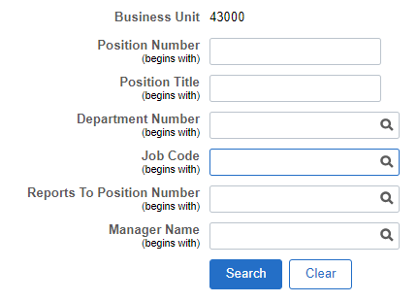
7. Click the arrow next to search criteria to search for the new position
8. Search for a new position using any combination of the fields provided
Once the appropriate position is located, click on it to select it.

Slide 17
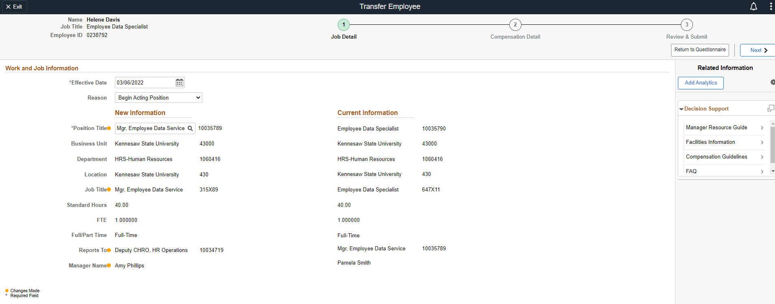
10. Navigate to next step
9. Verify under “New Information” that the yellow dots appear (which indicates that a change has been made) and that the information displayed matches the correct new information.
(Names here are redacted here for privacy.)

Slide 18
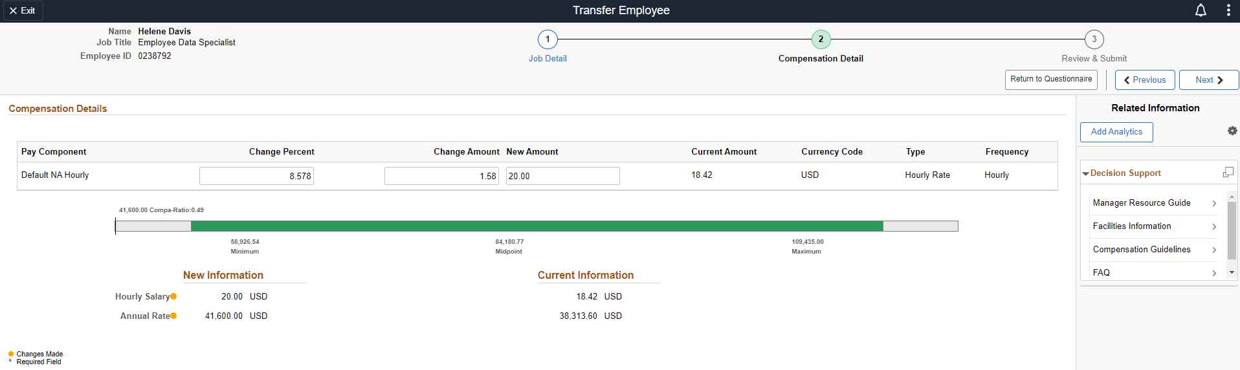
11. If you chose to change salary at the beginning of the transaction, this page will be next. If you chose not to change salary at the beginning of the transaction, the transaction will automatically skip this page.
14. Navigate to next step
12. Enter the salary change information.
If the employee is currently paid hourly, the hourly rate of the new position needs to be entered.
If the employee is currently paid monthly, the monthly rate of the new position needs to be entered.
13. Verify under “New Information” that the yellow dots appear (which indicates that a change has been made) and that the rate displayed matches the correct new rate.

Slide 19
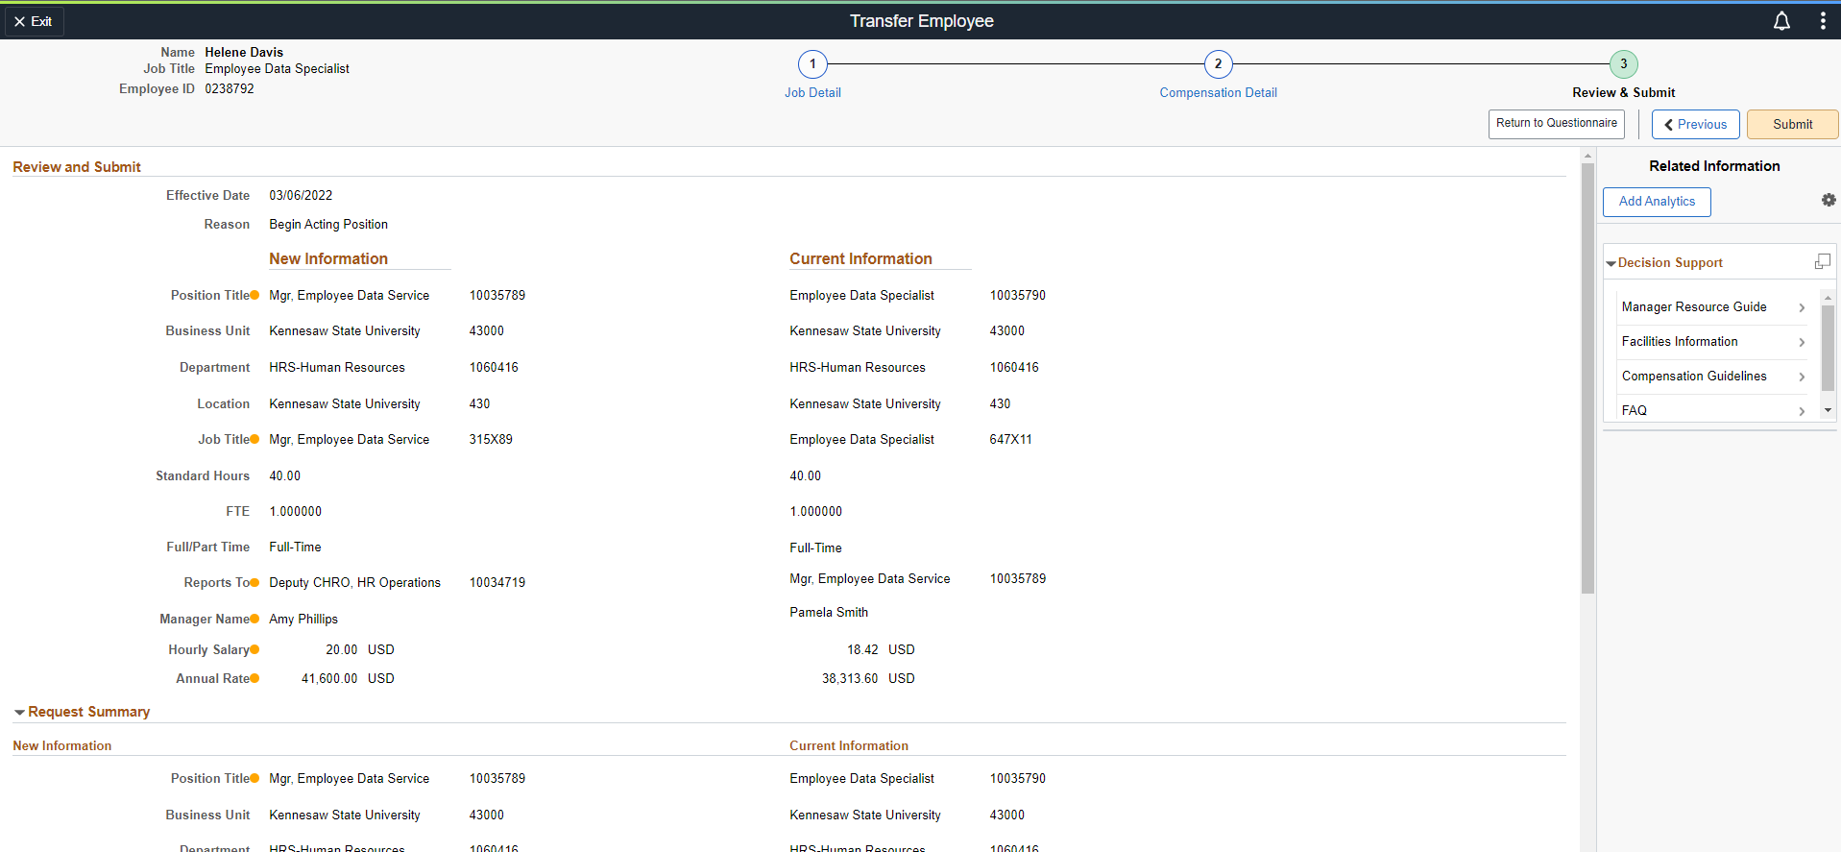
16. Click Submit
15. Review the transaction one more time for accuracy and add any appropriate comments and attachments.
Make sure to use the scroll bar to scroll all the way to the bottom during review.

Slide 20
What resources are available?

Slide 21

Shared Services Center Knowledge Base
https://usg.service-now.com/usgsp
Resource developed by the University System of Georgia Shared Services Center to assist employees of the university system in navigating OneUSG products using knowledge articles and job aids.

Slide 22
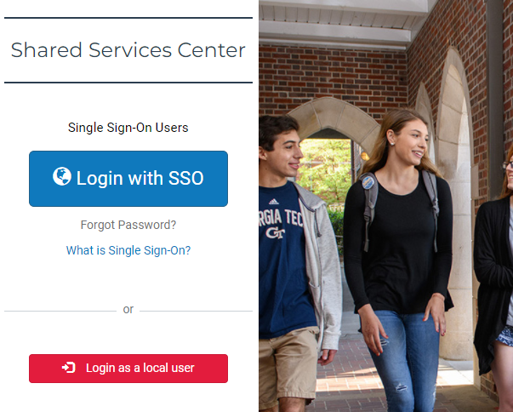
Click the blue log in button and then use your KSU NetID and password to log in, using DUO to authenticate.

Slide 23
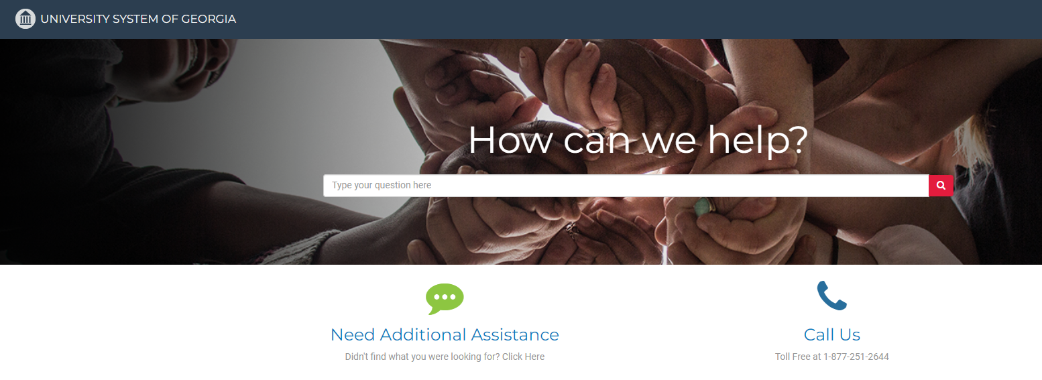
Search the landing page for topics related to
OneUSG transactions and/or products.

Slide 24
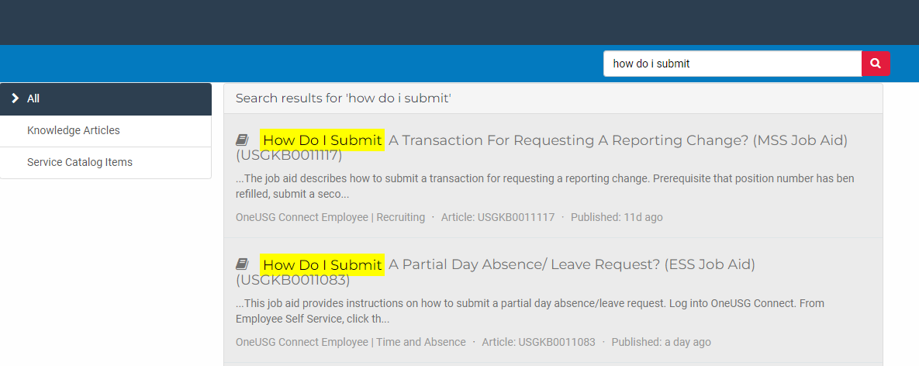
Search the search page for specific text within the searched articles.

Slide 25


https://hr.kennesaw.edu/ communication/newsletter.php
Resource developed by the KSU Human Resources team to inform employees of HR happenings and important topics.
MSS Tips and Tricks articles cover MSS materials and known tips and tricks for transaction success.
HR Newsletter Articles MSS Tips and Tricks

Slide 26

HR team members provide a monthly webinar and lunch and learn that covers one MSS topic each month.
*See the next slide for a list of topics by month.
https://ksu.percipio.com/channels/df2be379-6673-4008-bd93-2db8587e2217?tab=ATTEND&localeCode=en-US
*Must log in with KSU NetID to view courses
*Dates and times of training sessions are decided at the beginning of the calendar year and all sessions are loaded into the HR Training website.
HR Training Monthly MSS Sessions

Slide 27
January: Where do I click? (Manage Positions and My Team Tiles)
February: Managing Your Seats (Add/Change Position Transaction)
March: They’re Not Mine! (Reporting and Time&Absence)
April: Extra! Extra! (Supplemental Pay Transaction)
May: Moving To a New Seat (Transfers, Promotions, Demotions)
June: Sorry To See You Go! (Terminations)
July: Show Me the Money! (Salary Changes)
August: Let’s Change It All! (Multiple Simultaneous Changes)
September: Where’s It At? (Viewing and Approving Transactions)
October: Where’s It Go? (In-Depth Transaction Workflow)
November: Managing Your Bleachers (Multi-Incumbent Positions)
December: Can you cover me? (Delegations)
HR Training Monthly MSS Sessions (continued)

Slide 28
Have an MSS or HR related issue?
Don’t know who to call?
Check out this website for more info!
https://hr.kennesaw.edu/hrteams.php
Who’s Who in HR?

Slide 29
Questions?

Slide 30
Have a Great Day!

