Slide 1
Welcome!
We will begin promptly at 2pm.

Slide 2
Extra! Extra!
An In-Depth Look at the Supplemental Pay Transaction

Slide 3
What is Supplemental Pay?
  Explanation
  Types of Supplemental Pay
How Do I Submit a Supplemental Payment?
  Transaction Walk Through
What resources are available?
  SSC Knowledge Base
  HR Newsletter
  HR Training
  HR Teams
AGENDA

Slide 4
What is Supplemental Pay?

Slide 5
Supplemental pay is payment made to an employee in addition to the employee’s regular wages.
Supplemental pay can happen for a variety of reasons, all of which fall into one of two types: one-time payments and defined-term payments.

Slide 6
One-Time Payments
One-time payments are lump sum payments paid to an employee as one flat amount.
(These payments do not continue for any period of time.)

Slide 7
Awards
  Monetary staff/faculty awards
Incentives
  Goal-based Incentives (Athletics coach takes a team to a national conference)
  Critical Hiring Incentives (Employee is offered a flat amount as a sign-on bonus)
Project Pay
  Pay for completion of a project that is outside of job description and completed outside of normal working hours
  Pay for teaching a seminar that is not part of a faculty member’s contract
Pay Differential
  An hourly employee works in a role that earns a higher compensation rate than their normal rate – the difference in pay is paid as a one-time lump sum once the work is performed
One-Time Payments

Slide 8
Defined-Term Payments
Defined-term payments are payments paid to an employee for a pre-determined period of time – either monthly or hourly depending on the employee’s type.
(These payments continue for a specific period of time.)

Slide 9
Interim Pay
  An employee takes on the responsibility and authority of a vacant role for a period usually exceeding 3 months.
Acting Duties
  An employee assumes temporary authority for another position, usually for a period not exceeding 3 months.
Temporary Assignment
  An employee assumes duties on a short-term basis for a specific purpose that is outside their normal job description.
Overloads
  A faculty employee takes on more than a full course load and is compensated for credits taught beyond a typical faculty workload.
Defined-Term Payments

Slide 10
How Do I Submit a
Supplemental Payment?

Slide 11
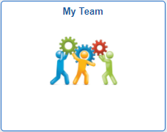
Actions that affect an EMPLOYEE are
routed through supervisor’s MY TEAM
My Team
Use when employee is moving to a new position number
Use when employee information is changing
Transfer
Promote
Demote
Change Time/Absence Approver
Reports To
Retire
Terminate
Salary Change
Supplemental Pay

Slide 12
My Team transactions can NOT
be edited by anyone once
they are submitted.
Ensuring that all data is complete and accurate prior to submission, especially effective date, will prevent HR from having to deny the transaction and you from having to start all over.

Slide 13
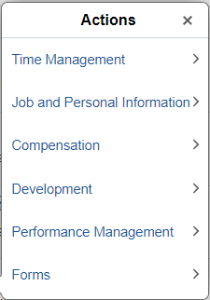
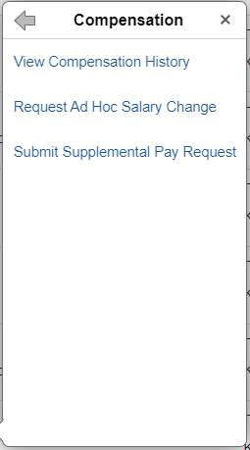
In My Team, you will see a list of employees who report to you. Find the person you wish to change and click the blue arrow next to their name.
Choose Compensation from the actions menu and then choose Submit Supplemental Pay Request.

Slide 14
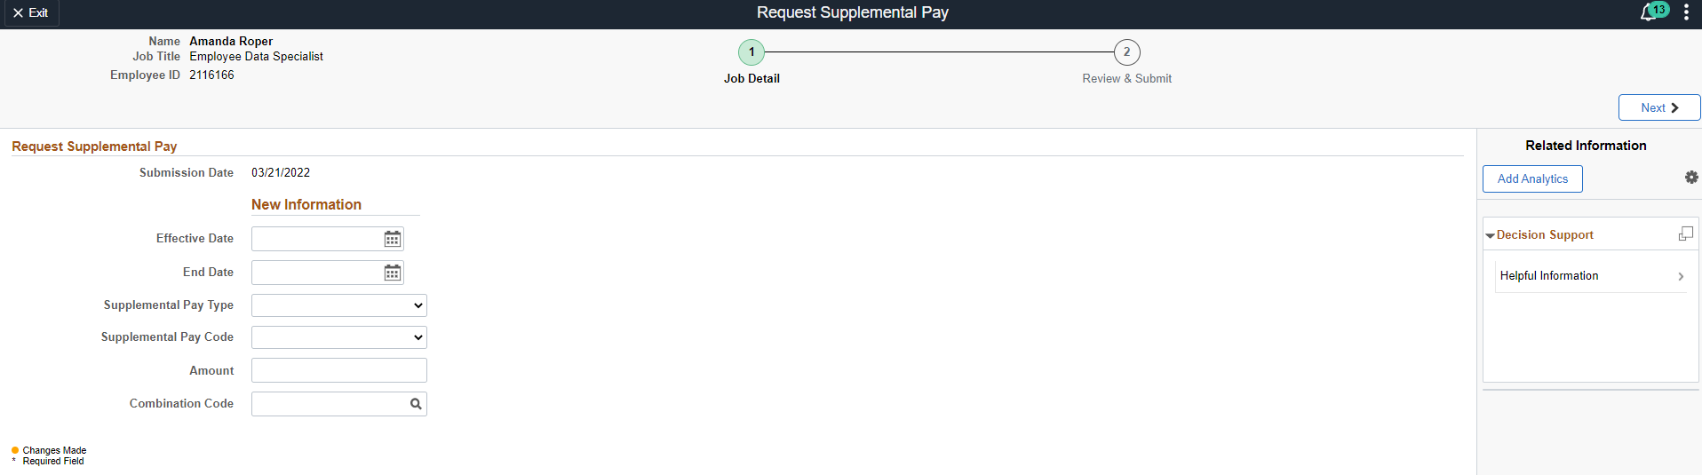
1. Type of transaction
3. Employee information – redacted here for privacy
2. Steps to complete transaction – current step is indicated with a green circle.
10. Navigate to next step
4. Effective date – if one-time payment, should coincide with when the work was performed; if defined-term payment, must be the first day of a pay period
5. End date - if one-time payment, should coincide with when the work was performed; if defined-term payment, must be the last day of a pay period
6. Supplemental Pay Type – choose one-time payment or defined-term payment
7. Supplemental Pay Code – choose reason for supplemental pay
8. Amount – enter amount of payment (full amount if one-time payment; monthly amount if salaried employee and defined-term payment; hourly amount if hourly employee and defined-term payment)
9. Combination Code – alternative combo code to be used for funding, if applicable (if funding follows position, leave blank)

Slide 15
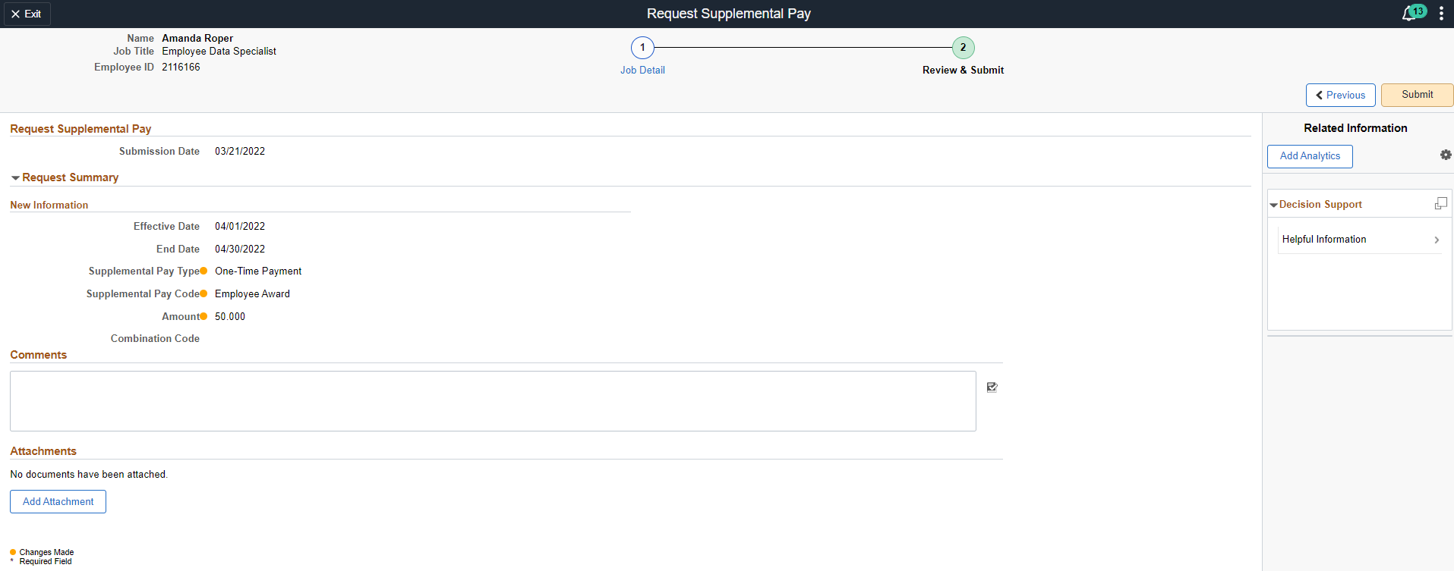
12. Click Submit
11. Review the transaction one more time for accuracy and add any appropriate comments and attachments.

Slide 16
What resources are available?

Slide 17

Shared Services Center
Knowledge Base
https://usg.service-now.com/usgsp
Resource developed by the University System of Georgia Shared Services Center to assist employees of the university system in navigating OneUSG products using knowledge articles and job aids.

Slide 18
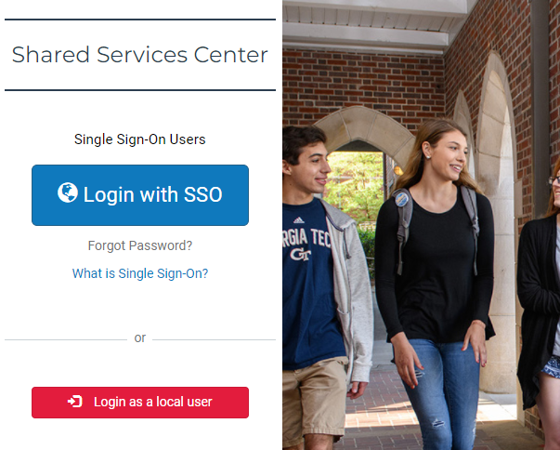
Click the blue log in button and then use your KSU NetID and password to log in, using DUO to authenticate.

Slide 19
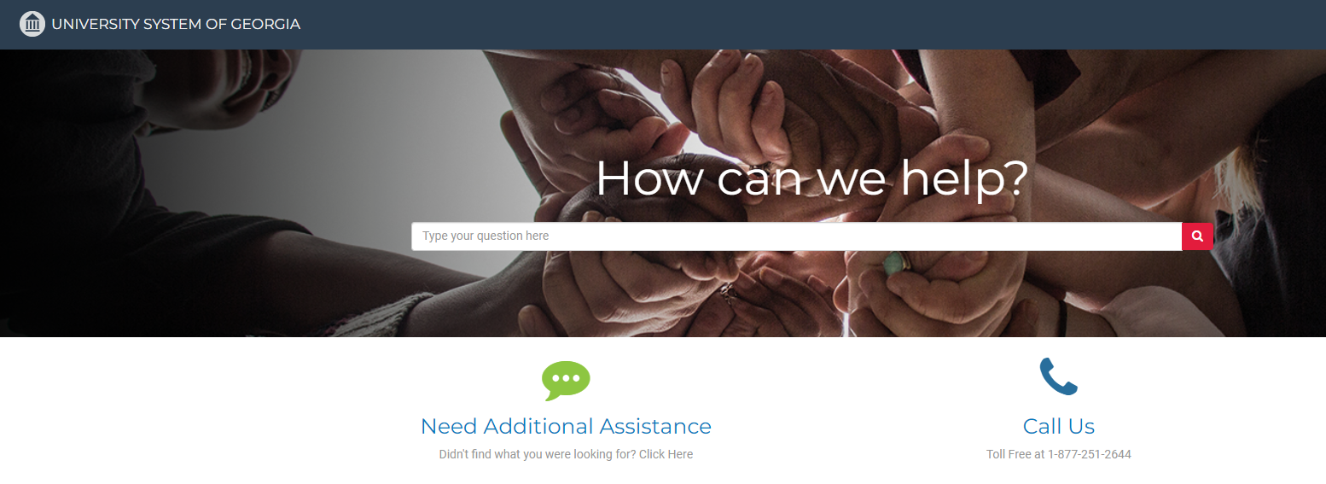
Search the landing page for topics related to
OneUSG transactions and/or products.

Slide 20
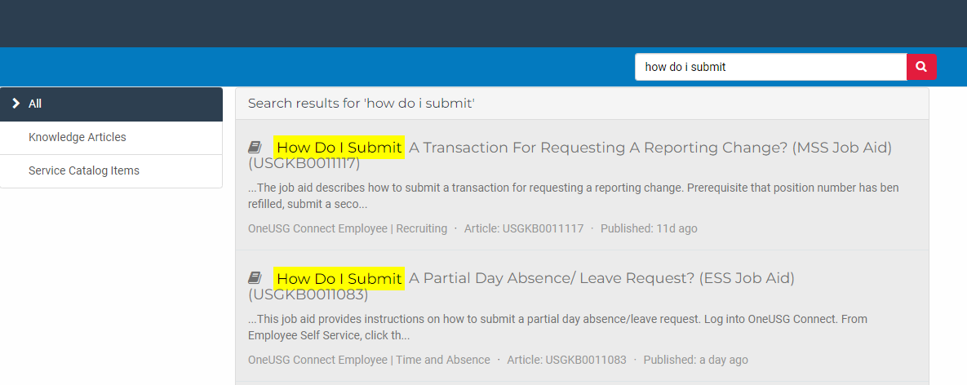
Search the search page for specific text within the searched articles.

Slide 21


https://hr.kennesaw.edu/
communication/newsletter.php
Resource developed by the KSU Human Resources team to inform employees of HR happenings and important topics.
MSS Tips and Tricks articles cover MSS materials and known tips and tricks for transaction success.
HR Newsletter Articles
MSS Tips and Tricks

Slide 22

HR team members provide a monthly webinar and lunch and learn that covers one MSS topic each month.
*See the next slide for a list of topics by month.
https://ksu.percipio.com/channels/df2be379-6673-4008-bd93-2db8587e2217?tab=ATTEND&localeCode=en-US
*Must log in with KSU NetID to view courses
*Dates and times of training sessions are decided at the beginning of the calendar year and all sessions are loaded into the HR Training website.
HR Training
Monthly MSS Sessions

Slide 23
January:
Where do I click? (Manage Positions and My Team Tiles)
February:
Managing Your Seats (Add/Change Position Transaction)
March:
They’re Not Mine! (Reporting and Time&Absence)
April:
Extra! Extra! (Supplemental Pay Transaction)
May:
Moving To a New Seat (Transfers, Promotions, Demotions)
June:
Sorry To See You Go! (Terminations)
July:
Show Me the Money! (Salary Changes)
August:
Let’s Change It All! (Multiple Simultaneous Changes)
September:
Where’s It At? (Viewing and Approving Transactions)
October:
Where’s It Go? (In-Depth Transaction Workflow)
November:
Managing Your Bleachers (Multi-Incumbent Positions)
December:
Can you cover me? (Delegations)
HR Training
Monthly MSS Sessions
(continued)

Slide 24
Have an MSS or HR related issue?
Don’t know who to call?
Check out this website for more info!
https://hr.kennesaw.edu/hrteams.php
Who’s Who in HR?

Slide 25
Questions?

Slide 26
Have a Great Day!

