Slide 1
Welcome!
We will begin promptly at 2pm.

Slide 2
They’re Not Mine
An In-Depth Look at the Reporting and Time Approver Transactions

Slide 3
What is a Reports To Manager?
  Explanation
How Do I Submit a Reporting Change?
  Transaction Walk Through
What is a Time Approver?
  Explanation
How Do I Change the Time Approver?
  Transaction Walk Through
What resources are available?
  SSC Knowledge Base
  HR Newsletter
  HR Training
  HR Teams
AGENDA

Slide 4
What is a Reports To Manager?

Slide 5
The reports to manager is the person responsible for personnel actions and performance management for an employee.
Keep in mind that employees do not report to other employees. The position a person sits in dictates the reporting position.

Slide 6

This seat represents position number 12345678.
Position 12345678 is an Administrative Assistant in Human Resources. It is a regular, 40 hours per week position and reports to the Office Manager, position 87654321.
It is funded 100% from Human Resources.
This person represents employee 1122334.
Employee 1122334 is hired into position 12345678. The data from the position is added to the employee for as long as the employee remains in the position.
Employee 1122334 earns compensation based on the classification and their experience level.

Slide 7
This means that if either the manager or the employee change position numbers, the reporting relationship changes!
Any time an employee changes position numbers, reporting relationships should be reviewed to ensure accuracy.

Slide 8
How Do I Submit a Reporting Change?

Slide 9
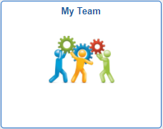
Actions that affect an EMPLOYEE are
routed through supervisor’s MY TEAM
My Team
Use when employee is moving to a new position number
Use when employee information is changing
Transfer
Promote
Demote
Change Time/Absence Approver
Reports To
Retire
Terminate
Salary Change
Supplemental Pay

Slide 10
Only positions with a single incumbent should be changed via Reporting Change transaction.
Positions with multiple incumbents should be changed via Manage Positions transaction.

Slide 11
My Team transactions can NOT
be edited by anyone once
they are submitted.
Ensuring that all data is complete and accurate prior to submission, especially effective date, will prevent HR from having to deny the transaction and you from having to start all over.

Slide 12
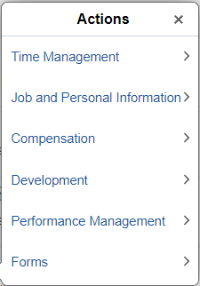
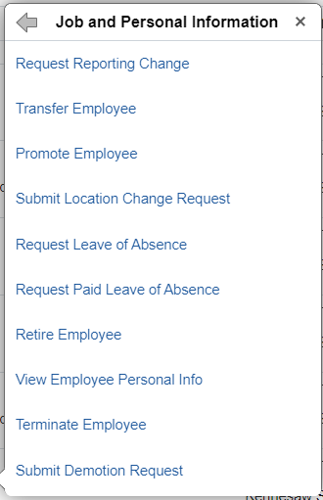
In My Team, you will see a list of employees who report to you. Find the person you wish to change and click the blue arrow next to their name.
Choose Job and Personal Information from the actions menu and then choose Request Reporting Change.

Slide 13
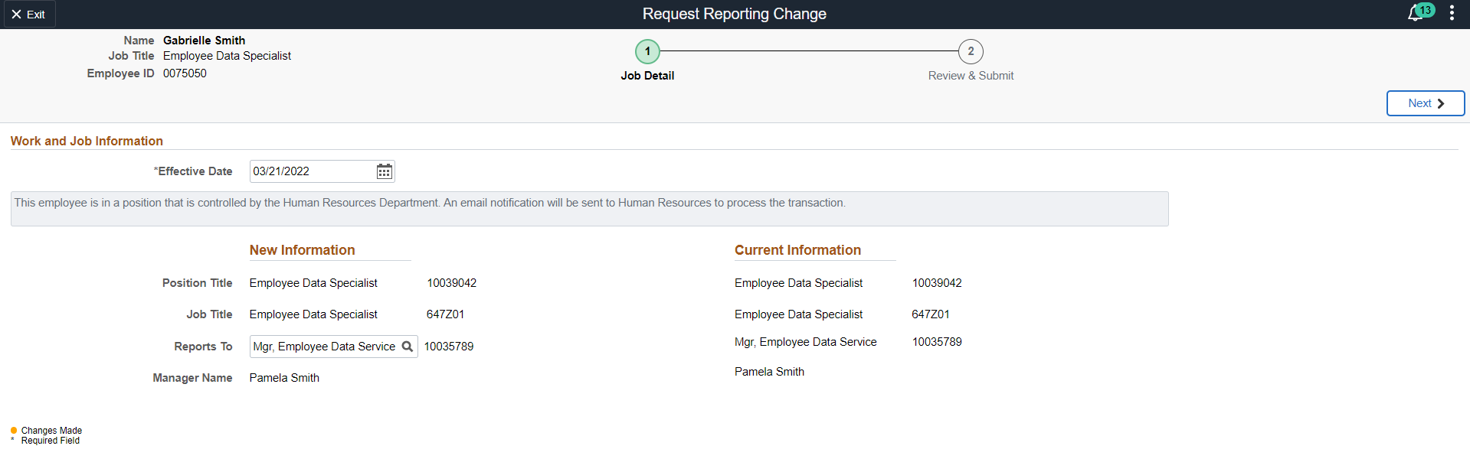
1. Type of transaction
3. Employee information – redacted here for privacy
2. Steps to complete transaction – current step is indicated with a green circle.
4. Effective date – must be changed to date that coincides with the beginning of a payroll period
5. Click the magnifying glass next to the reports to title to select a new reports to position for this employee’s position and wait for the Lookup window to open

Slide 14
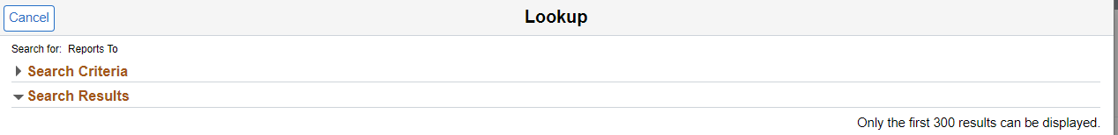
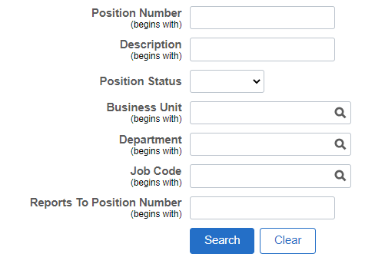
6. Click the arrow next to search criteria to search for a reports to position
7. Search for a reports to position using any combination of the fields provided
Once the appropriate position is located, click on it to select it.

Slide 15
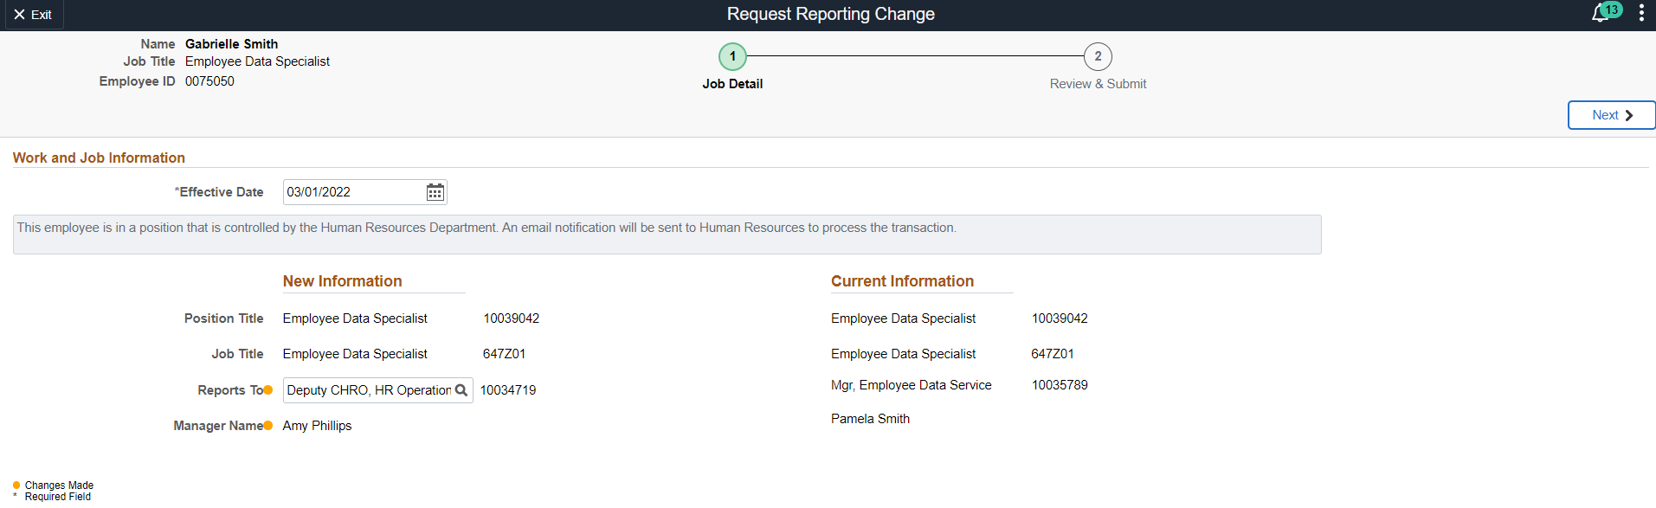
9. Navigate to next step
8. Verify under “New Information” that the yellow dots appear (which indicates that a change has been made) and that the manager name displayed matches the correct new reports to manager.
(The name is redacted here for privacy.)

Slide 16
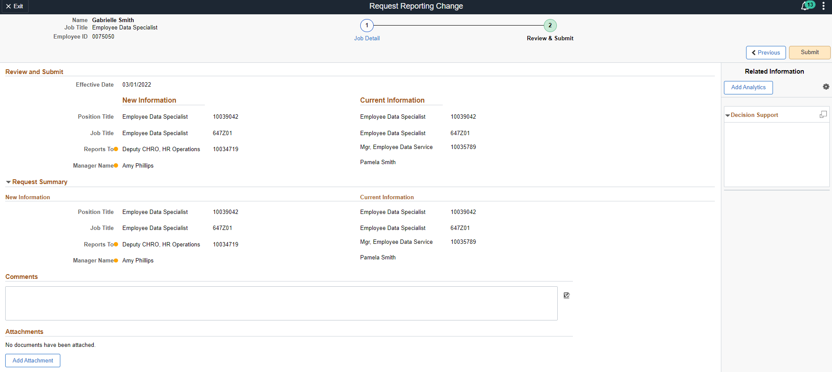
11. Click Submit
10. Review the transaction one more time for accuracy and add any appropriate comments and attachments.
Make sure to indicate in the comments of a reporting change transaction how you expect the transaction to affect time approver – either change it concurrently or leave it as is.

Slide 17
What is a Time Approver?

Slide 18
The time approver is the person responsible for managing and approving time for an employee.
For many employees, this is the same person as their reports to manager, but it can be different in work arrangements where it makes sense to have an Admin or Team Lead approving time instead.

Slide 19
If the reporting relationship changes, it can affect the time approver as well!
Any time an employee’s reports to manager changes, the time approver should also be reviewed to determine if changes are needed.

Slide 20
How Do I Change Time Approver?

Slide 21
Actions that affect an EMPLOYEE are
routed through supervisor’s MY TEAM
My Team
Use when employee is moving to a new position number
Use when employee information is changing
Transfer
Promote
Demote
Change Time/Absence Approver
Reports To
Retire
Terminate
Salary Change
Supplemental Pay

Slide 22
If time approver is changing concurrently with a manager change, it only needs to be indicated in the comments of the Reporting Change transaction.
Sometimes, time approver will change even though reports to manager is staying the same. In those cases, a Change Time/Absence Approver request should be submitted instead.

Slide 23
My Team transactions can NOT
be edited by anyone once
they are submitted.
Ensuring that all data is complete and accurate prior to submission, especially effective date, will prevent HR from having to deny the transaction and you from having to start all over.

Slide 24
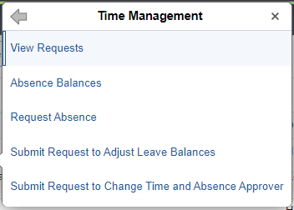
In My Team, you will see a list of employees who report to you. Find the person you wish to change and click the blue arrow next to their name.
Choose Time Management from the actions menu and then choose Submit Request to Change Time and Absence Approver.

Slide 25
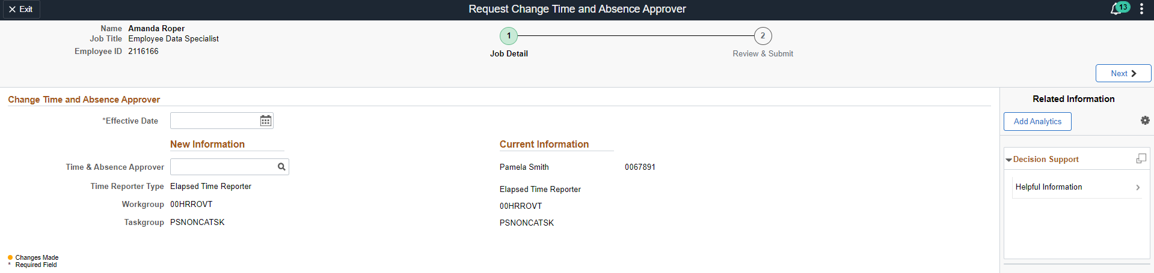
1. Type of transaction
3. Employee information – redacted here for privacy
2. Steps to complete transaction – current step is indicated with a green circle.
4. Effective date – must be changed to date that coincides with the beginning of a payroll period
5. View current time approver information here
(Name has been redacted here for privacy)
6. Click the magnifying glass next to the time & absence approver field to select a new time approver for this employee and wait for the Lookup window to open

Slide 26
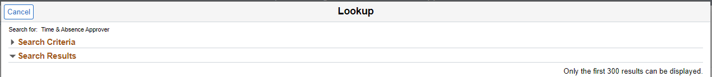
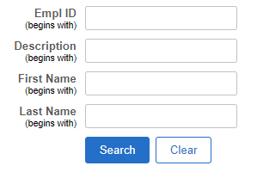
7. Click the arrow next to search criteria to search for a time approver
8. Search for a time approver using any combination of the fields provided
Note that Empl ID is NOT the same as KSU ID or position number.
Once the appropriate time approver is located, click on that person to select them.

Slide 27

10. Navigate to next step
9. Verify under “New Information” that the new time approver’s name appears in the field.
(The name is redacted here for privacy.)

Slide 28
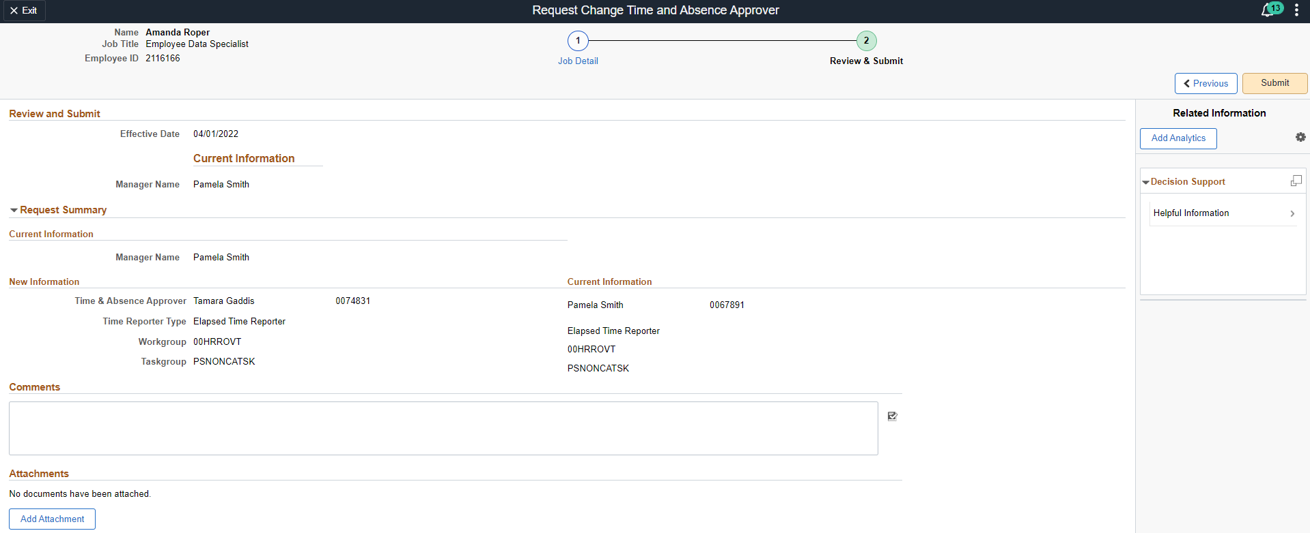
12. Click Submit
11. Review the transaction one more time for accuracy and add any appropriate comments and attachments.
You can NOT change reports to manager by just adding a comment here, so make sure if reports to manager is changing that you are submitting the Reporting Change transaction instead.

Slide 29
What resources are available?

Slide 30

Shared Services Center
Knowledge Base
https://usg.service-now.com/usgsp
Resource developed by the University System of Georgia Shared Services Center to assist employees of the university system in navigating OneUSG products using knowledge articles and job aids.

Slide 31
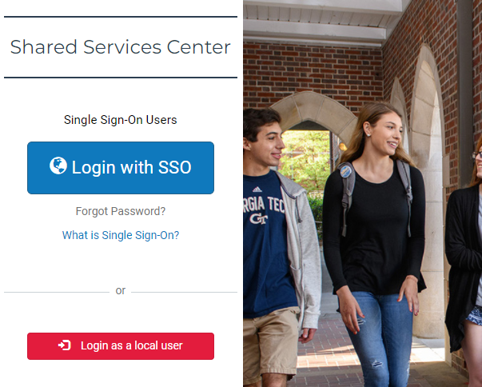
Click the blue log in button and then use your KSU NetID and password to log in, using DUO to authenticate.

Slide 32
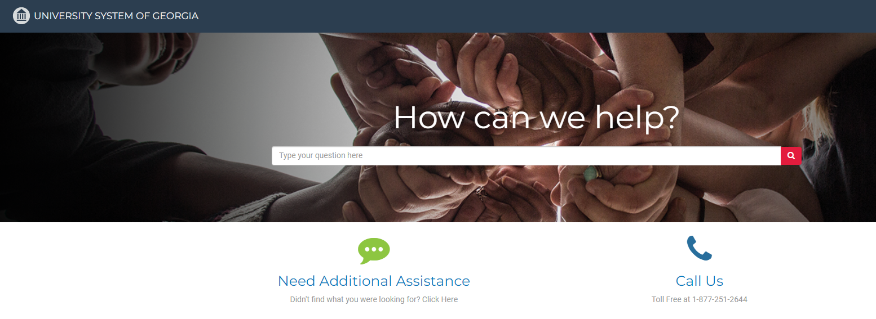
Search the landing page for topics related to
OneUSG transactions and/or products.

Slide 33
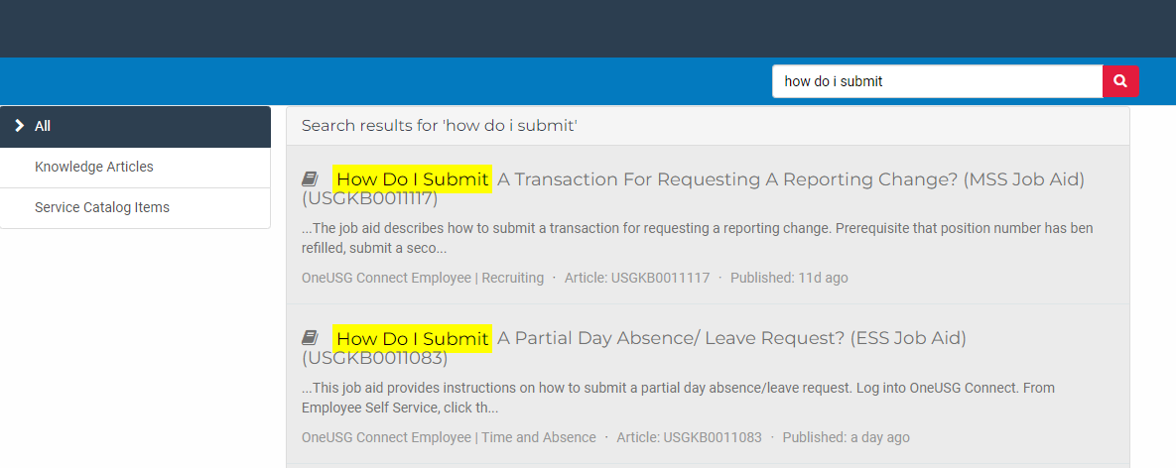
Search the search page for specific text within the searched articles.

Slide 34


https://hr.kennesaw.edu/
communication/newsletter.php
Resource developed by the KSU Human Resources team to inform employees of HR happenings and important topics.
MSS Tips and Tricks articles cover MSS materials and known tips and tricks for transaction success.
HR Newsletter Articles
MSS Tips and Tricks

Slide 35

HR team members provide a monthly webinar and lunch and learn that covers one MSS topic each month.
*See the next slide for a list of topics by month.
https://ksu.percipio.com/channels/df2be379-6673-4008-bd93-2db8587e2217?tab=ATTEND&localeCode=en-US
*Must log in with KSU NetID to view courses
*Dates and times of training sessions are decided at the beginning of the calendar year and all sessions are loaded into the HR Training website.
HR Training
Monthly MSS Sessions

Slide 36
January:
Where do I click? (Manage Positions and My Team Tiles)
February:
Managing Your Seats (Add/Change Position Transaction)
March:
They’re Not Mine! (Reporting and Time&Absence)
April:
Extra! Extra! (Supplemental Pay Transaction)
May:
Moving To a New Seat (Transfers, Promotions, Demotions)
June:
Sorry To See You Go! (Terminations)
July:
Show Me the Money! (Salary Changes)
August:
Let’s Change It All! (Multiple Simultaneous Changes)
September:
Where’s It At? (Viewing and Approving Transactions)
October:
Where’s It Go? (In-Depth Transaction Workflow)
November:
Managing Your Bleachers (Multi-Incumbent Positions)
December:
Can you cover me? (Delegations)
HR Training
Monthly MSS Sessions
(continued)

Slide 37
Have an MSS or HR related issue?
Don’t know who to call?
Check out this website for more info!
https://hr.kennesaw.edu/hrteams.php
Who’s Who in HR?

Slide 38
Questions?

Slide 39
Have a Great Day!

