Slide 1
Welcome!
We will begin promptly at 2pm.

Slide 2
Where’s It Go?
A detailed look at MSS workflow/routing

Slide 3
How are workflows set up?
  Definition of terms
  Review of basic MSS workflow/routing
How does KSU pre-define routing?
  Review of KSU routing set up
How do I view the required approvals for a specific MSS transaction?
  Review workflow/routing for transactions
What resources are available?
  SSC Knowledge Base
  HR Newsletter
  HR Training
  HR Teams
AGENDA

Slide 4
How are workflows set up?

Slide 5
Workflow
A workflow is the sum of all approvers that are assigned to a transaction. The workflow for an MSS transaction is created at the time of submission.
Approver
An approver is a person whose approval is required to process a specific type of transaction. There are several different types of approver:
  1-Up Approver – A 1-Up approver is the next-level supervisor of the employee named in a transaction.
  Line VP Approver – A Line VP approver is the first person in the hierarchy/reporting chain within a specific range of classifications. This is intended to find the department or division leader.
  Role-Based Approver – A role-based approver is an approver that is set up through the use of a specific role added by HR to an individual’s security profile. This is intended to allow additional functional areas to approve, such as HR and Budget.
  HR Processor – An HR Processor is the person responsible for keying or pushing the transaction into the HR system.
  Ad Hoc Approver - An ad hoc approver is somebody who is added by the submitter or by another approver whose approval is also required to process a specific type of transaction. (Examples include additional managers, budget managers, additional team members, etc.)
What Does It Mean?

Slide 6
All transactions may have up to five pre-defined approvals:
Level 1
1-Up
Level 2
Line VP
Level 3
Role-Based
Level 4
Role Based
Level 5
HR Processor
Each transaction may have any number of added approvals, called ad hoc approvers, which are added individually by the submitter or by any other approver.
**Each arrow above is a place where ad hoc approvers can be added.
Level 1
1-Up
Level 2
Line VP
Level 3
Role-Based
Level 4
Role Based
Level 5
HR Processor
Level 1.01
Ad Hoc
Level 2.01
Ad Hoc
Level 3.01
Ad Hoc
Level 4.01
Ad Hoc
Level 1.02
Ad Hoc
Level 2.02
Ad Hoc
Level 3.02
Ad Hoc
Level 4.02
Ad Hoc
The sum of all approvers for any individual transaction is that transaction’s workflow.

Slide 7
How does KSU pre-define routing?

Slide 8
The HR system allows HR to pre-define the five basic approvals based on the type of transaction and the type of employee.
Level 1
1-Up
Level 2
Line VP
Level 3
Role-Based
Level 4
Role Based
Level 5
HR Processor
Available Customization:
Turn on/off
Available Customization:
Turn on/off
Available Customization:
Turn on/off
Choose role-based approvers
Available Customization:
Turn on/off
Choose role-based approvers
Available Customization:
Turn on/off
Choose processors

Slide 9
The system has 14 different types of transactions and 4 different pay groupings, so this allows for 56 different customizations that are specific to KSU’s internal processes.
Each pay grouping and transaction has its own pre-defined routing. These can not be customized at the department or manager level, so they are maintained by HR.
Pay grouping is the type of employee:
Faculty includes 12-month and 10-month, full-time and part-time, administrative and instructional faculty members.
Staff includes 12-month and 10-month, benefited (regular, 20+ hours/wk), salaried and hourly staff members. Also includes GRAs.
Student includes all student assistants and all non-benefitted staff members (all temporary staff AND all regular staff with < 20 hours/wk).
FWS includes all federal work study students.
Transaction refers to which type of transaction was submitted.
Location refers to where that transaction is found in Manager Self Service.
Levels 1-5 refer to the 5 levels of approval you saw on the last slide.
Box Color: The box color indicates whether that approval level is turned on/off.
Text: The text will describe the routing as customized by KSU. N/A will skip that level. Anything in parentheses with an “AH” is an expected ad hoc approver. Anything in parenthesis with an “AH” and a “?” is an ad hoc approver that may be needed but is not always required.

Slide 10
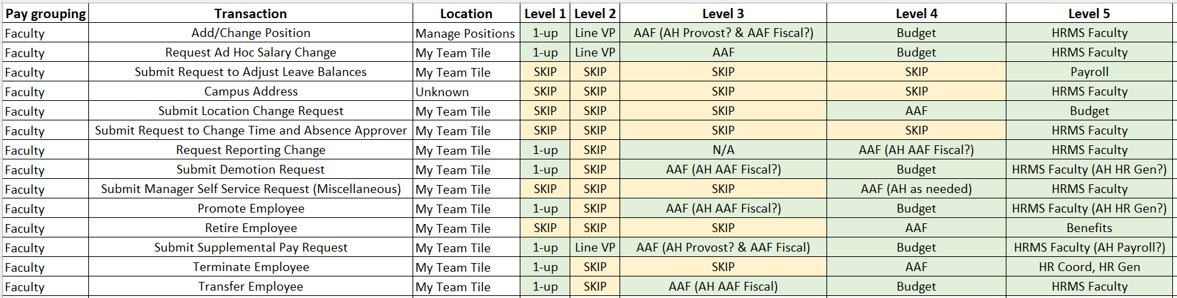
Pre-defined workflow for faculty pay grouping:

Slide 11
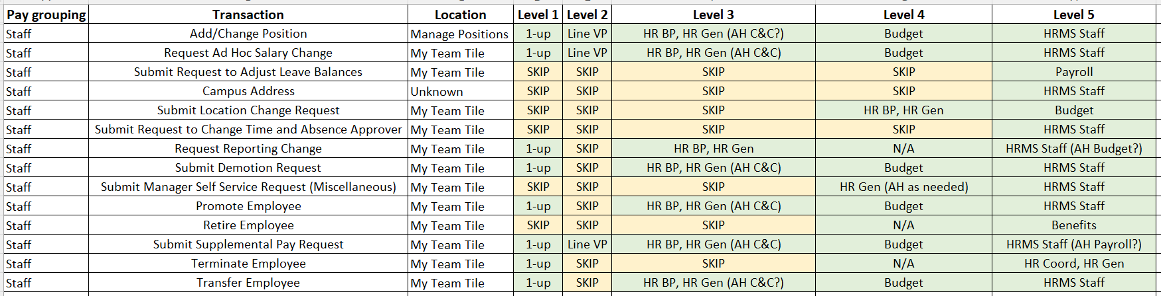
Pre-defined workflow for staff pay grouping:

Slide 12
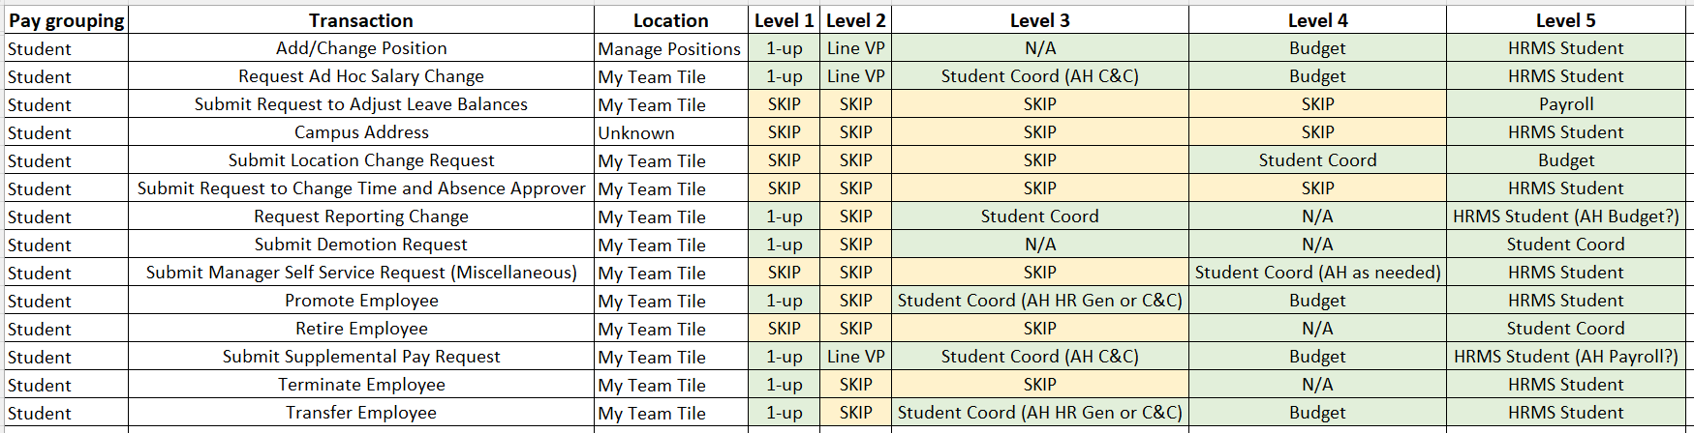
Pre-defined workflow for student pay grouping:

Slide 13
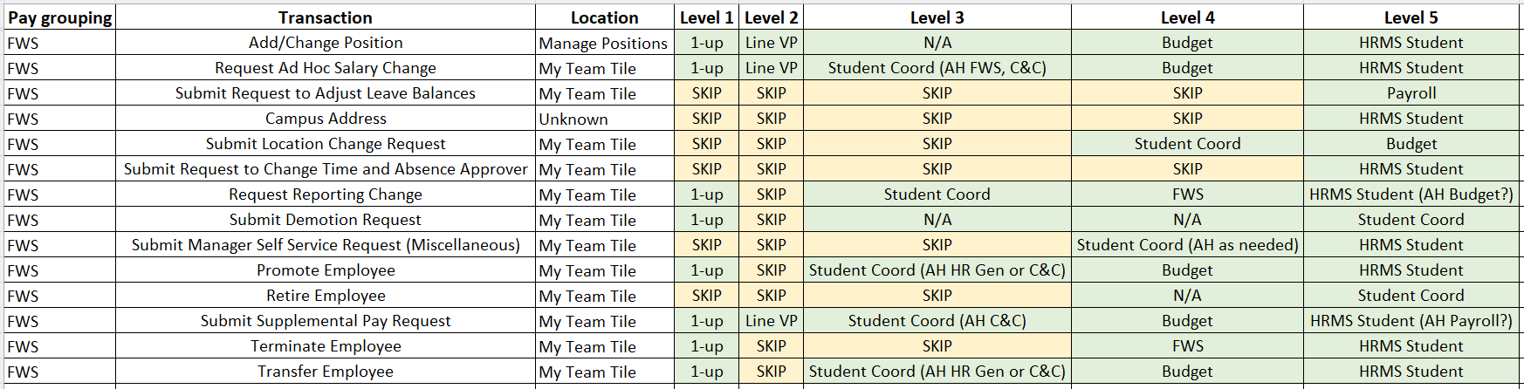
Pre-defined workflow for FWS pay grouping:

Slide 14
How do I view the required approvals for a specific transaction?

Slide 15
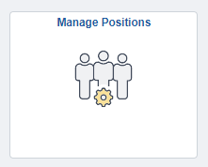
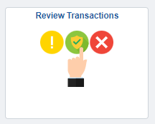
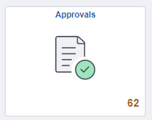
There are multiple ways to see a specific transaction’s workflow in Manager Self Service. Those methods were covered in last month’s MSS training session, Where’s It At?
Please note that viewing a transaction’s workflow is limited to the submitter and current or past approvers. Future approvers can not see a transaction’s workflow until their approval is due. Nobody else can see the workflow for a transaction on behalf of somebody else. If you need assistance with a transaction and you are not the submitter or a current/past approver, you will need to reach out to your HRBP or HR Generalist.

Slide 16
What resources are available?

Slide 17

Shared Services Center
Knowledge Base
https://usg.service-now.com/usgsp
Resource developed by the University System of Georgia Shared Services Center to assist employees of the university system in navigating OneUSG products using knowledge articles and job aids.

Slide 18
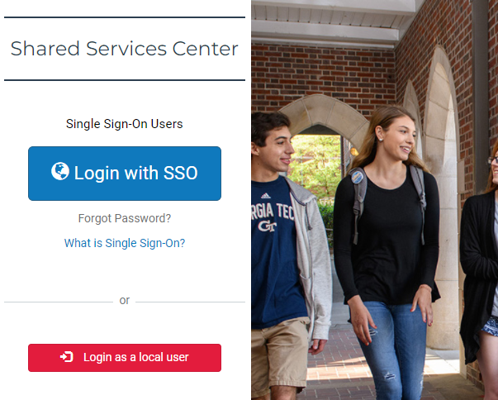
Click the blue log in button and then use your KSU NetID and password to log in, using DUO to authenticate.

Slide 19
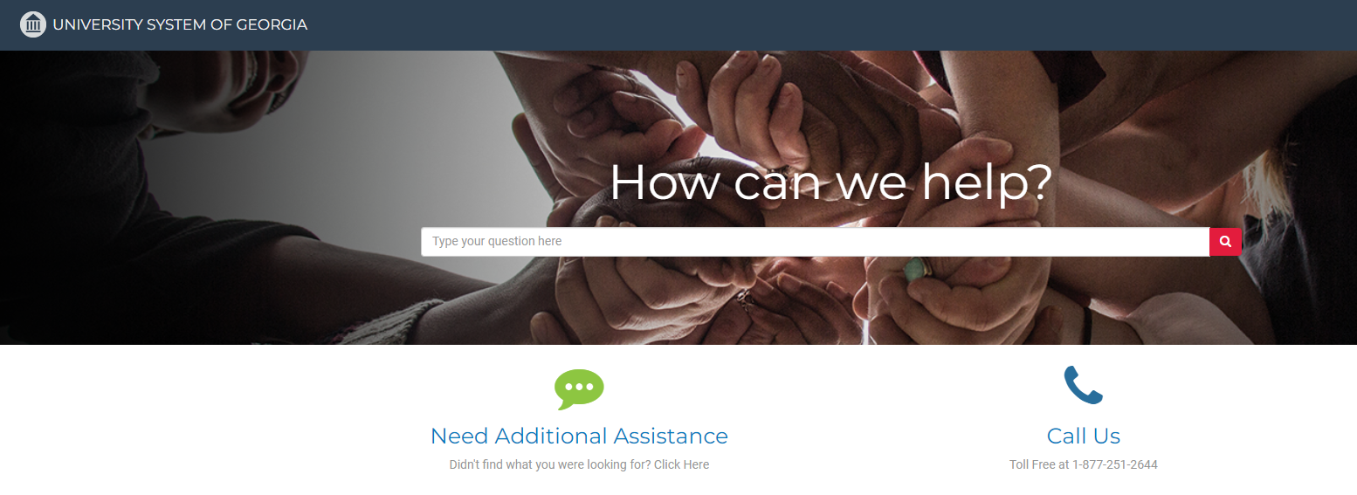
Search the landing page for topics related to
OneUSG transactions and/or products.

Slide 20
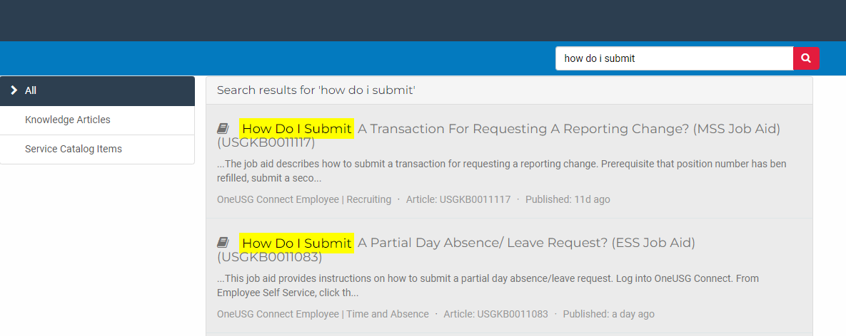
Search the search page for specific text within the searched articles.

Slide 21


https://hr.kennesaw.edu/
communication/newsletter.php
Resource developed by the KSU Human Resources team to inform employees of HR happenings and important topics.
MSS Tips and Tricks articles cover MSS materials and known tips and tricks for transaction success.
HR Newsletter Articles
MSS Tips and Tricks

Slide 22

HR team members provide a monthly webinar and lunch and learn that covers one MSS topic each month.
*See the next slide for a list of topics by month.
https://ksu.percipio.com/channels/df2be379-6673-4008-bd93-2db8587e2217?tab=ATTEND&localeCode=en-US
*Must log in with KSU NetID to view courses
*Dates and times of training sessions are decided at the beginning of the calendar year and all sessions are loaded into the HR Training website.
HR Training
Monthly MSS Sessions

Slide 23
January:
Where do I click? (Manage Positions and My Team Tiles)
February:
Managing Your Seats (Add/Change Position Transaction)
March:
They’re Not Mine! (Reporting and Time&Absence)
April:
Extra! Extra! (Supplemental Pay Transaction)
May:
Moving To a New Seat (Transfers, Promotions, Demotions)
June:
Sorry To See You Go! (Terminations)
July:
Show Me the Money! (Salary Changes)
August:
Let’s Change It All! (Multiple Simultaneous Changes)
September:
Where’s It At? (Viewing and Approving Transactions)
October:
Where’s It Go? (In-Depth Transaction Workflow)
November:
Managing Your Bleachers (Multi-Incumbent Positions)
December:
Can you cover me? (Delegations)
HR Training
Monthly MSS Sessions
(continued)

Slide 24
Have an MSS or HR related issue?
Don’t know who to call?
Check out this website for more info!
https://hr.kennesaw.edu/hrteams.php
Who’s Who in HR?

Slide 25
Questions?

Slide 26
Have a Great Day!

