Slide 1
Welcome!
We will begin promptly at 2pm.

Slide 2
Where Do I Click?
An Overview of the Manager Self Service Tiles

Slide 3
What is Manager Self Service?
  Explanation
  Definition of Terminology
What are the two different areas for submitting transactions?
  When To Use
  Types of Transactions
  Notes and Reminders
What resources are available?
  SSC Knowledge Base
  HR Newsletter
  HR Training
  HR Teams
AGENDA

Slide 4
What is Manager Self Service?

Slide 5
Manager Self Service allows managers to perform tasks online that previously required the assistance of HR personnel.
This includes accessing information about your team members and utilizing paperless transaction and workflow processes.

Slide 6
Manager (i.e. Direct Supervisor)
An employee’s manager or direct supervisor is the person who occupies the position to which that employee’s position reports.
Transaction
A transaction is a specific action that is originated by the manager and sent through a list of approvers before being pushed or manually keyed into OneUSG Connect by the HR team.
What Does It Mean?

Slide 7
Position (Number)
A unique 8-digit number is assigned to each position or role on campus. Employees are hired and assigned to these position numbers in order to create the data related to their job.
Position data elements include classification/title, regular/temporary status, department, location, manager (i.e. the reports to or the direct supervisor), hours per week, and funding source.
Some positions can hold only one employee at a time while others may hold multiple employees as long as they share all the same data related to their job.
Employee
An employee is an individual who works for Kennesaw State University.
What Does It Mean?

Slide 8

This seat represents position number 12345678.
Position 12345678 is an Administrative Assistant in Human Resources. It is a regular, 40 hours per week position and reports to the Office Manager, position 87654321.
It is funded 100% from Human Resources.
This person represents employee 1122334.
Employee 1122334 is hired into position 12345678. The data from the position is added to the employee for as long as the employee remains in the position.
Employee 1122334 earns compensation based on the classification and their experience level.

Slide 9
What are the two different areas for submitting transactions?

Slide 10
Actions that affect a POSITION are
routed through MANAGE POSITIONS
Manage Positions
Use for vacant positions
-OR-
Use when employee is changing while
staying in current position number
Classification (Job Code / Title)
Department
Reports To
Standard Hours / FTE
Pay Frequency
Position Funding

Slide 11
Employees who share a position number must all be changed in the same way if making changes via Manage Positions.
If only one or a group of employees within a position is changing, the employee(s) changing will need to be moved to a new position number via Transfer action.

Slide 12
Manage Position transactions can be edited once they are submitted by the HRBP or by HRMS.
However, ensuring that all data is complete and accurate prior to submission, including effective date, will prevent unnecessary delays and possible denial of submissions.

Slide 13
Actions that affect an EMPLOYEE are
routed through supervisor’s MY TEAM
My
Team
Use when an employee
is moving to a new
position number
Use when an employee’s information is changing
Transfer
Promote
Demote
Change Time/Absence Approver
Reports To
Retire
Terminate
Salary Change
Supplemental Pay

Slide 14
My Team transactions can not be edited once they are submitted by the submitter, approvers, or Human Resources.
Making sure that all details, including effective date, are correct prior to submitting is key to a successful transaction.

Slide 15
What resources are available?

Slide 16

Shared Services Center
Knowledge Base
https://usg.service-now.com/usgsp
Resource developed by the University System of Georgia Shared Services Center to assist employees of the university system in navigating OneUSG products using knowledge articles and job aids.

Slide 17
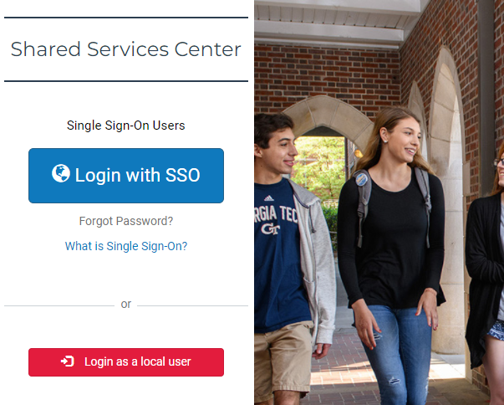
Click the blue log in button and then use your KSU NetID and password to log in, using DUO to authenticate.

Slide 18
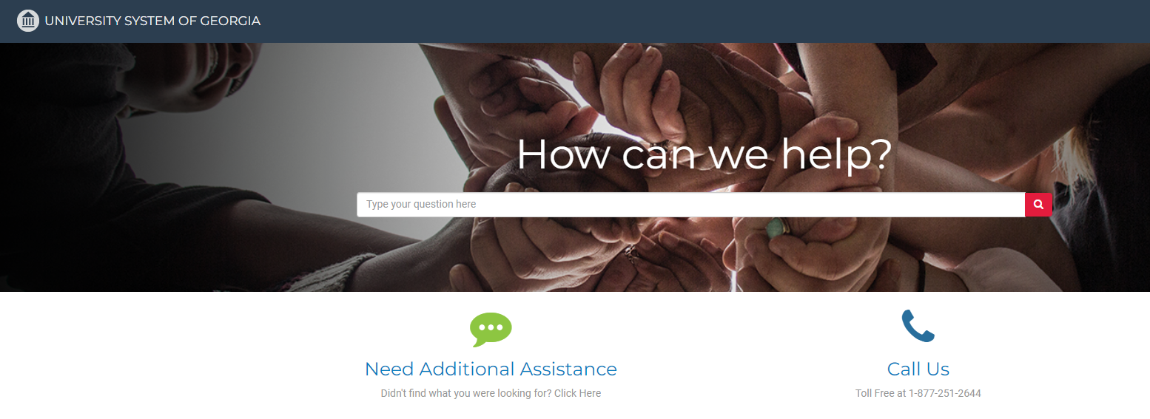
Search the landing page for topics related to
OneUSG transactions and/or products.

Slide 19
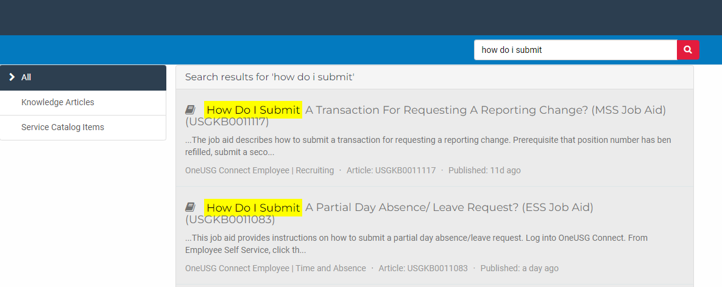
Search the search page for specific text within the searched articles.

Slide 20


https://hr.kennesaw.edu/
communication/newsletter.php
Resource developed by the KSU Human Resources team to inform employees of HR happenings and important topics.
MSS Tips and Tricks articles cover MSS materials and known tips and tricks for transaction success.
HR Newsletter Articles
MSS Tips and Tricks

Slide 21

HR team members provide a monthly webinar and lunch and learn that covers one MSS topic each month.
*See the next slide for a list of topics by month.
https://ksu.percipio.com/channels/df2be379-6673-4008-bd93-2db8587e2217?tab=ATTEND&localeCode=en-US
*Must log in with KSU NetID to view courses
*Dates and times of training sessions are decided at the beginning of the calendar year and all sessions are loaded into the HR Training website.
HR Training
Monthly MSS Sessions

Slide 22
January:
Where do I click? (Manage Positions and My Team Tiles)
February:
Managing Your Seats (Add/Change Position Transaction)
March:
They’re Not Mine! (Reporting and Time&Absence)
April:
Extra! Extra! (Supplemental Pay Transaction)
May:
Moving To a New Seat (Transfers, Promotions, Demotions)
June:
Sorry To See You Go! (Terminations)
July:
Show Me the Money! (Salary Changes)
August:
Let’s Change It All! (Multiple Simultaneous Changes)
September:
Where’s It At? (Viewing and Approving Transactions)
October:
Where’s It Go? (In-Depth Transaction Workflow)
November:
Managing Your Bleachers (Multi-Incumbent Positions)
December:
Can you cover me? (Delegations)
HR Training
Monthly MSS Sessions
(continued)

Slide 23
Have an MSS or HR related issue?
Don’t know who to call?
Check out this website for more info!
https://hr.kennesaw.edu/hrteams.php
Who’s Who in HR?

Slide 24
Questions?

Slide 25
Have a Great Day!

