Slide 1

SMART GOALS
2022 Guidelines
Notes:
Many of us have learned – from bosses, seminars, and business articles – to set S.M.A.R.T goals.
It seems natural to assume that by setting a goal that’s Specific, Measurable, Attainable, Relevant, and Time-based, we will be well on our way to accomplishing it.

Slide 2
People with goals succeed because they know where they’re going.
Earl Nightingale (American Author 1921 - 1989)
Notes:
The Origins of SMART
It is generally accepted that the SMART acronym was first written down in November 1981 in Spokane, Washington. George T. Doran, a consultant and former Director of Corporate Planning for Washington Water Power Company published a paper titled "There's a S.M.A.R.T. Way to Write Management's Goals and Objectives".
In his paper, Doran provides some clarification for readers on applying the SMART acronym:
'How do you write meaningful objectives?'- that is, frame a statement of results to be achieved, Managers are confused by all the verbal from seminars, books, magazines, consultants, and so on. Let me suggest therefore, that when it comes to writing effective objectives, corporate officers, managers, and supervisors just have to think of the acronym SMART. Ideally speaking, each corporate, department and section objective should be: (SMART).
George T. Doran

Slide 3
SMART GOALS
Why SMART Goals?
What are they?
How do you reach them?
How do I write Goals?
GOAL 3
When is this due?
GOAL 2
GOAL 4
What are SMART Goals?
GOAL 5
GOAL 1
What will I accomplish?
Why do I need Goals?
Notes:
This presentation acts as an introduction to SMART Goal writing, explains what SMART Goals are, why they are used, and finally writing SMART Goals.

Slide 4

Why SMART Goals?
Goals state a desired future achievement
SMART goals assist in “getting focused”
SMART goals help define exactly what the “future state” looks like and how it will be measured
SMART goals show others how their work “aligns” and relates to the focus of the unit, department, division and University.
Notes:
A SMART goal indicates a specific way to articulate and focus goals.
The real aim of this method is to define who, what, where, when, and why so that there is no room for ambiguity or misunderstanding of the end result. Remember that the ultimate purpose is to help the University – and you – succeed.
What are SMART goals:
SMART goals are concrete targets that you strive to achieve over a certain period of time. These goals should be carefully drafted by you the manager and your direct report to set them up for success. "SMART" is an acronym that describes the most important characteristics of each goal.
So, what does SMART stand for?

Slide 5
SMART GOALS
S
M
A
R
T
SPECIFIC
What exactly do you want to achieve?
MEASURABLE
Establish clear definitions that are measurable
ATTAINABLE Is your goal attainable?
RELEVANT
Alignment with other business goals
TIME-Based
How long will it take to reach your goal?
Notes:
The "SMART" acronym stands for "specific," "measurable," "attainable," "relevant," and "time-based." Each SMART goal you create should have these five characteristics to ensure the goal can be reached and benefits the employee.

Slide 6
SPECIFIC
WHY?
WHO?
Specific reasons, purposes or benefits of accomplishing the goal.
WHAT?
Who is involved?
WHEN?
What do I want to accomplish?
WHERE?
Establish a time frame
WHICH?
Identify a location.
Identify requirements and constraints.
A specific goal has a much greater chance of being accomplished than a general goal.
Goals should be straightforward to accomplish.
Specifics help us to focus our efforts and clearly define our action plan.
Notes:
[S] for Specific:
A specific goal has a much greater chance of being accomplished than a general goal. To set a specific goal you must answer the six “W” questions:
*Who: Who is involved? *What: What do I want to accomplish? *Where: Identify a location. *When: Establish a time frame. *Which: Identify requirements and constraints. *Why: Specific reasons, purpose or benefits of accomplishing the goal.
A broad goal won’t bring you much success because you can’t exactly pinpoint its main purpose. With a specific goal, you can be sure to set the right initiatives in place.
SMART goals are "specific" in that there's a hard and fast destination the employee is trying to reach. "Get better at my job," isn't a SMART goal because it isn't specific. Instead, ask yourself: What are you getting better at? How much better do you want to get?

Slide 7
MEASURABLE
HOW WILL YOU TRACK YOUR PROGRESS?
Establish concrete criteria for measuring progress toward the attainment of each goal you set.
When you measure your progress, you stay on track, reach your target dates, and experience the achievement that encourages you on to continued efforts required to reach your goals.
Notes:
[M] for Measurable:
Establish concrete criteria for measuring progress toward the attainment of each goal you set.
When you measure your progress, you stay on track, reach your target dates, and experience the achievement that spurs you on to continued effort required to reach your goal.
To determine if your goal is measurable, ask questions such as……
How much?
How many?
How will I know when it is accomplished?
Unless you include concrete, measurable values to your goal, how will you know if you’ve actually accomplished it?

Slide 8
ATTAINABLE – Action Oriented
Goal
IS YOUR GOAL CHALLENGING BUT NOT OVERWHELMING?
When you identify goals that are most important to you, you begin to figure out ways you can make them doable.
You develop the attitudes, abilities, skills, qualitative and quantitative capacity.
You begin seeing previously overlooked opportunities to bring yourself closer to the achievement of your goals.
Notes:
[A] for Attainable:
An "attainable" SMART goal considers the employee's ability to achieve it. Make sure that “that target date or % increase” is rooted reality.
When you identify goals that are most important to you, you begin to figure out ways you can make them doable. You develop the attitudes, abilities, skills, and qualitative and quantitative capacity to reach them. You begin seeing previously overlooked opportunities to bring yourself closer to the achievement of your goals.
You can attain most any goal you set when you plan your steps wisely and establish a time frame that allows you to carry out those steps. Goals that may have seemed far away and out of reach eventually move closer and become attainable, not because your goals shrink, but because you grow and expand to match them.
As you build out your goals, be realistic. Knowing your knowledge and resources, make sure you set goals that are possible to reach by your deadline.

Slide 9
RELEVANT - Realistic
DOES YOUR GOAL RELATE TO YOUR MISSION? HOW WILL MEETING THIS GOAL HELP YOU?
Relevance refers to focusing on somethings that makes sense with the broader business goals.
Realistic in this case means do-able. Devise a plan or a way of getting there to make the goal realistic.
Notes:
[R] for Relevant / Realistic
Ask yourself why is this goal important? What are the urgent needs? Who are the support people?
To be relevant, a goal must represent an objective toward which you are both willing and able to work. A goal can be both high and realistic; you are the only one who can decide just how high your goal should be. But be sure that every goal represents substantial progress.
Realistic in this case means do-able. Devise a plan or a way of getting there to make the goal realistic.
Your goal should be relevant to your department's and/or University mission and reflect one or more core values. If it doesn’t pertain to a main initiative you have for the quarter or just seems completely random, it’s probably not a goal worth pursuing.
You want goals that can yield your business impactful results, so focus your attention on the ones that matter most.
Ensure that you identify goals that help you with professional growth and are aligned with departmental goals. Identify support needed.

Slide 10
TIME-BASED
JANUARY
SUN
MON
TUE
WED
THU
FRI
SAT
AT WHAT POINT WILL YOU MEET YOUR GOAL AND MEASURE BENCHMARKS ALONG THE WAY?
EVENT
Your goal should be time-based. With no time frame, there's no sense of urgency.
Putting an end date on your goal gives you a clear target to work towards.
Remember: Goals must be measurable, attainable and relevant.
Notes:
[T] for Time-based:
A goal should be grounded within a time frame. With no time frame tied to it there’s no sense of urgency. If you want to lose 10 lbs, when do you want to lose it by? “Someday” won’t work. But if you anchor it within a timeframe, “by January 10th ”, then you’ve set your mind into motion to begin working on the goal.
Deadlines set too far out may be missed. You will need to constantly monitor and could forget. Deadlines that are too short, may not give you enough time to achieve desired results.
A "time-based" SMART goal keeps you on schedule. Improving on a goal is great, but not if it takes too long. Attaching deadlines to your goals puts a healthy dose of pressure on your team to accomplish them. This helps you make consistent and significant progress in the long term.

Slide 11
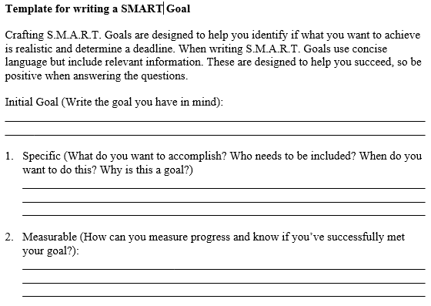
How to Write a SMART Goal…
Notes:
Speak through slide

Slide 12
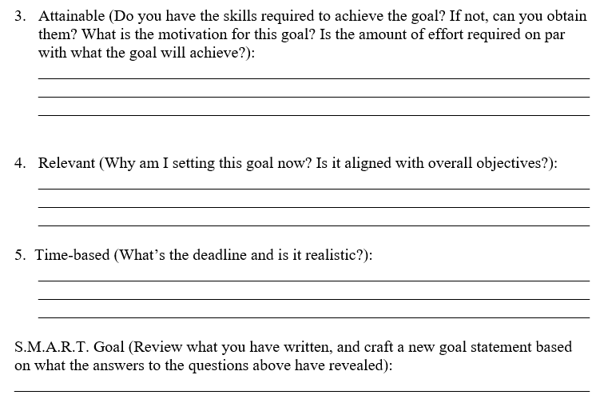

How to Write a SMART Goal…
Notes:
Speak through slide

Slide 13
Sample Smart Goals
Establish a recruiting system by hiring a talent manager by August 30th and reduce time-to-hire from 30 days to 20 days by Q4.
1
Boost our client retention rate by 25 percent in six months by conducting a customer listening campaign to learn where to add value for mature accounts.
2
By the end of Q2, take Coaching Effectively course and pass the certification exam to better educate myself on increasing employee performance.
3
Notes:
Sample 1:
What-Reduce time to hire from 30 days to 20 days.
How – establishing a recruiting system by hiring a talent manager
This example has 2 time-based goals- hiring a manager by August 30th and reducing time to hire by Q4.
Sample 2:
What-Boost client retention rate by 25%.
How-listening and learning from our customers to determine where to add value to our accounts.
By when-in 6 months.
Sample 3:
What-increase employee performance.
How-better educate myself by taking the Coaching Effectively course.
By when-end Q2.

Slide 14


Tips and Resources
Use Excel to track progress
Have visual reminders
Manage the amount of goals
Discuss during 1:1
Smarter, Faster, Better, by Charles Duhigg
9 Things Successful People Do Differently, by Heidi Grant Halvorson
Notes:
Gantt Charts (bar chart) are a great way to track you progress to ensure you are meeting each of your milestones and you can use it to send reminders on specific tasks that are due. (Project management tool)
Visual Reminders- Post it Notes on computer or white board. Use the Sticky Notes on computer. Laminate. Set reminders on your calendar.
Depending on the department and the employees' level of responsibility anywhere from 3-5 goals is manageable.
Discuss your progress, roadblocks, resources that you might need.
Smarter, Faster, Better-Great book, talks about 8 key productivity concepts, from motivation and goal setting to focus and decision making. Also wrote the Power of Habit, which is another great book.
9 Things Successful People Do Differently – Heidi Grant Halvorson, this is a research backed book that outlines the 9 things successful people do differently.

Slide 15

Questions?
Notes:
Any Questions on Goal Writing

Slide 16


