Slide 1
Micro-Learning, Macro-Impact: Credentials for a Rapidly Changing Workforce
Dr. Jill Lane
Associate Vice Chancellor, Academic Innovation
University System of Georgia

Slide 2
Micro-Learning, Macro-Impact: Why Now?
Shift in perception of traditional degrees.
Learner preference for short, career-relevant credentials.
Overcoming the enrollment cliff.

Slide 3
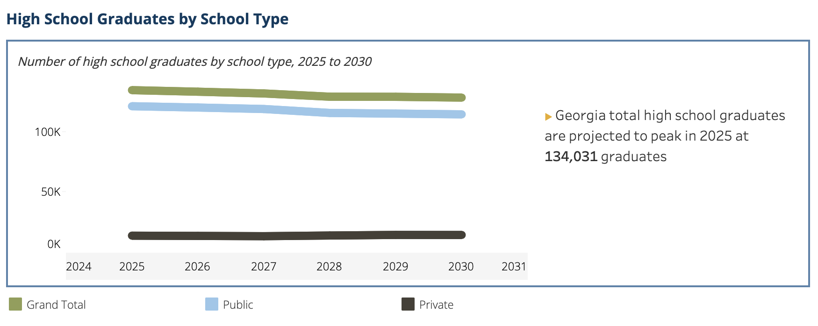
Micro-Learning, Macro-Impact: Enrollment Opportunity
According to GOSA, around 58% of high school graduates in Georgia attend postsecondary institutions after graduation. (78,540)
According to EducationData.org, 78,325 students received an Associate's or Bachelor’s degree in 2025.
WICHE High School Graduate Data

Slide 4
Micro-Learning, Macro-Impact: Enrollment Opportunity
Source: National Student Clearinghouse, 2025 Report on Some College No Credential Student Outcomes

Slide 5
Micro-Learning, Macro-Impact: Workforce Needs
Over 300 occupations are contained on the 2026 Statewide High Demand Career list.
Over 60% of jobs on 2026 Statewide High Demand Career list require some form of postsecondary credential.
Rapid changes in different job-related knowledge and skills are requiring more workers to upskill.

Slide 6
Micro-Learning, Macro-Impact: Employability
77% of employers indicated the need to reskill or upskill workers to better work alongside GenAI¹
63% of employers indicated skill gaps in the labor market as a barrier to organizational transformation.¹
85% of employers indicated upskilling the workforce is a major strategy to respond to workforce macrotrends for 2025-2030.¹
¹ World Economic Forum, Future of Jobs Survey 2024

Slide 7
Micro-Learning, Macro-Impact: Employability
68% of employees indicated that learning helps them adapt during times of change.¹
89% of students in the survey agreed or strongly agreed that earning an entry-level professional certificate or microcredential will help them stand out to employers and secure jobs.²
¹ LinkedIn Workplace Learning Report, 2025
² Coursera Survey, 2021

Slide 8
Micro-Learning, Macro-Impact: 2026 High Demand Careers

Slide 9
Micro-Learning, Macro-Impact: 2026 High Demand Careers

Slide 10
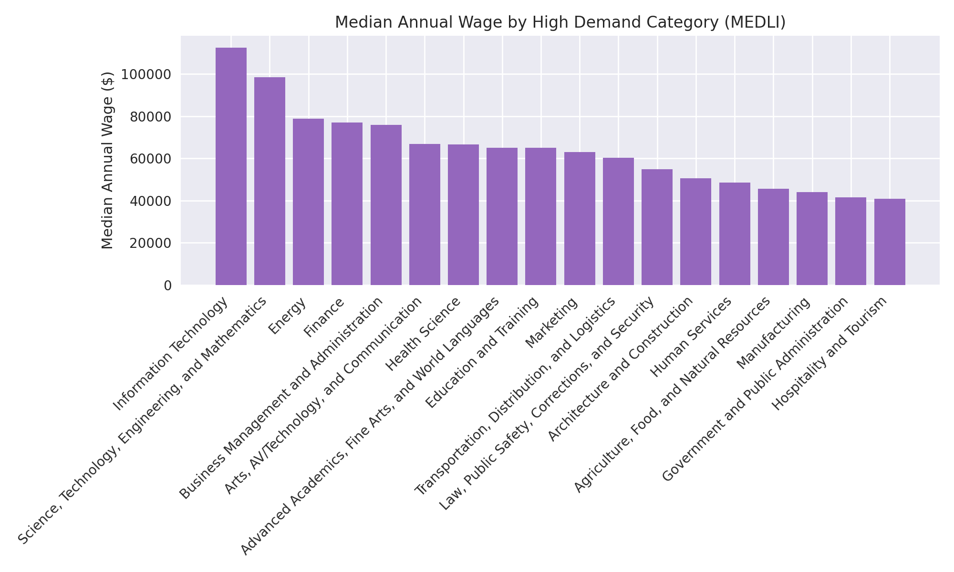
Micro-Learning, Macro-Impact: Return on Investment

Slide 11
Micro-Learning, Micro-Impact: Classification of Credentials
Notes:
A credential that indicates achievement of specific skills or competencies.
Gained through workshops or limited coursework
Non-credit through continuing and professional education.
For-credit for less than 9 hours
Not currently eligible for federal financial aid

Slide 12
Micro-Learning, Micro-Impact: Types of Credentials
Badge: A credential that indicates student achievement of specific skills or competencies gained through certified learning experiences, workshops, or programs.
Digital badges can be awarded, verified, and displayed online.
If offered for credit, for-credit badges are under nine hours and are not eligible for Federal Financial Aid unless embedded within an existing degree program.
Certification: A credential that indicates mastery of knowledge, skills, and abilities of competencies identified by a recognized entity such as a licensing body, disciplinary organization, or industry.
Certifications usually contain a cluster of competencies that lead to an industry-awarded certification.
Certificate: A credential that indicates the completion of a cohesive curriculum that is more coursework than a badge but less coursework than a degree program.
Microcredential Implementation Guide: https://www.usg.edu/academic_innovation/microcredentials

Slide 13
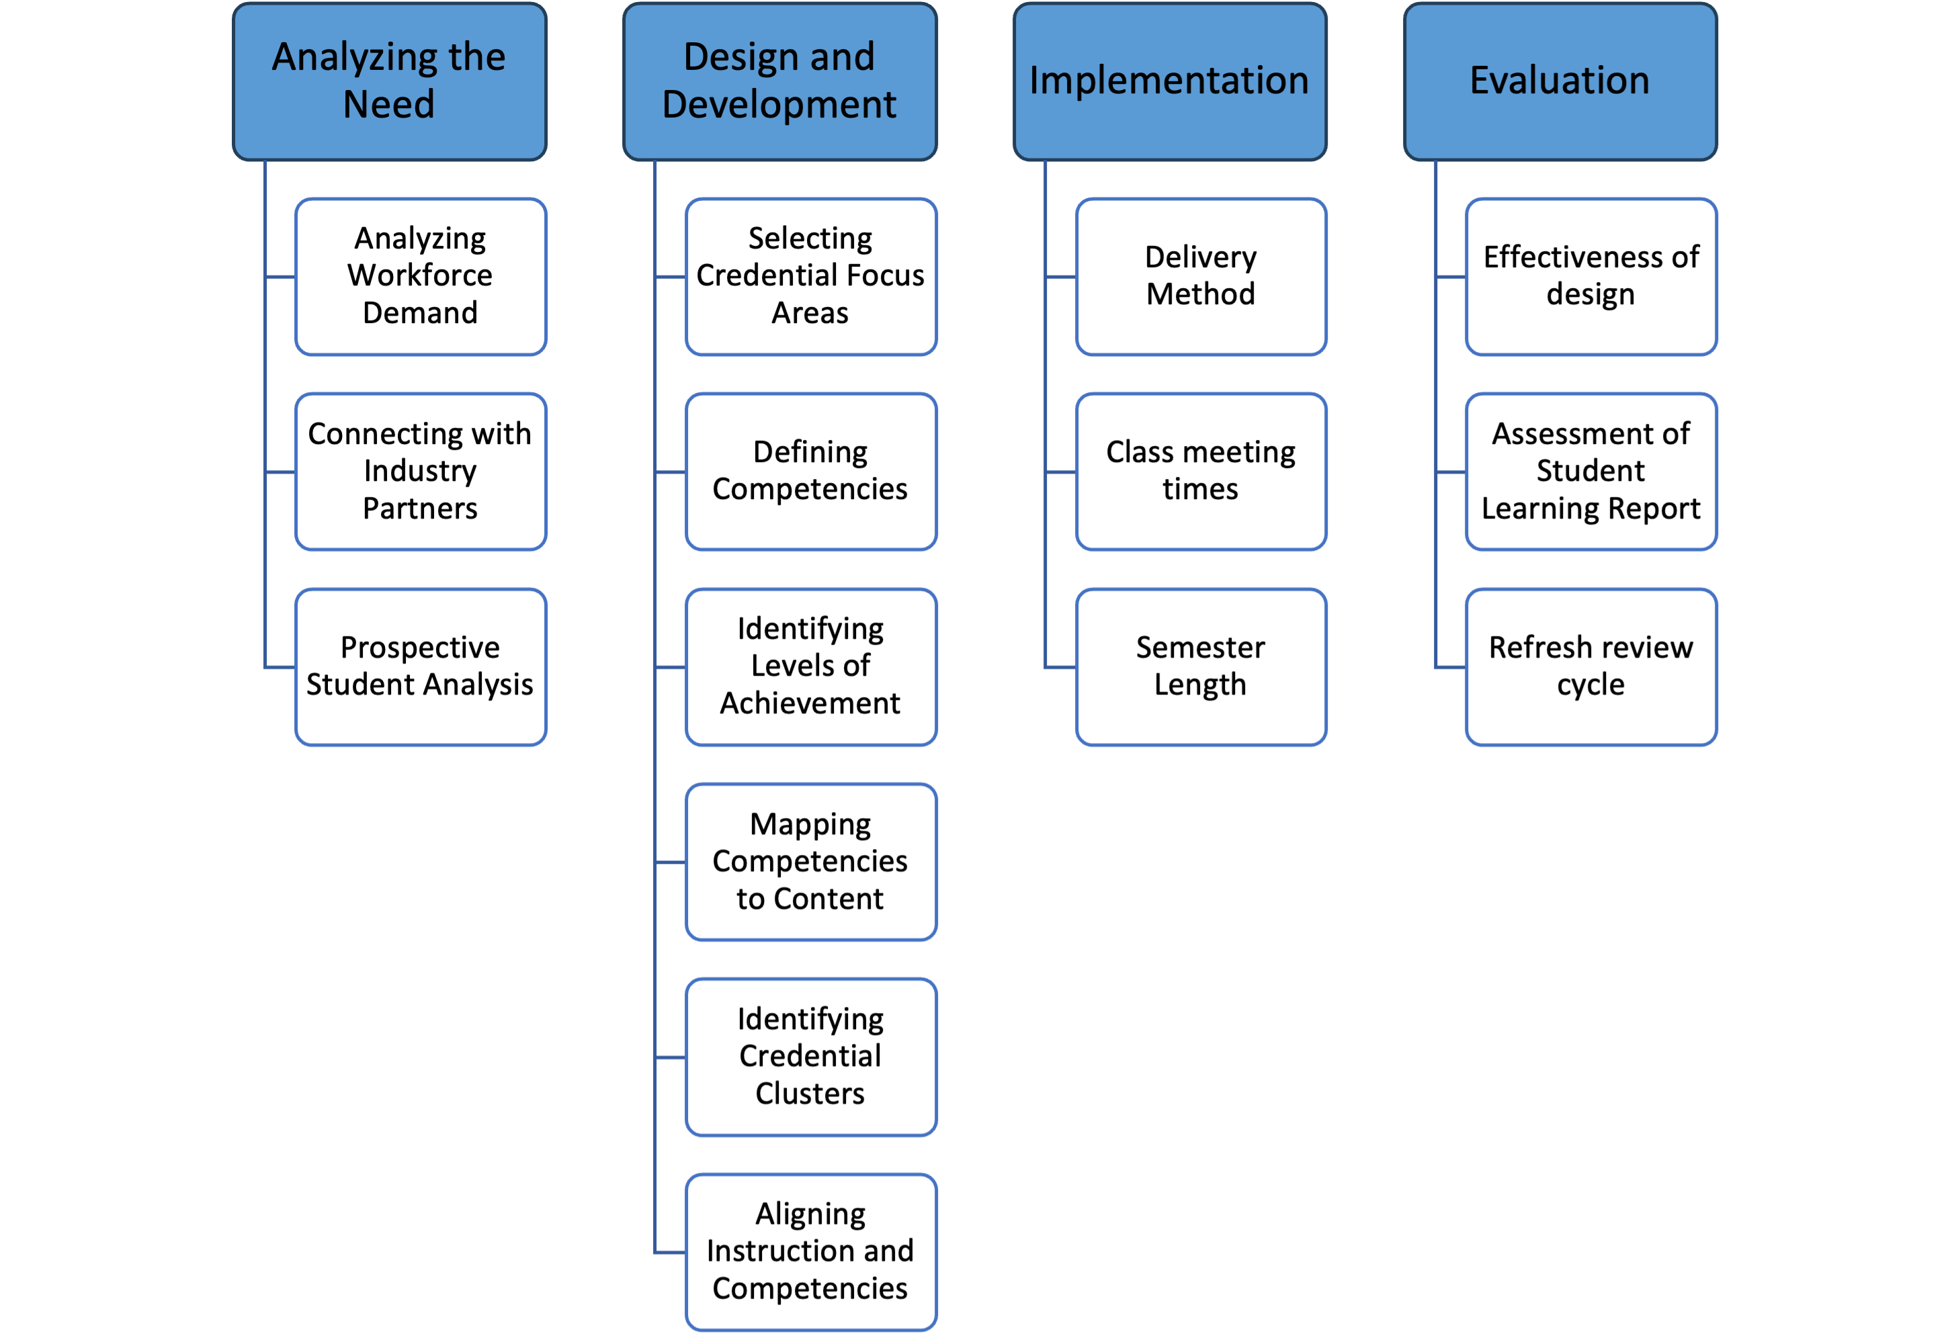
Micro-Learning, Macro-Impact: Development Framework

Slide 14
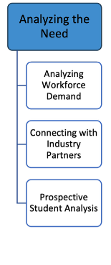
Micro-Learning, Macro-Impact: Starting the Process
Questions to Consider
What skills are in high demand in our service area or across the state?
Which key businesses and industries might benefit from the credential?
What is the target audience for the credential?
Is there sufficient demand for the credential?
What are the specific learning needs of potential students?
What support will potential students need?

Slide 15
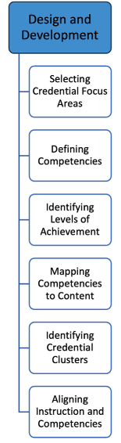
Micro-Learning, Macro-Impact: Pulling it Together
Questions to Consider
What competencies are needed for the high-demand skills?
Do we need to redesign existing courses to align with the competencies?
How can we verify that students have mastered the required degree of learning for each competency?
Will the competencies require more than one credential?
Can credentials be stacked toward a degree?
Are there opportunities for students to use prior learning?
What support will potential students need?

Slide 16
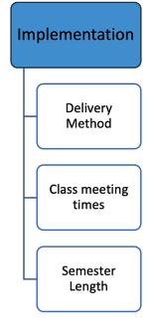
Micro-Learning, Macro-Impact: Implementation Considerations
Questions to Consider
What delivery method works best for the students?
Are there certain class times that should be considered?
Can the credential be offered in less than 15 weeks?

Slide 17
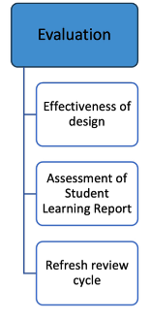
Micro-Learning, Macro-Impact: Continuous Improvement
Questions to Consider
Do we need to schedule an annual refresh of competencies with employers?
How are students performing in the curriculum?
Are the required competencies being met?
What are the enrollment, completion, and placement rates?

Slide 18
Micro-Learning, Macro-Impact: Important Take Aways
Prior learning policies that allow for the acceptance of professional education courses and military training
Importance of an industry partner and/or advisory board
Recognition that the design of the credential is based on competencies
Need clear admissions policies
Institutional teams should include financial aid officers if a credential is offered for-credit.
Need to establish procedures for tracking student attainment of the competencies and awarding of the credentials.
Regular review cycle to ensure that competencies are current.

Slide 19
Questions?

Slide 20
References:
Father Guido Sarducci, 5-Minute University, available at: https://www.youtube.com/watch?v=fke1_Hi_ZkA
Adobe Firefly AI Video, Hiring Manager
USG MEDLI Dashboard, available at: https://www.usg.edu/academic_innovation/workforce_demand_tools
Georgia Unified High Demand Career List, available at: https://topstatefortalent.georgia.gov/explore-georgias-high-demand-career-list
USG Microcredential Implementation Guide, available at: https://www.usg.edu/academic_innovation/microcredentials
LinkedIn Workplace Learning Report, 2025, available at: https://learning.linkedin.com/resources/workplace-learning-report
2021 Coursera Impact Report, available at: https://www.coursera.org/about/press/wp-content/uploads/2021/11/2021-Coursera-Impact-Report.pdf
World Economic Forum, Future of Jobs Report, available at: https://www.weforum.org/publications/series/future-of-jobs/
Western Interstate Commission for Higher Education High School Graduate Data Profiles, available at: https://www.wiche.edu/knocking/data-visualizations/geography/
Governor’s Office of Student Achievement High School Graduate Outcomes, available at: https://hsgrad.gosa.ga.gov/noauth/extensions/HighSchoolGradOutcomes/HighSchoolGradOutcomes.html
EducationData.org College Graduation Statistics, available at: https://educationdata.org/number-of-college-graduates

