Slide 1
WCAG Compliance
Connecting the What, Why, and How

Slide 2
NOT a new legislation or changed law
This rule is new regulation for 1990’s ADA legislation
  ADA broadly forbids discrimination on the basis of disability
  How laws are applied in specific situations is determined by
    Federal Agencies (the DOJ in this case)
    Courts
  Federal agencies create “regulations” or “rules”
Prior to publishing this rule in April of 2024, DOJ had not mandated a specific standard and scope for digital accessibility; it relied on broad language since 1996.
HOWEVER, ADA compliance has always been an expectation.

Slide 3
Highlights of the Requirements
From the DOJ Civil Rights Division ADA Info page

Slide 4
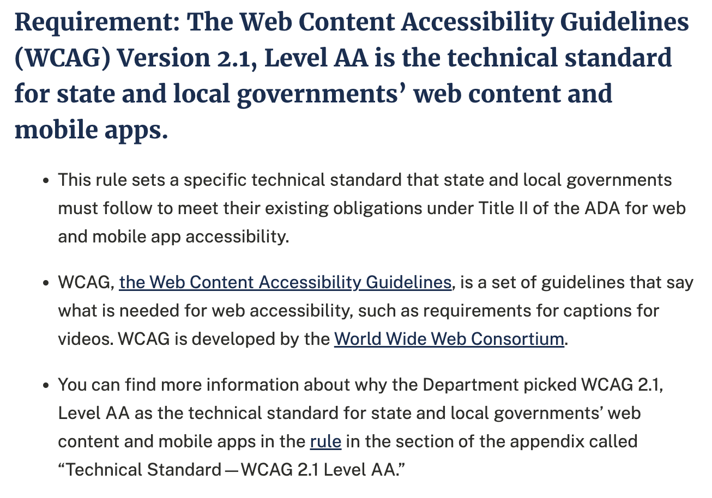
Requirement 1
DOJ officially establishes WCAG 2.1 AA as technical standard (with very few specific exceptions).

Slide 5
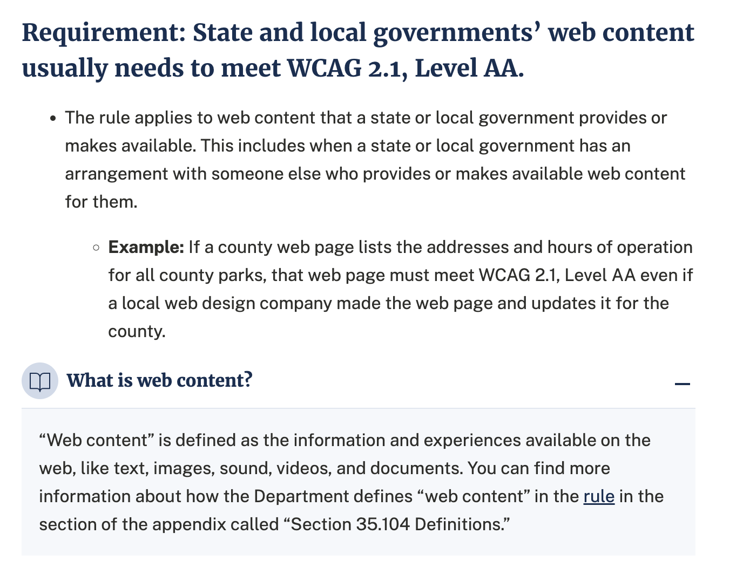
Requirement 2
Most state and local agencies web content must meet WCAG 2.1 AA.
Web content is, broadly, anything that can be accessed through a web browser.

Slide 6
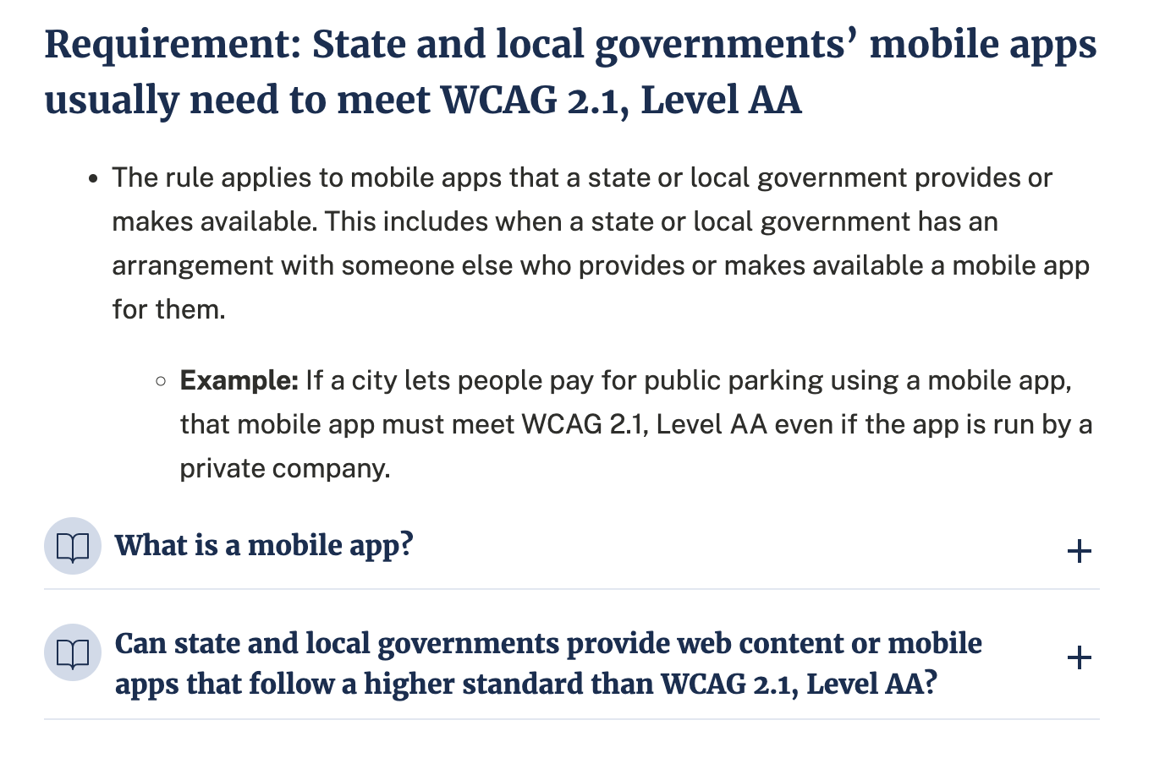
Requirement 3
Mobile apps will also need to meet WCAG 2.1 AA.

Slide 7
Due Dates
The rule focuses on state and local governments but is applicable to public education, i.e.: universities and school districts.
The DOJ will expect institutions like KSU to be compliant by 4/24/2026
State and local government size | Compliance date
0 to 49,999 persons | April 26, 2027
Special district governments | April 26, 2027
50,000 or more persons | April 24, 2026

Slide 8
Foreseeable Impacts
WCAG 2.1 AA is for everyone

Slide 9
Scope and Reach
Non-academic:
Academic:
All departments that create digital content that is distributed publicly or to students will need to make sure it meets WCAG 2.1 AA.
Communications (institution-wide emails, meetings, etc.) must comply.
All applications built, purchased, or used must meet WCAG 2.1 AA.
All digital course content, whether online, hybrid, or in-person must comply.
All digital third-party content and applications (publisher content, etc.).
Urgency for accessibility resources for unique challenges has increased (STEM, expansion of current tools, etc.).
Notes:
All development must keep it in mind

Slide 10
Why else?
Who do you want to exclude from the content you create and publish?

Slide 11
What is WCAG?
Getting to know the technical standard

Slide 12
Summary from WAI
(WCAG) 2.1 will make content more accessible to a wider range of people with disabilities, including accommodations for blindness and low vision, deafness and hearing loss, limited movement, speech disabilities, photosensitivity, and combinations of these, and some accommodation for learning disabilities and cognitive limitations;

Slide 13
WCAG Breakdown
4 Principles
13 Guidelines (examples)
3 Levels of Conformance
78 Success Criteria (example)
Perceivable
Operable
Understandable
Robust
1.1 Text alternatives
2.1 Keyboard Accessible
3.2 Predictable (logical structure)
4.1 Compatible
A
  Lowest, most essential, level
AA
  Mid-level and the required standard
AAA
  Highest level, often not measured
1.2.2 Captions (Prerecorded)
  Level A
  Captions are provided for all prerecorded audio content in synchronized media, except when the media is a media alternative for text….

Slide 14
Essentially…
When we make content accessible, we are…
  Making sure that content can be perceived through multiple senses.
  Optimizing content for use with assistive technology.
Demos
  Assistive Technology Demo
  How a Table is Read by a Screen Reader (Video)
  How List Styles are Read by a Screen Reader (Video)

Slide 15
The Basic Four
A simple set of habits anyone can easily adopt

Slide 16
The Basic Four
Document Structure
Alternative Text
Media Accessibility
Accessible Applications
Semantic (Heading) Structure
List styles
Tables
Text color contrast
Descriptive links
Text alternative for images, charts, graphs, etc.
No images of text
Transcripts of audio recordings
Closed captions of for video with timed audio
Audio descriptions for video where content is communicated only visually
Ensuring third-party applications and content are compliant
  Accessibility statements
  Voluntary Product Accessibility Templates (VPATs)

Slide 17
YuJa Product
We are working on an acquisition (YuJa Suite) to replace Ally and provide for STEM and PDF content as well as expanded document checking and remediation workflows outside of the LMS for staff units.

Slide 18
What to Expect Today
Breakout Sessions

Slide 19
Breakouts will…
Show you practical steps and provide resources for
  Documents
  Media
  Website
  Reviewing third-party sources
There will likely be overlap of some concepts—that’s OK!
Some language will be used interchangeably
  508/WCAG, web/digital, etc.
Ask Questions!

Slide 20
Resources and References
Where to go next

Slide 21
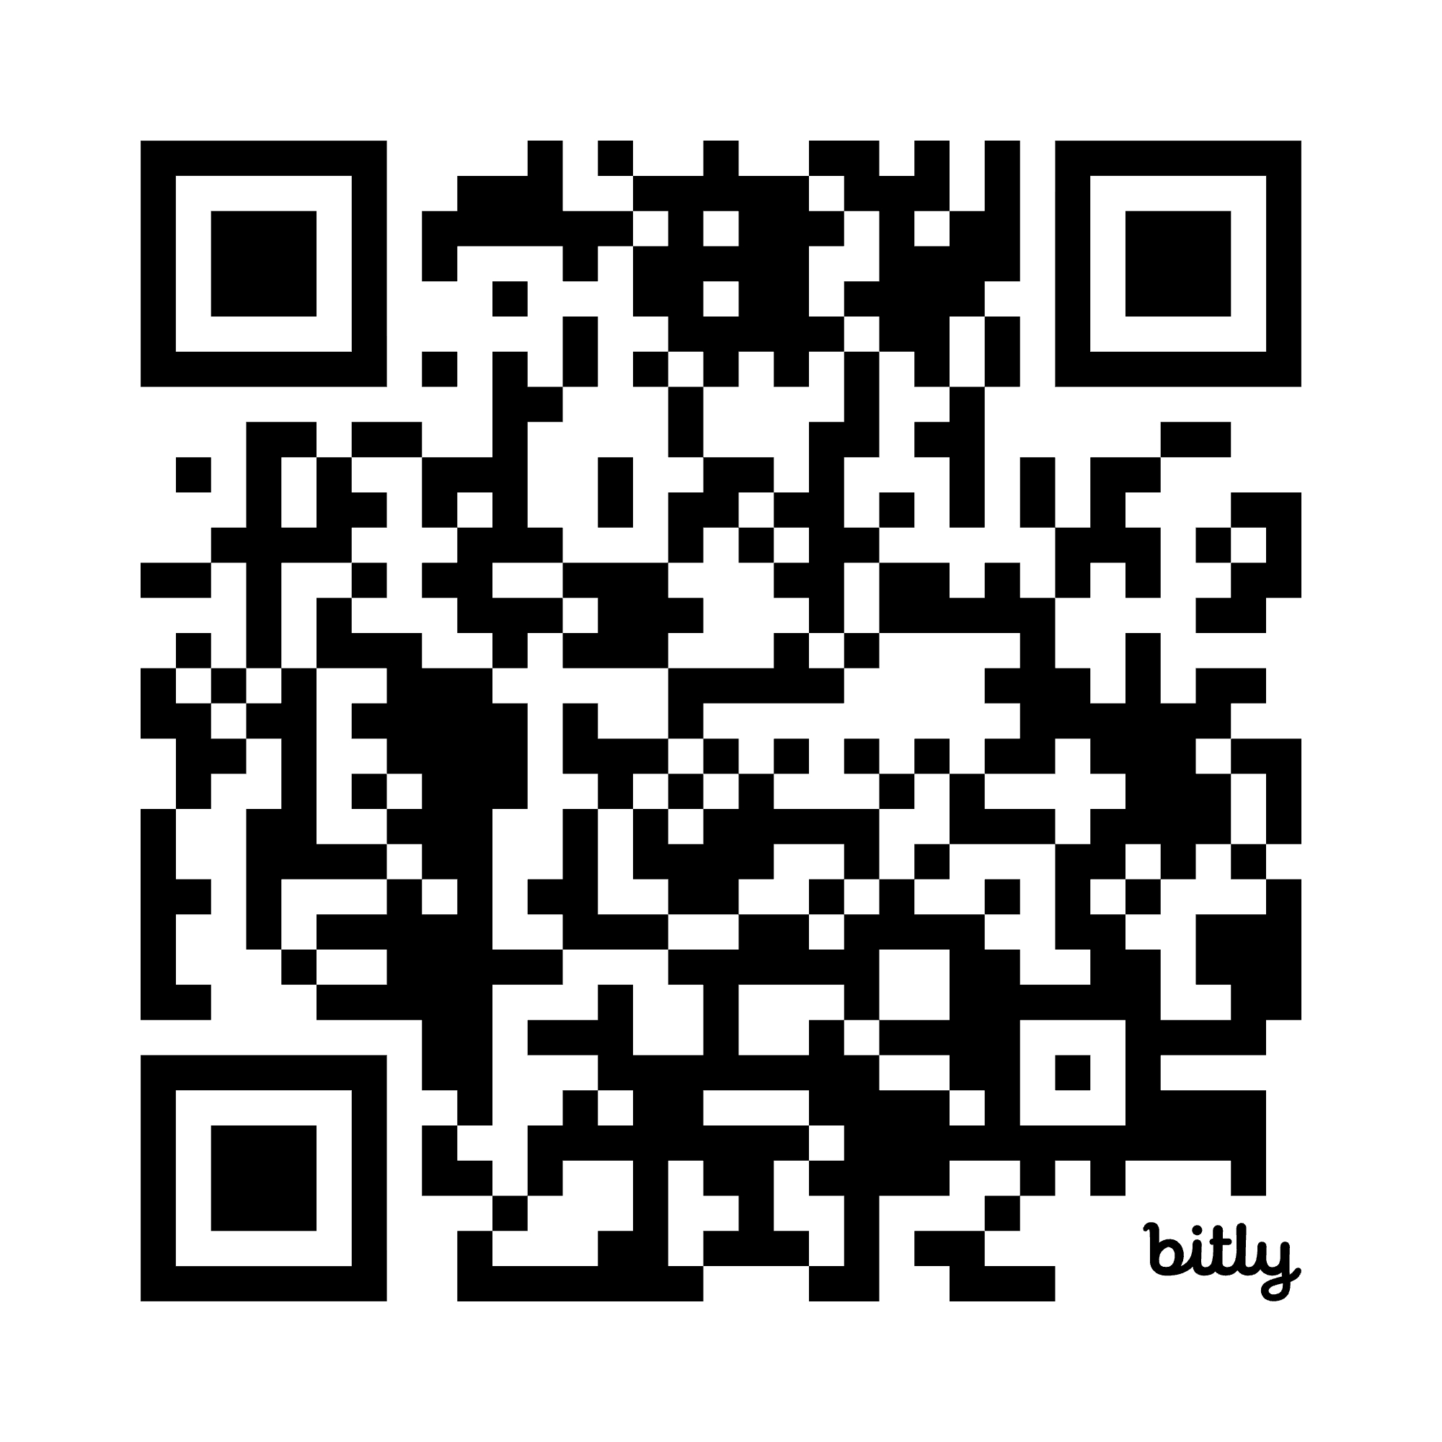
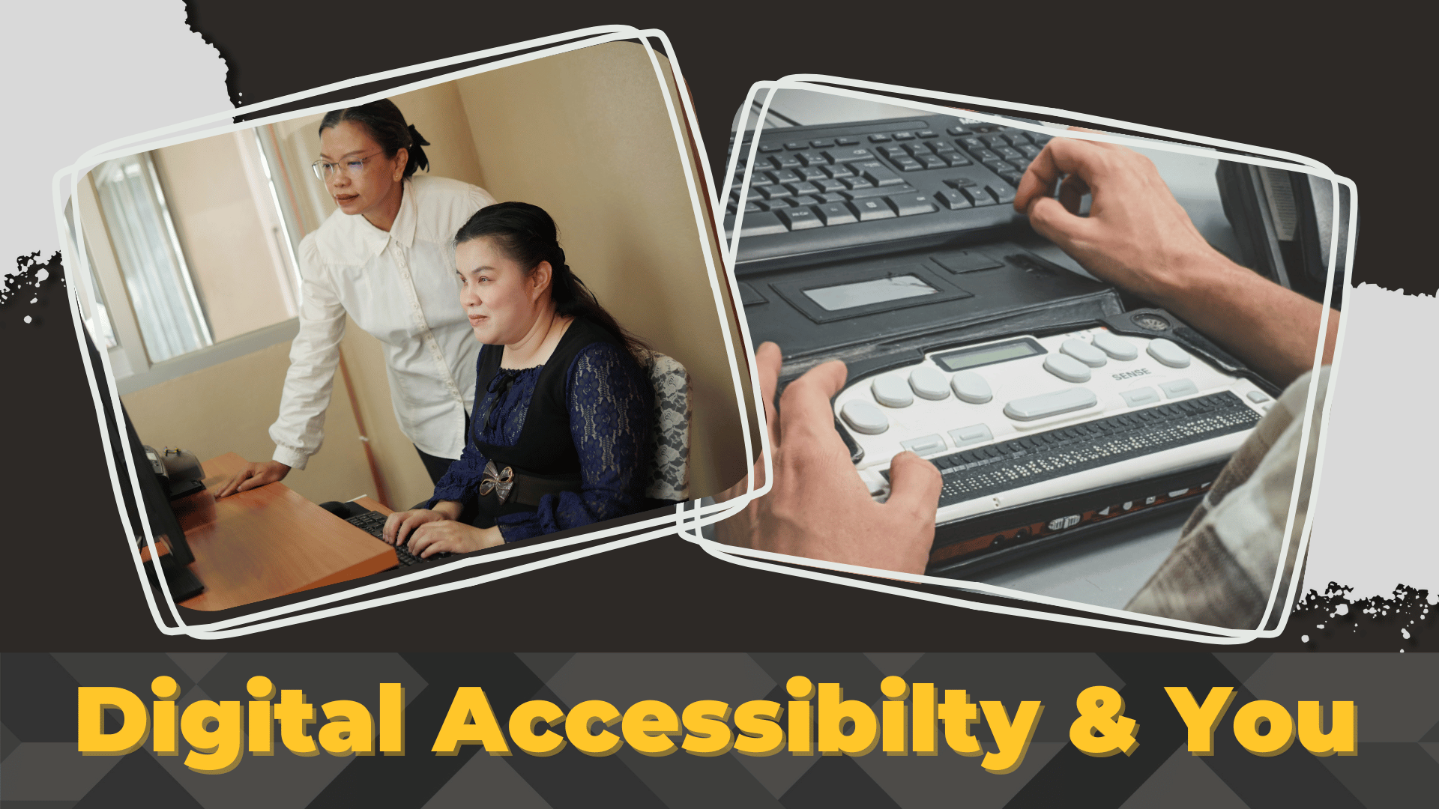
Digital Accessibility & You 20 Minute Module
The DAAY module provides an essential overview of the DOJ rule, WCAG, and where KSU staff and faculty can go for more training and resources.
go.kennesaw.edu/awatrain

Slide 22
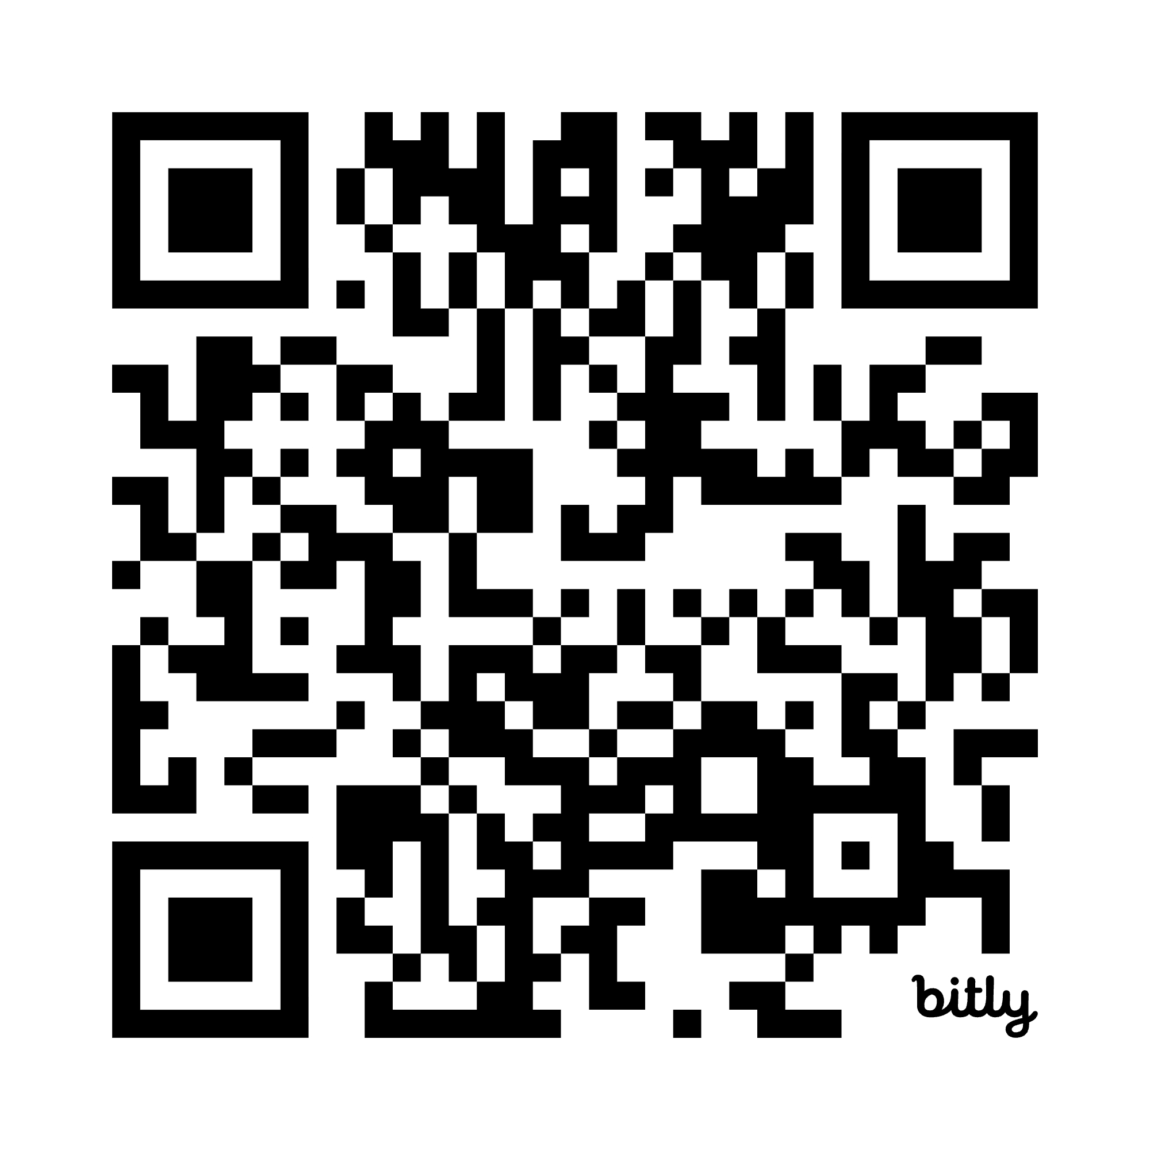

Web Accessibility Essentials Workshop (AWE)
Asynchronous online workshop open to staff and student assistants
Hands-on practice creating accessible documents and media
go.kennesaw.edu/awatrain

Slide 23
OPMO/DLI Resources
Academic Web Accessibility Site (go.kennesaw.edu/awa)
Self-Paced Accessibility Training Resources (go.kennesaw.edu/awatrain)
The Basic Four Page (WCAG simplified into basic habits)
Creating Accessible Content (various platform-specific instructions and accessibility checking)
DOJ Rule: Nondiscrimination on the Basis of Disability (summary page)
WCAG Compliance Unit Toolkit (for academic and non-academic units)
Web Content Accessibility Guidelines (WCAG) (summary page)

Slide 24
Workshops
Accessible Teaching Essentials (Academic Accessibility Training)
  Three-week, asynchronous, self-paced, and open to faculty and student assistants
Accessible Web Essentials (Broader Accessibility Training)
  Three-week, asynchronous, self-paced, geared for public-facing web creators, and open to staff and student assistants

Slide 25
References
Fact sheet: New rule on the accessibility of web content and mobile apps provided by state and local governments. ADA.gov. (April 8, 2024).
Nondiscrimination on the Basis of Disability; Accessibility of Web Information and Services of State and Local Government Entities. Federal Register. (April 24, 2024).
New Federal Standards for Digital Accessibility of public elementary, secondary, and Postsecondary School websites, Apps, course content, and social media posts . Thompson & Horton. (n.d.).
Web Content Accessibility Guidelines (WCAG) 2.1. W3C. (n.d.).

