Slide 1
Media Accessibility Inclusive Images, Videos, & Audio
Sarah Cooper,
Michael Kingston
& John McPherson
Digital Learning Innovations

Slide 2

Welcome & Objectives 👋
This hands-on session focuses on enhancing your understanding of media accessibility and providing practical tips for evaluating and improving your content.
Additionally, you will learn where to find resources and how to seek assistance with media accessibility challenges.
By the end of this session, you will be able to:
📝Write meaningful alternative text for images.
🎥Edit video captions & describe the benefits of Kaltura Mediaspace.
📧Request assistance for complex media accessibility needs.

Slide 3
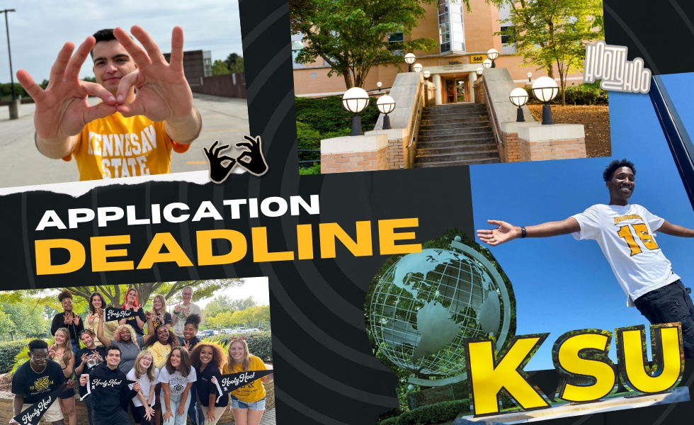
How do we ensure images are accessible for people with visual disabilities?
Alternative Text (alt-text), provides written context to non-text elements in web pages and documents.
It gets read by screen readers so people with visual or cognitive disabilities can understand what the image is about. ​
If the image doesn't load or the user opts to hide images, this text shows up instead. ​
It also gives search engines some context and meaning for the image, helping with SEO (Search Engine Optimization).

Slide 4
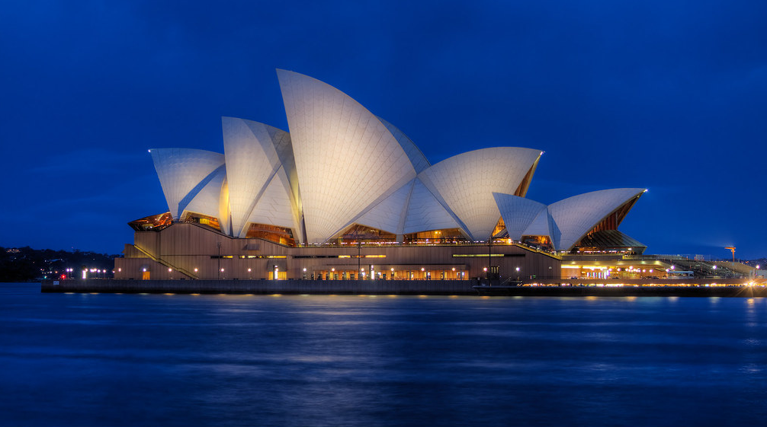
How would you describe this image?

Slide 5



Alt Text: Three Key Questions
What do I want my audience to learn from this image?
Has it already been described in adjacent text?
Is there a specific part of the image that’s most important for the audience to notice?

Slide 6



Alt Text: Three Rules
Be accurate, equivalent, and succinct.
(object – action – context)
Avoid redundancy.
Use “Mark as Decorative” for images without meaningful content or function.

Slide 7
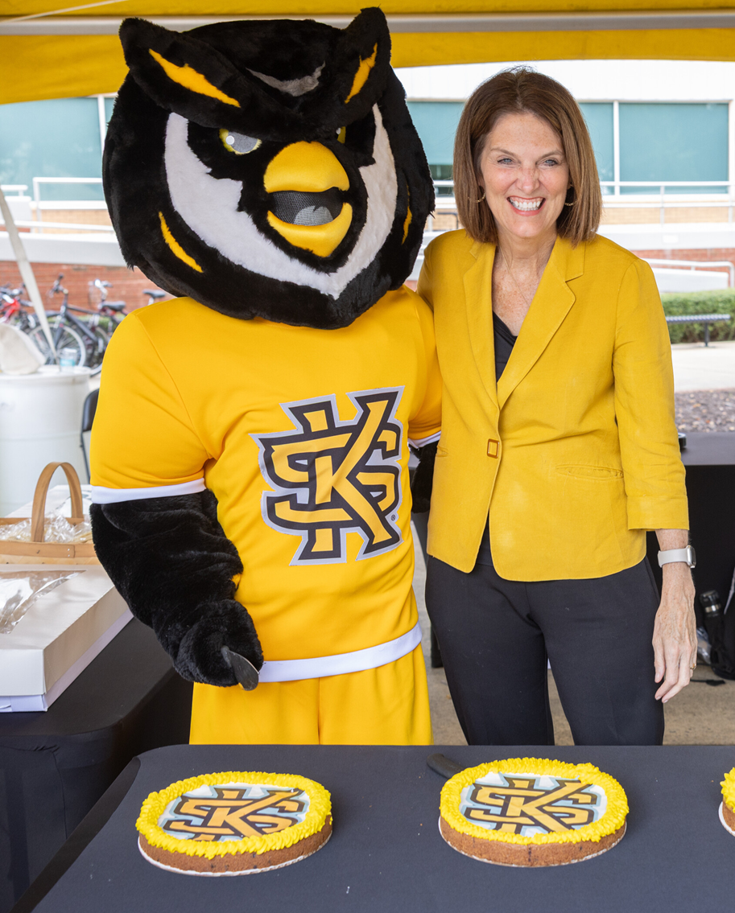

Image 1 Context
This image will be featured in a KSU ad campaign.
A. Scrappy the Owl, wearing a yellow jersey featuring the KSU logo on the front is embracing a smiling KSU President, Kat Schwaig. She is wearing a yellow jacket and they are standing in front of a table with First Day of School Cakes.
B. Mark as Decorative
C. Mascot and President
D. Scrappy the Owl and Pres. Kat Schwaig prepare to cut First Day of School cake.
Check the Notes below for explanations.
Notes:
Answer A has all the right parts (object – action – context), however, it is too wordy and doesn’t meet the standard for being succinct.
Answer B won’t work in this context because as an advertisement for the university, I want all students to be aware of the fun events we have planned.
Answer C isn’t descriptive enough. What mascot? Which President?
Answer D gives object – action context in a succinct and equivalent way. This is the best option out of these choices.

Slide 8
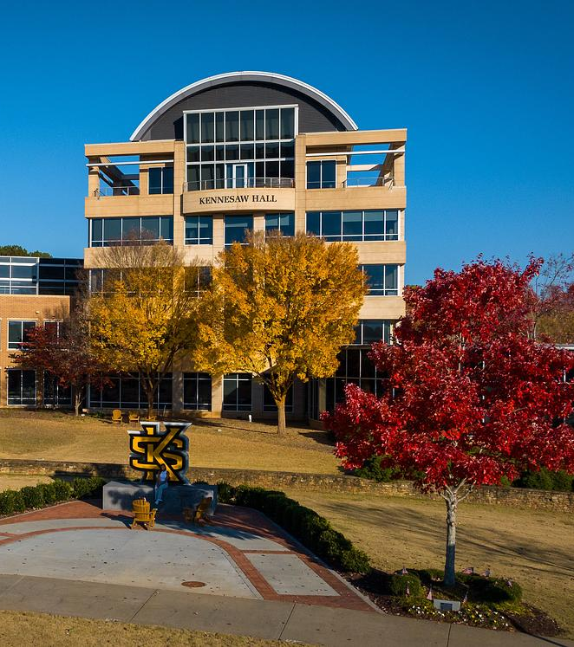
Image 2 Context
This image will be used as an example of current architecture.
A. Kennesaw Hall
B. Mark as Decorative
C. Five floor building with rounded roof and open observation deck at top.
D. img_325a42.jpg
Check the Notes below for explanations.
Notes:
Answer A is useful when the situation calls for identifying Kennesaw Hall, but in this context we want to talk about architecture.
Answer B won’t work in this context because it doesn’t give an equivalent experience to learners with low to no vision. They need to understand what is being shown.
Answer C is the best answer of this bunch. My terrible explanation of architecture notwithstanding.
Answer D exists to remind people that some programs have auto alt-text and will say it passes. If you haven’t actually set the alt-text for your images, you should check each one as you place them to confirm it is conveying the proper context and it is accurate.

Slide 9

Image 3 Context
This sample has multiple images to be considered for alt text. How many can you spot?
A. 2
B. 3
C. 4
D. 5
D. 6
See next slide for explanation.

Slide 10
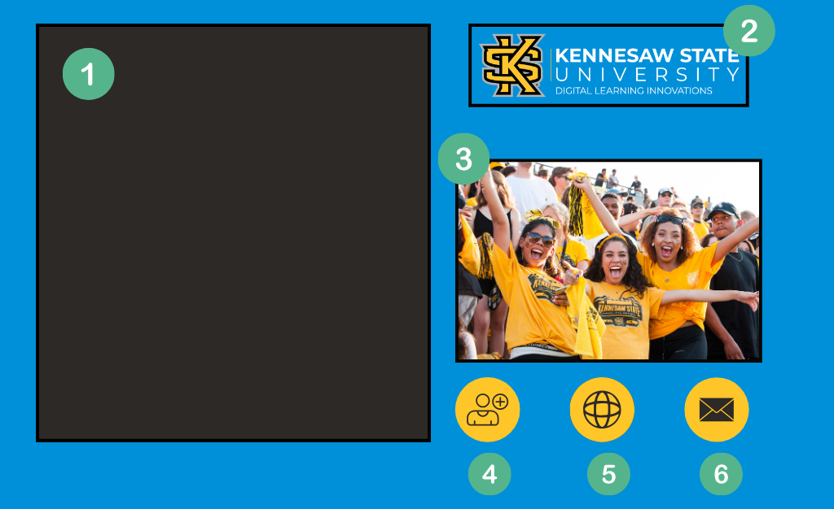
Image 3: Deconstructed
Notes:
Background box, mark as decorative
Logos are advertisement, so you want to use alt text for them. This one would read: Kennesaw State University logo, Digital Learning Innovations department.
This image, for our purposes, would be marked as decorative because it’s really just there as decoration.
This icon would be used as a functional link to our one-on-one services so it would be read as: Link – One-on-One Request
This icon is also functional and would read as a link to the DLI website
This icon is also functional and would read as a link to an email address

Slide 11
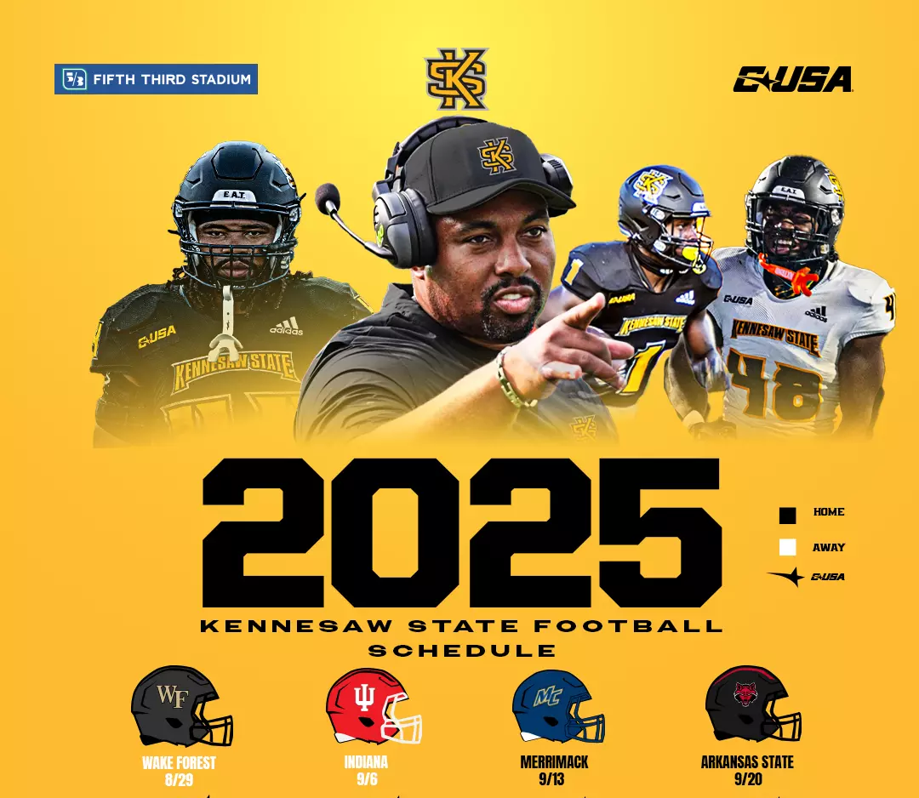
What alt text would you write for this image?
Remember the three key principles:
What do I want my audience to learn from this schedule?
Has it already been described in the adjacent text?
Is there a specific part of the image that’s most important?
Schedule Link

Slide 12
Long Descriptions
part of the surrounding text
an adjacent link
Image alt text reads: “long description follows” or “long description provided in link”.
[2025 KSU Football Schedule (Conference USA) featuring 2 away games: August 29 at Wake Forest, September 6 at Indiana. And 2 home games in Fifth Third Stadium: September 13 against Merrimack, September 20 against Arkansas State].

Slide 13

Pt. 2: Accessible Videos & Audio
What are the accessible options for video and audio content?
What are some available support tools for making this content accessible?

Slide 14
Subtitles vs. Captions
Subtitles
Captions
Definition:
Translation of spoken language into text
Text for spoken language + important sounds
WCAG Requirement:
Not required to meet WCAG standards
Required to meet WCAG 2.1, Level AA on prerecorded and live video with audio
Purpose:
Language accessibility (translation service)
For deaf/hard of hearing users
Example:
English subtitles on a French language video
“[laughter] hello!”

Slide 15
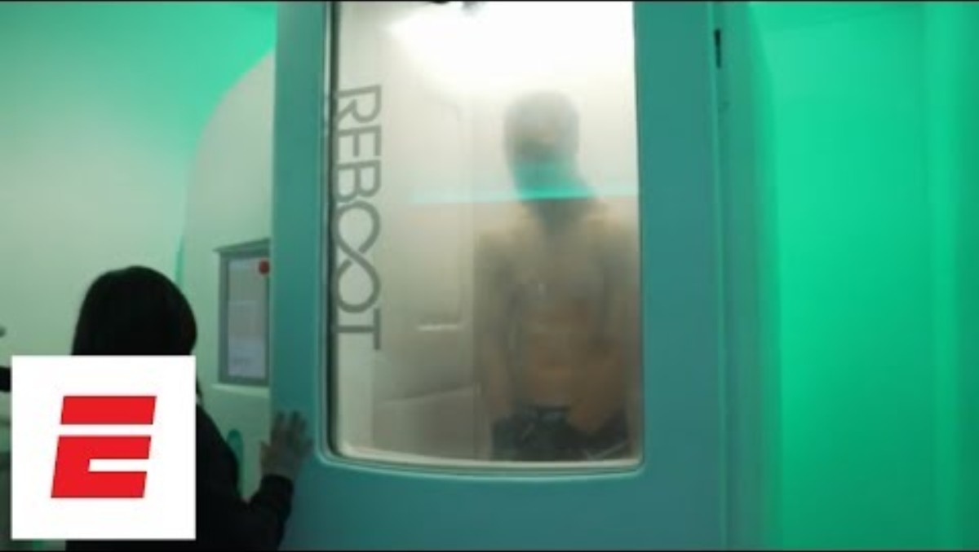
Caption Fail: Please Don’t Do This!

Slide 16
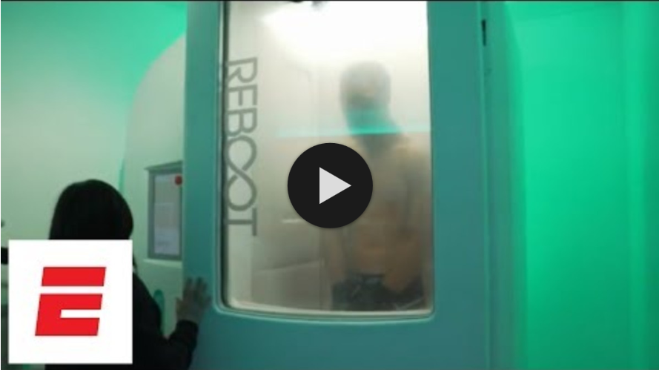
There, I Fixed It
WCAG Compliant Fix

Slide 17

Closed Captioning Checklist
Accurate and in-synch with dialogue.
Proper spelling and punctuation.
Non-speech & other important sounds in brackets.
Speaker labels when necessary: [NARRATOR], [Kat], etc.
Try to stay around 32 characters per line (including spaces).

Slide 18
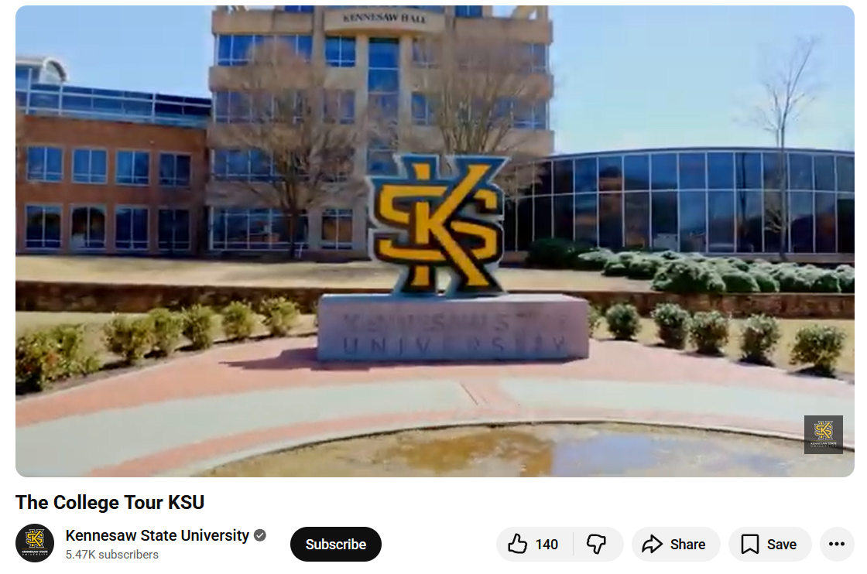
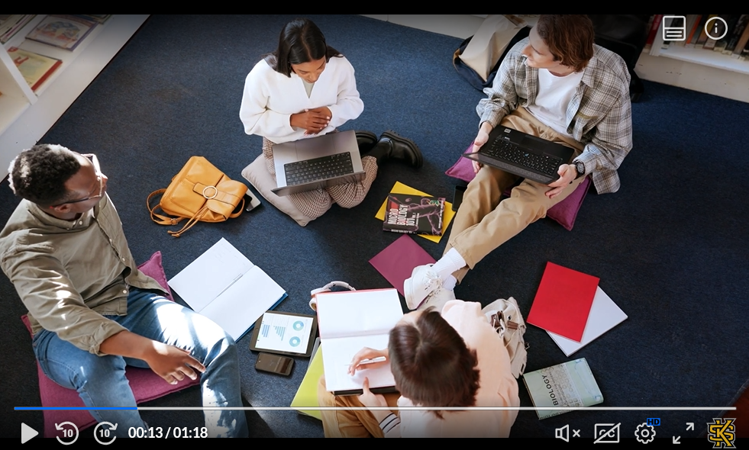
A Tale of Two Options
Kaltura MediaSpace
YouTube

Slide 19
Transcripts and Audio Descriptions
Transcripts
Audio Descriptions
Definition:
Full text of audio content + important sounds + ID speakers
Narration of visual elements to enhance understanding of video
WCAG Requirement:
Required to meet WCAG 2.1, Level AA on audio-only content
Required to meet WCAG 2.1, Level AA on prerecorded videos
Purpose:
For deaf/hard of hearing users
For blind/low vision users
Example:
Podcast transcript
“Three woman appear on the hill”

Slide 20
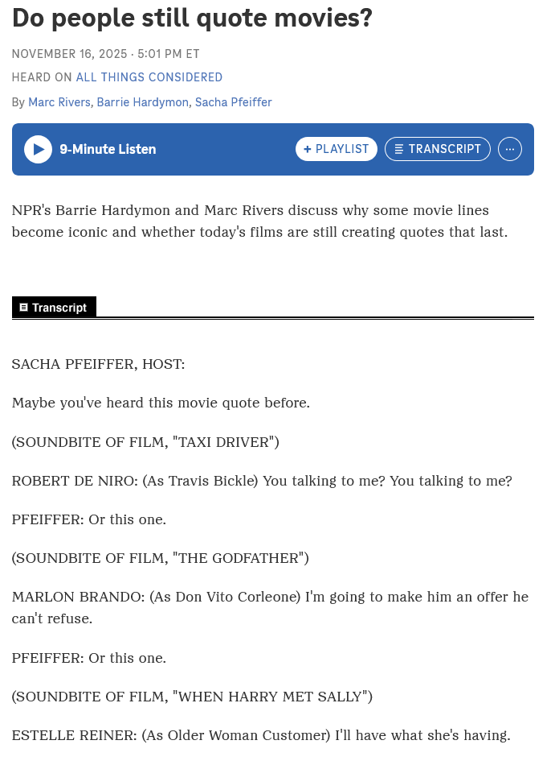

Providing Descriptions
Transcript Linked
Audio-Only Media (e.g. podcasts)
Transcript Labeled
Transcripts required for WCAG 2.1, Level AA
Text appears on the page with the media
Or linked immediately after the audio clip (clearly labeled)
Speakers and non-speech sound identified throughout

Slide 21
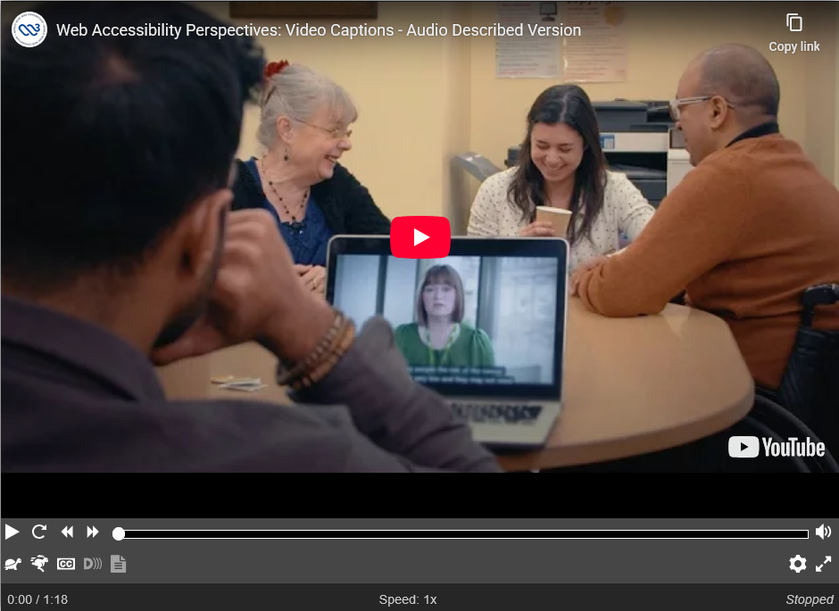
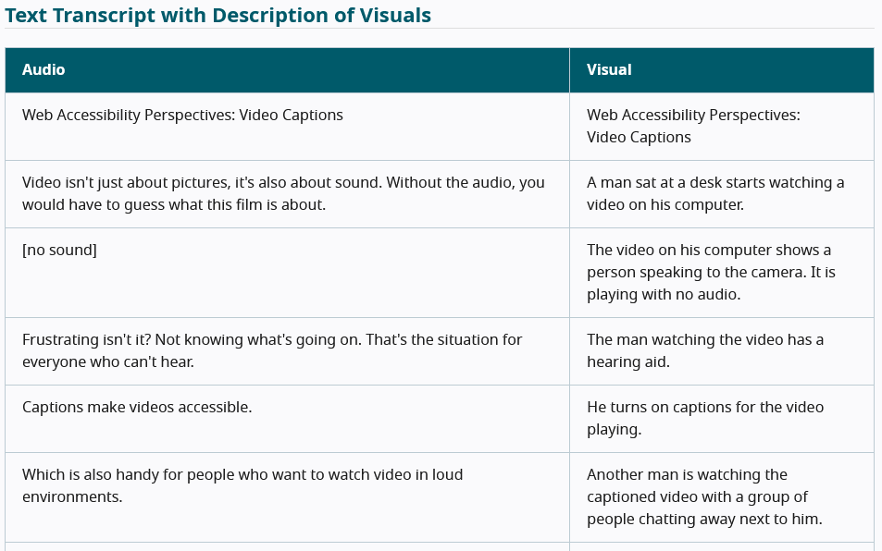

Providing Audio Descriptions
Audio Descriptions
(for video content)
Audio Description tracks or descriptive transcripts are required for WCAG 2.1, Level AA
Linkable audio track
Text transcript with descriptions of visuals (table format)
Enable Audio Description
This video information is available as a Text Transcript with Description of Visuals below.

Slide 22
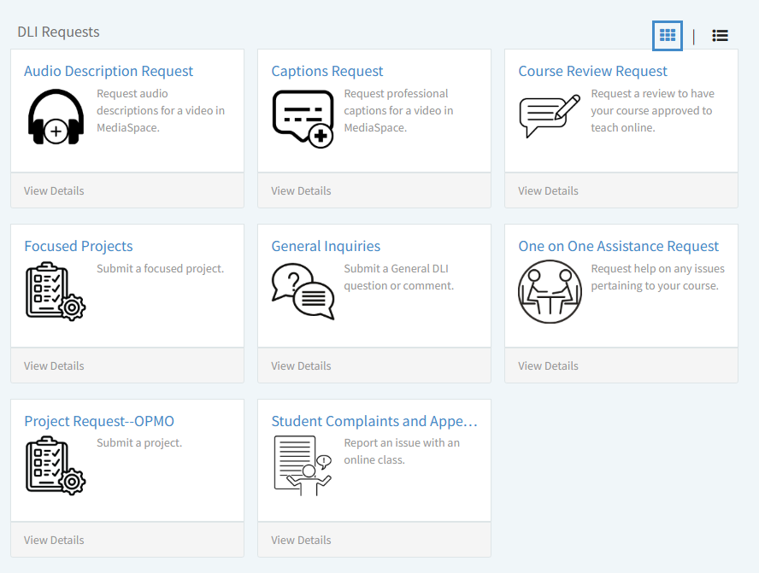
Request assistance
For complex accessibility needs or questions contact the DLI/OPMO Team via a ServiceNow Form.
Overview
We hope you leave this session confident in how to:
📝Write meaningful alternative text for images.
🎥Edit video captions using Kaltura Mediaspace.
📧Request assistance for media accessibility needs.

Slide 23
References 🧐
Chen, A. (2020, July 17). How to write an image description. UX Collective. https://uxdesign.cc/how-to-write-an-image-description-2f30d3bf5546.
ESPN. (2017, May 20). Hang Time: Cryotherapy with Stephen Curry and JaVale McGee [Video]. ESPN. https://www.youtube.com/watch?v=m5NpMHVWIkY.
Kennesaw State University Athletics. (2025, February 6). Kennesaw State football’s full 2025 schedule announced. https://ksuowls.com/news/2025/2/6/kennesaw-state-footballs-full-2025-schedule-announced.aspx
Rivers, M., Hardymon, B., & Pfeiffer, S. (2025, November 16). Do people still quote movies? All Things Considered. NPR. https://www.npr.org/2025/11/16/nx-s1-5604882/do-people-still-quote-movies
World Wide Web Consortium. (2025, September 22). How to meet WCAG 2.2 quick reference: Guideline 1.1 – Text alternatives. Web Accessibility Initiative. https://www.w3.org/WAI/WCAG22/quickref/#text-alternatives.
World Wide Web Consortium. (2019, 23 January ). Video captions: Web accessibility perspectives. https://www.w3.org/WAI/perspective-videos/captions/

