Slide 1
ADA Best Practices
For Modern Campus (Omni CMS)
Web Team from The Office of Strategic Communications & Marketing
Created by: Jonathan Gillam & Sharon McAleer

Slide 2
ADA Act
Elements Outside of Your Control
What Can You Do in Modern Campus
Accessible Page Content
Snippet Usage
ADA Checklist
ADA Resources
In this workshop:
Notes:
Our session description: Website Accessibility in Modern Campus CMS
Description:
Join the KSU Web Team from Strategic Communications & Marketing for a one-hour session focused on creating accessible, inclusive, and compliant web content within the Modern Campus CMS. This presentation will walk editors and site managers through best practices for meeting ADA and Section 508 requirements, using real examples from KSU sites.
Participants will learn:
How accessibility applies to content built in Modern Campus templates
Common accessibility pitfalls (e.g., color contrast, alt text, headings, and links) and how to avoid them
Best practices when using Snippets and other built-in Modern Campus tools to meet accessibility requirements
KSU’s expectations, resources, and upcoming accessibility initiatives
The session will include live demos, quick tips you can apply immediately, and time for Q&A. Whether you edit pages occasionally or manage a full site, this session will help ensure your content is usable by everyone and fully compliant with KSU standards.

Slide 3
Americans with Disabilities Act (ADA)
Title II of the ADA applies to all state and local government entities, including public colleges and universities
Public universities must ensure that all digital content is accessible
This includes websites, web apps, learning systems, digital documents, mobile apps, student portals, and online services.
The legal standard:
Web Content Accessibility Guidelines (WCAG) 2.1 AA
Deadline April 24, 2026
WCAG 2.2 AA became official October 2023
Notes:
WCAG 2.2 Adds 9 New Success Criteria
In 2.2 3.3.8 Accessible Authentication (Minimum) – login must not rely on memory tests (like CAPTCHAs or “enter the same pattern”)
Focus not obscured
24x24 touch targets or have enough spacing

Slide 4
It’s the Law
Section 508 of the Rehabilitation Act of 1973
Americans with Disabilities Act of 1990
Features of Compliance
Proper alternative (alt) text for images
Keyboard accessibility
Color contrast compliance
Clear headings and structure
Accessible documents (PDFs, PPT)
Captions and description for video/audio
In 1998, the US Congress amended the Rehabilitation Act to require Federal agencies to make their electronic and information technology accessible to people with disabilities.
In 2021, 42.5 million people in the US civilian noninstitutionalized population had a disability, according to the Census.gov.
Notes:
26 years after section 508 in 2024 title 2 of the ADA required state, local governments and universities….

Slide 5
Proactive Monitoring & Remediation
The Department of Justice (DOJ) expects universities to:
Conduct regular accessibility audits
Fix issues quickly (remediation)
Maintain an internal governance framework
Ensure vendors meet accessibility standards
Track issues across colleges, departments and units
Implement ongoing campus-wide training

Slide 6
Non-compliance
Results in:
Mandatory corrective action plans
Multi-year audits
Public settlement agreements
Reputational damage
Significant staff time and cost
Best to be proactive ahead of the April 24, 2026 deadline
Notes:
Examples: In 2006, The National Federation of the Blind v. Target Corp. — The NFB sued Target over inaccessible website content for blind screen‐reader users. monetary damages in the amount of six million

Slide 7
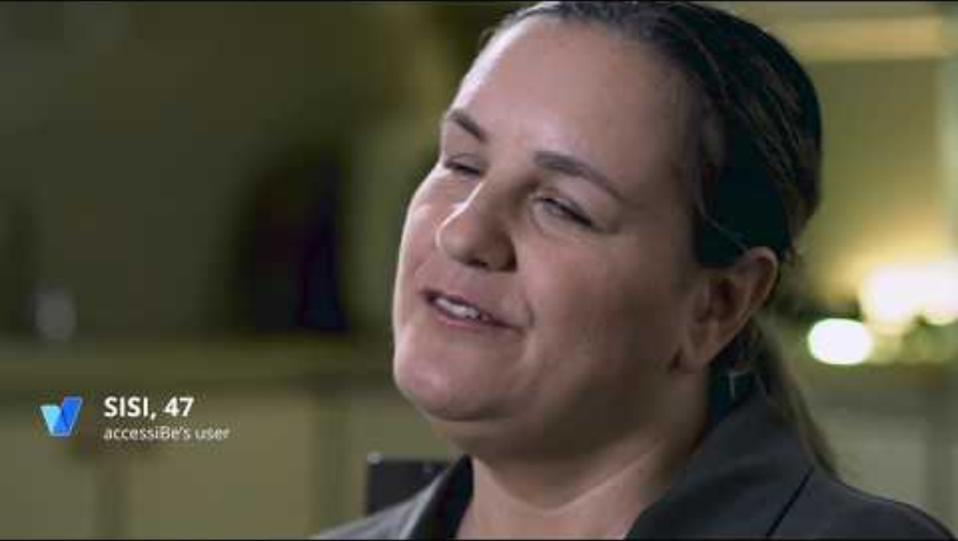
Why It’s Important
https://www.youtube.com/watch?app=desktop&v=a2hqmqZzegg

Slide 8
Accessibility in Modern Campus (Omni)

Slide 9
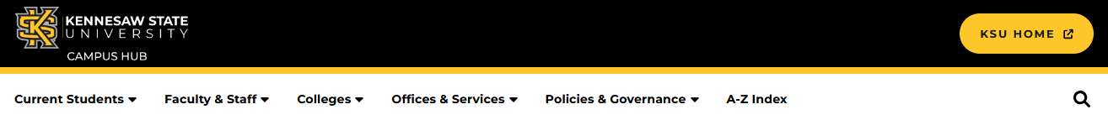
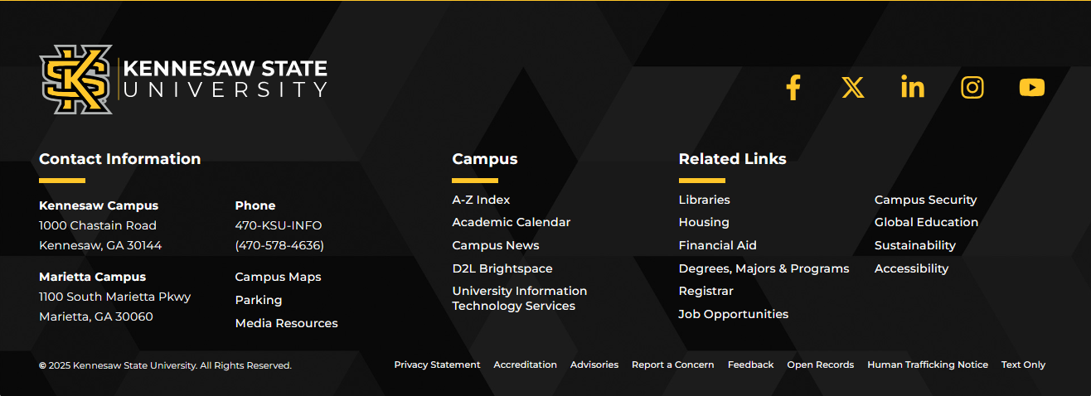
What is outside of your control?
Header Content
Footer Content
The header and footer are maintained by StratComm and UITS. If you see any issues or would like to request a change, please send us a service request.

Slide 10
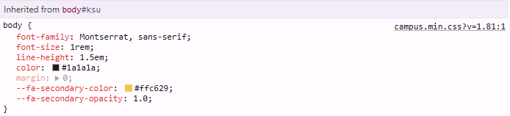
What is outside of your control?
CSS (Font, Color, Styles)
Toolbar Options
What’s Not on the Toolbar:
Underline Text
Strikethrough Text
Justify Alignment
Fonts
Font Sizes
Text Color
Background Color
Table* (*snippet available)

Slide 11
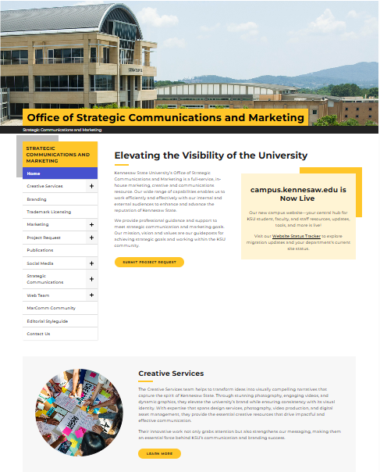
What can you control?
Page Content
Text
Headings
Links
Images
Video
Snippet Usage

Slide 12
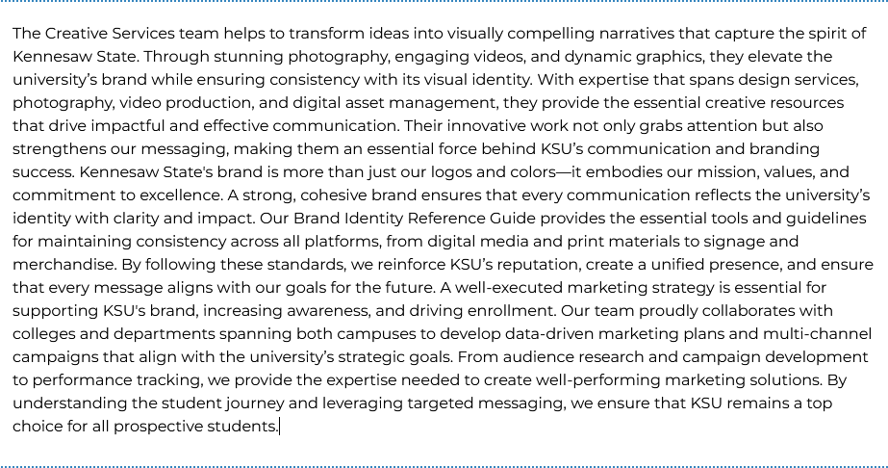
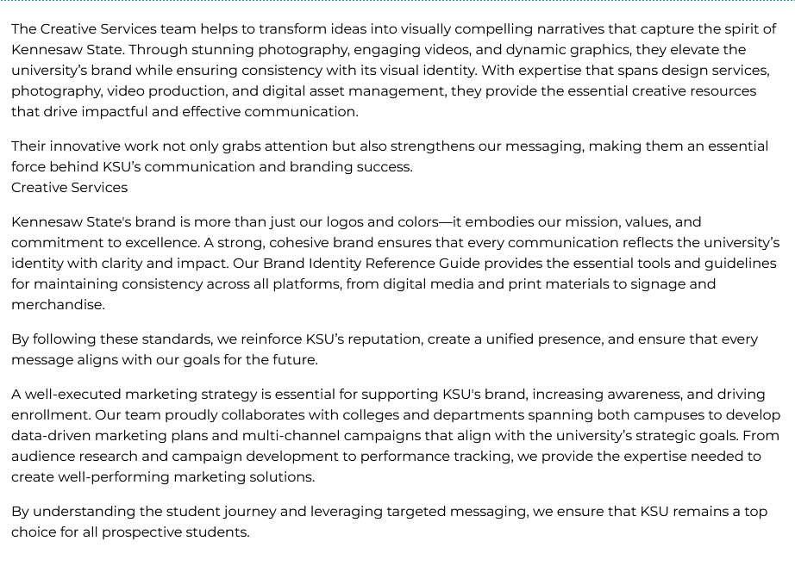
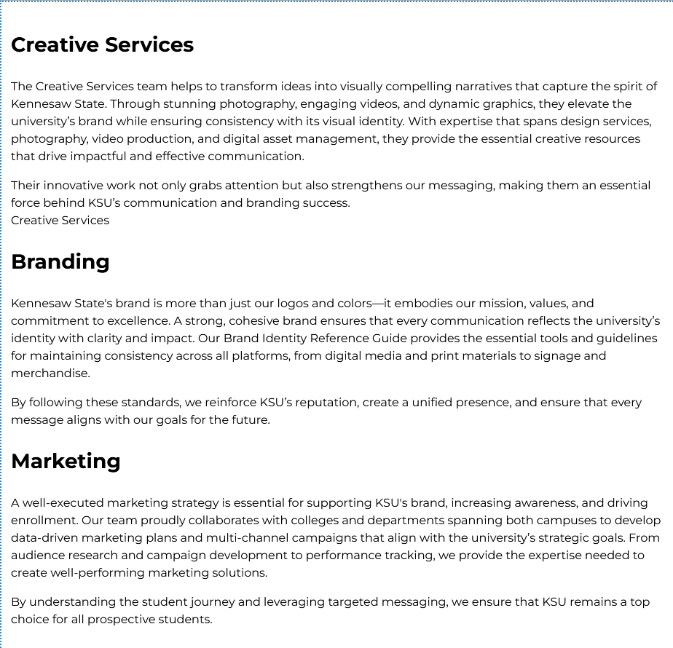
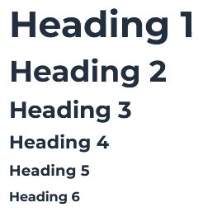
Text and Headings
Break Up Long Paragraphs
Chunk content
Use Headings
Only Use One H1; Should be Unique
Follow a Hierarchy
Don’t skip levels

Slide 13
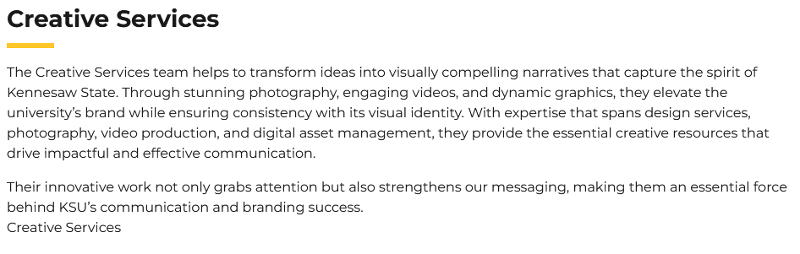
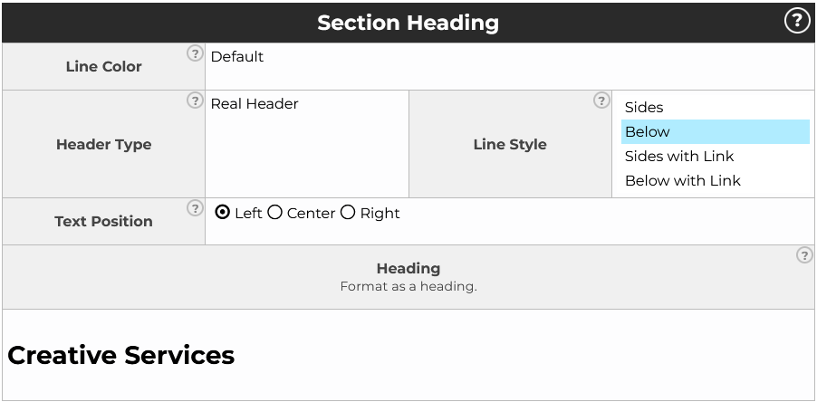
Section Headings
Use a Section Heading
Section Heading formatted as Heading (good example)
<h3 class="heading is_ is_bottom is_left">Creative Services</h3>
Section Heading defaut (bad example)
<p id="" class="is_text_3 heading is_ is_bottom is_left">Creative Services</p>
Note: Be sure to use the heading format for this text. It will default to something that looks like an H3 but will use a class tag.

Slide 14


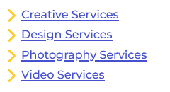
Links
Don’t Use
Here
Click Here
Read More
Learn More
Website
Link
More
Document
This Form
This Page
Download
PDF
Use a Descriptive Link
In a sentence
As a button
With a link list

Slide 15
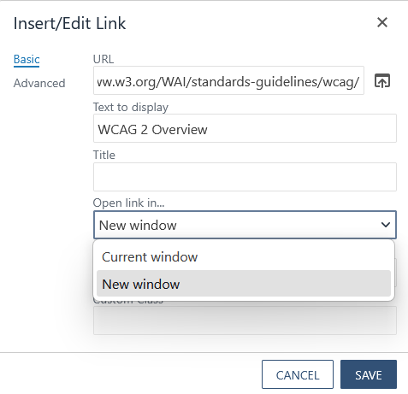
Outside Links
Open a Link in a New Tab
Use for Outside Links
Do not use new tab for KSU links

Slide 16

Images
Use Images
Relevant to the Page Content
Avoid Text Images
Write an Image Description
Briefly Describe the Image
Demographic Information is Not Usually Needed (unless it is essential to understanding the image)
Include Emotion, if Possible
Do Not Say “image of…”
Long Description (for Complex Images, Info-graphics)
A group of people collaborates around a table filled with colorful papers, sticky notes, and design drafts, conveying teamwork and creativity.

Slide 17
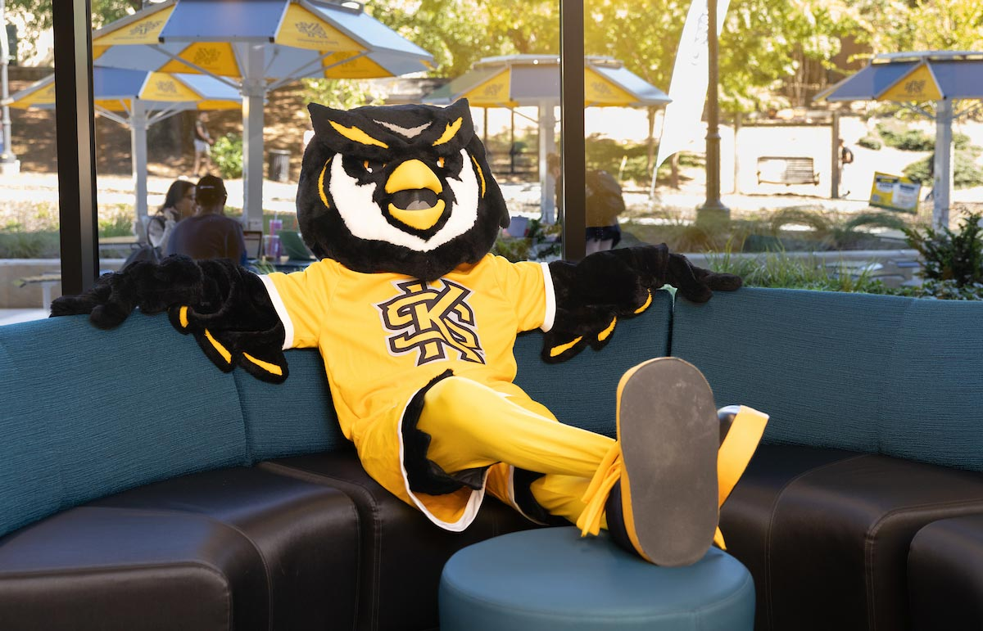
Practice!
Write an Image Description…

Slide 18
Practice!
Write an Image Description…
AI might give you… A mascot, resembling an owl, relaxes on a blue couch wearing a bright yellow jersey. The scene is cheerful, with a sunlit courtyard visible outside.
Adjust it as needed… A scrappy mascot, resembling an owl, relaxes on a blue couch wearing a bright yellow KSU jersey. The scene is cheerful, with a sunlit courtyard visible outside.

Slide 19
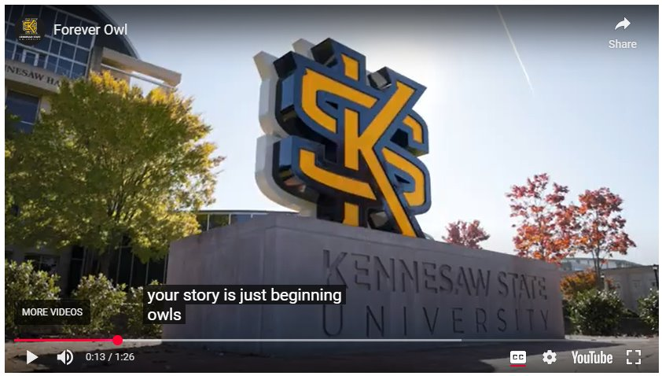
Video
Use Video
Include closed captioning and/or audio description​
Use current branding​
Make sure content is correct and relevant​
Strategic Communications Video Services: http://go.kennesaw.edu/video

Slide 20

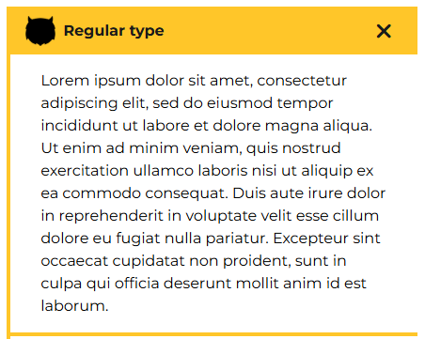
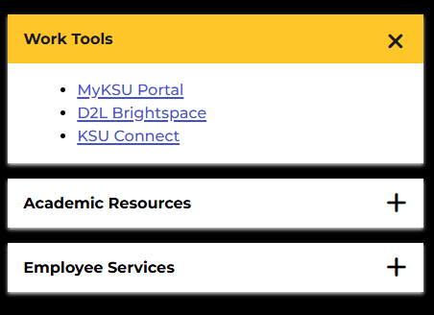

How Do I..?
Use the Accordion Snippet
Keep lists to 5-7 items
Use sparingly
Don't nest within other accordions
Don't use images in headings

Slide 21
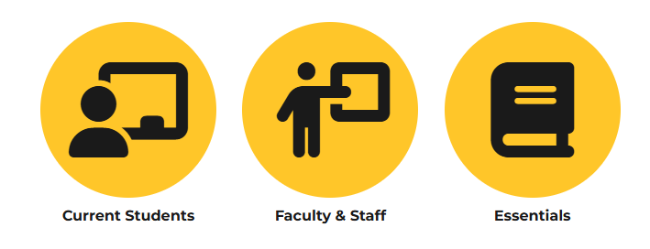
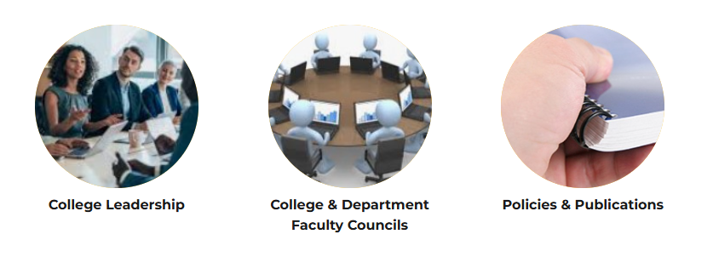
Channels
Use the Channels Snippet
Use for Links
May Have Icons or Images
Use Font-awesome Icons
Remember Image Descriptions Tip: "college leadership" does not describe this image...

Slide 22
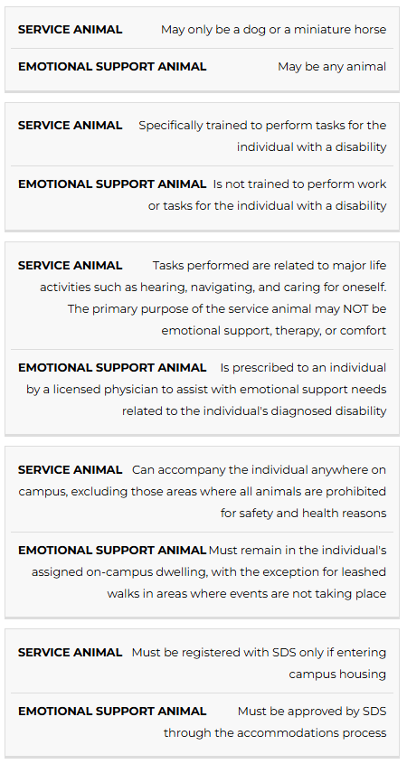
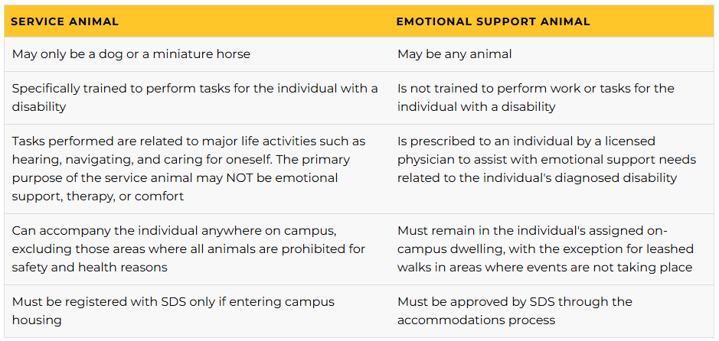
Tables
Use Tables
Use the Columns tool for Page Layout
Use the Table Snippet for Data
Note: It Does Not Look Like a Table in Mobile

Slide 23
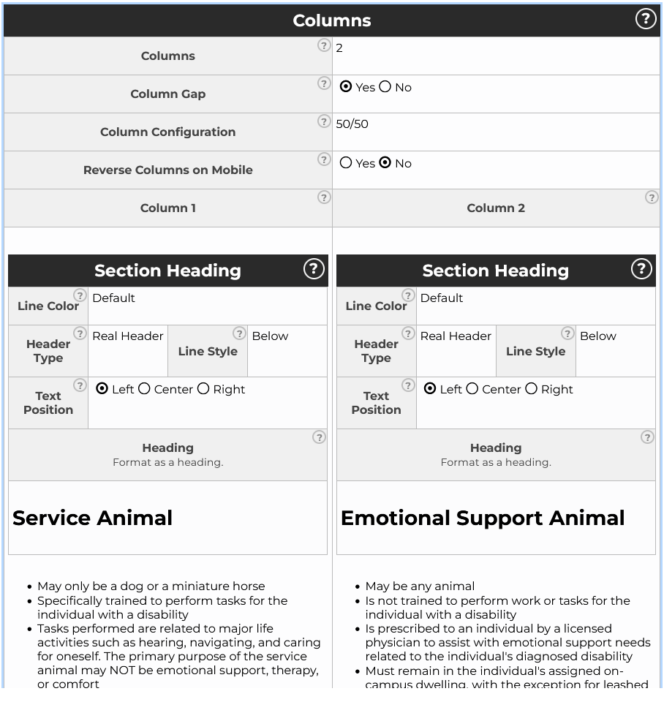
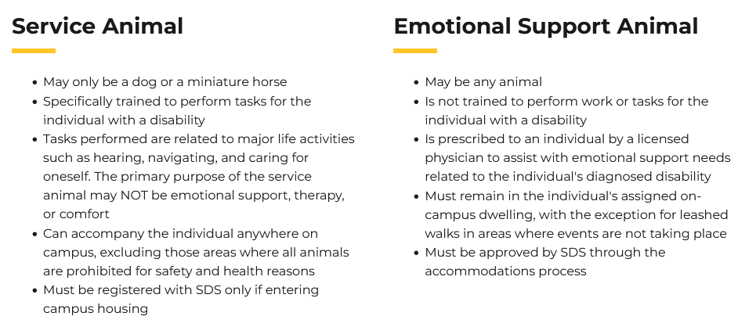
Columns
Use the Columns Snippet for Page Layout

Slide 24
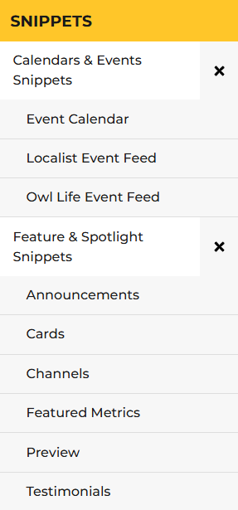
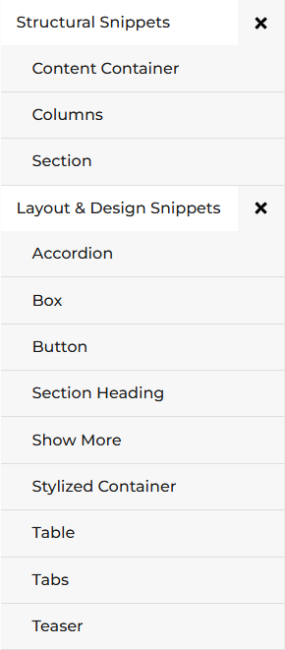
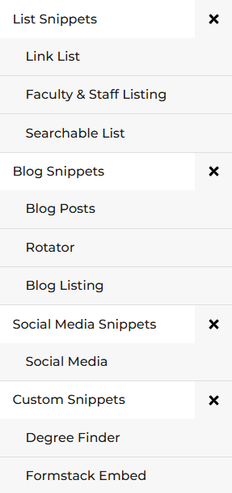
Snippet Library
See the Full Snippet Library https://campus.kennesaw.edu/offices-services/omnicms/snippets/

Slide 25
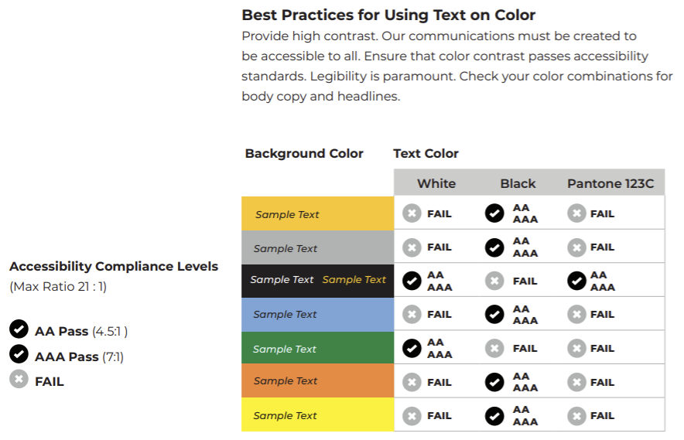
Background Colors
Apply Text on Color KSU Brand Center - Color Guidelines

Slide 26

ADA Checklist
One Unique H1
Heading Hierarchy
Scannable Text
Descriptive Links
Image Descriptions
Closed Captions Videos
Table Column Headings
Also Test for:
Spelling Errors
Broken Links

Slide 27
ADA Resources
GSA Section508.gov
ADA.gov
Web Content Accessibility Guidelines (WCAG) 2.1
KSU - Student Disability Services
KSU - Academic Web Accessibility
Tools
Use the WebAIM Contrast Checker
Accessibility Testing Tool - ANDI
What is Ally?
Blackboard - Ally Accessibility Checklist
Policy
KSU - Web Accessibility Policy

Slide 28

Questions..?

Slide 29

Our Team
Leadership:
Joe Lacy - Director, SEO and Website Strategy
Sharon McAleer - Web Team Manager
Writers:
Josie Carter - Lead Marketing and SEO Copywriter
Malik Jones - Marketing and SEO Copywriter
Webmasters:
Jonathan Gilliam – Senior Webmaster and SEO Specialist
Anthony Matusko - Senior Webmaster and SEO Specialist
Elizabeth Ball - Webmaster and SEO Specialist
Sean Bresnan - Webmaster and SEO Specialist
Matthew Gordon - Webmaster and SEO Specialist
Tara Rose - Webmaster and SEO Specialist
Notes:
Something to consider

