Slide 1


Strategies for Recruiting Human Subjects
Wellstar College Lunch & Learn Faculty Development Series
4/7/2023

Slide 2
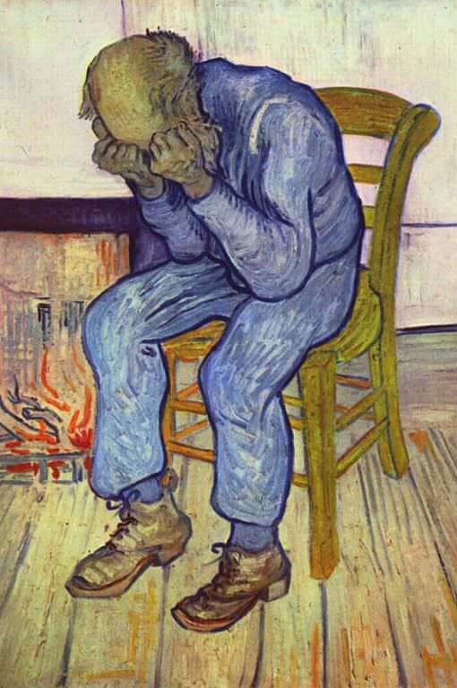

“Recruiting is the bane of my existence”
Researcher at NWU

Slide 3
Introduction
KSU and Human Subjects Research
WCHHS and Human Subjects Research

Slide 4

Working with Clinical Partners

Slide 5

Clinical Partners
Relationships
Timing (prior to grant submission, part of LoS) – be realistic!
Rules, competition

Slide 6

WHS – Nursing partnership
Meriel “Molly” McCollum, PhD, RN
Director of Nursing Implementation and Research
Wellstar Health System

Slide 7
Clinical Partners
Relationships
Timing (prior to grant submission, part of LoS) – be realistic!
Rules, competition

Slide 8
Caveats
No recruiting without IRB approval!
IRB protocol includes recruiting language & medium, flyers, website text, etc.
HIPAA Restrictions
Clinician can’t just give you a list!

Slide 9

Inclusion and Exclusion Criteria
How wide is your funnel?

Slide 10

Don’t over-promise your sample size
Sample size estimation
Convenience Sample
Statistical Significance
Post-hoc power analysis

Slide 11

Other Resources for Research with Human Subjects

Slide 12


Qualtrics survey administration

Slide 13

NIH ResearchMatch
researchmatch.org
nonprofit program funded by the National Institutes of Health (NIH). It helps to connect people interested in research studies with researchers from top medical centers across the U.S.

Slide 14
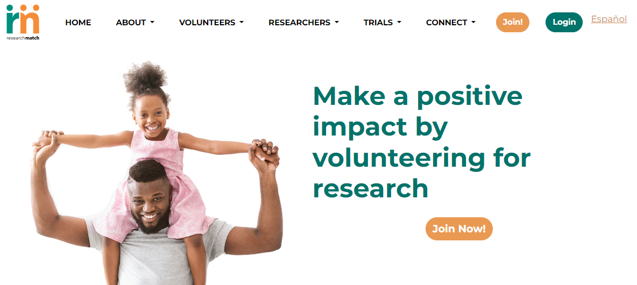

Slide 15

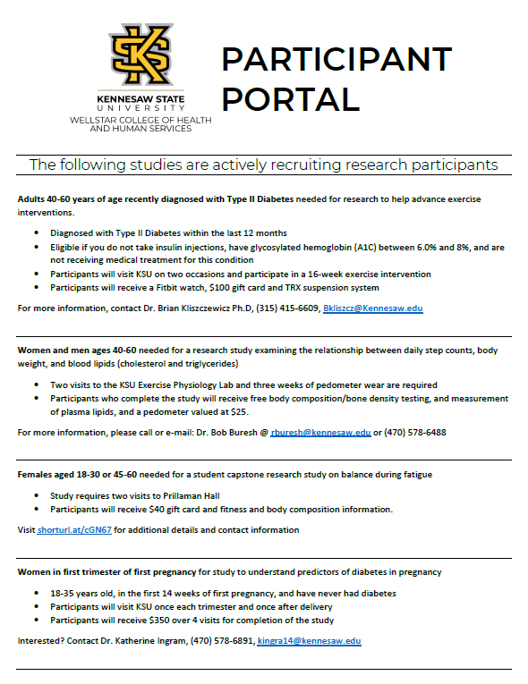
KSU Today – Alternatives?

