Slide 1



Student Success
We will increase degree completion through high quality and lifelong academic options, focused learning and elimination of barriers to access and success for all Georgians.
~USG Strategic Plan 2024 Goals

Slide 2

Sticky Policies
Jennifer A. Wade-Berg, WCHHS Assistant Dean for Student Success
Paul Parker, Executive Director and Registrar – Registrar & Records
March 2, 2023
12:30 PM

Slide 3

AGENDA
The Role of the University Registrar?
Academic Policies
FERPA Training
Use of the Grade IP
Incomplete Policy
Reminders
Midterm Grading Pilot

Slide 4

The Role of the University Registrar

Slide 5
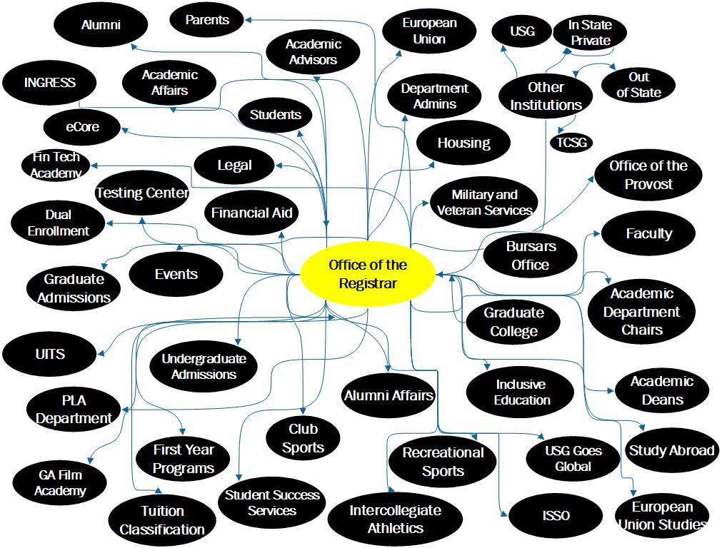

Slide 6
"On any campus, it takes a village to turn ideas into action. But we should recognize that at the center of enrollment and employment pathways is the registrar, whose evolving role encompasses challenging and important work with transformational impact."
~Matthew Pittinsky, Parchment CEO, Inside Higher Ed
Quoted in the article, The Role of the University Registrar with Rodney Parks, Elon University, on the Coursedog website

Slide 7

The Registrar is the only official office who can…
Issue a diploma or certificate (Please do not create in-house certificates, etc).
Confer degree and certificate completion
Issue transcripts
Build and make changes to curriculum in Banner and Degree Works
Processes course substitutions

Slide 8

FERPA

Slide 9
FERPA
The Family Educational Rights and Privacy Act of 1974 (FERPA), as amended, is a federal law that sets forth requirements regarding the privacy of student records. FERPA governs the disclosure of student records maintained by an educational institution as well as access to those records. Students enrolled in any course offered by KSU, at any location or through any method of delivery (i.e., campus/on-site, hybrid, partially online and fully online) are covered by FERPA. KSU defines an admitted student as one who is in attendance upon enrollment/registration for classes. Institutions that receive funds administered by the U.S. Department of Education are bound by FERPA requirements and failure to comply may result in the loss of federal funding.
WHAT IS AN EDUCATIONAL RECORD?
In general, the term means records that are directly related to a student and are maintained by an educational institution. This include most anything about a student that is written down, regardless of whether it is in a formal document or in an email or letter, recording or photograph.

Slide 10
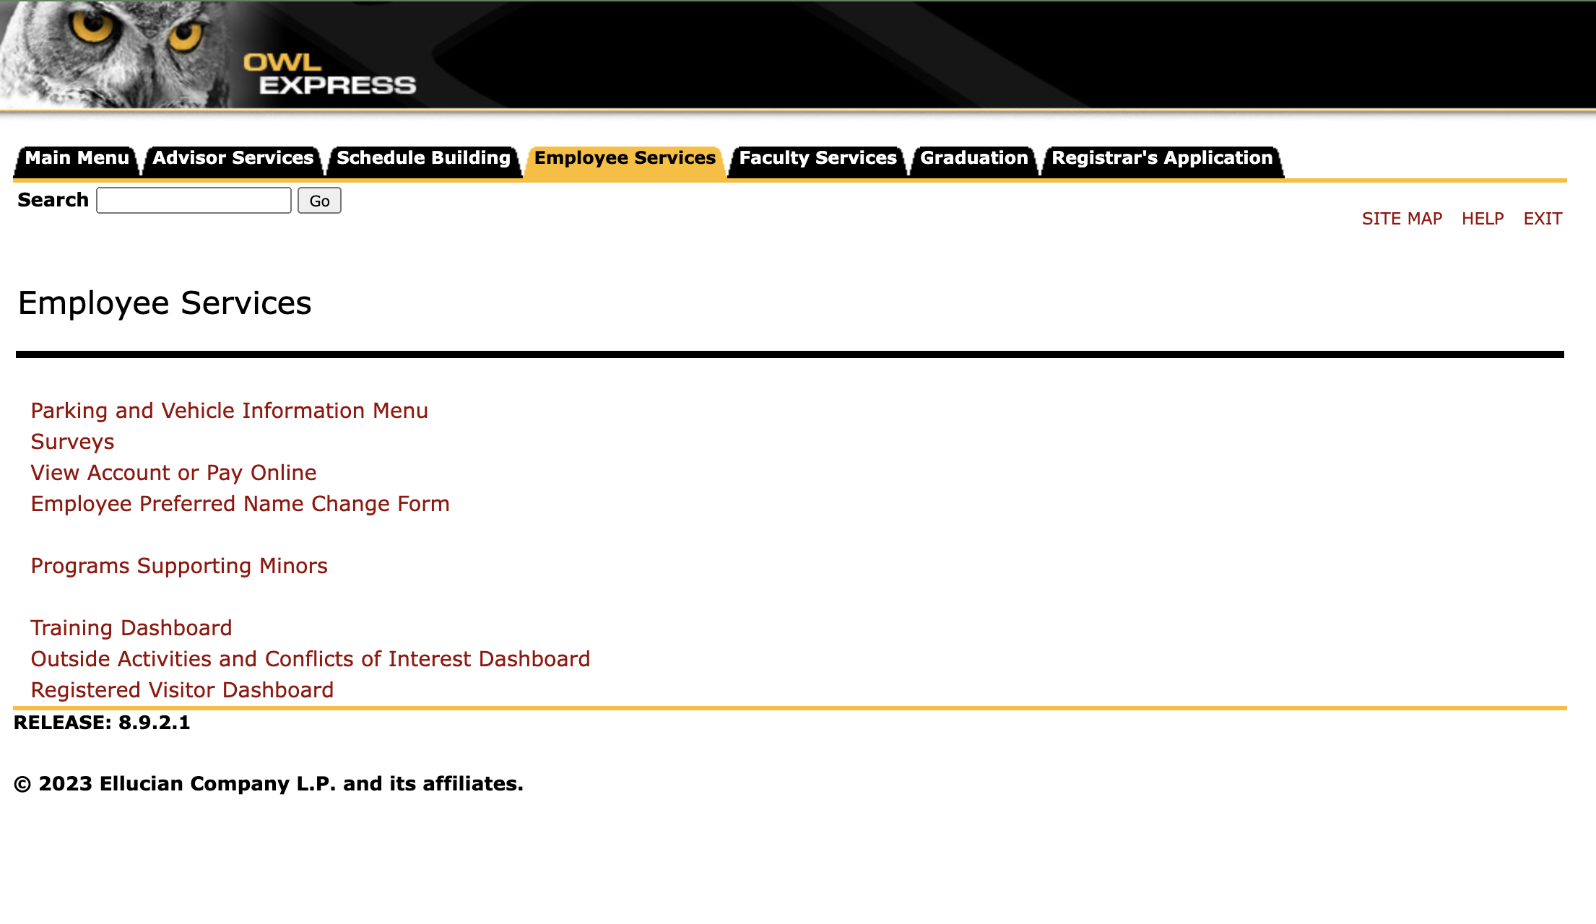
Important Things to Remember!
FERPA Training & Renewal Training is Mandatory and Annual (Due in Fall)
FERPA Training should be completed by anyone handling student records including, faculty (tenured, tenure track, lecturers, & part time), administrators and designated staff
You can track your required
Click Employee Services
Click Training Dashboard

Slide 11
FERPA DO NOTs
You may not disclose personally identifiable information from education records to persons other than the student in question and a University official who has a legitimate educational interest.
Employees may not disclose information contained in education records without the student’s consent, except under certain limited conditions. For example, the University may disclose what is considered to be “directory” information unless the student has restricted disclosure of such information. Institutions are not required by FERPA to disclose directory information. When in doubt, do not release information.

Slide 12
FERPA DO NOTs
use the University ID number of a student in a public posting of grades or in any other information
link the name of student with that student’s University ID number in any public manner
leave graded tests, papers, or other student materials for students to pick up in a stack that requires sorting through the papers of all students
circulate a printed class list with student name and University ID number, photo, or grades as an attendance roster
discuss the progress of any student with anyone other than the student (including parents) without the consent of the student
provide anyone with lists or files of students enrolled in your classes for any reason
provide anyone with student schedules or assist anyone other than university employees in finding a student on campus
access the records of any student for personal reasons

Slide 13
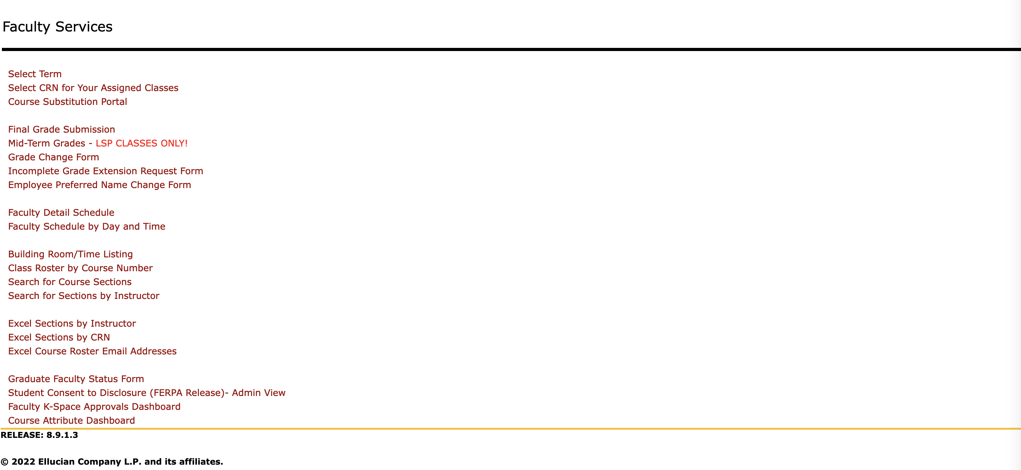

Slide 14
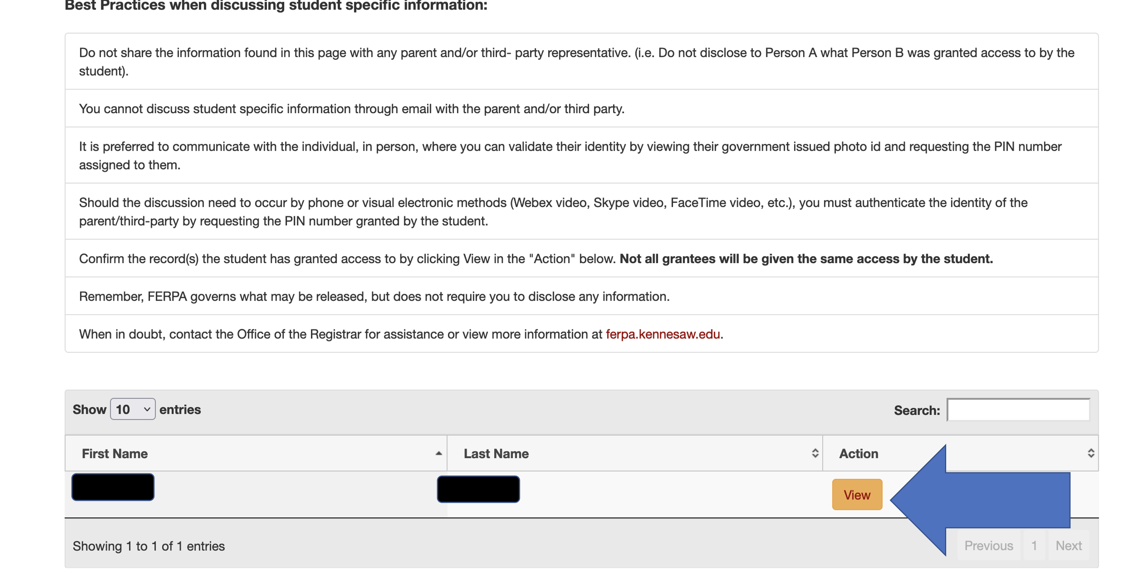

Slide 15
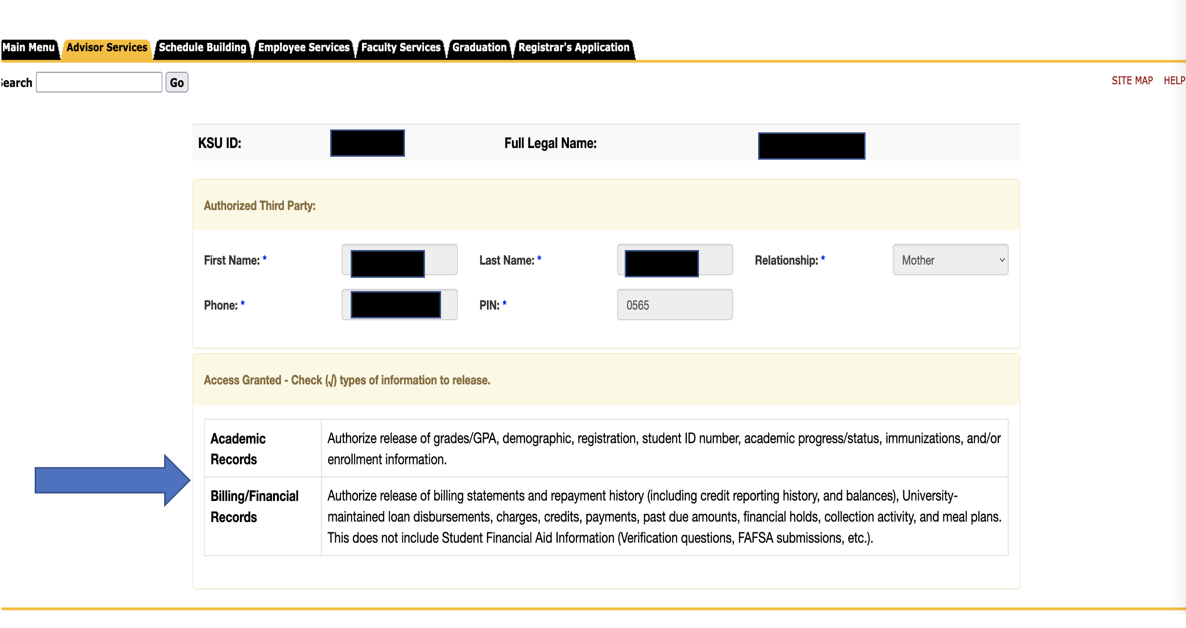

Slide 16
GRADE REVIEW

Slide 17
What is the Grade of IP?
IP: indicates that credit has not been given in a course that requires a continuation of work beyond the term for which the student enrolled in the course. This symbol cannot be substituted for an “I.”

Slide 18
The Grade Policy – Undergraduate Catalog & Graduate Catalog https://catalog.kennesaw.edu/content. TAKEN FROM DRAFT 2023 CATALOGnavoid=4496
I: denotes an incomplete grade for the course. An incomplete grade may be awarded only when the student was doing satisfactory work prior to the last two weeks of the semester but for NONACADEMIC reasons beyond the student’s control, was unable to meet the full requirements of the course.

Slide 19
Differences between the Undergraduate and Graduate Policy
Undergraduate
Graduate
Must be removed by completing requirements within one calendar year from the end of the semester in which the "I" was originally assigned. If the student enrolls in classes during the calendar year, the grade of I must be removed by the end of the first semester of enrollment during the calendar year
Faculty can submit for an incomplete extension to the Registrar's Office using the form found on Owl Express
Must be removed by the end of the next semester or term in which the "I" was originally assigned
No extensions after the last day of the term in which it is required

Slide 20
Access to Undergraduate Extension Form

Slide 21


Slide 22

Timely Submission of Final Grades
7-Week I: Final Grades due March 3, 2023, by 12:00 PM EST
15-Week: May 11, 2023, by 12:00 PM EST
7-Week II: Final Grades due May 11, 2023, by 12:00 PM EST
Timely Submission of Grades is a Faculty Responsibility
Final grades are always due by Noon on the date given!

Slide 23
Mid Term Grading Pilot

Slide 24

Midterm Grading Pilot
Input your student’s cumulative grade as calculated by the midpoint of the semester into OWL Express by the designated date based on part of term you are teaching.
This midterm grade is for assessing mid-semester performance prior to the last day to withdraw without academic penalty.
Faculty can use this initiative to evidence their focus on student success in their 2023 FPA and subsequently their 2024 ARD – under Teaching, Supervision and Mentoring

Slide 25
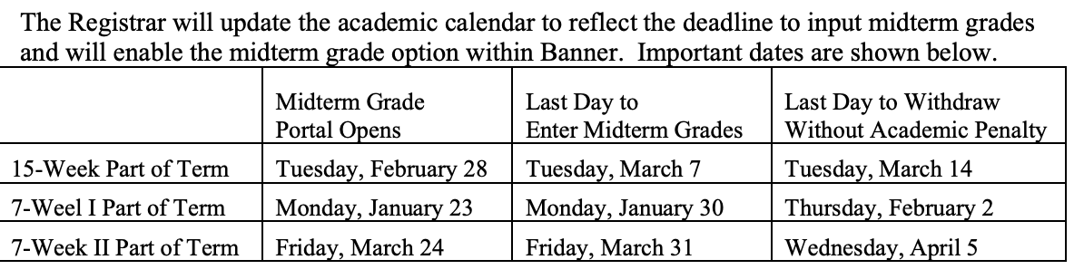
Midterm Grades Things to Remember
There will be no confirmation email sent when you submit the grades.
The Dean’s Office will get updated reporting and will confirm your submission with you directly.

Slide 26


Questions, Comments & Discussion!

