Slide 1
Establishing a Writing Group
WCHHS Lunch & Learn Faculty Development Series
February 17, 2023

Slide 2

‘Inspiring and creative places where people talk, write and learn together because they are being nurtured, empowered and stimulated’ (Aitchison, 2009, p. 261)
Creation guide: https://www.sjsu.edu/writingcenter/docs/Faculty%20Writing%20Groups%20Creation%20Guide-May2022.pdf

Slide 3

Benefits
Accountability
Safe and Formative Feedback
Breaking Down Frustrations
Fostering Collaborations
Deliverables!

Slide 4
Benefits
It’s an opportunity to discuss ideas at all stages of development. You know that article is going to get a review from experts in the field before it’s accepted for publication. If you begin that process in a writing group, even with people in different disciplines, they can help you get it ready for a more “official” peer review.
Your peers offer a fresh perspective. We have all gotten to the point with a piece of writing where we can no longer “see” it clearly. We need distance and a fresh pair of eyes.
You learn about what others are working on. Your colleagues provide inspiration and knowledge (which is the whole idea behind conferences, right?). Chances are your peers will know of a resource that is just what you need at just the right time.
These groups facilitate time management because this scheduled time allows you to say no to other things because you are already committed.
Your peers provide emotional support and encouragement. Let’s face it. Writing can be exhausting, and we need moral support.
https://blog.ung.edu/ctll/the-benefits-of-faculty-writing-groups/

Slide 5
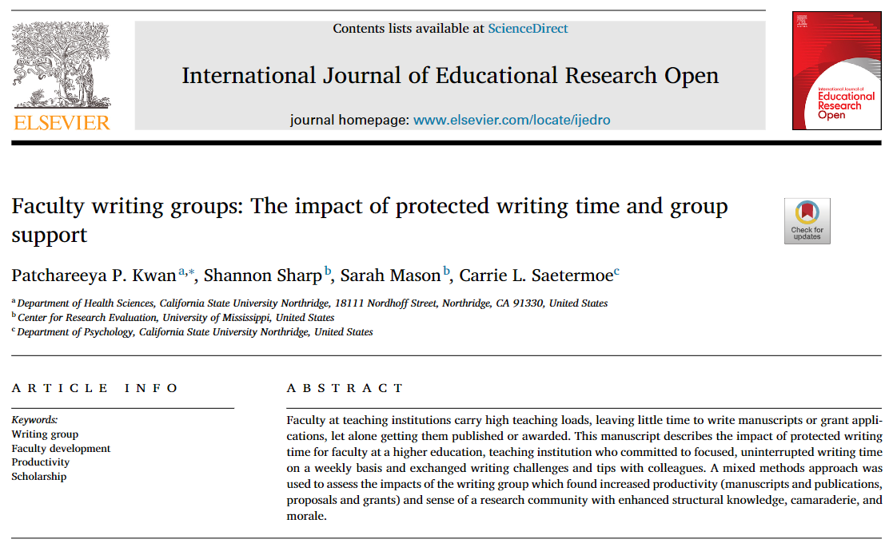

Slide 6

Logistics
Duration can vary
Summer
Length of a defined project
A set number of sessions
Can also formulate as a 1- to 2-day drop-in “Writing Retreat”
Can establish an “Expectation Agreement”
Can write together, or write on your own time and meet to share progress and get feedback
Create a calendar and a place to share materials
Take time to celebrate accomplishments

Slide 7

https://www.facultydiversity.org/

Slide 8
14-day writing challenge
Write for at least 30 minutes every day - Monday through Friday - for two weeks. Writing, in this case, refers to any scholarly activity ranging from the spark of a new idea to polishing a near-complete project (article, grant proposal, exhibit, book chapter, etc.).
https://www.facultydiversity.org/14-day-challenge

Slide 9

Existing and Proposed Writing Groups
Student Success
Health Equity
Physical Disability and Mental Health
mHealth
TOPOWA

