Slide 1
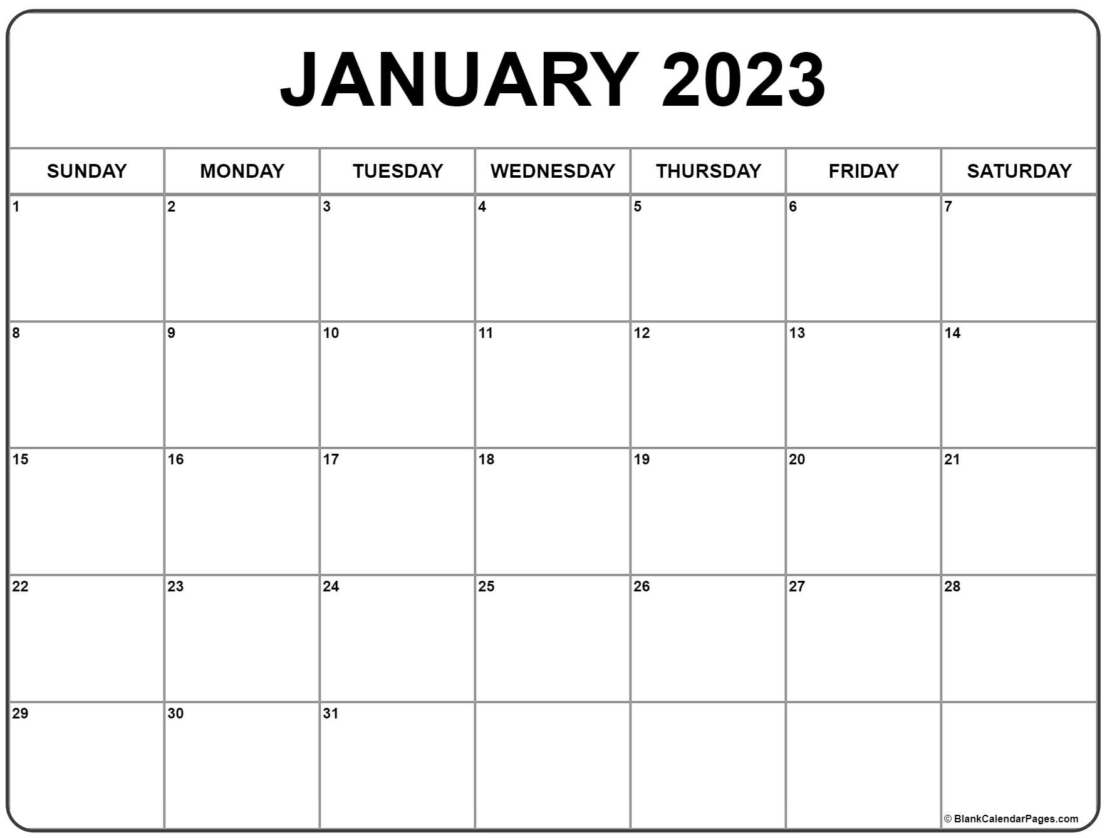
Annual Review

Slide 2

Review KSU policy on the annual review process
Provide additional guidance on process and effective practices
Suggestions for working in Watermark – Faculty Success
Discuss college expectations for external reviewers

Slide 3

Purposes of Annual Review?
From the KSU Faculty Handbook:
  “Performance evaluation of a faculty member is required at KSU.”

Slide 4
Faculty Performance Agreement
Establish clearly defined professional goals that align with the needs of the Department, College & University
Faculty must include workload percentages in their FPA
Goals should be written to reflect KSU’s R2 Status
Articulate how activities align with department’s Promotion and Tenure guidelines
Ensure workload expectations are reasonable, specific and measurable
New FPA expectations for AY 2023 – Student Success Goal

Slide 5
Annual Review Document
Describe the quality and significance of your work over the last year in each area in which you have workload
  Teaching and Mentorship
  Scholarship and Creative Activity
  Professional Service
Articulates how this work fits into the larger context of your professional goals (FPA), as well as the department’s Promotion and Tenure expectations
Due: Friday, January 27th

Slide 6
Practical Matters
We want all faculty to be successful
Process is an opportunity to receive performance feedback that can help you grow in your role
Annual review process is important for all faculty not just those on the tenure track
Implications for multi-year reviews, non-renewals and merit allocations

Slide 7

Annual Review Process – University Updates
2022 ARD will use a three-point scale
2023 ARD will use a five-point scale
Faculty need to designate a category and series of activities for “continuous professional growth” in their 2023 FPAs
Student Success KSU Faculty Handbook Section 2.5
  Must be specifically identified, documented and planned in a minimum of one area (but can be more)

Slide 8
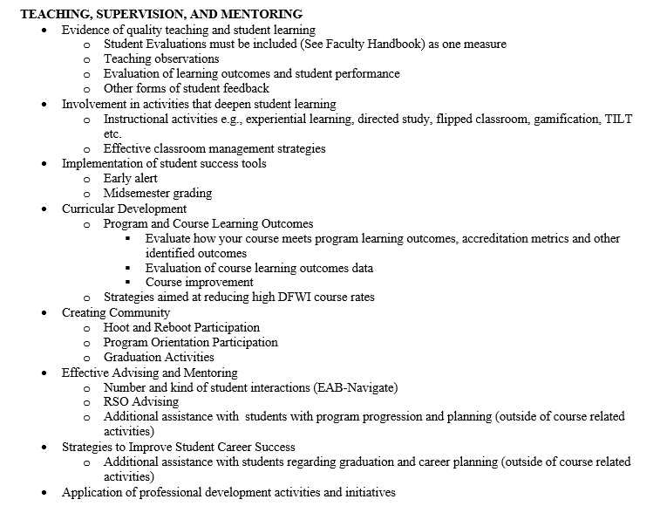
Student Success
Teaching, Supervision, and Mentoring
Dr. Jennifer Wade-Berg, Assistant Dean for Student Success, has provided some Wellstar College specific examples

Slide 9
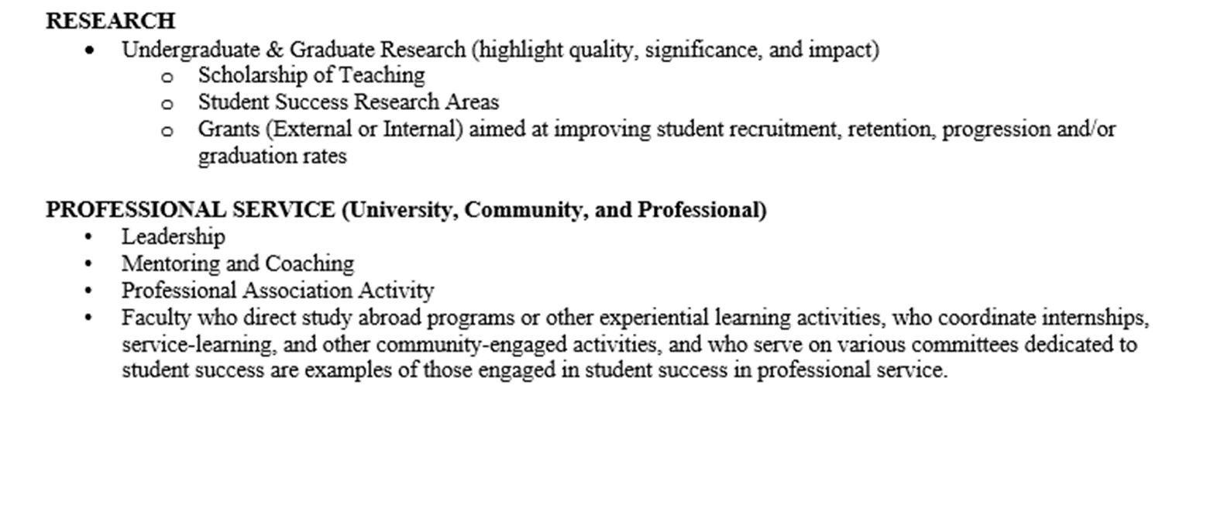
Student Success (Continued)

Slide 10
What Should I Include in My Annual Review Materials?

Slide 11
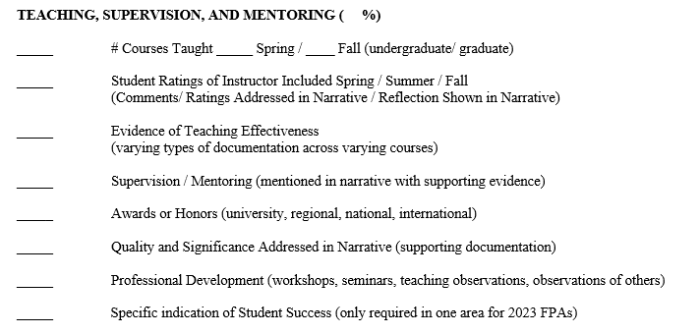
Annual Review Discussion Checklist

Slide 12
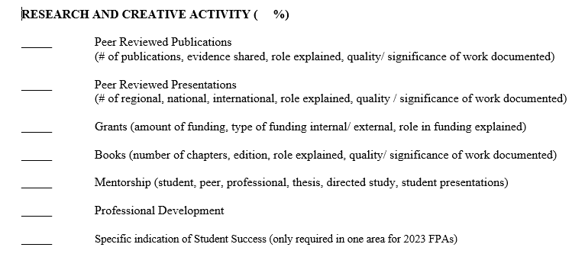
Annual Review Discussion Checklist

Slide 13
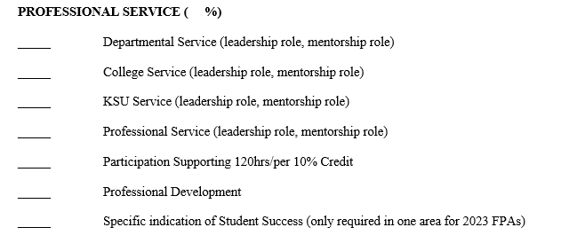
Annual Review Discussion Checklist

Slide 14
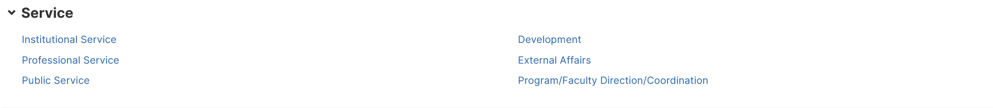
Professional Service and Community Engagement
Institutional Service: Program, Department, College & KSU Committees and Other Forms of Service
Professional Service: Professional Associations/Committees/Organizations related to your work a KSU
Public Service: Generally, not directly related to your professional expertise
Development: Examples, a new course, a policy, strategic planning and other development
External Affairs: Examples, work that you do in the community, international work not related to research development
Program/Faculty Direction/Coordination: May be better to use Institutional Service tab to indicate work in this area; Senior faculty mentorship is well suited for this tab

Slide 15
Faculty Development
“Faculty need to designate a category and series of activities for "continuous professional growth" in their 2023 FPAs. Kennesaw State University encourages faculty to pursue continuous professional growth throughout their careers. Continuous professional growth for faculty can occur in their teaching, scholarship, and creative activity, and/or professional service, and can range broadly from attending CETL or professional conference workshops to implementing new techniques and ideas into their classrooms to building their scholarship. Like student success, faculty should identify how they will pursue continuous professional growth in at least one area of their teaching, scholarship, and creative activity, and/or professional service in their FPA. Faculty will then annually record their progress in the narrative for their ARD.”

Slide 16
General Suggestions on the Annual Review Process
Know your department, college and university guidelines/expectations
Be clear, be open, be honest, be specific
Explain actual accomplishments, not just ideas
Quality and significance needs to be indicated, not just a list of activities
Ask for specific feedback on what you need to do/improve

Slide 17
For Faculty Considering Promotion and/or Tenure

Slide 18

For those Eligible for Promotion &/or Tenure
Know your contracted review dates
Ask for specific feedback not only on your annual performance but on progress toward department’s P&T requirements
Discuss whether you will submit a portfolio for elective review during the review process

Slide 19
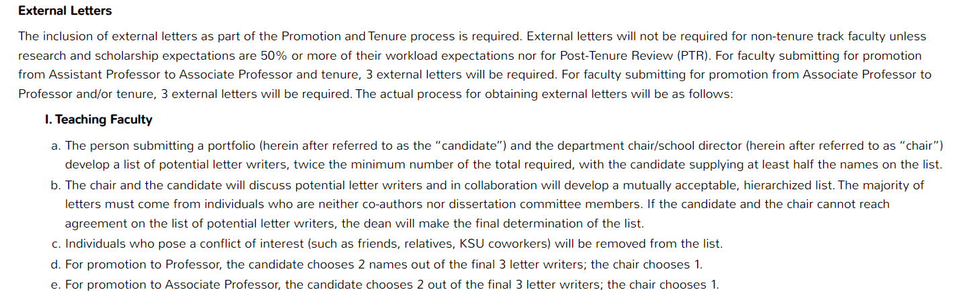
KSU Faculty Handbook
3.12 Faculty Review Process

Slide 20
External Letter Writers
Should:
Speak to your scholarly reputation in the field
Be objective about your scholarship record
Come from a carefully cultivated list of respected individuals in the discipline
Should not:
Serve as a professional reference
Address teaching and professional service activities
Be an after thought for those seeking promotion

Slide 21

Please Consider
Rank of letter writers
  Promotion to Associate – Associate Professor or Professor
  Promotion to Full – Professor
Affiliation of letter writers (Peer & Aspirational Programs)
  Carnegie Classification - R2: High Research Activity – or - R1: – Very High Research Activity
  KSU Comparator Peer Institutions
  Nationally Recognized Program Reputation

Slide 22

Help Avoid the Appearance of Conflict of Interest
KSU prohibits friends, relatives & co-workers
Would suggest avoiding when possible:
Co-authors
Co-presenters
Dissertation committee members
Colleagues you’ve worked closely with in professional associations

Slide 23
What You will Need to Upload
Current CV
Situational Context (not your portfolio narrative)
  This is my reality….
  This is what I accomplished…
Department Promotion and Tenure Guidelines
Documentation as appropriate by discipline
  Be respectful to the letter writers…
    3 to 5 five peer reviewed papers that represent lines of research
    What else??? Grant proposals, book chapters, presentations (if they assist in illuminating the scholarly reputation)

Slide 24
Submitting Your Annual Review Materials in Watermark

Slide 25
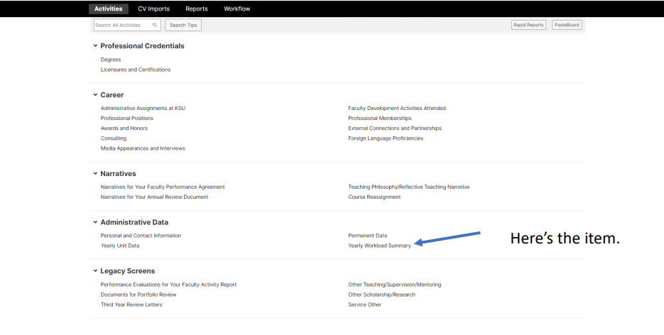
How Do I Enter My Data?
First enter your workload data
  Click on “Add New”
  Create 2023
  If 2022 is not there, add it too
  Click save
  Need help: https://facultyactivitydata.kennesaw.edu/activity-insight/Entering%20WorkLoad%20Percents%20for%20FPA.pdf

Slide 26
How Do I Enter My Data?
Enter your accomplishments on main activity page under the appropriate heading
Upload documentation and click box for “Include File for Portfolio Review”
Enter a few items and check to see how it populates into your report
Narratives for Annual Review go under the heading “Narratives for Your Annual Review Document”
Something not working?
  Check the FAQs here:
    https://facultyactivitydata.kennesaw.edu/portfolio-information/annual-review-information/faculty-ar-info.php
  Email: facultyactivitydata@kennesaw.edu

Slide 27
How do I access my course evaluations?
Course evaluations will not automatically populate into Watermark (yet)
Can be found here: https://courseevals.kennesaw.edu/
This document walks you through how to download from Explorance Blue and upload into Watermark
    https://facultyactivitydata.kennesaw.edu/activity-insight/Including%20Course%20Evals%20in%20Annual%20Review.pdf

Slide 28
How Do I Check My Reports?
Once you log into Watermark, you will see an option called "Workflow"
If you click on that, you should see 2022-23 Annual Review process
Three reports will automatically be generated
  2022 ARD
  2023 FPA
  Your Vita-Interactive
Before you begin, you should "Refresh" these reports

Slide 29
What if there is an Error in My Reports?
If there are any corrections to be made, make them in the main activity area where you entered your data
Once done go back to Workflow and click "Refresh Report”
Check to see if the information updated
Check that Vita Interactive includes links to uploaded documents (publications, course evaluations, etc.)

Slide 30
How Do I Submit My Annual Review Documents?
When ready, save everything one more time
Click “Actions” and then select “Submit to the Department Chair”
Materials do not automatically advance if you do not submit
Video: https://mediaspace.kennesaw.edu/media/Submitting+the+ARD+FPA+-+Workflow/1_olf1mv9h

Slide 31
Great Resource:
Bagwell College ARD/FPA Videos https://bagwell.kennesaw.edu/faculty-staff/ard-fpa-videos.php

Slide 32
Questions

