Slide 1
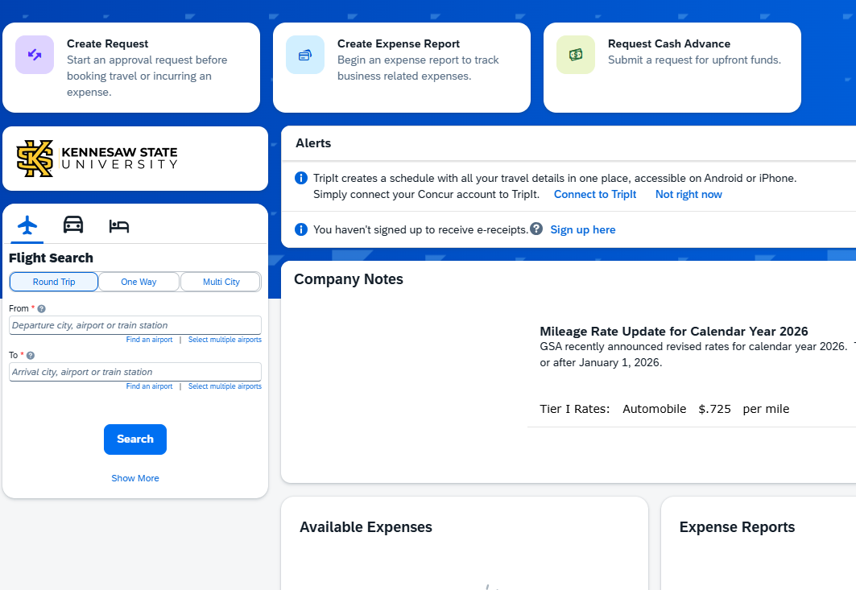
How to Create a Mileage Expense Report
On the top left
Click "Create Expense Report"

Slide 2
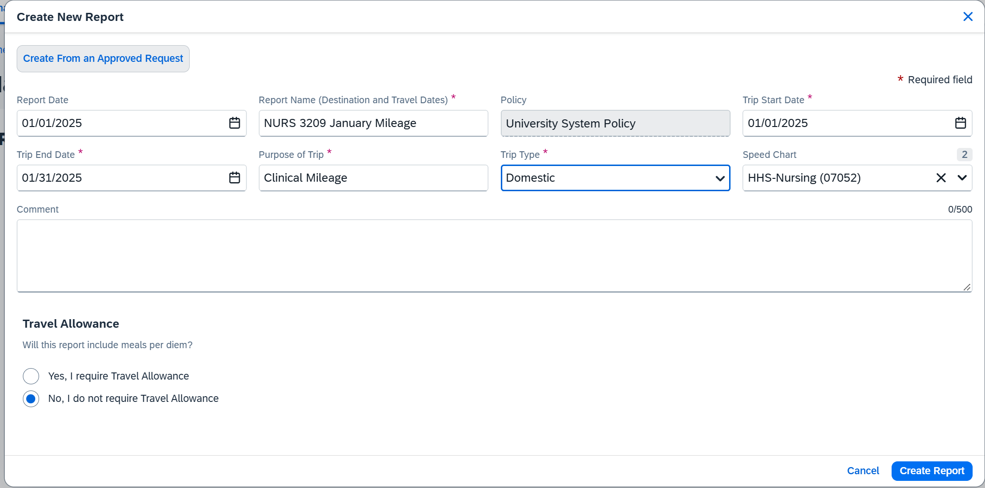
Fill out every box that has a red asterisk
Report Date
Trip Start Date – First day of the Month
Trip End Date – Last day of the month
Purpose of Trip – Your class name and month traveling
For example, NURS 3209 January Mileage
Trip Type – Domestic
Travel Allowance – No, I do not require a Travel allowance
Comment – List the name of the course and hospitals visiting.
Must include “Does not have an on-campus office”

Slide 3
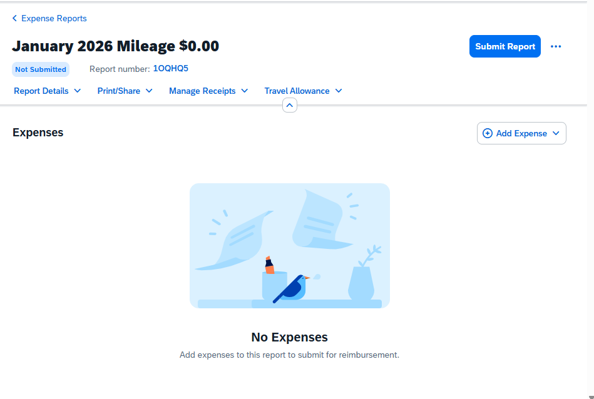
Adding Expenses
Hit the blue “Add Expense” button
Select "Manually Create Expense"
Select "Personal Car Mileage"

Slide 4
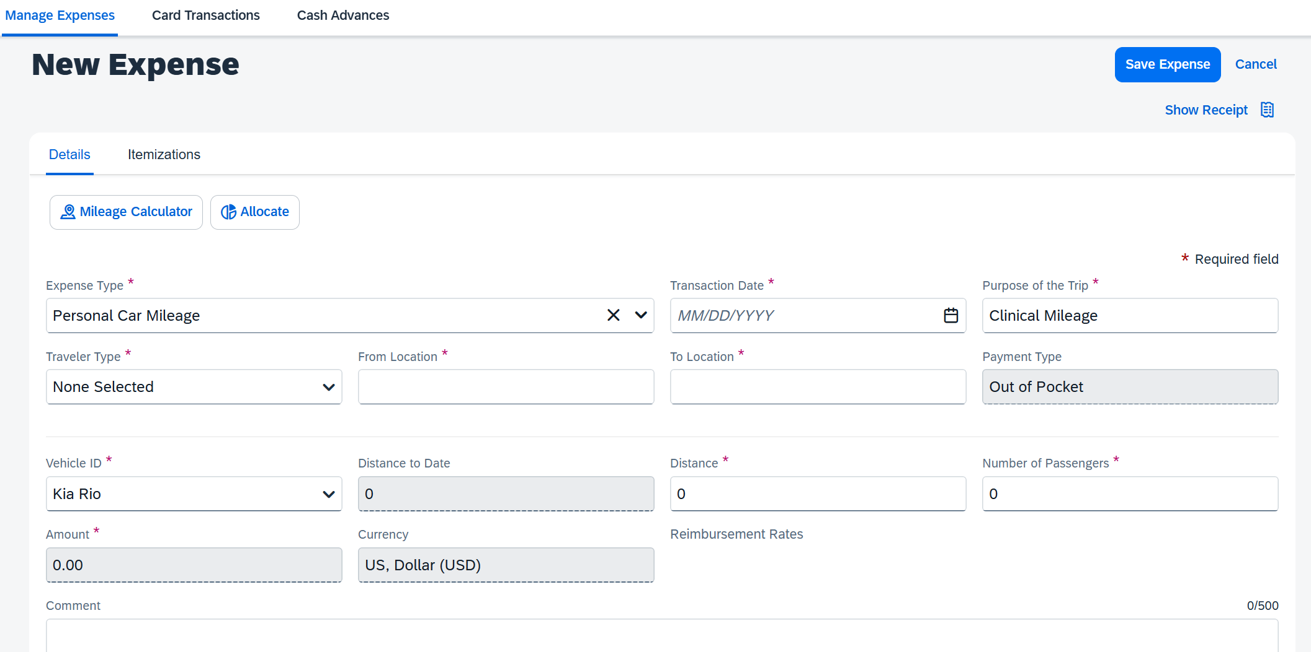
Before filling out the boxes click “Mileage Calculator”

Slide 5
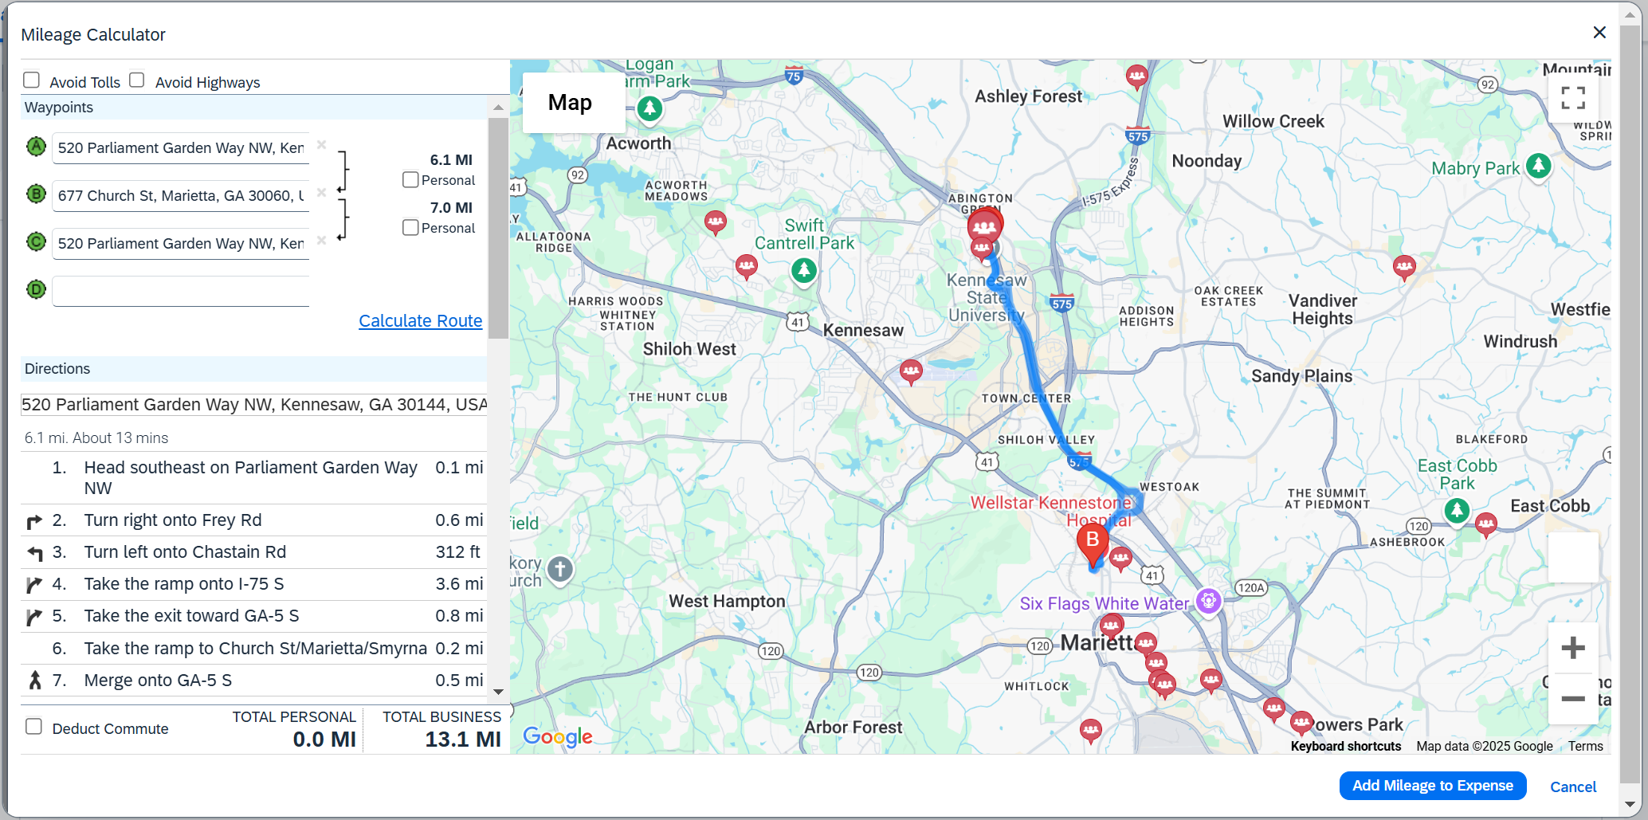
Entering Your Mileage
Enter your home address
Enter the hospital’s address
Hit “Calculate Route”
Hit “Make Round Trip”
Hit “Add Mileage to Expense”
You can add multiple locations if you visit more than one site in a day
Please note that these instructions only apply to part-time instructors. Full-time faculty must follow a different process.

Slide 6
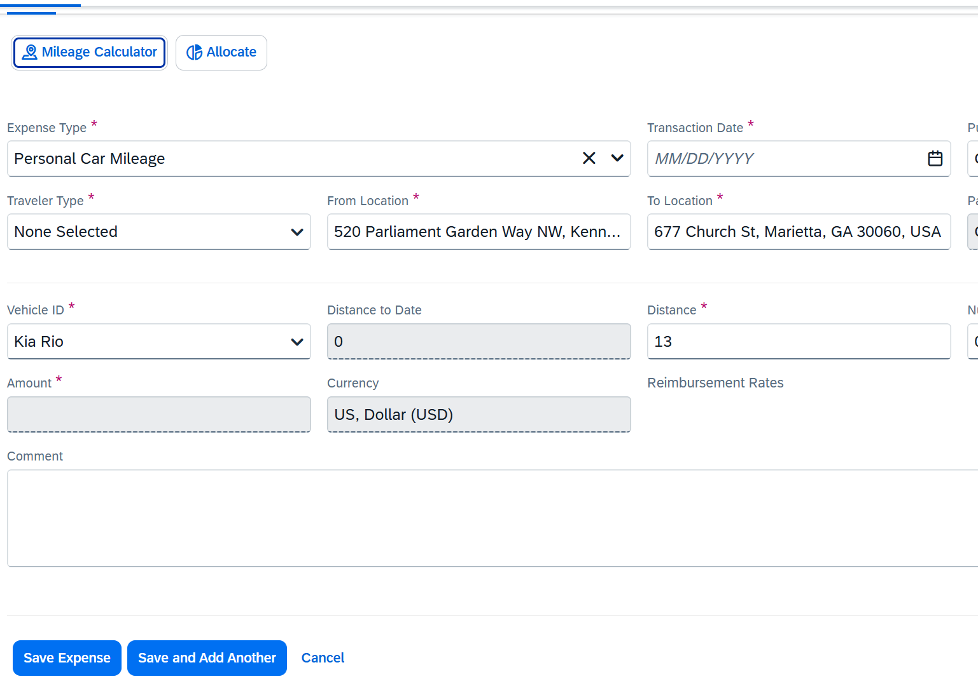
Fill out the remaining boxes that have red asterisks
Transaction Date
Traveler Type – Employee
Hit “Save Expense”
Then repeat each step for each travel date

Slide 7
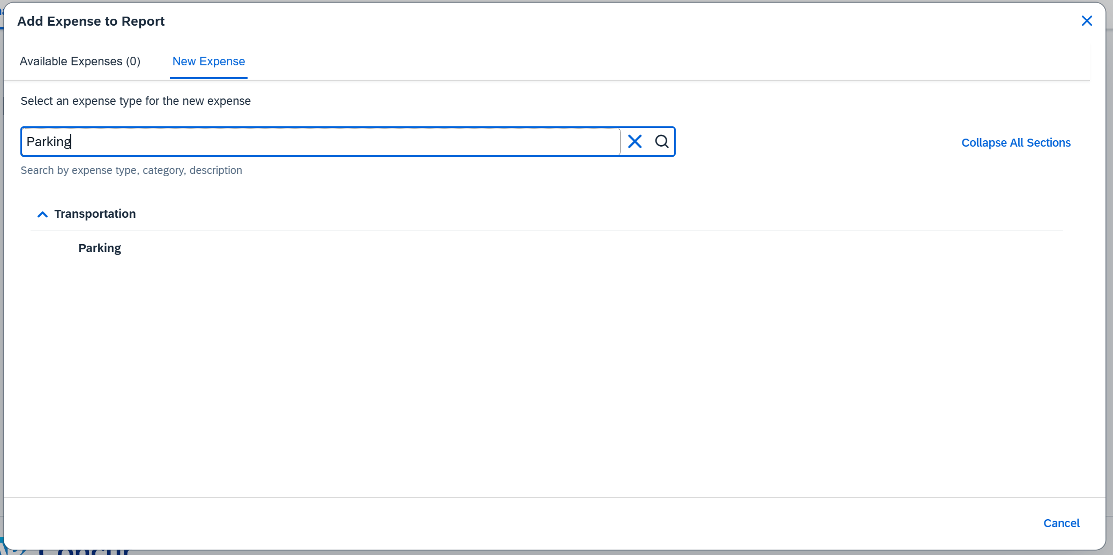
Parking
Hit the blue “Add Expense” button
Scroll or type “Parking” in search box

Slide 8
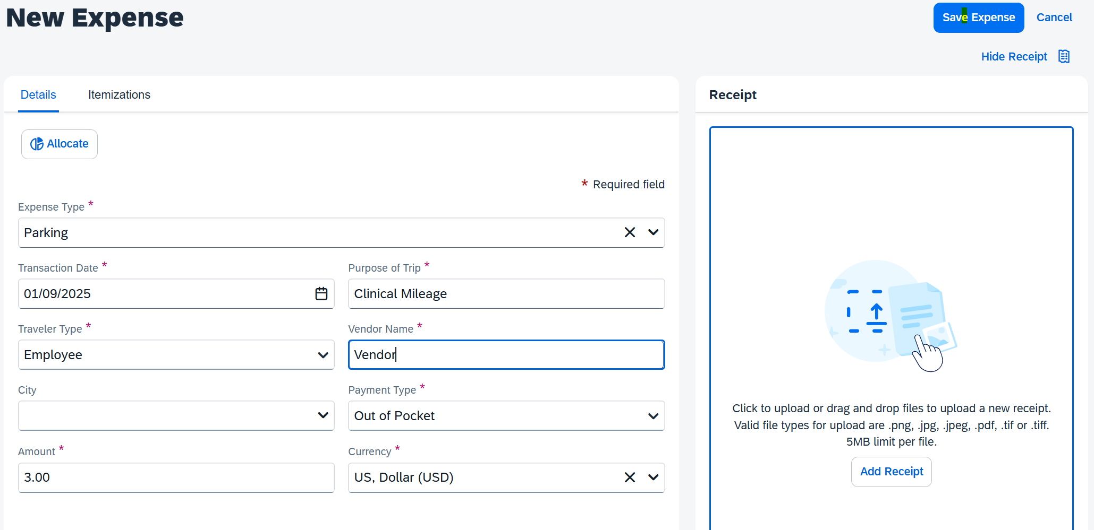
Parking
Transaction Date
Purpose of trip – Clinical Mileage
Traveler Type – Employee
Vendor Name
Amount
Attach a photo of your receipt
Hit “Save Expense”
Parking must be submitted on the months report on a separate line item, with a photo receipt.

Slide 9
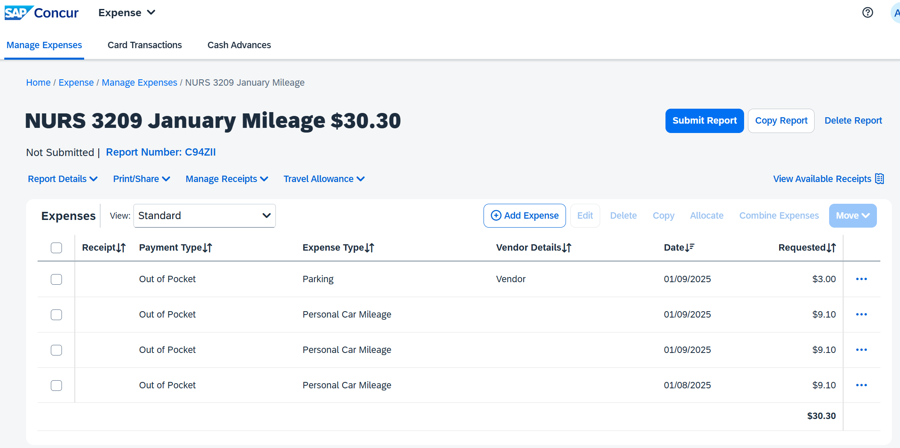
Before you submit your report…
Please email Keisha Driver at kdriver7@kennesaw.edu to approve your report before submission or if you have any questions.
After you get approval, you can hit the blue “Submit Report” button.
Travel mileage and parking for the whole month must be submitted on one single report.

