Slide 1
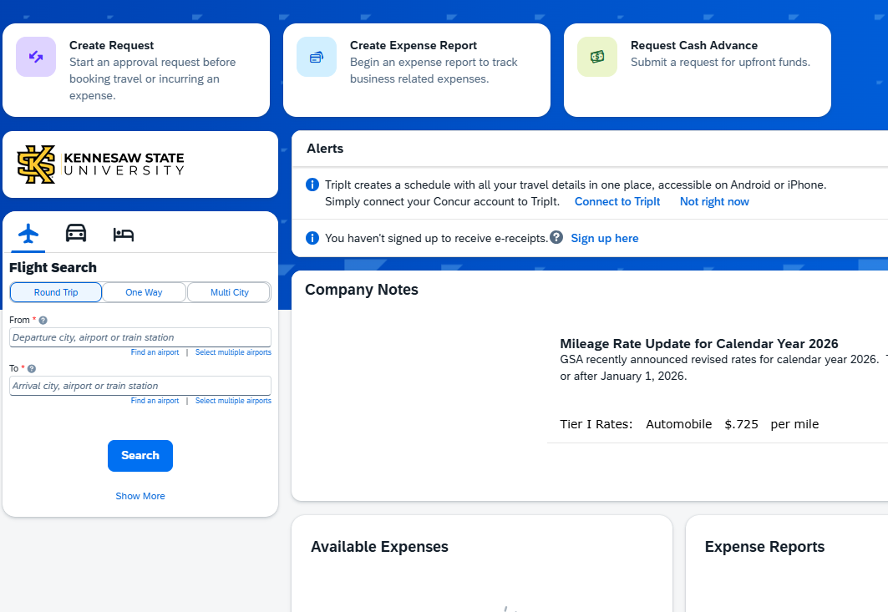
How to Create a Mileage Expense Report
On the top left
  Click "Create Expense Report"

Slide 2
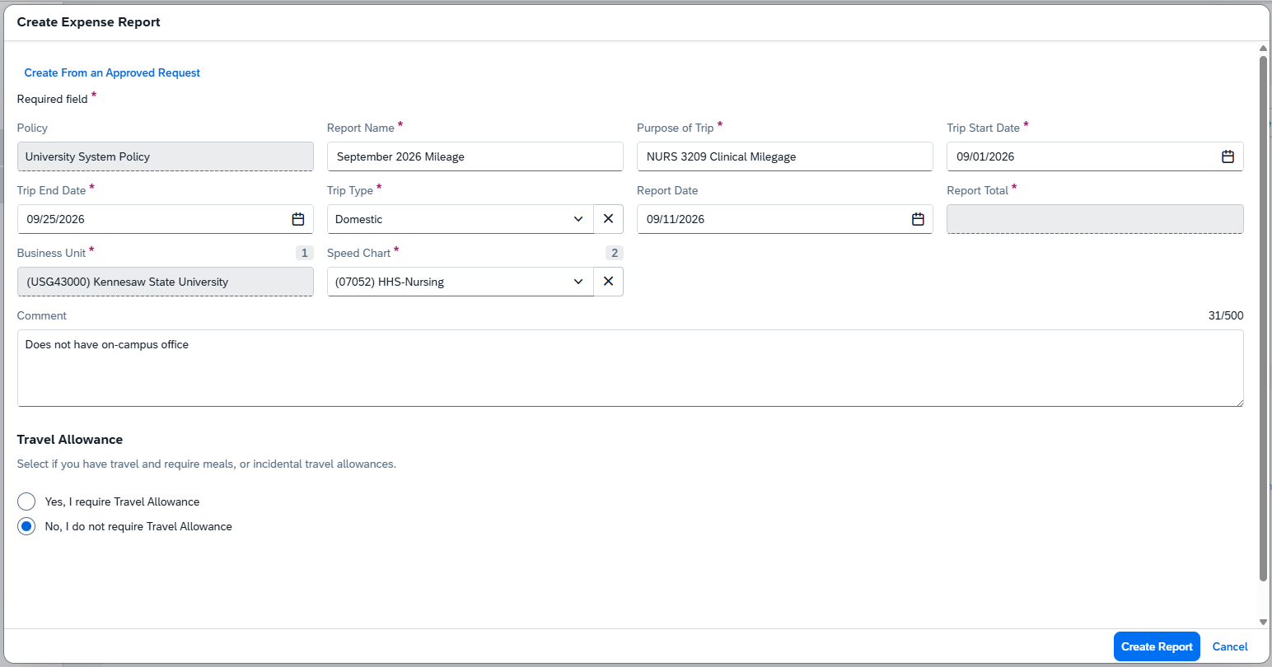
Fill out every box that has a red asterisk
Report Name – Month traveling & Year
  For example, January (YEAR) Mileage
Purpose of Trip – Your class name & month traveling
  For example, NURS 3209 Clinical Mileage
Trip Start Date – First day of the Month
Trip End Date – Last day of the month
Trip Type – Domestic
Travel Allowance – No, I do not require a Travel allowance
Comment – List the name of the course and hospitals visiting.
  Must include “Does not have an on-campus office”

Slide 3
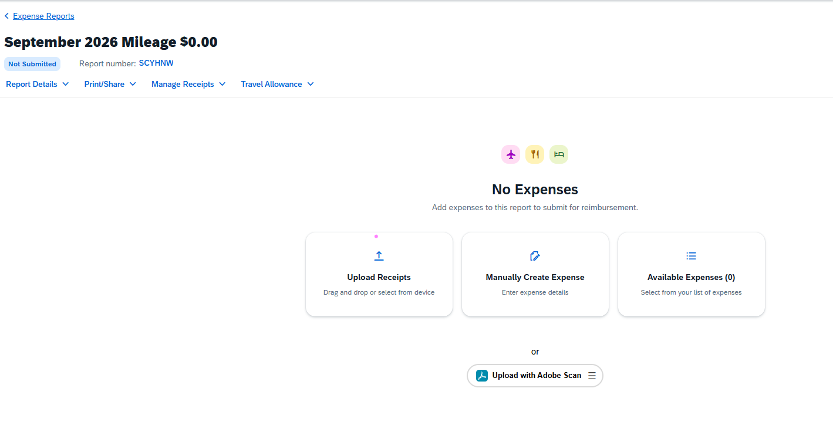
Adding Expenses
Select the “Manually Create Expense” tile

Slide 4
Adding Expenses
Select the “Manually Create Expense” tile

Slide 5
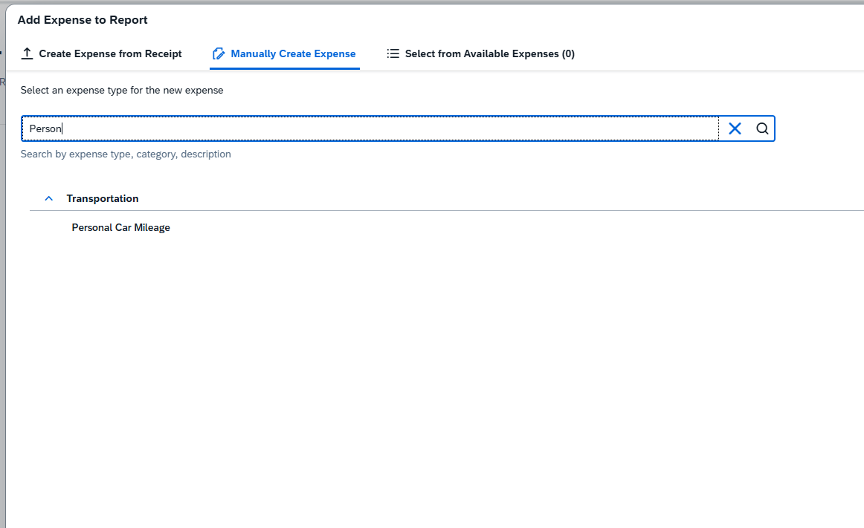
Adding Expenses
In the search bar, type "Personal Car Mileage"

Slide 6
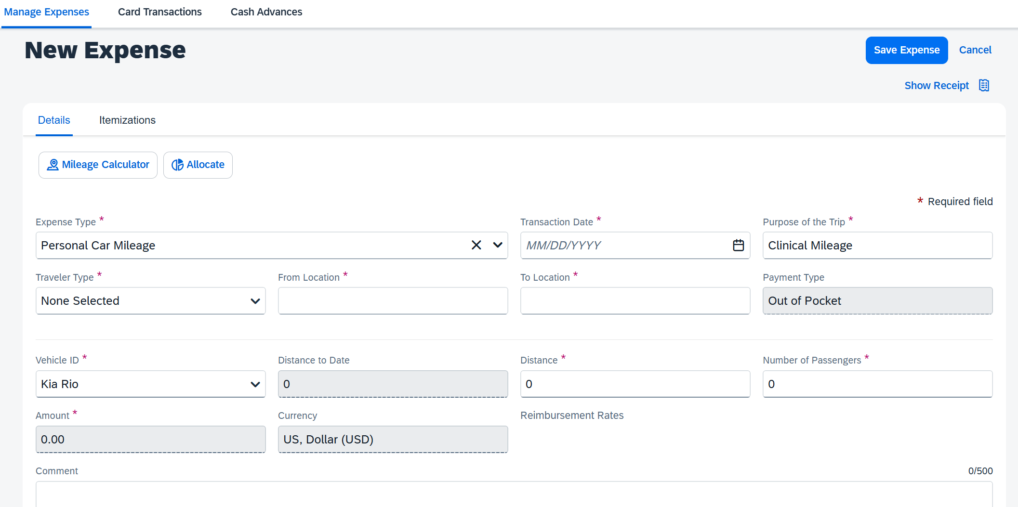
Before filling out the boxes click “Mileage Calculator”

Slide 7
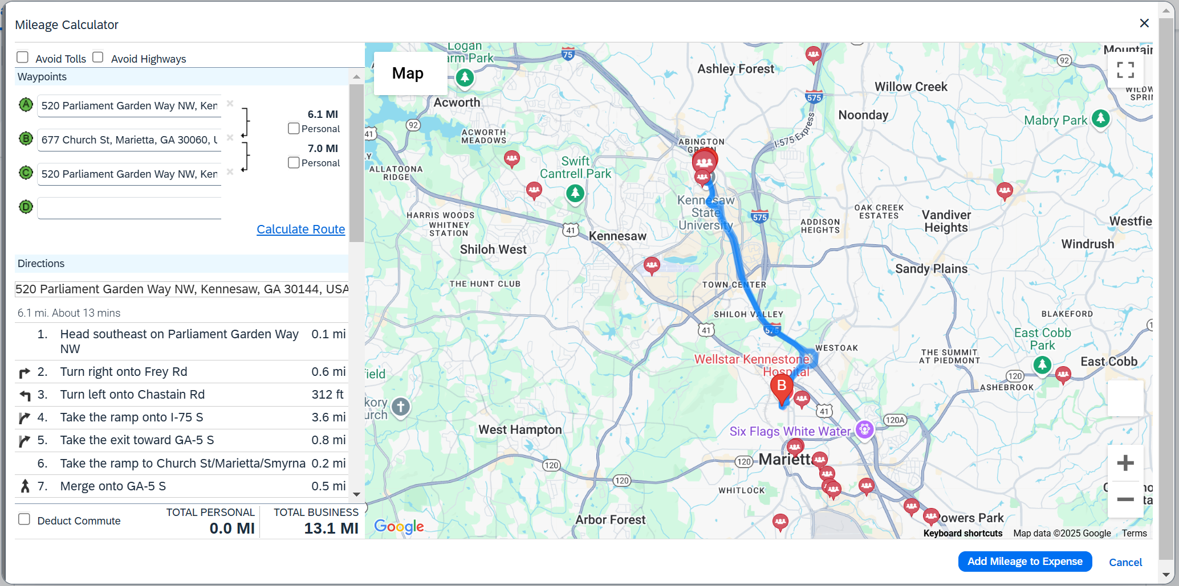
Entering Your Mileage
Enter your home address
Enter the sites address
Hit “Calculate Route”
Hit “Make Round Trip”
Hit “Add Mileage to Expense”
You can add multiple locations if you visit more than one site in a day
Please note that these instructions only apply to part-time instructors. Full-time faculty must follow a different process.

Slide 8
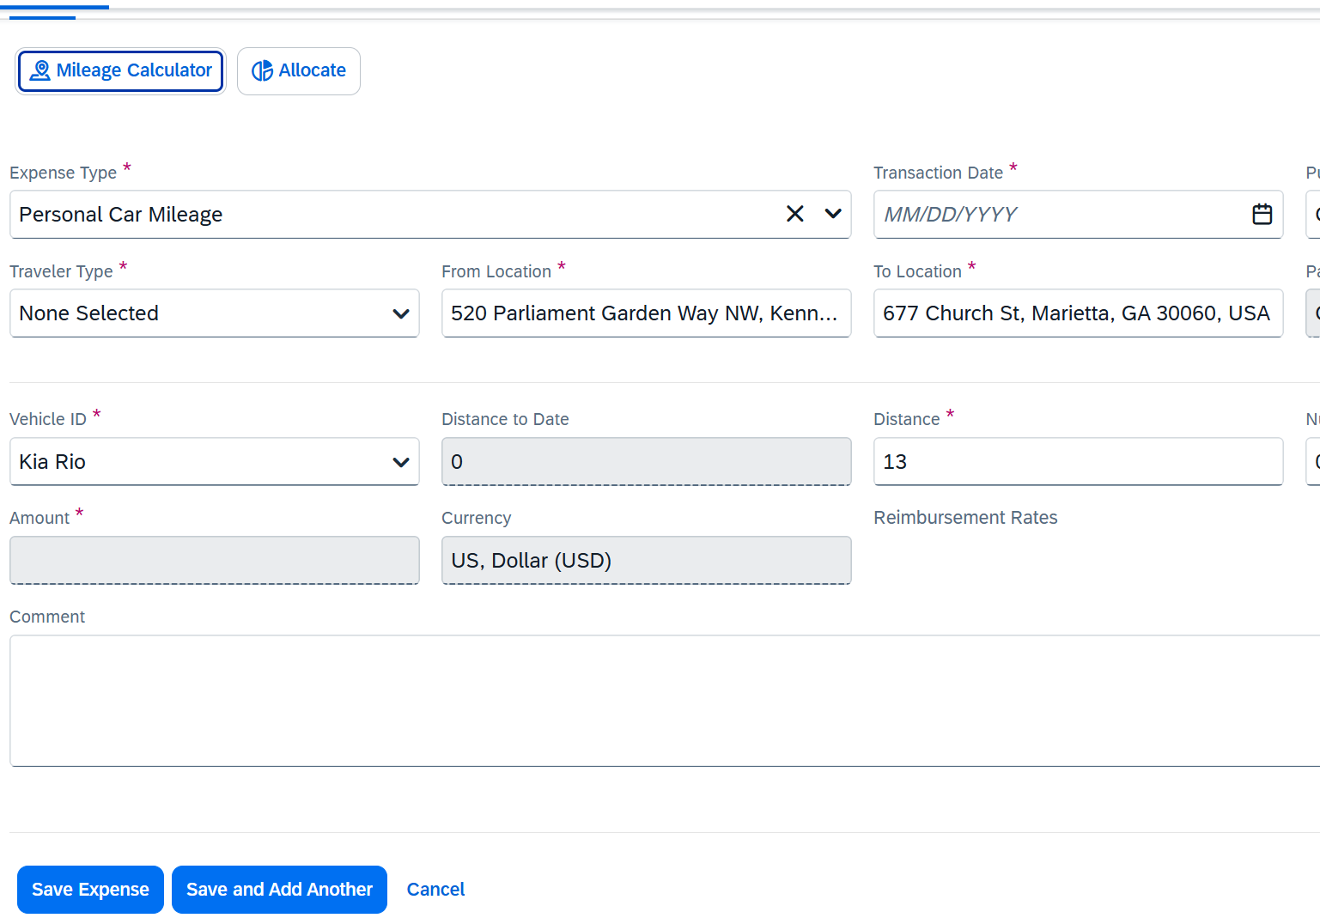
Fill out the remaining boxes that have red asterisks
Transaction Date
Traveler Type – Employee
Hit “Save Expense”
Then repeat each step for each travel date

Slide 9
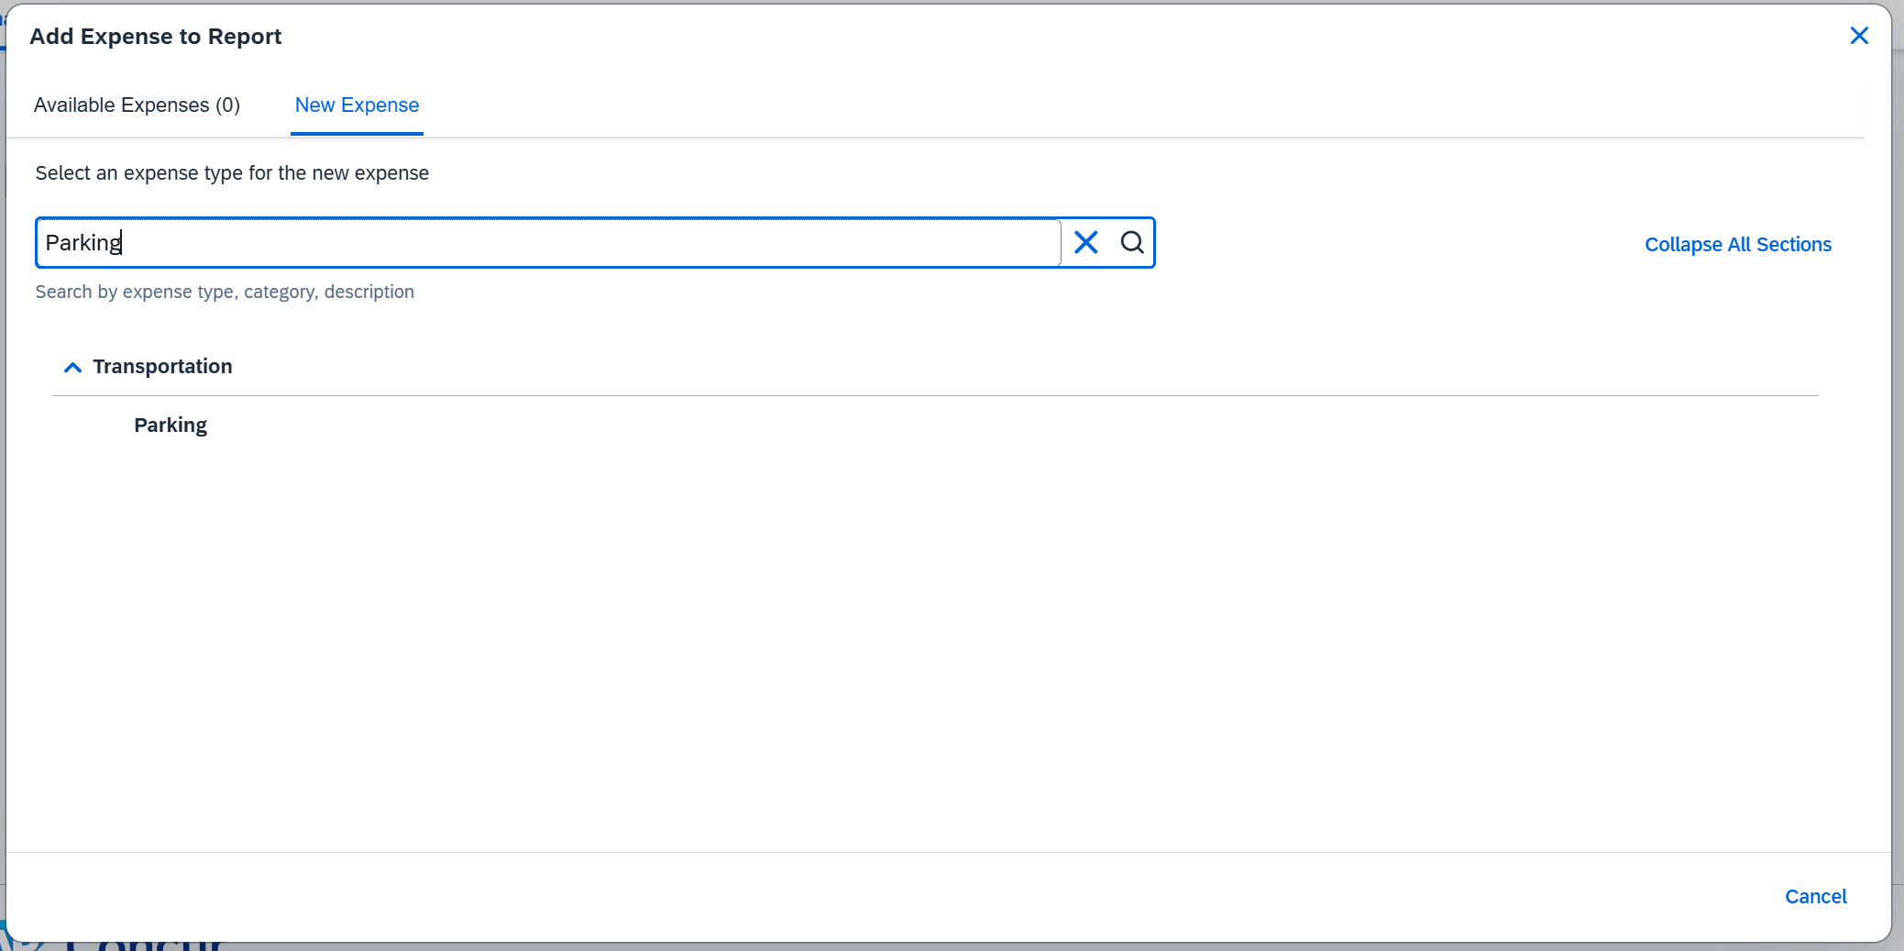
Parking
Hit the blue “Add Expense” button
Scroll or type “Parking” in search box

Slide 10
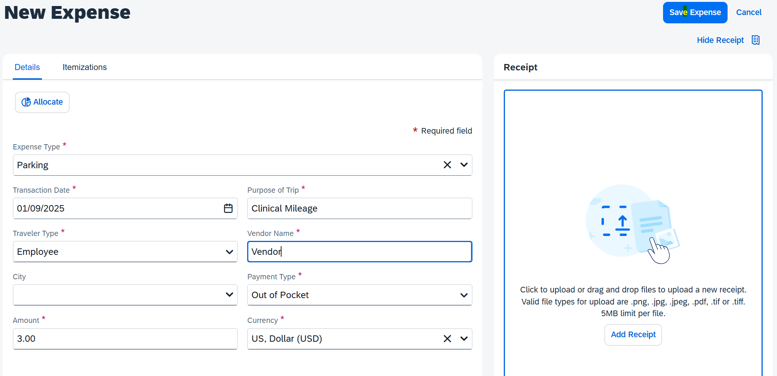
Parking
Transaction Date
Purpose of trip – Clinical Mileage
Traveler Type – Employee
Vendor Name
Amount
Attach a photo of your receipt
Hit “Save Expense”
Parking must be submitted on the months report on a separate line item, with a photo receipt.

Slide 11
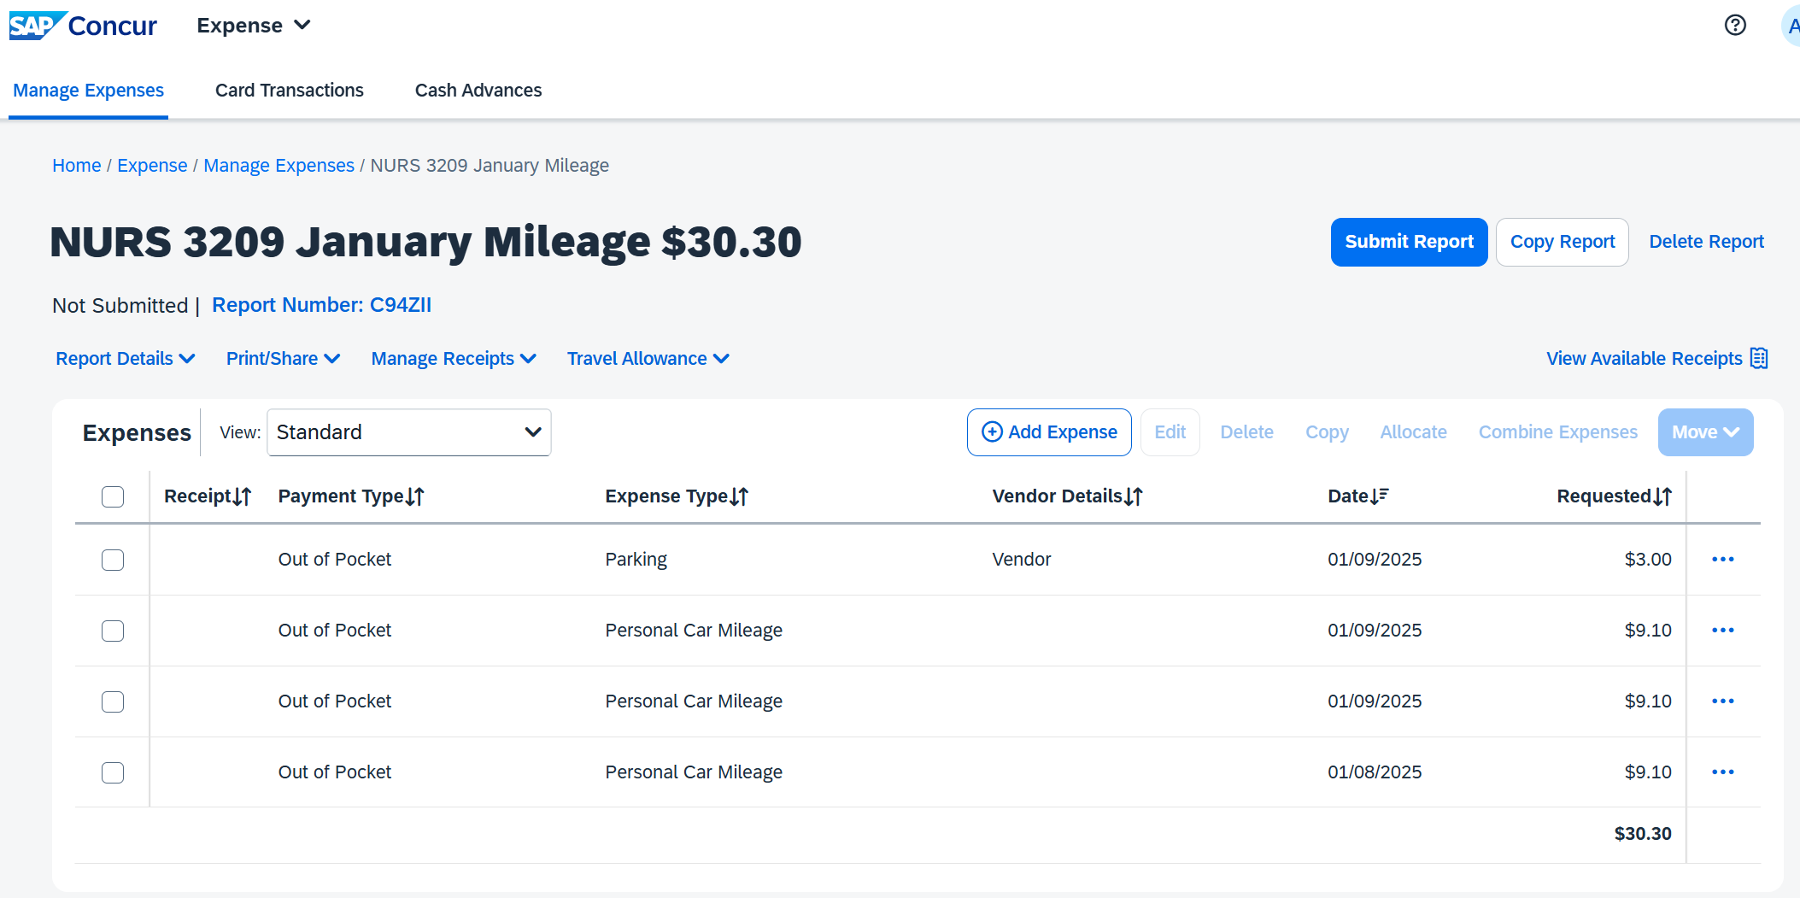
Before you submit your report…
Please email Marina Humphrey at mhumph40@kennesaw.edu to review your report before submission or if you have any questions.
After you get approval, you can hit the blue “Submit Report” button.
Mileage and parking for the whole month must be submitted on one single report.
  Reports that span two months will not be reviewed.

