Slide 1

Student Nurse Education Module
Atlanta VA Health Care System
Jeanne L. Overby MSN, RN
Valencia Johnson MSN, RN
August 16,2013
Revised August 19, 2019
Revised August 16, 2021
Notes:
Click to add notes

Slide 2
Introduction
Goal: to educate faculty & students on policies developed to enhance the safety & care for all patients within the Atlanta VA Health Care System.
Notes:
How presentation will benefit audience: Adult learners are more interested in a subject if they know how or why it is important to them.
Presenter’s level of expertise in the subject: Briefly state your credentials in this area, or explain why participants should listen to you.

Slide 3
Training Outline
Module 1: Administration of Medications
Module 2: Patient Lifting
Module 3: Cardiopulmonary Resuscitation Alert (Code-99)
Module 4:Restraint and Seclusion
Module 5:Disruptive Behavior (Code-44)
Notes:
Lesson descriptions should be brief.

Slide 4

Module 1: Objective
By the end of orientation students will be able to describe the safe medication and administration policy at the Atlanta VAMC
Notes:
Example objectives
At the end of this lesson, you will be able to:
Save files to the team Web server.
Move files to different locations on the team Web server.
Share files on the team Web server.

Slide 5
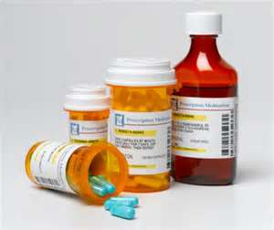
Module 1: Medication Administration
Nursing students may administer medications under the direct supervision of a clinical instructor or RN preceptor with prior approval
Orders are electronically entered via the computer or written on a doctors order sheet.
Telephone orders are discouraged; however they shall be written by an RN or pharmacist

Slide 6
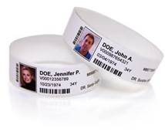
Patient Identification
Use at Least Two Identifiers When Providing Care, treatment and services
The VA uses patient’s Social Security Number and birth date

Slide 7

Transcription and Verification of Provider Orders
Medication and treatment orders are transcribed electronically or manually by an RN.
The RN verifies orders by utilizing the five rights:

Slide 8
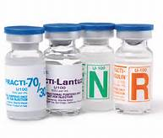
Medication Administration Cont’d
Multiple dose vials must be labeled with a 30 day expiration date once opened
Insulin Vials Are Dated For 90 Days After Opening

Slide 9
High Risk Medications
Insulin
Heparin
Parental Nutrition
Chemotherapy
Concentrated electrolytes

Slide 10
High Risk Medications
High Risk medications require two person verification and patient identifiers
Validation of Patient Identification, Order, Drug, Dose, or Rate or Rate of IV Infusions, route, and Second Verifier, Shall be Documented in the Barcode Medication Administration (BCMA) System

Slide 11

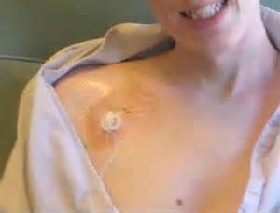
Intravenous Therapy
Students will be allowed to perform peripheral intravenous access with the supervision of a clinical instructor/ preceptor.
Access of central venous devices such as arm ports and chest ports will not be permitted by students

Slide 12
Medication Module 1 Summary
To improve the accuracy of patient identification
To improve medication safety
Use at least two identifiers
Label and date all medications containers and other solutions (Medication containers include syringes, medication cups, and basins )

Slide 13
Module 2: Patient Lifting
Objective: Students & faculty will state the responsibilities and procedures necessary to provide safe transfer of patients with limited mobility at the Atlanta VA Medical Center

Slide 14
Patient Lifting, Cont’d
Patient transfer and lifting devices are key components of an effective program to control the risk of injury to patients and staff associated with lifting, transferring, repositioning or movement of patients

Slide 15
Patient Lifting Cont’d
The transfer team will assist the nursing staff with transferring patients from one surface to another, by using mechanical equipment, patient handling aids and techniques that support a no lift environment and culture of safety.

Slide 16
Patient Lifting cont’d
All lifts/ and or transfer of patients with impaired mobility will require a minimum of two employees, and the appropriate mechanical lift, transfer device or transfer techniques.

Slide 17
Patient Lifting cont’d
Employees are responsible, prior to each transfer/lift of a patient to assess and determine the safest transfer/lift technique appropriate for the patient’s functional and mental status.

Slide 18
Patient Lifting cont’d
Employees are responsible for utilizing the appropriate mechanical lifts and transfer devices to comply with policy.

Slide 19
Lesson 2: Summary
The education and training of healthcare employees at the Atlanta VA Health Care System is geared towards preventing hazardous injuries in the workplace. The VA enforces the use and the selection of the appropriate patient lifting equipment and devices, as recommended by review of research-based practices of safe patient handling.

Slide 20
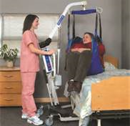
Course Review
Who can safely lift patients?
What is the VA policy on one man lifts?
What is the purpose of the safe lifting policy?

Slide 21
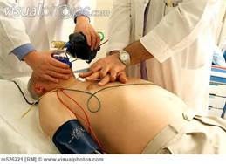
Module 3: Cardiopulmonary Resuscitation Alert (Code99)
Objective : students will identify the process to call for assistance for Cardiopulmonary resuscitation “Code 99” at the Atlanta VA Medical Center.

Slide 22

Module 3: “Code-99”
Basic Life Support should be initiated immediately when signs of sudden or unexpected death are recognized by personnel trained in Basic Life Support(BLS).
A (code 99) can be Activated from the nearest phone by dialing the numbers 204911 and give the operator the exact location and the nature of the emergency which will be Code 99.

Slide 23
Code-99, cont’d”
Code buttons are located at the head of the bed in the inpatient areas, the Dialysis unit, emergency room and the observation unit.
When the code button is pressed the Code 99 system is automatically activated by the operator who will activate code pagers and overhead announce the Code 99 and location.

Slide 24
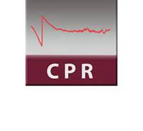
Lesson 3: Summary
To activate a “Code 99” you must“ Dial 204911” from the phone, or if in-patient area press the button at the head of the bed
Code Pagers are carried by all code team members

Slide 25

Module 4:Restraint & Seclusion
Objective: Provide Faculty & Students with the policy and procedure, of the Restraint and Seclusion interventions utilized at the Atlanta VA Medical Center.

Slide 26
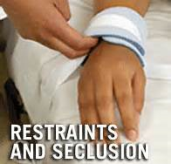
Restraint & Seclusion
The Atlanta VA has strict policies that govern Restraint and Seclusion
We are committed to the prevention and reduction of the use of restraints
Every effort must be made to prevent situations that can lead to restraint use

Slide 27
Categories of restraints used at Atlanta VAMC
MEDICAL/SURGICAL Restraints:
Are utilized for acute medical problem, i.e. DT’s, electrolyte imbalance, LOC,
Promotes physical healing, i.e. need to prevent removal of IV’s, O2, ETT, NGT, etc.
Behavioral Restraints: protect the individual against injury to him/herself or others, including staff, because of an emotional or behavioral disorder

Slide 28
Restraints cont’d
Behaviors that may need restraints use are:
Assaultive behaviors
Self abuse
Verbalizing or demonstrating intent to do harm to self or others
Interference with medical plan of care

Slide 29
SECLUSION
SECLUSION- is confinement of a patient alone, and prevents them from leaving for any period of time
Seclusion is a form of restraint
Seclusion rooms are located on In-patient psychiatric units, and the emergency room

Slide 30
Restraints are not…
Routine immobilization devices
Splints
Protective helmets
Dressings or bandages
Orthopedic prescribed devices
Routine methods of care that may involve physically holding a patient during routine procedures

Slide 31
What is a restraint?
It is either physical device or chemical that is being used as a means to control the being used as a means to control the movement of a patient movement of a patient.

Slide 32
Restraint Requirements
Orders from a Licensed Independent Practitioner(LIP)
Atlanta VAMC training
Timely assessments and re-assessment of patients
Education of patients and families

Slide 33
At the AVAHCS:
An RN Can Initiate an emergency restraint /seclusion in an response to a patient that poses an immediate harm to self or others

Slide 34
Module 5:”Code 44”
Code 44 is called when an individual (patient, visitor or other person) is threatening to injure you, others or themselves and verbal interventions are not successful

Slide 35
When to Call a (Code44)
The Atlanta VA uses verbal “de-escalation” techniques first before calling a (Code44)
De-escalation is a technique used during a potential crisis situation in an attempt to prevent a person from causing harm to us, themselves or others (Johnson, 2011)

Slide 36
There are 3 Levels of Intervention for Disruptive Behavior:
Level 1 : Non-Emergency
Level 2: Disruption that does not respond to verbal redirection
Level 3: Disruptive behavior that results in hostile action

Slide 37
Levels 1: Non-Emergency
Non-emergency assistance: when an individual’s is displaying anger or making threatening comments.
Clinical staff role includes:
use verbal de-escalation,
evaluation by clinical team to assess for mental health consult
May choose to call the police for their physical presence and support at ext.204911

Slide 38
Level 2:Code 44
Disruptive behavior that does not respond to verbal redirection is called a (Code 44)
1st Responder Role includes:
Dial “204911” and notify the operator of the Code 44 and the location
Stay with the individual and assist team when they arrive, provide information and support

Slide 39
Level 3: Code 44 Blue
Disruptive behavior that results in hostile action and immediate threat to the physical safety of personnel and others
Call Code 44 Blue by dialing “204911” and the police will answer and direct the proper announcement
Police secures the individual and limits hostile activity

Slide 40
References
The Joint Commission (2022). National patient safety goals: Hospital Accreditation Program. Retrieved https://www.jointcommission.org/standards/national-patient-safety-goals/
Administration of medications, Intravenous fluids, by professional nurse, licensed practical nurses and nursing students. Nursing policy #118-3

Slide 41
References
United States Department of Labor. (n.d). Occupational Safety and Health Administration: Safe patient handling. Retrieved August 19, 2019, from
https://www.osha.gov/SLTC/healthcarefacilities/safepatienthandling.html
Safe Lifting Policy #11-63. Atlanta VA Medical Center

Slide 42
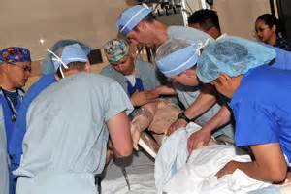
Reference
Atlanta VA Medical Center , Memorandum Cardiopulmonary Resuscitation Alert, #11-24.

Slide 43

Reference
Atlanta Medical Center Memorandum 11-52, dated May 4, 2016.

Slide 44
References
ASIS Healthcare Security Council (2010). Managing disruptive behavior and workplace violence in Healthcare. Retrieved from
https://asprtracie.hhs.gov/technical-resources/resource/1947/managing-disruptive-behavior-and-workplace-violence-in-healthcare.
Johnson, A (2011). De-escalation stratégies for crisis situations. Retrieved from: http://www.hdsa.org/images/content/1/5/15047.pdf.

