Slide 1

How do you feel about this assignment?
STRATEGIES TO ASSESS STUDENT CONFIDENCE & ENGAGEMENT
Dr. Valerie A. Smith
Lecturer of English, Kennesaw State University

Slide 2

Why assess Student confidence?
Student
Confidence
Various Modalities
Student Accommodations
Writing as a Process
Community-Engagement
Transparency in Learning and Teaching (TILT)
Questions
Concerns
Engagement
Validation
Input in Process
Dr. Valerie A. Smith
Lecturer of English, Kennesaw State University

Slide 3
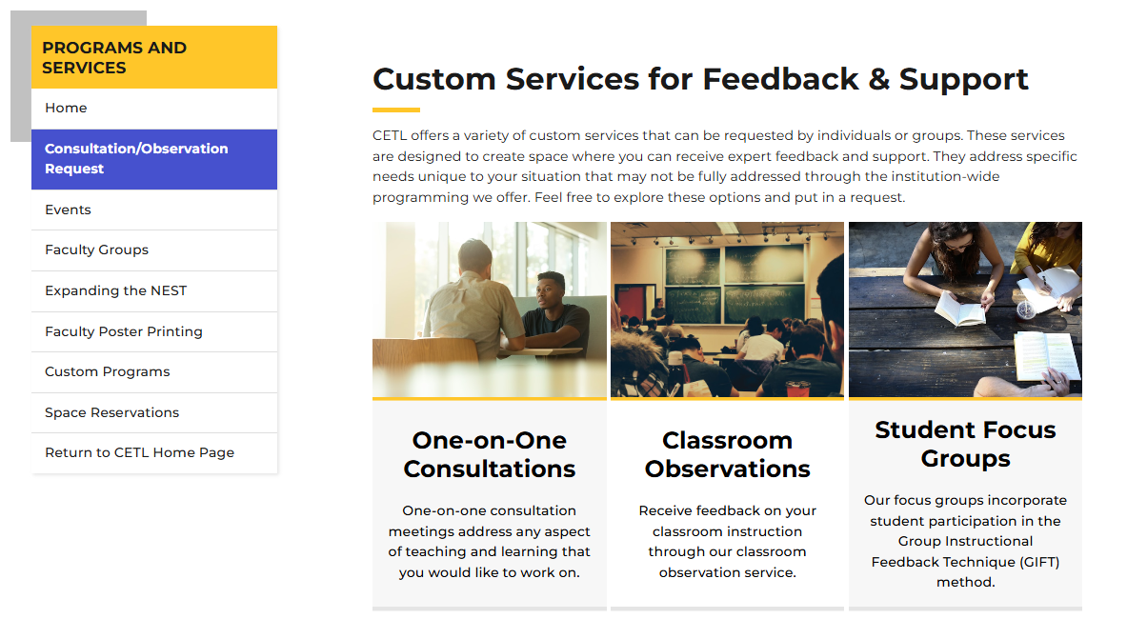
Cetl mentorship
Dr. Valerie A. Smith
Lecturer of English, Kennesaw State University

Slide 4
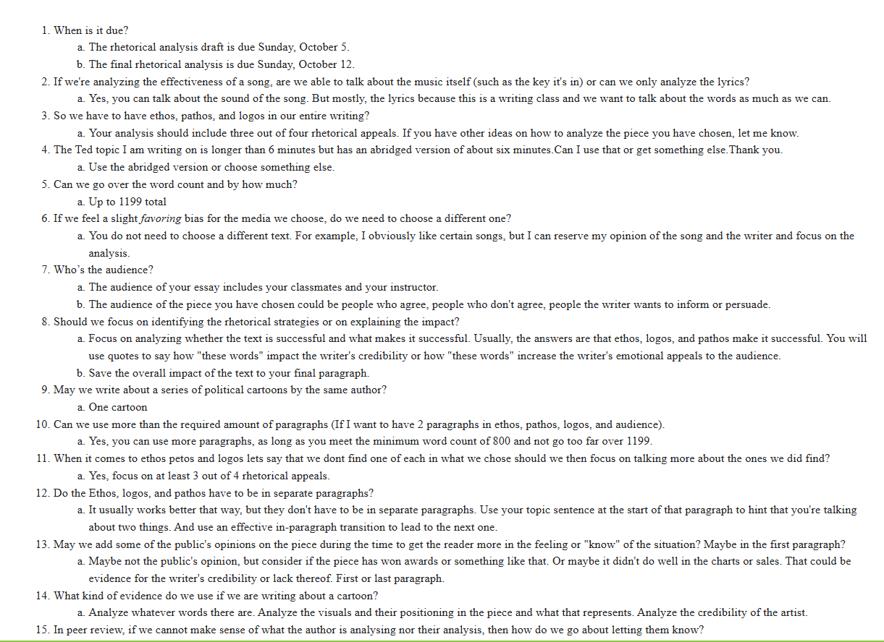
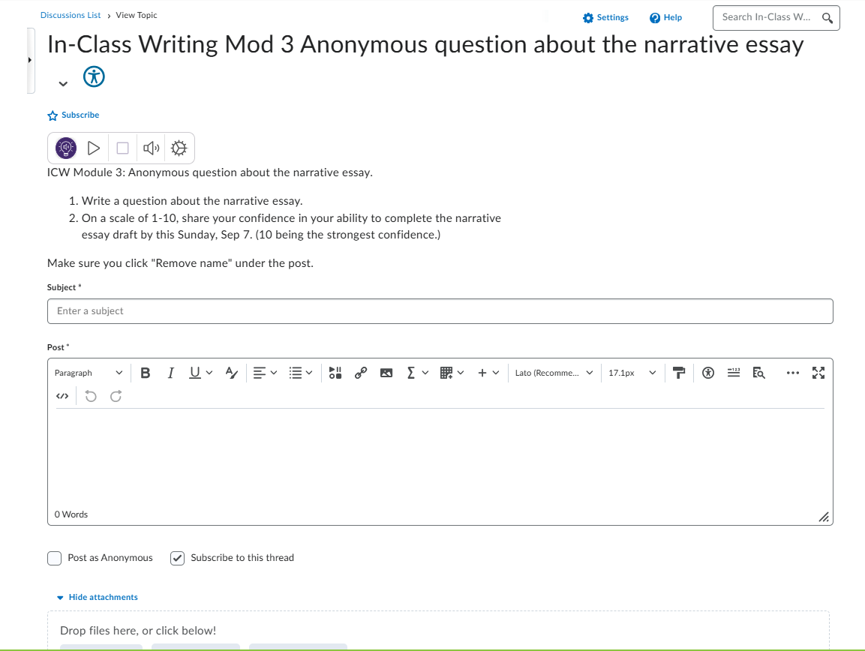
d2L Anonymous question & Results
By a Show of Hands!

Slide 5
Results for teachers
More Teaching
More Time
Individual Conferences
Positive Evaluations & Annual Reviews
Teacher Confidence
Dr. Valerie A. Smith
Lecturer of English, Kennesaw State University

Slide 6


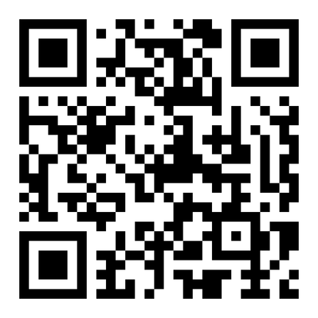
Additional strategies
Take this survey!
https://www.surveymonkey.com/r/TBHJDTS
Survey Monkey
By a Show of Hands!
Kahoot
Quizziz
Padlet
Discord
TeamSpeak
On a scale of 1-10, how do you feel about completing this assignment by Sunday?

Slide 7

Questions?
Student
Confidence
Teacher Confidence
Write an Anonymous Question
By a Show of Hands!
Reflect, Learn & Grow
Questions
Concerns
Engagement
Validation
Input in Process
More Teaching?
More Time?
Individual Conferences?
Engagement?
On a scale of 1-10, how do you feel about completing this assignment by Sunday?
Between Assignments
Scaffolding
End of Semester
Annual Reviews
Discussion Board
Useful Technology

Slide 8
Thank you
Dr. Valerie A. Smith
vsmith37@Kennesaw.edu
Lecturer of English, Kennesaw State University

