Slide 1
The Collaborative Syllabus
Designing for Student Success Together

Slide 2
The Collaborative Syllabus
Instructor and students co-create course policies
  Students propose policies
  They discuss with each other and with the instructor to reach consensus
  Students vote on whether to adopt policies

Slide 3
What
Policies
Do We end up With?
Virtually the same policies I already had.

Slide 4
So Why Bother?
For Students
Increases buy-in
Improves understanding of policies
Engages critical thinking
For Instructors
Clarifies your priorities
Saves time later
Establishes ethos
For Both
Builds rapport and trust
Promotes empathy

Slide 5
Student Comments
“It let me know that the teacher cares what we have to say.”
“[N]ow we feel more inclined to abide by the policies because we ourselves have decided what we think is and is not reasonable…”
“It feels more inclusive.”
“[M]akes it so that we can hold ourselves to a level we know we can uphold, in that we suffer the consequences that we set up for ourselves.”
“[I]t made it seem like our professor actually cares about our opinions.”

Slide 6
Implementation is flexible
You decide:
  What content/policies are up for debate
  How to facilitate
  How to reach consensus

Slide 7
Considerations
How many courses and sections you teach
How many total students you have
Students’ experience level (Freshmen? Upperclassmen?)
Course descriptions and level of standardization
Course modalities (F2F, hybrid, synchronous/ asynchronous)

Slide 8
Potential Collaborative Elements
Content (to whatever extent is reasonable)
Course policies
Grading system
Communication method(s)
Assignment components and modalities

Slide 9
English 1101 & 1102
Attendance (absences and tardies)
Late work (minor and major assignments)
Classroom conduct (tech and phone use)

Slide 10
Example
Part 1
Set basic expectations
Share grounding principles
Assignment: Proposed policies for next class
Part 2
Part 3

Slide 11
Expectations & Grounding Principles
Work with students to make two lists:
  What do you want/expect from your professors to help you be successful in a course?
  What are your responsibilities as a student to be successful in a course?
Then, provide your grounding principles for course policies:
  Natural consequences
  Mutual respect
  Professionalism
  Student self-efficacy
Remind them that these expectations and grounding principles should be used to inform the policies they propose.

Slide 12
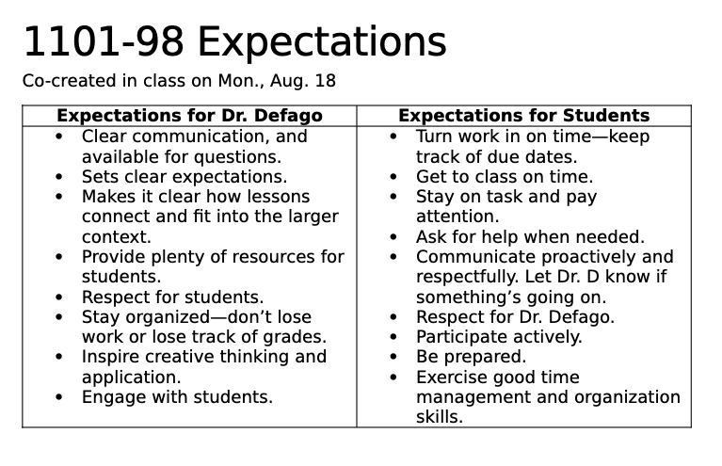

Slide 13
Example
Part 1
Set basic expectations
Part 2
Look for commonalities in proposals and condense in one document
Discuss as a class
Assignment: Optional additional comments/ proposals
Part 3
Share grounding principles
Assignment: Proposed policies for next class

Slide 14
Students’ Proposed policies
More Strict than Me
Less Strict Than Me
Attendance policy
Deadlines for major assignments
Deadlines for minor assignments
Classroom conduct/ tech use

Slide 15

Managing Discussion
Use the Socratic method to test their policies.
  Tie to grounding principles and list of expectations.
Refer to past policies and provide rationale.
  “In previous semesters, I haven’t differentiated between excused and unexcused absences, and here’s why…”
When setting and holding a boundary, lead with how it supports their success.

Slide 16
Example
Part 1
Set basic expectations
Share grounding principles
Assignment: Proposed policies for next class
Part 2
Look for commonalities in proposals and condense in one document
Discuss as a class
Assignment: Optional additional comments/ proposals
Part 3
Present final draft of policies
Final questions/ comments & voting

Slide 17
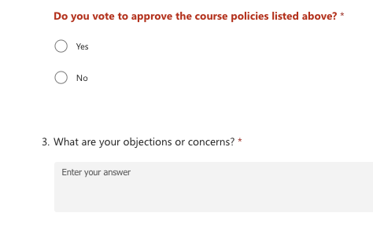
Voting

Slide 18
Results: Fall 2025
Emailed the link to anyone who hadn’t voted by the original deadline to invite them to at least register their vote.
Reached out to both students who voted “No” inviting them to meet with me to discuss their questions or concerns.

Slide 19
Big Picture Recommendations
Start with explanation of what a syllabus is and set general expectations and responsibilities.
Move through proposals and discussion as efficiently as possible.
Provide a clear method for students to follow up with questions or concerns.
Apply the same policies across multiple sections of the same course.

Slide 20
Questions?

Slide 21
Make it Work for You
Identify your own grounding principles.
1
Reducing workload? Promoting self-efficacy? Maintaining specific academic standards?
Determine which policies to collaborate on.
2
Identify your own boundaries/ minimum standards.
Decide how to facilitate.
3
Asynchronous vs. synchronous? Class time? Small groups? Voting?
How much time do you want to devote to this?

Slide 22
Additional Options to Supplement
Short readings on task-switching and phones/tech in the classroom.
Questionnaire to generate proposed policies.
Periodic student reflections & self-assessments throughout the semester.
Problem-solving activity within the first three weeks.

Slide 23

Thank You!
Dr. Madelyn Fox-Defago
Lecturer of English
mfoxdefa@kennesaw.edu
University Hall 102A

