Slide 1

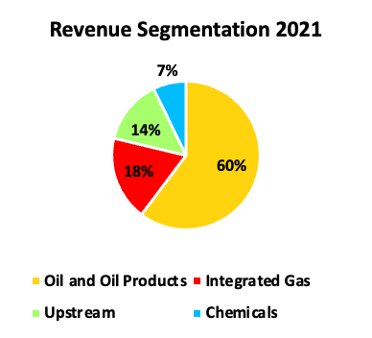
Shell PLC
As of 2/16/2023
Nicholas Wilson – Junior Analyst – nwilso90@students.ksu.edu
Carter Bray – Junior Analyst – cbray12@students.ksu.edu
Shell (SHEL)
Executive Summary
Market Profile
Closing Price | $56.16
Price Target | $72.31
Enterprise Value | $256.60B
Market Cap | $208.65B
Beta | .99
Dividend Yield | 3.42%
Payout Ratio | 19.27%
P/E | 5.47
Forward P/E | 7.00
ROE LF | 23.35%
Given our analysis of this company and the strength of the oil and gas industry shown over the last year, we believe that it is in the best interest of the firm to hold our current position in Shell. At a weight of 4.67% cash excluded, our position in this stock is in the upper limit of the weighting it can hold in the portfolio. We believe that due to their strong natural gas operations, a positive outlook for the oil industry, and relatively cheap valuation relative to competitors, Shell is a strong investment to continue holding. The firm is currently slightly overweight in energy where Shell, along with many of its competitors, entered the year 2023 with an extremely healthy balance sheet. By keeping our position in Shell constant, we are presenting the firm with an opportunity to overweight further in an energy sector that is coming off its most profitable year since 2008. Shell is well positioned to take advantage of any shifts to renewable energy due to lower margin investments it has made in that space, but if that happens it will not be much of a factor until 2025 at least.

Slide 2
Industry Outlook
The oil market experienced a great deal of volatility in 2022, with prices for crude oil rising sharply in March following the Russian invasion of Ukraine before falling back down by the end of the year. Factors contributing to this volatility included the largest-ever release from the US Strategic Petroleum Reserve, fears of a slower recovery in oil demand due to the pandemic, and a slowdown in global economic activity. The largest source of weakness in oil demand has been China due to its zero-COVID strategy and several macroeconomic challenges.
The prospects for growth in oil demand have improved due to the earlier-than-expected easing of Covid-19 containment measures in China. On the supply side, uncertainties around Russia continue to cloud the outlook, meanwhile OPEC is expected to continue supply cuts of 2 million barrels per day through the rest of 2023. With OECD oil inventories at their lowest level since 2004 and spare capacity set to continue dwindling, we believe higher prices will be needed to slow down oil demand growth and encourage investments in new production.
The United States has said it will replenish its strategic petroleum reserves when oil trades in the $68-$72 range. As a result, there is a strong buyer in that area. Bullish forecasters such as Goldman Sachs and Morgan Stanley expect a tighter oil market in the second half of the year, with some predicting Brent to top $100 per barrel and even reach $105-110 per barrel by the end of the year. The situation with Russian oil production is less clear, and while Western sanctions were expected to have a significant impact, the redirection of exports rather than a production cut ensured a relatively modest impact on global oil supply and prices.
The high possibility of a recession, especially in developed countries and China, continues to give uncertainty to oil demand growth for the rest of the year. The oil market remains in a wait and see mode in anticipation of supply shifts over the coming months, seasonal demand improvement, and a ramp up in Chinese and other sources of pent-up demand. We expect to the oil market to tighten throughout the rest of the year due to a combination of Chinese demand and OPEC+ supply cuts. This tightening should lead to a growing deficit, indicating that oil prices should trade higher from current levels.

Slide 3
Investment Opportunity
Shell has some of the most attractive assets in the global energy business, notably one of the world’s largest liquefied natural-gas business and the biggest network of service stations. At a current price of $56.47, it is trading at 5.47x projected earnings which is significantly lower than its American counterparts Exxon Mobil and Chevron, which trade at 10.52x and 10.79x projected earnings, respectively.
Shell reported record profits in 2022, generated by high energy prices and strong demand, especially from China. In Q4 2022, the company recorded total revenues of $101.3 billion, with adjusted earnings of about $9.8 billion. For 2022, revenues jumped to $381.3 billion, a YoY growth of 46% versus 2021. Shell's performance was mainly driven by two key drivers: Integrated Gas and Upstream, with the integrated gas adjusted earnings at record numbers and the upstream business more than doubling. Shell has distributed close to $26 billion to shareholders in 2022 in dividends and buybacks.
The company has several integrated gas projects under construction to maintain and increase its LNG output. Meanwhile, it has many more in development as well as planning to expand existing operations to fuel their growth in the upcoming years. Shell capitalized on strong conditions in the LNG market to earn record profits in 2022. The success of this business will be crucial for Shell to enable it to continue delivering robust cash flows that it returns to shareholders through repurchases and increasing dividends.
In 2023, there is little reason to assume that the market for fossil fuel, and energy prices in general, will not continue to grow, even if the growth is only in line with the global nominal GDP growth. The company has a solid renewable energy business, positioning itself as one of the top producers globally. As China ends COVID and Europe recovers, strong demand tailwind is expected in the first half of 2023. If the Brent benchmark bounces within the range of $60 - $80, then Shell could likely write about $30 - $40 billion of profits in 2023. Shell stock is currently undervalued, and the European Oil Major is trading at an EV/Sales of x0.64 and an EV/EBITDA of x2.99.
R-Squared - .836

Slide 4
Business Description
Shell is a publicly traded company with headquarters in the Netherlands and registered offices in London, UK. It is one of the largest companies in the world, with operations in over 70 countries and a workforce of approximately 86,000 employees. Shell operates as a fully integrated oil and gas company, meaning it is involved in every stage of the value chain. The company's upstream operations involve the exploration and production of oil and gas resources, which are then transported to its downstream operations for refining and marketing. In recent years, Shell has made a significant effort to transition towards cleaner energy sources, acknowledging the need to address the global climate crisis.
Shell’s activities in the energy sector can be divided into four segments: Oil Products, Integrated Gas, Upstream, and Chemicals. Their Oil Products business, which makes up most of Shell’s revenue, refines crude oil into products like gasoline, jet fuel, and diesel. These products are marketed and sold around the world for domestic, industrial, and transport use. Integrated Gas includes the company’s liquified natural gas (LNG) operations, mostly the exploration, extraction, and transportation of natural gas. LNG is mostly sold commercially as fuel for large vehicles and ships and residentially for heating and cooking. Since LNG produces significantly less carbon dioxide than oil or other fossil fuels, Shell houses its investments in renewable energy solutions in this segment. Shell’s Chemicals segment supply businesses and consumers with a range of chemicals used to make everyday products. These chemicals are made in large manufacturing plants that are often located near their refineries. This segment makes up a small amount of Shell’s total revenue. Upstream operations involve the exploration and extraction of crude oil and natural gas. This segment oversees the infrastructure that gets the oil from the ground into the gas pumps. The company has a significant presence in many key markets around the world, which enables it to respond to changes in demand and market conditions in a more agile and flexible manner than some of its competitors. Shell entered into multiple new drilling agreements in 2021 to explore new frontiers in Argentina and expand existing drilling operations in places like the Gulf of Mexico and Brazil. They have made some key acquisitions in renewable energy in the last couple years such as electric vehicle charging company, Volta. Shell generates revenue mostly from Asia (35%) and then Europe and the United States roughly 30% each. The remainder of revenue comes from Other Americas, mainly Brazil.

Slide 5
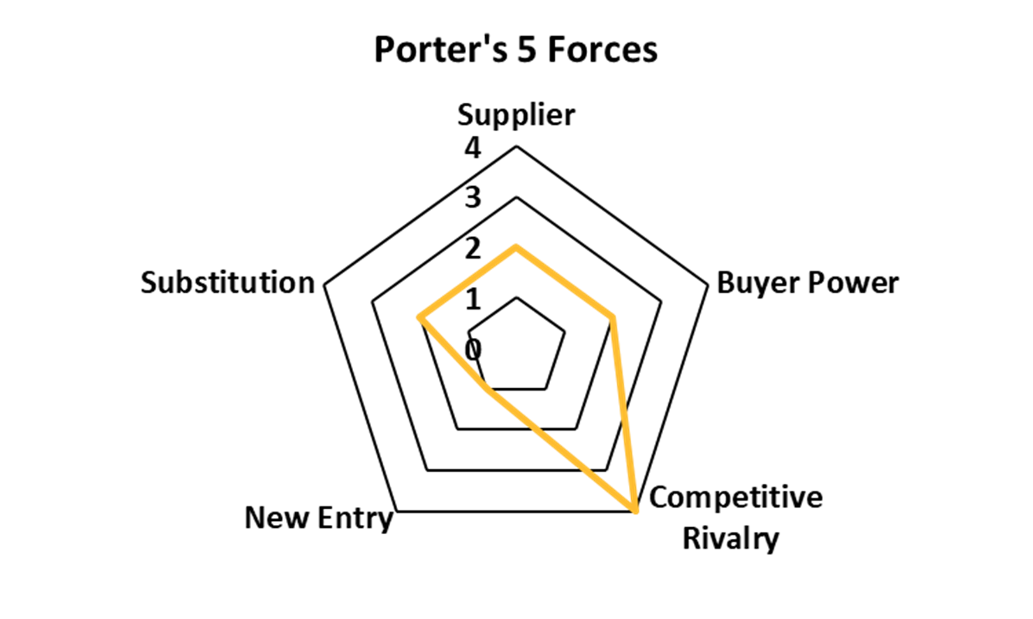
Competition/Industry
Choosing the Porter’s 5 Forces method, we analyzed this industry in competition, new entrants, the power of the customer, the power of the supplier, and the threat of potential substitutes.
Competitive Rivalry (4): Competition is a very important element of this industry as there are a multitude of wealthy companies vying for a limited resource. All these companies compete for drilling licenses, operating equipment, and buyer relations which leads to a very high capital requirement for companies looking to enter this industry.
New Entry (1): The capital requirement is one of the largest in any industry, and it results in very few companies pivoting to oil and gas drilling effectively which is why this industry scored so low in the new entrant's category.
Buyer Power (2): The customer does have power in this industry; however, they do not have much because oil and gas are always going to be in demand until alternate fuel sources are further and more fully developed which will be another 10+ years.
Supplier (2): Like the customer, the supplier also does contain some power, but due to the competitive nature of the oil and gas industry, there are always going to be different suppliers that E&P companies could use instead, resulting in another reason for the intense competition found here.
Substitution (2): Lastly, substitutes factor in due to the renewable energy transition that oil and gas companies are starting to research, develop, and implement. Shell leads this the charge with the most amount of renewable energy research done annually, but other companies are starting to see the benefits and create their own renewable energy divisions, respectively. This will continue to affect the Oil and Gas industry as time moves forward.

Slide 6
Although there are many large competitors within the US energy industry, Shell stands out among the crowd. Their most prominent competitors are Exxon, Chevron, PetroChina, and British Petroleum. Like Shell, these companies are fully-integrated and deal with every aspect of oil and natural gas, including drilling, refining, and distribution. Despite this competition, Shell manages to take strides other companies are not yet taking, and it has proven to reap plenty of rewards. An example of this would be their global scale of service station facilities. Shell currently owns nearly 47,000 different gas stations around the world while Exxon and Chevron combined only own about 28,000. Shell’s stations are spread all over the world, but they mainly provide these services with the United States and Eastern Europe. Another example is shown when evaluating Shell’s commitment to achieving Net Zero Emissions by 2050, and their desire to stay in line with the Paris Accord. They have already taken many steps to prove that they are willing to make sure climate change does not get reach the point of no-return.
The energy production industry has a notorious background of being highly competitive, but what it lacks in friendliness it makes up for in revenue. Within the energy production industry, oil and gas is one of the largest sectors in the world purely based off dollar value. Even with the massive hit that most oil and gas companies took in 2020, this industry is on track to outperform other industries in terms of growth due to expected high demand on both the consumer and national level.
Competition/Industry
Exxon Mobil’s main sources of revenue come from the Upstream, Downstream, and Chemical production segments with Upstream being the main contributor. Exxon is entirely based in the US with more than 21,000 service stations.
Chevron, unlike its competitors, only deal in Upstream and Downstream products. Their largest market share is within the Petroleum Refining industry, where they make up around 14.2% of total industry revenue.
PetroChina, owned by the Chinese state, is the largest oil producer in Asia and second largest in China. Although they have such a high influence on arguably the largest oil market in the world, controversies are plentiful with this company ranging from tax evasion, to negligence, to and abuse of power.
British Petroleum has operations spanning 78 different countries with its hand in Upstream, Downstream, and Renewable Chemicals. Worldwide, BP owns around 18,000 service stations, with the United States accounting for nearly one-third of their total operations.

Slide 7
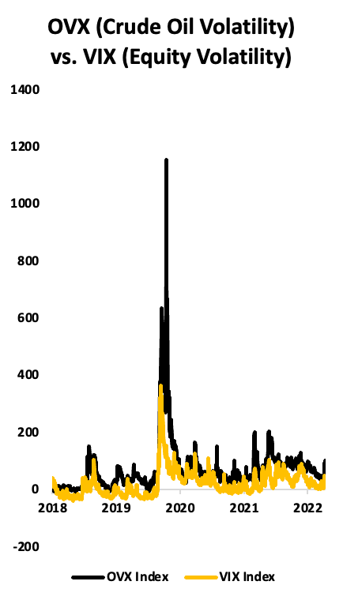
Risk
Shell is subject to numerous strategic and operational risks that must be considered. These risks could have a negative effect on earnings, cash flows, and overall financial stability. Reliance of external factors like volatility of commodity prices, environmental risks, geopolitical conditions, and high competition in the industry are all examples of risks that Shell faces over the next several years.
Heavy reliance on external factors such as the volatility of oil prices and changes in customer sentiment towards renewable energy also affect Shell. Shell’s profits are highly correlated with movements in the price of oil as they are highly leveraged towards oil. The shift to new energy solutions could hurt Shell if they do not move at the pace in which this adoption is occurring. They could also be put at a disadvantage if they move too quickly in the transition towards renewables. Overall, there is much uncertainty about the future of renewable energy and if consistent returns are going to be able to be generated. Shell’s transition relies heavily on steady profits being generated from their large Integrated Gas business. Shell is also hoping that their investments in chemical products will pay off by generating increased revenue in a department where they are lacking.
Climate change and its consequences is one of the main issues that Shell will continue to face in the future. Because societal expectations are increasing for businesses, there is an increased focus on the oil and gas sector in the context of climate change. As the world shifts towards cleaner energy, there may be regulatory changes and shifts in consumer demand that could impact Shell's business. Oil spills are an ever-present risk for oil companies with offshore drilling operations and can be devastating to a firm’s brand value as seen during the BP oil spill a decade ago. Most of Shell’s spills have occurred in Nigeria, where they have onshore operations. This is due to sabotage from the locals and Shell is looking to potentially divest from operations in this area. The primary ESG risk associated with Shell is its impact on the environment. This impact arises mainly from the carbon emissions resulting from its operations and the waste generated during activities such as oil spills
Future hydrocarbon production depends on the success of future large and integrated projects, and their ability to replaced drained oil and gas reserves. The nature of these operations expose Shell and the communities they are working into a variety and health and safety risks especially if any accidents occur. Shell relies heavily on information technology systems so any failure in their electronics systems during operations could be catastrophic. Any damage to Shell's reputation from an accident could affect their ability to secure new resources or enter new markets.

Slide 8
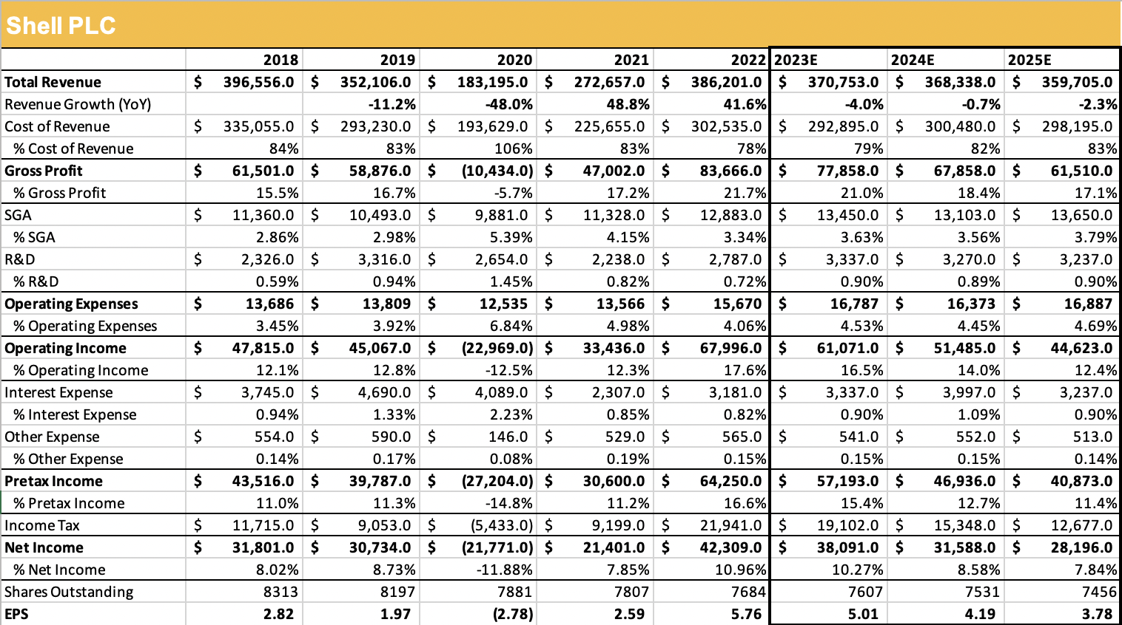
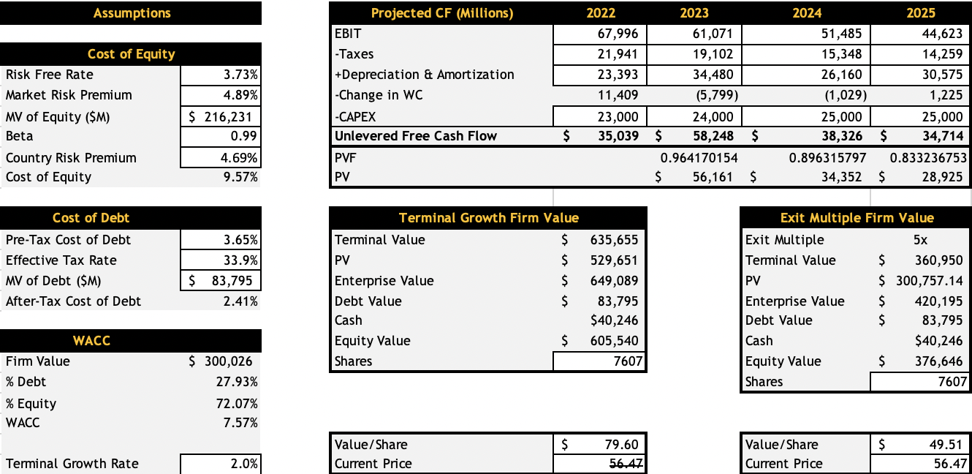
Appendix

Slide 9
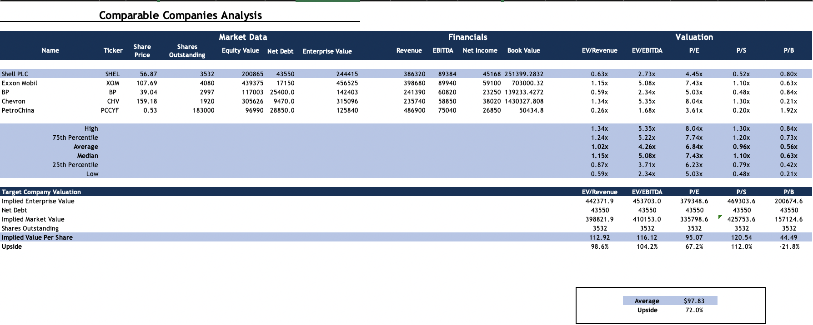
Appendix

Slide 10
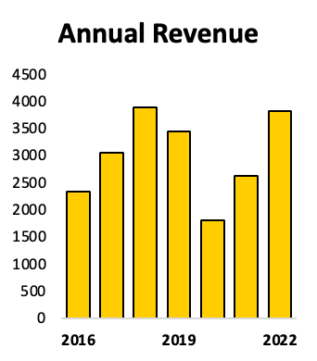
Appendix

Slide 11
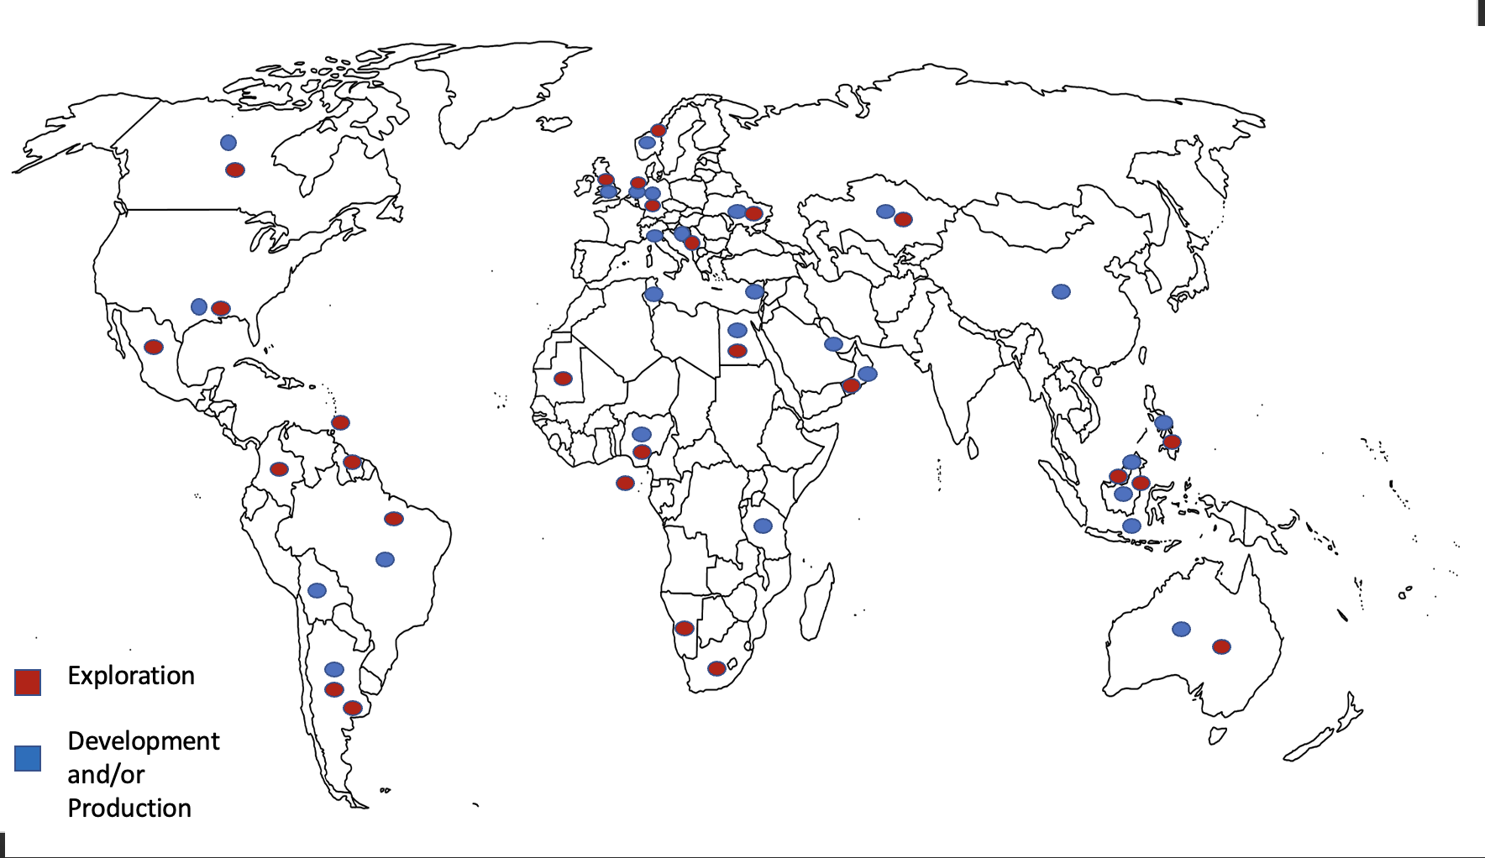

Slide 12
Appendix

