Slide 1


Shell PLC
HOLD
Nicholas Wilson – JUNIOR ANALYST
Carter Bray – JUNIOR ANALYST

Slide 2

DESCRIPTION
Fully Integrated Oil and Gas Company
Global Operations
Second Largest LNG Producer
Notes:
Carter – their lng shipping operations represent 20% of the global lng shipping fleet.

Slide 3
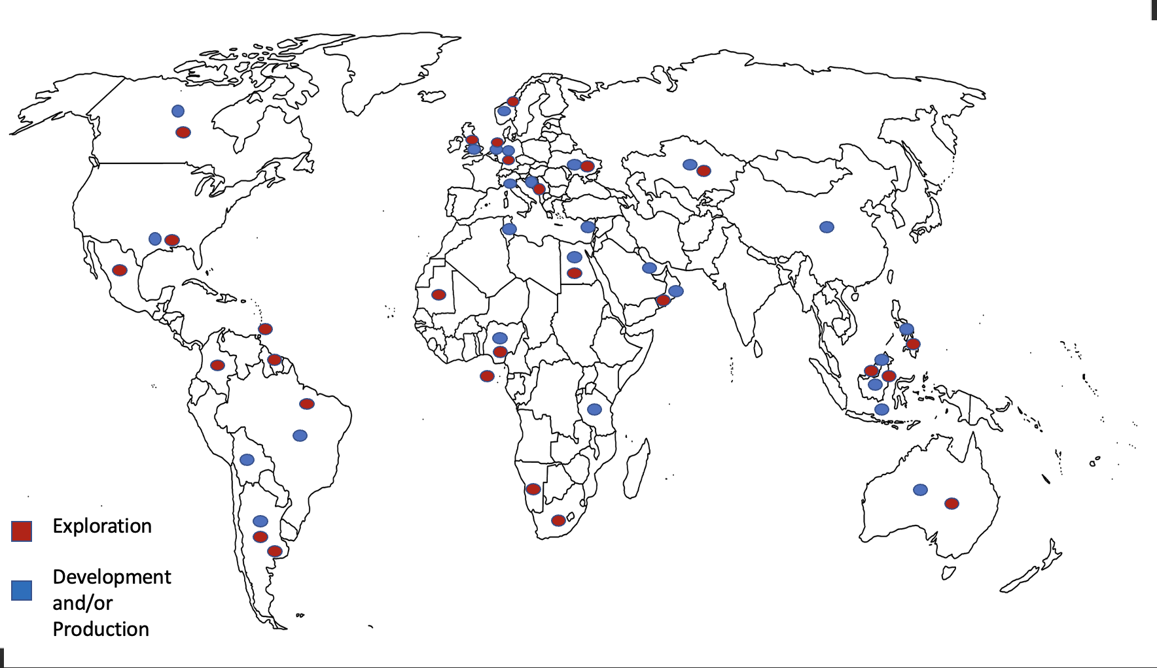
Notes:
Nick

Slide 4
DRIVERS
Notes:
Carter - Break even price of roughly 30s-40s in offshore drilling operations. Historically during recessionary periods, there has been a spike in oil prices

Slide 5
DRIVERS
$100-$110
$60-$85
$40-$60
Notes:
Nick

Slide 6
DRIVERS
Shell Annual Revenue ($m)
R Squared – 0.835
Price of Oil ($)
Notes:
Nick

Slide 7
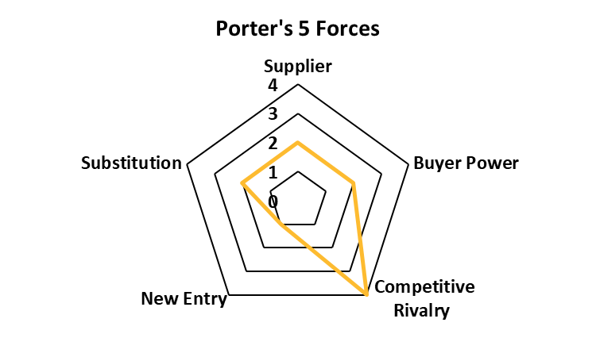
INDUSTRY OUTLOOK
Chinese Demand
OPEC Supply Cuts
Sanctions On Russian Oil
LNG Production
US Strategic Petroleum Reserve
Climate Change
Notes:
Nick – 1 million barrels per day being released SPR since march last year – was set to expire in October but still happening. Opec had supply cuts last year announced supply cut of 2 million barrels per day to go through the rest of 2023. Key to oil demand growth will be China reopening and the effect this will have in this country region and the world. Western sanctions banning the importation of Russian oil to Europe still in effect. Production in Russia projected to fall. Opec says a relative slowdown remains imminent based on rising interests rates that are expected to rise through rest of year.

Slide 8
COMPETITORS
Company (Ticker) | Mkt Cap (B) | ROE | OPM | Div Yield | Div P/O | FCF Yld. | Debt/Equity | P/E | Forward P/E | Beta (3Y- Weekly)
Mean | 231.56 | 16.93% | 16.18% | 4.68 | 26.79% | 17.85 | 36.26% | 7.86 | 8.16 | 0.89
Shell (SHEL) | 200.98 | 23.35% | 17.36% | 3.86 | 21.22% | 14.66 | 43.51% | 5.47 | 7.43 | 0.99
Exxon Mobil (XOM) | 425.55 | 30.66% | 18.02% | 3.37 | 29.55% | 12.97 | 23.11% | 10.52 | 10.57 | 1.08
Chevron (CVX) | 291.86 | 23.53% | 14.64% | 3.74 | 42.71% | 12.05 | 16.76% | 10.79 | 10.7 | 1.15
PetroChina (PTR) | 127.1 | 10.61% | 6.64% | 8.24 | 30.00% | 25.92 | 31.07% | 5.41 | 5.32 | 0.85
British Petroleum (BP) | 112.29 | -3.48% | 24.25% | 4.17 | 9.99% | 23.65 | 66.87% | 6.15 | 6.77 | 0.73
Notes:
Carter - Shell is most well positioned for the future due to having the most investment in renewables relative to competitors and during that transition they have the worlds second largest LNG operations.

Slide 9
COMPETITORS
*Fracking boom led to energy prices collapsing
Notes:
Nick – slightly below competitors due to chevron and exxon mobil having appreciated strongly but are relatively expensive now compared to shell.

Slide 10
RISK
Volatility of Commodity Prices
  Oil & Natural Gas
Customer Sentiment Towards Renewable Energy
Climate Change
  Regulatory Shifts
  Carbon Tax
Future Hydrocarbon Production
  Success of Future Projects
  Ability to Replace Drained Reserves
Notes:
Hydrocarbons are just refined natural gas and crude oil products like petroleum which is refined into diesel and gasoline

Slide 11
FINANCIAL ANALYSIS
Notes:
Nick – free cash flow used to pay off debt, growing the business, paying dividends and share buybacks

Slide 12
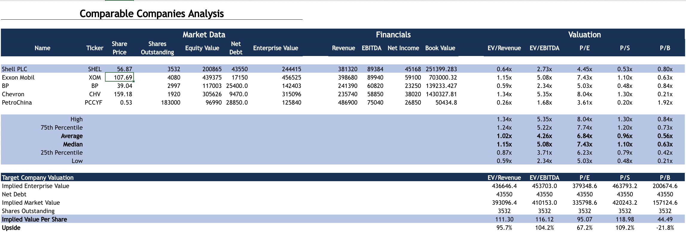


Slide 13
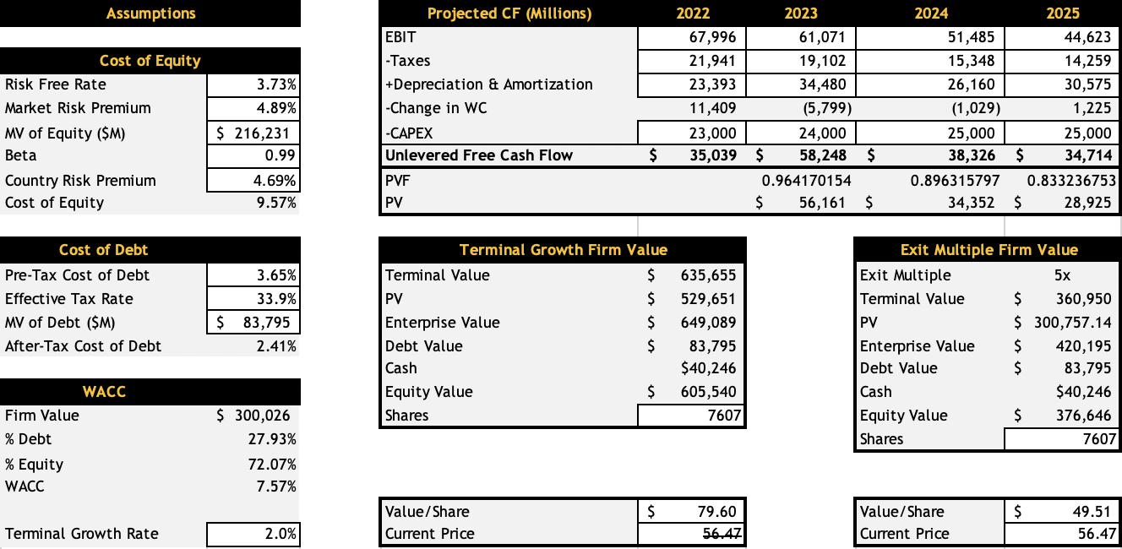

Slide 14
CONCLUSION
Hold
Overweight 1.5% in Energy Sector (3% vs. 4.5%)
Currently 3.86% of the Portfolio
Advise Overweighting Further in Energy
80% Sector Weighting
$72.31 Weighted Value/Share
28% Upside

Slide 15
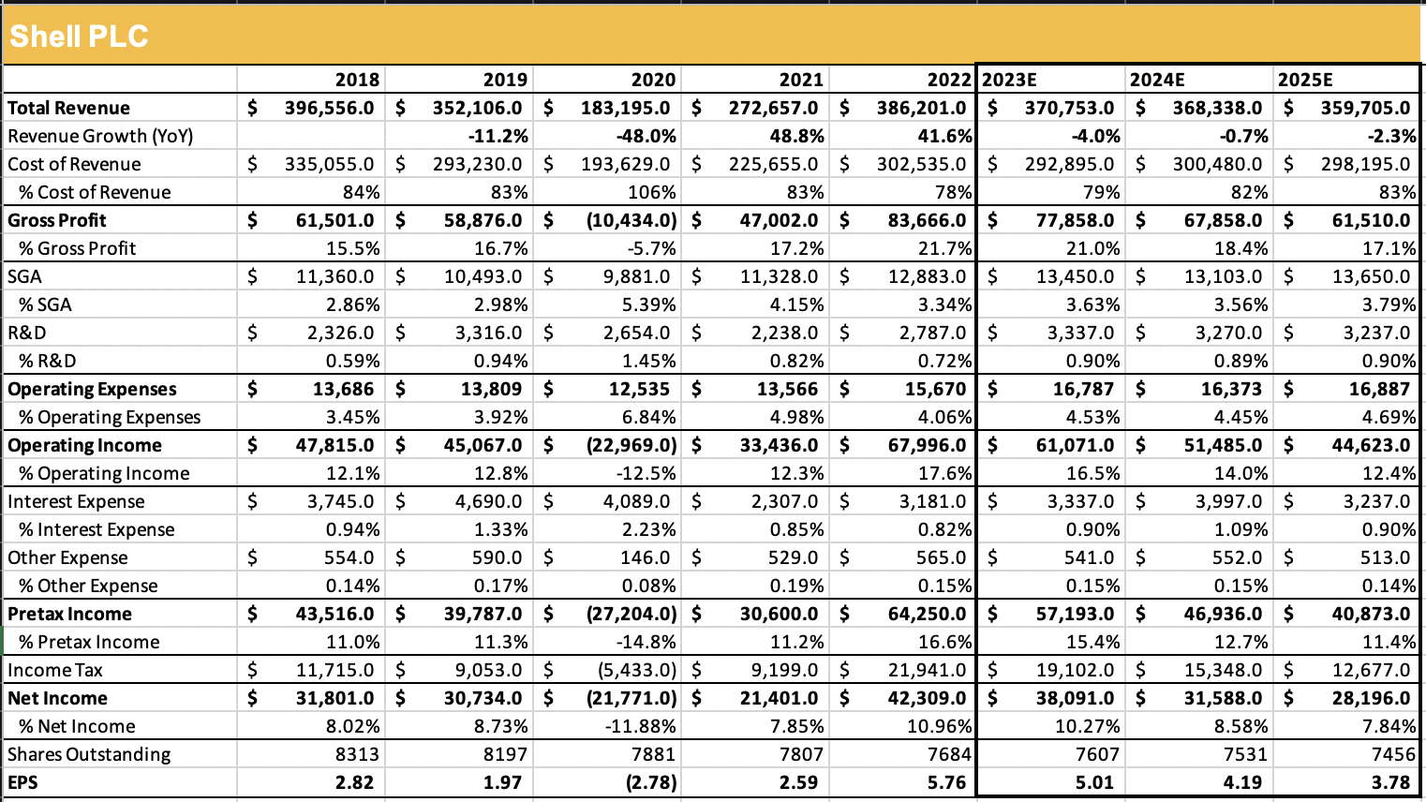
Notes:
Nick – free cash flow used to pay off debt, growing the business, paying dividends and share buybacks

