Slide 1

Nexstar Media Group, Inc. (NXST)
As of 04/17/2022
John Henry Davis III – Junior Analyst – jdavi680@kennesaw.edu
Executive Summary
Market Profile
Closing Price | 170.02
Market Cap | 7.42B
Beta | 1.5
WACC | 6.6%
P/E | 8.94
Fwd P/E | 7.97
Enterprise Value | 14.6B
Nexstar Media Group, Inc. has developed a diversified and prevalent media company that has leveraged localism to bring new services to customers and advertisers through its traditional cable, digital, and mobile media platforms. The recent market correction has created a fantastic buying opportunity for a company that continues to increase profits, household coverage, and markets of which it operates within. Additionally, their growing customer base through the online channel has created a new segment of revenue we can expect to enable higher profits in the years to come as it has been drastically growing since their mobile applications were introduced in 2017. For these reasons we recommend the purchase of 53 shares of Nexstar at a cost basis of $170.2 per share. We are currently 7.24% underweight in the communication services sector with Alphabet as our only other holding within it. This purchase would make Communication Services weight move from 5.04% to 8.04% leading the firm to be underweight in this sector by just 4.42% from 6.82%. (Price projection graphic page 7).
Investment Opportunity
Nexstar is a high-performer and has a strong focus on shareholder returns. Nexstar stock has provided a 50%t return since April 2019 and a 1,826% return since 2013. $655 million was returned to shareholders in 2021 in the form of dividends and repurchases. In addition, Nexstar has announced plans to initiate a $1.4 billion share repurchase program and dividends are expected to increase by at least 25% every year, as they have done historically. Nexstar’s revenue has nearly doubled from $2.4 billion to $4.6 billion from 2017 to 2021. High revenues are expected to continue and we project them to exceed $6 billion through 2026. This is partly due to a string of high-value acquisitions in recent years. Notably, Media General, Tribune Media, and The Hill. Nexstar and the National Association of Broadcasters has partnered with Sony, Samsung, and LG to release Nextgen TV in 20 markets throughout 2022, which would reach more than 50% of U.S. households during the year. Nextgen TV, also known as “Advanced Television Systems Committee 3.0 standard” is a drastic upgrade and major overhaul to broadcasting technology, which will allow for enhanced definition, clarity, and color, and provide Dolby Digital sound over standard television broadcasting. Researchers at S&P Global estimate that revenues from Nextgen TV could exceed $5 billion by 2027 and as much as $15 billion by 2030. Furthermore, Nexstar generally provides 15% of political broadcasting (in terms of dollars spent) for the U.S. during election seasons. While political advertising only accounts for about 1-2% of Nexstar’s revenue during non-election years, that number jumps to around 9-11% during election years. Political ad revenue equalled $507.5 million in 2020. The 2022 and 2024 election seasons are estimated to bring similar returns. Lastly, Nexstar Digital reached a 45% year-over-year growth in January 2022 for unique visitors to its websites, generating more than 820 million page views and becoming a powerful opportunity for advertisers and further increasing revenue.
Business Description / Drivers
Nexstar Media Group, Inc. is America’s largest local television and television broadcasting company focused on the acquisition, development, and operation of television stations in medium using traditional, digital, and mobile media platforms. As of December 31, 2021, they owned, operated, programmed, or provided sales and other services to 199 full power television stations and one AM radio station in 116 markets across 39 states. Their stations are affiliated with ABC, NBC, FOX, CBS, The CW, MNTV and other broadcasted networks. They aim to capitalize on this diverse network affiliation with these stations representing approximately 11.5%, 20.3%, 20.9%, 24.0%, 13.0% and 4.0% respectively. Nexstar provides the programming for these stations to broadcast sporting events such as NFL football, NBA basketball, Major League Baseball, NCAA sports, PGA golf and the Olympic games.

Slide 2
Business Description / Drivers
Because network programming and ratings change frequently the diversity of their station portfolio’s network affiliation reduces their reliance on the quality of programming from a single network. Nexstar has created a duopoly by entering into local service agreements. This gives them the right to own more than two stations in the same city or community. Additionally, they own NewsNation, a daily live national news network, as well as a 31.3% ownership stake in TV Food Network, and various digital products and services. During 2021, Nexstar received cash distributions from TV Food Network total $239 million. In August of 2020 they acquire “The Hill,” an independent, political digital media platform. This acquisition cost $137.7 million and was funded solely by cash on hand.
This acquisition demonstrates the continuation of Nexstar’s content-first strategy which focuses primarily on news to further leverage and monetize their growing presence in the digital media environment. The Hill is currently the #2 site in the United States in Comscore’s Politics category which is a media company that analyzes media company measurements by providing marketing data and analytics to enterprises, agencies, and publishers. Their acquisition strategy revolves around pursuing businesses where they believe they can improve revenue, operating income, EBITDA, and cash flow through the active management of these platforms. From 2015 to 2020, the company’s revenue increased from $896 million to $ 4.5 billion averaging out to reflect an average annual growth rate of 43.1%. While a first look at Nexstar’s balance sheet may scare off investors by the companies $7.8 billion of debt. However, when comparing Nexstar to its closest competitors, the stocks ratios are in-line or below the industry's median.
Currently their television stations reach approximately 68% of U.S. households which does not include the additional households that have access to News Nation or their other multicast networks. In over 76% of their markets, they produce local newscasts that rank among the top two stations in local news viewership. Nexstar’s primary sources of revenue include the sale of commercial airtime on its stations to local and national advertisers, political advertising, and the transmission and retransmission of broadcasts through their tv stations, as well as digital streaming and advertising. Nexstar is always focused on developing new revenue streams by leveraging the platform and assets of the company.
Given their extensive portfolio and geographic coverage they have begun to convert the technology used by their stations to the new standard, ATSC 3.0 which will enable them to provide new high speed data transmission services to their consumers. In 2021, Nexstar upgraded their stations with this technology in 17 markets expanding their reach 29% and they plan to convert another 20 markets in 2022. They anticipate that this conversion will enable them to develop new customers to generate additional revenue in the future.
For firms within the broadcast and media industry there are a few identifiable areas of focus in which directly affect the sustainability of their business. Relevance stood out as the first and most key driver for a successful broadcasting firm. They must stay relevant to their audience otherwise viewers will go elsewhere for content. This means the company with the most relevant media will have the most viewers and loyalty among their audience. Since Nexstar has such a large involvement in news networks this relevancy is vital to maintaining and growing a viewer base. Digitization aids in the spread and reach of this industry. The digitization of TV platforms has given way to better technology, picture, and sound quality for viewers. This increase in mobile and internet penetration has created a new way of consuming media among younger generations allowing access to content anywhere, anytime. Against the background of these broader technological developments are a few trends that are central to the digital transformation of this industry. Data analytics and collections has enabled companies to get consumer information across many channels allowing them to distinguish what media is most relevant and meaningful to consumers experiences. Companies' expenditure for advertising is probably Nexstar’s largest driver of revenue. Considering Nexstar derives over 50% of their revenue from advertising, the more companies spend on advertising campaigns associated with a growing viewer base will drive their advertisement revenues higher in the years to come. Even during the pandemic total advertising expenditures only dropped from 253.3 million to 250.0 million demonstrating the importance of investing in advertising for companies even in the face of economic downturn. Considering the mid term elections are right around the corner and our holding period coincides with the next term election, Nexstar will see their political advertising segment greatly increase from these events as it has in the past.

Slide 3
Competitors / Industry
Competition in the television industry takes place on several levels: competition for audience, competition for programming, and competition for advertising. Nexstar competes for audience share specifically based on program popularity. The popularity of a stations programming has a direct effect on the advertising rates it can charge its advertisers. While the commercial television broadcast industry continues to generate a significant percentage of viewership from the ABC, NBC, CBS, and FOX networks, other cable television networks and video streaming services command significant audiences. Additionally, NewsNation is Nexstar’s personal national news channel they own and operate. This channel competes directly with other established national newscasts such as CNN, FOX News, and MSNBC for viewers.
Competition for programming involves negotiating with national program distributors or syndicators that sell first-run and off-network rerun packages of programming. Stations compete against market specific station operators, cable network and streaming services for exclusive access to off-network reruns and first-run products in their respective markets. Tegna, Inc., Gray Television, Inc., Sinclair, The E.W. Scripps Company, Fox Corporation, and Paramount Global each own a major television network and multiple cable networks as well as some production studios which is the primary source of programming for their networks. These broadcasters compete for network programming unique to the markets they serve. This means stations strive to provide exclusive news stories and unique features such as investigative reporting and coverage of community event and to secure the broadcast rights for regional and local sporting events. Nexstar’s stations compete for advertising revenue with other stations in their respective markets and other advertising media such as online media, radio stations, newspapers, outdoor advertising, and direct mail.
Competition for advertising dollars in the broadcasting industry occurs primarily within individual markets. Generally, a television broadcast station in a particular market does not compete with stations in other market areas. NewsNation also competes for advertising revenue with other advertising media and other established national networks such as CNN, FOX News, and MSNBC. The broadcasting industry is continually facing technological changes and innovation, which aim to increase popularity of competing stations. Further advances in technology may increase competition for household audiences and advertisers. The ability to reach very narrowly defined audiences is expected to alter the competitive dynamics for advertising expenditures. It is too difficult to predict the effect that these changes will have on the broadcast television industry or on the future results of operations because there is very little information on how these broadcast companies change their advertising strategies within each specific market they operate within.
Currently Nexstar has the greatest market share within the television broadcasting industry. This can be attributed to their vast market reach and success in their acquisitions, development, and operation of television stations, interactive community websites, and digital media services in the United States. Their significant market share can also be attributed to the successful duopoly agreements Nexstar has entered with some of their closest competitors. This is not a typical economic duopoly where two firms dominate a market for a given product or service but is rather a broadcasting industry term for firms that own two or more stations within the same city or community. The FCC approved these kinds of duopolies because the agreements resulted in larger more established companies like NXST taking ownership of stations run by smaller firms that are in poor financial condition and have been normally operating at a loss for at least three years prior. The allowance for cross ownership of stations has enabled NXST to capitalize on market it had no participation in prior and has resulted in a huge gains in their Revenue over the past decade after these FCC regulations were relaxed initially in 2010.
When comparing Nexstar to their closest competitors it becomes clear that the most established television broadcast firms have taken hold of their respective positions in this industry. These six firms were chosen based on their very similar operating strategies and overall influence and size within this industry. Nexstar is currently fairly valued compared to this industry and their forward PE reflects the expectation of EPS to increase in the future. This can not be said about the industry as a whole because 24 of the 30 operating broadcasting firms are very small compared to these companies and have been experiencing an operating loss the last five and six years. Nexstar appears to be heavily leveraged by debt, since their acquisitions have been funded majorly by cash on hand, they have taken on a lot of debt to finance future acquisitions which they expect to be very active and aggressive towards. Considering they have taken so much debt it can be seen as understandable because they operate with a healthy and above industry average interest coverage ratio demonstrating their ability to cover these routine repayments. Nexstar also provides an above industry average dividend. While Sinclair appears to have a much more attractive yield, they are currently experiencing a significant loss in income as a result of a ransomware cyber attack that resulted in $63 million dollars being stolen and the company having to pay $11 million in damages in just one quarter. They expect to recoup losses in the coming years, but it will take a lot of work to enable customers to trust their security awareness and protection against future attacks.
 | P/E | FWD P/E | D/E | DY | DPR | ICR
Tegna | 7.07 | 7.76 | 1.3x | 1.69% | 16.50% | 4.45
Gray TV | 50.3 | 5.38 | 2.8x | 1.72% | 33.97% | 1.63
Sinclair | N/A | 20.06 | 9.5x | 4.37% | 18.18% | 0.79
E.W. Scripps | 25.34 | 15.26 | 2.5x | N/A | N/A | 3.01
Fox Corp | 15.96 | 14.54 | 0.7x | 1.23% | 19.59% | 6.74
Nexstar | 8.94 | 7.97 | 2.6x | 2.12% | 18.93% | 4.89
Industry | 9.83 | 24.99 | 1.4x | 1.73% | 15.80% | 4.26

Slide 4
Investment Risks
As Nexstar increases their internet presence cyber security will more crucial then ever. The loss Sinclair experienced as a result of their attack was truly detrimental to their performance last year. While Nexstar is adamant on the exceptional system in place led by their cybersecurity committee their idea of security could easily be met with an intense attack if there is an unanticipated failure in their protocol or an unsuspecting area is hit with a ransomware attack. It is too hard to predict the inevitability of these attacks, but it is well known that they can have a dramatic affect on the business's operation. They expect to have a large enough focus on cyber security that the need to cope with associated losses can be prevented from preventing the attack from ever taking place. Additionally, Nexstar is active in various nationwide lawsuits. No rulings up to this point have generated material losses and have majorly been filed by Nexstar themselves against other entities or persons. Litigation is very costly and although settlements in the past showed to weigh in their favor there is no exception that they could be confronted with a suit against them. For one, the company is male dominated with 80% of management being men. This has prompted multiple lawsuits in a few states claiming Nexstar has purposefully discriminated against hiring women based on age and gender. Nothing has been settled yet so if Nexstar is found guilty they could face serious penalties and fines that will negatively affect their business operations. Lastly, if there is a major shift from cable subscription to streaming services sooner than anticipated this would drastically affect their revenue if the older demographic of viewers makes a sudden shift to streaming.
S.W.O.T Analysis
Strengths:
The firm’s reliable supply chain has created a strong base of reliable suppliers of raw material which has enabled the company to easily overcome any supply chain bottlenecks that many other industries have experienced this past year. Nexstar has not reported any complications or experienced operating losses directly correlated to supply chain issues.
They have spent a great deal of time building a strong and diversified brand portfolio including all primary major network affiliates including but not limited to ABC, CBS, NBC, Fox, and The CW.
Since the relaxation of industry regulations in 2010, Nexstar has capitalized and built an expertise at entering new markets and expanding their organization to create new revenue streams and further diversify the economic cycle risk in the markets it operates within.
They have a successful track record of developing new products, this includes the 316 local media mobile applications and 120 local websites it has created to be implemented in their respective markets around the United States. These product innovations has helped bring Nexstar to the top-rated firm in the local news category. The explosive digital growth they have experienced reflects the trust customers place in Nexstar as a source of credible, engaging, and relevant local news and entertainment.
Nexstar has anticipated the drastic change in the television broadcasting industry expected in the next decade and as a result has aimed to be the first broadcasting group to make the slow but major shift into a streaming and mobile media presence.
Weaknesses:
Funding the investment in better technology has been pricey considering the scale of expansion and different geographies the company is planning on expanding towards. They have stated their recent financing of debt was with an intention of using it towards innovations and acquisitions in these new and existing markets. An example of this is the ATSC 3.0 that was mentioned earlier to enhance customers experience and amount of land the broadcast can cover.
A decent portion of the property Nexstar owns is rented rather than purchased. They must pay a significant amount on rent adding on to their costs and constricting their operating margin.
As a result of their recent debt obligations the company is experiencing lower levels of current assets compared to their current liabilities, this could potentially create liquidity problems for its operations. However, it is important to remember their interest coverage ratio is almost 5 times their cash on hand, so this risk is not as worrisome. Additionally, 20% of this debt is due in 2024 which Nexstar prepaid funded by cash on hand.
Decision making in Nexstar is highly centralized, major decisions by any team must be approved by certain officials. This could greatly reduce the efficiency of decision making by making them much more time consuming and complicated. This could also affect the rate at which they innovate if the central decision-making authority does not share the same viewpoints of whatever project is being proposed due to ignorance of the market or nature of a lesser-known technology.
Opportunities:
Nexstar is experiencing a large influx of customers from their online channels. Over the past few years, the company has invested into the development of online platforms to serve local communities demand for news through a medium separate from television broadcasting. In the coming years the firm can leverage this opportunity by knowing its customer base better and serving their needs using big data analytics.
The FCC relaxing regulations will continue to dilute existing competitor advantages stemming from geography and enable Nexstar to increase its competitiveness in these newer markets.
The further emphasis on digitization increasing the penetration of internet, e-commerce, and social media will create a new base of customers that Nexstar can collect data on to make decisions that will have the maximum benefit for the company.
Threats:
If Nexstar were to experience a cyber attack like Sinclair it could devastate their business operations as they would not only have to recoup losses and costs associated with it but also experience a drastic change in customer sentiment as they would become less trusted to protect their assets and their customers sensitive information.
If inflation continues to increase as drastic as it recently has this could increase their input costs and negatively affect their bottom line.
Since political advertising fluctuates so drastically from year to year if the company experienced a slow year in addition to no political advertising this could drastically decrease their bottom line.

Slide 5
Financial Analysis
It is very important to understand which of these six firms have the most reach in the United States because their revenue is directly correlated to how many households they can reach across the greatest number of markets as well as having a strong correlation to revenue recognized through advertising agreements. Currently Nexstar has the second largest coverage in the United States reaching 68% of households as of 2021. Additionally, they are tied with Sinclair in the number of markets they operate within, but Sinclair has a much smaller reach of households as a result of their loss in customer trust and operating losses resulting in the close of certain stations in areas they covered prior to their cyber breach. Nexstar’s high market participation and above average viewership can be attributed to their strategic ownership of stations in highly dense areas with a large demographic of age fifty and older viewers. Nexstar owns at least two of their over 200 stations in all major cities across the United States allowing them to maximize the reach each station has to its respective geographic location. Considering their recent acquisitions of three large media news outlets we can expect their coverage to maintain high levels or continually increase as they gain popularity and are introduced to new markets Nexstar is already participating in but didn’t have the rights to broadcast in with this content prior to the acquisition. They plan to continually identify markets that they are not currently in to see if entry would reap benefits for the company. So, their current market reach is not final as they plan to expand towards lesser-known markets that have not been operated in heavily by major broadcasting outlets.
Viewership demographics enable broadcasts to negotiate greater advertising rates to advertisers who wish to target their products to specific audiences. It is important to understand the cable TV industries demographics to understand what audience these companies are catering towards and will allow the actual broadcasting companies to determine what prices are the most competitive for advertising in their respective markets and audience demographics. The smallest segment being those aged 34 to 18 represent the deteriorating portion of this industry’s viewership. This is largely due to the increasing presence of online subscription services with on demand streaming. Even with broadcasting firms introducing their own mobile applications and streaming services to compete with this new form of distribution still been met with a decline in viewership from this demographic. Viewers ages 35 to 64 account for the greatest portion of viewership with these audience primarily subscribing to stations that have a large emphasis on news, sports, and event broadcasting. The audience above 65 is the most important segment of this industry. These audiences are the most active in primetime dramas, nightly news programming, and events either local, national, or global. It is well known that this demographic has not begun the shift to new forms of on demand streaming and showed a steady but slow increase the last decade. Considering our holding period is 3-5 years, there will be no major shift in this demographic for at least a decade to come when the 35-49 years old's shift into the older demographic but grandfather in the streaming services they have known and used prior to aging. What I mean is as 35-49 years old transition to the older demographic they are most likely to still subscribe to streaming services that have been around for a while, and they are familiar with. It is the same reason the current demographic of 50+ has not made this shift entirely yet; they are most familiar with television broadcasting and therefore are most likely to use it over newer innovations to streaming.

Slide 6
Financial Analysis
Nexstar has tracked just above the S&P since 2019 until both drastically dropped in value in March of 2020. They rallied with the market until a drastic increase in digital advertising and contributions from recent acquisitions propelled them above the S&P’s current growth. This most recent contractions can be viewed as a great buying opportunity because although the shares have decreased almost 10% the last month but their business performance and financial condition demonstrate a growing and profitable company. Following a few years of great performance, it is understandable that this 10% correction could take place.
The SP 500 Broadcasting Industry Index is designed to measure the performance of the relatively narrow sub industry of Television Broadcasting & Programming Services. This index contains Nexstar’s most relevant peer group and consists of Gray Television, Tegna, Sinclair, E.W. Scripps, Fox Corporation, and Paramount Global. Nexstar has routinely outperformed this index although it did have a much more violent contraction in 2020 before recovering and maintaining a steady increase while the index has failed to gather any positive momentum since 2017. After an investor presentation in 2021 Paramount's stock tumbles more than 20% causing a significant change in the index during this year. Prior to this decrease the price jumped almost 14% as a result of them announcing a new flood of film and TV series.

Slide 7
Earnings Model Assumptions
Our earning model was built with the assumption that Nexstar will continue to increase core advertising as a result of their customer base growing, their emergence in new markets, and the operation of their growing online channels of media. Even if cable subscribers are dropping overall, they are gaining more customers by operating in markets they did not have a prior presence within. So even though there is an overall loss of cable subscriptions they are gaining customers by expanding their overall reach. Political advertising will be extremely beneficial for them in the near future as mid term elections are coming up and the general in two years. We accounted for the increase in revenue to each respective future election and accounted for the decline in each for years without major elections taking place. Regarding their distribution revenue, we expect it to continually increase at a steady rate in the future. This is majorly since the slow decline in cable subscriptions in the past decade has caused broadcasting companies to increase their programming and broadcast fees to keep up with this slight decline in demand. This has been a common theme since 2015 and networks have proven to be able to easily cope with small annual increases in these associated fees. Digital revenue is one of their newest and most explosive revenue segments that has experienced a massive influx of customers since 2017. As they slowly shift broadcasting via satellite with FCC licenses and place an emphasis on the demand for digital media outlets, we can anticipate the growth of this segment as more applications and websites develop and their respective user bases grow as well. Lease liabilities and general and administrative costs make up most of their operating expenses. We can expect this segment to steadily increase as expansion will require new employees to be brought on to operate in new markets and new buildings will need to be purchased for office space. After considering all these assumptions and running a discounted cash flow model, we found that the intrinsic value of the company is around $322.10 compared to its current trading price of $170.02. This reflects the potential for an 82% upside for the company's stock price. This seems steep until it is compared to the over 1,800% increase in value Nexstar has experienced over the past nine years.

Slide 8
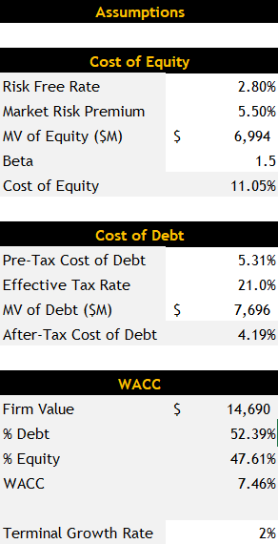
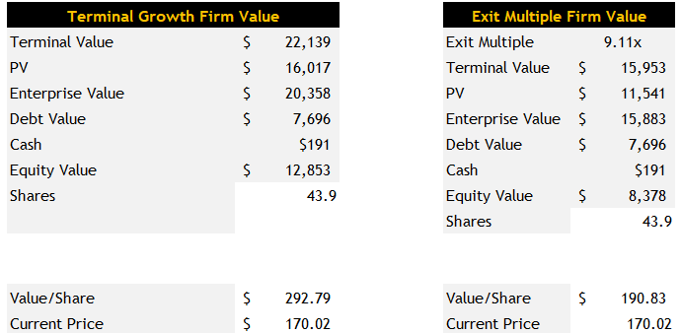
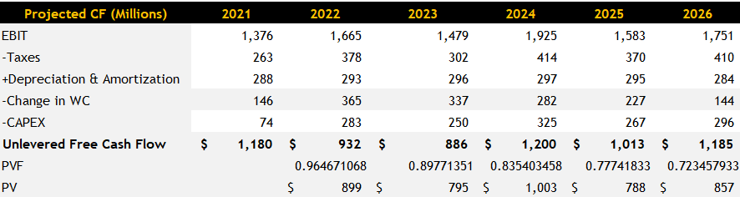
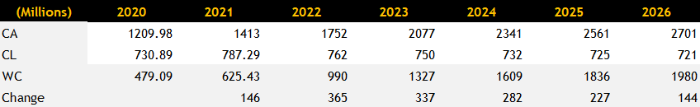
Valuation

Slide 9
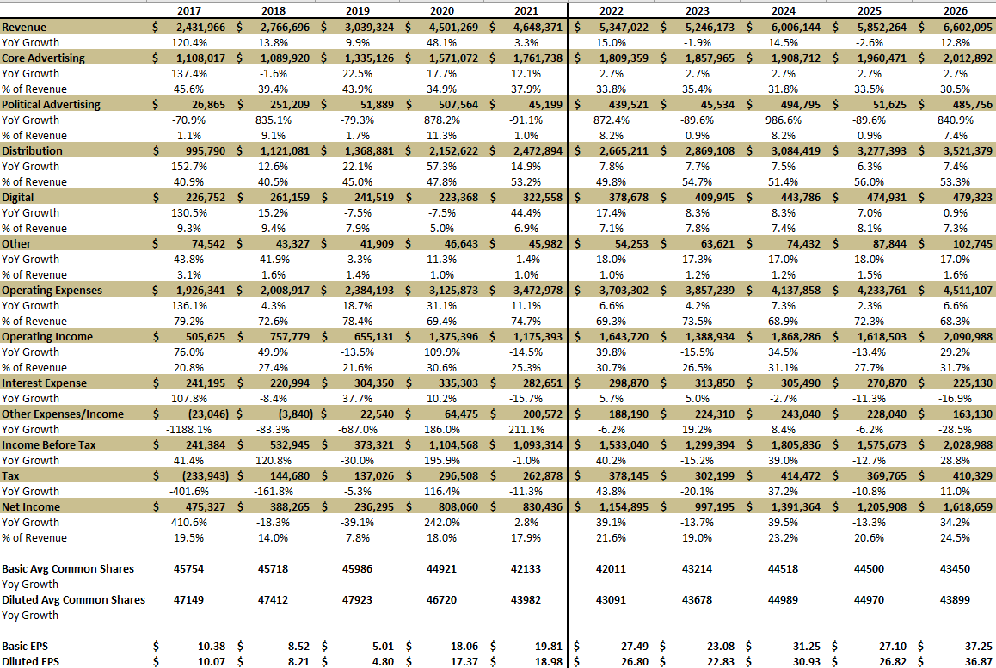
Appendix (Earnings Model)

Slide 10
Sources
https://tvnewscheck.com/business/article/nexstar-still-no-1-gray-scripps-allen-busy-buyers/
https://seekingalpha.com/symbol/NXST/peers/comparison
https://my.ibisworld.com/us/en/industry/51512/about
https://www.forbes.com/companies/nexstar-media-group/?sh=97bc3022a2bb
https://www.tvtechnology.com/news/2021-cyberattack-cost-sinclair-dollar63m-in-lost-ad-revenue
https://www.comscore.com/por/Insights/Blog/Reach-vs-Ratings-Bridging-the-Divide-Between-TV-and-Digital-Metrics
https://www.economicshelp.org/blog/glossary/duopoly/
https://en-academic.com/dic.nsf/enwiki/11670594
https://www.grandviewresearch.com/industry-analysis/broadcasting-and-cable-tv-market
https://www.justice.gov/atr/case/us-v-nexstar-media-group-inc-and-tribune-media-company
https://www.newsweek.com/ex-tv-anchor-files-age-discrimination-suit-against-nexstar-media-alleges-men-treated-better-1622678
https://www.nexstar.tv/sinclair-nexstar-settle-lawsuit/
https://www.cablefax.com/regulation/sinclair-nexstar-settle-lawsuit

