Slide 1


Nexstar Media Group, INC.
John Henry Davis III - JUNIOR ANALYST

Slide 2
Company Overview
Own, operate, and provide services to 199 full power television stations.
Major emphasis on local and national news, sporting events, and political events.
Relevancy, technological edge, leveraging localism through cable and streaming, elections.

Slide 3
Competitors and Industry
Leader in ATSC 3.0 “Next Gen TV”
Most affordable subscription options
Acquisition of high traffic media outlets

Slide 4
Competitors and Industry (continued)
 | P/E | FWD P/E | D/E | DY | DPR | ICR
Nexstar | 8.9 | 6.8 | 2.6x | 2.12% | 18.93% | 4.89
Gray TV | 50.3 | 5.38 | 2.8x | 1.72% | 33.97% | 1.63
Sinclair | N/A | 20.06 | 9.5x | 4.37% | 18.18% | 0.79
E.W. Scripps | 25.34 | 15.26 | 2.5x | N/A | N/A | 3.01
Fox Corp | 15.96 | 14.54 | 0.7x | 1.23% | 19.59% | 6.74
Tegna | 7.1 | 7.8 | 1.3x | 1.69% | 16.50% | 4.45
Industry | 9.83 | 24.99 | 1.4x | 1.73% | 15.80% | 4.26

Slide 5
Competitors and Industry (continued)
Major emphasis on expanding their streaming platform and digital media reach.
Greatly increased their market share after FCC regulation relaxation

Slide 6
Competitors and Industry (continued)
Involved in 116 of the 210 markets with one of the highest % of households covered
284 mobile apps
121 websites

Slide 7

Investment Risks
Cyber Security
Cable Subscription Decrease
Litigation

Slide 8
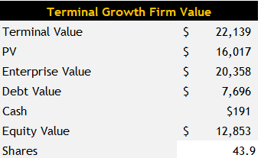
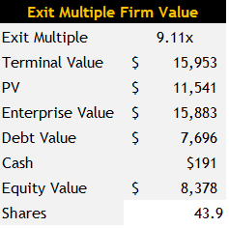



Valuation
Current Price: $165
Undervalued via DCF and PE multiple analysis

Slide 9
Investment Opportunity
Upcoming midterm and then general election.
Digital media has grown over 500% in active viewers in 2 years.
Acquisition of The Hill, Media General, and Tribune media.
The company offers lower prices than competition.

Slide 10
Investment Opportunity (Continued)
Growing streaming and mobile segments.
Market share expansion
Strong and sustainable revenues and growth.
Buy 53 shares

Slide 11
