Slide 1

Joshua Mbugua

Slide 2


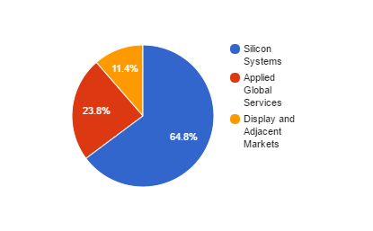
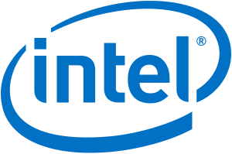

Company Overview
Founded on November 10th 1967 by Michael A. McNeilly in Santa Clara, CA
20.4% of market share
Largest U.S. based Semiconductor Machinery Manufacturer

Slide 3
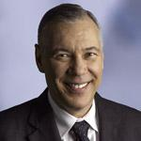
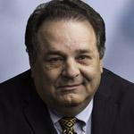
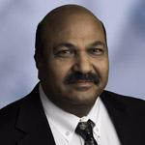
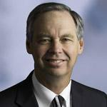
Management
CTO:
Dr. Omkaram Nalamasu
CFO:
Bob Halliday
CEO:
Gary Dickerson
Head of Engineering Operations and Quality:
Dr. Gino Addiego

Slide 4
Recent News
February 2016: Samsung OLED Displays
May 2016: TSMC Building 3 Billion Dollar Wafer Plant
October 2016: Samsung’s Note 7 is the BOMB
August 2016: Emerging Technologies bringing demand for semiconductors
July 2016: Semiconductor Capital Spending to reach 31B by 2019 (Gartner)

Slide 5
SWOT Analysis
Strengths
Exposure to strong companies
Research and Patents
OLED Machinery
Weaknesses
Large exposure to Semiconductors
Cyclical Revenues
Opportunities
Large exposure to Semiconductors
Internet Of Things:
Increases in Worldwide Corp IT Spending
Threats
Competition in Largest Segment
Exposure to Clients that all have exposure to certain markets
Slowing of Moore’s Law

Slide 6
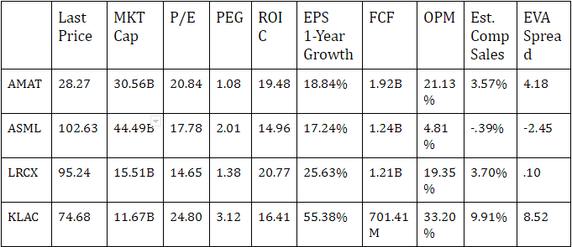
Competitors
AMAT has a ROE of 20.02% and a ROA of 10.55% which outperforms 86% of the competitors

Slide 7
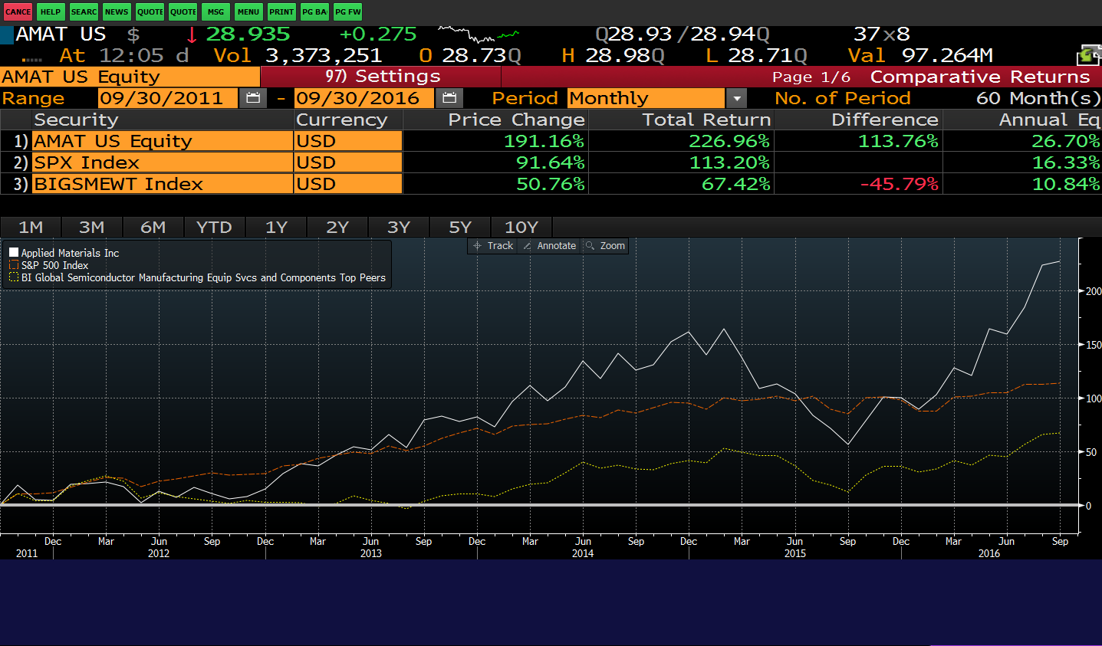
Growth Analysis
1.7B in OCF in 2016 (Reported in Q3) 22% of Sales
26% YOY order growth
Beat analysts sales expectations by $1B

Slide 8
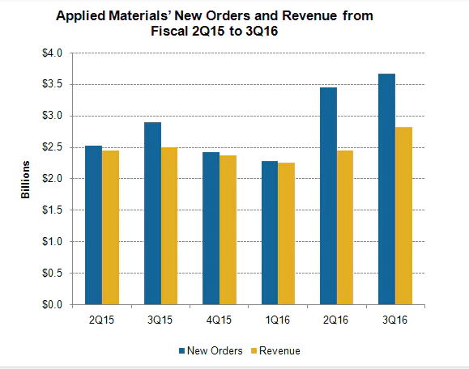
Growth Analysis (Cont.)

Slide 9
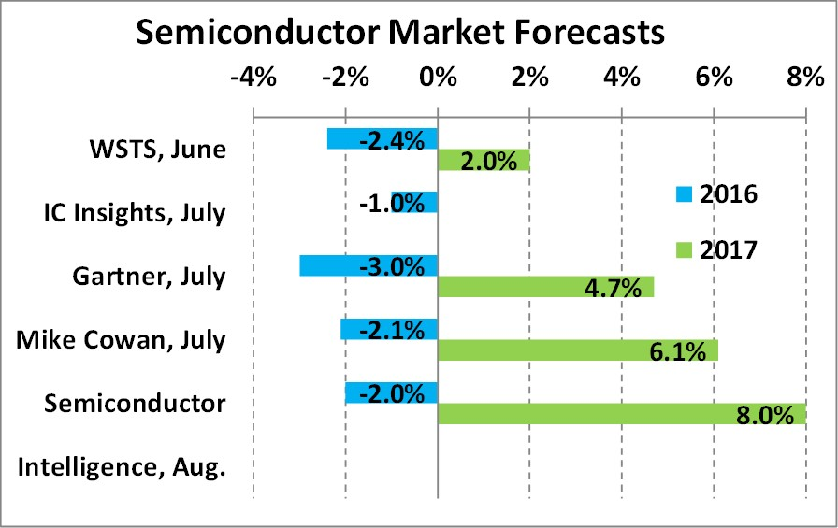
Growth Analysis: Silicon Systems 15% YoY Order Growth
Revenue highest 5 years, 31.1% highest level in 4 years
Guidance set at 80% YOY increase in Revenue
Consumer Electronics 4.4% CAGR (2014-2022)
Corporate IT spending 3.3% CAGR (2016-2020)
Driven by IOT and Emerging Technologies
Semiconductor CAPEX to grow at 9% CAGR (2015-2019)

Slide 10
Growth Analysis: Global Applied Services 9% Order Growth YOY
Record Level Revenue reached of 657M
23.8% of Revenues
Dependent on clientele’s need for services
Supplemental to Silicon systems Segment
Segment can still realize growth of Silicon Systems is lagging.

Slide 11
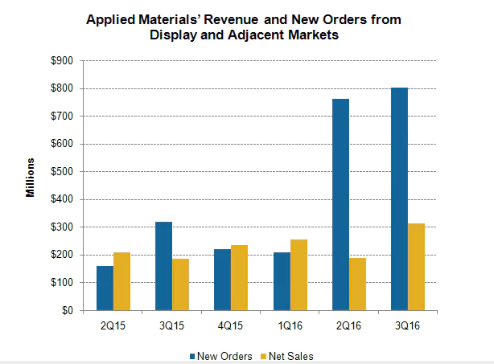
Growth Analysis: Display and Adjacent 153% YoY Revenue
Orders totalling in $852M, Half of these orders coming from China
Operating Margin - 20.1%
VR technology dependent on OLED
New Order growth at 483%
Few companies in OLED space
UBS expects 15 cent increase in EPS from Apple demand

Slide 12
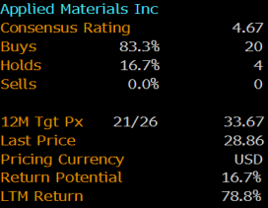

Valuation
Analysts have a median 1YR price target of $33.67
$45.18 PT through the P/E multiple method

Slide 13
Investment Thesis: Buy Price Target of $40
200 Shares @ 27.50 Total Value of $27.50
Porfolio Weight: 3.42%
Ramping down its languishing Solar Equipment Business
Provides machinery to the largest semiconductor manufacturers
Applied Materials is positioned to take advantage of big tech shift
Expecting increased sales due to impending OLED demand
Focused on the future, 1.5B in R&D, Increasing margins

Slide 14
Questions?

