Slide 1
CSE1300
Introduction to Web Development
Notes:
Introduce yourself and welcome the students

Slide 2
Introduction
﻿Web development refers to the building, creating, and maintaining of websites. It includes aspects such as web design, web publishing, web programming, and database management.
﻿﻿It is the creation of an application that works over the internet i.e. websites.
﻿﻿The term development is usually reserved for the actual construction of these things (that is to say, the programming of sites). The basic tools involved are programming languages called HTML (Hypertext Markup Language), CSS (Cascading Style Sheets), and JavaScript.

Slide 3
Classification
Web Development can be classified into two ways:
﻿﻿Frontend Development: The part of a website that the user interacts directly is termed as front end. It is also referred to as the 'client side' of the application.
﻿﻿Backend Development: Backend is the server side of a website. It is the part of the website that users cannot see and interact. It is the portion of software that does not come in direct contact with the users. It is used to store and arrange data.

Slide 4
Frontend Roadmap
﻿HTML: HTML stands for HyperText Markup Language. It is used to design the frontend portion of web pages using markup language. It acts as a skeleton for a website since it is used to make the structure of a website.
﻿﻿CSS: Cascading Style Sheets fondly referred to as CSS is a simply designed language intended to simplify the process of making web pages presentable. It is used to style our website.
﻿﻿JavaScript: JavaScript is a scripting language used to provide a dynamic behavior to our website

Slide 5
Frontend
﻿Bootstrap: Bootstrap is a free and open-source tool collection for creating responsive websites and web applications.
It is the most popular CSS framework for developing responsive, mobile-first websites. Nowadays, the websites are perfect for all the browsers (IE, Firefox, and Chrome) and for all sizes of screens (Desktop, Tablets, Phablets, and Phones).
﻿﻿Bootstrap 4
﻿﻿Bootstrap 5

Slide 6
Backend Roadmap
﻿PHP: PHP is a server-side scripting language designed specifically for web development.
﻿﻿Java: Java is one of the most popular and widely used programming language. It is highly scalable.
﻿﻿Python: Python is a programming language that lets you work quickly and integrate systems more efficiently.
﻿﻿Node.js: Nodejs is an open source and platform runtime environment for executing
JavaScript

Slide 7
What is HTML?
HTML stands for Hyper Text Markup Language
HTML is the standard markup language for creating Web pages
HTML describes the structure of a Web page
HTML consists of a series of elements
HTML elements tell the browser how to display the content
HTML elements label pieces of content such as "this is a heading", "this is a paragraph", "this is a link", etc.

Slide 8
Example
<!DOCTYPE html>
<html>
<head>
<title>Page Title</title>
</head>
<body>
<h1>My First Heading</h1>
<p>My first paragraph.</p>
</body>
</html>

Slide 9
Example Explained
The <!DOCTYPE html> declaration defines that this document is an HTML5 document
The <html> element is the root element of an HTML page
The <head> element contains meta information about the HTML page
The <title> element specifies a title for the HTML page (which is shown in the browser's title bar or in the page's tab)
The <body> element defines the document's body, and is a container for all the visible contents, such as headings, paragraphs, images, hyperlinks, tables, lists, etc.
The <h1> element defines a large heading
The <p> element defines a paragraph

Slide 10
What is an HTML Element?
An HTML element is defined by a start tag, some content, and an end tag:
<tagname> Content goes here... </tagname>
The HTML element is everything from the start tag to the end tag:
<h1>My First Heading</h1>
<p>My first paragraph.</p>

Slide 11
HTML Documents
All HTML documents must start with a document type declaration: <!DOCTYPE html>.
The HTML document itself begins with <html> and ends with </html>.
The visible part of the HTML document is between <body> and </body>.
<!DOCTYPE html>
<html>
<body>
<h1>My First Heading</h1>
<p>My first paragraph.</p>
</body>
</html>

Slide 12
The <!DOCTYPE> Declaration
The <!DOCTYPE> declaration represents the document type, and helps browsers to display web pages correctly.
It must only appear once, at the top of the page (before any HTML tags).
The <!DOCTYPE> declaration is not case sensitive.
The <!DOCTYPE> declaration for HTML5 is:
<!DOCTYPE html>

Slide 13
HTML Headings
HTML headings are defined with the <h1> to <h6> tags.
<h1> defines the most important heading. <h6> defines the least important heading:
<h1>This is heading 1</h1>
<h2>This is heading 2</h2>
<h3>This is heading 3</h3>

Slide 14
HTML Paragraphs
HTML paragraphs are defined with the <p> tag:
<p>This is a paragraph.</p>
<p>This is another paragraph.</p>

Slide 15
HTML Links
HTML links are defined with the <a> tag:
<a href="https://www.w3schools.com">This is a link</a>
The link's destination is specified in the href attribute.
Attributes are used to provide additional information about HTML elements, which is advanced HTML.

Slide 16
HTML Images
HTML images are defined with the <img> tag.
The source file (src), alternative text (alt), width, and height are provided as attributes:
<img src="w3schools.jpg" alt="W3Schools.com" width="104" height="142">

Slide 17
What is CSS?
CSS stands for Cascading Style Sheets
CSS describes how HTML elements are to be displayed on screen, paper, or in other media
CSS saves a lot of work. It can control the layout of multiple web pages all at once
External stylesheets are stored in CSS files

Slide 18
Why Use CSS?
CSS is used to define styles for your web pages, including the design, layout and variations in display for different devices and screen sizes.
body {
background-color: lightblue;
}
h1 {
color: white;
text-align: center;
}
p {
font-family: verdana;
font-size: 20px;
}

Slide 19
CSS Solved a Big Problem
HTML was NEVER intended to contain tags for formatting a web page!
HTML was created to describe the content of a web page, like:
<h1>This is a heading</h1>
<p>This is a paragraph.</p>
When tags like <font>, and color attributes were added to the HTML 3.2 specification, it started a nightmare for web developers. Development of large websites, where fonts and color information were added to every single page, became a long and expensive process.
To solve this problem, the World Wide Web Consortium (W3C) created CSS.
CSS removed the style formatting from the HTML page!

Slide 20
CSS Saves a Lot of Work!
The style definitions are normally saved in external .css files.
With an external stylesheet file, you can change the look of an entire website by changing just one file!

Slide 21
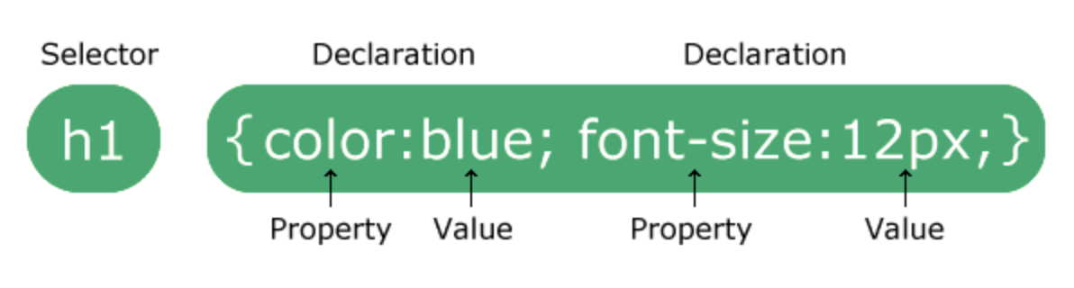
CSS Syntax
A CSS rule consists of a selector and a declaration block.
The selector points to the HTML element you want to style.
The declaration block contains one or more declarations separated by semicolons.
Each declaration includes a CSS property name and a value, separated by a colon.
Multiple CSS declarations are separated with semicolons, and declaration blocks are surrounded by curly braces.

Slide 22
Example
In this example all <p> elements will be center-aligned, with a red text color:
p {
color: red;
text-align: center;
}
p is a selector in CSS (it points to the HTML element you want to style: <p>).
color is a property, and red is the property value
text-align is a property, and center is the property value

Slide 23
What is JavaScript?
JavaScript is the programming language of the web.
It can update and change both HTML and CSS.
It can calculate, manipulate and validate data.

Slide 24
JavaScript Can Change HTML Content
One of many JavaScript HTML methods is getElementById().
The example below "finds" an HTML element (with id="demo"), and changes the element content (innerHTML) to "Hello JavaScript":
document.getElementById("demo").innerHTML = "Hello JavaScript";
JavaScript accepts both double and single quotes:
document.getElementById('demo').innerHTML = 'Hello JavaScript';

Slide 25
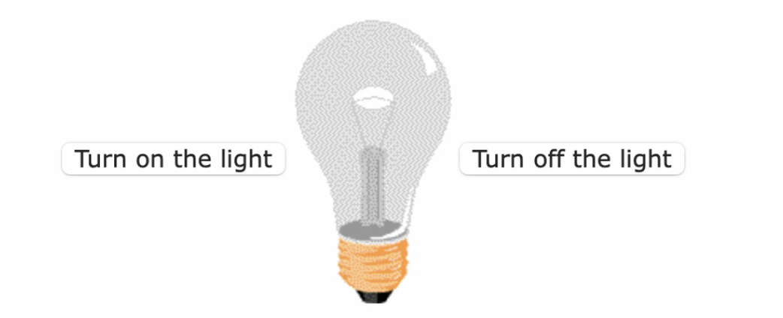
JavaScript Can Change HTML Attribute Values
In this example JavaScript changes the value of the src (source) attribute of an <img> tag: (play the video)

Slide 26
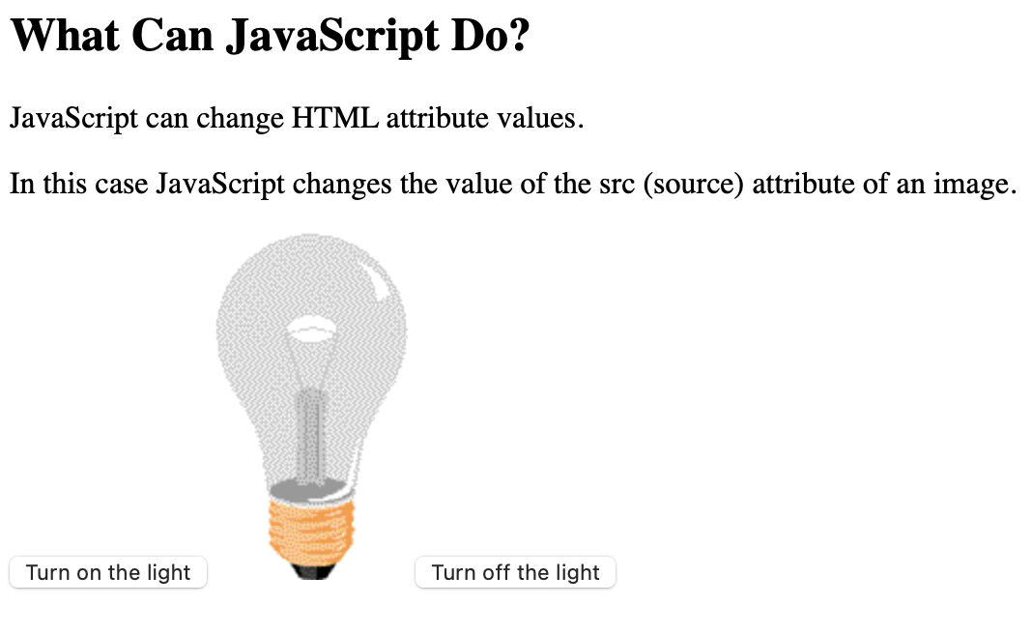
The code can look just as simple
<!DOCTYPE html>
<html>
<body>
<h2>What Can JavaScript Do?</h2>
<p>JavaScript can change HTML attribute values.</p>
<p>In this case JavaScript changes the value of the src (source) attribute of an image.</p>
<button onclick="document.getElementById('myImage').src='pic_bulbon.gif'">Turn on the light</button>
<img id="myImage" src="pic_bulboff.gif" style="width:100px">
<button onclick="document.getElementById('myImage').src='pic_bulboff.gif'">Turn off the light</button>
</body>
</html>

Slide 27
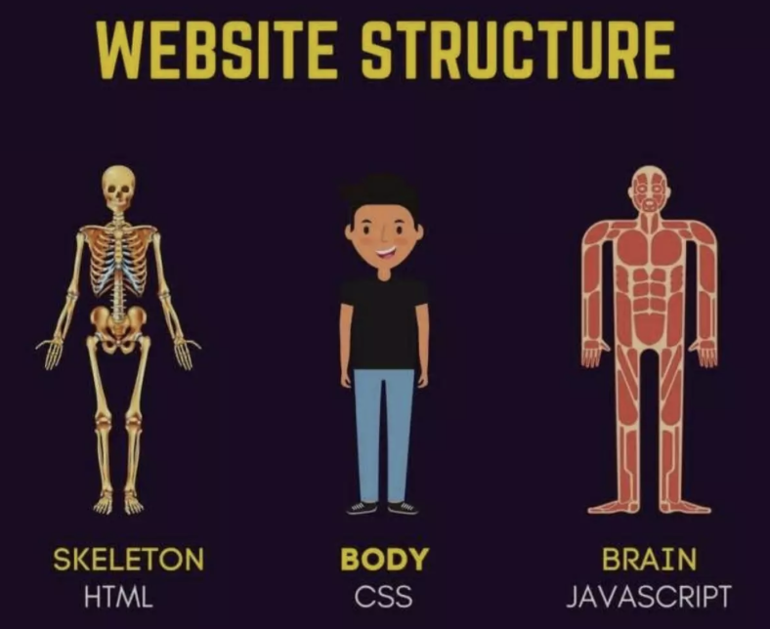
Website structure

Slide 28
What is Web Hosting?
﻿Web Site - Consists of files and programs that can be accessed through the Internet.
﻿﻿Web Server - A computer that retains information for a web site that allows others to view.
Web Host - A company that maintains servers that allow users to put their web sites on the Internet.
A Web host is like a Landlord

Slide 29
Why have a web host?
WEBSITES
The small face of your business
The only way to establish a prominent online presence in the digital world and up your sales, is to have website.
NOT HAVING A WEBSITE IS EQUAL TO BECOMING EXTINCT IN THE ONLINE WORLD
Few benefits of having a website :
﻿﻿Establishing Business identity
﻿Greater Lead Generation
﻿Wider Business Reach

Slide 30
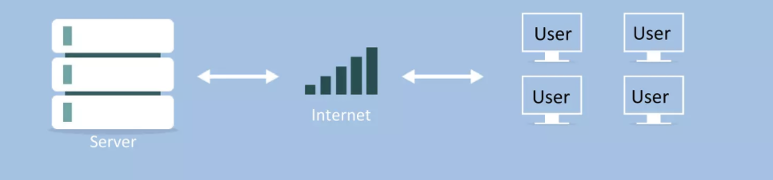
HOW DOES HOSTING HELPS?
﻿﻿
Makes Website easily accessible
﻿﻿Runs Website efficiently

Slide 31
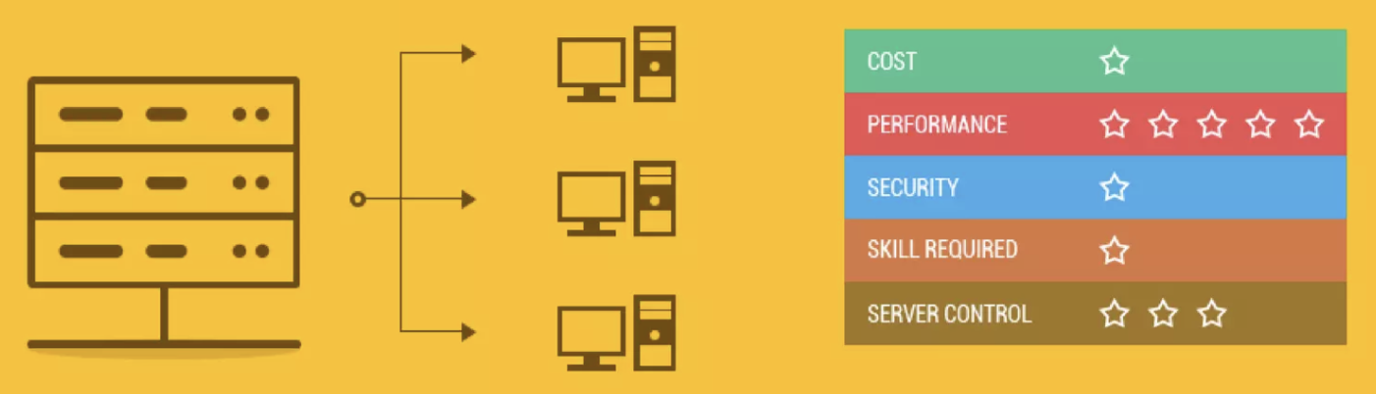
Types of Hosting
SHARED HOSTING - One's website is placed on the same server as many other sites, ranging from a few to hundreds or thousands. Typically, all domains may share a common pool of server resources, such as RAM and the CPU. It is not only the most popular, but also the most affordable web hosting plan.

Slide 32
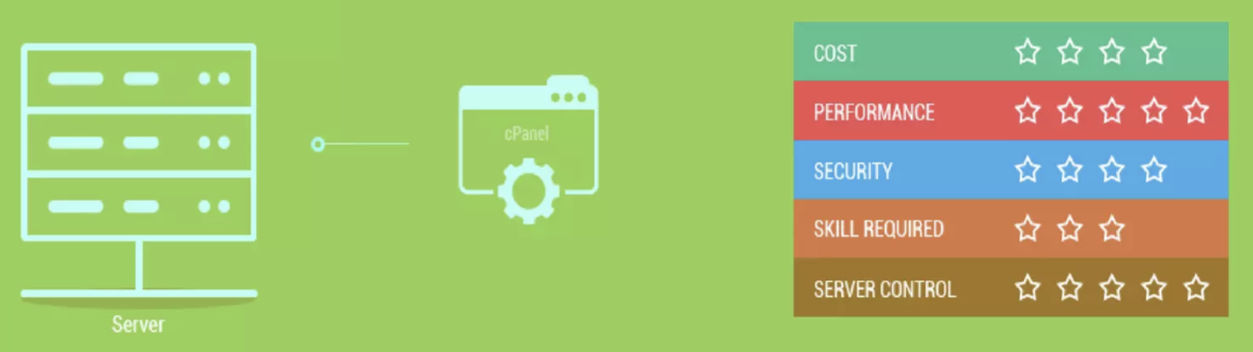
Types of Hosting continued
DEDICATED HOSTING - The user gets his or her own Web server and gains full control over it (user has root access for Linux/administrator access for Windows); however, the user typically does not own the server. It is best suited for websites that require higher server performance, security and control.

Slide 33
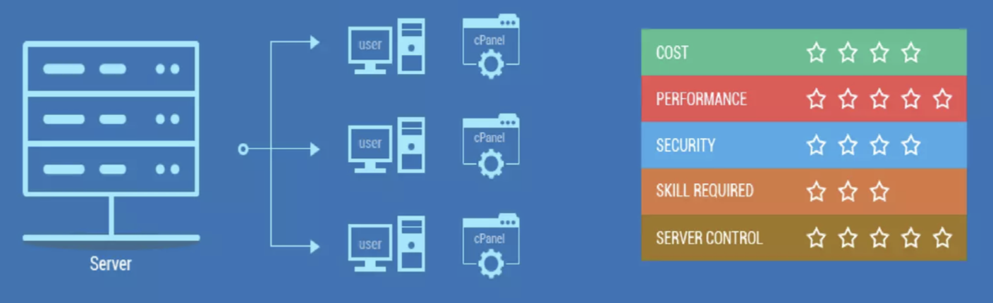
Types of Hosting cont.
VPS HOSTING - In this hosting plan, a server is divided into multiple virtual units and each unit acts as a dedicated server that hosts only one website.

Slide 34
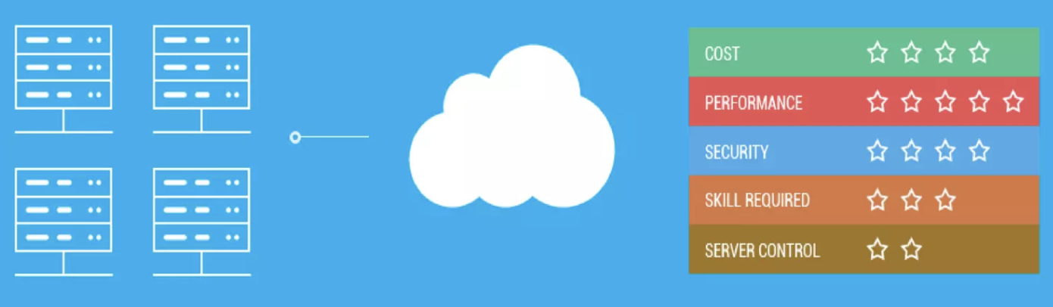
Types of Hosting cont…
CLOUD HOSTING - This is a new type of hosting platform that allows customers powerful, scalable and reliable hosting based on clustered load-balanced servers and utility billing. A cloud hosted website may be more reliable than alternatives since other computers in the cloud can compensate when a single piece of hardware goes down.

Slide 35
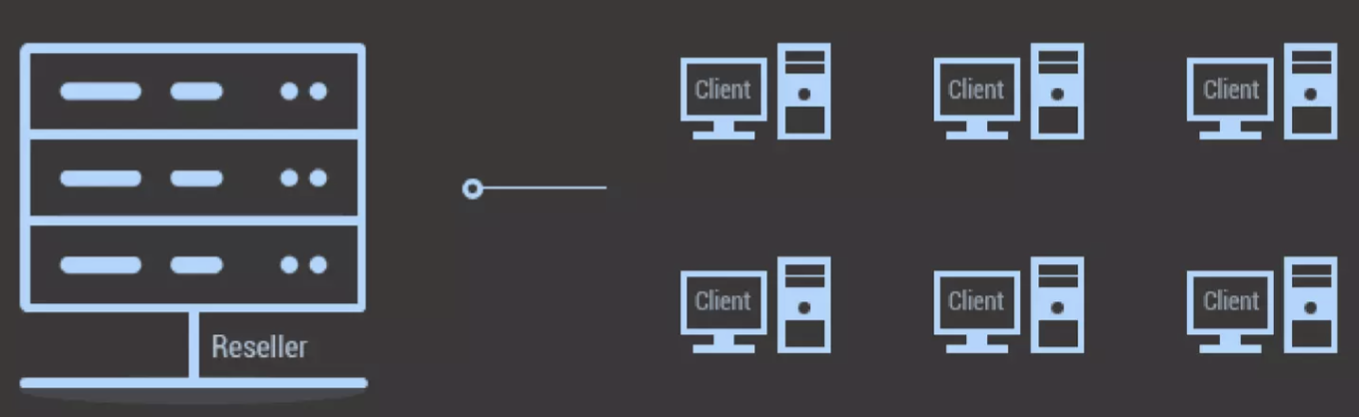
Types of Hosting cont..
RESELLER HOSTING - This hosting plan, allows clients to become web hosts themselves. Resellers could function, for individual domains, under any combination of these listed types of hosting, depending on who they are affiliated with as a reseller.

Slide 36
DOES IT PROVIDE ENOUGH DISK SPACE?
On an average, a website doesn't need anything more than 1GB of disk space. Don't fall for the 'unlimited' trap when it comes to disk space.
Opt a web host that is transparent about their resource allocation.

Slide 37
DO THEY HAVE 24/7 TECHNICAL
SUPPORT?
A website has dozens of programs and extensions running in the background; a technical glitch can arise anytime. To ensure your website doesn't break down and suffer bounce offs, choose a web host that offers 24/7 prompt technical support.

Slide 38
WHAT HARDWARE ARE THEY USING?
Always enquire about the hardware being used by web hosts to provide you services. Hardware has a direct impact on the efficiency of your website. Don't go for hosts hesitant on giving out details.

Slide 39
IS THEIR USER INTERFACE FOR YOU?
Before you sign up for any hosting plan, go for a free trial to test if the user interface and control panels fulfill your needs; you don't want to be switching hosts later.

Slide 40
DOES IT OFFER EMAIL?
Ensure that your web host offers emailing features like smart inbox, auto responders, etc. This helps you make your website fully interactive.

Slide 41
CAN IT FLEX?
Your website resource needs might change with time and your plan should be able to cater to them. Look for a web host that lets you scale resources up or down easily; or upgrade from one hosting plan to another. Changing hosts isn't a good idea as your website could incur content loss and will be at the risk of being hacked.

Slide 42
HOW MUCH DOES IT COST?
One of the prime factors that affect your hosting decision is the pricing. Web hosts may charge you according to the resources your website utilizes or the plan you sign up for, on a periodic basis. Spend some time to research and compare hosting plans offered by different web hosts, and pick the one that suits your hosting budget.

Slide 43
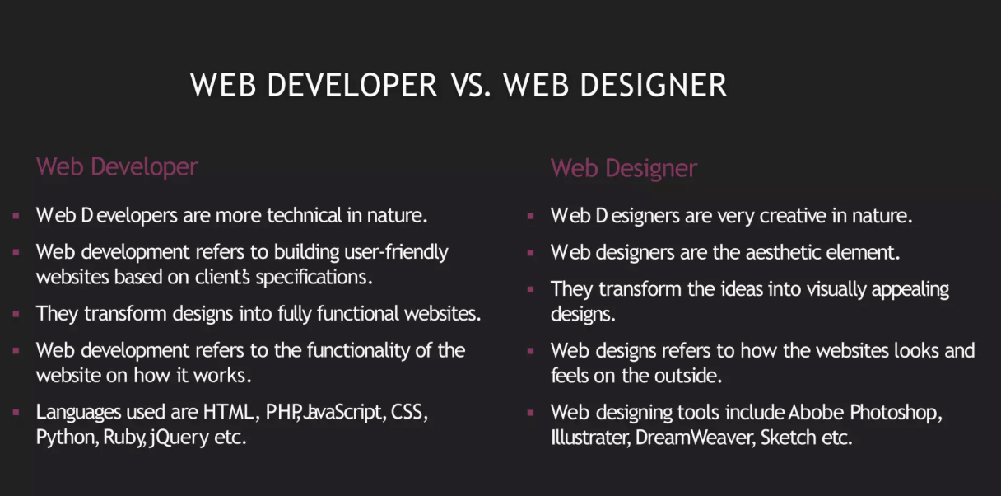
Difference between Web Developer Vs Web Designer

Slide 44
What is Ul?
﻿User Interface
﻿﻿How people interact with other products / services
﻿﻿Used in Web & Mobile Applications
﻿﻿A bridge between a human being and a system

Slide 45
What is UX?
﻿User Experience
﻿﻿What a person feels as they experience a product or service
Important role in all kinds of marketing
﻿﻿Plays a crucial role in web & Mobile Applications
﻿﻿Bridge between a product and its targeted audience

Slide 46
Design
﻿A unique Design is present in all things, whether they are natural or man-made, and a good design always attracts the eye.
﻿﻿The smallest of the smallest things in your life and the largest of the large, are all designed in some way.
﻿﻿Many forms of Designing
﻿﻿Web & Mobile UX-Ul
Desig

Slide 47
Designing for Purpose
﻿Today's age is more tuned to designing for a purpose
﻿﻿UX-Ul Design is prime example of Designing for purpose
﻿﻿Our purpose is to make things functional look good.
﻿﻿Evolution from Skeuomorphic design to Flat Design

Slide 48
Skeuomorphic Design
A derivative object that retains ornamental design cues to a structure that was necessary in the original, even when not functionally necessary.
﻿﻿In terms of user interface, this means applications that are designed to have elements of them that look or behave like their real-world counter-parts. For example turning a digital page to resemble the experience of reading a physical book.
﻿﻿Skeuomorphic interfaces feel instantly familiar
﻿﻿Visually rich and engaging
﻿﻿Demonstrates attention to detail
﻿﻿Designers love any excuse to use textures
Example :﻿﻿http://www.cheeseandburger.com

Slide 49
Flat Design
﻿Flat design is a minimalistic design approach that emphasizes usability. It features clean, open space, crisp edges, bright colours and two-
﻿﻿In flat design, ornamental elements are viewed as unnecessary clutter. If an aspect serves no functional purpose, it's a distraction from user experience. This is the reason for the minimalistic nature of flat design.
﻿﻿White space has meaning
﻿﻿Flat design reverts back to the basics of design as a functional tool. A website is designed and judged by how well it works, as opposed to what it looks like.
Example: http://news.microsoft.com/stories/invisible-revolution/?ref=webdesignernews.co

Slide 50
Material Design
﻿Goal: Create a visual language that synthesizes classic principles of good design with the innovation and possibility of technology and science.
﻿﻿Google states that their new design language is based on paper and ink
﻿﻿The material environment is a 3D space, which means all objects have x, y, and z dimensions.
﻿﻿Within the material environment, virtual lights illuminate the scene. Key lights create directional shadows, while ambient light creates soft shadows from all angles.
﻿﻿Material casts shadows. It has motion.
﻿﻿http://material.cmiscm.com

Slide 51
UX-Ul beyond Web & Apps
﻿Design centred approach has become prime focus for any technology driven company, because a good design solves problems - Fights crime!
﻿﻿As the trend continues more and more industries are opting for design centred approaches for better handling of customers and maintaining higher standards of service.
﻿﻿A good design is invisible. Even two year olds can handle it

Slide 52
Future of Design
﻿Design transforms based on the age of a user
﻿﻿Watches, Glasses, Driverless Cars, Voice Activated Devices
﻿﻿Emergence of Artificial
Intelligence
﻿﻿Foldable displays, Holographic
Displays, Skin displays

Slide 53
Conclusion
﻿In today's Web development, a good page design is essential. A bad design will lead to the loss of visitors and that can lead to a loss of business. In general, a good page layout has to satisfy the basic elements of a good page design.
﻿This includes color contrast, text organization, font selection, style of a page, page size, graphics used, and consistency. In order to create a well-designed page for a specific audience.

