Slide 1
Module 8
Part 3
Trees and Graphs

Slide 2
Non-Linear data structures
2 primary types:
Trees
Graphs
All trees are graphs, but not all graphs are trees
Recursion is useful and is the easiest way to process them. It helps keep track of what's been processed and what remain

Slide 3
Trees
Single parent
0 or more children
A node with no children is called a "leaf"
The topmost node is called the "root"
N-ary trees
Binary trees

Slide 4
N-ary Trees
The best example of an n-ary tree is your computer’s directory system. It has a single starting point and then 0 or more branches.

Slide 5
Binary Search Trees
Binary search trees allow for fast insertion and removal of elements
They are specially designed for fast searching
A binary tree consists of two nodes, each of which has two child nodes
All nodes in a binary search tree fulfill the property that:
Descendants to the left have smaller data values than the node data value
Descendants to the right have larger data values than the node data value

Slide 6
BST Tree Nodes
This is important and is worthy of being repeated:
All nodes in a binary search tree fulfill the property that:
Descendants to the left have smaller data values than the node data value
Descendants to the right have larger data values than the node data value

Slide 7
Build the Tree
Insert the following data into a BST that has a root node of 15:
25, 8, 4, 10, 30, 20, 6, 2, 12, 17, 36, 24, 9, 28
15
8 25
4 10 20 30
2 6 9 12 17 24 28 36

Slide 8
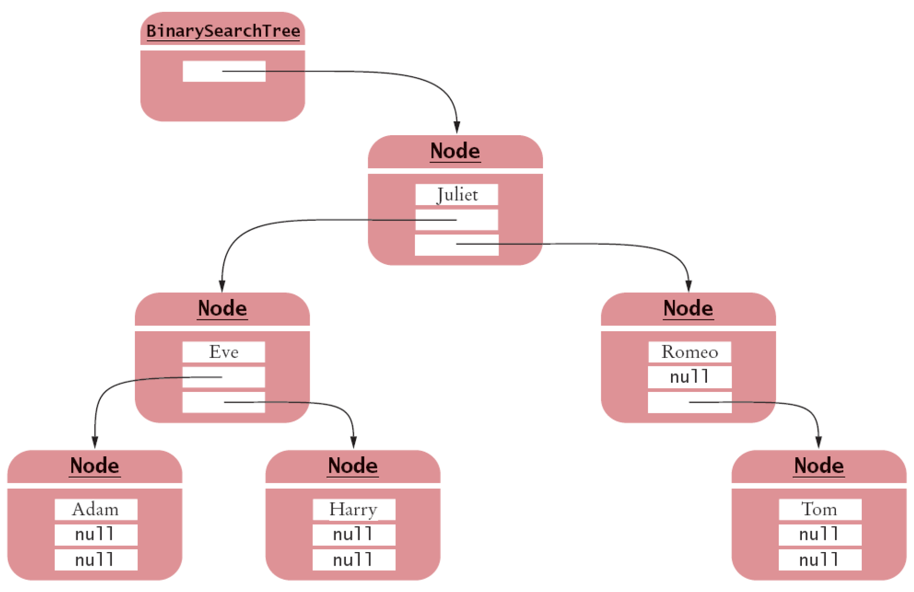
A BST

Slide 9
BST
Balanced tree: each node has approximately as many descendants on the left as on the right
If a binary search tree is balanced, then adding an element takes O(log(n)) time
If the tree is unbalanced, insertion can be slow
Perhaps as slow as insertion into a linked list

Slide 10
Tree Traversal
Tree traversal schemes include
Preorder traversal –generates prefix order for expression tree
Inorder traversal – generates the data in sorted order
Postorder traversal – useful for deleting nodes from the tree
These are depth first processes. You will encounter other processes in data structures.

Slide 11
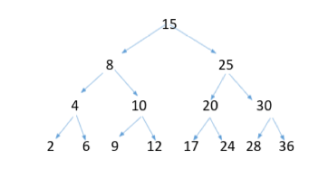
Tree Traversal
Using L for the left child, R for the right child and P for Print
Preorder traversal is P L R
Inorder traversal is L P R
Postorder traversal is L R P
Inorder: 2, 4, 6, 8, 9, 10, 12, 15, 17, 20, 24, 25, 28, 30, 36
PreOrder: 15, 8, 4, 2, 6, 10, 9, 12, 25, 20, 17, 24, 30, 28, 36
PostOrder: 2, 6, 4, 9, 12, 10, 8, 17, 24, 20, 28, 36, 30, 25, 15

Slide 12
Recursive Processing Example
void PrintTree(Node current) {
if (current != null) {
PRINT(current.data);
PrintTree(current.left);
PrintTree(current.right);
}
}

Slide 13
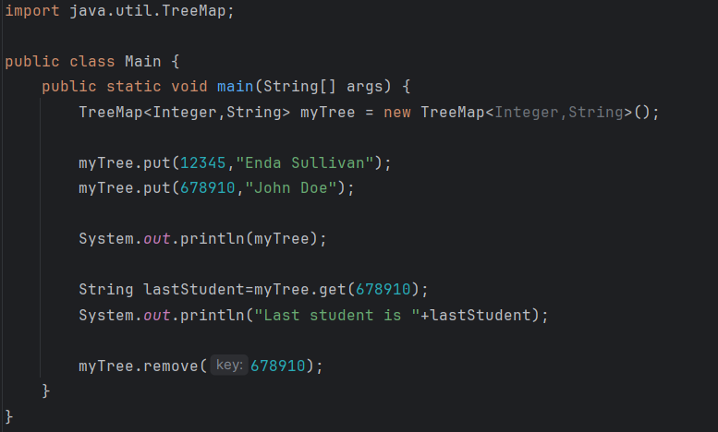
In Java
A built in implementation of a Binary Search Tree in Java is TreeMap:

Slide 14
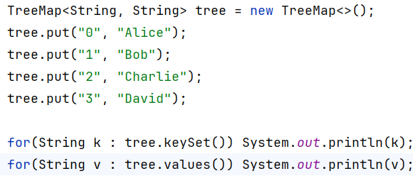
Iterating a Tree using a foreach

Slide 15
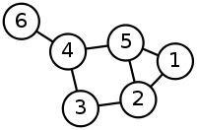
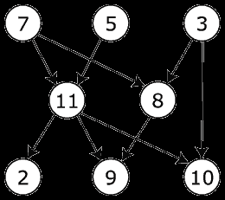
Graphs
Graphs can have multiple references in and multiple references out (whereas tree node only has one reference in)
Graphs can be directed or undirected and cyclic or acyclic

Slide 16
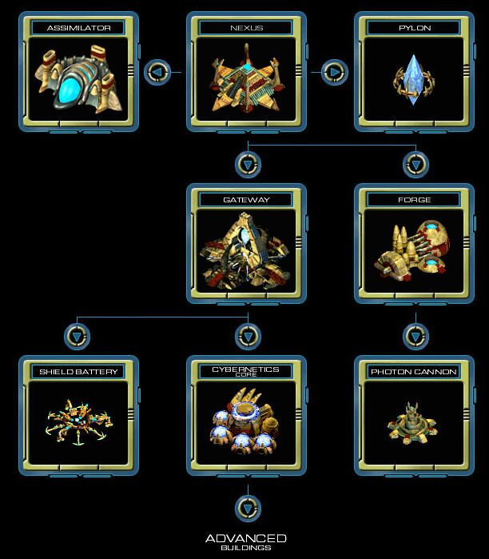
Tree

Slide 17
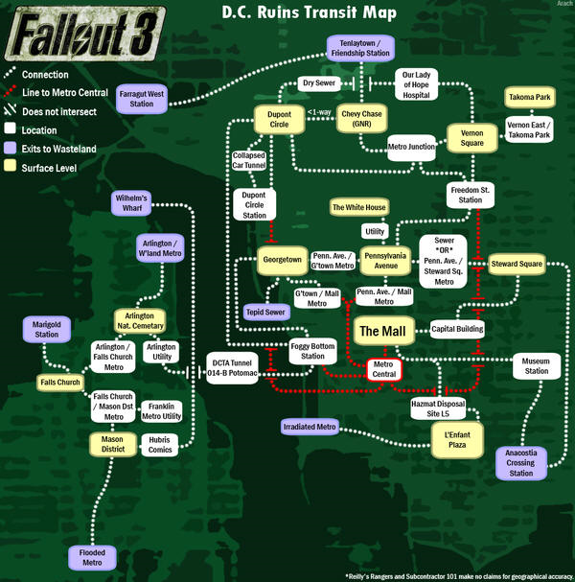
Graph

