Slide 1
Module 8
Part 1
Linked Lists
Doubly Linked Lists

Slide 2
Linked Lists
Dynamic data structures can grow and shrink at execution time.
A linked list is a linear collection (i.e., a sequence) of nodes, connected by reference links (“chained together”).
It can be singly or doubly linked
A linked list is appropriate when the number of data elements is unpredictable.
Linked lists become full only when the system has insufficient memory.

Slide 3
Java has a built in list
import java.util.LinkedList;
Now you can make a linked list, just like you make an ArrayList:
LinkedList<String> myList = new LinkedList<String>();
You can insert items or delete items with:
myList.addFirst(“CSE1322”);
myList.addLast(“CSE1322”);
myList.removeFirst();
You can retrieve items from the list with:
myList.getFirst();
myList.getLast();
myList.get(3); //Returns the 4th element

Slide 4
Comparison to an ArrayList
Linked List and ArrayList share many attributes:
They are generic (ie, the type of the list is determined when you create it. You put the type in the <>’s)
They dynamically grow as you add items
They also differ in some key ways:
While you can access items in both with a .get method, it’s much faster to access items in an arrayList than a LinkedList.
This is because ArrayLists are based on Arrays, and accessing a cell in an array is considered O(1). LinkedLists, require O(N) to access an item that is not the first or last.
ArrayLists grow in blocks. Initially they have 10 cells, when you insert the 11th item, it grows the underlying array by 1.5x or 2x. By comparison LinkedLists simply add 1 more node.
As such LinkedList are more efficient when it comes to memory usage.

Slide 5
Use the built in class
If you wish to use a LinkedList, you should use the built in Java LinkedList class.
However, it is important to understand how a linked list works, thus we are going to show you how they are created, and how they work.
For the purposes of this class, you are required to know how to use the built in class, and you must understand how a linked list works, but you do not need to memorize the implementation of a linked list.

Slide 6
Nodes
A self-referential class contains a member that refers to an object of the same class type.
In the class declaration Next references an object of type Node, an object of the same type being declared.
Next is referred to as a link.
class Node{
public String data;
public Node next ;
}

Slide 7

A Linked List
A linked list can be thought of as a chain of linked nodes.
A node is an object with at least two attributes:
data
the location of the next node in the chain
A backslash indicates a null link.
Not setting the link in the last node of a list to null is a logic error.

Slide 8
Common tasks include:
Inserting to the front
Inserting to the end
Inserting in between the front/end
Deleting
Searching
Sorting
Each of these tasks takes different amounts of time depending upon how the linked list is implemented

Slide 9

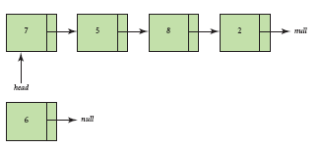
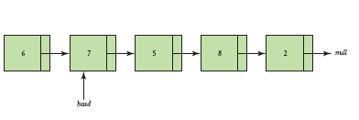
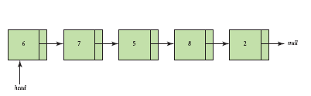
The insert at front Method
The original list:
The new node is
instantiated:
The new node is
attached to the
beginning of the list:
head now points to
the new node:

Slide 10
The insert at front method does:
Instantiate a new node containing the int to be inserted.
In the new node, change the next link to point to the same place as the lists head.
Change the head to point to the new node.

Slide 11
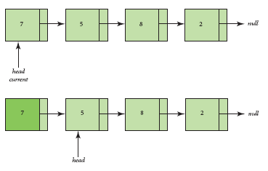
Deleting an Item That is the Head
The list before deleting
the item whose value
is 7:
The link from the first
node becomes the
new head:

Slide 12
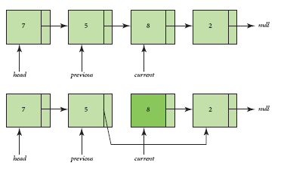
Deleting an Item That is Not the Head
The list before
deleting the item
with the value 8:
The previous node
is connected to the
node after current:

Slide 13
The delete Method
Three scenarios:
The item is found and is the head of the list.
The item is found and is not the head of the list.
The item is not found, and therefore, cannot be deleted.
To find the node to delete, we iterate through the list. We stop on the node before the one we wish to remove.
We update that nodes next link to the node after it.

Slide 14
A linked list of ints
public class LinkListClass { private Node first;
class Node { public int num; public Node next; } public LinkListClass() { first=null; }
public void addNode(int n) {
Node newNode = new Node();
newNode.num=n;
newNode.next=first;
first=newNode;
}
}

Slide 15
A linked list of ints -- add back
public void addBack(int n) { Node temp= new Node(); temp.num=n;
temp.next=null;
if(first==null) {
first=temp;
}
else { Node current = first; while(current.next!=null) { current=current.next; }
current.next=temp;
}
}

Slide 16
A linked list of ints -- remove
public void remove(int n) {
Node curr=first; Node prev=curr; if(curr.num==(n)) { first=curr.next; return; } while(curr.num!=(n)) { prev=curr; curr=curr.next; if(curr==null) { return; } } prev.next=curr.next; }
}

Slide 17
A linked list of ints -- display
public String display() {
Node current= first; String data= ""; while(current.next!=null) { data+=" "+current.num+" --> " ; current=current.next; } data+=" "+current.num+" --> " ; return data; }

Slide 18
Challenge
Write a method that sums up all of the numbers held within a linked list and returns the sum

Slide 19
Solution
double Sum(Node current) //Recursive Solution
{
if (current == null)
return 0;
else
return current.Data + Sum(current.Next);
}
double Sum(Node current) //Iterative Solution
{
int s = 0;
while (current != null) {
s += current.Data;
current = current.Next;
}
return s;
}

Slide 20
Challenge
Write a recursive method that adds 10 to the data in each node of a linked list.

Slide 21
Challenge Solution
Write a recursive method that adds 10 to the data in each node of a linked list.
void AddTen(Node n)
{
if (n != null)
{
n.Data += 10;
AddTen(n.Next);
}
}

Slide 22
Doubly Linked List
Each node has two links: one forward (as before) and one backward.
The Node class now has an additional instance variable:
previous, the previous Node.
Thus, we can traverse a doubly linked list either forward or backwards.
Every time we insert or delete, both links must be updated.

Slide 23

Doubly Linked Node
A doubly linked node looks like this
The right arrow represents next.
The left arrow represents previous.

Slide 24
Inserting into a Doubly Linked List
There are three cases:
insert at the beginning.
insert in the middle.
insert at the end.
Updating the links will differ in the three cases above.
Furthermore, when a node is inserted at the beginning, head needs to be updated.

Slide 25
Inserting in the Middle
In order to insert a node before a node named current, the following steps need to be performed:
Instantiate a new node.
Set two forward links: new node to current, node before current to new node.
Set two backward links: current to new node, new node to node before current.
Update the number of items.
Updating the links will differ in the three cases above.

Slide 26
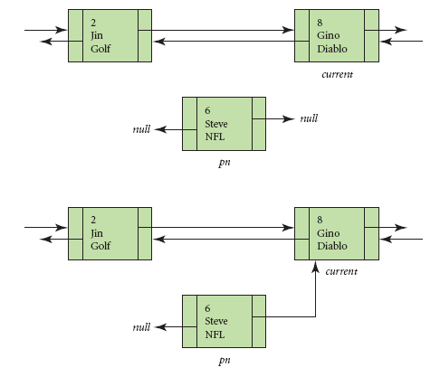
Inserting into a Doubly Linked List
1. Instantiate the new node
2. Set next in new node to current.

Slide 27
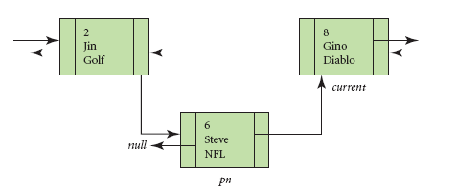
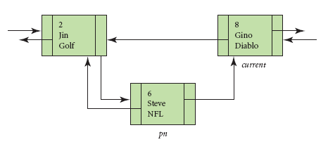
Inserting into a Doubly Linked List
3. Set next in node
before current to the new node.
4. Set previous in the new node to the node before current.

Slide 28
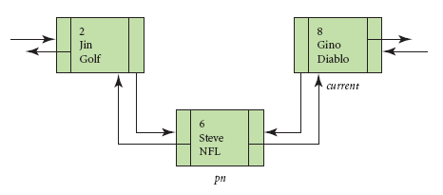
Inserting into a Doubly Linked List
5. Set previous in current to the new node.

Slide 29
Deleting from a Doubly Linked List
There are four cases:
delete at the beginning.
delete in the middle.
delete at the end.
cannot delete.
Updating the links will differ in the first three cases above.
Furthermore, when a node is deleted at the beginning, head needs to be updated.

Slide 30
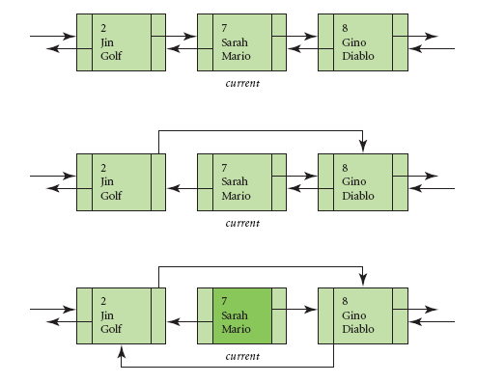
Deleting in the Middle of a Doubly Linked List
We will delete the
Player with id 7
Set next in the node
before current to the node
after current.
2. Set previous in the node
after current to the node
before current.

Slide 31
Summary
If you use a linked list, you should use the built in LinkedList<> class.
The built in LinkedList class is implemented with a doubly linked list.
You need to understand how linked lists work.

