Slide 1
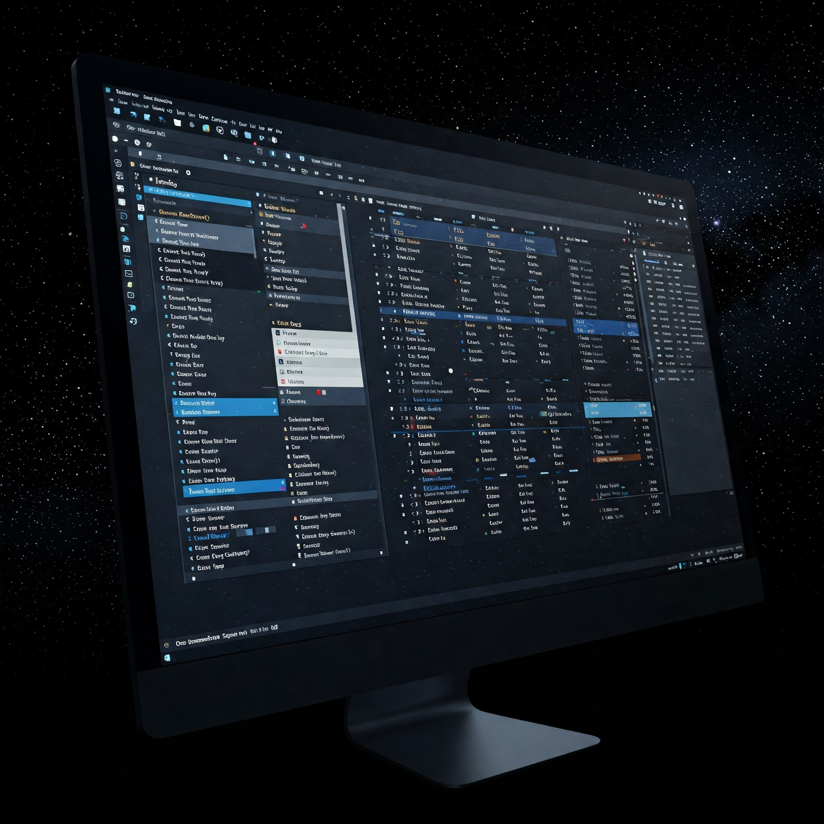
Module 6
File IO and
Internet Sockets

Slide 2
File Input / Output
Saving to file is a way to make data persistent
Instead of user input, we can read from files
Working with files is conceptually the same as reading/writing to the console
Must be comfortable with try/catch (Exceptions)

Slide 3
Streams
Streams push and pull data to/from a source:
We can read data from (as an input stream):
  Keyboard (System.in, Console)
  Files
  Network (called Sockets)
We can write data (as an output stream):
  The display (System.out and Console)
  Files
  Network (called Sockets)

Slide 4
General File Process:
Open the file stream in a "mode"
  read, write, append, create…
Do what you need to do (read/write)
Close the file stream
  free it for use by other programs
You can imagine that there is an "active cursor" that is moved around the file as you read/write

Slide 5
Reading Files
Must know the structure of the file:
  One element per line?
  Multiple elements per line?
How are the fields divided?
  Is there a delimiter such as a space or comma?
  Are the fields defined by a certain number of bytes?
  Perhaps the file is binary

Slide 6
File Structure Example
An airline company could store the following data:
  flight number
  origin airport
  destination airport
  number of passengers
  average ticket price
Such a file could contain the following data:
AA123,BWI,SFO,235,239.5
AA200,BOS,JFK,150,89.3
In this case, the delimiter is a comma.

Slide 7
Airline Example
import java.io.*;
import java.util.*;
public class Main {
public static void main (String args[]) {
try {
String dataline = "";
File myFile = new File("source.csv");
Scanner scan = new Scanner(myFile); // Note the layering
while (scan.hasNextLine()) {
dataline = scan.nextLine();
// Split the string by commas
String[] tokens = dataline.split(",");
System.out.println (dataline);
}
}
catch (IOException ioex) {
System.out.println ("Error: " + ioex.getMessage());
}
// Don’t forget to close the file at some point
}
}

Slide 8
Writing Text to Files
Similar to printing to the screen
In Java, you’ll use a PrintWriter (similar to System.out)

Slide 9
Writing Text to File
import java.io.*;
import java.util.*;
public class Main {
public static void main (String args[]) {
File myFile;
PrintWriter pw = null;
try {
myFile = new File ("output.txt");
pw = new PrintWriter(myFile); // layering
pw.println("Bob was here");
pw.println("and he's angry");
}catch (IOException ioex) {
System.out.println ("Error: " + ioex.getMessage());
}finally {
if (pw != null) pw.close();
}
}
}

Slide 10
Appending to a Text File
If you wish to append to a text file in java, it’s a little more complex.
Create a File object just like you would for Scanner.
Then create a FileOutputStream object that takes the File Object as a parameter
  The second parameter will be true to indicate you want append mode.
Finally make a PrintWriter object taking the FileOutputStream as a parameter.

Slide 11
Appending to a Text to File
import java.io.*;
class Main {
public static void main(String[] args) {
try {
File f=new File("a.txt");
FileOutputStream fos=new FileOutputStream(f,true);
PrintWriter pw = new PrintWriter(fos);
pw.println("Test Line");
pw.close();
}
catch(Exception e) {
}
}
}

Slide 12
How file systems are laid out
On Windows, the file system typically starts in C:\
  In there you’ll find a users folder, in there you’ll find a folder with the name that you log in as.
  In there you’ll find Documents, Desktop and other folders.
On Unix based systems (Mac, Linux) the file system starts in \
  In there, you’ll find usr, in there you’ll find a folder with the name you log in as.
  In there you’ll find Documents and Desktop also
When you access a file you have to say which folder you want to access the file in.
  This is not magical, it doesn’t go find the file.
  This is the most common problem students have with FileIO, where they get “File Not Found” exceptions even though they have the file on their Desktop.

Slide 13
Where are my Files?
Intellij
  By default It will read and write all files in the IdeaProjects folder for your project.
    For example, if your project is called Lab99 you’d look in C:/users/yourName/IdeaProjects/Lab99 or /usr/yourName/IdeaProjects/Lab99

Slide 14
Using fully qualified paths
Instead of relying on the default directories, you can specify where to read/write files when you open them in your code:
  File myFile = new File(“C:\users\bob\Desktop\myFile.txt”);
  PrintWriter pw = new PrintWriter(myFile);
The same can be done with Scanner when reading a file.

Slide 15
Binary Files
Not all files are text:
  Audio files
  Images
  PDFs
Working with binary files is usually very low level
  Most often write an array of bytes
  Write primitive data types (chars, ints, bytes)

Slide 16
Binary Files: Images
One of the most common binary files you’ll encounter are image files
Almost every image is really a stream of binary data
  There is a written specification for each image format
  Programs follow this format when they read in images, so they know how to display the actual picture
Some specifications are very complex, like PNGs and JPEGs
Others are simpler, like Windows BMP files

Slide 17
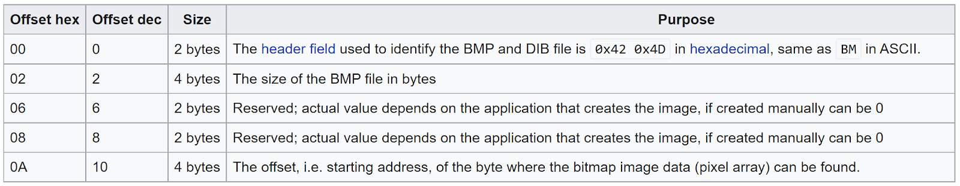
Binary Files: Windows BMP
The program first reads in a “header”, a series of bytes that define width, height, color mode, and more
  You read each value based on how many bytes long it is
  ints take up 4 bytes, shorts take up 2 bytes, etc.
After that, the rest is image data
  Again, just a sequence of bytes
Link to the Window BMP Header specification

Slide 18


Binary Files: Windows BMP
You can use a program called a hex editor to examine the binary data inside an image
Once you know the file format specification, you can even manually change aspects of the image like width and height
  Changing byte 22 – 25 alters the height

Slide 19
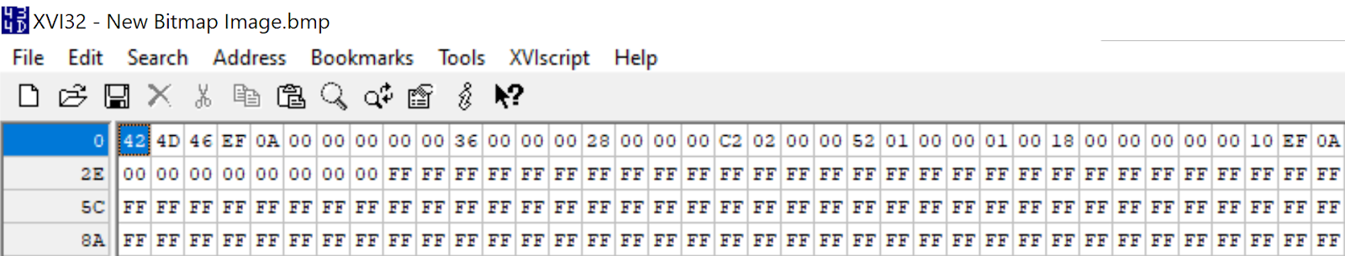
Binary Files: Windows BMP
You can use a program called a hex editor to examine the binary data inside an image
Once you know the file format specification, you can even manually change aspects of the image like width and height
You can verify if your program read and wrote the image file correctly

Slide 20
Layers
While reading text, Scanner is abstracting away some of the details. When working with binary data, you’ll use more low level methods:
You typically “layer” streams:
  Create a stream (stream1)
  Create another stream (stream2) using stream1 as a data source
  Create another stream (stream3) using stream2 as a data source
The purpose of layers?
  Stream1 works at a “low level” like bytes
  Stream2 constructs higher level data using stream1 as a source
  Stream3 constructs even higher level using stream2 as a source

Slide 21
Example of Layering
import java.io.*;
import java.util.*;
public class Main {
public static void main (String args[]) {
try {
// Can only read bytes from fis – super low level
FileInputStream fis = new FileInputStream("source.csv");
// Can read characters from isr
InputStreamReader isr = new InputStreamReader (fis);
// Can read entire strings from br
BufferedReader br = new BufferedReader (isr);
}
catch (IOException ioex) {
System.out.println ("Error: " + ioex.getMessage());
}
}
}

Slide 22
Writing Binary data in Java
//This writes a file with the letter A in it, because A in ascii is #65.
import java.io.FileOutputStream;
public class FileOutputStreamExample {
public static void main(String args[]){
try{
FileOutputStream fout=new FileOutputStream("myfile.txt");
fout.write(65);
fout.close();
}
catch(Exception e) {
System.out.println(e);}
}
}

Slide 23
Software Engineering Tip
Calling the close method is optional. When the program finishes executing, all the resources of any unclosed files are released (back to the operating system)
It is good practice to call the close method, however, especially if you will be opening a number of files (or opening the same file multiple times.)
Do not close the standard input, output, or error devices, however. They are intended to remain open.

Slide 24
Writing and “The Buffer”
It’s *much* more efficient to write giant blocks of data instead of individual bytes/characters
When you write (or print), it goes into a buffer:
  A buffer is just a chunk of memory used to hold data
  You never see the buffer
  When that buffer is full, the buffer gets pushed out
  When a stream is closed, the buffer gets pushed out
There’s a “flush” method for almost all output streams
  Forces everything in the buffer to be forced out of the stream
SO, don’t forget to flush!

Slide 25
An awesome new skill
If all you have to do is change the source, how hard is it to read from the Internet?

Slide 26
Reading from Google
import java.io.*;
import java.util.*;
import java.net.*;
// This code reads the homepage of Google and prints it line by line
public class Main {
public static void main (String args[]) {
try {
String dataline = "";
Socket mySock = new Socket("www.google.com", 80);
OutputStream os = mySock.getOutputStream(); // Note the layering
PrintWriter pw = new PrintWriter(os);
pw.println("GET /index.html \n\n");
pw.flush();
Scanner scan = new Scanner(mySock.getInputStream());
while (scan.hasNextLine()) {
dataline = scan.nextLine();
System.out.println (dataline);
}
scan.close();
}
catch (IOException ioex) {
System.out.println ("Error: " + ioex.getMessage());
}
}
}

Slide 27
Doing something useful
A lot of time coding will be spent with your computer needing to get information from or send information to another computer.
Most apps that you use on your phone communicate with a central service.
  Email/Social Media/Chat clients have to get their info from a central server
  Weather apps pull info from a central server
  Most games need to save state and score to a central server.
  Things like photo storage apps need to upload images to be stored on the cloud.

Slide 28
APIs
A very common way people communicate with other computers is via API calls.
Service providers offer a bunch of APIs. They provide documentation which explains what calls you can make
  Think of these as method calls, except they are not happening on your computer, they are happening on a remote computer
  Like method calls, they can:
    Take in parameters
    Return values
Beyond the scope of this class, but most of the world has agreed on the format of this data to be either JSON or XML. These are just ways of formatting data as text

Slide 29
Let’s see a real world example
I’ve decided to write an app that lets people look up music information.
  The user will be able to type in an artist, and see all that artists albums, songs and general info.
  The user can also enter a song, and see what album it was released on, who the artist is (there may be one) etc.
Choice 1:
  I write a MASSIVE multidimensional array with all the info in it. Then I publish my app.
    10 minutes after publishing my app, the data is out of date.
Choice 2:
  Find an internet service I can use which keeps this data up to date for me, and just query it!

Slide 30
Presenting MusicBrainz
This is an opensource (ie, free) website that contains the information we just discussed.
Go to musicbrainz.org in a browser to check it out.
  Type an artist into the top right corner, click search and see results.
But wait, there’s more!
  They allow you to query this information via an API. So let’s write some code to access this information.
  Warning the information comes back in XML format.
    If you’ve ever used HTML, it’s a generic form of HTML.
    <variable>value</variable>
    <array><cell>value</cell><cell>value2</cell></array>

Slide 31
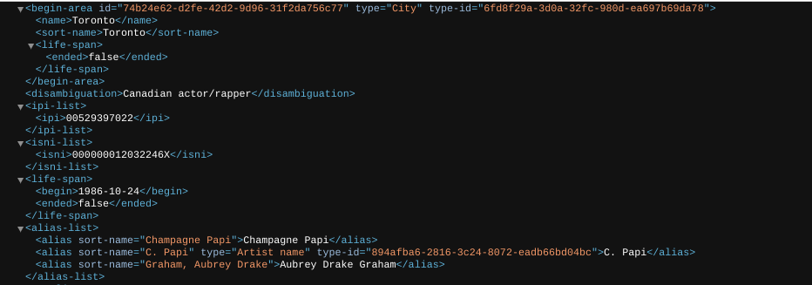
Making an API call
Musicbrainz API is simple, and you can use it in a browser:
musicbrainz.org/ws/2/artist?query=Drake

Slide 32
You’ll need some imports and main:
import java.util.Scanner;
import java.net.Socket;
import java.io.IOException;
import java.io.OutputStream;
import java.io.PrintWriter;
public static void main(String[] args) {
artist_info("Drake");
}

Slide 33
artist_info method
public static void artist_info(String artistName) {
try {
String HostName="musicbrainz.org";
String QueryString="GET /ws/2/artist?query="+artistName+" HTTP/1.0";
Socket mySocket = new Socket(HostName,80);
OutputStream myoutputstream=mySocket.getOutputStream();
PrintWriter pw=new PrintWriter(myoutputstream);
pw.println(QueryString);
pw.println("Host: "+HostName);
pw.println("User-Agent: Mozilla/5.0 (Windows NT 6.1; Win64; x64; rv:47.0) Gecko/20100101 Firefox/47.0");
pw.println();
pw.flush();
Scanner returnPage = new Scanner(mySocket.getInputStream());
while (returnPage.hasNextLine()) {
String result = returnPage.nextLine();
System.out.println (result);
}
}
catch(IOException ioe) {
System.out.println("Unable to get info about artist "+artistName+" Error:"+ioe);
}
}

Slide 34
Summary
We write files to keep persistent data
Working with files (or the network) is similar to working with keyboard and console
You need to know the format of the data you’re working with
Just like ogres, code for reading and writing files has layers

