Slide 1
Module 4
Part 3
More Recursion

Slide 2
Class Problem
Write a recursive method called string_reverse.
  It must take in a string
  It must return a string
It should recursively reverse the string.
  If called with string_reverse(“abcd”) it should return “dcba”

Slide 3
How to solve this
Base case
  String is one character long => it’s already reversed.
Recursive call:
  Take the first letter off the string and reverse what's left, add the first character to the end.
    e.g. “abc”
    reverse(“bc”) add “a” to the end.
    That will become:
    reverse (“c”) and add “b” to the end”
    “c” + “b” + “a” = “cba”

Slide 4
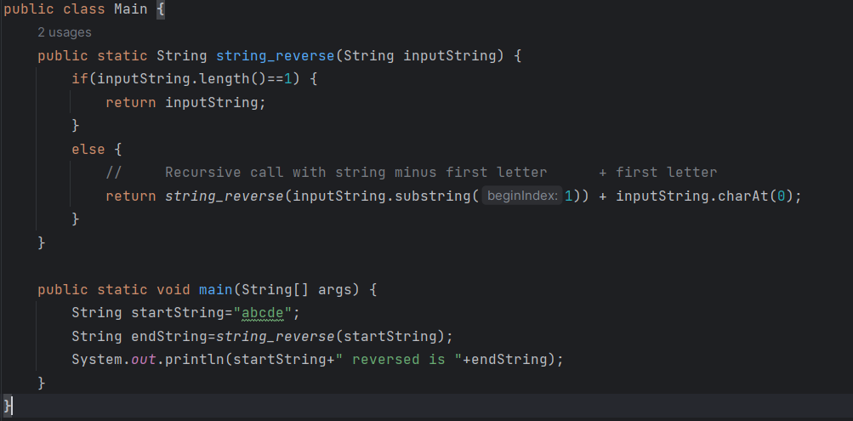
string_reverse code.

Slide 5
Sum the numbers in an array
Assume you are passed an array of integers.
How can you use recursion to sum the values in the array?
  First figure out the base condition:
    If you are given an array of size 1, you know it’s sum is the value in the one cell.
    If you are given an array of size 0, the answer is 0.
  Next realize that the sum of the values in the array is the first value + the sum of the rest.
You probably don’t want to change the size of the array on each recursive call, so just keep track of which cell you are looking at on each call.

Slide 6
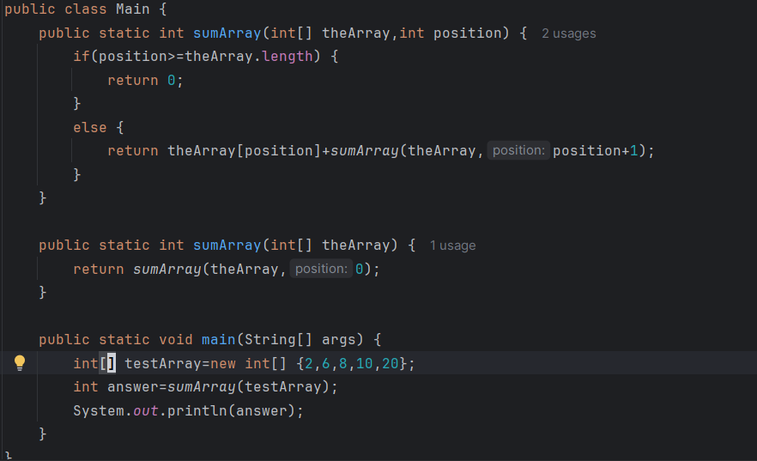
A solution

Slide 7
Helper method
In the previous solution you’ll notice there are 2 methods called sumArray.
  They are OverLoaded methods.
The reason for this is that the user who needs the sum of an array shouldn’t have to be told to pass the array and the number 0.
So instead you give the user a sumArray() which simply takes in the Array, and calls the other version of sumArray() passing it the same array and the number 0.
  This is called a helper method and is a common practice.

Slide 8
But…why recursion?
We’ve shown you recursive algorithms for reversing strings, calculating power, and talked through others.
But…you could have done all those things with a loop…so…why recursion?
  It is honestly less intuitive than iteration (loops)
  It sometimes fails if you give it a big enough number (stack overflow), where as well written loops will always finish
  It often uses more memory
All the problems we showed you so far are linear.
  Truthfully they should be solved with a loop. But we wanted to show you recursion with them first, because it’s easier to picture.

Slide 9
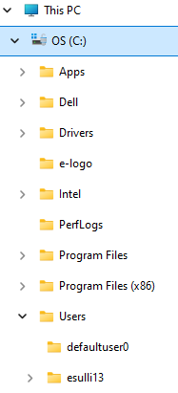
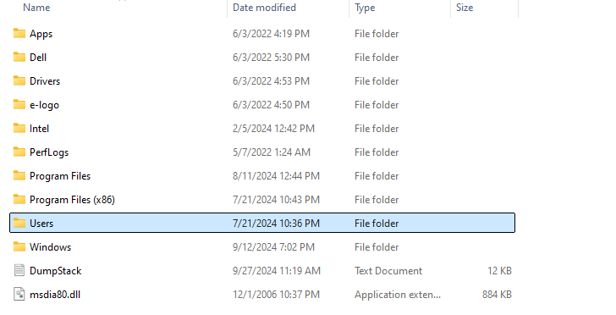
Think…
Write a program that counts all of the files on your hard drive
  You have multiple folders/directories that contain multiple files and multiple folders/directories!
Count all files in the current directory, and add to that, the count of files in each folder in this current directory.

Slide 10
File/Folder issue
You could possibly solve this using iteration, but it would be very messy as you’d need to keep track of where you were in the file structure using additional dynamic data structure.
  Recursion uses the activation stack as a "reminder" (breadcrumb) of where we've been and what remains to be done.
Sometimes recursion involves processing things non-linearly (i.e. multiple available paths)

Slide 11
Non-linear Recursion
Consider the steps to count the total number of files:
  If we're in a folder with no subfolders, then we return the number of files in the current folder
  Otherwise, we return the count of the files in the folder + a recursive call for the subfolders
It's the second part that's tricky... but notice that's where the recursive call comes in. We just need to recursively call for each subfolder (so this is recursion wrapped inside of iteration)

Slide 12
“Pseudocode” Solution
int CountFiles(Directory d) {
int file_count = 0;
file_count = # of files in d
foreach (Directory d in d.GetDirectories())
file_count += CountFiles(sub_folder);
return file_count;
}
// Start with CountFiles (“/” or “C:\”)

Slide 13
Let’s trace some a more complex recursive algorithm
void DoWork(int i)
{
System.out.println(i);
if (i > 2)
{
DoWork(i-1); // Multiple recursive calls
DoWork(i-2);
}
System.out.println(i);
}
// Call using DoWork(4)

Slide 14
Tracing Recursion with two recursive calls
void DoWork(int i)
{
System.out.print(i+” “);
if (i > 2){
DoWork(i-1);
DoWork(i-2);
}
System.out.print(i+” “);
}
Main:
i = 3

Slide 15
Tracing Recursion with two recursive calls
void DoWork(int i)
{
System.out.print(i+” “);
if (i > 2){
DoWork(i-1);
DoWork(i-2);
}
System.out.print(i+” “);
}
Output:
3
Main:
i = 3

Slide 16
Tracing Recursion with two recursive calls
void DoWork(int i)
{
System.out.print(i+” “);
if (i > 2){
DoWork(i-1);
DoWork(i-2);
}
System.out.print(i+” “);
}
Output:
3
Main:
i = 3

Slide 17
Tracing Recursion with two recursive calls
void DoWork(int i)
{
System.out.print(i+” “);
if (i > 2){
DoWork(i-1);
DoWork(i-2);
}
System.out.print(i+” “);
}
Output:
3
Main:
i = 3 DoWork(2)

Slide 18
Tracing Recursion with two recursive calls
void DoWork(int i)
{
System.out.print(i+” “);
if (i > 2){
DoWork(i-1);
DoWork(i-2);
}
System.out.print(i+” “);
}
Output:
3
i = 2
Main:
i = 3 DoWork(2)

Slide 19
Tracing Recursion with two recursive calls
void DoWork(int i)
{
System.out.print(i+” “);
if (i > 2){
DoWork(i-1);
DoWork(i-2);
}
System.out.print(i+” “);
}
Output:
3 2
i = 2
Main:
i = 3 DoWork(2)

Slide 20
Tracing Recursion with two recursive calls
void DoWork(int i)
{
System.out.print(i+” “);
if (i > 2){
DoWork(i-1);
DoWork(i-2);
}
System.out.print(i+” “);
}
Output:
3 2
i = 2
Main:
i = 3 DoWork(2)

Slide 21
Tracing Recursion with two recursive calls
void DoWork(int i)
{
System.out.print(i+” “);
if (i > 2){
DoWork(i-1);
DoWork(i-2);
}
System.out.print(i+” “);
}
Output:
3 2 2
i = 2
Main:
i = 3 DoWork(2)

Slide 22
Tracing Recursion with two recursive calls
void DoWork(int i)
{
System.out.print(i+” “);
if (i > 2){
DoWork(i-1);
DoWork(i-2);
}
System.out.print(i+” “);
}
Output:
3 2 2
i = 2
Main:
i = 3 DoWork(2)

Slide 23
Tracing Recursion with two recursive calls
void DoWork(int i)
{
System.out.print(i+” “);
if (i > 2){
DoWork(i-1);
DoWork(i-2);
}
System.out.print(i+” “);
}
Output:
3 2 2
Main:
i = 3 DoWork(1)

Slide 24
Tracing Recursion with two recursive calls
void DoWork(int i)
{
System.out.print(i+” “);
if (i > 2){
DoWork(i-1);
DoWork(i-2);
}
System.out.print(i+” “);
}
Output:
3 2 2
i = 1
Main:
i = 3 DoWork(2)

Slide 25
Tracing Recursion with two recursive calls
void DoWork(int i)
{
System.out.print(i+” “);
if (i > 2){
DoWork(i-1);
DoWork(i-2);
}
System.out.print(i+” “);
}
Output:
3 2 2 1
i = 1
Main:
i = 3 DoWork(2)

Slide 26
Tracing Recursion with two recursive calls
void DoWork(int i)
{
System.out.print(i+” “);
if (i > 2){
DoWork(i-1);
DoWork(i-2);
}
System.out.print(i+” “);
}
Output:
3 2 2 1
i = 1
Main:
i = 3 DoWork(2)

Slide 27
Tracing Recursion with two recursive calls
void DoWork(int i)
{
System.out.print(i+” “);
if (i > 2){
DoWork(i-1);
DoWork(i-2);
}
System.out.print(i+” “);
}
Output:
3 2 2 1 1
i = 1
Main:
i = 3 DoWork(2)

Slide 28
Tracing Recursion with two recursive calls
void DoWork(int i)
{
System.out.print(i+” “);
if (i > 2){
DoWork(i-1);
DoWork(i-2);
}
System.out.print(i+” “);
}
Output:
3 2 2 1 1
i = 1
Main:
i = 3 DoWork(2)

Slide 29
Tracing Recursion with two recursive calls
void DoWork(int i)
{
System.out.print(i+” “);
if (i > 2){
DoWork(i-1);
DoWork(i-2);
}
System.out.print(i+” “);
}
Output:
3 2 2 1 1 3
Main:
i = 3

Slide 30
Tracing Recursion with two recursive calls
void DoWork(int i)
{
System.out.print(i+” “);
if (i > 2){
DoWork(i-1);
DoWork(i-2);
}
System.out.print(i+” “);
}
Output:
3 2 2 1 1 3
Main:
i = 3

Slide 31
Tracing Recursion with two recursive calls
void DoWork(int i)
{
System.out.print(i+” “);
if (i > 2){
DoWork(i-1);
DoWork(i-2);
}
System.out.print(i+” “);
}
Output:
3 2 2 1 1 3
Main:

Slide 32

Output

Slide 33

Fibonacci Sequence
Assume you start with 2 rabbits in a field:
After a month, they will mate, and you’ll now have 3 rabbits.
One month later, you’ll have 5 rabbits:
The next month, you’ll have 8 rabbits
The formula for each month is how many you had last month + how many you had the month before.

Slide 34
Multiple Recursion
Fibonacci series: a_{n}= a_{(n-1)} +a_{(n-2)}
Example: 0,1,1,2,3,5,8,13,…
Write a recursive method:
int Fib (int n)
{
}

Slide 35
Steps
Base case:
  It’s a definition that the fibonacci(1) = 1 and the fibonacci(2) = 1
Recursive Call
  All later fibonacci numbers are defined as:
  Fibonacci of N = Fibonacci of N-1 + Fibonacci of N-2

Slide 36
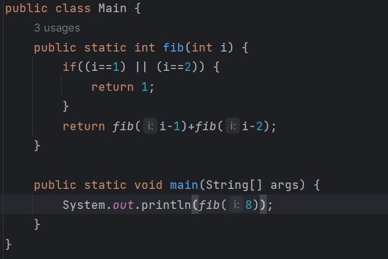
The solution

Slide 37
Bubble Sort
In CSE1321 you learned about Bubble Sort, as a way to sort an array
  Bubble Sort
    Compare array[i] and array[i+1]
      If they are in the wrong order, swap them
    Continue comparing neighbours until you reach end of array.
    Start over, do it again. You’ll repeat this once for each element in the array
      Each pass moves one number to its correct place.

Slide 38
Selection and Insertion Sort
Selection Sort
  Assume the first cell holds the smallest value, check every other cell in the array. Once you identify the smallest swap it with cell 0.
  Now assume cell 1 is the smallest, compare it with every other cell in the array. Once you identify the new smallest, swap it with cell 1 …
  Repeat for all cells until sorted.
Insertion Sort
  Find the smallest move it to a new array
  Find the next smallest, move it to the next cell in the new array.
  Repeat until all cells are moved.

Slide 39
Big O
For all 3 of these sort algorithms, we’d say that they are O(N^2)
  Sorting an array with 10 things will take 100 operations
  Sorting an array with 1,000,000 cells will take 1,000,000,000,000 operations.
Thus they are not great.
  Surely there must be a better way?
  Yes, now that we understand recursion, let’s look at Merge Sort
  It has a BigO of O(N LogN)
  Let’s see it run:
    https://www.hackerearth.com/practice/algorithms/sorting/merge-sort/visualize/

Slide 40
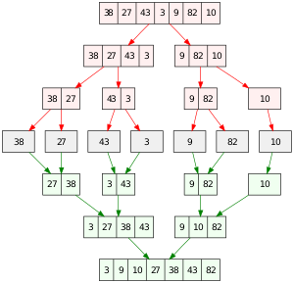
Merge Sort Example
Source: Vineet Kumar. Wikipedia
Public Domain

Slide 41
MergeSort Method
public static void mergeSort(int[] a, int n) {
if (n < 2) {
return;
}
int mid = n / 2;
int[] l = new int[mid];
int[] r = new int[n - mid];
for (int i = 0; i < mid; i++) {
l[i] = a[i];
}
for (int i = mid; i < n; i++) {
r[i - mid] = a[i];
}
mergeSort(l, mid);
mergeSort(r, n - mid);
merge(a, l, r, mid, n - mid);
}

Slide 42
Merge Method
public static void merge(
int[] a, int[] l, int[] r, int left, int right) {
int i = 0, j = 0, k = 0;
while (i < left && j < right) {
if (l[i] <= r[j]) {
a[k++] = l[i++];
}
else {
a[k++] = r[j++];
}
}
while (i < left) {
a[k++] = l[i++];
}
while (j < right) {
a[k++] = r[j++];
}
}

Slide 43
A main method to call it
public static void main(String[] args) {
int[] myArray = new int[] {50,2,9,7,44,32,17,5};
mergeSort(myArray,8);
for(int i=0;i<8;i++) {
System.out.println(myArray[i]+" ");
}
}

Slide 44
Multiple recursive problem:
Here is an algorithm to get out of the room you are currently in, and to a different room in the same building.
  Base condition:
    You are at the destination, stop.
    You’ve hit a wall/end of a road, and can’t go any further, stop
    You’ve ended up somewhere you’ve already been, stop
  Recursive call:
    Try going left and see if that gets you there.
    If that didn’t work, try going right, and see if that gets you there.
    If that didn’t work, try going forward and see if that gets you there.
    If that didn’t work, try going backwards and see if that gets you there.

Slide 45
Maps
This is how most mapping programs find paths.
You could in theory write this with loops…but good luck, you have to keep track of where you are going in data structures.
With recursion the stack keeps track of it for you.
This is one of a class of problems which are best solved with recursion.

Slide 46
In-class Questions
Warm-up: write a recursive function that determines how many function calls can go on the stack until it crashes. Hint: pass it a number.
Medium: Imagine an array of numbers. Can you use recursion to sum them up? Hint: the sum is array[0] + the sum of the rest of the array.
Medium: Imagine an array of sorted numbers. In the most efficient way possible, can you see if the number 45 exists in that array using recursion (hint: right half and left half)
Medium: Calculate compound interest on a starting amount over a number of years.
Harder: Towers of Hanoi
Harder: Imagine a 1000x1000 2D array of characters that represents a maze. If the cell has an ‘X’, there is a wall there. If a call has a space ‘ ‘, there is no wall. Assume there is a valid path out and you start in the middle. Use recursion to find your way out!

