Slide 1
Module 2
Part 1:
Methods

Slide 2
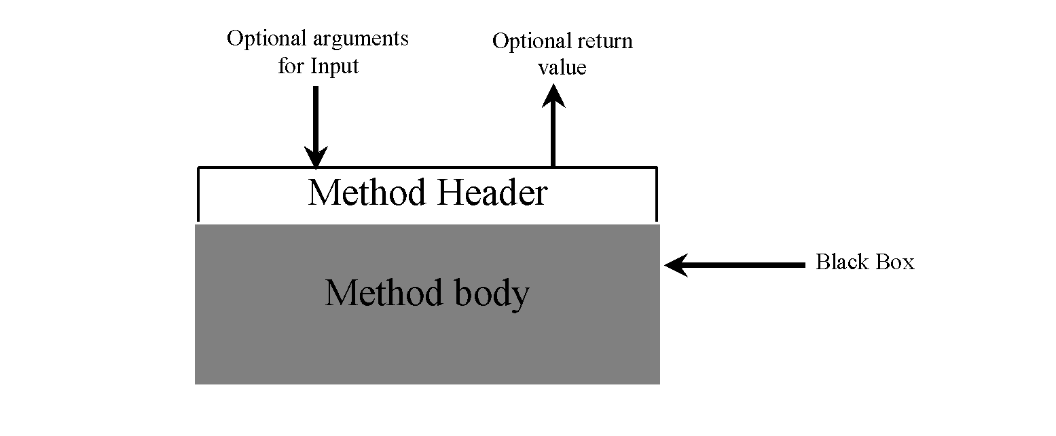
Review: What is a Method?
Think of a method as a black box that contains the detailed implementation for a specific task.
The method may use inputs (parameters)
It may return an output with a specific type.

Slide 3
Methods in Java
Methods in Java do the same job as functions in Python.
They allow you to group a block of code together, name it and allow for reuse.
Both can take in parameters
Both can return values

Slide 4
Declaring Methods
You declare a method in Java using the following pattern:
<return type> <name> (<parameter(s)>) { <body of method> }

Slide 5
Calling the Method
Return Type
Method Name
Formal Parameters
Modifiers
Method Header
public static int addTwoNums (int x, int y) { return x + y; }
Method Body
Actual parameters (called ”arguments”)
int result = addTwoNums (5, 2);

Slide 6
Method Returns
The return type of a method indicates the type of value that the method sends back to the calling location.
The return statement has 2 purposes:
It halts execution within the method
And (optionally) returns a value
A method that does not return a value has a void return type
A return statement specifies the value that will be returned
return expression;
Its expression must conform to the return type

Slide 7
Method Name
You should name each method with a name that describes what the method is doing.
e.g A method which finds the smallest number in an array?
public int findSmallest(int[] theArray) {
This will be helpful for you when you write larger code. It’s also very helpful for the next person who’ll have to maintain your code.

Slide 8
Parameters
A method can have 0 or more parameters.
If there are 0 parameters you must still put empty ()’s
Each parameter will have:
A type
A name
The type must match the arguments you pass when you call the method
The name can be anything, but should again be relevant to what the purpose of the parameter is.

Slide 9
Example
A method to find the length of a name:
public int nameSize(String theName) {
return theName.length();
}
This method returns an int, because that’s what a string.length() returns.

Slide 10
Differences between Python and Java Methods
Python
Defined using the “def” keyword
Parameters can have default values
Can return any data type
Lack of “return” keyword makes the method return “None”
Java
You must declare the type of all parameters they cannot have default values
Must always return the datatype in the method’s header
Generally should be public,sometimes will be private.
Must declare what datatype they return (can be void)
Methods inside the Driver class must always be static, methods in other classes generally will not be static.
Can be overloaded (*More on this later…)

Slide 11
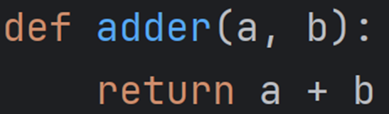
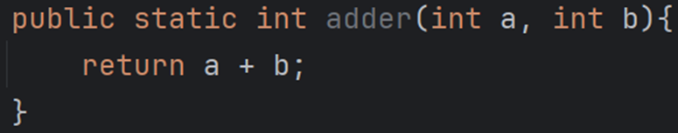
Indentation
In python all code in the body of the method had to be indented.
While not strictly required in Java, you should always do this to make your code more readable:
Python | Java

Slide 12
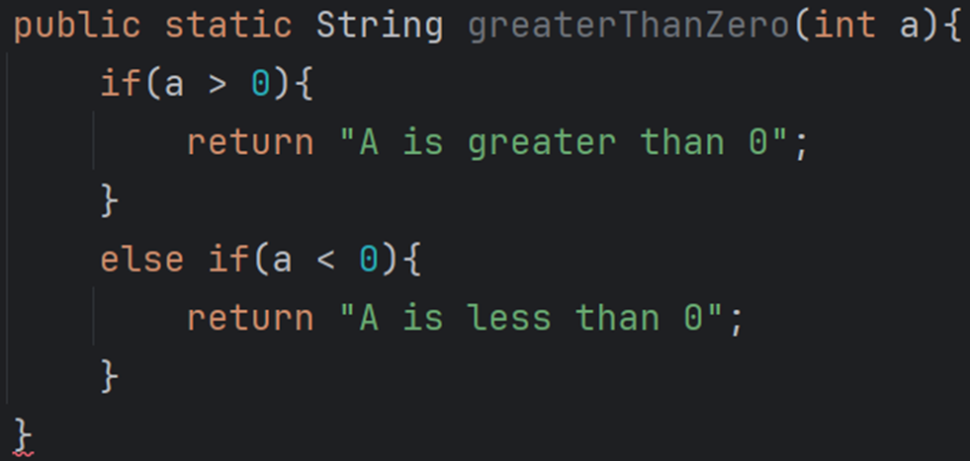
Return types and parameter types are enforced
Java requires that all types match
This method will not compile because it may fail to return a string (if a==0).

Slide 13
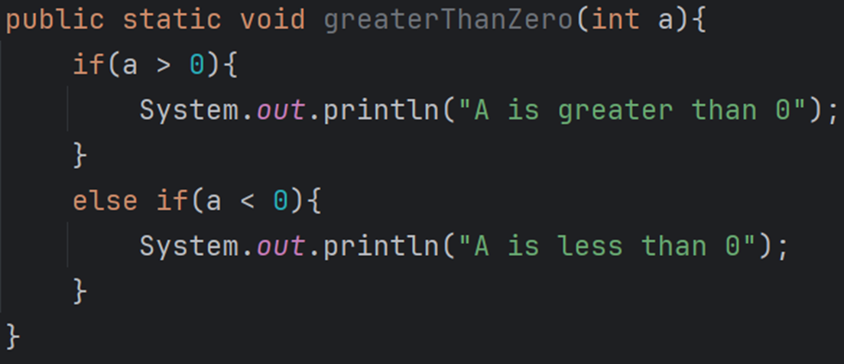
Void return type
A return type of void means the method will not return anything.
Specifically it CANNOT return anything.
Here is an example of a method which does not return anything.

Slide 14
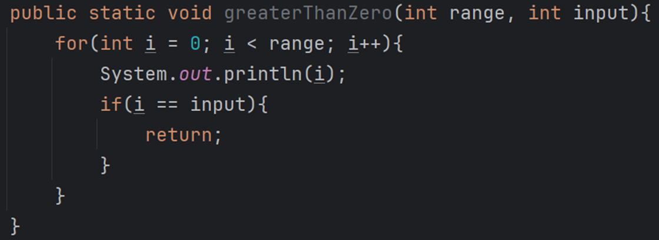
Void methods can have return
Void methods can have the return keyword, so long as it isn’t returning any value.
In this case, the return keyword is being used to signal that the method is done executing

Slide 15
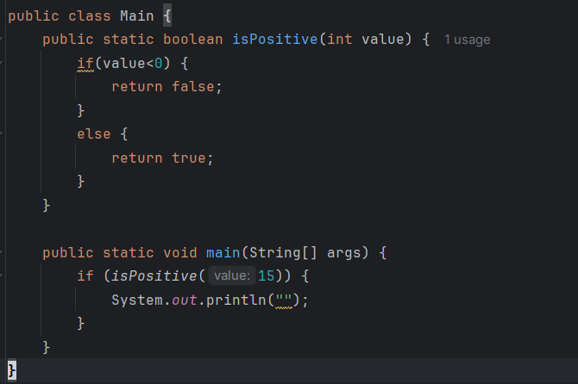
Passing arguments & Using Return Type
The number, type and order of the arguments must match the parameters in the method.
In this case we are passing a single integer, so value is assigned 15 at the start of isPositive()
isPositive() returns a boolean. That return value is used in an if statement in main.

Slide 16
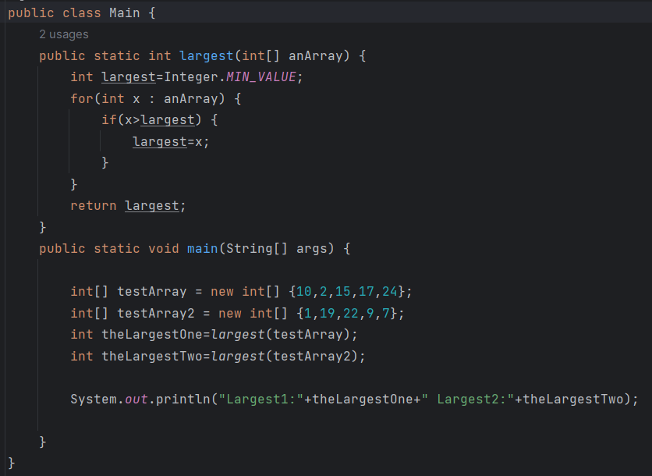
Capturing Return Values
Remember to capture the return value.
Otherwise why did you call the method?

Slide 17
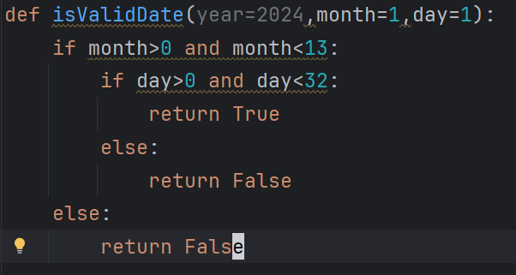
Python default parameters
In Python you can pass default values to parameters in methods.
Allows you to call the method without passing any of year, month and day. It assume you meant 2024, 1, and 1.

Slide 18
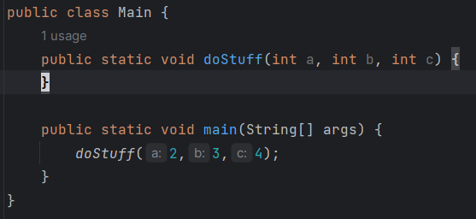
Java has no default parameters
It’s not possible to add default values to parameters in Java.
No matter what, if a method has parameters, you must send it values when you call it.

Slide 19
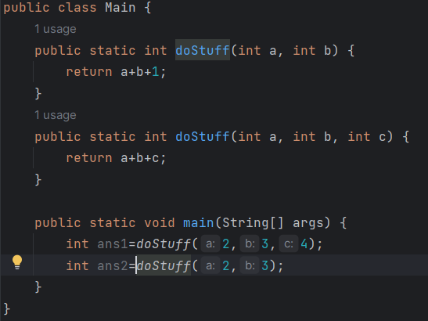
Java’s solution: overloaded methods
Java allows you to have multiple versions of the same method. Each with different parameters.

Slide 20
Overloading rules
You can have as many overloads as you like.
Each must have different parameters. Specifically:
Different number of parameters
Different type parameters
Different order of parameters
For example, you have have:
one overload which takes (int a, double b)
another which takes (double a, int b)
another which takes (int a, int b)
another which takes (double a, double b)
another which takes (char a)

Slide 21

Useful Example:
Imagine you need to divide 2 numbers, you might do:
You can call that with: divideTwoNumbers(10,3) and it’ll return 3.3333. Great.

Slide 22

Next try:
Notice Java is unhappy:
We need another version of divideTwoNumbers which expects 2 doubles.
Now it works.

Slide 23
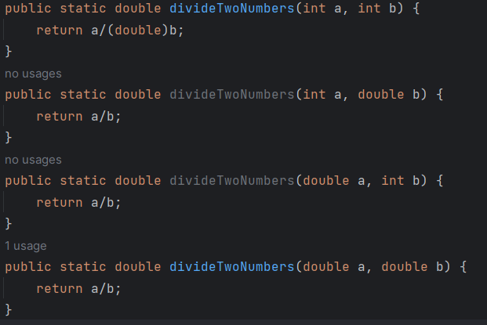
Possibly need a few versions:

Slide 24
Which one is called?
The Java compiler determines which version of the method is being invoked by analyzing the parameters
It will call the one which most closely matches the arguments in the call.
Note: The return type of the method is not part of the signature

Slide 25
Which is called?
float tryMe (int x){
return x + .375;
}
float tryMe (int x, float y){
return x*y;
}
// Which tryMe is called?
result = tryMe (25, 4.32f);

Slide 26
What is the output of this code?
static void B(int x) { // Built-in type argument passing
x += 9;
System.out.println(x); //Prints 51, because x was 42, then 9 was added.
}
public static void main (String[] args) {
int a = 42;
System.out.println(a); // Prints 42
B(a); // Prints 51 because is call-by-value;
System.out.println(a); // Prints 42
}

Slide 27
Very Important:
In that last example we called method B and passed it an argument of: a
a is an integer
Method B has a formal parameter x which is given a COPY of the value of a
Thus changes to x have no effect on a, as x was given a COPY of the value.
This is true for all primitive types (int, long, float, double and even String)

