Slide 1
Module 7 – Part 4
Arrays

Slide 2
Arrays
The basic collection type in Java is the Array.
Arrays are a lot more restrictive compared to Python lists
  Arrays cannot change their size once they are created
  Arrays can only hold a single data type
  You must manually check if an element is inside an array
  Arrays cannot be sliced
  Basic syntax for creating an array is:
  type[] name = new type[size];
  Reading from or writing to an array has very similar syntax
  name[position] = value; // stores value at position in name
  variable = name[position]; // reads value at position in name

Slide 3
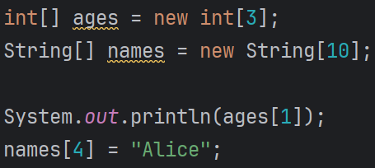
Arrays
You must always declare the type of the array
Notice that, in general, you must declare the size of the array when you create it.
This size will be unchanged throughout the lifetime of the array

Slide 4
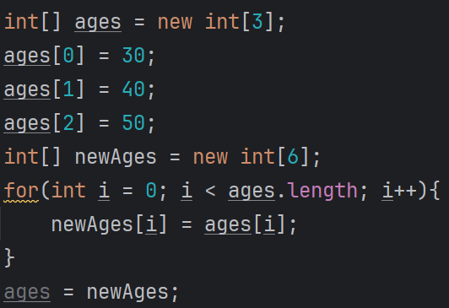
Resizing Arrays
What if you create an array but realize later on that you need a bigger array?
You’ll have to create a new array with the new size, and then copy over the contents of the old array.
We can determine the size of an array by using .length

Slide 5
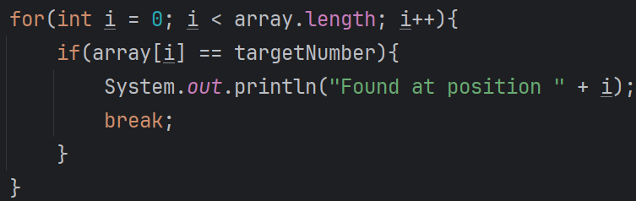
Searching Arrays
If you want to check if a particular element is inside an array, you’ll need to do it manually.
There is no “in” keyword for a “if element in array:” statement.

Slide 6


Printing Arrays
Printing an array simply prints out its memory representation

Slide 7
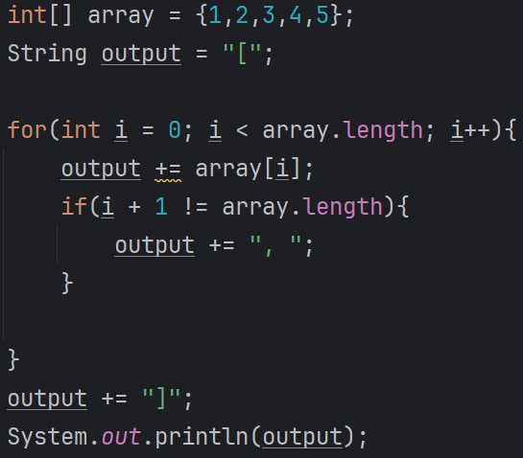

Printing Arrays
If you want to print the contents of an array, you’ll have to do it manually

Slide 8
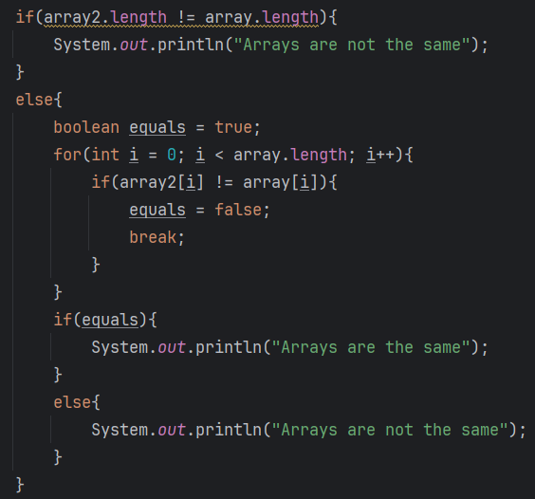
Comparing Arrays
If you want to compare if two arrays have the same contents, much like with strings, using == will not work.
You’ll have to compare the arrays manually

Slide 9
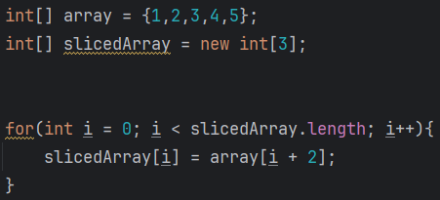
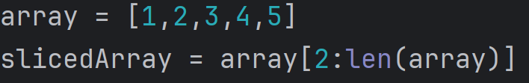
Slicing Arrays
If you want to slice an array, you’ll have to do it manually
The examples below are equivalent

Slide 10
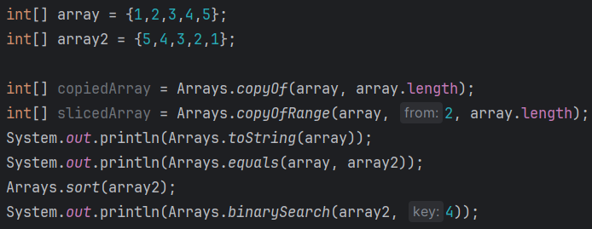

Arrays class
The previous slides aren’t strictly true
Java has an Arrays class, with lots of helpful methods to interact with arrays
Notice that binarySearch() will only work if the array is sorted first.

Slide 11
ArraysLists
Java does have a data structure that is similar to Python’s lists, called ArrayLists
The library needs to be imported before use
import java.util.ArrayList;
These are objects which you need to create
Just like everything else in Java, you must declare what data type the ArrayList is holding
ArrayList<type> name = new ArrayList<>();
You use them through their methods
name.method();
ArrayLists can only ever have one dimension

Slide 12
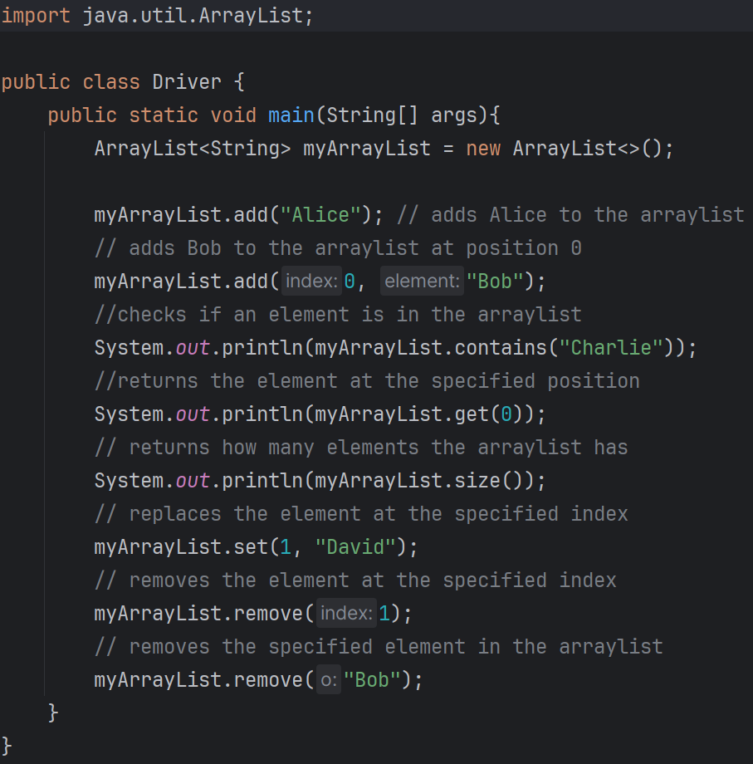
ArraysLists syntax and methods

Slide 13
Multi-dimensional arrays
In Python, we were able to put lists inside of lists
  This can be called a multi-dimensional list
  E.g.: storing columns inside of rows
In Java, there is specific syntax for creating and interacting with multi-dimensional arrays
  A 2D array uses 2 square braces, a 3D array uses 3 square braces, etc.
  type[][] name = new type[num_of_rows][num_of_cols];
  If you wish to traverse through the whole array, you’ll need as many loops as there are dimensions
    If your array is 2D, you’ll need a loop with a nested loop inside
    The inner loop traverses the columns and the outer loop traverses the rows
    For a 3D array, you’ll need a loop with a nested loop inside, which itself contains a nested loop

Slide 14
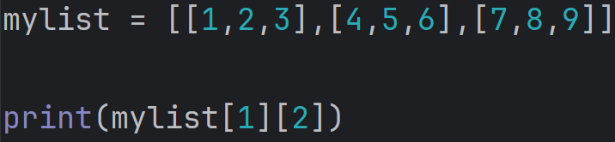
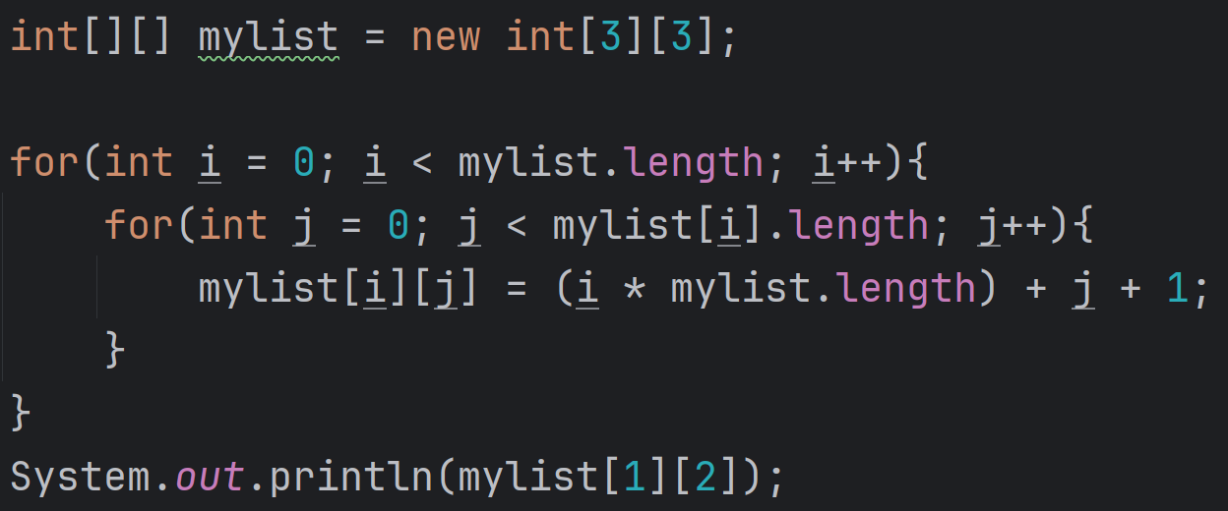
Multi-dimensional arrays

