Slide 1
Module 7 – Part 2
Operators and Expressions

Slide 2
Math operators - Addition
In both languages:
integer + integer = addition, resulting in an integer
float + (integer or float) = addition, resulting in a float
string + string = concatenation between two strings
Python:
  A number and a string cannot be added
Java:
  A number and a string can be added
  The operation is concatenation
  The result is always a string

Slide 3
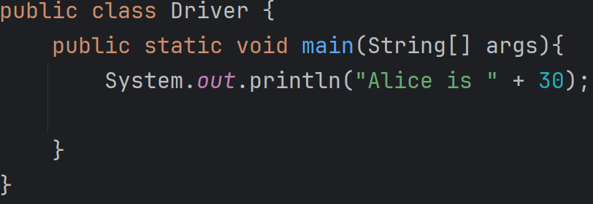

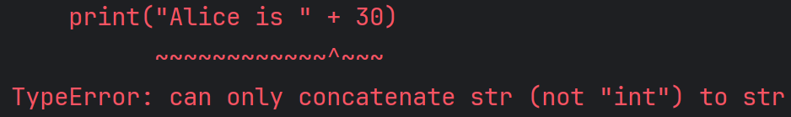

Math operators - Addition
Java
Python

Slide 4
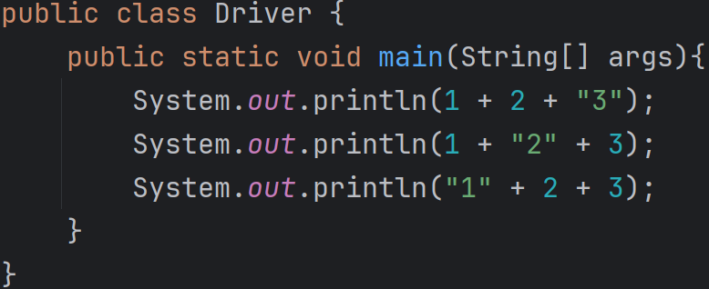

Math operators - Addition
Beware of the order of operations.
Addition and concatenation have the same order of precedence
  As such, they are always resolved left to right

Slide 5
Math operators - Multiplication
In both languages
  Multiplying two numbers gives you their product
  If both numbers are integers, the result is an integer
  If one of the numbers is a float, the result is a float
Python
  You can multiply a string by an integer
  The result is that string, repeated that many times
    print(“Alice” * 3) # prints “AliceAliceAlice”
Java
  You may not multiply strings with numbers

Slide 6
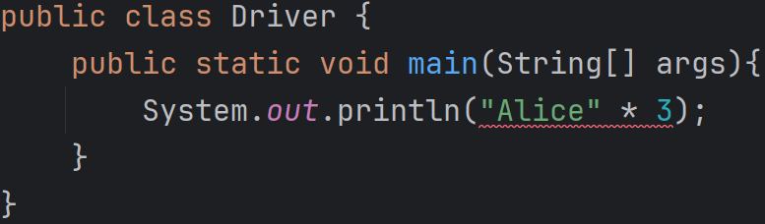


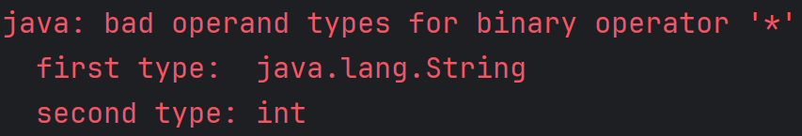
Math operators - Multiplication
Java
Python

Slide 7
Math operators - Division
Python
  Dividing two numbers always gives you a float
Java
  Dividing two integers always gives you an integer, rounded down
  Dividing an integer and a float always gives you a float

Slide 8
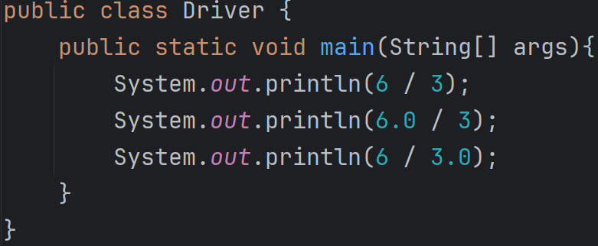
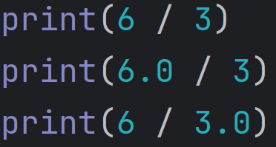


Math operators - Division
Java
Python

Slide 9
Math operators - Power
Python
  We have a power operator
  print(2 ** 3) # prints 6
Java
  There is no power operator
  Must use a Math method
  System.out.println(Math.pow(2,3)); // prints 6

Slide 10
Math operators – Floor division
Python
  We have a floor division operator
  print(7 // 2.0) # prints 3.0
Java
  There is no floor division operator
  Must use a Math method
  double result = 7 / 2;
  System.out.println(Math.floor(result)); // prints 3.0

Slide 11
Comparison operators
Available in both languages
  Equality (==)
  Inequality (!=)
  Greater than (>)
  Less than (<)
  Greater than or Equal (>=)
  Less than or Equal (<=)
Not available in Java
  in, not in, is, is not

Slide 12
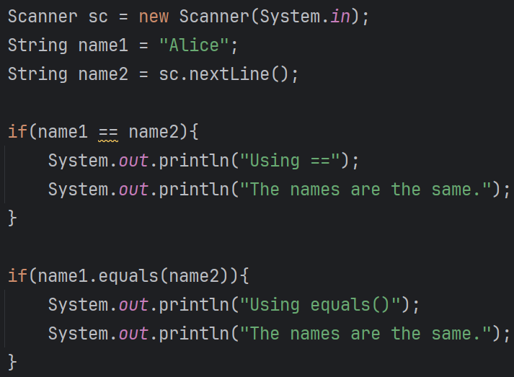
Checking strings for equality in Java
Do not use == to check if two strings are equal in Java
Use the equals() method instead

Slide 13
Logical operators
Operator name | Python syntax | Java Syntax
Logical NOT | not | !
Logical AND | and | &&
Logical OR | or | ||

