Slide 1
CSE 1321
Module 6
Object-Oriented Programming

Slide 2
Object Oriented Programming
Object-Oriented Programming (OOP) is based on the concept of classes, from which objects are created.
In essence, classes work as a blueprint for creating something, while objects created from that class are the actual thing.

Slide 3
Classes
When we create a class, we are creating a new data type.
A class represent the concept or idea of things in the real world, for example a dog.

Slide 4
Parts of a Class
A class is composed of these three components:
  Class name/identifier: We use this to be able to re-call the class.
  Attributes/Fields/Variables: We use these to define the properties of the class.
  Member Functions/Functions/Methods: We use these to define the "behavior" or actions of the class.

Slide 5
Initializing a class
We have created a new data type, and we have created the concept of a dog.
Although, we do not have any dogs yet.
Think about functions, defining a function does not make "work". The function will only work when it is called.
class Dog:
pass

Slide 6
Objects
Also described as an Instance.
An object or instance is an entity in the real world that can be distinctly identified.
It represents a particular dog, employee, student, etc.
It has a unique identity, state, and behavior.

Slide 7
Objects: Identify, State, and Behavior
An objects has a unique identity as it represents one entity, itself.
  Many objects may share the same definition/blueprint, but each object will have their own unique state values.
The object state consists of a set of data fields or attributes (instance variables or properties) with their current values.
The object behavior is defined by a set of methods.

Slide 8
Objects: Example
We can define a class called Students that describe individual students, such that each student defined by this class has:
  A unique ID
  Its own state (First and Last Name, GPA, address, etc.)
  And all share same behaviors (methods)

Slide 9
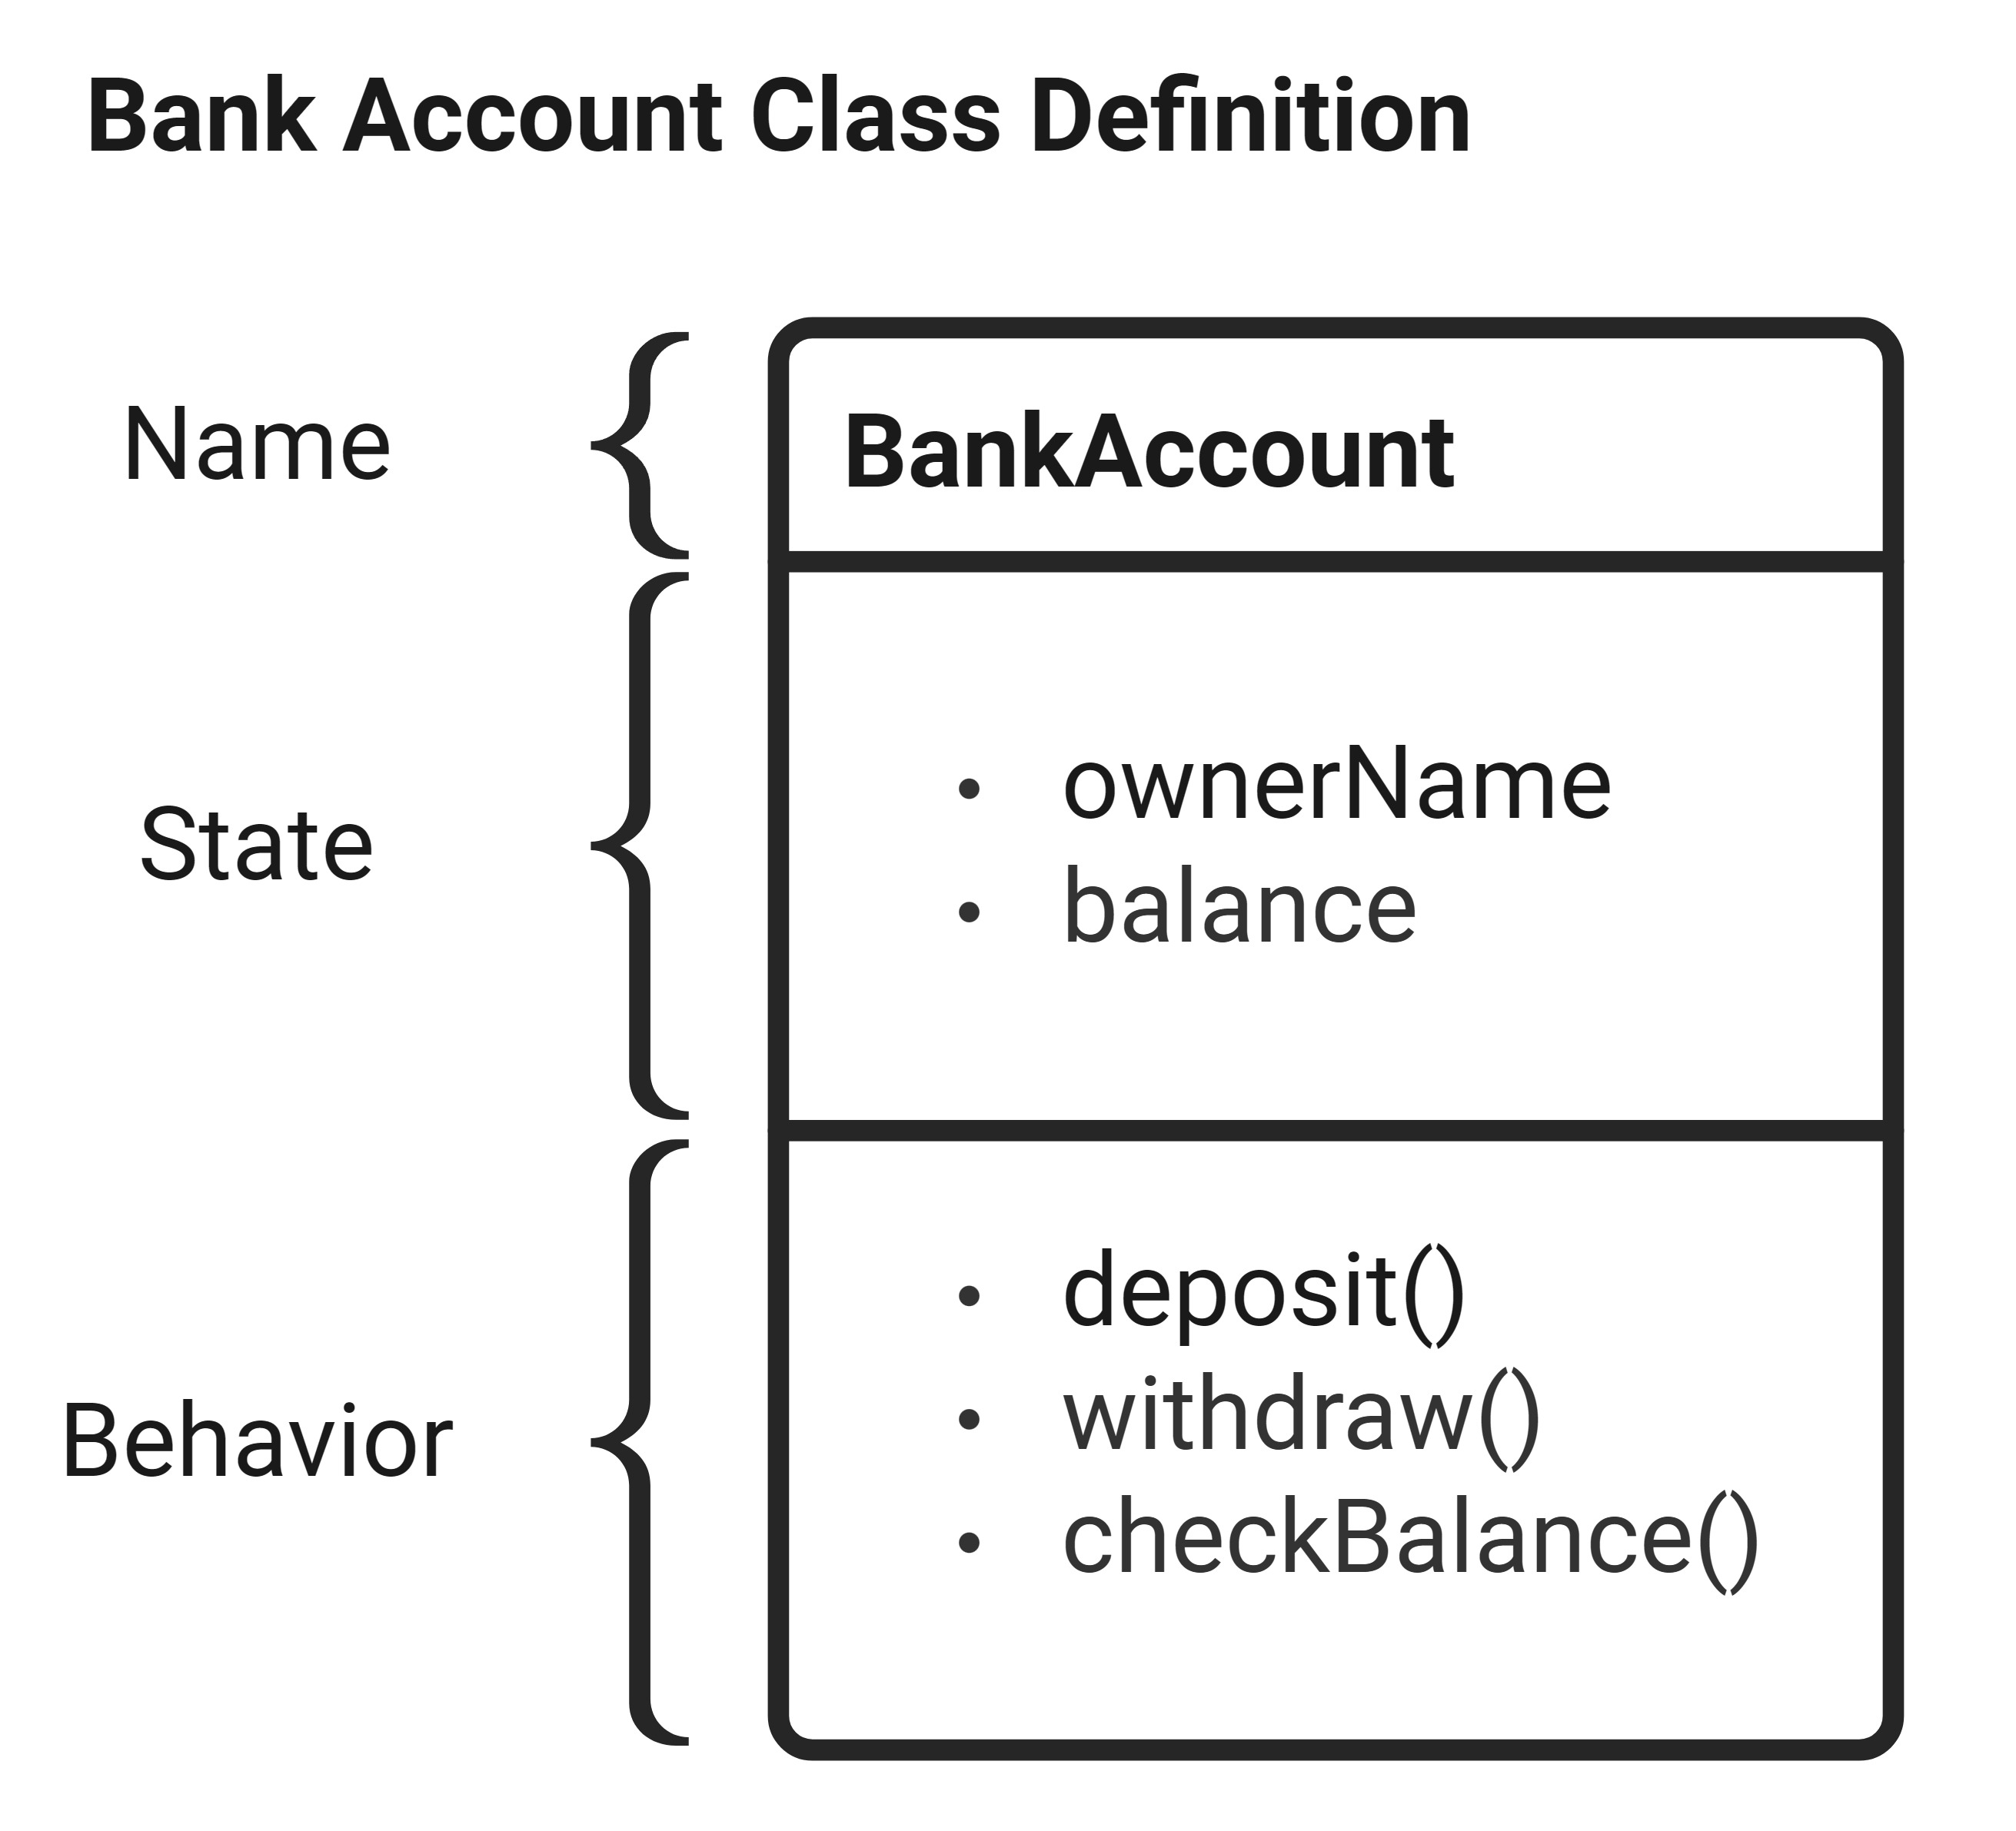
Example: Class Bank Account
From this Bank Account class definition, we can create multiple objects:
  John's Bank Account:
    ownerName: John
    balance: $7,890.00
  Amy's Bank Account:
    ownerName: Amy
    balance: $298,987.00
  Ed's Bank Account:
    ownerName: Ed
    balance: $860,883.00
These objects share the same set of attribute (state) and behaviors (functions) but each object are unique.

Slide 10
Example: Dog Class
In this example we will define a Dog class.
To start, we need to define a Dog's attributes and behaviors.
  We do not have be thorough, just the necessary attributes and behaviors relevant for us.
Attributes:
  Whether the dog is rabid or not (Boolean)
  The weight of the dog (Number)
  The name of the dog (String)
Behaviors:
  The dog's growl
  The ability of the dog to eat

Slide 11
Dog Class Example: Step 1 – Class & Name Definition
class Dog:
pass
Notice that we use the reserved keyword: class, to start defining the class in Python.
Also, notice that for classes we do not have a set of parentheses after the name/identifier.

Slide 12
Dog Class Example: Step 2 – Define Attributes
class Dog:
# States of a Dog
rabid = False
weight = 0.0
name = ""

Slide 13
Dog Class Example: Step 3 – Define Behaviors
class Dog:
# States of a Dog
rabid = False
weight = 0.0
name = ""
# Behaviors of a Dog
def growl(self):
print(f"{self.name} says grr")
def eat(self, food):
self.weight += food
print(f"{self.name} now weighs {self.weight}")
Notice the `self` keyword defined in the parameter of the class functions. We will discuss this next.

Slide 14
About the `self` Keyword
We use the self keyword to be able to reference and access an object's unique state.
Remember that objects of the same class share the same set of attribute, but each object's state of these attribute is unique.
This parameter is necessary for accessing the fields inside the object.
When you call these functions, you will not pass any arguments for the `self`, this is automatically handled by the computer.

Slide 15
About the Dot `.` operator
The Dot `.` operator is used to:
  Get access to an instance's attributes
  Get access to an instance's behaviors
Format:
  <instance/object>.<attribute or behavior>

Slide 16
Example: Creating Dog Class Objects
d1 = Dog()
d1.name = "Alice"
d1.rabid = True
d1.weight = 50.0
d2 = Dog()
d2.name = "Bob"
d2.weight = 30.0
Using the Dog class definition in the previous example, we can initialize two dog objects by creating two variables that will hold an individual dog object.
For each object, d1 and d2, we use the dot operator to access their attributes and set them to their respective values.
d1 and d2 are objects of the same class, but each of their attribute values are unique and different from each other.

Slide 17
Example: Comparing d1 and d2 Dog objects
print(f"d1's name: {d1.name}")
print(f"d2's name: {d2.name}")
print()
# Renaming just d1
d1.name = "Fido"
print(f"d1's name: {d1.name}")
print(f"d2's name: {d2.name}")
Console Output:
Alice
Bob
Fido
Bob
Notice how d2's name stayed as "Bob" even after re-setting d1's name.

Slide 18
The Constructor Function (1 of 2)
In Python, we have a special type of function that are used to "construct" or initialize an object or instance of a class.
This function is used to give initialize a class attribute and initialize them with their values.
Also, you will use the constructor function to define any logic you want the computer to execute when the object is initialized or constructed.
Since this is a special function, it must be named using a reserved keyword: `__init__`
  Note the double underscores before and after the `init`

Slide 19
The Constructor Function (2 of 2)
In Python, to properly define the attributes of a class we will use a constructor function.
The way we defined the Dog class in the previous example is therefore not the appropriate way.
We will correct this in the next example by adding a proper constructor function.

Slide 20
Dog Class Example: Defining the Constructor function
class Dog:
def __init__(self, rabid, weight, name):
print("Constructing a Dog object...")
# initializing attributes:
self.rabid = rabid
self.weight = weight
self.name = name
# Behaviors of a Dog
def growl(self):
print(f"{self.name} says grr")
def eat(self, food):
self.weight += food
print(f"{self.name} now weighs {self.weight}")
Seems like extra work. Why initialize the fields inside the constructor instead of directly into the class body?
This allows initializing the class fields in the constructor parameters.
It also prevents unintended behavior when using mutable fields.
Notice how the constructor is just another class function. It uses the `def` keyword, has parameters, and has the `self` parameter.
What makes this function a constructor is the name: __init__

Slide 21
Dog Class Example: Constructor – Attribute vs Parameter
class Dog:
def __init__(self, rabid, weight, name):
print("Constructing a Dog object...")
# initializing attributes:
self.rabid = rabid
self.weight = weight
self.name = name
# Behaviors of a Dog
def growl(self):
print(f"{self.name} says grr")
def eat(self, food):
self.weight += food
print(f"{self.name} now weighs {self.weight}")
One important distinction to make here is the difference between `rabid` and `self.rabid`.
As explained previously, we use the `self` keyword to specify anything related to an object.
In this situation, we use the self to differentiate the attribute we are initializing (`self.rabid`) and the parameter (`rabid`).

Slide 22
Designing the Constructor
In the constructor function, how we handle attribute initialization will vary. Whether an attribute should be initialized by a parameter, initialized with a default value, or initialized without a parameter value.
Usually, you can follow this guideline, based on the Dog class example:
  Are all Dogs born with the same rabid state? – Yes, they are all born non-rabid.
  Are all Dogs born with the same weight? – No, they are born with different weights.
  Are all Dogs born with the same name? – No, they all have different names.
If ever "no", then you need information passed in as parameters.

Slide 23
Designing the Constructor: Fixing the attributes
def __init__(self, weight, name):
print("Constructing a Dog object...")
# initializing attributes:
self.rabid = False
self.weight = weight
self.name = name
Notice how the constructor attribute now only takes in two parameters: a value for weight, and a value for the name.
Also notice how the rabid class attribute now is defined as False, meaning any Dog object initialized will have the rabid attribute set to False by default

Slide 24
Class Attributes vs Instance Attributes (1 of 4)
Previously, we explained that the attributes rabid, weight, and name should be defined and initialized within the constructor and not "outside".
This is because we have two types of attributes that we can define within the class: Class Attributes and Instance (object) attribute.

Slide 25
Class Attributes vs Instance Attributes (2 of 4)
The attributes rabid, weight, and name describe properties of a Dog, meaning those are Instance Attributes.
Instance Attributes are defined in the constructor.
In the other hand, Class Attributes are properties that describe the class itself.
For example, we can have a `species` attribute defined as "Canis Lupus Familiaris" or have a class attribute called `kingdom` with the value set to "Animalia"
Class Attributes are defined "outside" or how we had defined the instance attributes on the earlier examples before we introduced the constructor function.

Slide 26
Class Attributes vs Instance Attributes (3 of 4)
Even before we were able to initialize the first Dog object, we already had one: The class itself.
This allows us to change the default values of newly created objects
For this example, have the following code as our temporary definition of the dog class:
class Dog:
# States of a Dog
rabid = False
weight = 0.0
name = ""

Slide 27
Class vs Instance Attributes: Example
d1 = Dog()
d1.name = "Alice"
print(f"d1's name: {d1.name}, d1's weight: {d1.weight}")
print(f"Is d1 rabid?: {d1.rabid}")
print()
Dog.rabid = True
Dog.weight = 200.0
d2 = Dog()
d2.name = "Bob"
print(f"d1's name: {d1.name}, d1's weight: {d1.weight}")
print(f"Is d1 rabid?: {d1.rabid}")
print(f"d2's name: {d2.name}, d2's weight: {d2.weight}")
print(f"Is d2 rabid?: {d2.rabid}")
Console Output:
d1's name: Alice, d1's weight: 0.0
Is d1 rabid?: False
d1's name: Alice, d1's weight: 200.0
Is d1 rabid?: True
d2's name: Bob, d2's weight: 200.0
Is d2 rabid?: True
Notice how changing the rabid and weight attributes from the class level (Dog.rabid), it changed d1's and d2's rabid and weight attribute values, but not name.

Slide 28
Class vs Instance Attributes: What is happening
Let's see how the code from the previous example worked.
When accessing a field using the class name, we say that "field belongs to the class".
In practice, what is happening is that a class field is shared across all newly created objects until an assignment is done.
After the first assignment operation, the object will have its own copy of the field.

Slide 29
Class vs Instance Attributes: What is happening Example (1 of 7)
class Dog:
# States of a Dog
rabid = False
weight = 0.0
name = ""
At this stage of the program, we do not have class of type object, but we do have the class itself as an object.
The class Dog has the class attributes:
  `rabid` set to `False`,
  `weight` set to `0.0`
  `name` set to ""

Slide 30
Class vs Instance Attributes: What is happening Example (2 of 7)
class Dog:
# States of a Dog
rabid = False
weight = 0.0
name = ""
d1 = Dog()
After defining the Dog class, we have created a Dog type object called `d1`.
The Dog object d1, at this point in the program, does not have any instance or object attribute.

Slide 31
Class vs Instance Attributes: What is happening Example (3 of 7)
class Dog:
# States of a Dog
rabid = False
weight = 0.0
name = ""
d1 = Dog()
d1.rabid = True
As soon as we assign the class attribute `rabid` at the object or instance level, we add `rabid` as an object attribute.
This means that `rabid` at the class level stays as `False` while the d1 object will have a `rabid` attribute set as `True`.

Slide 32
Class vs Instance Attributes: What is happening Example (4 of 7)
class Dog:
# States of a Dog
rabid = False
weight = 0.0
name = ""
d1 = Dog()
d1.rabid = True
print(d1.weight)
print(d1.rabid)
In this program we have a "catch".
When printing `d1.rabid` we are calling the d1's object attribute `rabid`.
In the previous slide we explained that d1 gained this attribute by simply defining it by doing `d1.rabid = True`.
Otherwise, printing `d1.weight` will not call the d1's object attribute because d1 does not have a `weight` attribute.
  Remember that this attribute has only been defined at the Class attribute level, not instance and has not been defined at object level like `rabid`.
But, if you try running this program, you will notice it will not crash, instead it will print `0.0`
This is because `d1.weight` will call the class attribute `weight` since the object itself does not possess an attribute called `weight`.

Slide 33
Class vs Instance Attributes: What is happening Example (5 of 7)
class Dog:
# States of a Dog
rabid = False
weight = 0.0
name = ""
d1 = Dog()
d1.rabid = True
print(d1.weight)
print(d1.rabid)
d2 = Dog()
By creating d2, we have initialized a second Dog object.
This new object, like d1 initially, does not have any instance attributes.

Slide 34
Class vs Instance Attributes: What is happening Example (6 of 7)
class Dog:
# States of a Dog
rabid = False
weight = 0.0
name = ""
d1 = Dog()
d1.rabid = True
print(d1.weight)
print(d1.rabid)
d2 = Dog()
print(d2.rabid)
By printing `d2.rabid`, the program will output `False`
This is because we have not assigned the `rabid` attribute at object level.
Instead, the program will call the class attribute `rabid`, hence printing `False`.

Slide 35
Class vs Instance Attributes: What is happening Example (7 of 7)
class Dog:
# States of a Dog
rabid = False
weight = 0.0
name = ""
d1 = Dog()
d1.rabid = True
print(d1.weight)
print(d1.rabid)
d2 = Dog()
print(d2.rabid)
Dog.rabid = None
print(d2.rabid)
Lastly, by re-assigning the `rabid` attribute at class level, printing `d2.rabid` will now also output `None`.
Again, d2 does not have a `rabid` instance attribute, so `d2.rabid` will be reaching the class attribute.

Slide 36
Class Attributes vs Instance Attributes (4 of 4)
To reiterate, when an object does not have a field, it will reach up to the class fields.
You can force an object to have its own fields by:
  Doing an assignment operation on the object's field:
    d1.rabid = True
  Initializing the field in the constructor:
        class Dog:
        def __init__(self, weight, name):
        self.rabid = False
        self.weight = weight
        self.name = name

Slide 37
Mutable Fields
Normally, it makes no difference if an object has its own copy of the field or if it is using the classes' field.
This is because the object will have its own copy, once an assignment operation is done.
But this is a big problem for mutable fields types like lists

Slide 38
Mutable Fields: Example (1 of 4)
class Student:
name = ""
class Classroom:
list_of_students = []
def print_students(self):
for student in self.list_of_students:
print(student.name, end=", ")
print()
s1 = Student()
s1.name = "Alice"
s2 = Student()
s2.name = "Bob"
All normal so far, we have initialized two student objects and have initialized the object attribute `name` for both objects respectively.

Slide 39
Mutable Fields: Example (2 of 4)
class Student:
name = ""
class Classroom:
list_of_students = []
def print_students(self):
for student in self.list_of_students:
print(student.name, end=", ")
print()
s1 = Student()
s1.name = "Alice"
s2 = Student()
s2.name = "Bob"
c1 = Classroom()
c2 = Classroom()
All normal as well, we have initialized two Classroom objects.

Slide 40
Mutable Fields: Example (3 of 4)
class Student:
name = ""
class Classroom:
list_of_students = []
def print_students(self):
for student in self.list_of_students:
print(student.name, end=", ")
print()
s1 = Student()
s1.name = "Alice"
s2 = Student()
s2.name = "Bob"
c1 = Classroom()
c2 = Classroom()
c1.list_of_students.append(s1)
c2.list_of_students.append(s2)
Here, we are appending student objects into a list in the classroom objects.
Given that Alice is in Classroom 1, we append s1 in c1's list of students.
Same thing for Bob, we append s2 in c2's list of students

Slide 41
Mutable Fields: Example (4 of 4)
class Student:
name = ""
class Classroom:
list_of_students = []
def print_students(self):
for student in self.list_of_students:
print(student.name, end=", ")
print()
s1 = Student()
s1.name = "Alice"
s2 = Student()
s2.name = "Bob"
c1 = Classroom()
c2 = Classroom()
c1.list_of_students.append(s1)
c2.list_of_students.append(s2)
c1.print_students()
c2.print_students()
As soon as we press run in this program, you will notice something wrong.
The program will output the names contained in those two lists.
But the program will print out both Alice and Bob for both print student function call.

Slide 42
Mutable Fields: What happened?
Adding Alice to Classroom 1 also added her to Classroom 2, and adding Bob to Classroom 2 it also added him into Classroom 1.
This is because the `list_of_student` field belongs to the class.
Given that `c1` and `c2` do not have their individual instance copies of this attribute, they are sharing the one from the class.
We never assigned a `list_of_students` field for `c1` or `c2`, we appended information to it.
We can solve this by initializing a `list_of_students` for both c1 or c2, or by handling `list_of_students` in the constructor.

Slide 43
Mutable Fields: Fixing the problem – Assigning list_of_students
class Student:
name = ""
class Classroom:
list_of_students = []
def print_students(self):
for student in self.list_of_students:
print(student.name, end=", ")
print()
s1 = Student()
s1.name = "Alice"
s2 = Student()
s2.name = "Bob"
c1 = Classroom()
c1.list_of_students = []
c2 = Classroom()
c2.list_of_students = []
c1.list_of_students.append(s1)
c2.list_of_students.append(s2)
c1.print_students()
c2.print_students()
Console Output:
Alice,
Bob,

Slide 44
Mutable Fields: Fixing the problem – Assigning in the constructor
class Student:
name = ""
class Classroom:
def __init__(self):
self.list_of_students = []
def print_students(self):
for student in self.list_of_students:
print(student.name, end=", ")
print()
s1 = Student()
s1.name = "Alice"
s2 = Student()
s2.name = "Bob"
c1 = Classroom()
c2 = Classroom()
c1.list_of_students.append(s1)
c2.list_of_students.append(s2)
c1.print_students()
c2.print_students()
Console Output:
Alice,
Bob,

Slide 45
Summary
A class:
has attributes (which are just variables)
has a constructor which is used to initialize attributes
has other methods (like eat and growl)
is a blueprint (template) for creating objects
creates a new data type
An object:
is an instance of a class
has a state (variables) that is independent from others
trying to access a variable that the object doesn’t have prompts the object to reach to the class for that variable
mutable fields at the class level need to be handled with care

