Slide 1
CSE 1321
Module 3
Methods

Slide 2
Topics
What is a method?
Why do we use methods?
Defining a method
Calling a method
Importing methods
Python Built-in methods

Slide 3
Module 3:
What is a method?

Slide 4
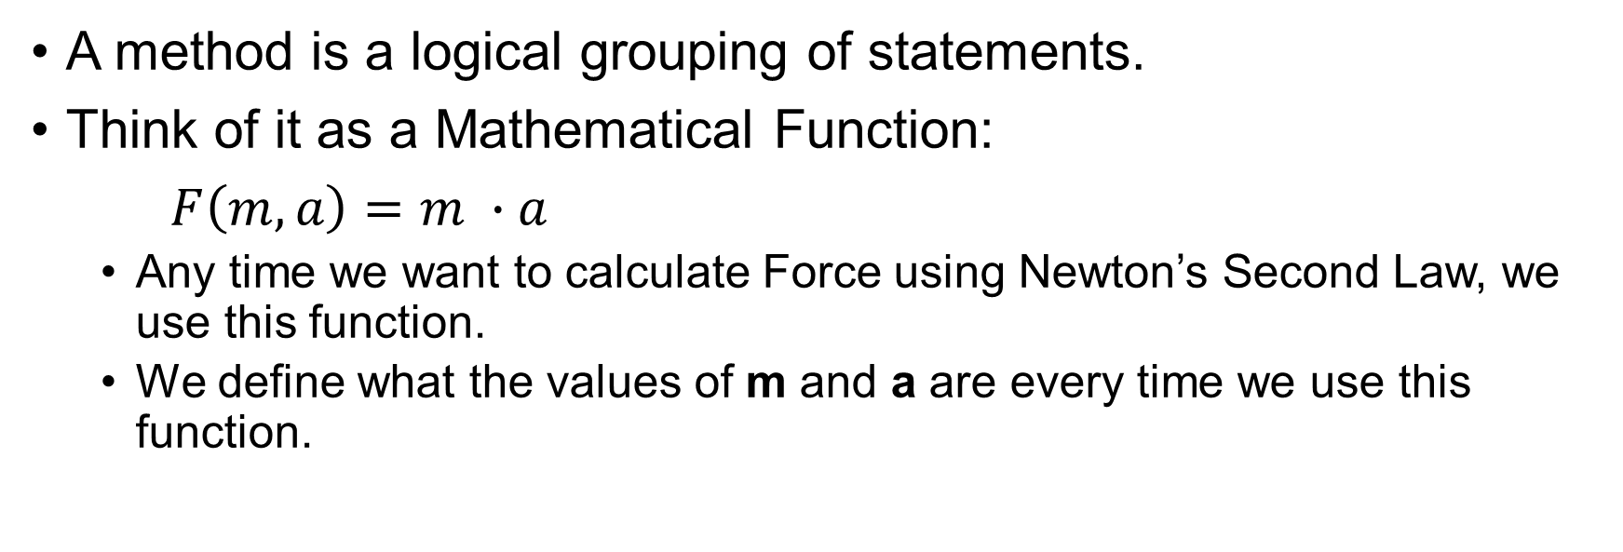
What is a method?
A method is a logical grouping of statements.
Think of it as a Mathematical Function:
$F\left(m, a\right)=m ∙a$
  Any time we want to calculate Force using Newton’s Second Law, we use this function.
  We define what the values of m and a are every time we use this function.

Slide 5
What is a method?: Also, knowns as…
Procedures
Module
Method
Function
Behavior (OOP)
Member function (OOP)
Subroutine

Slide 6
Why do we use methods?
Methods helps us organize our program by grouping processes together.
  This helps reducing the complexity by adding levels of abstraction.
It also enable us to create re-usable code:
  Define a function once and call this function anytime you need to repeat the process it performs.

Slide 7
Module 3:
Defining a method

Slide 8
Defining a method
A method is composed of two main components:
  The header or definition
  And the body
def is_even(number): # Header
return number % 2 == 0 # Body

Slide 9
Defining a method: Header
The Definition or Header is the method declaration:
  It’s at the top line
  In Python, it contains the name of the method and its parameters.
  In Python, it starts with the def keyword.
  In Python, the header is prefixed with a colon : to denote the "end" of the header.
def is_even(number): # Header
return number % 2 == 0 # Body

Slide 10
Defining a method: Header – Name
The name or identifier of the function it is how the function will be referred in within the code.
For example, if you wanted to use the function defined here, you would call:
  print(isEven(2))
def is_even(number): # Header
return number % 2 == 0 # Body

Slide 11
Defining a method: Header – Parameters
Parameters are the input values that will be used in the method.
  One input per parameter.
The method parameters are defined within the parentheses.
For example:
  If you wanted to use the function defined here, you need to provide a value for the `number` parameter. The function will use this value to determine if it is even or not
def is_even(number): # Header
return number % 2 == 0 # Body

Slide 12
Defining a method: Header – Parameters Code Example
Methods can have any number of parameters (including none).
def hello_world():
print("Hello World")
def is_odd(number):
return number % 1 == True
def average(n1, n2, n3, n4):
return (n1 + n2 + n3 + n4) / 4

Slide 13
Defining a method: Header – Parameters: Required Params.
Some methods have required parameters.
If you want to call that method, you must pass all the parameters it requires.
def average(n1, n2, n3, n4):
return (n1 + n2 + n3 + n4) / 4
print(average(80, 90, 39, 40)) # Good!
print(average(90, 30, 40)) # ERROR

Slide 14
Defining a method: Header – Parameters: Optional Params.
Some methods have optional parameters or default parameters.
If you do not pass an argument, the method will use a default value
Notice in the code that the second call, even though there is no fourth parameter, it will resolve as 0.
def average(n1, n2, n3, n4 = 0):
return (n1 + n2 + n3 + n4) / 4
print(average(80, 90, 39, 40)) # Good!
print(average(90, 30, 40)) # Good!

Slide 15
Defining a method: Header – Parameters: Optional Params. Disclaimer
Be careful with the order of your optional parameters:
  Required Parameters must be declared before optional ones.
# Syntax Error
def average(n1 = 0, n2, n3, n4):
return (n1 + n2 + n3 + n4) / 4

Slide 16
Defining a method: Body
The method Body is a collection of statements grouped together to perform an operation.
It's the code that gets executed whenever this method is used/called.
As with selection or repetition structures, the body must be at least 1 level of indentation after the header/definition.
def is_even(number): # Header
return number % 2 == 0 # Body

Slide 17
Defining a method: Body – Scope
Variables and parameters declared inside the scope of a method, only exist inside that method’s scope.
This enables us to re-use names for variables.
It is important that you understand that just because they have the same name, they do not refer to the same value.
Note that the following code will crash because the variables mass and acceleration have not been defined since they only exist within the main function.
def force_calculation():
force = mass * acceleration
return force
def main():
mass = 40
acceleration = 50
print(f"Mass: {mass}")
print(f"Acceleration: {acceleration}")
print(f"Force: {force_calculation()}")

Slide 18
Defining a method: Body – `return` statement
One useful statement that we can use within a function is the return statement.
There are two actions the return keyword perform:
  The return keyword is used to forcefully terminated a method.
    Like the break keyword on a loop.
  Also, we use the return keyword to return a value.
    The method call becomes an expression of whatever we return
    For example, isEven() is just a Boolean expression.
def is_even(number):
return number % 2 == 0

Slide 19
Defining a method: Body – `return` statement disclaimer
If we do not specify a return statement in a function, python will make the return return `none`.
def hello_world():
print("Hello World")
print(type(hello_world()))

Slide 20
Defining a method: Body – `return` statement disclaimer Code Example
def hello_world():
print("Hello World")
print(type(hello_world()))
Hello World
<class 'NoneType'>
Notice how before the type function returns the data type of the function call, it has to process the function. Hence why it prints hello world first.

Slide 21
Module 3:
Calling a method

Slide 22
Calling a method
We have discussed how to declare methods, declare parameters, define a body, and returning a value.
Defining a method does not make it executable.
We need to call it.
We can call a method from anywhere: Top-level, inside a function, inside an IF statement, inside a loop, etc..

Slide 23
Calling a method: Code Example
def hello_world():
print("Hello World")
# Top Level Call
hello_world()
# Inside a method
def main():
hello_world()
# Inside an IF statement
if True:
hello_world()
# Inside a loop
for i in range(3):
hello_world()
Hello World
Hello World
Hello World
Hello World
Hello World
Hello World

Slide 24
Calling a method: Argument vs Parameter
One important distinction is going to be understanding what is an argument and what is a parameter.
  Parameters:
    Parameters are defined in the function header.
    Inputs the method can receive.
  Arguments:
    Arguments are defined in the function call.
    Actual input value passed.
def Force_Calculation(mass, acceleration):
force = mass * acceleration
return force
def main():
mass = 40
acceleration = 50
print(f"Mass: {mass}")
print(f"Acceleration: {acceleration}")
print(f"Force: {Force_Calculation(mass, acceleration)}")

Slide 25
Module 3:
Importing Methods

Slide 26
Importing Methods
We have discussed how you can define methods and call them whenever they are defined in the same file as your main program.
With methods, we have discussed that we can leverage re-usable code, but this reusability does not mean reusable only within a single file.
We can create a separate file that can contain some methods and import them to different files to access our methods.

Slide 27
Importing Methods: Disclaimer
To make sure this works properly, we need to keep all of our .py files at the same directory.
  It is possible to import files in different directories, but this is out of the scope of this class.
Always make sure your project file is well structured and organized.
When importing a file, beware that any code outside a method (top-level) will always execute.

Slide 28
Importing Methods: Syntax
Methods can be imported by:
  Importing the entire file with all its functions.
  Or by importing specific functions from the file
# import everything
import file_name
# import only selected function(s)
from file_name import your_function

Slide 29
Module 3:
Python Built-in methods

Slide 30
Python Built-in method
Be mindful of the following:
  Some methods will return a value, which will need to be stored or handled.
  Some methods return no value but perform actions on the object it was called from.
  Some methods require inputs while others need to be called from a specific object.

Slide 31
Python Built-in method: Some examples 1 of 4
enumerate()
  returns a number and an element in a sequence
float()
  Returns a floating-point number representation of the parameter
int()
  Returns an integer representation of the parameter

Slide 32
Python Built-in method: Some examples 2 of 4
len()
  Returns the number of elements of the parameter
max() & min()
  Return the highest and lowest element in a sequence, respectively
print()
  prints the parameter to the console

Slide 33
Python Built-in method: Some examples 3 of 4
range()
  returns an iterable of the given range.
round()
  rounds the input to the nearest whole number
str()
  returns a string representation of the parameters

Slide 34
Python Built-in method: Some examples 4 of 4
type()
  returns the type of the parameter
More can be found at https://docs.python.org/3/library/functions.html
Or by searching “python built-in functions”

Slide 35
Python Built-in method: Built-in object methods
Data types and classes (more on this later) can have their own list of methods
These are usually available to perform routine operations on the data type without the need to write the code ourselves

Slide 36
Python Built-in method: Built-in string methods examples 1 of 4
The methods below must be called from a specific string. Replace the “str” with the string in question.
str.capitalize()
  returns a string with the first caracter capitalized and all others in lower case
str.isalpha()
  returns true if all characters are alphabetic characters

Slide 37
Python Built-in method: Built-in string methods examples 2 of 4
The methods below must be called from a specific string. Replace the “str” with the string in question.
str.isalnum()
  returns true if all characters are alphanumeric characters
str.replace(old, new)
  returns a copy of a string with all occurrences of the “old” parameter replaced with the “new” parameter

Slide 38
Python Built-in method: Built-in string methods examples 3 of 4
The methods below must be called from a specific string. Replace the “str” with the string in question.
str.isdigit()
  returns true if all characters are digits
str.isupper() & str.islower()
  returns true if all characters are upper or lower case, respectively

Slide 39
Python Built-in method: Built-in string methods examples 4 of 4
The methods below must be called from a specific string. Replace the “str” with the string in question.
str.upper() & str.lower()
  returns the string with all character in upper and lower case, respectively
More can be found at https://docs.python.org/3/library/stdtypes.html#string-methods
Or by searching “python string methods”

