Slide 1
CSE1300
Introduction to Software Engineering
Notes:
Introduce yourself and welcome the students

Slide 2
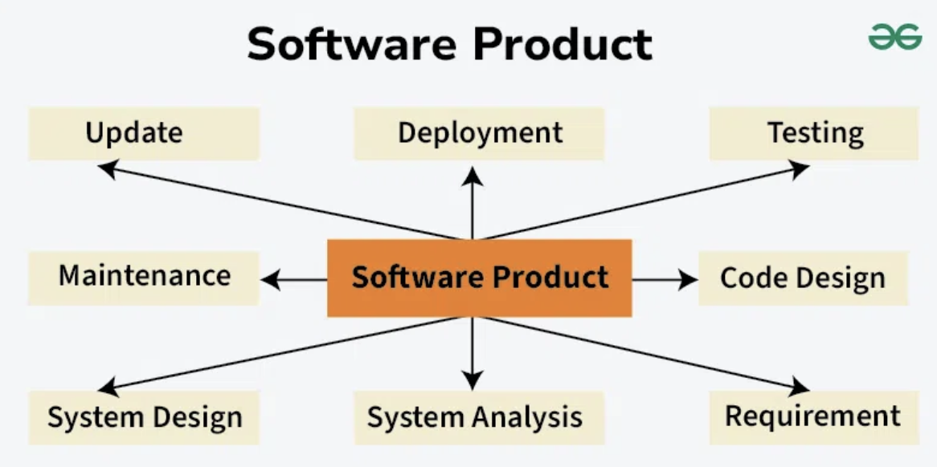
What is Software Engineering?
Software Engineering is the process of designing, developing, testing, and maintaining software. It is a systematic and disciplined approach to software development that aims to create high-quality, reliable, and maintainable software. Software engineering includes a variety of techniques, tools, and methodologies, including requirements analysis, design, testing, and maintenance.

Slide 3
Software engineering includes a variety of techniques, tools, and methodologies, including requirements analysis, design, testing, and maintenance.
It is a rapidly evolving field, and new tools and technologies are constantly being developed to improve the software development process.
By following the principles of software engineering and using the appropriate tools and methodologies, software developers can create high-quality, reliable, and maintainable software that meets the needs of its users.
Software Engineering is mainly used for large projects based on software systems rather than single programs or applications.
The main goal of Software Engineering is to develop software applications for improving quality, budget, and time efficiency.
Software Engineering ensures that the software that has to be built should be consistent, correct, also on budget, on time, and within the required requirements.

Slide 4
Key Principles of Software Engineering
Modularity: Breaking the software into smaller, reusable components that can be developed and tested independently.
Abstraction: Hiding the implementation details of a component and exposing only the necessary functionality to other parts of the software.
Encapsulation: Wrapping up the data and functions of an object into a single unit and protecting the internal state of an object from external modifications.
Reusability: Creating components that can be used in multiple projects, which can save time and resources.
Maintenance: Regularly updating and improving the software to fix bugs, add new features, and address security vulnerabilities.
Testing: Verifying that the software meets its requirements and is free of bugs.

Slide 5
Key Principles of Software Engineering
Design Patterns: Solving recurring problems in software design by providing templates for solving them.
Agile methodologies: Using iterative and incremental development processes that focus on customer satisfaction, rapid delivery, and flexibility.
Continuous Integration & Deployment: Continuously integrating the code changes and deploying them into the production environment.

Slide 6
Main Attributes of Software Engineering
Software Engineering is a systematic, disciplined, quantifiable study and approach to the design, development, operation, and maintenance of a software system. There are four main Attributes of Software Engineering.
Efficiency: It provides a measure of the resource requirement of a software product efficiently.
Reliability: It assures that the product will deliver the same results when used in similar working environment.
Reusability: This attribute makes sure that the module can be used in multiple applications.
Maintainability: It is the ability of the software to be modified, repaired, or enhanced easily with changing requirements.

Slide 7
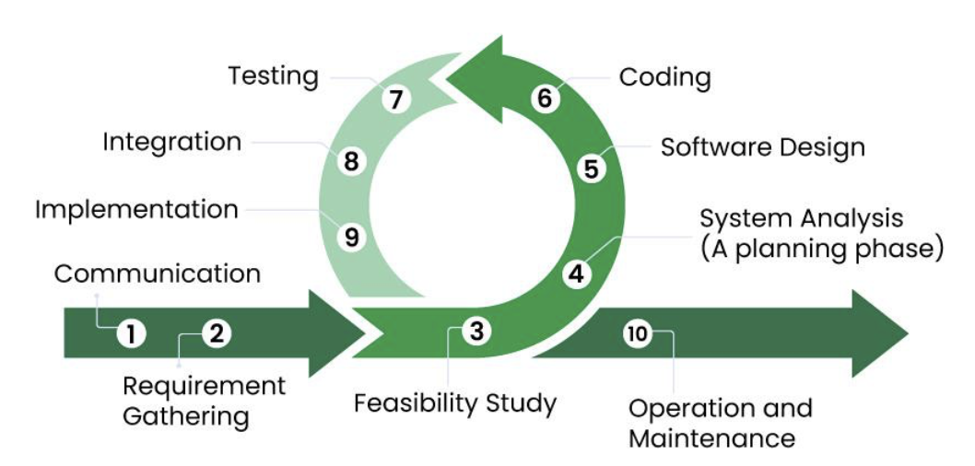
Software Development Process
The software development process is the approach to developing and delivering software applications. This process might include improving design and product management by splitting the work into smaller steps or processes.

Slide 8
Software Development Life Cycle (SDLC)
Software development life cycle (SDLC) is a structured process that is used to design, develop, and test good-quality software. SDLC, or software development life cycle, is a methodology that defines the entire procedure of software development step-by-step. The goal of the SDLC life cycle model is to deliver high-quality, maintainable software that meets the user’s requirements. SDLC in software engineering models outlines the plan for each stage so that each stage of the software development model can perform its task efficiently to deliver the software at a low cost within a given time frame that meets users requirements.

Slide 9
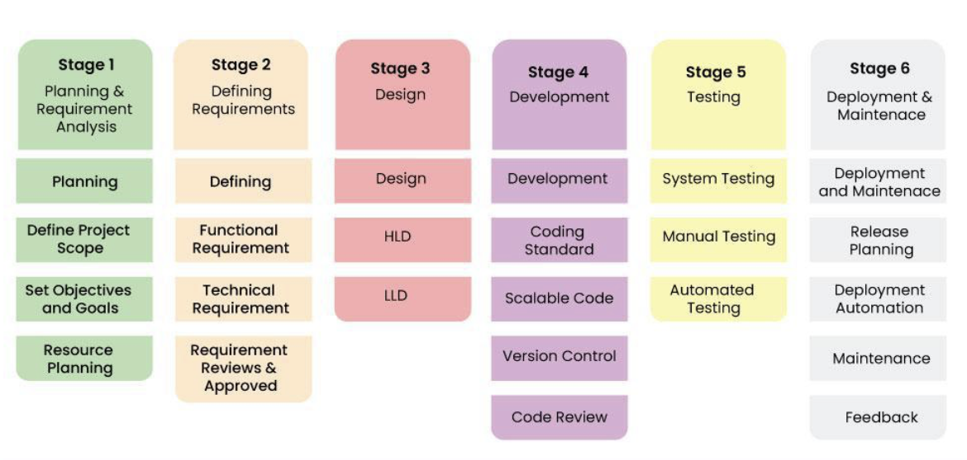
Stages of the Software Development Life Cycle

Slide 10
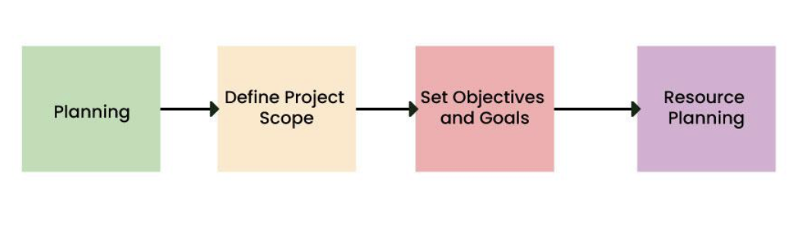
Stage-1: Planning and Requirement Analysis
Planning is a crucial step in everything, just as in software development. In this same stage, requirement analysis is also performed by the developers of the organization. This is attained from customer inputs, and sales department/market surveys.
The information from this analysis forms the building blocks of a basic project. The quality of the project is a result of planning. Thus, in this stage, the basic project is designed with all the available information.

Slide 11
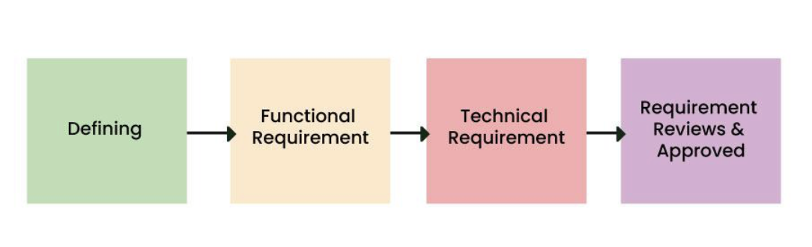
Stage-2: Defining Requirements
In this stage, all the requirements for the target software are specified. These requirements get approval from customers, market analysts, and stakeholders. This is fulfilled by utilizing SRS (Software Requirement Specification). This is a sort of document that specifies all those things that need to be defined and created during the entire project cycle.

Slide 12
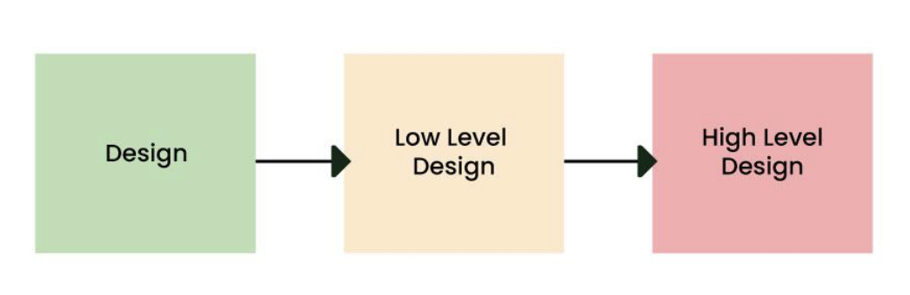
Stage-3: Designing Architecture
SRS is a reference for software designers to come up with the best architecture for the software. Hence, with the requirements defined in SRS, multiple designs for the product architecture are present in the Design Document Specification (DDS). This DDS is assessed by market analysts and stakeholders. After evaluating all the possible factors, the most practical and logical design is chosen for development.

Slide 13
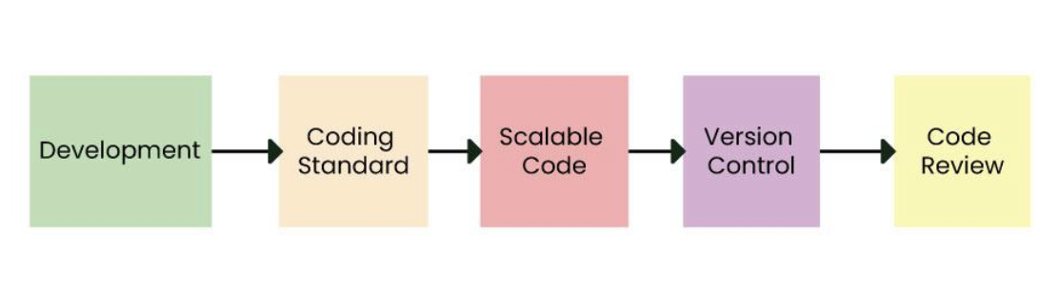
Stage-4: Developing Product
At this stage, the fundamental development of the product starts. For this, developers use a specific programming code as per the design in the DDS. Hence, it is important for the coders to follow the protocols set by the association. Conventional programming tools like compilers, interpreters, debuggers, etc. are also put into use at this stage. Some popular languages like C/C++, Python, Java, etc. are put into use as per the software regulations.

Slide 14
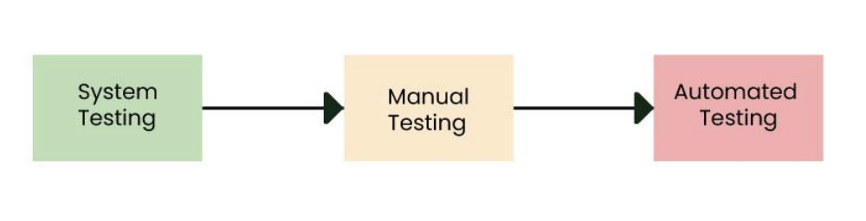
Stage-5: Product Testing and Integration
After the development of the product, testing of the software is necessary to ensure its smooth execution. Although, minimal testing is conducted at every stage of SDLC. Therefore, at this stage, all the probable flaws are tracked, fixed, and retested. This ensures that the product confronts the quality requirements of SRS.

Slide 15
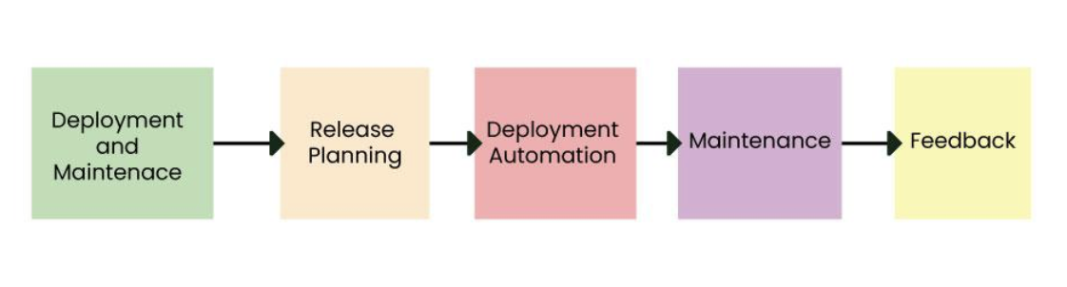
Stage-6: Deployment and Maintenance of Products
After detailed testing, the conclusive product is released in phases as per the organization’s strategy. Then it is tested in a real industrial environment. It is important to ensure its smooth performance. If it performs well, the organization sends out the product as a whole. After retrieving beneficial feedback, the company releases it as it is or with auxiliary improvements to make it further helpful for the customers.

Slide 16
Difference between Traditional and Agile Software Development
Traditional Software Development
Traditional Software Development is the software development process used to design and develop simple software. It is used when the security and many other factors of the software are not much important. It is used by freshers to develop the software.
Agile Software Development Agile Software Development is the software development process used to design complicated software. It is used when the software is quite sensitive and complicated. It is used when security is much more important. It is used by professionals to develop the software.

Slide 17
Agile Software Development
Traditional Software Development
1. Planning 2. Requirement Analysis 3. Designing 4. Implementation 5. Testing 6. Deployment
Examples
Sky
Phillips
JP Morgan Chase
1. Requirement Analysis
2. Design 3. Implementation 4. Coding and Testing 5. Maintenance
Examples
Office productivity suites
Data management software
Media players
Security programs

Slide 18
Software Testing
The Software Testing Tutorial serves as a comprehensive guide for learning Software Testing. It covers all software testing basics to the most advanced concepts, making it beneficial for both beginners and experienced professionals.
Testing is basically a collection of methods to evaluate an application’s suitability for use by a predetermined script. The basic goal of testing is to find application flaws so that they may be identified and fixed.

Slide 19
What is Software Testing?
Software testing involves executing a program to identify any error or bug in the software product’s code.
This process takes into account all aspects of the software, including its reliability, scalability, portability, reusability, and usability.
The main goal of software testing is to ensure that the system and its components meet the specified requirements and work accurately in every case.

Slide 20
Manual Testing
Manual testing is the process of verifying an application’s functionality by client requirements without using any automated techniques. We do not need to have in-depth knowledge of any testing tool to do manual testing on any application; rather, we should have a thorough grasp of the product to quickly create the test document.
Automation Testing
With the use of automation tools or a programming language referred to as automation testing, any manual test cases may be converted into test scripts. We can increase the pace of our test execution with the aid of automated testing as there is no need for human labour. It is necessary to create and run test scripts.

Slide 21
Software Testing Principles
Software testing is putting software or an application to use to find errors or faults. We must go by certain guidelines while testing software or applications to ensure that the final result is free of flaws. This saves the test engineers’ time and effort as they can more efficiently test the program. We will learn about the seven fundamental tenets of software testing in this part.
Testing shows the presence of defects
Exhaustive Testing is not possible
Early Testing
Defect Clustering
Pesticide Paradox
Testing is context-dependent
Absence of errors fallacy

Slide 22
Advantages of Software Engineering
Improved Quality: By following established software engineering principles and techniques, the software can be developed with fewer bugs and higher reliability.
Increased Productivity: Using modern tools and methodologies can streamline the development process, allowing developers to be more productive and complete projects faster.
Better Maintainability: Software that is designed and developed using sound software engineering practices is easier to maintain and update over time.
Reduced Costs: By identifying and addressing potential problems early in the development process, software engineering can help to reduce the cost of fixing bugs and adding new features later on.

Slide 23
Advantages of Software Engineering
Increased Customer Satisfaction: By involving customers in the development process and developing software that meets their needs, software engineering can help to increase customer satisfaction.
Better Team Collaboration: By using Agile methodologies and continuous integration, software engineering allows for better collaboration among development teams.
Better Scalability: By designing software with scalability in mind, software engineering can help to ensure that software can handle an increasing number of users and transactions.
Better Security: By following the Software Development Life Cycle (SDLC) and performing security testing, software engineering can help to prevent security breaches and protect sensitive data.

Slide 24
Disadvantages of Software Engineering
High upfront costs: Implementing a systematic and disciplined approach to software development can be resource-intensive and require a significant investment in tools and training.
Limited flexibility: Following established software engineering principles and methodologies can be rigid and may limit the ability to quickly adapt to changing requirements.
Bureaucratic: Software Engineering can create an environment that is bureaucratic, with a lot of processes and paperwork, which may slow down the development process.
Complexity: With the increase in the number of tools and methodologies, software engineering can be complex and difficult to navigate.

Slide 25
Disadvantages of Software Engineering
Limited creativity: The focus on structure and process can stifle creativity and innovation among developers.
High learning curve: The development process can be complex, and it requires a lot of learning and training, which can be challenging for new developers.
High dependence on tools: Software engineering heavily depends on the tools, and if the tools are not properly configured or are not compatible with the software, it can cause issues.
High maintenance: The software engineering process requires regular maintenance to ensure that the software is running efficiently, which can be costly and time-consuming.

Slide 26
Conclusion
Software engineering is a key field that involves creating and maintaining software. It combines technical skills, creativity, and problem-solving. As technology advances, the need for software engineers increases, making it a great career choice. Whether you’re new to the field or want to learn more, understanding software engineering is crucial. Keep exploring, learning, and enjoying the challenges and opportunities this field offers.

