Slide 1
CSE1300
An Introduction to Encryption, Network Security, and Social Engineering
Notes:
Introduce yourself and welcome the students

Slide 2
Introduction to Security
Security refers to the protection of digital information, networks, and systems from unauthorized access, attacks, or damage.
Cybersecurity is essential in today's digital world to safeguard personal, corporate, and governmental data.
This presentation covers encryption, network security, and social engineering.

Slide 3
Encryption
Encryption is the process by which a readable message is converted to an unreadable form to prevent unauthorized parties from reading it.
Used in online transactions, messaging apps, and data storage.
WHY Encryption?
Encryption is essential for ensuring data security by protecting sensitive information from unauthorized access. It maintains confidentiality, integrity, and authenticity in digital communications. Encryption is widely used in various applications, including secure online transactions, data storage, and confidential messaging. It helps prevent data breaches, cyberattacks, and identity theft by making intercepted data unreadable without the correct decryption key.

Slide 4
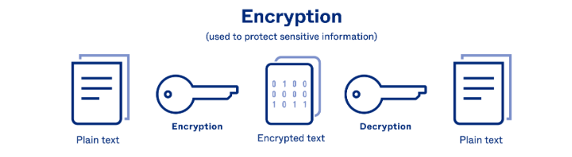
Decryption
﻿Decryption is the process of converting an encrypted message back to its original format(readable).
﻿﻿The original message is called the plaintext message.

Slide 5
Terminology
﻿PLAIN TEXT: Plain text is readable unencrypted message.
﻿﻿CIPHER TEXT: Cipher text is unreadable encrypted message.
﻿﻿PRIVATE KEY: Private key is used to decode the encrypted data at receiver's end.
﻿﻿PUBLIC KEY: Public key is used to encrypt the message at sender's end

Slide 6
Types of Encryption
Symmetric Encryption: Uses a single secret key for both encryption and decryption. Faster but requires secure key exchange.
Asymmetric Encryption: Uses a public and a private key. More secure but computationally expensive.
Hashing: Converts data into a fixed-length string, ensuring integrity. Cannot be reversed.

Slide 7
Symmetric Encryption
The same key is used for both encryption and decryption.
Examples: AES (Advanced Encryption Standard), DES (Data Encryption Standard), Blowfish.
Pros: Faster processing, suitable for bulk data encryption.
Cons: Key distribution poses security risks.

Slide 8
Asymmetric Encryption
Uses a public key for encryption and a private key for decryption.
Examples: RSA (Rivest-Shamir-Adleman), ECC (Elliptic Curve Cryptography).
Pros: More secure key distribution.
Cons: Slower encryption due to complex computations.

Slide 9
Hashing
Converts data into a fixed-length hash value.
Examples: SHA-256 (Secure Hash Algorithm), MD5 (Message Digest Algorithm – outdated).
Used for verifying data integrity but cannot be decrypted.

Slide 10
Encryption in Daily Life
Web security: HTTPS uses encryption to secure websites.
Messaging apps: WhatsApp and Signal use end-to-end encryption.
Disk encryption: Tools like BitLocker and VeraCrypt protect stored data.

Slide 11
Introduction to Network Security
Network security offers a level of guarantee that all the users and machines only have the appropriate access they need to do their job.
This can include:
﻿﻿Preventing unauthorized people from acting on the system maliciously
﻿﻿Preventing users from performing involuntary operations that are capable of harming the system
﻿﻿Securing data by anticipating failures
﻿﻿Guaranteeing that services are not interrupted

Slide 12
Introduction to Network Security
﻿When connecting a machine to a network, you must ensure it is mostly hidden, and only exposes the services that are necessary to the network.
﻿﻿Once a machine is on a network, you should expect people will attempt to scan the machine looking for vulnerabilities.
﻿To protect against that, one should disable any unnecessary network service they are running
Also ensure the machine is fully patched.

Slide 13
Need for Network Security
In the past, hackers were highly skilled programmers who understood the details of computer communications and how to exploit vulnerabilities.
Today almost anyone can become a hacker by downloading tools from the Internet. These complicated attack tools and generally open networks have generated an increased need for network security and dynamic security policies.
The easiest way to protect a network from an outside attack is to close it off completely from the outside world.
A closed network provides connectivity only to trusted known parties and sites; a closed network does not allow a connection to public networks.

Slide 14
Types of Network Security
Firewalls: Filters incoming and outgoing traffic.
Intrusion Detection Systems (IDS): Monitors for malicious activity.
Intrusion Prevention Systems (IPS): Takes action against threats.
﻿Wi-Fi Protected Access (WPA): Encrypts Information.

Slide 15
Firewalls
Acts as a protective barrier between internal networks and external threats.
Types: Hardware and Software firewalls.
Methods: Packet filtering, proxy-based firewalls, stateful inspection.

Slide 16
IDS and IPS
Intrusion Detection System (IDS): Alerts administrators about suspicious activities.
Intrusion Prevention System (IPS): Actively blocks malicious traffic.
Examples: Snort, Suricata.

Slide 17
﻿Wi-Fi Protected Access (WPA)
﻿﻿WPA encrypts information and checks to make sure that the network security key has not been modified.
WPA also authenticates users to help ensure that only authorized people can access the network.
WPA is designed to work with all wireless network adapters, but it might not work with older routers or access points

Slide 18
Virtual Private Network (VPN)
Encrypts internet traffic to secure communication.
Used for: Remote work, security against hackers, bypassing geo-restrictions.
Prevents: Data interception and ISP tracking.

Slide 19
Wireless Network Security
Securing Wi-Fi networks to prevent unauthorized access.
Encryption standards: WPA3 (latest), WPA2 (widely used), WEP (insecure).
Best practices: Strong passwords, hiding SSID, MAC filtering.

Slide 20
Common Network Attacks
Man-in-the-Middle (MITM): Intercepts and alters communication.
Denial of Service (DoS): Overloads a system with traffic to make it unavailable.
Phishing: Deceives users into providing sensitive data.

Slide 21
System Security
Securing devices, operating systems, and applications from cyber threats.
User access control: Implementing role-based access and authentication.
Regular updates: Patching vulnerabilities to prevent exploits.

Slide 22
Security Policies and Compliance
Organizations follow security frameworks to maintain cybersecurity.
Examples: NIST (National Institute of Standards and Technology), ISO 27001, GDPR (General Data Protection Regulation).
Ensures legal compliance and protects consumer data.

Slide 23
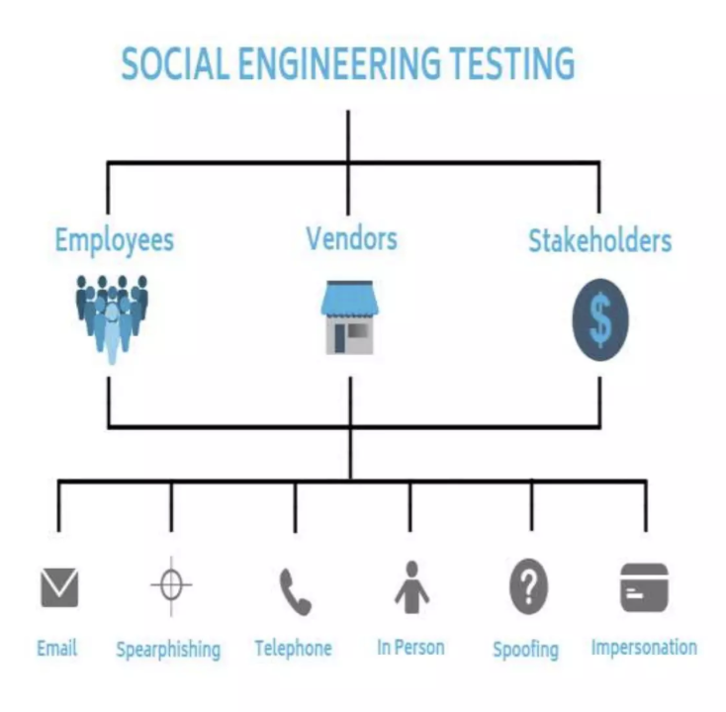
Introduction to Social Engineering
Psychological manipulation used to trick individuals into revealing sensitive information.
Exploits human psychology rather than technical vulnerabilities.
Common in cybercrime and corporate espionage.

Slide 24
Types of Social Engineering Attacks
Phishing: Fraudulent emails or messages requesting sensitive information.
Baiting: Offering something enticing (e.g., free software, USB malware).
﻿Dumpster Diving
﻿﻿Shoulder surfing

Slide 25
Dumpster Diving
"Dumpster diving" means searching trash for useful information. The trash may be in a public dumpster or in a restricted area requiring unauthorized entry. Dumpster diving depends on a human weakness: the lack of security knowledge. Many things can be found dumpster diving (e.g., CDs, DVDs, hard drives, company directories, and so forth). Probably the most famous example of dumpster diving.
﻿﻿Credit Card Receipts.
﻿﻿Bills.
﻿﻿Printed Email.
﻿﻿Password.
﻿﻿Phone Number.
﻿﻿Names.
﻿﻿Printed Emails.
﻿﻿Expense Reports.

Slide 26
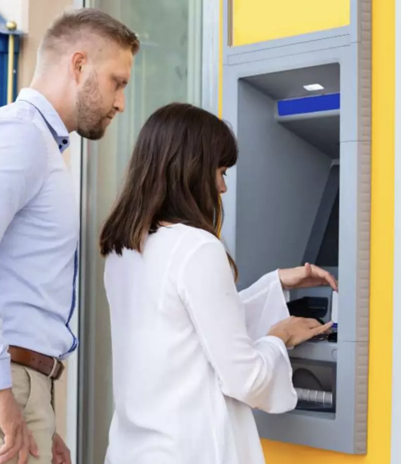
Shoulder Surfing
A shoulder surfing attack explains a situation when the attacker can physically view the devices screens and the password typing keypad to obtain personal information i.e. one of the group of attack methods requires the hacker (attacker) to be physically close to the victims for the attack to succeed and thus a few shoulder surfing attacks will occur with intruders virus malicious intentions or virus malware accessing it. Some similar might result from nosy to people, where it is more an invasion of our privacy.

Slide 27

Baiting
﻿As mentioned above, baiting is a kind of attack where a social engineer will use a false promise or reward to trap victims and steal their sensitive information by infecting their systems with malware. Baits are very attractive and enticing, not to mention manipulative, and their end goal is to infect your system and gain access to personal information.
﻿﻿Attackers who practice baiting use physical devices and enticing offers that appeal to people's curiosity or need to trap them and get what they want from their victims. In many ways, baiting is similar to phishing attacks, but overall, it's different from most social engineering attacks. Why? Because these attacks offer something free that's relevant to the target

Slide 28
Phishing
Phishing is a form of social engineering where attackers deceive people into revealing sensitive information or installing malware such as ransomware.
Types of Phishing:
﻿﻿Spear Phishing.
﻿﻿Whaling.
﻿﻿Vishing.
﻿﻿Email Phishing-General

Slide 29
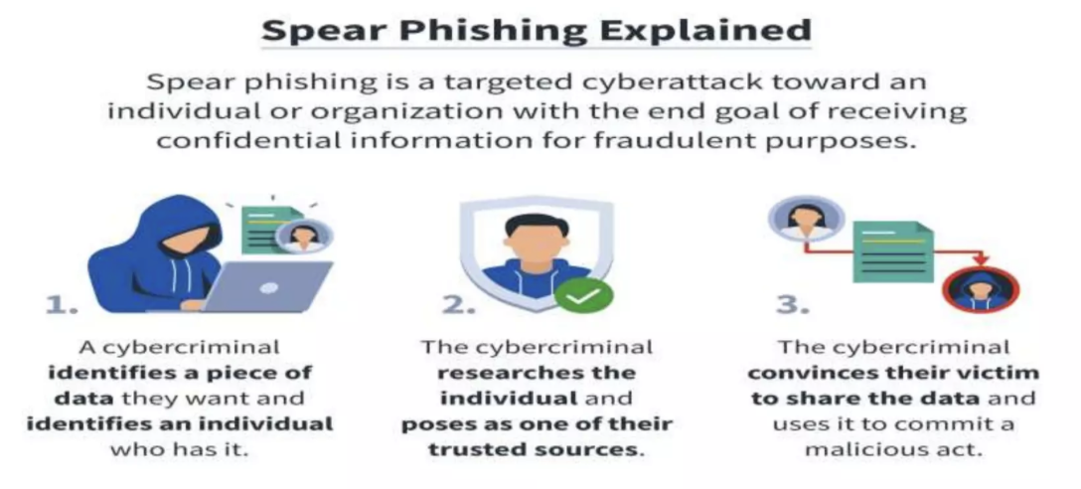
Spear Phishing
Spear phishing is an email or electronic communications scam targeted towards a specific individual, organization or business.

Slide 30
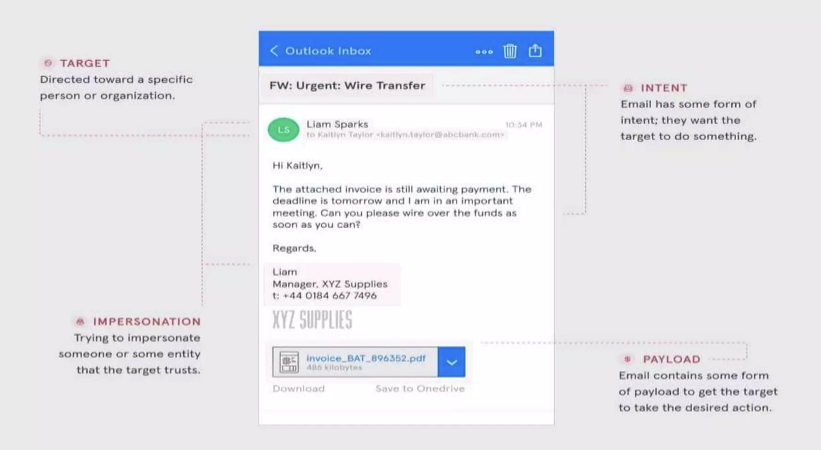
Whaling
A whaling attack, also known as whaling phishing or a whaling phishing attack, is a specific type of phishing attack that targets high-profile employees, such as the chief executive officer or chief financial officer, in order to steal sensitive information from a company.

Slide 31
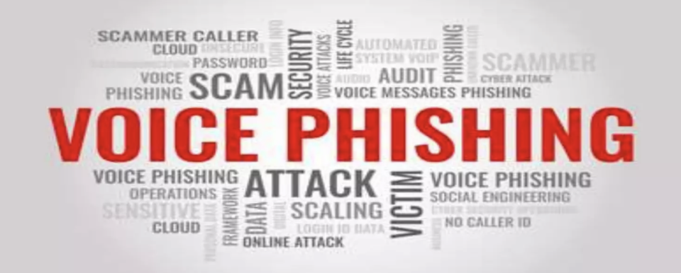
VISHING
Vishing is a cyber crime that uses the phone to steal personal confidential information from victims. Often referred to as voice phishing.

Slide 32
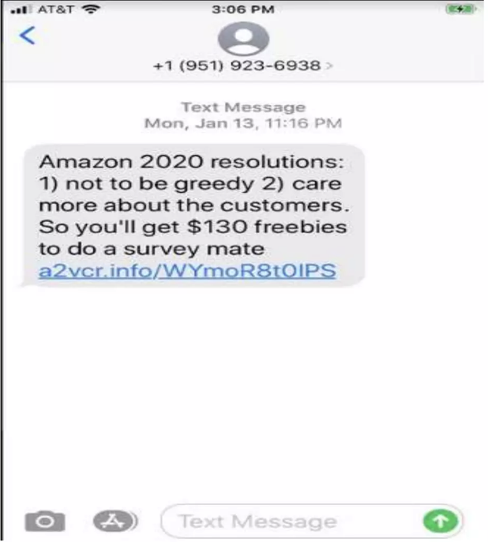
Smishing
Smishing is a type of phishing attack that uses social engineering to get personal information about someone using text messaging.

Slide 33
How Zoom is being exploited for phishing attacks
﻿Creating a Zoom phishing email
﻿﻿Sending fake Zoom meeting to victim
﻿﻿Victim clicks on Zoom meeting phishing link
﻿﻿Malicious code is loaded in the victims system

Slide 34
Social Engineering in the Workplace
Exploiting employees to access confidential data.
Techniques: Impersonation, tailgating, baiting.
Solution: Security awareness training.

Slide 35
Protecting Against Social Engineering
Conducting security awareness training.
Implementing Multi-Factor Authentication (MFA).
Using identity verification protocols.

Slide 36
Best Practices for Security
Use strong, unique passwords and password managers.
Keep software updated to patch vulnerabilities.
Regular security audits and penetration testing.

Slide 37
Ethical Hacking
Ethical hackers help identify security weaknesses.
Conduct penetration tests to simulate attacks.
Certifications: Certified Ethical Hacker (CEH), Offensive Security Certified Professional (OSCP).

Slide 38
Future of Cybersecurity
AI and machine learning enhance threat detection.
Quantum computing poses risks to encryption.
Zero Trust security models increase security.

Slide 39
Conclusion
Cybersecurity awareness is crucial for everyone.
Adopting best practices significantly reduces risks.
Stay informed and proactive.

