Slide 1

Algorithmic Thinking

Slide 2
Learning Objectives
Understanding Algorithmic thinking
Identify the difference between algorithmic thinking and algorithms
Importance and application of algorithmic thinking
Graphical representation of algorithms by Flowcharts

Slide 3
What is Algorithmic Thinking?
Let's define Algorithm first: "An Algorithm is a method to solve a problem that consists of exactly defined instructions”[1]
Algorithmic thinking is a competency that allows us to understand and construct algorithms to solve a problem.
Algorithmic thinking is a key skill in the field of computing that can be developed independently of any programming language.
Algorithmic thinking is not limited to the field of computing and can be applied in other disciplines and daily life.
[1]Futschek, G. (2006, November). Algorithmic thinking: the key for understanding computer science. In International conference on informatics in secondary schools-evolution and perspectives (pp. 159-168). Springer, Berlin, Heidelberg.​

Slide 4
Algorithmic Thinking Includes:
Being able to precisely define the problem
The ability to analyze a given problem
Identify the fundamental steps required to solve a given problem
Thinking about all scenarios and cases of the given problem
Defining a set of detailed instructions to solve the problem (designing the algorithm)
Examining the developed algorithm and improving its efficiency
Futschek, G. (2006, November). Algorithmic thinking: the key for understanding computer science. In International conference on informatics in secondary schools-evolution and perspectives (pp. 159-168). Springer, Berlin, Heidelberg.

Slide 5

Importance of Algorithmic Thinking
There is an algorithm behind any computer program.
Algorithmic thinking is the core skill required for programming.
To be able to develop robust programs we need to invest time in developing efficient algorithms before coding.
We need to train our brains to understand the algorithmic logic and improve its algorithmic thinking skill to be able to intuitively develop algorithms.

Slide 6
Algorithmic Thinking
Example
For sorting students' papers alphabetically based on their last name, the basic algorithm would be like this:
  Skip the first name
  Take the first character of the last name
  Put it in the list alphabetically
  If another paper exists with the same first letter of the last name, then compare the first letter of the first name and sort accordingly.
  Continue until no paper is left unsorted.
Another example of the algorithms in everyday life is when you follow a recipe to make a meal, start the car and drive to school, traffic lights, etc.
What other algorithms you follow daily?
Name some of them

Slide 7
Examples of Algorithms in Computer Science
Algorithms are the core of computer science.
Computers don't think. We need to think for them by creating the algorithms and providing details for them about what they should do to accomplish a task.
Examples of Algorithm in CS that you use daily are:
  Google search
  Google map
  ATM
  Logging into your electronic accounts.
Can you think of more CS algorithms you use daily and explain the steps?

Slide 8
Algorithms in Games and Entertainments
Algorithms play a big role in developing games and the entertainment industry.
They mostly use specific types of algorithms such as Finite State Machines (FSM), or decision trees.
Consider a game that you like to play.
Think about the steps you follow to play it and explain it in the form of itemized steps.

Slide 9
Sample Algorithm:
  Set variables X with a number between (1 to 9).
  Divide X by 2.
  Store the remainder in variable Y.
  If Y equals 0, print X is even.
  Else, If Y equals 1, print X is odd.
This algorithm explains in detail how to write a code that determines if an input integer number between 1 to 9 is odd or even.

Slide 10
Flowcharts and Algorithms
Flowcharts can be seen as graphical representations of algorithms.
Flowcharts are more intuitive and make it easy to understand the algorithms. (depending on the complexity of the problem however, sometimes algorithms may better represent the steps to solve the problem)
We use standard symbols and shapes in a Flowchart to show the sequential steps of an algorithm.

Slide 11
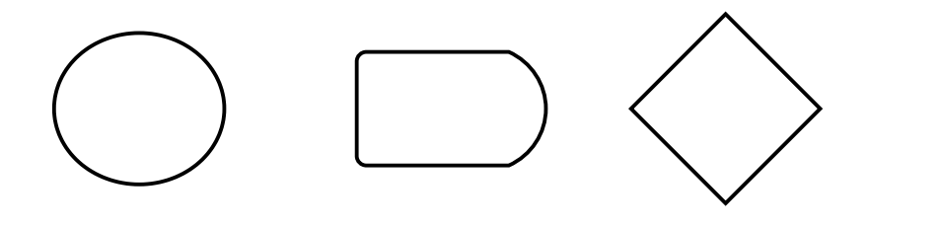
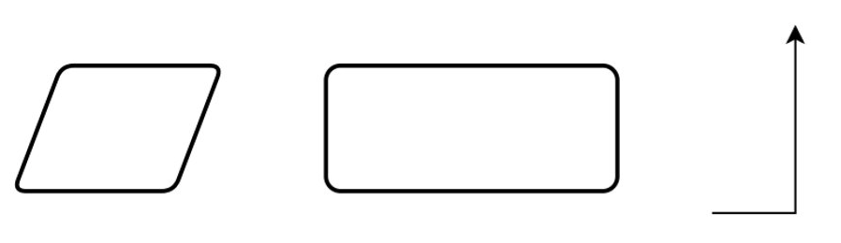
Flowchart Symbols
Start/ End
Display
Decision
Input / Output
Process/instruction
Connecting arrows

Slide 12
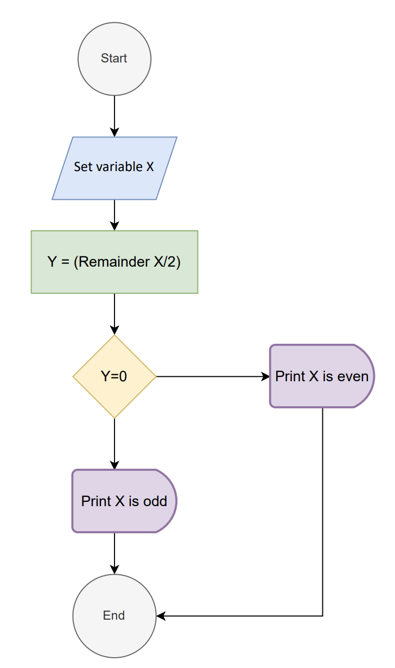
Flowchart Example
Let's make a flowchart for the algorithm of finding odd/even numbers:
Set variables X with a number between (1 to 9).
Divide X by 2.
Store the remainder in variable Y.
If Y equals 0, print X is even.
Else, If Y equals 1, print X is odd.
This algorithm explains in detail how to write a code that determines if an input number is odd or even.
Yes
No

Slide 13
Additional Resources
https://www.youtube.com/watch?v=6hfOvs8pY1k
https://www.youtube.com/watch?v=e_WfC8HwVB8
https://www.youtube.com/watch?v=PY82qqyWJJs
https://www.youtube.com/watch?v=SWRDqTx8d4k
https://equip.learning.com/algorithmic-thinking-computational-thinking/
https://medium.com/tech-based-teaching/if-curious-then-learn-a-brief-intro-to-algorithmic-thinking-ba683bf44994
https://learntocodewith.me/posts/algorithmic-thinking/
https://www.invisibly.com/learn-blog/algorithm-examples-everyday-life

