Slide 1
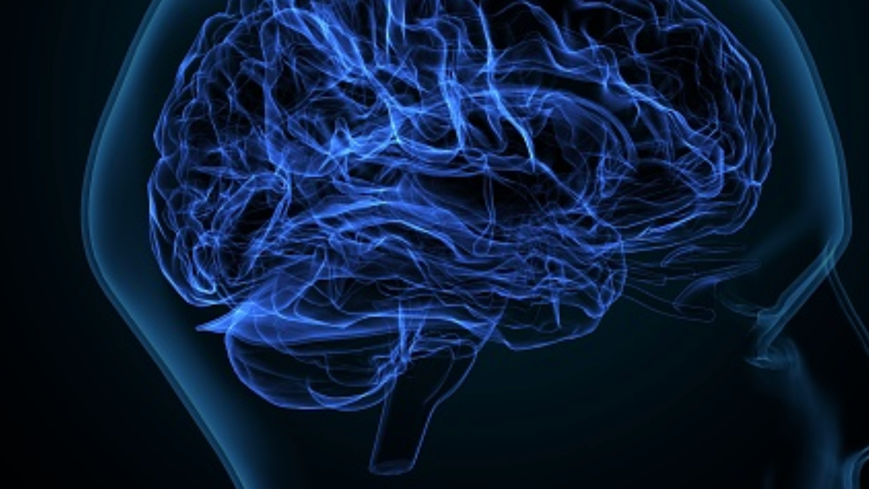
Computational Thinking

Slide 2
Computational Thinking Competencies
Algorithmic Thinking
Pattern Recognition
Decomposition
Abstraction

Slide 3

What is Computational Thinking?
Computational thinking is a thought process and problem-solving approach that involves breaking down complex problems into smaller and manageable components or subproblems (Decomposition), using a sequence of steps (Algorithms) to solve problems, identifying the most important information to solve a problem (Abstraction), reviewing how the solution transfers to similar problems (Pattern Recognition), and finally determining if we can use computers to help us solve the problem more efficiently (Automation).
Yadav, A., Hong, H., & Stephenson, C. (2016). Computational thinking for all: Pedagogical approaches to embedding 21st century problem solving in K-12 classrooms. TechTrends, 60(6), 565-568.

Slide 4
Computational Thinking
Computational thinking is a fundamental skill in computing, engineering, and more in general, STEM education, that improves the problem-solving and algorithmic thinking abilities of the learners.
Computational thinking is a way of thinking about given problems and processing the stages leading to a solution.
It is considered a problem-solving method that can be applied by anyone with different background.
Computational thinking can help in improving students' performance in academia in diverse disciplines, especially in the field of computing.
In computing, computational thinking entails using core computer science concepts to solve problems, write programs and develop systems.
McClelland, K., & Grata, L. A. (2018). Review of the Importance of Computational Thinking in K-12. Proceedings of the eLmL, 2-34.

Slide 5
Why is Computational Thinking Important?
According to McClelland and Lori Grata [1], "computational thinking provides students with problem-solving skills that are applicable in numerous scenarios."
With computational thinking skills, students will have:
Confidence and persistence when working on complex problems
Higher skills in handling the ambiguity in given problems
Ability to deal with open-ended problems
Better communication and collaboration skills
[1] McClelland, K., & Grata, L. A. (2018). Review of the Importance of Computational Thinking in K-12. Proceedings of the eLmL, 2-34.

Slide 6

Decomposition
When doing your assignment such as writing a paper or documentation of your project you create an outline and work on each section separately, then you combine different sections together to complete the document.

Slide 7

Algorithmic Thinking
The word "Algorithm" may seem like a complex technical word. However, we apply algorithms and "think algorithmically" in everyday life.
For example, when we are cooking a meal or baking, we follow certain steps sequentially based on the recipe.

Slide 8
Abstraction
We apply Abstraction in daily activities such as studying, driving, and cooking.
Abstraction helps up retain the most important information we need to accomplish a task without digging into details.
When you learn how to drive the car you don't need to know how the internal parts of the car operate. As long as you know the basics of driving you can drive any car and go anywhere.
When you summarize an article or a movie that you watched you will only extract the most important information in the context and disregard other irrelevant information.

Slide 9

Pattern Recognition
We observe patterns everywhere in our daily lives.
It is not limited to physical patterns but may be patterns in habits, routines, as well as traditions.
Patterns help us solve complex problems by drawing from the solution of a similar problem solved in the past.
Pattern recognition in data analysis: When we are analyzing data, we examine the patterns of data and visualize it.

Slide 10

Computational Thinking in Academics
Computational thinking impacts how students approach and solve problems.
It encourages students to find new ways of looking at the problem.
Computational thinking can help students develop their creative thinking.
Even though computational thinking might seem mostly applied in Mathematics and Science, it spans all other fields.
Research suggests that computational thinking skills can improve student academic performance in computer science undergraduates.
Lemay, D. J., Basnet, R. B., Doleck, T., Bazelais, P., & Saxena, A. (2021). Instructional interventions for computational thinking: examining the link between computational thinking and academic performance. Computers and Education Open, 2, 100056.
McClelland, K., & Grata, L. A. (2018). Review of the Importance of Computational Thinking in K-12. Proceedings of the eLmL, 2-34.
This Photo by Unknown author is licensed under CC BY.

Slide 11
Computational Thinking in the Professional World
Employers are looking for a workforce with analytical thinking and problem-solving skills that can solve complex problems in the real world.
Many jobs need employees with high computational thinking skills to create solutions and develop systems to get the necessary outcomes.
Computational thinking is also very valuable in sectors outside of techs such as Finance, Law, Education, Healthcare, Energy, Travel, and Tourism.

Slide 12

Computational Thinking in Business
Modern-day business is mostly concerned with problem-solving – applying tweaks to improve a company's profit and production.
Most operations of modern corporates are infused with computational thinking.
In the 21st century, in a data-driven industry, employees would need to apply computational thinking skills to analyze consumer behavior, monitor and assess market changes and service performance.

