Slide 1
Logic Gates
Module 1
Part 5

Slide 2
Logic Gates
We’ve seen how a computer has a CPU, and a CPU has an ALU, so how does the ALU work?
Specifically, how does a computer add 2 binary numbers?
There are 3 “gates” we must learn about to answer that question.
We’ll understand logic gates on paper first, then we’ll see how to use them to do addition.
All gates work on Boolean values (true or false)

Slide 3
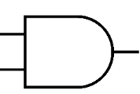
Logical AND
When you see a logical And it’ll look like a capital D with lines.
You can remember this because AND
The two “wires” on the left are inputs, the one “wire” on the right is an output.
Think of the top wire on the left as input 1, and the bottom wire on the left as input 2

Slide 4
How an and gate works
In order to pass this class, you must pass all the assignments AND pass all the tests.
Question: do you pass the class if you fail all the projects?
Answer: no
In order to pass the class BOTH things must be true.
This is how and gates work.

Slide 5
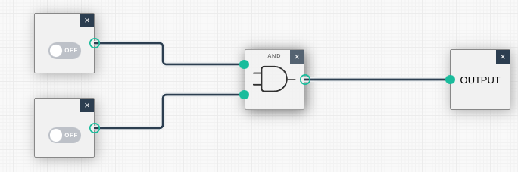
Circuit simulator
Go to this address:
https://academo.org/demos/logic-gate-simulator/
You’ll need to add 2 inputs (use the box on the right to add Input).
Add an AND gate
Wire the 2 inputs to the and gate, wire the output to the output.
You should end up with something like this:

Slide 6
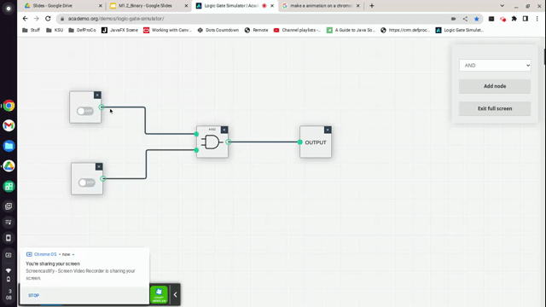
Seeing an AND gate in action

Slide 7
AND
For an AND gate to return true, both inputs must be true.
Input 1 | Input 2 | Output
0 | 0 | 0
0 | 1 | 0
1 | 0 | 0
1 | 1 | 1

Slide 8
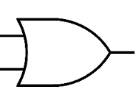
Next up, OR gate
You can pass this class if you already know this material OR, you study hard.
In the case of an OR gate if either input is true, the output is true.
It’s drawn like someone sat on an AND gate

Slide 9
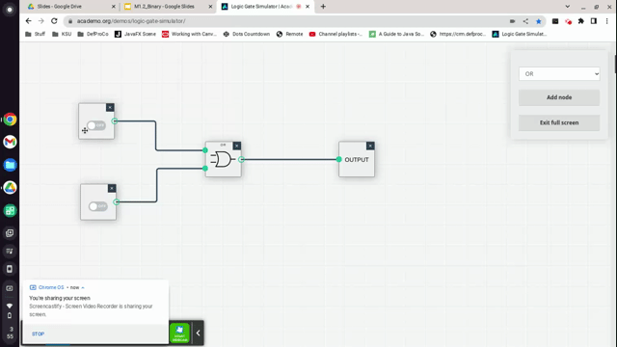
Seeing an OR gate in action

Slide 10
OR
OR will always return true if at least one input is true.
To phrase it differently, OR only returns false is both inputs are false
Input 1 | Input 2 | Output
0 | 0 | 0
0 | 1 | 1
1 | 0 | 1
1 | 1 | 1

Slide 11
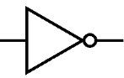
NOT
Our final gate is NOT
If you do NOT study, you will not pass the class.
A NOT gate is drawn as a triangle with a circle on front of it.

Slide 12
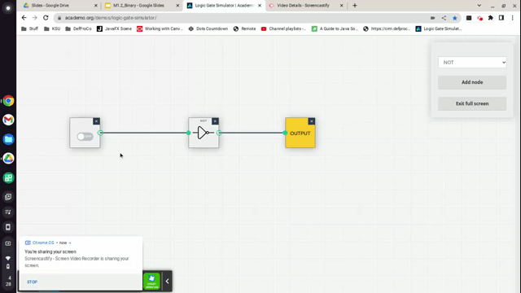
Seeing a NOT gate in action

Slide 13
NOT
NOT is a unary operator, meaning it only has a single input.
NOT simply returns the opposite value it was passed. NOT true is false, NOT false is true:
Input | Output
0 | 1
1 | 0

Slide 14
Adding numbers 1 + 2
1 + 2 = 3
In binary:
01 + 10 = 11

Slide 15
Adding bigger numbers
00001101
00001010
--------
1
Just like with regular math, start on the rightmost digit.
Here we have a 1 + 0 = 1

Slide 16
Adding bigger numbers
00001101
00001010
--------
11
Next, we work left.
We have a 0 + 1 = 1

Slide 17
Adding bigger numbers
00001101
00001010
--------
111
Again, moving left.
We have a 1 + 0 = 1

Slide 18
Adding bigger numbers
00001101
00001010
--------
0111
Again, moving left.
We have a 1 + 1 = 0
And we carry 1
In decimal the same thing happens 9+1=0, and we carry 1

Slide 19
Adding bigger numbers
00001101
00001010
1 - The carry!
--------
10111
Finally, we are on the left most.
We have a 0 + 0 + 1(the carry) = 1
And we carry 1
In decimal the same thing happens 9+1=0, and we carry 1

Slide 20
Let’s check our answer
00001101 is 8+4+1=13
00001010 is 8+2=10
--------
00010111 is 16+4+2+1=23
Thus, we got 13+10 = 23, which is correct!

Slide 21
How can you do binary math with logic gates?
First notice this:
0+0 = 0
0+1 = 1
1+0 = 1
1+1 = 0 - with a carry of 1
This is *almost* an OR gate. The only problem is the case 1+1 = 0, with an OR gate 1 or 1 = 1.
What we need is an Exclusive OR (XOR)!

Slide 22
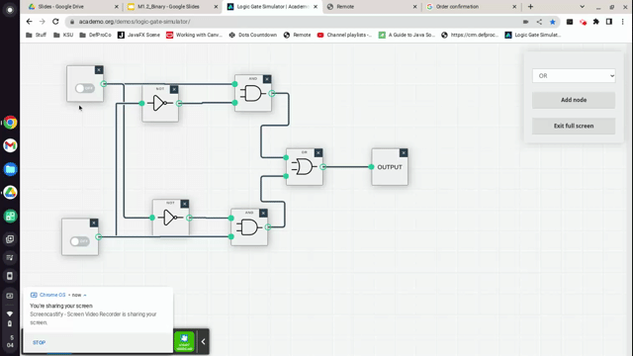
Exclusive OR (XOR)
You are not required to create this, just understand it.

Slide 23

XOR is so common it has its own symbol
This is just a shortcut to represent the circuit you just saw.
Input 1 | Input 2 | Output
0 | 0 | 0
0 | 1 | 1
1 | 0 | 1
1 | 1 | 0
Notes:
XOR output is 1 only when inputs differ.

Slide 24
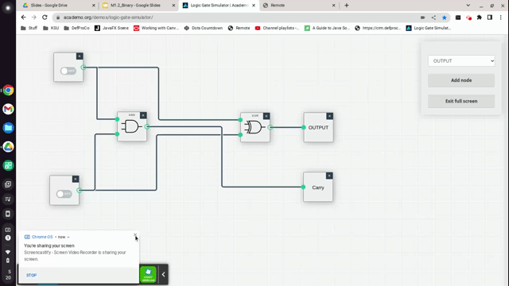
Adding 2 digits (adder circuit)
XOR and AND gates
0+0=0
1+0=1
0+1=1
1+1=0
carry

Slide 25
Scalable
Combining this circuit with another copy of itself allows you to add 4 bits.
It’s possible to increase this until you can add 16 bits
Or 32 bits, or eventually 64 bits.
Similarly, you could produce a circuit that subtracts bits.
Once you can add and subtract, multiply and divide can be implemented utilizing add, subtract.

Slide 26
Summary
In this section you learned:
What an AND gate is
What an OR gate is
What a NOT gate is
For AND, OR, and NOT you should understand their truth table (e.g.: True AND False = False)
You learned how to do binary addition.
You will not be tested on:
Creating a XOR gate
Creating an adder circuit.

